Slide 1
Building Conceptual Understanding of Statistical Inference with Lock⁵
Dr. Kari Lock Morgan
Department of Statistical Science
Duke University
Wake Forest
November, 2013

Slide 2
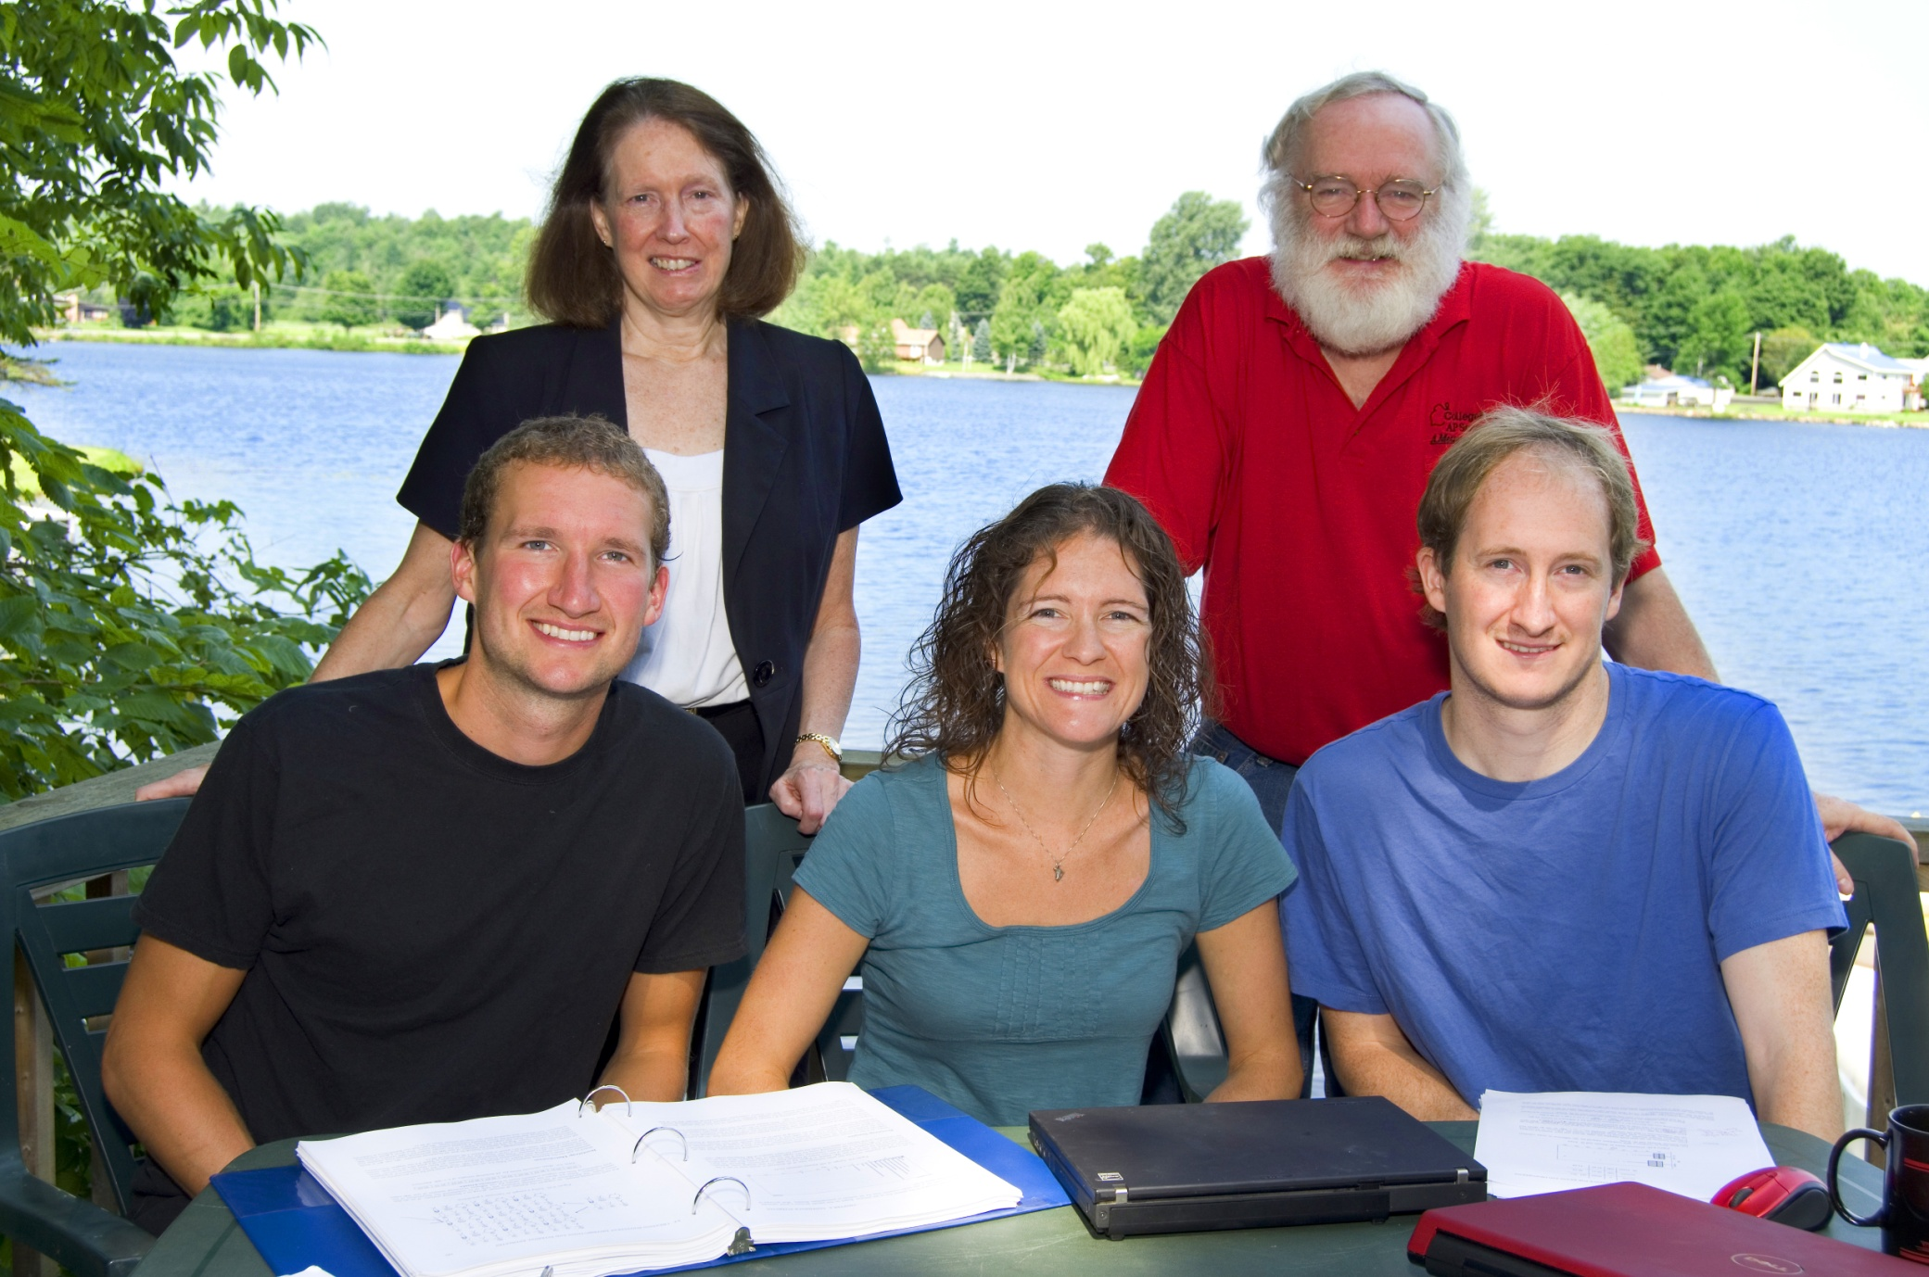
The Lock⁵ Team
Robin & Patti
St. Lawrence
Dennis
Iowa State
Kari
Harvard/Duke
Eric
UNC/Duke

Slide 3
Advantages of Lock⁵
1. All examples and exercises based on real data – chosen to be interesting to students (and instructors!)
Just open to any exercise set!
2. Lots of resources to help instructors (all created by us, the Locks)

Slide 4
Instructor Resources
Instructor’s manual including sample syllabi, teaching tips, and recommended class examples, activities, and assignments for each section
Powerpoint slides (with or without clicker questions)
Videos to instructors for each chapter and section
Handouts for class activities and examples
Full instructor solutions manual

Slide 5
Big Advantages of Lock⁵
All examples and exercises based on real data – chosen to be interesting to students (and instructors!)
2. Lots of resources to help instructors (all created by us, the Locks)
3. Use of simulation methods (bootstrap intervals and randomization tests) to introduce inference

Slide 6
New Simulation Methods
“The Next Big Thing”
United States Conference on Teaching Statistics, May 2011
Common Core State Standards in Mathematics
Increasingly used in the disciplines

Slide 7
New Simulation Methods
Increasingly important in DOING statistics
Outstanding for use in TEACHING statistics
Help students understand the key ideas of statistical inference

Slide 8
“New” Simulation Methods?
"Actually, the statistician does not carry out this very simple and very tedious process, but his conclusions have no justification beyond the fact that they agree with those which could have been arrived at by this
elementary method."
-- Sir R. A. Fisher, 1936

Slide 9
Bootstrap Confidence Intervals
and
Randomization Hypothesis Tests

Slide 10
First:
Bootstrap Confidence Intervals

Slide 11
Example 1: What is the average price of a used Mustang car?
Select a random sample of n=25 Mustangs from a website (autotrader.com) and record the price (in $1,000’s) for each car.

Slide 12
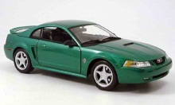
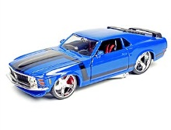
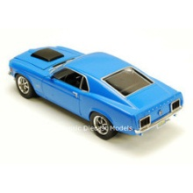
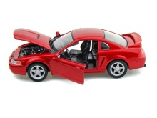
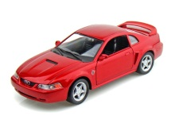
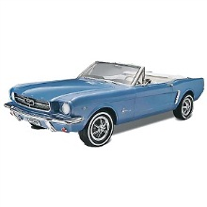
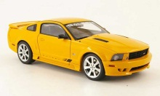
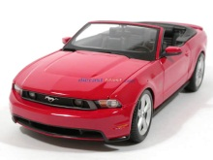
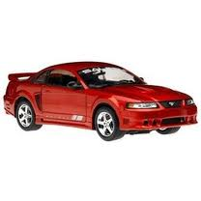
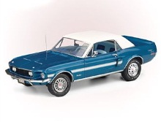
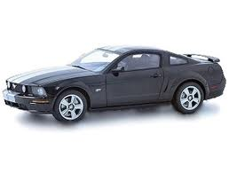
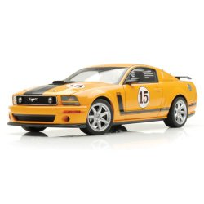
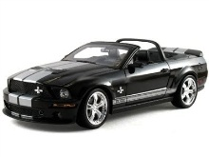
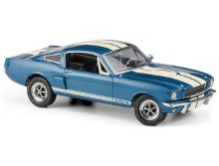
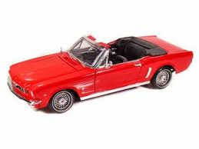
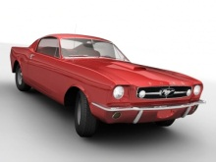
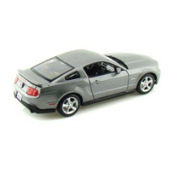
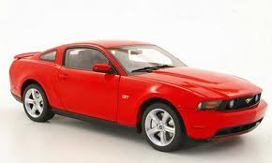
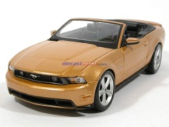
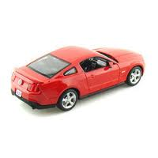
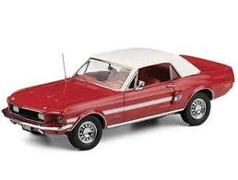
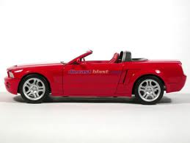
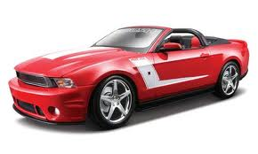
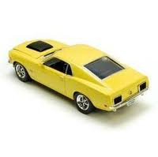
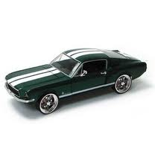
Sample of Mustangs:
Our best estimate for the average price of used Mustangs is $15,980, but how accurate is that estimate?

Slide 13
Our best estimate for the average price of used Mustangs is $15,980, but how accurate is that estimate?
We would like some kind of margin of error or a confidence interval.
Key concept: How much can we expect the sample means to vary just by random chance?

Slide 14
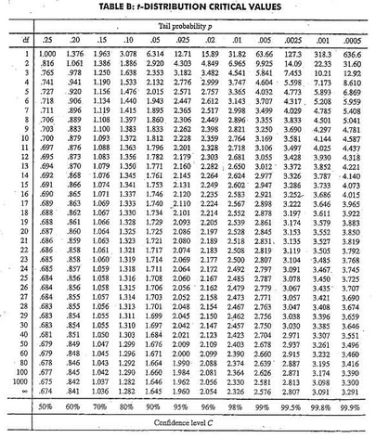

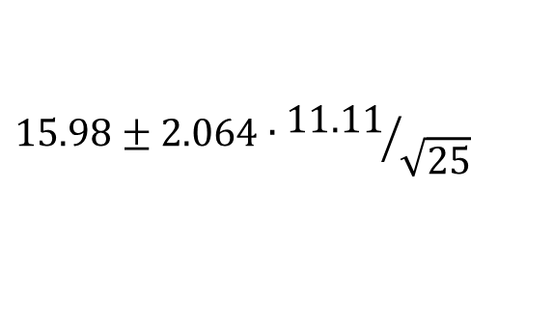

Traditional Inference
1. Check conditions
2. Which formula?
CI for a mean
3. Calculate summary stats
4. Find t*
5. df?
df=25$−$1=24
t*=2.064
6. Plug and chug
$$15.98±2.064∙{11.11}/{\sqrt{25}}$$
$$15.98±4.59=(11.39, 20.57)$$
7. Interpret in context

Slide 15
“We are 95% confident that the mean price of all used Mustang cars is between $11,390 and $20,570.”
Answer is good, but the process is not very helpful at building understanding.
Our students are often great visual learners but get nervous about formulas and algebra. Can we find a way to use their visual intuition?

Slide 16
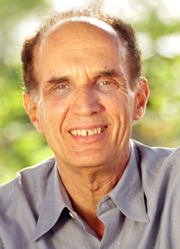
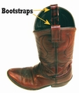
Bootstrapping
Brad Efron
Stanford University
“Let your data be your guide.”
Key Idea: Assume the “population” is many, many copies of the original sample.

Slide 17
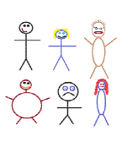
Suppose we have a random sample of 6 people:
Notes:
Patti

Slide 18
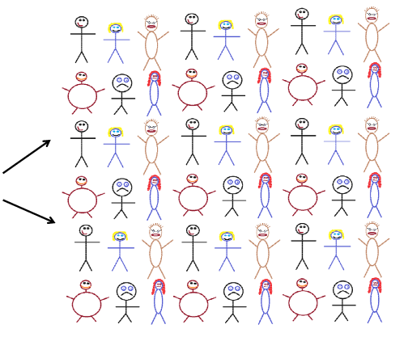
Original Sample
A simulated “population” to sample from
Notes:
Patti

Slide 19




Bootstrap Sample: Sample with replacement from the original sample, using the same sample size.
Original Sample
Bootstrap Sample
Notes:
Patti

Slide 20
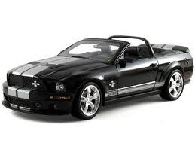
Original Sample
Bootstrap Sample

Slide 21
BootstrapSample
Bootstrap Statistic
BootstrapSample
Bootstrap Statistic
Original Sample
Bootstrap Distribution
●
●
●
●
●
●
Sample Statistic
BootstrapSample
Bootstrap Statistic

Slide 22
We need technology!
StatKey
www.lock5stat.com
(Free, easy-to-use, works on all platforms)
Notes:
Patti

Slide 23
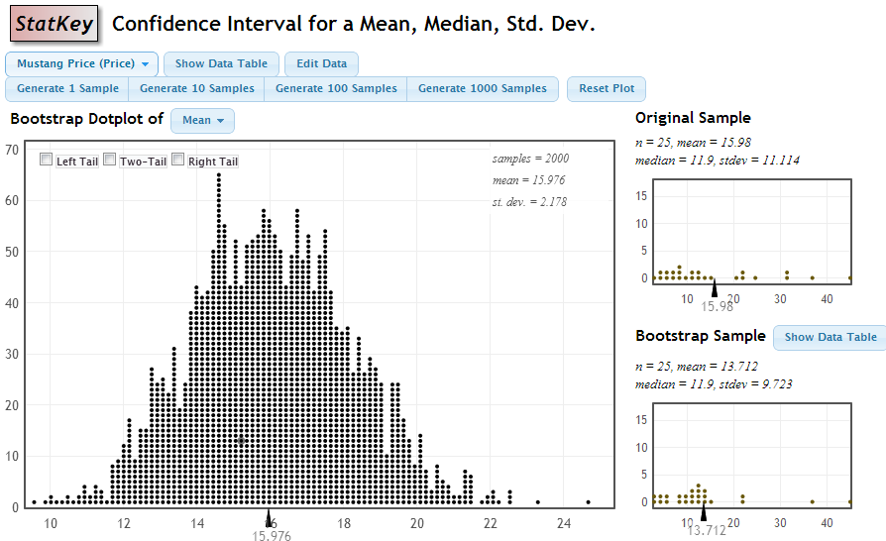

StatKey
Standard Error
95% CI: statistic ± 2SE = 15.98 ± 2(2.178) = (11.624, 20.336)

Slide 24
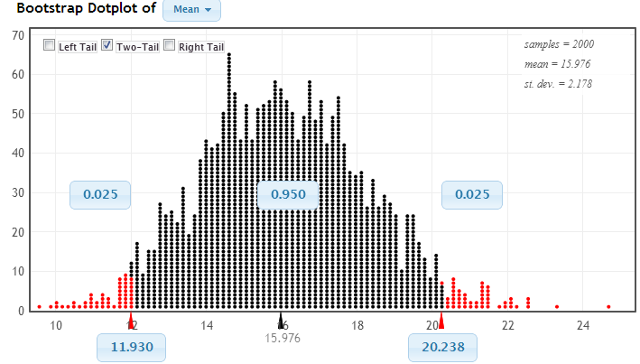
Using the Bootstrap Distribution to Get a Confidence Interval
Chop 2.5% in each tail
Keep 95% in middle
Chop 2.5% in each tail
We are 95% sure that the mean price for Mustangs is between $11,930 and $20,238

Slide 25
Bootstrapping
Key ideas:
Sample with replacement from the original sample using the same sample size.
Compute the sample statistic.
Collect lots of such bootstrap statistics.
Use the distribution of bootstrap statistics to assess the sampling variability of the statistic.
Why does this work?

Slide 26
Sampling Distribution
Population
BUT, in practice we don’t see the “tree” or all of the “seeds” – we only have ONE seed
µ
Notes:
Robin

Slide 27
Bootstrap Distribution
What can we do with just one seed?
Bootstrap
“Population”
Estimate the variability (SE) from the bootstrap statistics
Grow a NEW tree!
µ
Notes:
Robin

Slide 28
Example 2: What yes/no question do you want to ask the sample of people in this audience?
Raise your hand if your answer to the question is YES.
Example #2 : Find a 90% confidence interval for the proportion who answer “yes” to this question.
Notes:
Denn

Slide 29
Example 3: Diet Cola and Calcium
What is the difference in mean amount of calcium excreted between people who drink diet cola and people who drink water?
Find a 95% confidence interval for the difference in means.

Slide 30
What About Hypothesis Tests?

Slide 31
P-value: The probability of seeing results as extreme as, or more extreme than, the sample results, if the null hypothesis is true.
Say what????

Slide 32
Example 1: Beer and Mosquitoes
Does consuming beer attract mosquitoes?
Experiment:
25 volunteers drank a liter of beer,
18 volunteers drank a liter of water
Randomly assigned!
Mosquitoes were caught in traps as they approached the volunteers.¹
¹ Lefvre, T., et. al., “Beer Consumption Increases Human Attractiveness to Malaria Mosquitoes, ” PLoS ONE, 2010; 5(3): e9546.

Slide 33
Beer and Mosquitoes
Number of Mosquitoes
Beer Water
27 21
20 22
21 15
26 12
27 21
31 16
24 19
19 15
23 24
24 19
28 23
19 13
24 22
29 20
20 24
17 18
31 20
20 22
25
28
21
27
21
18
20
Does drinking beer actually attract mosquitoes, or is the difference just due to random chance?
Beer mean = 23.6
Water mean
= 19.22
Beer mean – Water mean = 4.38

Slide 34
Traditional Inference
1. Check conditions
2. Which formula?
5. Which theoretical distribution?
6. df?
7. find p-value
3. Calculate numbers and plug into formula
4. Plug into calculator
0.0005 < p-value < 0.001

Slide 35
Simulation Approach
Number of Mosquitoes
Beer Water
27 21
20 22
21 15
26 12
27 21
31 16
24 19
19 15
23 24
24 19
28 23
19 13
24 22
29 20
20 24
17 18
31 20
20 22
25
28
21
27
21
18
20
Does drinking beer actually attract mosquitoes, or is the difference just due to random chance?
Beer mean = 23.6
Water mean
= 19.22
Beer mean – Water mean = 4.38

Slide 36
Simulation Approach
Number of Mosquitoes
Beer Water
27 21
20 22
21 15
26 12
27 21
31 16
24 19
19 15
23 24
24 19
28 23
19 13
24 22
29 20
20 24
17 18
31 20
20 22
25
28
21
27
21
18
20
Find out how extreme these results would be, if there were no difference between beer and water.
What kinds of results would we see, just by random chance?

Slide 37
Simulation Approach
Number of Mosquitoes
Beer Water
27 21
20 22
21 15
26 12
27 21
31 16
24 19
19 15
23 24
24 19
28 23
19 13
24 22
29 20
20 24
17 18
31 20
20 22
25
28
21
27
21
18
20
Number of Mosquitoes
Beverage
27 21
20 22
21 15
26 12
27 21
31 16
24 19
19 15
23 24
24 19
28 23
19 13
24 22
29 20
20 24
17 18
31 20
20 22
25
28
21
27
21
18
20
Find out how extreme these results would be, if there were no difference between beer and water.
What kinds of results would we see, just by random chance?

Slide 38
Simulation Approach
Beer Water
Number of Mosquitoes
Beverage
20 22
21 15
26 12
27 21
31 16
24 19
19 15
23 24
24 19
28 23
19 13
24 22
29 20
20 24
17 18
31 20
20 22
25
28
21
27
21
18
20
Find out how extreme these results would be, if there were no difference between beer and water.
What kinds of results would we see, just by random chance?
27
21
21
27
24
19
23
24
31
13
18
24
25
21
18
12
19
18
28
22
19
27
20
23
22
20
26
31
19
23
15
22
12
24
29
20
27
29
17
25
20
28

Slide 39
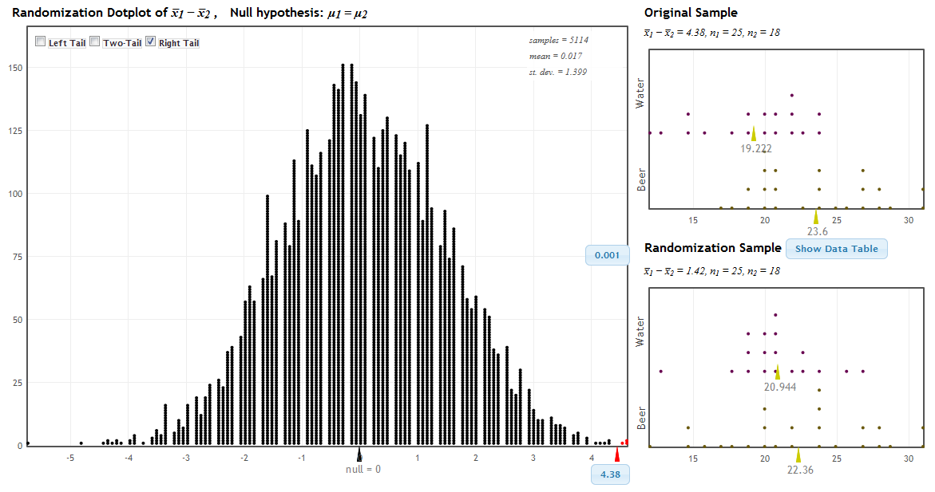
StatKey!
www.lock5stat.com
P-value

Slide 40
Traditional Inference
1. Which formula?
4. Which theoretical distribution?
5. df?
6. find p-value
2. Calculate numbers and plug into formula
3. Plug into calculator
0.0005 < p-value < 0.001

Slide 41
Beer and Mosquitoes
The Conclusion!
The results seen in the experiment are very unlikely to happen just by random chance (just 1 out of 1000!)
We have strong evidence that drinking beer does attract mosquitoes!

Slide 42
“Randomization” Samples
Key idea: Generate samples that are
based on the original sample
AND
consistent with some null hypothesis.

Slide 43
Example 2: Malevolent Uniforms
Do sports teams with more “malevolent” uniforms get penalized more often?

Slide 44
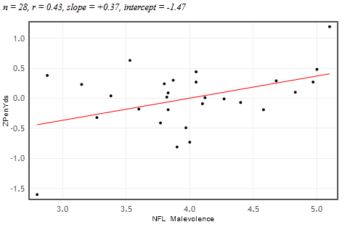


Example 2: Malevolent Uniforms
Sample Correlation
= 0.43
Do teams with more malevolent uniforms commit more penalties, or is the relationship just due to random chance?

Slide 45
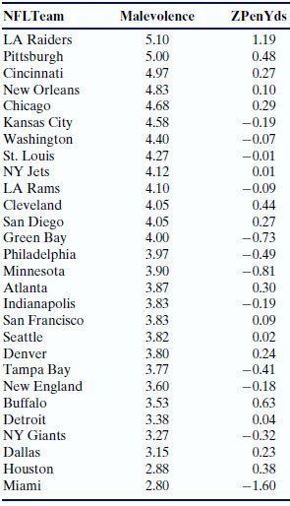
Simulation Approach
Sample Correlation = 0.43
Find out how extreme this correlation would be, if there is no relationship between uniform malevolence and penalties.
What kinds of results would we see, just by random chance?

Slide 46
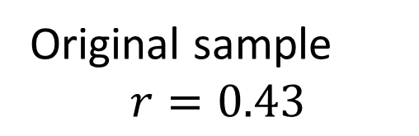
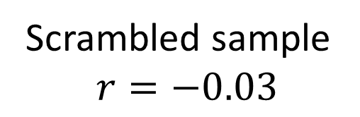
Randomization by Scrambling
Original sample
$$r=0.43$$
Scrambled sample
$$r=−0.03$$

Slide 47
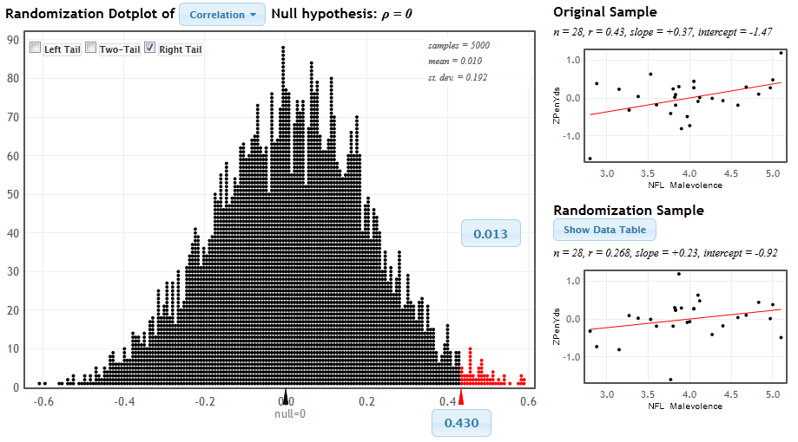
StatKey
www.lock5stat.com/statkey
P-value

Slide 48
Malevolent Uniforms
The Conclusion!
The results seen in the study are unlikely to happen just by random chance (just about 1 out of 100).
We have some evidence that teams with more malevolent uniforms get more penalties.

Slide 49
P-value: The probability of seeing results as extreme as, or more extreme than, the sample results, if the null hypothesis is true.
Yeah – that makes sense!

Slide 50
Example 3:
Light at Night and Weight Gain
Does leaving a light on at night affect weight gain? In particular, do mice with a light on at night gain more weight than mice with a normal light/dark cycle?
Find the p-value and use it to make a conclusion.

Slide 51
Simulation Methods
These randomization-based methods tie directly to the key ideas of statistical inference.
They are ideal for building conceptual understanding of the key ideas.
Not only are these methods great for teaching statistics, but they are increasingly being used for doing statistics.

Slide 52
How does everything fit together?
We use these methods to build understanding of the key ideas.
We then cover traditional normal and t-tests as “short-cut formulas”.
Students continue to see all the standard methods but with a deeper understanding of the meaning.

Slide 53
It is the way of the past…
"Actually, the statistician does not carry out this very simple and very tedious process, but his conclusions have no justification beyond the fact that they agree with those which could have been arrived at by this elementary method."
-- Sir R. A. Fisher, 1936

Slide 54
… and the way of the future
“... the consensus curriculum is still an unwitting prisoner of history. What we teach is largely the technical machinery of numerical approximations based on the normal distribution and its many subsidiary cogs. This machinery was once necessary, because the conceptually simpler alternative based on permutations was computationally beyond our reach. Before computers statisticians had no choice. These days we have no excuse. Randomization-based inference makes a direct connection between data production and the logic of inference that deserves to be at the core of every introductory course.”
-- Professor George Cobb, 2007

Slide 55
Additional Resources
www.lock5stat.com
Statkey
Descriptive Statistics
Sampling Distributions
Normal and t-Distributions

Slide 56
Thanks for listening!
kari@stat.duke.edu
www.lock5stat.com

