Slide 1
StatKey
Online Tools for Teaching a Modern Introductory Statistics Course
Robin Lock
Burry Professor of Statistics
St. Lawrence University
rlock@stlawu.edu
Wiley Faculty Network - March 11, 2013

Slide 2
What is it?
StatKey
A set of web-based, interactive, dynamic statistics tools designed for teaching simulation-based methods such as bootstrap intervals and randomization tests at an introductory level.
Freely available at
www.lock5stat.com/statkey
Runs in (almost) any browser.
Also available as a Google Chrome App.

Slide 3
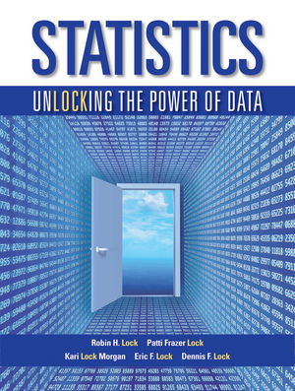
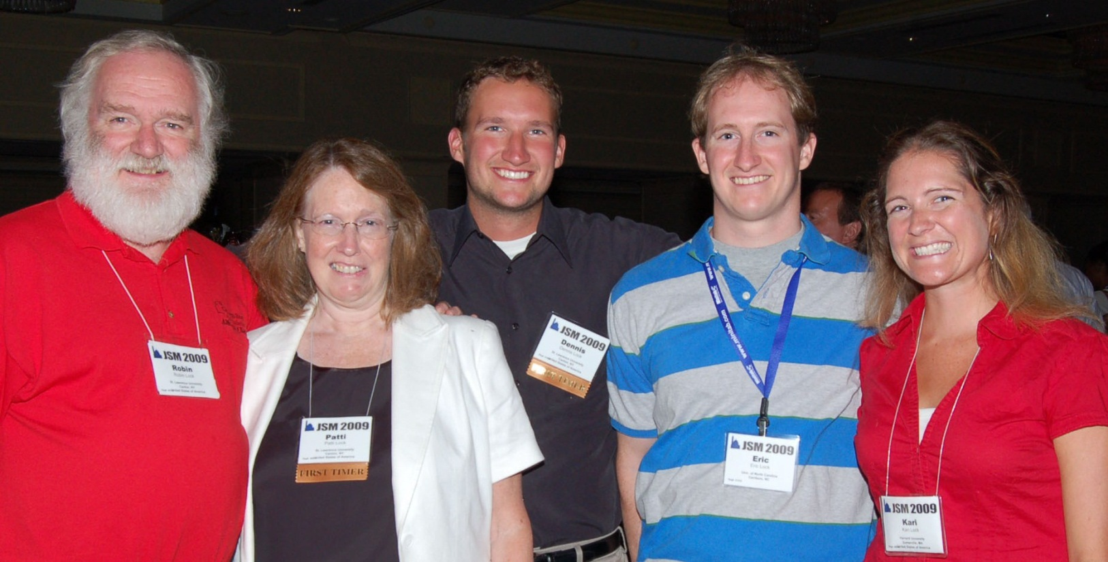
Who Developed StatKey?
The Lock⁵ author team to support a new text:
Statistics: Unlocking the Power of Data
Dennis
Iowa State
Kari
Harvard/Duke
Wiley (2013)
Eric
UNC/Duke
Robin & Patti
St. Lawrence

Slide 4
StatKey
WHY?
Address instructor concerns about accessibility of simulation-based methods at the intro level
Design an easy-to-use set of learning tools
Provide a no-cost technology option for any environment OR as a supplement to existing technology
Support our new textbook, while also being usable with other texts or on its own

Slide 5



Programming Team
StatKey
Rich Sharp
Stanford
Kevin Angstadt
St. Lawrence
Ed Harcourt
St. Lawrence
StatKey is programmed in JavaScript

Slide 6
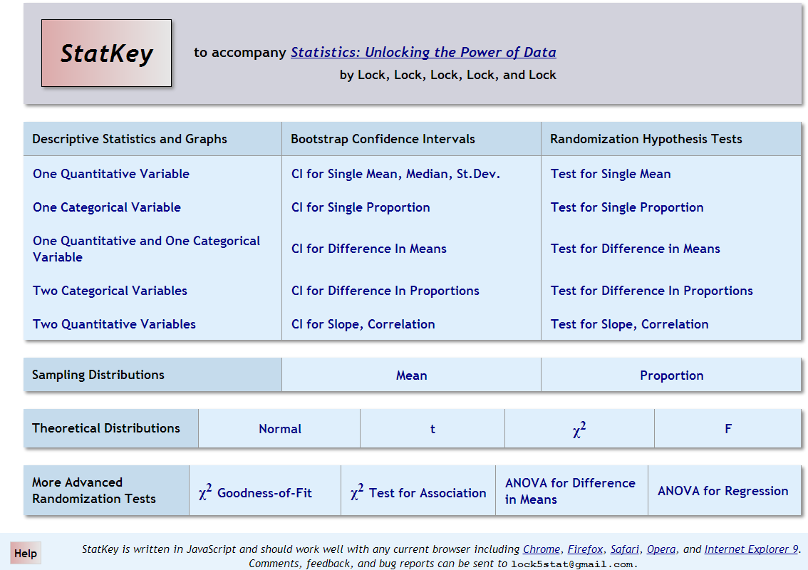

Slide 7
StatKey
Let’s try it out!
www.lock5stat.com

Slide 8
Sampling Distribution
Look at many samples from the population to see how a statistic varies from sample to sample.
BUT, in most real situations...
WE ONLY HAVE ONE SAMPLE!
BOOTSTRAP!
Key idea: To simulate a sampling distribution, we take many samples with replacement from the original sample using the same n.

Slide 9
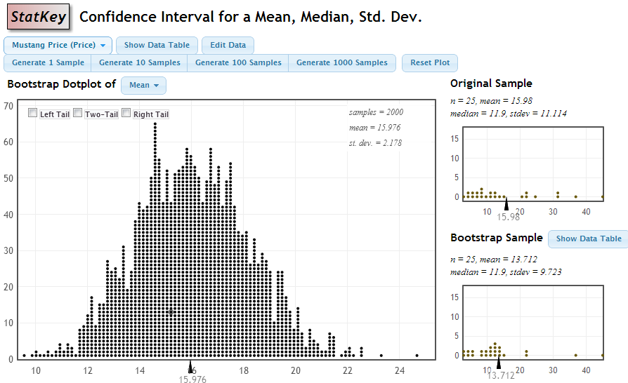
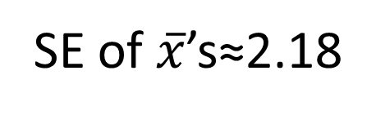
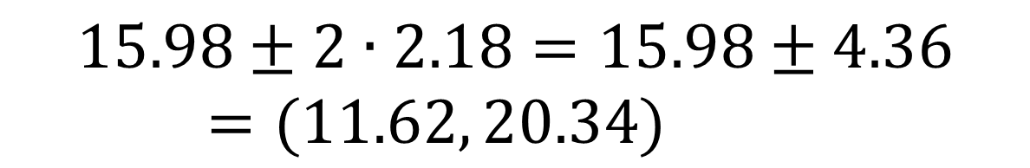
SE of $\overline{x}$’s≈2.18
$$15.98±2∙2.18=15.98±4.36=(11.62, 20.34)$$

Slide 10
Why
does the bootstrap work?

Slide 11
Sampling Distribution
Population
BUT, in practice we don’t see the “tree” or all of the “seeds” – we only have ONE seed
µ
Notes:
Robin

Slide 12

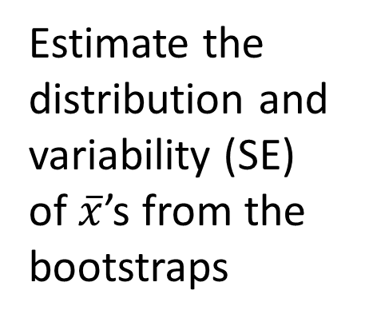
Bootstrap Distribution
What can we do with just one seed?
Bootstrap
“Population”
Estimate the distribution and variability (SE) of $\overline{x}$’s from the bootstraps
Grow a NEW tree!
$$\overline{x}$$
µ
Notes:
Robin

Slide 13
Golden Rule of Bootstraps
The bootstrap statistics are to the original statistic
as
the original statistic is to the population parameter.

Slide 14
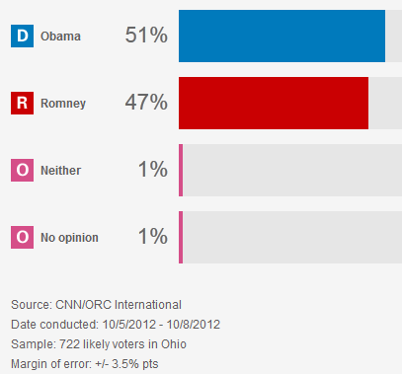
According to a CNN poll of n=722 likely voters in Ohio:
368 choose Obama (51%)
339 choose Romney (47%)
15 choose otherwise (2%)
http://www.cnn.com/POLITICS/pollingcenter/polls/3250
Find a 95% confidence interval for the proportion of Obama supporters in Ohio.

Slide 15
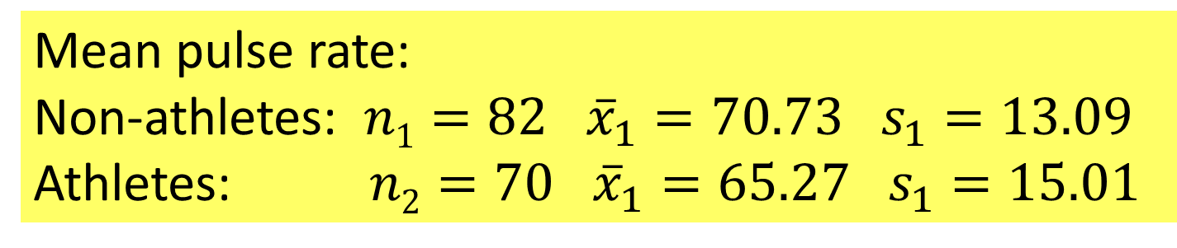
Example: Pulse Rate by Athlete?
Mean pulse rate:
Non-athletes: $n1=82$ ${\overline{x}}_{1}=70.73 s_{1}=13.09$
Athletes: $n2=70$ ${\overline{x}}_{1}=65.27 s_{1}=15.01$
Find a 95% CI for the difference in mean pulse rate between students who are not athletes and those who are.

Slide 16
Beer and Mosquitoes
Does consuming beer attract mosquitoes?
H₀: μ_{B}=μ_{W}
H₀: μ_{B}>μ_{W}
Experiment:
25 volunteers drank a liter of beer,
18 volunteers drank a liter of water
Randomly assigned!
Mosquitoes were caught in traps as they approached the volunteers.¹
¹ Lefvre, T., et. al., “Beer Consumption Increases Human Attractiveness to Malaria Mosquitoes, ” PLoS ONE, 2010; 5(3): e9546.
Beer mean = 23.6
Water mean = 19.22

Slide 17

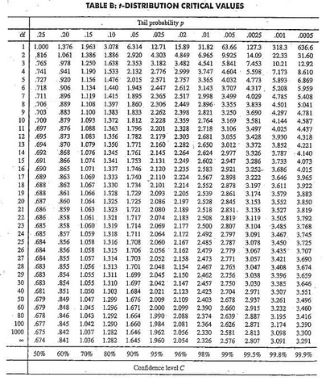
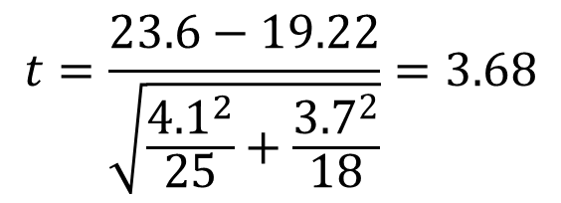
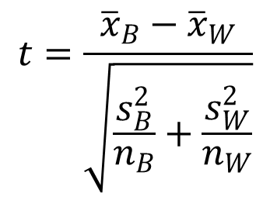
Traditional Inference
1. Which formula?
$$t=\frac{{\overline{x}}_{B}−{\overline{x}}_{W}}{\sqrt{\frac{s_{B}^{2}}{n_{B}}+\frac{s_{W}^{2}}{n_{W}}}}$$
2. Calculate numbers and plug into formula
$$t=\frac{23.6−19.22}{\sqrt{\frac{{4.1}^{2}}{25}+\frac{{3.7}_{}^{2}}{18}}}=3.68$$
3. Which theoretical distribution?
4. Find p-value
0.0005 < p-value < 0.001

Slide 18
StatKey
www.lock5stat.com/statkey
Give it a try!
Send comments and feedback
rlock@stlawu.edu

