Slide 1
Using Lock5
Statistics: Unlocking the Power of Data
Classroom Suggestions
Patti Frazer Lock

Slide 2
Chapter 1: Collecting Data
Why is this first?
  Comes first in actual analysis
  More interesting than histograms and mean/median!
Data!
  Categorical vs Quantitative Variables
  Concept of a dataset with cases as rows and variables as columns
Data Collection
  “Random” in random sampling does not mean haphazard!
  And you can NOT do random!
  Randomized experiment necessary to make conclusions about causality
  ALWAYS think about how the data were collected before making conclusions

Slide 3
Chapter 1: Collecting Data
Focus is not on memorizing methods, but on thinking critically about how data are collected
Should be fun and interesting!
(See Instructor Resources)
Relatively hard to assess
Can give only minimal coverage to some of the details if desired

Slide 4
Chapter 2: Describing Data
Pretty straightforward
Outline:
  Single variables
    Categorical
    Quantitative
  Relationships between variables
    Two categorical
    One categorical and one quantitative
    Two quantitative
Discuss relevant graphs and summary statistics in each case

Slide 5
Chapter 2: Describing Data
All graphs and most statistics found using technology
Use interesting datasets!
Reinforce ideas from Chapter 1
Possibly introduce StatKey or other relevant software at this point
www.lock5stat.com/statkey

Slide 6
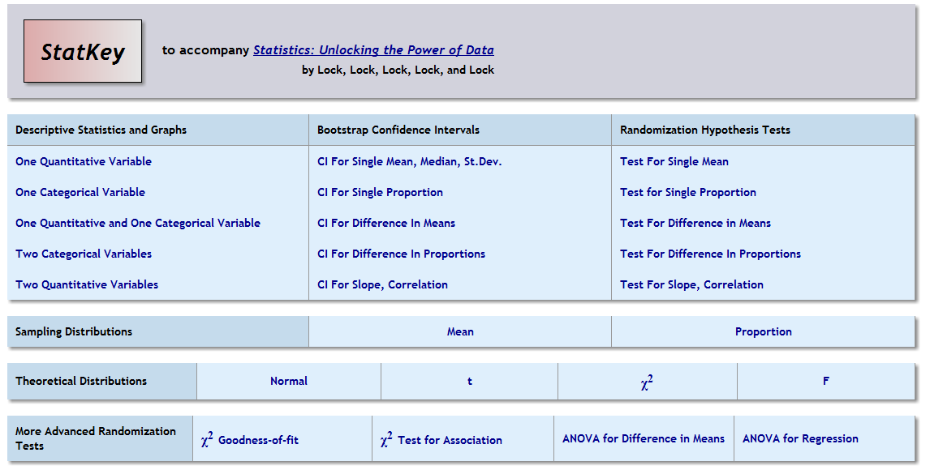
StatKey
www.lock5stat.com/statkey

Slide 7
Unit A Essential Synthesis
One day
Flipped classroom
Integrate ideas from Chapters 1 and 2

Slide 8
Chapter 3: Confidence Intervals
Sampling variability/Sampling distributions
Concepts of “margin of error” and “standard error”
Concept of a confidence interval or interval estimate
StatKey might be helpful

Slide 9
StatKey
www.lock5stat.com/statkey

Slide 10
Chapter 3: Confidence Intervals
Sampling Distribution:
  Have access to entire population
  Take many samples of the same size and record some statistic
  Not feasible in practice!
Bootstrap Distribution
  Only have one sample
  Take many samples of the same size (with replacement) from that one sample and record some statistic
  Feasible!! And gives same approximate shape and standard error!!

Slide 11
Chapter 3: Confidence Intervals
Using Bootstrap Distributions to reinforce the ideas of:
  Sampling variability/Sampling distributions
  Margin of error
  Standard error
  Interval estimate that is likely to contain the true value of the parameter

Slide 12
Chapter 3: Confidence Intervals
Using Bootstrap Distributions to construct confidence intervals:
  Using: Statistic ± 2· SE
  (helps get them used to the formulas that will come later)
  Using middle 95%
  (helps them understand confidence level)

Slide 13
StatKey
www.lock5stat.com/statkey

Slide 14
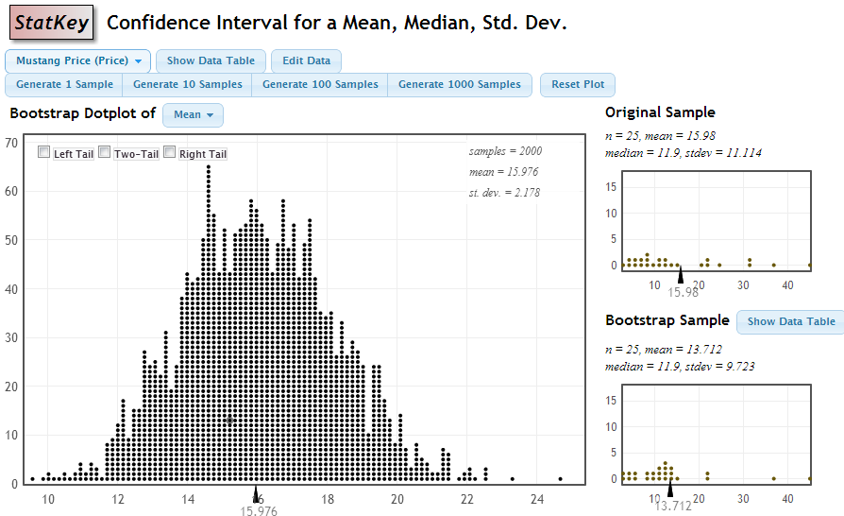
StatKey
Sample mean
Standard Error

Slide 15

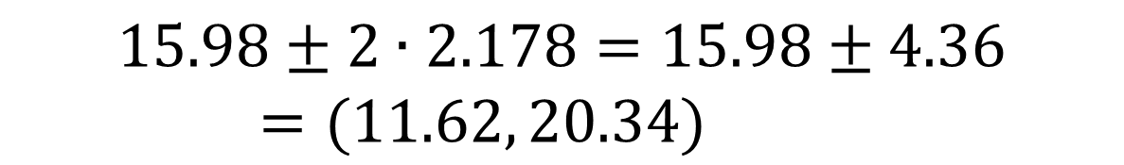
Using the Bootstrap Distribution to Get a Confidence Interval – Method #1
The standard deviation of the bootstrap statistics estimates the standard error of the sample statistic.
Quick interval estimate :
$$Original Statistic ±2∙SE$$
For the mean Mustang prices:
$$15.98±2∙2.178=15.98±4.36=(11.62, 20.34)$$

Slide 16
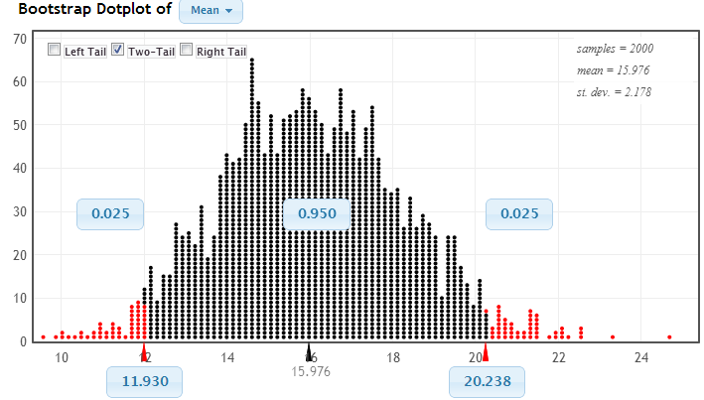
Using the Bootstrap Distribution to Get a Confidence Interval – Method #2
Chop 2.5% in each tail
Keep 95% in middle
Chop 2.5% in each tail
We are 95% sure that the mean price for Mustangs is between $11,930 and $20,238

Slide 17
Chapter 3: Confidence Intervals
At the end of this chapter, students should be able to understand and interpret confidence intervals (for a variety of different parameters)
(And be able to construct them using the bootstrap method) (which is the same method for all parameters)

Slide 18
Chapter 4: Hypothesis Tests
State null and alternative hypotheses (for many different parameters)
Understand the idea behind a hypothesis test (stick with the null unless evidence is strong for the alternative)
Understand a p-value (!)
State the conclusion in context
(Conduct a randomization hypothesis test)

Slide 19
P-value: The probability of seeing results as extreme as, or more extreme than, the sample results, if the null hypothesis is true.
Say what????

Slide 20
Example 1: Beer and Mosquitoes
Does consuming beer attract mosquitoes?
Experiment:
25 volunteers drank a liter of beer,
18 volunteers drank a liter of water
Randomly assigned!
Mosquitoes were caught in traps as they approached the volunteers.¹
¹ Lefvre, T., et. al., “Beer Consumption Increases Human Attractiveness to Malaria Mosquitoes, ” PLoS ONE, 2010; 5(3): e9546.

Slide 21


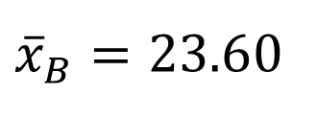
Beer and Mosquitoes
Number of Mosquitoes
Beer
27
20
21
26
27
31
24
19
23
24
28
19
24
29
20
17
31
20
25
28
21
27
21
18
20
Water
21
22
15
12
21
16
19
15
24
19
23
13
22
20
24
18
20
22
Does drinking beer actually attract mosquitoes, or is the difference just due to random chance?
H₀: μ_{B} = μ_{W}
H_{a}: μ_{B} > μ_{W}
${\overline{x}}_{B}=23.6$0
$${\overline{x}}_{W}=19.22$$
$${\overline{x}}_{B}−{\overline{x}}_{W}=4.38$$

Slide 22
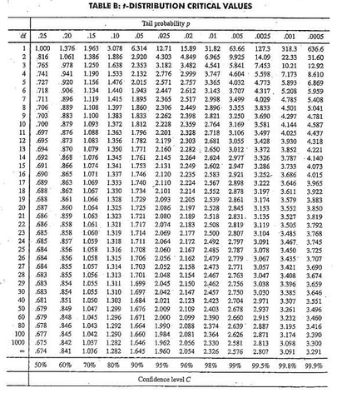

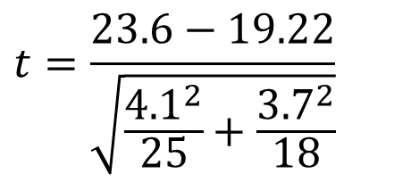
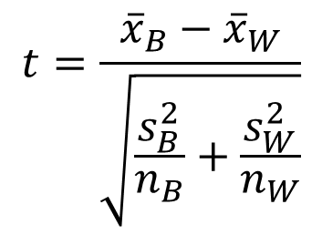
Traditional Inference
1. Check conditions
5. Which theoretical distribution?
2. Which formula?
$$t=\frac{{\overline{x}}_{B}−{\overline{x}}_{W}}{\sqrt{\frac{s_{B}^{2}}{n_{B}}+\frac{s_{W}^{2}}{n_{W}}}}$$
6. df?
7. find p-value
8. Interpret a decision
3. Calculate numbers and plug into formula
$$t=\frac{23.6−19.22}{\sqrt{\frac{{4.1}^{2}}{25}+\frac{{3.7}_{}^{2}}{18}}}$$
4. Chug with calculator
$$t=3.68$$
0.0005 < p-value < 0.001

Slide 23
Simulation Approach
Number of Mosquitoes
Beer
27
20
21
26
27
31
24
19
23
24
28
19
24
29
20
17
31
20
25
28
21
27
21
18
20
Water
21
22
15
12
21
16
19
15
24
19
23
13
22
20
24
18
20
22
Does drinking beer actually attract mosquitoes, or is the difference just due to random chance?
H₀: μ_{B} = μ_{W}
H_{a}: μ_{B} > μ_{W}
${\overline{x}}_{B}=23.6$0
$${\overline{x}}_{W}=19.22$$
$${\overline{x}}_{B}−{\overline{x}}_{W}=4.38$$

Slide 24
Simulation Approach
Number of Mosquitoes
Find out how extreme these results would be, if there were no difference between beer and water.
What kinds of results would we see, just by random chance (i.e. beverage doesn’t matter)?
Beer
27
20
21
26
27
31
24
19
23
24
28
19
24
29
20
17
31
20
25
28
21
27
21
18
20
Water
21
22
15
12
21
16
19
15
24
19
23
13
22
20
24
18
20
22
27 21
20 22
21 15
26 12
27 21
31 16
24 19
19 15
23 24
24 19
28 23
19 13
24 22
29 20
20 24
17 18
31 20
20 22
25
28
21
27
21
18
20
Re-randomize results into Beer and Water groups

Slide 25



Simulation Approach
Number of Mosquitoes
Find out how extreme these results would be, if there were no difference between beer and water.
What kinds of results would we see, just by random chance (i.e. beverage doesn’t matter)?
Beer
Water
20 22
21 15
26 12
27 21
31 16
24 19
19 15
23 24
24 19
28 23
19 13
24 22
29 20
20 24
17 18
31 20
20 22
25
28
21
27
21
18
20
27
21
21
20
24
19
20
24
31
13
18
24
25
21
18
15
19
16
28
22
19
27
20
23
22
21
20
26
31
19
23
15
22
12
24
29
20
27
21
17
24
20
28
$${\overline{x}}_{B}=21.76$$
$${\overline{x}}_{W}=22.50$$
Re-randomize results into Beer and Water groups
StatKey
$${\overline{x}}_{B}−{\overline{x}}_{W}=−0.84$$
Repeat MANY times

Slide 26
StatKey
www.lock5stat.com/statkey

Slide 27
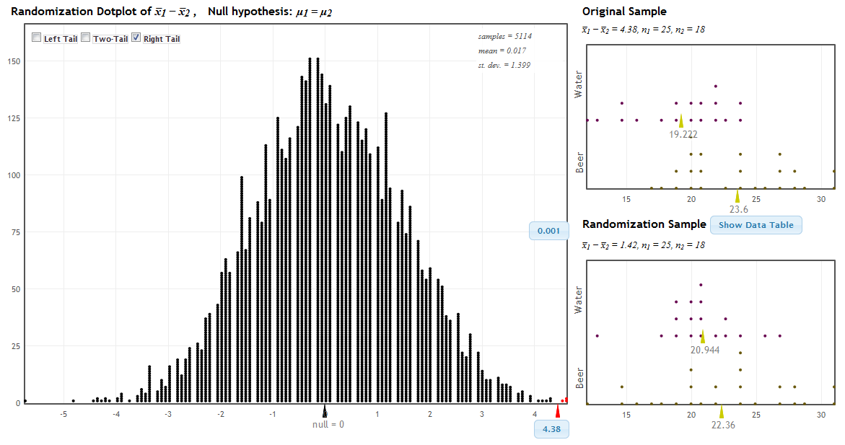
StatKey!
www.lock5stat.com
P-value

Slide 28
Traditional Inference
1. Which formula?
4. Which theoretical distribution?
5. df?
6. find p-value
2. Calculate numbers and plug into formula
3. Plug into calculator
0.0005 < p-value < 0.001

Slide 29
Beer and Mosquitoes
The Conclusion!
The results seen in the experiment are very unlikely to happen just by random chance (just 1 out of 1000!)
We have strong evidence that drinking beer does attract mosquitoes!

Slide 30
P-value: The probability of seeing results as extreme as, or more extreme than, the sample results, if the null hypothesis is true.
How extreme are the sample results in the randomization distribution?
Randomization distribution must assume null hypothesis is true

Slide 31
Chapter 4: Hypothesis Tests
State null and alternative hypotheses
Understand the idea behind a hypothesis test
Understand a p-value (!)
State the conclusion in context
Can minimize the details of how the randomization is carried out -- Important idea is that the process must assume the null hypothesis is true!

Slide 32
By this point in the course, students have all the key ideas of inference!!!!
Take your time through Chapters 3 and 4
You can make up the time later – Chapters 5 and 6 go quickly!

Slide 33
Unit B Essential Synthesis
One day
Flipped classroom
Integrate ideas from Chapters 1 through 4

Slide 34

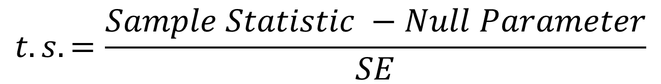
Chapter 5: Normal Distribution
Finding probabilities and cutoff values on a normal distribution
Using a distribution for confidence intervals:
And hypothesis tests:
$$Sample Statistic±z^{∗}∙SE$$
$$t.s.=\frac{Sample Statistic −Null Parameter}{SE}$$

Slide 35
StatKey
www.lock5stat.com/statkey

Slide 36
Chapter 6: Short-cut Formulas
Short sections can be covered in any order you want!!
  Proportions or means first
  One sample or two first
  Confidence intervals or hypothesis tests first
Can be covered quickly! Mostly just lots of new SE formulas! Do more than one section a day!!!

Slide 37
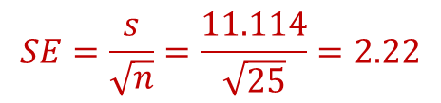
StatKey
Sample stats
$$SE=\frac{s}{\sqrt{n}}=\frac{11.114}{\sqrt{25}}=2.22$$

Slide 38
Additional Topics
Chi-square Tests (Chapter 7)
ANOVA for difference in means (Chapter 8)
Inference for simple regression (Chapter 9) and multiple regression (Chapter 10)
These can be done in any order
(Also, probability – chapter 11 – can be omitted or covered at any point in the course)

Slide 39
StatKey
www.lock5stat.com/statkey

Slide 40
Instructor Resources
PowerPoint slides for every section
Clicker questions for every section
Notes and suggestions for every section
Instructor video for every section
Class worksheet(s) for every section
Class activity for every section
Videos for every example and every learning goal
WileyPLUS (with most content designed by us)
Software manuals for R, Minitab, Fathom, Excel, SAS, TI calculators
Datasets ready to import in these formats
Test bank

Slide 41
Feel free to contact me or any of the authors at any time if you have any questions or suggestions for improvement. Thanks! lock5stat.com

