Slide 1
Understanding the P-value… Really!
Kari Lock Morgan
Department of Statistical Science, Duke University
kari@stat.duke.edu
with Robin Lock, Patti Frazer Lock, Eric Lock, Dennis Lock
Statistics: Unlocking the Power of Data
Wiley Faculty Network
10/11/12

Slide 2
Mind-Set Matters
84 hotel maids recruited
Half were randomly selected to be informed that their work satisfies recommendations for an active lifestyle
After 8 weeks, the informed group had lost 1.59 more pounds, on average, than the control group
Did the information actually cause them to lose more weight, or might we see a difference this extreme just by random chance???
Crum, A.J. and Langer, E.J. (2007). “Mind-Set Matters: Exercise and the Placebo Effect,” Psychological Science, 18:165-171.

Slide 3
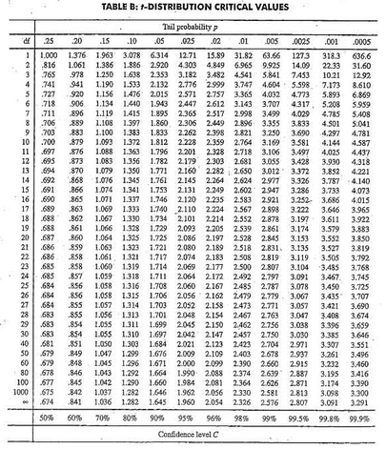
Traditional Inference
1. Which formula?
4. Which theoretical distribution?
5. df?
6. find p-value
0.005 < p-value < 0.01
2. Calculate numbers and plug into formula
> pt(2.65, 33, lower.tail=FALSE)
[1] 0.006130769
3. Plug into calculator

Slide 4
Traditional Inference
Confidence intervals and hypothesis tests using the normal and t-distributions
With a different formula for each situation, students often get mired in the details and fail to see the big picture
Plugging numbers into formulas does little to help reinforce conceptual understanding

Slide 5
Simulation Methods
Simulation methods (bootstrapping and randomization) are a computationally intensive alternative to the traditional approach
Rather than relying on theoretical distributions for specific test statistics, we can directly simulate the distribution of any statistic
Great for conceptual understanding!

Slide 6
Hypothesis Testing
To generate a distribution assuming H₀ is true:
Traditional Approach: Calculate a test statistic which should follow a known distribution if the null hypothesis is true (under some conditions)
Randomization Approach: Decide on a statistic of interest. Simulate many randomizations assuming the null hypothesis is true, and calculate this statistic for each randomization

Slide 7
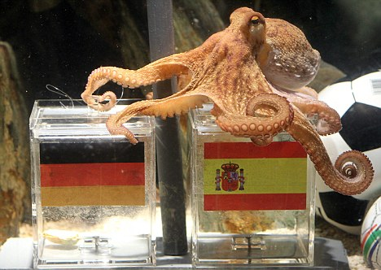
Paul the Octopus
http://www.youtube.com/watch?v=3ESGpRUMj9E

Slide 8
Paul the Octopus
Paul the Octopus predicted 8 World Cup games, and predicted them all correctly
Is this evidence that Paul actually has psychic powers?
How unusual would this be if he was just randomly guessing (with a 50% chance of guessing correctly)?
How could we figure this out?

Slide 9
Simulate with Students
Students each flip a coin 8 times, and count the number of heads
Count the number of students with all 8 heads by a show of hands (will probably be 0)
If Paul was just guessing, it would be very unlikely for him to get all 8 correct!
How unlikely? Simulate many times!!!

Slide 10
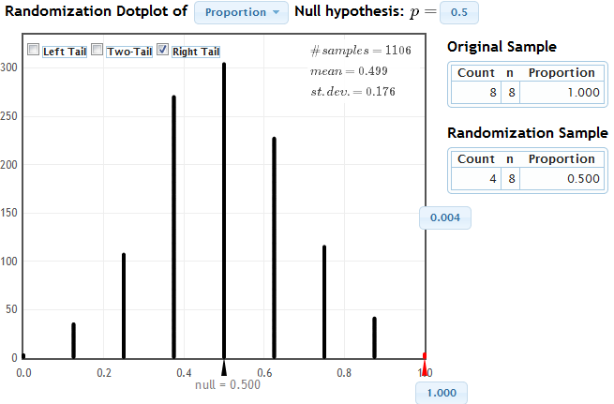
Simulate with StatKey
www.lock5stat.com/statkey

Slide 11
Cocaine Addiction
In a randomized experiment on treating cocaine addiction, 48 people were randomly assigned to take either Desipramine (a new drug), or Lithium (an existing drug)
The outcome variable is whether or not a patient relapsed
Is Desipramine significantly better than Lithium at treating cocaine addiction?

Slide 12
R
R
R
R
R
R
R
R
R
R
R
R
R
R
R
R
R
R
R
R
R
R
R
R
R
R
R
R
R
R
R
R
R
R
R
R
R
R
R
R
R
R
R
R
R
R
R
R
1. Randomly assign units to treatment groups
New Drug
Old Drug
R
R
R
R
R
R
R
R
R
R
R
R
R
R
R
R
R
R
R
R
R
R
R
R
R
R
R
R
R
R
R
R
R
R
R
R
R
R
R
R
R
R
R
R

Slide 13
2. Conduct experiment
3. Observe relapse counts in each group
R = Relapse
N = No Relapse
1. Randomly assign units to treatment groups
New Drug
Old Drug
R
R
R
R
R
R
R
R
R
R
R
R
R
R
R
R
R
R
R
R
R
R
R
R
R
R
R
R
R
R
R
R
N
R
N
R
R
R
R
R
R
R
R
R
R
R
R
R
N
R
N
R
N
N
N
N
N
N
N
N
R
R
R
R
R
R
R
R
R
R
R
R
N
N
N
N
N
N
N
N
N
N
N
N
N
N
N
N
N
N
N
N
N
N
N
N
10 relapse, 14 no relapse
18 relapse, 6 no relapse

Slide 14
Randomization Test
Assume the null hypothesis is true
Simulate new randomizations
For each, calculate the statistic of interest
Find the proportion of these simulated statistics that are as extreme as your observed statistic

Slide 15
R
R
R
R
R
R
R
R
R
R
R
R
R
R
R
R
N
N
R
R
R
R
R
R
N
N
N
N
N
N
R
R
R
R
R
R
N
N
N
N
N
N
N
N
N
N
N
N
10 relapse, 14 no relapse
18 relapse, 6 no relapse

Slide 16
R
R
R
R
R
R
R
R
R
R
R
R
R
R
R
R
N
N
R
R
R
R
R
R
N
N
N
N
N
N
R
R
R
R
R
R
N
N
N
N
N
N
N
N
N
N
N
N
Simulate another randomization
New Drug
Old Drug
R
N
R
N
N
N
N
R
R
R
R
R
R
R
N
R
R
N
N
N
R
N
R
R
R
N
N
R
N
R
R
N
R
N
N
N
R
R
R
N
R
R
R
R
16 relapse, 8 no relapse
12 relapse, 12 no relapse

Slide 17
Simulate another randomization
New Drug
Old Drug
R
R
R
R
R
R
R
R
R
R
R
R
R
N
R
R
N
N
R
R
R
R
R
R
R
R
N
R
N
R
R
R
R
R
R
R
R
N
R
N
R
R
N
N
N
N
N
N
17 relapse, 7 no relapse
11 relapse, 13 no relapse

Slide 18
Simulate with Students
Give students index cards labeled R (28 cards) and N (20 cards)
Have them deal the cards into 2 groups
Compute the difference in proportions
Contribute to a class dotplot for the randomization distribution

Slide 19
Cocaine Addiction
You want to know what would happen
by random chance (the random allocation to treatment groups)
if the null hypothesis is true (there is no difference between the drugs)
Why did you re-deal your cards?
Why did you leave the outcomes (relapse or no relapse) unchanged on each card?

Slide 20
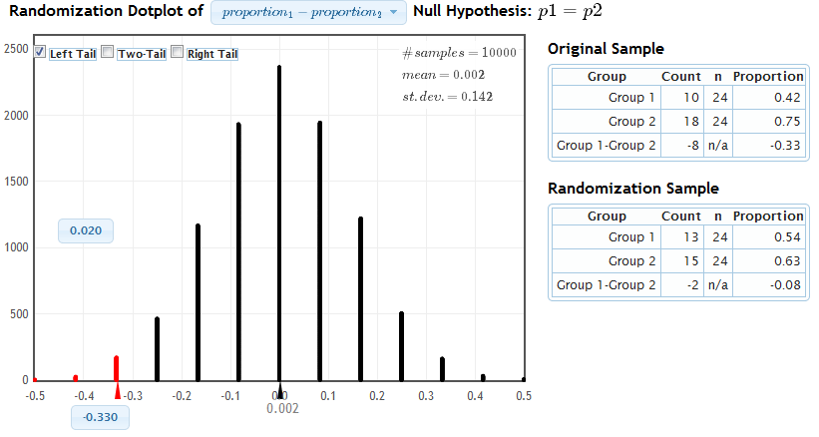
Simulate with StatKey
www.lock5stat.com/statkey
Distribution of Statistic Assuming Null is True
Proportion as extreme as observed statistic
observed statistic
The probability of getting results as extreme or more extreme than those observed if the null hypothesis is true, is about .02.
p-value

Slide 21
Mind-Set Matters
84 hotel maids recruited
Half were randomly selected to be informed that their work satisfies recommendations for an active lifestyle
After 8 weeks, the informed group had lost 1.59 more pounds, on average, than the control group
Did the information actually cause them to lose more weight, or might we see a difference this extreme just by random chance???
Crum, A.J. and Langer, E.J. (2007). “Mind-Set Matters: Exercise and the Placebo Effect,” Psychological Science, 18:165-171.

Slide 22
Simulation Approach
ACTUAL
SIMULATED
Non-Informed
0.4
-3.0
0.8
-1.6
-2.8
…
Informed
2.6
-5.4
-0.8
2.0
-9.6
…
Non-Informed
0.4
0.8
2.6
-5.4
2.0
…
Non-Informed
0.4
-3.0
-2.8
2.0
-9.6
…
Informed
-3.0
-1.6
-2.8
-0.8
-9.6
…
Informed
0.8
-1.6
2.6
-5.4
-0.8
…
Difference in means: 1.59
Difference in means: -0.47
Difference in means: 0.32

Slide 23
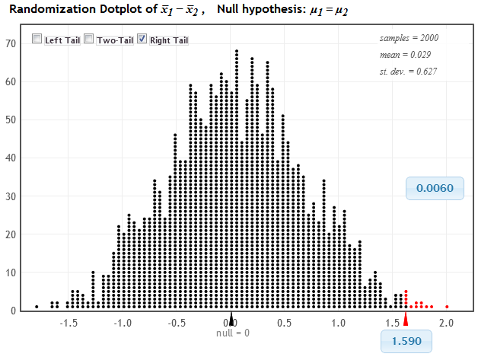
StatKey
www.lock5stat.com/statkey
Distribution of Statistic by random chance, if H₀ true
Proportion as extreme as observed statistic
p-value
observed statistic

Slide 24
Traditional Inference
1. Which formula?
4. Which theoretical distribution?
5. df?
6. find p-value
0.005 < p-value < 0.01
2. Calculate numbers and plug into formula
> pt(2.65, 33, lower.tail=FALSE)
[1] 0.006130769
3. Plug into calculator

Slide 25
Mind-Set and Weight Loss
The Conclusion!
The results seen in the experiment are very unlikely to happen just by random chance (just 6 out of 1000!)
We have strong evidence that the information actually caused the informed maids to lose more weight!
In other words, MIND-SET MATTERS!

Slide 26
Simulation vs Traditional
Simulation methods
intrinsically connected to concepts
same procedure applies to all statistics
no conditions to check
minimal background knowledge needed
Traditional methods (normal and t based)
familiarity expected after intro stats
needed for future statistics classes
only summary statistics are needed
insight from standard error

Slide 27
Simulation AND Traditional?
Our book introduces inference with simulation methods, then covers the traditional methods
Students have seen the normal distribution appear repeatedly via simulation; use this common shape to motivate traditional inference
“Shortcut” formulas give the standard error, avoiding the need for thousands of simulations
Students already know the concepts, so can go relatively fast through the mechanics

Slide 28
Topics
Ch 1: Collecting Data
Ch 2: Describing Data
Ch 3: Confidence Intervals (Bootstrap)
Ch 4: Hypothesis Tests (Randomization)
Ch 5: Normal Distribution
Ch 6: Inference for Means and Proportions (formulas and theory)
Ch 7: Chi-Square Tests
Ch 8: ANOVA
Ch 9: Regression
Ch 10: Multiple Regression
(Optional): Probability

Slide 29
Theoretical Approach
Normal and t-based inference after bootstrapping and randomization:
Students have seen the normal distribution repeatedly – CLT easy!
Same idea, just using formula for SE and comparing to theoretical distribution
Can go very quickly through this!

Slide 30
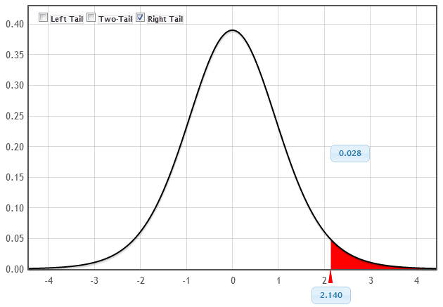
Theoretical Approach
www.lock5stat.com/statkey
p-value
t-statistic

Slide 31
Chi-Square and ANOVA
Introduce new statistic - χ² or F
Students know that these can be compared to either a randomization distribution or a theoretical distribution
Students are comfortable using either method, and see the connection!
If conditions are met, the randomization and theoretical distributions are the same!

Slide 32
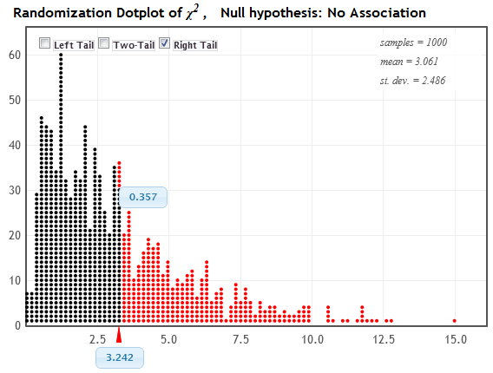
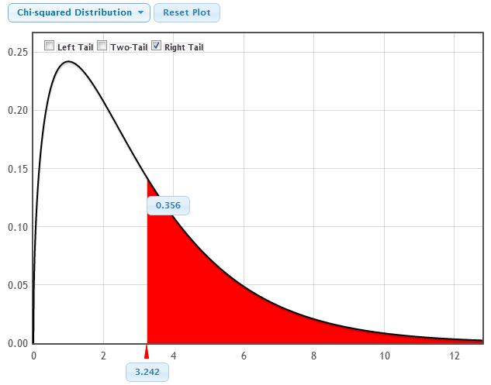
Chi-Square Statistic
Randomization Distribution
p-value = 0.357
Chi-Square Distribution (3 df)
χ² statistic = 3.242
p-value = 0.356
χ² statistic = 3.242

Slide 33
Student Preferences
Which way of doing inference gave you a better conceptual understanding of confidence intervals and hypothesis tests?
Bootstrapping and Randomization | Formulas and Theoretical Distributions
113 | 51
69% | 31%

Slide 34
Student Preferences
Which way did you prefer to learn inference (confidence intervals and hypothesis tests)?
Bootstrapping and Randomization | Formulas and Theoretical Distributions
105 | 60
64% | 36%
 | Simulation | Traditional
AP Stat | 31 | 36
No AP Stat | 74 | 24

Slide 35
Student Behavior
Students were given data on the second midterm and asked to compute a confidence interval for the mean
How they created the interval:
Bootstrapping | t.test in R | Formula
94 | 9 | 9
84% | 8% | 8%
Notes:
They had spent 6 classes on simulation methods over a month ago and the 7 most recent classes using theoretical distributions
they had just had to use the formulas on the in-class exam the day before

Slide 36
A Student Comment
" I took AP Stat in high school and I got a 5. It was mainly all equations, and I had no idea of the theory behind any of what I was doing. Statkey and bootstrapping really made me understand the concepts I was learning, as opposed to just being able to just spit them out on an exam.”
- one of my students

Slide 37
It is the way of the past…
"Actually, the statistician does not carry out this very simple and very tedious process [the randomization test], but his conclusions have no justification beyond the fact that they agree with those which could have been arrived at by this elementary method."
-- Sir R. A. Fisher, 1936

Slide 38
… and the way of the future
“... the consensus curriculum is still an unwitting prisoner of history. What we teach is largely the technical machinery of numerical approximations based on the normal distribution and its many subsidiary cogs. This machinery was once necessary, because the conceptually simpler alternative based on permutations was computationally beyond our reach. Before computers statisticians had no choice. These days we have no excuse. Randomization-based inference makes a direct connection between data production and the logic of inference that deserves to be at the core of every introductory course.”
-- Professor George Cobb, 2007

Slide 39
Book
Statistics: Unlocking the Power of Data
Robin H. Lock, St. Lawrence University
Patti Frazer Lock, St. Lawrence University
Kari Lock Morgan, Duke University
Eric F. Lock, Duke University
Dennis F. Lock, Iowa State
To be published November 2012
kari@stat.duke.edu

