Slide 1
Using Bootstrap Intervals and Randomization Tests to Enhance Conceptual Understanding in Introductory Statistics
Kari Lock Morgan
Department of Statistical Science, Duke University
kari@stat.duke.edu
with Robin Lock, Patti Frazer Lock, Eric Lock, Dennis Lock
Statistics: Unlocking the Power of Data
Wiley Faculty Network
3/29/12

Slide 2
Traditional Inference
Confidence intervals and hypothesis tests using the normal and t-distributions
With a different formula for each situation, students often get mired in the details and fail to see the big picture
Plugging numbers into formulas does little to help reinforce conceptual understanding

Slide 3
Simulation Methods
Simulation methods (bootstrapping and randomization) are a computationally intensive alternative to the traditional approach
Rather than relying on theoretical distributions for specific test statistics, we can directly simulate the distribution of any statistic
Great for conceptual understanding!

Slide 4
It is the way of the past…
"Actually, the statistician does not carry out this very simple and very tedious process [the randomization test], but his conclusions have no justification beyond the fact that they agree with those which could have been arrived at by this elementary method."
-- Sir R. A. Fisher, 1936

Slide 5
… and the way of the future
“... the consensus curriculum is still an unwitting prisoner of history. What we teach is largely the technical machinery of numerical approximations based on the normal distribution and its many subsidiary cogs. This machinery was once necessary, because the conceptually simpler alternative based on permutations was computationally beyond our reach. Before computers statisticians had no choice. These days we have no excuse. Randomization-based inference makes a direct connection between data production and the logic of inference that deserves to be at the core of every introductory course.”
-- Professor George Cobb, 2007

Slide 6
Hypothesis Testing
To generate a distribution assuming H₀ is true:
Traditional Approach: Calculate a test statistic which should follow a known distribution if the null hypothesis is true (under some conditions)
Randomization Approach: Decide on a statistic of interest. Simulate many randomizations assuming the null hypothesis is true, and calculate this statistic for each randomization

Slide 7
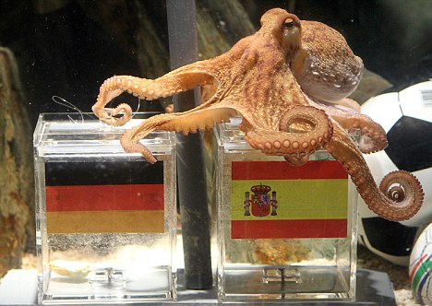
Paul the Octopus
http://www.youtube.com/watch?v=3ESGpRUMj9E

Slide 8
Paul the Octopus
Paul the Octopus predicted 8 World Cup games, and predicted them all correctly
Is this evidence that Paul actually has psychic powers?
How unusual would this be if he was just randomly guessing (with a 50% chance of guessing correctly)?
How could we figure this out?

Slide 9
Simulate with Students
Students each flip a coin 8 times, and count the number of heads
Count the number of students with all 8 heads by a show of hands (will probably be 0)
If Paul was just guessing, it would be very unlikely for him to get all 8 correct!
How unlikely? Simulate many times!!!

Slide 10
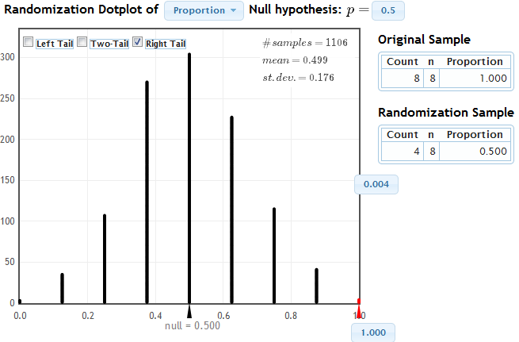
Simulate with StatKey
www.lock5stat.com/statkey

Slide 11
Cocaine Addiction
In a randomized experiment on treating cocaine addiction, 48 people were randomly assigned to take either Desipramine (a new drug), or Lithium (an existing drug)
The outcome variable is whether or not a patient relapsed
Is Desipramine significantly better than Lithium at treating cocaine addiction?

Slide 12
R
R
R
R
R
R
R
R
R
R
R
R
R
R
R
R
R
R
R
R
R
R
R
R
R
R
R
R
R
R
R
R
R
R
R
R
R
R
R
R
R
R
R
R
R
R
R
R
1. Randomly assign units to treatment groups
New Drug
Old Drug
R
R
R
R
R
R
R
R
R
R
R
R
R
R
R
R
R
R
R
R
R
R
R
R
R
R
R
R
R
R
R
R
R
R
R
R
R
R
R
R
R
R
R
R

Slide 13
2. Conduct experiment
3. Observe relapse counts in each group
R = Relapse
N = No Relapse
1. Randomly assign units to treatment groups
New Drug
Old Drug
R
R
R
R
R
R
R
R
R
R
R
R
R
R
R
R
R
R
R
R
R
R
R
R
R
R
R
R
R
R
R
R
N
R
N
R
R
R
R
R
R
R
R
R
R
R
R
R
N
R
N
R
N
N
N
N
N
N
N
N
R
R
R
R
R
R
R
R
R
R
R
R
N
N
N
N
N
N
N
N
N
N
N
N
N
N
N
N
N
N
N
N
N
N
N
N
10 relapse, 14 no relapse
18 relapse, 6 no relapse

Slide 14
Randomization Test
Assume the null hypothesis is true
Simulate new randomizations
For each, calculate the statistic of interest
Find the proportion of these simulated statistics that are as extreme as your observed statistic

Slide 15
R
R
R
R
R
R
R
R
R
R
R
R
R
R
R
R
N
N
R
R
R
R
R
R
N
N
N
N
N
N
R
R
R
R
R
R
N
N
N
N
N
N
N
N
N
N
N
N
10 relapse, 14 no relapse
18 relapse, 6 no relapse

Slide 16
R
R
R
R
R
R
R
R
R
R
R
R
R
R
R
R
N
N
R
R
R
R
R
R
N
N
N
N
N
N
R
R
R
R
R
R
N
N
N
N
N
N
N
N
N
N
N
N
Simulate another randomization
New Drug
Old Drug
R
N
R
N
N
N
N
R
R
R
R
R
R
R
N
R
R
N
N
N
R
N
R
R
R
N
N
R
N
R
R
N
R
N
N
N
R
R
R
N
R
R
R
R
16 relapse, 8 no relapse
12 relapse, 12 no relapse

Slide 17
Simulate another randomization
New Drug
Old Drug
R
R
R
R
R
R
R
R
R
R
R
R
R
N
R
R
N
N
R
R
R
R
R
R
R
R
N
R
N
R
R
R
R
R
R
R
R
N
R
N
R
R
N
N
N
N
N
N
17 relapse, 7 no relapse
11 relapse, 13 no relapse

Slide 18
Simulate with Students
Give students index cards labeled R (28 cards) and N (20 cards)
Have them deal the cards into 2 groups
Compute the difference in proportions
Contribute to a class dotplot for the randomization distribution

Slide 19
Cocaine Addiction
You want to know what would happen
  by random chance (the random allocation to treatment groups)
  if the null hypothesis is true (there is no difference between the drugs)
  Why did you re-deal your cards?
  Why did you leave the outcomes (relapse or no relapse) unchanged on each card?

Slide 20
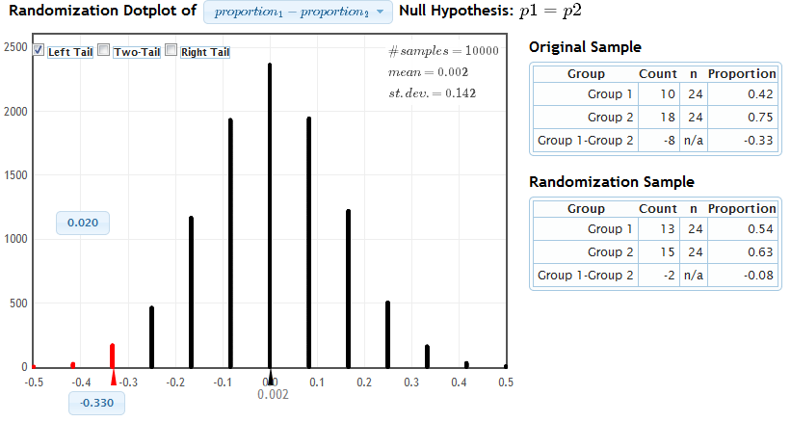
Simulate with StatKey
www.lock5stat.com/statkey
Distribution of Statistic Assuming Null is True
Proportion as extreme as observed statistic
observed statistic
The probability of getting results as extreme or more extreme than those observed if the null hypothesis is true, is about .02.
p-value

Slide 21
Confidence Intervals
From just one sample, we’d like to assess the variability of sample statistics
Imagine the population is many, many copies of the original sample (what do you have to assume?)
Sample repeatedly from this mock population
This is done by sampling with replacement from the original sample

Slide 22


Atlanta Commutes
What’s the mean commute time for workers in metropolitan Atlanta?
Data: The American Housing Survey (AHS) collected data from Atlanta in 2004.

Slide 23
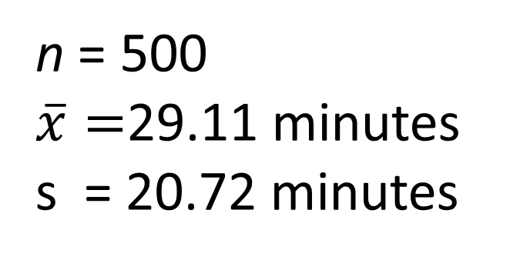
Atlanta Commutes - Sample
Where might the “true” μ be?

Slide 24
Original Sample

Slide 25
“Population” ≈ many copies of sample
Sample from this “population”

Slide 26
Bootstrapping
A bootstrap sample is a random sample taken with replacement from the original sample, of the same size as the original sample
A bootstrap statistic is the statistic computed on the bootstrap sample
A bootstrap distribution is the distribution of many bootstrap statistics

Slide 27
BootstrapSample
Bootstrap Statistic
BootstrapSample
Bootstrap Statistic
Original Sample
Bootstrap Distribution
.
.
.
.
.
.
Sample Statistic
BootstrapSample
Bootstrap Statistic

Slide 28
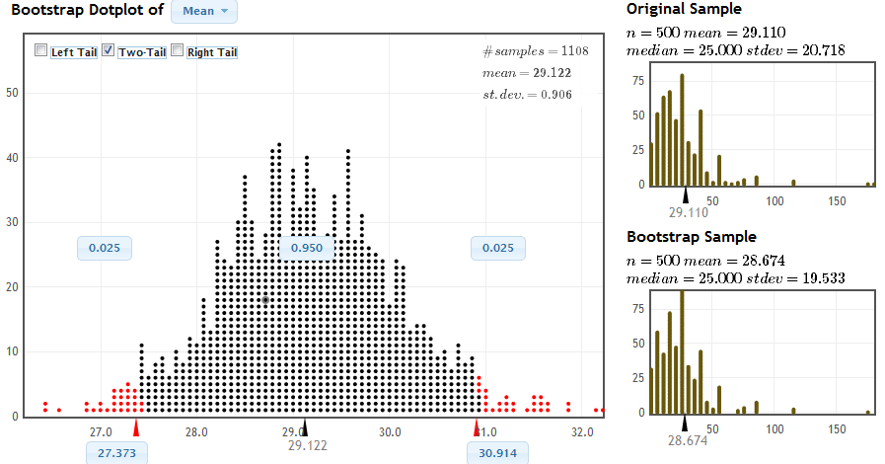
Simulate with StatKey
www.lock5stat.com/statkey
Middle 95% of bootstrap statistics: (27.4, 30.9)

Slide 29
Simulation vs Traditional
Simulation methods
  intrinsically connected to concepts
  same procedure applies to all statistics
  no conditions to check
  minimal background knowledge needed
Traditional methods (normal and t based)
  familiarity expected after intro stats
  needed for future statistics classes
  only summary statistics are needed
  insight from standard error

Slide 30
Simulation AND Traditional?
Our book introduces inference with simulation methods, then covers the traditional methods
Students have seen the normal distribution appear repeatedly via simulation; use this common shape to motivate traditional inference
“Shortcut” formulas give the standard error, avoiding the need for thousands of simulations
Students already know the concepts, so can go relatively fast through the mechanics

Slide 31
Topics
Ch 1: Collecting Data
Ch 2: Describing Data
Ch 3: Confidence Intervals (Bootstrap)
Ch 4: Hypothesis Tests (Randomization)
Ch 5: Normal Distribution
Ch 6: Inference for Means and Proportions (formulas and theory)
Ch 7: Chi-Square Tests
Ch 8: ANOVA
Ch 9: Regression
(Optional): Probability
Ch 1: Collecting Data
Ch 2: Describing Data
Ch 3: Confidence Intervals (Bootstrap)
Ch 4: Hypothesis Tests (Randomization)
Ch 5: Normal Distribution
Ch 6: Inference for Means and Proportions (formulas and theory)
Ch 7: Chi-Square Tests
Ch 8: ANOVA
Ch 9: Regression
(Optional): Probability

Slide 32
Student Preferences
Which way did you prefer to learn inference (confidence intervals and hypothesis tests)?
Bootstrapping and Randomization | Formulas and Theoretical Distributions
105 | 60
64% | 36%

Slide 33
Student Preferences
Which way do you prefer to do inference?
Bootstrapping and Randomization | Formulas and Theoretical Distributions
110 | 54
67% | 33%

Slide 34
Student Preferences
Which way of doing inference gave you a better conceptual understanding of confidence intervals and hypothesis tests?
Bootstrapping and Randomization | Formulas and Theoretical Distributions
113 | 51
69% | 31%

Slide 35
Student Preferences
Which way did you prefer to learn inference?
 | Simulation | Traditional
AP Stat | 31 | 36
No AP Stat | 74 | 24

Slide 36
A Student Comment
" I took AP Stat in high school and I got a 5. It was mainly all equations, and I had no idea of the theory behind any of what I was doing.
Statkey and bootstrapping really made me understand the concepts I was learning, as opposed to just being able to just spit them out on an exam.”
- one of my students

Slide 37
Book
Statistics: Unlocking the Power of Data
Robin H. Lock, St. Lawrence University
Patti Frazer Lock, St. Lawrence University
Kari Lock Morgan, Duke University
Eric F. Lock, UNC Chapel Hill
Dennis F. Lock, Iowa State
To be published Fall 2012
kari@stat.duke.edu

