Slide 1
Implementing a Randomization-Based Curriculum for Introductory Statistics
Robin H. Lock, Burry Professor of Statistics
St. Lawrence University
Breakout Panel
USCOTS 2011 - Raleigh, NC

Slide 2
Intro Stat (Math 113) at St. Lawrence
26-29 students per section
5-7 sections per semester
Only 100-level (intro) stat course on campus
Backgrounds: Students from a variety of majors
Setting: Full time in a computer classroom
Software: Minitab and Fathom
Randomization methods: Only token use until one section in Fall 2010…

Slide 3
Allan’s Questions
1. Pre-requisites
What comes before we introduce randomization-based inference?
2. Order of topics?
One vs. two samples?
Categorical vs. quantitative?
Significant vs. non-significant first?
Interval vs. test?

Slide 4
Math 113 – Traditional Topics
Descriptive Statistics – one and two samples
Normal distributions
Data production (samples/experiments)
Sampling distributions (mean/proportion)
Confidence intervals (means/proportions)
Hypothesis tests (means/proportions)
ANOVA for several means, Inference for regression, Chi-square tests

Slide 5
Math 113 – Revise the Topics
Descriptive Statistics – one and two samples
Normal distributions
Bootstrap confidence intervals
Bootstrap confidence intervals
Data production (samples/experiments)
Data production (samples/experiments)
Randomization-based hypothesis tests
Randomization-based hypothesis tests
Sampling distributions (mean/proportion)
Normal/sampling distributions
Confidence intervals (means/proportions)
Hypothesis tests (means/proportions)
ANOVA for several means, Inference for regression, Chi-square tests

Slide 6
Why start with Bootstrap CI’s?
Minimal prerequisites:
Population parameter vs. sample statistic
Random sampling
Dotplot (or histogram)
Standard deviation and/or percentiles
Same method of randomization in most cases
Sample with replacement from original sample
Natural progression
Sample estimate ==> How accurate is the estimate?
Intervals are more useful?
A good debate for another session…

Slide 7
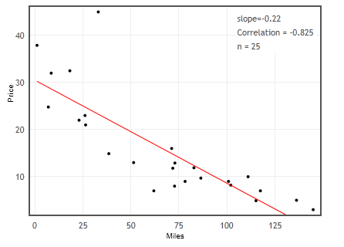
Example: Mustang Prices
Find a confidence interval for the slope of a regression line to predict prices of used Mustangs based on their mileage.
Data: Sample of 25 Mustangs listed on Autotrader.com

Slide 8
“Bootstrap” Samples
Key idea:
Sample with replacement from the original sample using the same n.
Compute the sample statistic for each bootstrap sample.
Collect lots of such bootstrap statistics
Imagine the “population” is many, many copies of the original sample.

Slide 9
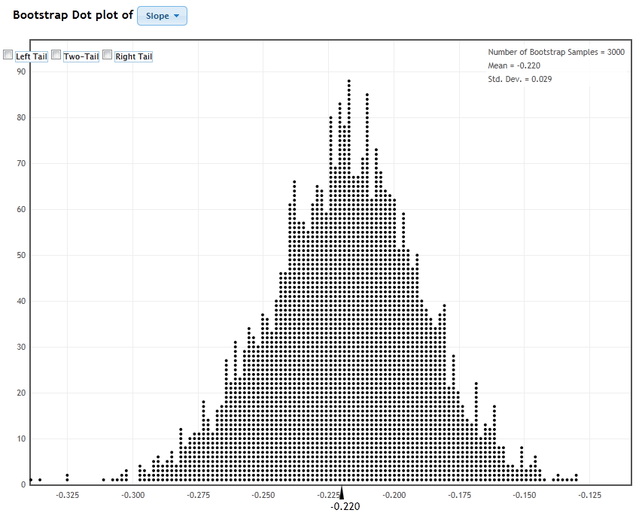
Distribution of 3000 Bootstrap Slopes

Slide 10
Using the Bootstrap Distribution to Get a Confidence Interval – Version #1
The standard deviation of the bootstrap statistics estimates the standard error of the sample statistic.
Quick interval estimate :
$$Original Statistic ±2∙SE$$
For the mean Mustang slope time:

Slide 11
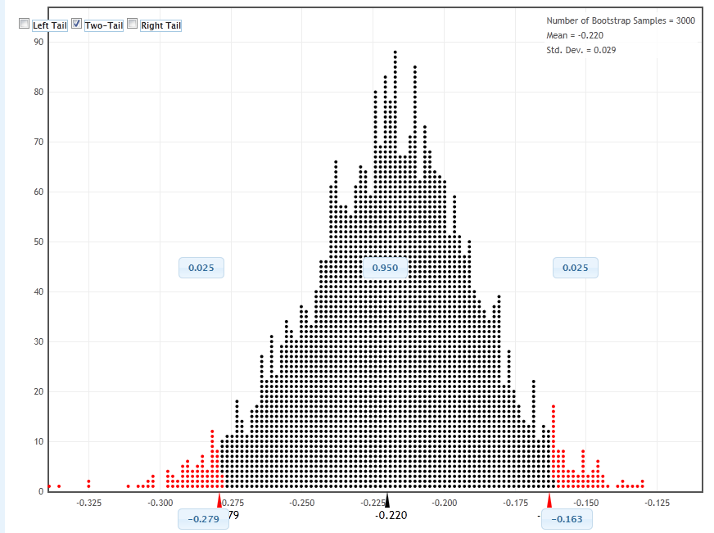
Using the Bootstrap Distribution to Get a Confidence Interval – Version #2
95% CI for slope
(-0.279,-0.163)
Chop 2.5% in each tail
Keep 95% in middle
Chop 2.5% in each tail

Slide 12
3. Simulation Technology?
Fall 2010: Fathom
Fall 2011: Fathom & Applets
Tactile simulations first?
Bootstrap – No (with replacement is tough)
Test for an experiment – Yes (1 or 2)

Slide 13
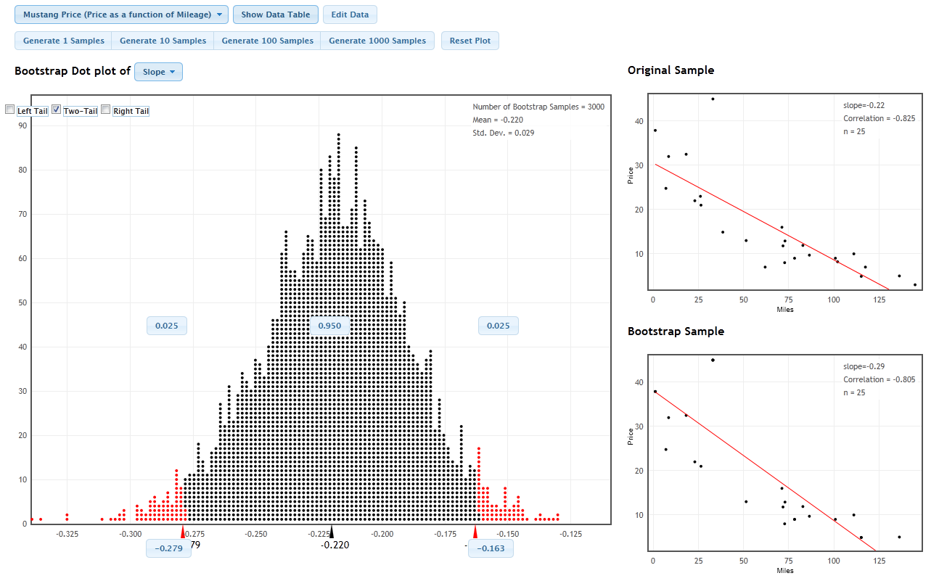
Desirable Technology Features?
One to Many Samples
Three Distributions

Slide 14
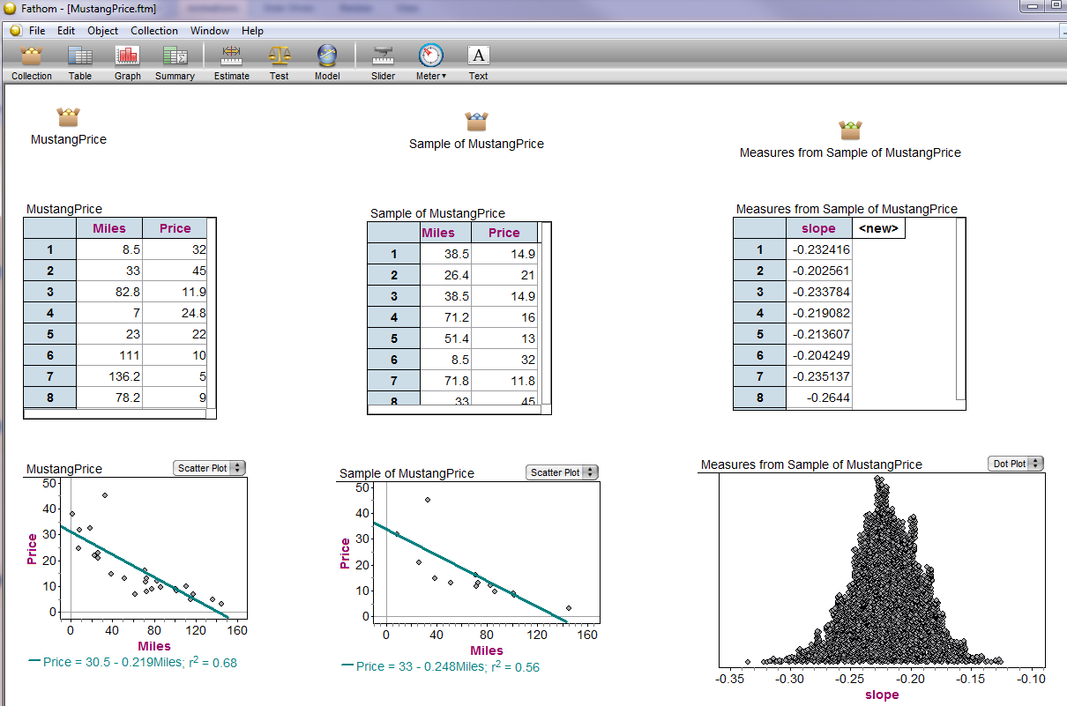
Desirable Technology Features

Slide 15
4. One Crank or Two?
Confidence Intervals – Bootstrap – one crank
Significance Tests – Two (or more) cranks
Rules for selecting randomization samples for a test. Be consistent with:
the null hypothesis
the sample data
the way data were collected

Slide 16
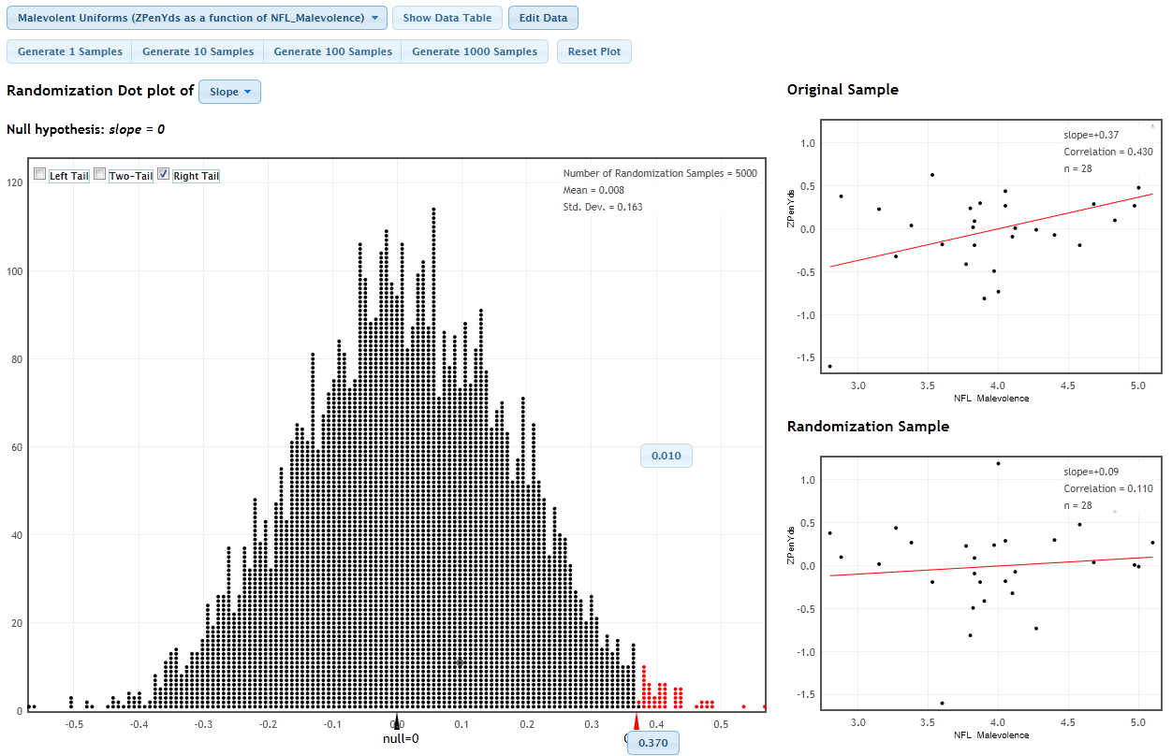
Randomization Test for Slope

Slide 17
5. Test for a 2x2 Table
First example: A randomized experiment
Test statistic: Count in one cell
Randomize: Treatment groups
Margins: Fix both
Later examples vary, e.g. use difference in proportions or randomize as independent samples with common p.

Slide 18
6. What about “traditional” methods?
AFTER students have seen lots of bootstrap and randomization distributions (and hopefully begun to understand the logic of inference) …
Introduce the normal distribution (and later t)
Introduce “shortcuts” for estimating SE for proportions, means, differences, …

Slide 19
Back to Mustang Prices
The regression equation is
Price = 30.5 - 0.219 Miles
Predictor Coef SE Coef T P
Constant 30.495 2.441 12.49 0.000
Miles -0.21880 0.03130 -6.99 0.000
S = 6.42211 R-Sq = 68.0% R-Sq(adj) = 66.6%

Slide 20
7. Assessment?
New learning goals
Understand how to generate bootstrap samples and distribution.
Understand how to create randomization samples and distribution.
Be able to use a bootstrap/randomization distribution to find an interval/p-value.

Slide 21
8. How did it go?
Students enjoyed and were engaged with the new approach
Instructor enjoyed and was engaged with the new approach.
Better understanding of p-value reflecting “if H₀ is true”.
Better interpretations of intervals.
Challenge: Few “experienced” students to serve as resources.

Slide 22
Going forward
Continue with randomization approach?
ABSOLUTELY (3 sections in Fall 2011)

