Slide 1
Using Bootstrapping and Randomization to Introduce Statistical Inference
Robin H. Lock, Burry Professor of Statistics
Patti Frazer Lock, Cummings Professor of Mathematics
St. Lawrence University
USCOTS 2011
Raleigh, NC

Slide 2
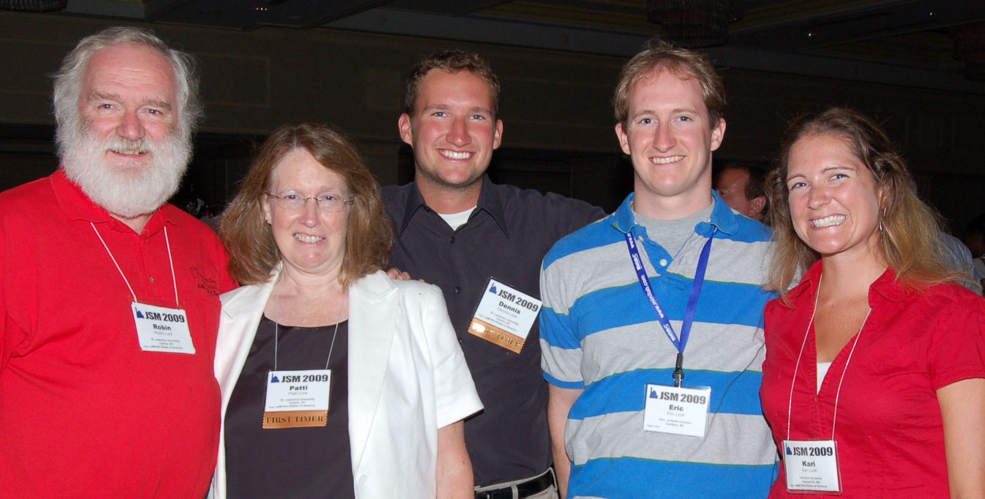
The Lock⁵ Team
Dennis
Iowa State
Kari
Harvard/Duke
Eric
UNC- Chapel Hill
Robin & Patti
St. Lawrence

Slide 3
Question
Can you use your clicker?
A. Yes
B. No
C. Not sure
D. I don’t have a clicker

Slide 4
Setting
Intro Stat – an introductory statistics course for undergraduates
“introductory” ==> no formal stat pre-requisite
AP Stat counts as “undergraduate”

Slide 5
Question
Do you teach a Intro Stat?
A. Very regularly (most semesters)
B. Regularly (most years)
C. Occasionally
D. Rarely (every few years)
E. Never

Slide 6
Question
Have you used randomization methods in Intro Stat?
A. Yes, as a significant part of the course
B. Yes, as a minor part of the course
C. No
D. What are randomization methods?

Slide 7
Question
Have you used randomization methods in any statistics class that you teach?
A. Yes, as a significant part of the course
B. Yes, as a minor part of the course
C. No
D. What are randomization methods?

Slide 8
Intro Stat - Traditional Topics
Descriptive Statistics – one and two samples
Normal distributions
Data production (samples/experiments)
Sampling distributions (mean/proportion)
Confidence intervals (means/proportions)
Hypothesis tests (means/proportions)
ANOVA for several means, Inference for regression, Chi-square tests

Slide 9
QUIZ
Choose an order to teach standard inference topics:
_____ Test for difference in two means
_____ CI for single mean
_____ CI for difference in two proportions
_____ CI for single proportion
_____ Test for single mean
_____ Test for single proportion
_____ Test for difference in two proportions
_____ CI for difference in two means

Slide 10
Intro Stat – Revise the Topics
Descriptive Statistics – one and two samples
?
?
Normal distributions
Bootstrap confidence intervals
Bootstrap confidence intervals
Data production (samples/experiments)
Data production (samples/experiments)
Randomization-based hypothesis tests
Randomization-based hypothesis tests
Sampling distributions (mean/proportion)
Normal/sampling distributions
Confidence intervals (means/proportions)
Hypothesis tests (means/proportions)
ANOVA for several means, Inference for regression, Chi-square tests

Slide 11
Question
Data Description: Summary statistics & graphs
Data Production: Sampling & experiments
What is your preferred order?
A. Description, then Production
B. Production, then Description
C. Mix them up

Slide 12
Example: Reese’s Pieces
Sample: 52/100 orange
Where might the “true” p be?

Slide 13
“Bootstrap” Samples
Key idea: Sample with replacement from the original sample using the same n.
Imagine the “population” is many, many copies of the original sample.

Slide 14
Simulated Reese’s Population

Slide 15
Creating a Bootstrap Sample:
Class Activity?
What proportion of Reese’s Pieces are orange?
Original Sample: 52 orange out of 100 pieces
How can we create a bootstrap sample?
Select a candy (at random) from the original sample
Record color (orange or not)
Put it back, mix and select another
Repeat until sample size is 100

Slide 16
Creating a Bootstrap Distribution
1. Compute a statistic of interest (original sample).
2. Create a new sample with replacement (same n).
3. Compute the same statistic for the new sample.
4. Repeat 2 & 3 many times, storing the results.
5. Analyze the distribution of collected statistics.
Time for some technology…

Slide 17
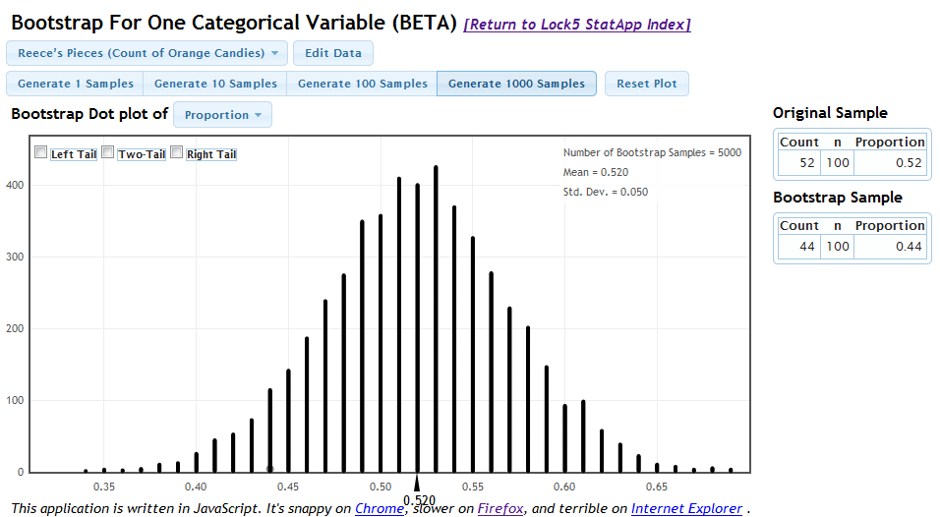
Bootstrap Proportion Applet

Slide 18
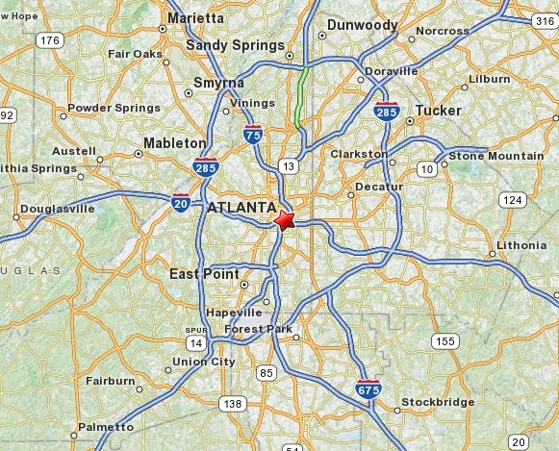
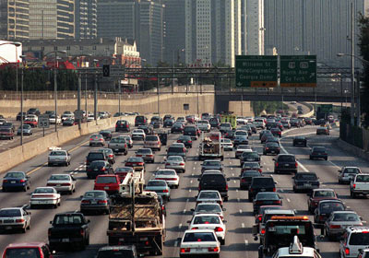
Example: Atlanta Commutes
What’s the mean commute time for workers in metropolitan Atlanta?
Data: The American Housing Survey (AHS) collected data from Atlanta in 2004.

Slide 19
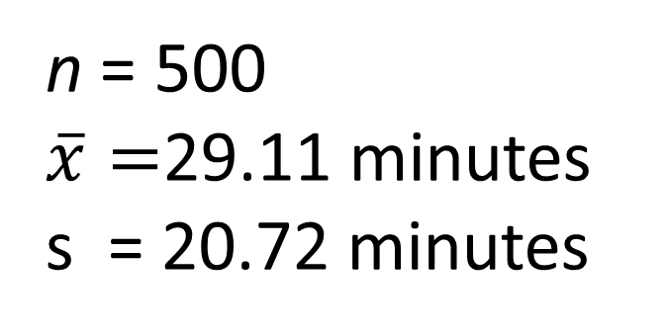
Sample of n=500 Atlanta Commutes
n = 500
$\overline{x}=$29.11 minutes
s = 20.72 minutes
Where might the “true” μ be?

Slide 20
Atlanta Commutes – Original Sample

Slide 21
Atlanta Commutes: Simulated Population
Sample from this “population”

Slide 22
Creating a Bootstrap Distribution
1. Compute a statistic of interest (original sample).
2. Create a new sample with replacement (same n).
3. Compute the same statistic for the new sample.
4. Repeat 2 & 3 many times, storing the results.
5. Analyze the distribution of collected statistics.
Time for some technology…

Slide 23
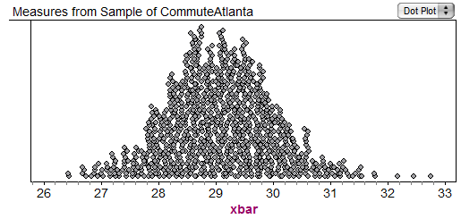
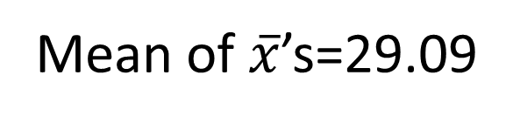
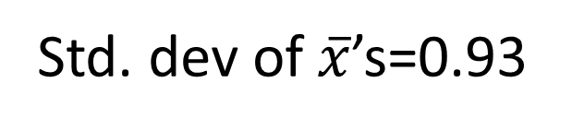
Bootstrap Distribution of 1000 Atlanta Commute Means
Mean of $\overline{x}$’s=29.09
Std. dev of $\overline{x}$’s=0.93

Slide 24

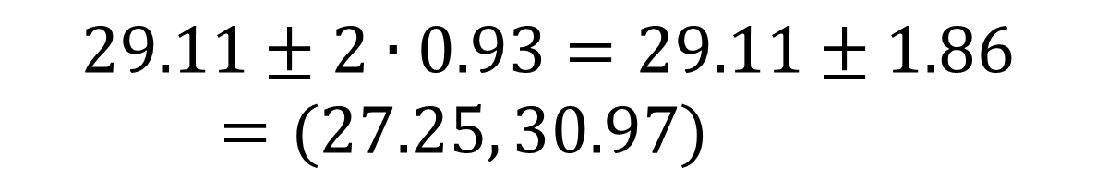
Using the Bootstrap Distribution to Get a Confidence Interval – Version #1
The standard deviation of the bootstrap statistics estimates the standard error of the sample statistic.
Quick interval estimate :
$$Original Statistic ±2∙SE$$
For the mean Atlanta commute time:
$$29.11±2∙0.93=29.11±1.86=(27.25, 30.97)$$

Slide 25
Quick Assessment
HW assignment (after one class on Sept. 29):
Use data from a sample of NHL players to find a confidence interval for the standard deviation of number of penalty minutes.
Results:
9/26 did everything fine
6/26 got a reasonable bootstrap distribution, but messed up the interval, e.g. StdError( )
5/26 had errors in the bootstraps, e.g. n=1000
6/26 had trouble getting started, e.g. defining s( )

Slide 26
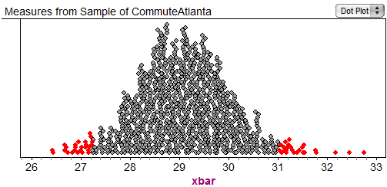
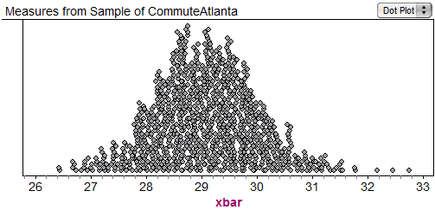
Using the Bootstrap Distribution to Get a Confidence Interval – Version #2
95% CI=(27.24,31.03)
27.24
31.03
Chop 2.5% in each tail
Chop 2.5% in each tail
Keep 95% in middle
For a 95% CI, find the 2.5%-tile and 97.5%-tile in the bootstrap distribution

Slide 27
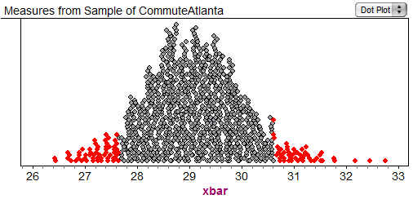
90% CI for Mean Atlanta Commute
90% CI=(27.60,30.61)
27.60
30.61
Chop 5% in each tail
Keep 90% in middle
Chop 5% in each tail
For a 90% CI, find the 5%-tile and 95%-tile in the bootstrap distribution

Slide 28
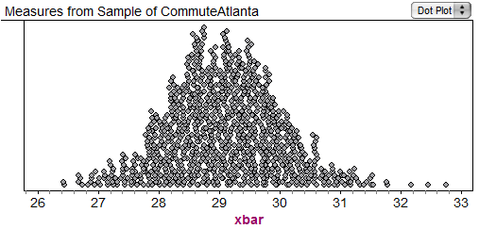
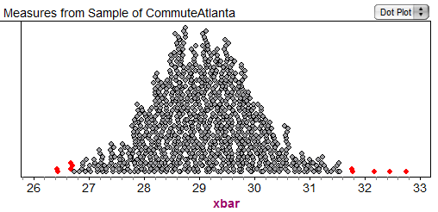
99% CI for Mean Atlanta Commute
99% CI=(26.73,31.65)
26.73
31.65
Keep 99% in middle
Chop 0.5% in each tail
Chop 0.5% in each tail
For a 99% CI, find the 0.5%-tile and 99.5%-tile in the bootstrap distribution

Slide 29
Bootstrap Confidence Intervals
Version 1 (2 SE): Great preparation for moving to traditional methods
Version 2 (percentiles): Great at building understanding of confidence intervals

Slide 30
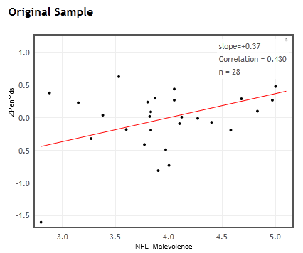


Using the Bootstrap Distribution to Get a Confidence Interval
Ex: NFL uniform “malevolence” vs. Penalty yards
r = 0.430
Find a 95% CI for correlation
Try web applet

Slide 31
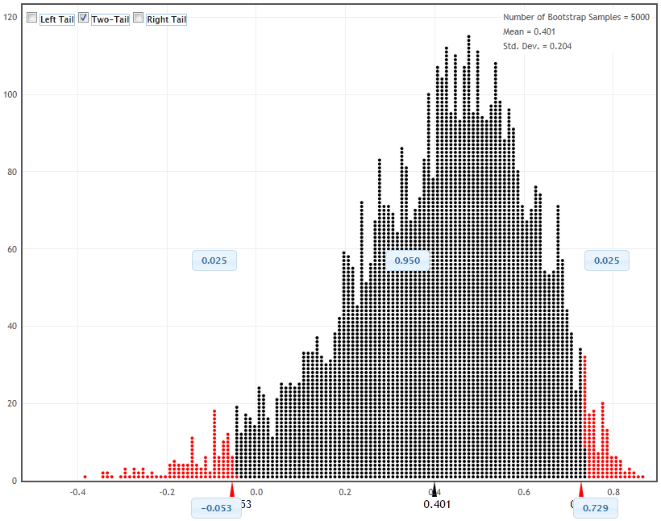
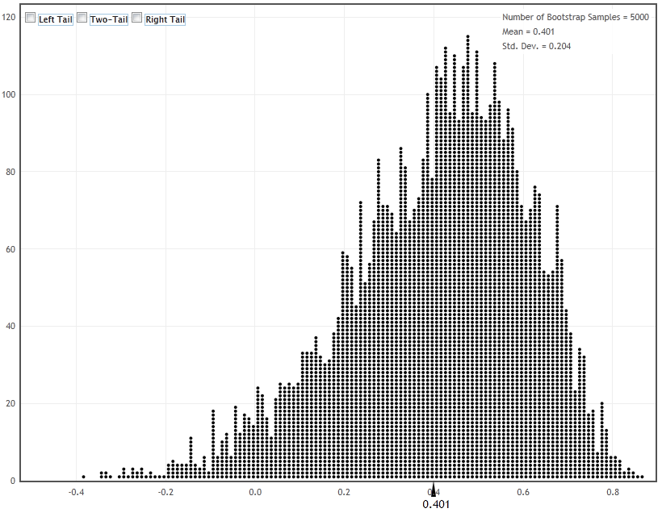
-0.053
0.729
0.430

Slide 32
Using the Bootstrap Distribution to Get a Confidence Interval – Version #3
0.483
0.299
-0.053
0.430
0.729
“Reverse” Percentile Interval:
Lower: 0.430 – 0.299 = 0.131
Upper: 0.430 + 0.483 = 0.913

Slide 33
Question
Which of these methods for constructing a CI from a bootstrap distribution should be used in Intro Stat?
(choosing more than one is fine)
#1: +/- multiple of SE
#2: Percentile
#3: Reverse percentile
A. Yes B. No C. Unsure
A. Yes B. No C. Unsure
A. Yes B. No C. Unsure

Slide 34
Question
Which of these methods for constructing a CI from a bootstrap distribution should be used in Intro Stat?
(choosing more than one is fine)
#1: +/- multiple of SE
#2: Percentile
#3: Reverse percentile
A. Yes B. No C. Unsure

Slide 35
Question
Which of these methods for constructing a CI from a bootstrap distribution should be used in Intro Stat?
(choosing more than one is fine)
#1: +/- multiple of SE
#2: Percentile
#3: Reverse percentile
A. Yes B. No C. Unsure

Slide 36
Question
Which of these methods for constructing a CI from a bootstrap distribution should be used in Intro Stat?
(choosing more than one is fine)
#1: +/- multiple of SE
#2: Percentile
#3: Reverse percentile
A. Yes B. No C. Unsure

Slide 37
What About Hypothesis Tests?

Slide 38
“Randomization” Samples
Key idea: Generate samples that are
consistent with the null hypothesis AND
based on the sample data.

Slide 39
Example: Cocaine Treatment
Conditions (assigned at random):
Group A: Desipramine
Group B: Lithium
Response: (binary categorical)
Relapse/No relapse

Slide 40
Treating Cocaine Addiction
Randomly assign to Desipramine or Lithium
Start with 48 subjects
Record the data: Relapse/No Relapse
Group A:
Desipramine
Group A:
Desipramine
Group B:
Lithium
Group B:
Lithium

Slide 41
Cocaine Treatment Results
 | Relapse | No Relapse
Desipramine
Lithium
10
18
14
6
24
24
28 | 20
Is this difference “statistically significant”?

Slide 42
Key idea: Generate samples that are
(a) consistent with the null hypothesis
(b) based on the sample data.
 | Relapse | No Relapse
Desipramine
Lithium
10
18
14
6
24
24
28 | 20
H₀ : Drug doesn’t matter

Slide 43
Key idea: Generate samples that are
(a) consistent with the null hypothesis
(b) based on the sample data.
In 48 addicts, there are 28 relapsers and 20 no-relapsers. Randomly split them into two groups.
How unlikely is it to have as many as 14 of the no-relapsers in the Desipramine group?

Slide 44
Cocaine Treatment- Simulation
1. Start with a pack of 48 cards (the addicts).
28 Relapse: Cards 3 – 9
20 Don’t relapse: Cards 10,J,Q,K,A
2. Shuffle the cards and deal 24 at random to form the Desipramine group (Group A).
3. Count the number of “No Relapse” cards in simulated Desipramine group.
4. Repeat many times to see how often a random assignment gives a count as large as the experimental count (14) to Group A.
Automate this

Slide 45
Distribution for 1000 Simulations
Number of “No Relapse” in Desipramine group under random assignments
28/1000

Slide 46
Understanding a p-value
The p-value is the probability of seeing results as extreme as the sample results, if the null hypothesis is true.

Slide 47

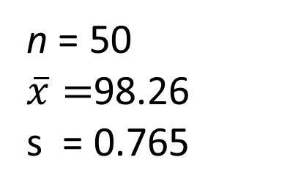
Example: Mean Body Temperature
Is the average body temperature really 98.6ºF?
H₀:μ=98.6
H_{a}:μ≠98.6
Data: A random sample of n=50 body temperatures.
n = 50
$\overline{x}=$98.26
s = 0.765
Data from Allen Shoemaker, 1996 JSE data set article

Slide 48
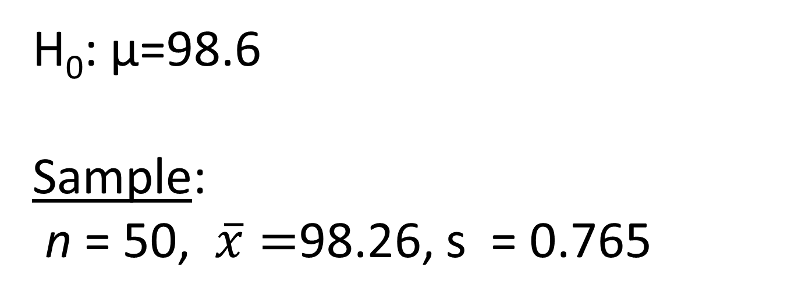
Key idea: Generate samples that are
(a) consistent with the null hypothesis
(b) based on the sample data.
How to simulate samples of body temperatures to be consistent with H₀: μ=98.6?
H₀: μ=98.6
Sample:
n = 50, $\overline{x}=$98.26, s = 0.765

Slide 49
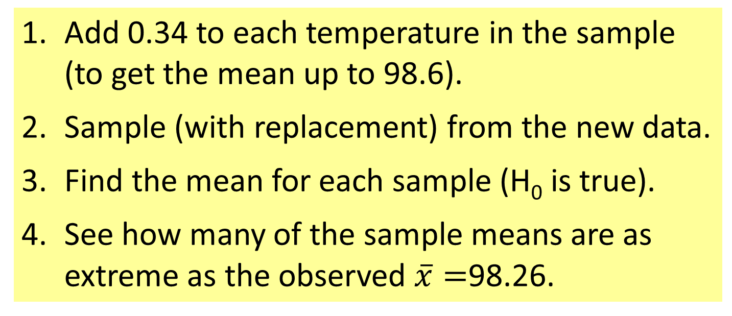
Randomization Samples
How to simulate samples of body temperatures to be consistent with H₀: μ=98.6?
Add 0.34 to each temperature in the sample (to get the mean up to 98.6).
Sample (with replacement) from the new data.
Find the mean for each sample (H₀ is true).
See how many of the sample means are as extreme as the observed $\overline{x}=$98.26.

Slide 50
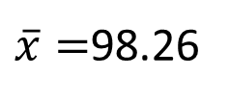
Randomization Distribution
$\overline{x}=$98.26
Looks pretty unusual…
p-value ≈ 1/1000 x 2 = 0.002

Slide 51
Connecting CI’s and Tests
Randomization body temp means when μ=98.6
Bootstrap body temp means from the original sample
Fathom Demo

Slide 52
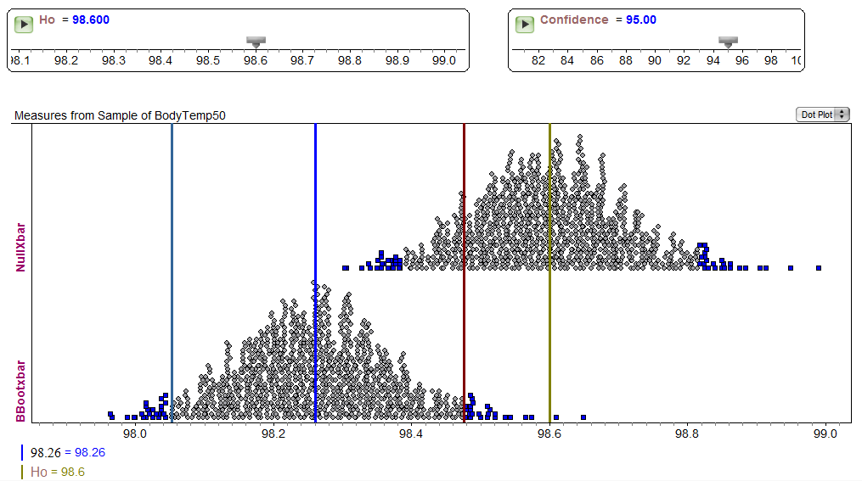
Fathom Demo: Test & CI

Slide 53
Intermediate Assessment
Exam #2: (Oct. 26) Students were asked to find a 95% confidence interval for the correlation between water pH and mercury levels in fish for a sample of Florida lakes – using both SE and percentiles from a bootstrap distribution.
Results:
17/26 did everything fine
4/26 had errors finding/using SE
2/26 had minor arithmetic errors
3/26 had errors in the bootstrap distribution

Slide 54
Choosing a Randomization Method
Example: Finger tap rates (Handbook of Small Datasets)
A=Caffeine | 246 | 248 | 250 | 252 | 248 | 250 | 246 | 248 | 245 | 250 | mean=248.3
B=No Caffeine | 242 | 245 | 244 | 248 | 247 | 248 | 242 | 244 | 246 | 241 | mean=244.7
H₀: μ_{A}=μ_{B} vs. H_{a}: μ_{A}>μ_{B}
Reallocate
Option 1: Randomly scramble the A and B labels and assign to the 20 tap rates.
Resample
Option 2: Combine the 20 values, then sample (with replacement) 10 values for Group A and 10 values for Group B.

Slide 55
“Randomization” Samples
Key idea: Generate samples that are
consistent with the null hypothesis AND
based on the sample data
and
(c) Reflect the way the data were collected.
“Reallocation” vs. “Resampling”

Slide 56
Question
In Intro Stat, how critical is it for the method of randomization to reflect the way data were collected?
A. Essential
B. Relatively important
C. Desirable, but not imperative
D. Minimal importance
E. Ignore the issue completely

Slide 57
What about Traditional Methods?

Slide 58
Transitioning to Traditional Inference
AFTER students have seen lots of bootstrap distributions and randomization distributions…
Students should be able to
Find, interpret, and understand a confidence interval
Find, interpret, and understand a p-value

Slide 59
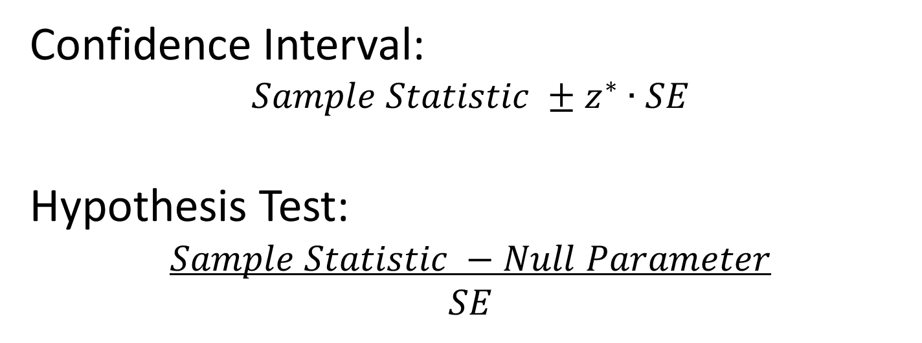
Transitioning to Traditional Inference
Introduce the normal distribution (and later t)
Introduce “shortcuts” for estimating SE for proportions, means, differences, slope…
Confidence Interval:
$$Sample Statistic ±z^{∗}∙SE$$
Hypothesis Test:
$$Sample Statistic −Null Parameter$$
$$SE$$

Slide 60
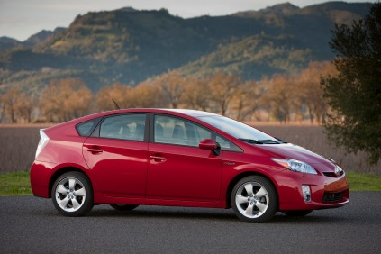
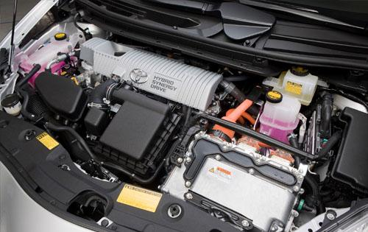
Toyota Prius – Hybrid Technology

Slide 61
Question
Order of topics?
A. Randomization, then traditional
B. Traditional, then randomization
C. No (or minimal) traditional
D. No (or minimal) randomization

Slide 62
QUIZ
Choose an order to teach standard inference topics:
_____ Test for difference in two means
_____ CI for single mean
_____ CI for difference in two proportions
_____ CI for single proportion
_____ Test for single mean
_____ Test for single proportion
_____ Test for difference in two proportions
_____ CI for difference in two means

Slide 63
What about Technology?

Slide 64
Possible Technology Options
Fathom/Tinkerplots
R
Minitab (macro)
SAS
Matlab
Excel
JMP
StatCrunch
Web apps
Others?
Try some out at a breakout session tomorrow!

Slide 65
What about Assessment?

Slide 66
An Actual Assessment
Final exam: Find a 98% confidence interval using a bootstrap distribution for the mean amount of study time during final exams
Results:
26/26 had a reasonable bootstrap distribution
24/26 had an appropriate interval
23/26 had a correct interpretation

Slide 67
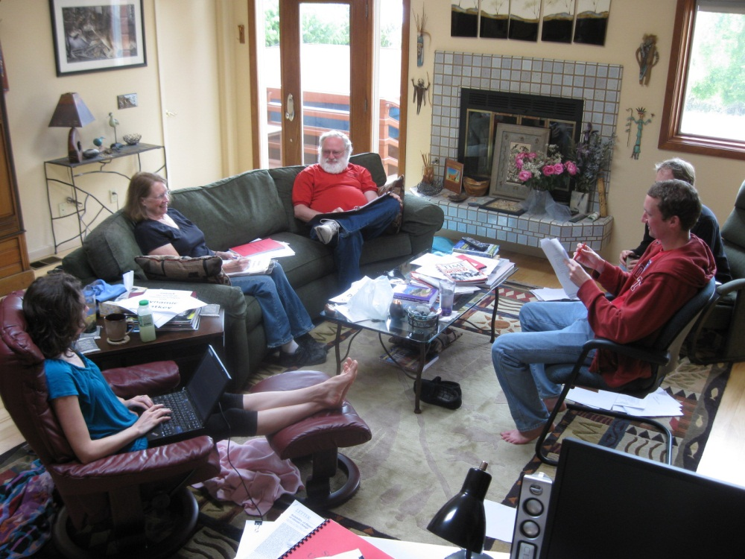
Support Materials?
We’re working on them…
Interested in learning more or class testing?
rlock@stlawu.edu plock@stlawu.edu
www.lock5stat.com

Slide 68
Example: CI for Weight Gain
Does binge eating for four weeks affect long-term weight and body fat?
18 healthy and normal weight people with an average age of 26.
Construct a confidence interval for mean weight gain 2.5 years after the experiment, based on the data for the 18 participants.

Slide 69
Construct a bootstrap confidence interval for mean weight gain two years after binging, based on the data for the 18 participants.
a). Parameter? Population?
b). Suppose that we write the 18 weight gains on 18 slips of paper. Use these to construct one bootstrap sample.
c). What statistic is recorded?
d). Expected shape and center for the bootstrap distribution?
e). Use a bootstrap distribution to find a 95% CI for the mean weight gain in this situation. Interpret it.

Slide 70
Example: Sleep vs. Caffeine for Memory
Is a nap or a caffeine pill better at helping people memorize a list of words?
24 adults divided equally between two groups and given a list of 24 words to memorize.
Test to see if there is a difference in the mean number of words participants are able to recall depending on whether the person sleeps or ingests caffeine.
Sleep | 14 | 18 | 11 | 13 | 18 | 17 | 21 | 9 | 16 | 17 | 14 | 15 | Mean=15.25
Caffeine | 12 | 12 | 14 | 13 | 6 | 18 | 14 | 16 | 10 | 7 | 15 | 10 | Mean=12.25

Slide 71
Test to see if there is a difference in the mean number of words participants are able to recall depending on whether the person sleeps or ingests caffeine.
a). Hypotheses?
b). What assumption do we make in creating the randomization distribution?
c). Describe how to use 24 cards to physically find one point on the randomization distribution. How is the assumption from part (b) used in deciding what to do with the cards?
d). Given a randomization distribution: What does one dot represent?
e). Given a randomization distribution: Estimate the p-value for the observed difference in means.
e). At a significance level of 0.01, what is the conclusion of the test? Interpret the results in context.

Slide 72
Example: Finger tap rates
A=Caffeine | 246 | 248 | 250 | 252 | 248 | 250 | 246 | 248 | 245 | 250 | mean=248.3
B=No Caffeine | 242 | 245 | 244 | 248 | 247 | 248 | 242 | 244 | 246 | 241 | mean=244.7
If we test: H₀: μ_{A}=μ_{B} vs. H_{a}: μ_{A}>μ_{B,}which of the following methods for generating randomization samples is NOT consistent with H_{0.} Explain why not.
A: Randomly scramble the A and B labels and assign to the 20 tap rates.
B: Sample (with replacement) 10 values from Group A and 10 values from Group B.
C: Combine the 20 values, then sample (with replacement) 10 values for Group A and 10 values for Group B.
D: Add 1.8 to each B rate and subtract 1.8 from each A rate (to make both means equal to 246.5). Sample 10 values (with replacement) within each group.

