Slide 1
Teaching with
Simulation-Based Inference, for Beginners
Robin H Lock, St. Lawrence University
Patti Frazer Lock, St. Lawrence University
Kari Lock Morgan, Penn State University
USCOTS
May 2019
Notes:
Dennis

Slide 2
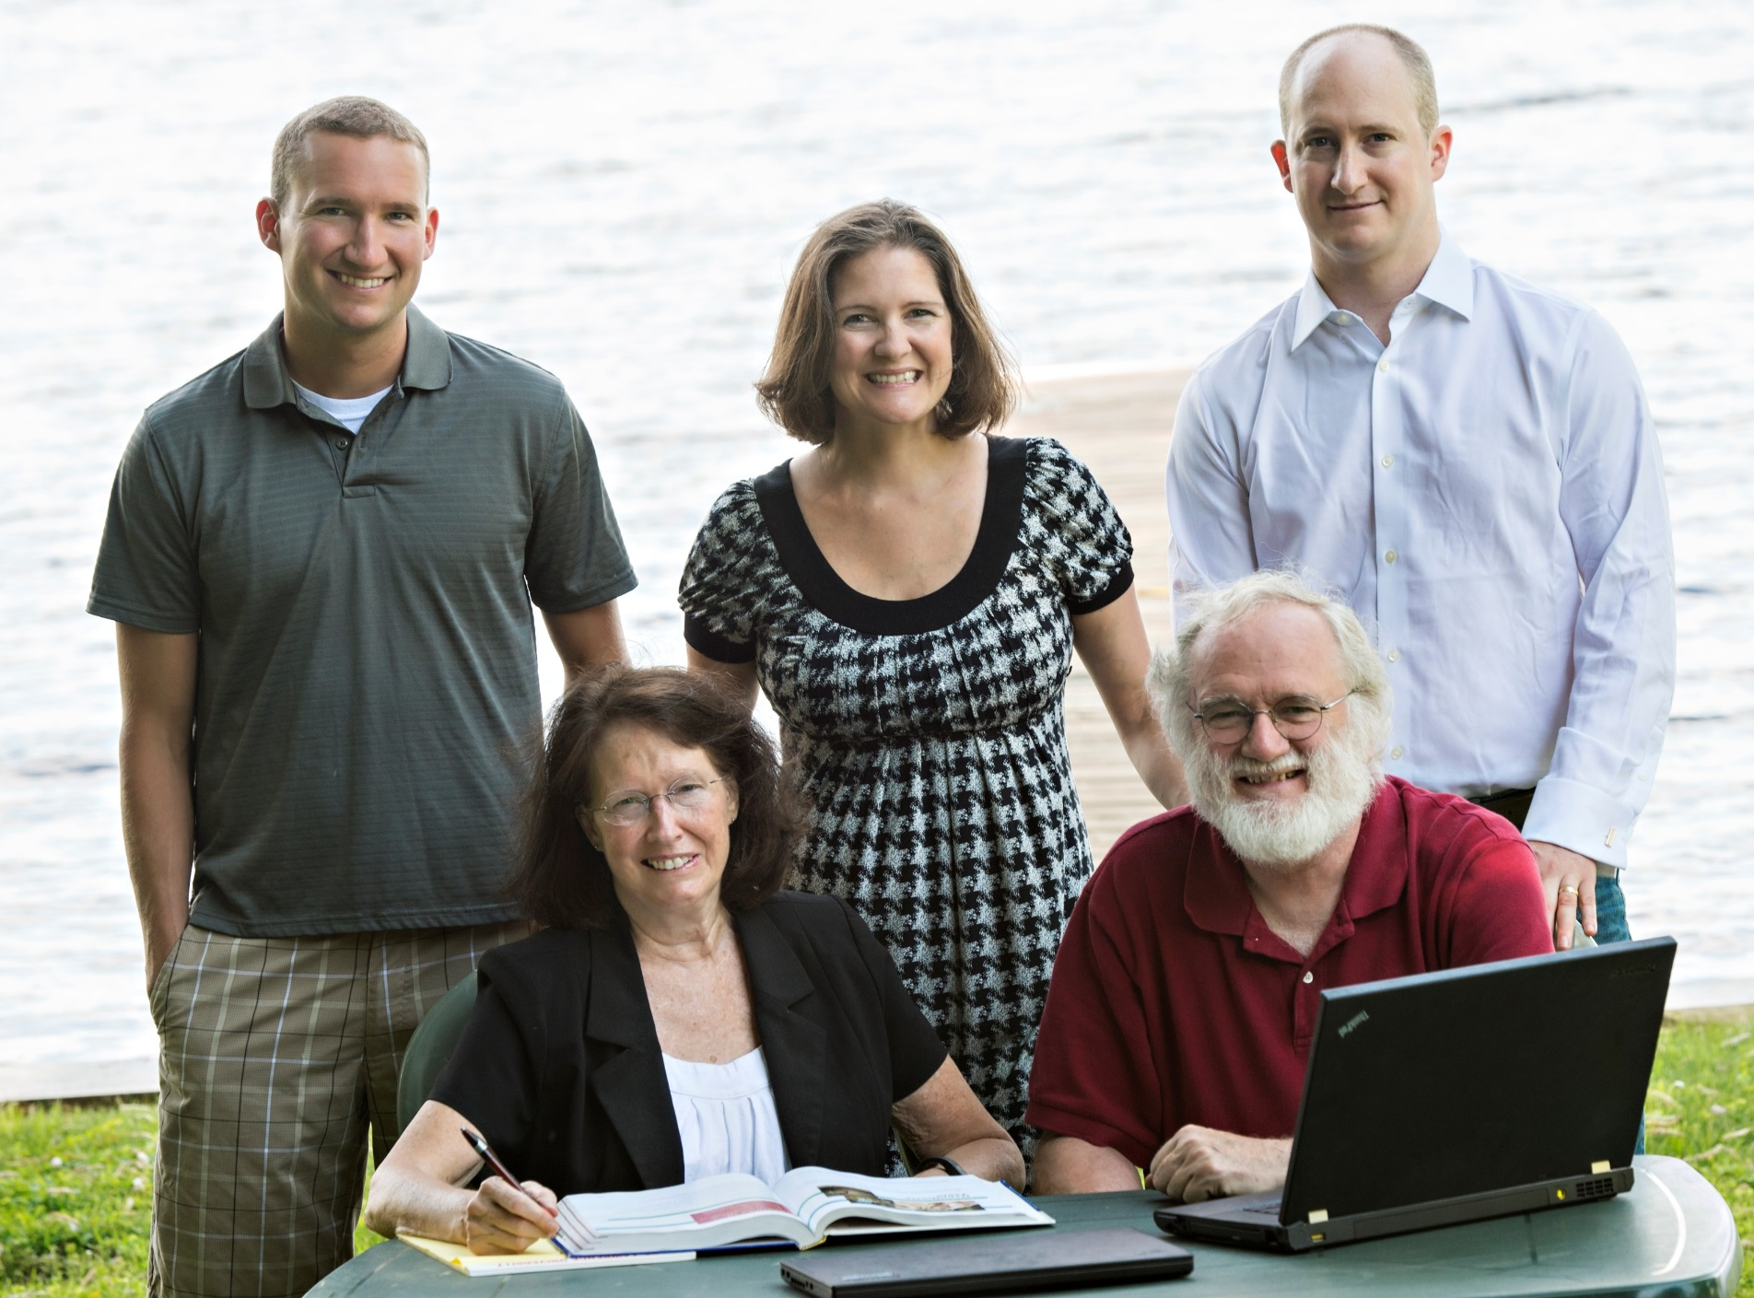
The Lock⁵ Team
Kari
[Harvard]
Penn State
Eric
[North Carolina]
Minnesota
Dennis
[Iowa State]
Buffalo Bills
Patti & Robin
St. Lawrence

Slide 3
Introductions:
Name
Institution
Experience
Notes:
Dennis

Slide 4
GOAL
Use
Simulation Methods
to
increase understanding
reduce prerequisites
Increase student success

Slide 5
Key Concept: Variability in Sample Statistics
Notes:
Bozz

Slide 6
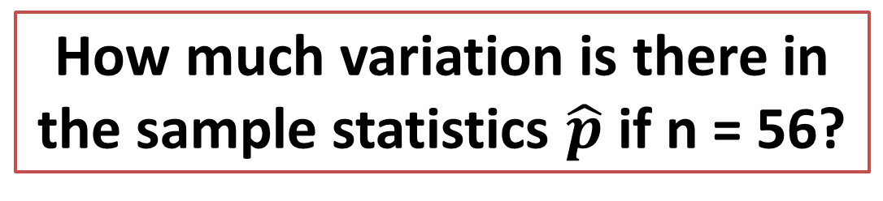
Example: We wish to estimate
p = the proportion of Reese’s Pieces that are orange.
How much variation is there in the sample statistics $\hat{p}$ if n = 56?
Find the proportion in your sample.
(Then feel free to eat the evidence!)
Notes:
Bozz

Slide 7
How much variation is there in the sample statistics $\hat{p}$ if n = 56?
We get a better sense of the variation if:
We have
thousands of samples!
Notes:
Bozz

Slide 8
We need technology!!
StatKey!!
www.lock5stat.com/statkey
Free, online, works on all platforms, easy to use

Slide 9
Sampling Distribution
Created from the population
Centered at the population parameter
Bell-shaped
Shows variability in sample statistics (Standard Error = standard deviation of sample statistics given a fixed sample size)
Notes:
Patti

Slide 10
Sampling Distribution:
Big Problem!!
In order to create a sampling distribution, we need to already know the population parameter or be able to take thousands of samples!
Not helpful in real life!!
Notes:
Patti

Slide 11
Key Concept:
Variability in Sample Statistics
Overview for Today:
Two simulated distributions for a statistic
Emphasize the key concept of variability
Are extremely useful in doing statistics
Notes:
Bozz

Slide 12
Simulated Distribution #1
Created using only the sample data
Centered at the sample statistic
Bell-shaped
Same Variability/Standard Error !!!
Bootstrap Distribution
(for Confidence Intervals)
Notes:
Patti

Slide 13
Simulated Distribution #2
Created assuming a null hypothesis is true
Centered at the null hypothesis value
Bell-shaped
Same Variability/Standard Error !!! (assuming the null hypothesis is true)
Randomization Distribution
(for Hypothesis Tests)
Notes:
Patti

Slide 14
Key Concept:
Variability in Sample Statistics
Sampling Distribution
Created from the population
Centered at population parameter
Bell-shaped
Gives variability/standard error
Simulated Distribution #1
Created from the sample
Centered at sample statistic
Bell-shaped
Gives variability/standard error
Simulated Distribution #2
Created assuming null is true
Centered at null value
Bell-shaped
Gives variability/standard error

Slide 15
Let’s get started…
This material can come very early in a course.
It requires only basic knowledge of summary statistics and sampling.
Notes:
Patti

Slide 16
Bootstrap Confidence Intervals
How can we estimate the variability of a statistic when we only have one sample?

Slide 17
Assessing Uncertainty
Key idea: how much do statistics vary from sample to sample?
Problem?
  We can’t take lots of samples from the population!
Solution?
  (re)sample from our best guess at the population – the sample itself!

Slide 18
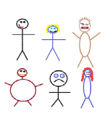
Suppose we have a random sample of 6 people:
Notes:
Patti

Slide 19
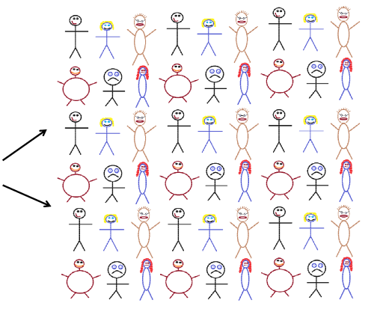
Original Sample
A simulated “population” to sample from
Notes:
Patti

Slide 20




Bootstrap Sample: Sample with replacement from the original sample, using the same sample size.
Original Sample
Bootstrap Sample
Notes:
Patti

Slide 21
BootstrapSample
Bootstrap Statistic
BootstrapSample
Bootstrap Statistic
Original Sample
Bootstrap Distribution
●
●
●
●
●
●
Sample Statistic
BootstrapSample
Bootstrap Statistic

Slide 22
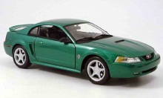
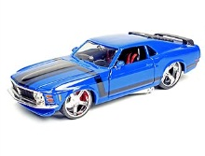
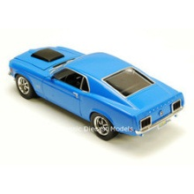
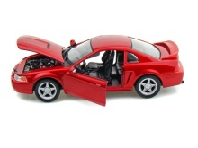
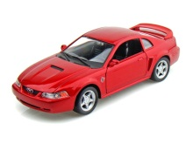
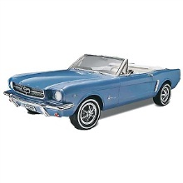
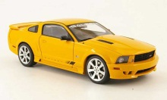
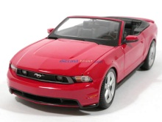
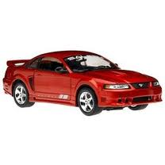
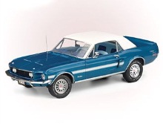
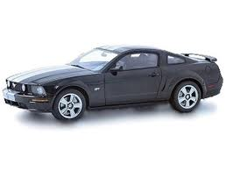
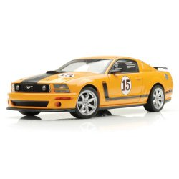
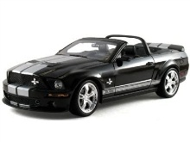
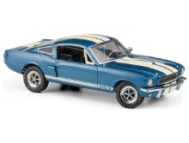
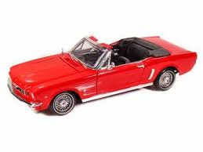

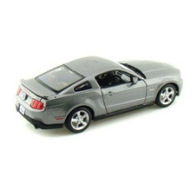
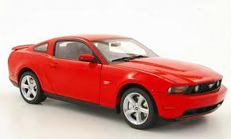
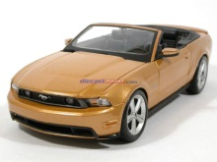
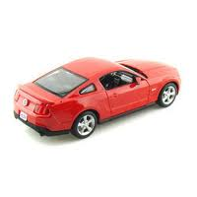
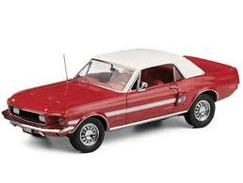
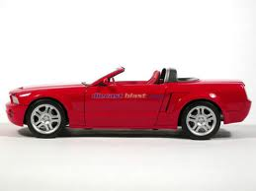
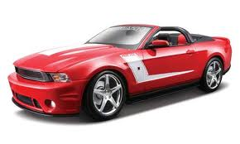
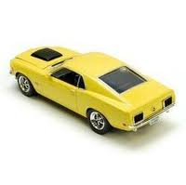
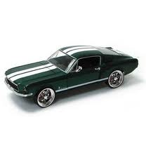

Example: Mustang Prices
Start with a random sample of 25 prices (in $1,000’s)
$$n=25 \overline{x}=15.98 s=11.11$$
Goal: Find an interval that is likely to contain the mean price for all Mustangs
Key concept: How much can we expect means for samples of size 25 to vary just by random chance?

Slide 23
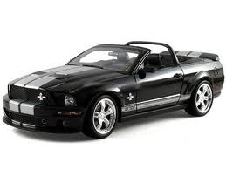


Original Sample
Bootstrap Sample
Repeat 1,000’s of times!
$$\overline{x}=15.98$$
$$\overline{x}=17.51$$
Notes:
Robin

Slide 24
We need technology!!
StatKey!!
www.lock5stat.com/statkey

Slide 25
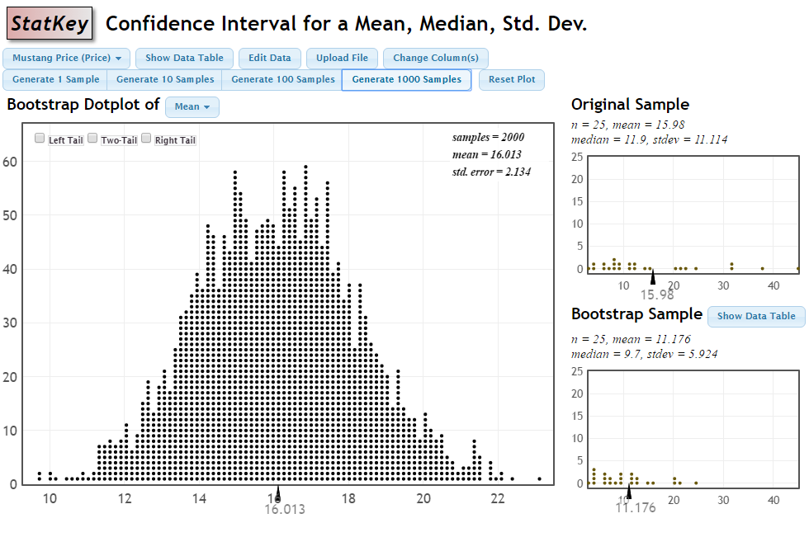
Bootstrap Distribution for Mustang Price Means

Slide 26
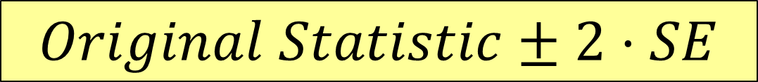
How do we get a CI from the bootstrap distribution?
Method #1: Standard Error
Find the standard error (SE) as the standard deviation of the bootstrap statistics
Find an interval with
$$Original Statistic±2⋅SE$$

Slide 27
Sample Statistic
Standard Error
$Statistic ±2∙SE=15.98±2∙\left(2.134\right)=(11.71, 20.25$)

Slide 28
How do we get a CI from the bootstrap distribution?
Method #1: Standard Error
Find the standard error (SE) as the standard deviation of the bootstrap statistics
Find an interval with
$$Original Statistic±2⋅SE$$
Method #2: Percentile Interval
For a 95% interval, find the endpoints that cut off 2.5% of the bootstrap means from each tail, leaving 95% in the middle

Slide 29
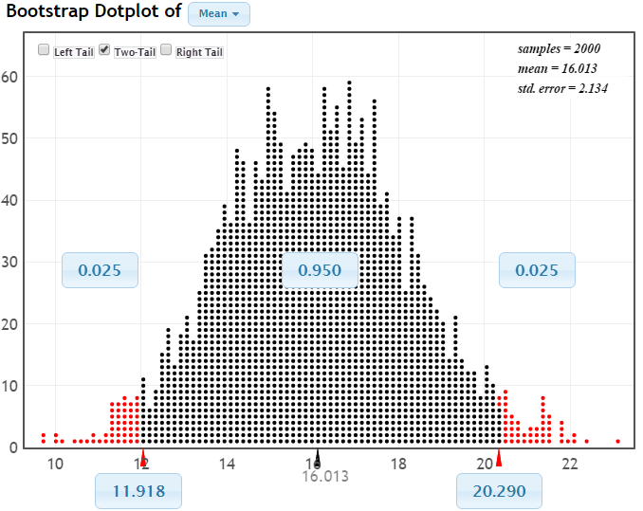
95% CI via Percentiles
Chop 2.5% in each tail
Keep 95% in middle
Chop 2.5% in each tail
We are 95% sure that the mean price for Mustangs is between $11,918 and $20,290

Slide 30
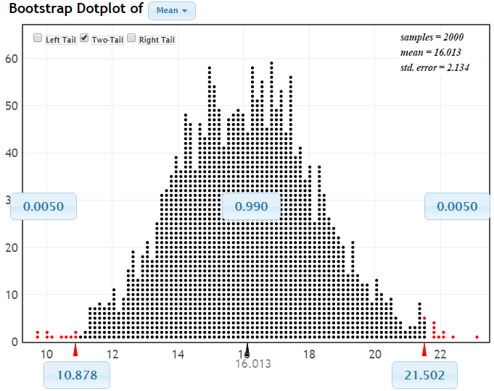
99% CI via Percentiles
Keep 99% in middle
Chop 0.5% in each tail
Chop 0.5% in each tail
We are 99% sure that the mean price for Mustangs is between $10,878 and $21,502

Slide 31
Bootstrap Confidence Intervals
Version 1 (Statistic ± 2 SE):
Great preparation for moving to
traditional methods
Version 2 (Percentiles):
Great at building understanding of
confidence level

Slide 32
Bootstrap Approach
Create a bootstrap distribution by simulating many samples from the original data, with replacement, and calculating the sample statistic for each new sample.
Estimate confidence interval using either statistic ± 2 SE or the middle 95% of the bootstrap distribution.
Same process works for different parameters!

Slide 33
Your Turn!
Three more examples.
Notes:
Rups introduces

Slide 34
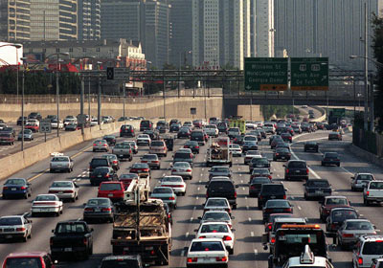
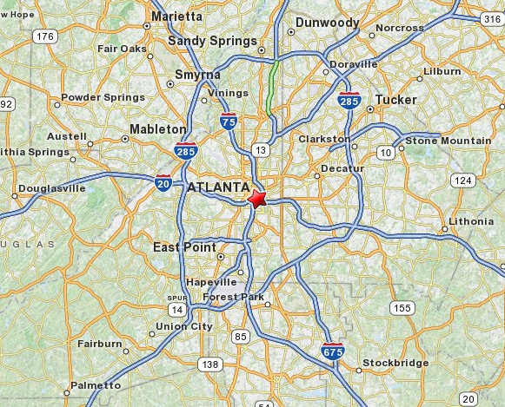
Example #1: Atlanta Commutes
What’s the mean commute time for workers in metropolitan Atlanta?
Data: The American Housing Survey (AHS) collected data from Atlanta. We have a microdata sample of 500 commuters from that sample.
Find a 95% confidence interval for the mean commute time for all Atlanta commuters.

Slide 35
Example #2: News Sources
How do people like to get their news?
A recent Pew Research poll asked “ Do you prefer to get your news by watching it, reading it, or listening to it?”
They found that 1,164 of the 3,425 US adults sampled said they preferred reading the news.
Use this information to find a 90% confidence interval for the proportion of all US adults who prefer to get news by reading it.
https://www.journalism.org/2018/12/03/americans-still-prefer-watching-to-reading-the-news-and-mostly-still-through-television/

Slide 36
Example #3: Diet Cola and Calcium
How much does diet cola affect calcium excretion?
In an experiment, 16 healthy women were randomly assigned to drink 24 ounces of either diet cola or water.
Calcium loss (in mg) was measured in urine over the next few hours.
Use this information to find a 95% confidence interval for the difference in mean calcium loss between diet cola and water drinkers.
Larson, N.S. et al, ‘Effect of Diet Cola on Urine Calcium Excretion”, Endocrine Reviews, 2010.

Slide 37
Sampling Distribution
Population
BUT, in practice we don’t see the “tree” or all of the “seeds” – we only have ONE seed
µ

Slide 38
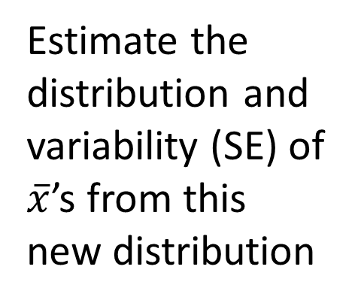

Using only the Sample Data
What can we do with just one seed?
“Simulated
Population”
Estimate the distribution and variability (SE) of $\overline{x}$’s from this new distribution
Grow a NEW tree!
$$\overline{x}$$
µ

Slide 39
Randomization
Hypothesis Tests
Key Concept: How do we measure strength of evidence?

Slide 40
Example: Beer & Mosquitoes
Question: Does consuming beer attract mosquitoes?
Experiment:
25 volunteers drank a liter of beer,
18 volunteers drank a liter of water
Randomly assigned!
Mosquitoes were caught in traps as they approached the volunteers.¹
¹ Lefvre, T., et. al., “Beer Consumption Increases Human Attractiveness to Malaria Mosquitoes, ” PLoS ONE, 2010; 5(3): e9546.

Slide 41
Beer and Mosquitoes
Number of Mosquitoes
Beer
27
20
21
26
27
31
24
19
23
24
28
19
24
29
20
17
31
20
25
28
21
27
21
18
20
Water
21
22
15
12
21
16
19
15
24
19
23
13
22
20
24
18
20
22
Beer mean = 23.6
Water mean
= 19.22
Beer mean – Water mean = 4.38
Does drinking beer actually attract mosquitoes or is the difference just due to random chance?

Slide 42
Beer and Mosquitoes
Number of Mosquitoes
What kinds of results would we see, just by random chance, if there were no difference between beer and water?
Beer
27
20
21
26
27
31
24
19
23
24
28
19
24
29
20
17
31
20
25
28
21
27
21
18
20
Water
21
22
15
12
21
16
19
15
24
19
23
13
22
20
24
18
20
22

Slide 43
Beer and Mosquitoes
Number of Mosquitoes
What kinds of results would we see, just by random chance, if there were no difference between beer and water?
Beer
27
20
21
26
27
31
24
19
23
24
28
19
24
29
20
17
31
20
25
28
21
27
21
18
20
Water
21
22
15
12
21
16
19
15
24
19
23
13
22
20
24
18
20
22
27 19 21 24
20 24 18 19
21 29 20 23
26 20 21 13
27 27 22 22
31 31 15 20
24 20 12 24
19 25 21 18
23 28 16 20
24 21 19 22
28 27 15
We can find out!! Just re-randomize the 43 values into one pile of 25 and one of 18, simulating the original random assignment.

Slide 44
Beer and Mosquitoes
Number of Mosquitoes
What kinds of results would we see, just by random chance, if there were no difference between beer and water?
Beer
Water
24
20 24 18 19
21 29 20 23
26 20 21 13
27 27 22 22
31 31 15 20
24 20 12 24
19 25 21 18
23 28 16 20
24 21 19 22
28 27 15
27
19
21
20
24
19
20
24
31
13
18
24
25
21
18
15
21
16
28
22
19
27
20
23
22
21
20
26
31
19
23
15
22
12
24
29
20
27
21
17
24
28
Compute the beer mean minus water mean of this simulated sample.
Do this thousands of times!

Slide 45
We need technology!!
StatKey!!
www.lock5stat.com/statkey

Slide 46
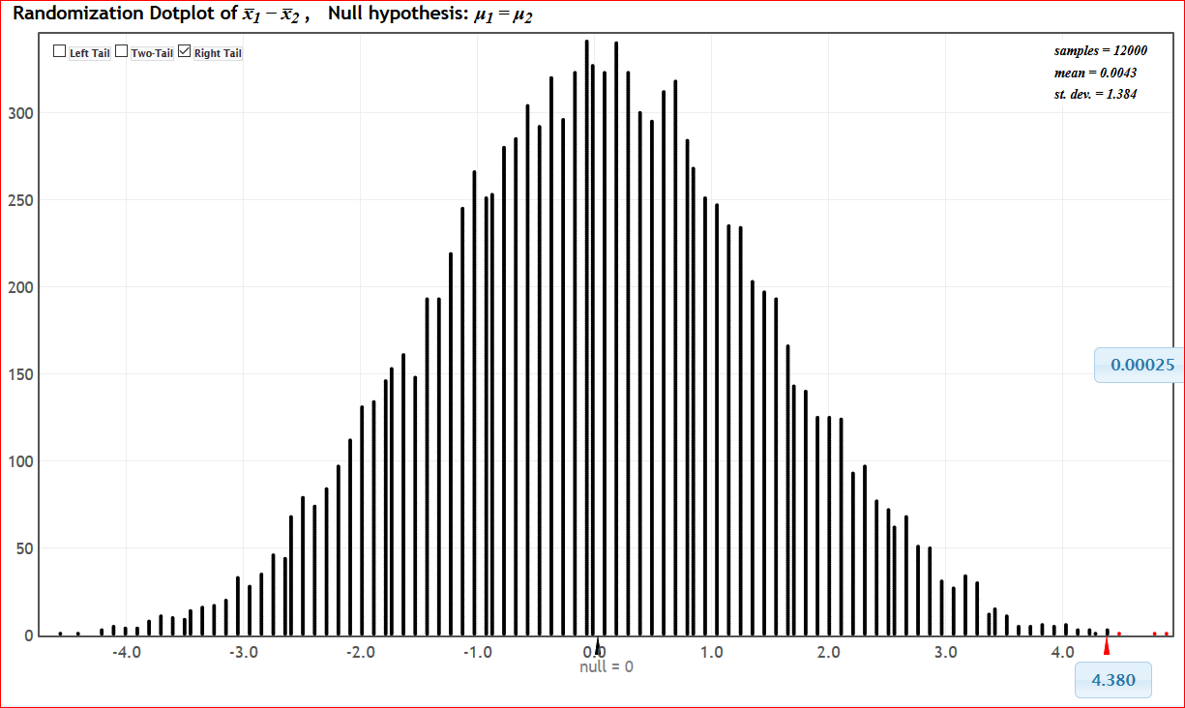
P-value
This is what we are likely to see just by random chance if beer/water doesn’t matter.
This is what we saw in the experiment.

Slide 47
Beer and Mosquitoes
The Conclusion!
The results seen in the experiment are very unlikely to happen just by random chance (less than 1 out of 1000!)
We have strong evidence that drinking beer does attract mosquitoes!

Slide 48
What about the traditional approach?
“Students’ approach to p-values … was procedural … and [they] did not attach much meaning to p-values”
-- Aquilonius and Brenner, “Students’ Reasoning about P-Values”, SERJ, November 2015

Slide 49
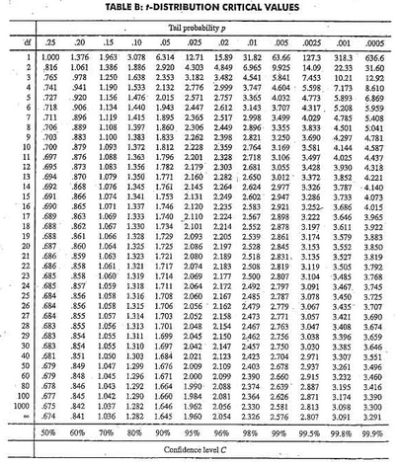

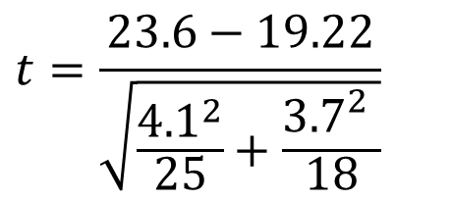
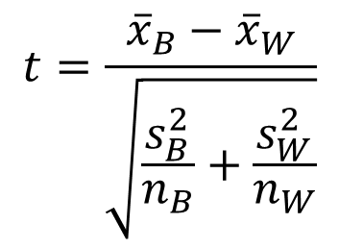
Another Look at Beer/Mosquitoes
1. Check conditions
2. Which formula?
5. Which theoretical distribution?
$$t=\frac{{\overline{x}}_{B}−{\overline{x}}_{W}}{\sqrt{\frac{s_{B}^{2}}{n_{B}}+\frac{s_{W}^{2}}{n_{W}}}}$$
6. df?
7. Find p-value
8. Interpret a decision
3. Calculate numbers and plug into formula
$$t=\frac{23.6−19.22}{\sqrt{\frac{{4.1}^{2}}{25}+\frac{{3.7}_{}^{2}}{18}}}$$
4. Chug with calculator
$$t=3.68$$
0.0005 < p-value < 0.001

Slide 50
P-value
This is what we are likely to see just by random variation if the null hypothesis is true.
This is what we saw in the study.

Slide 51
Conclusions are the same, but the process is very different!

Slide 52
Your Turn!
Three more examples.
Notes:
Rups introduces

Slide 53
Example #1: Light at Night
Does having a light on at night increase weight gain? (in mice)
Experiment:
10 mice had a light on at night
8 mice had darkness at night
Randomly assigned!
Weight gain (in grams) was recorded after three weeks.
Do the data provide convincing evidence that the mean weight gain is higher with a light at night?
¹ Fonken, L., et. al., “Light at night increases body mass by shifting time of food intake, ” Proceedings of the National Academy of Sciences, 2010; 107(43).

Slide 54
Example #2: Malevolent Uniforms
Do football teams with more malevolent uniforms and logos tend to get more penalties?
NFL_Malevolence is scored so that larger values indicate more malevolence.
ZPenYds is a z-score for penalty yards over a season.
Is there convincing evidence of a positive correlation between malevolence and penalty yards?
Ffrank, M.G. and Gilovich, T. “The Dark Side of Self- and Social Perception: Black Uniforms and Aggression in Professional Sports”, Journal of Personality and Social Psychology (1988)

Slide 55
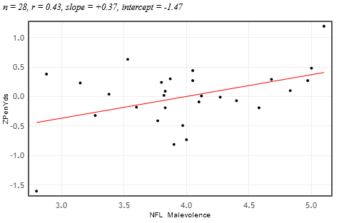


Example #2: Malevolent Uniforms
Is there convincing evidence of a positive correlation between malevolence and penalty yards?
Frank, M.G. and Gilovich, T. “The Dark Side of Self- and Social Perception: Black Uniforms and Aggression in Professional Sports”, Journal of Personality and Social Psychology (1988)

Slide 56

Example #3: Split or Steal?
http://www.youtube.com/watch?v=p3Uos2fzIJ0
Are younger players less likely to split than older players?
 | Split | Steal | Total
Under 40 | 187 | 195 | 382
40 & over | 116 | 76 | 192
Total | 303 | 271 | n=574
Is there convincing evidence that the proportion who split is lower for players under 40 than 40 & over?
Van den Assem, M., Van Dolder, D., and Thaler, R., “Split or Steal? Cooperative Behavior When the Stakes Are Large,” 2/19/11.

Slide 57

Simulation Methods
Visual!
Intuitive!
Easily incorporates active learning!
Ties directly to key idea of strength of evidence!
Ties directly to key idea of random variation!
(Note: No theoretical distributions. No formulas. No algebra. Same process for all parameters.)

Slide 58
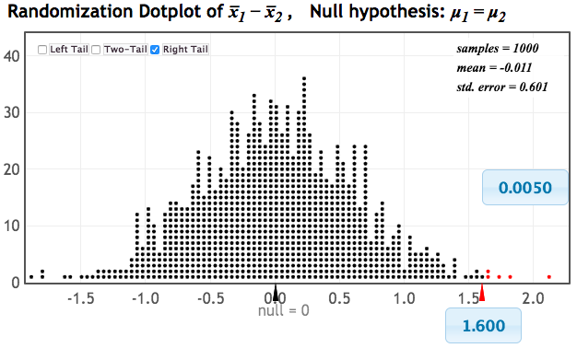
p-value: The chance of obtaining a statistic as extreme as that observed, just by random chance, if the null hypothesis is true
p-value: The chance of obtaining a statistic as extreme as that observed, just by random chance, if the null hypothesis is true
p-value: The chance of obtaining a statistic as extreme as that observed, just by random chance, if the null hypothesis is true
p-value: The chance of obtaining a statistic as extreme as that observed, just by random chance, if the null hypothesis is true
p-value: The chance of obtaining a statistic as extreme as that observed, just by random chance, if the null hypothesis is true

Slide 59
What about
Traditional Inference?
After seeing simulation-based inference:
Students have seen lots of “bell-shaped” distributions and dealt often with finding “proportions in tails”.
Students have seen standard error as a measure of variability of sample statistics
Students have seen how to understand and interpret confidence intervals
Students have seen the conceptual underpinnings of hypothesis tests, and how to interpret a p-value.
Notes:
M Lock

Slide 60
What about
Traditional Inference?
After seeing simulation-based inference:
Students are ready to learn about theoretical distributions such as the normal distribution.
Students are ready to learn how to calculate standard error from formulas and summary statistics.
They already understand the basic ideas of inference!
Notes:
M Lock

Slide 61
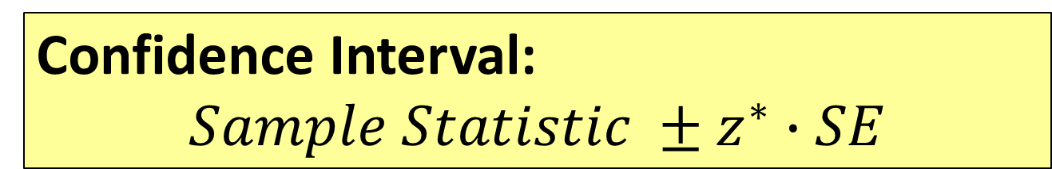
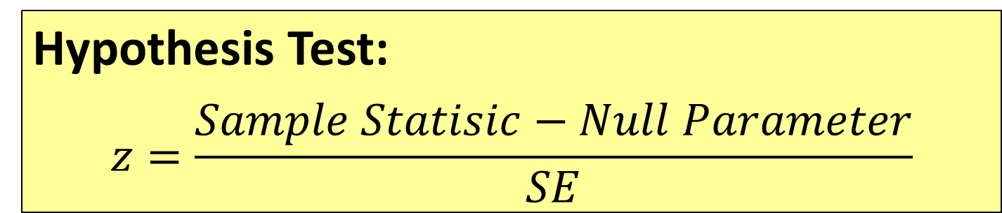
Transitioning to
Traditional Inference
Confidence Interval:
$$Sample Statistic ±z^{∗}∙SE$$
Hypothesis Test:
$$z=\frac{Sample Statisic−Null Parameter}{SE}$$
Notes:
M Lock

Slide 62
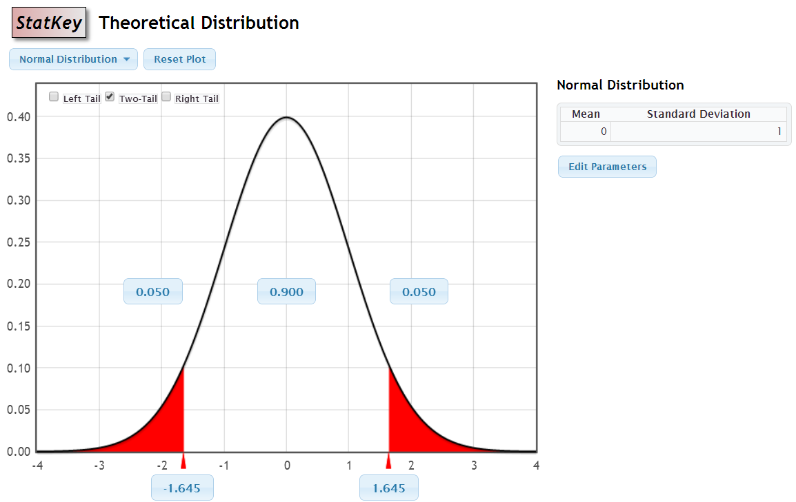
StatKey – Theoretical Distributions

Slide 63
Motivation
“... Before computers statisticians had no choice. These days we have no excuse. Randomization-based inference makes a direct connection between data production and the logic of inference that deserves to be at the core of every introductory course.”
-- Professor George Cobb, 2007
(TISE article at http://escholarship.org/uc/item/6hb3k0nz)
"Actually, the statistician does not carry out this very simple and very tedious process, but his conclusions have no justification beyond the fact that they agree with those which could have been arrived at by this elementary method."
-- Sir R. A. Fisher, 1936
Notes:
bozz

Slide 64
GOAL
Use
Simulation Methods
to
increase understanding
reduce prerequisites
Increase student success

Slide 65
Questions?
rlock@stlawu.edu
plock@stlawu.edu
klm47@psu.edu
www.lock5stat.com

