Slide 1
Teaching a Data-Driven Approach to Inference
Patti Frazer Lock, St. Lawrence University
Robin Lock, St. Lawrence University
Kari Lock Morgan, Penn State University
USCOTS 2017
Notes:
Dennis

Slide 2
Yes, we are related! (And there are more of us…)
Kari
[Harvard]
Penn State
Eric
[North Carolina]
Minnesota
Dennis
[Iowa State]
Miami Dolphins
Patti & Robin
St. Lawrence

Slide 3
Overview
We see how to use
ONLY THE SAMPLE DATA
for doing inference and for understanding these key ideas in inference:
Variability of an Estimate
Strength of Evidence

Slide 4
Overview
We see how to use
ONLY THE SAMPLE DATA .
No theoretical distributions!
No formulas!

Slide 5
Why this approach? These methods…
Have students focus explicitly on the data
Are quite intuitive
Offer visual connections to the key ideas
Can be easily adapted to different situations
Are reflected in the Common Core:
“develop a margin of error through the use of simulation methods”
“use simulations to decide if differences between parameters are significant”

Slide 6
Outline
Part 1: A data-driven approach to help students understand variability of estimates.
Part 2: A data-driven approach to help students understand strength of evidence.

Slide 7
A Data-Driven Approach to Understanding Variability of Estimates

Slide 8
Example #1: What is the average immediate depreciation on a new car?
Data: kellybluebook.com
Car | Depreciation
Mazda3 | 2630
Buick Encore | 2135
Toyota Corolla | 1330
Chevrolet Tahoe | 2026
Chevrolet Equinox | 2447
$$⋮$$ | $$⋮$$
$$n=20$$
$$\overline{x}=2356$$

Slide 9
Based on the sample of 20 cars, our best estimate for the average immediate depreciation of a new car is $2356, but how accurate is that estimate?
Key concept: How much can we expect means for samples of size 20 to vary just by random chance?

Slide 10
Sampling Distribution
Population
BUT, in practice we don’t see the “tree” or all of the “seeds” – we only have ONE seed
µ

Slide 11
Using only the Sample Data
What can we do with just one seed?
“Simulated
Population”
Estimate the distribution and variability (SE) of $\overline{x}$’s from this new distribution
Grow a NEW tree!
$$\overline{x}$$
µ

Slide 12
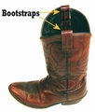
Bootstrapping
Brad Efron
Stanford University
“Let your data be your guide.”
How can we measure the variability of a sample statistic using only the data in that one sample?

Slide 13
Simulating Samples
What is our best guess at the population, given sample data?
The sample itself!
Draw samples of the same sample size repeatedly from the sample data
… with replacement!
This is known as bootstrapping
Simulate many bootstrap samples
Calculate statistic for each
Measure variability of the statistic using this simulated distribution

Slide 14
Assessing Uncertainty
Key idea: how much do statistics vary from sample to sample?
Problem?
We can’t take lots of samples from the population!
Solution?
(re)sample from our best guess at the population – the sample itself!

Slide 15
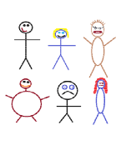
Suppose we have a random sample of 6 people:
Notes:
Patti

Slide 16
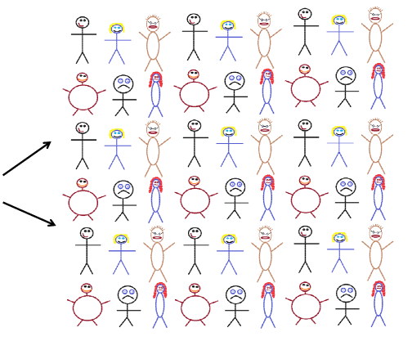
Original Sample
A simulated “population” to sample from
Notes:
Patti

Slide 17
Bootstrap Sample: Sample with replacement from the original sample, using the same sample size.
Original Sample
Bootstrap Sample
Notes:
Patti

Slide 18
BootstrapSample
Bootstrap Statistic
BootstrapSample
Bootstrap Statistic
Original Sample
Bootstrap Distribution
●
●
●
●
●
●
Sample Statistic
BootstrapSample
Bootstrap Statistic

Slide 19
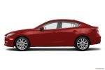
Example 1: What is the average depreciation on a new car as soon as it is driven off the lot?
Look up a random sample of 20 new car models (2015) on kellybluebook.com to record value new and value after it has been driven 10 miles.
New
10 miles
$17,956
$15,326
$2,630

Slide 20
Car | New | Used | Depreciation
Mazda3 | 17956 | 15326 | 2630
Buick Encore | 23633 | 21498 | 2135
Toyota Corolla | 16091 | 14761 | 1330
Chrevolet Tahoe | 45489 | 43463 | 2026
Chrevolet Equinox | 21596 | 19149 | 2447
Ford Fiesta | 14246 | 12220 | 2026
BMW 528i | 46227 | 44582 | 1645
Mitsubishi Mirage | 14013 | 11603 | 2410
GMC Yukon | 47295 | 45635 | 1660
Dodge Dart | 16139 | 13880 | 2259
Honda Accord Hybrid | 27124 | 25008 | 2116
Audi Q5 | 37521 | 35579 | 1942
Hyundai Elantra | 16807 | 14876 | 1931
Kia Sedona | 25710 | 22178 | 3532
Dodge Grand Caravan | 21337 | 17390 | 3947
Lexus CT | 30743 | 27182 | 3561
Lincoln MKZ Hybrid | 33522 | 30892 | 2630
Mercedez-Benz E-Class | 47178 | 42956 | 4222
Scion tC | 19748 | 18697 | 1051
MINI Countryman | 25130 | 23513 | 1617
$$n=20$$
$$\overline{x}=2356$$
$$s=858$$

Slide 21
Based on the sample of 20 cars, our best estimate for the average depreciation of a new car is $2356, but how accurate is that estimate?
Key concept: How much can we expect means for samples of size 20 to vary just by random chance?
Time to Bootstrap!

Slide 22
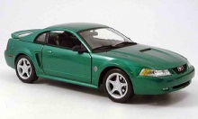
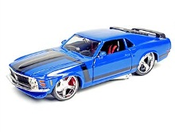
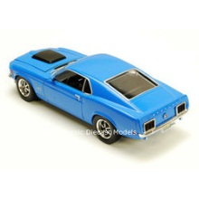
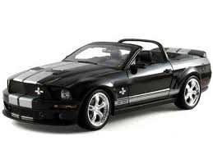
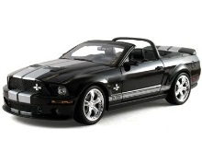
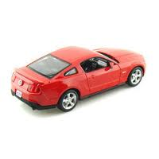
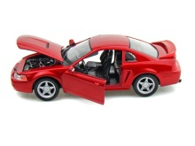
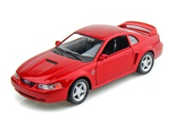
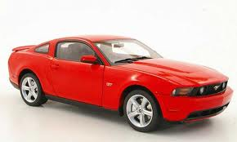
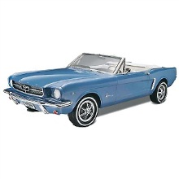
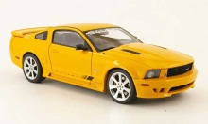
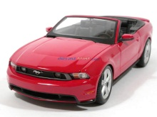
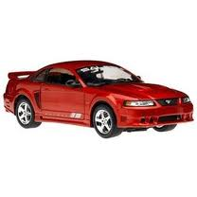
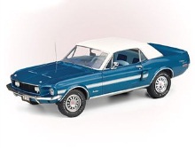
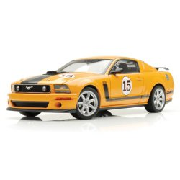
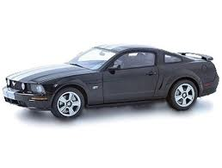
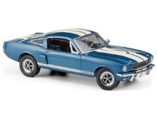
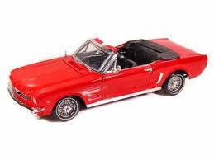
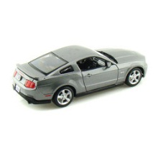
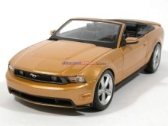
Original Sample
Bootstrap Sample
Repeat 1,000’s of times!
We need technology!
$$\overline{x}=2356$$
$$\overline{x}=2543$$
Notes:
Robin

Slide 23
StatKey
lock5stat.com/statkey
Freely available web apps with no login required
Runs in (almost) any browser (incl. smartphones/tablets)
Google Chrome App available (no internet needed)
Use standalone or supplement to existing technology
Notes:
Patti

Slide 24
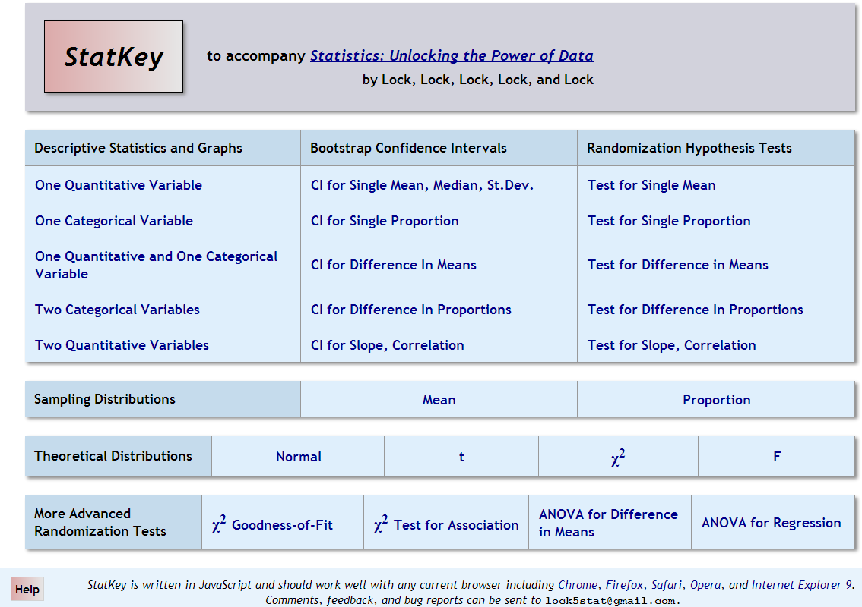
lock5stat.com/statkey

Slide 25
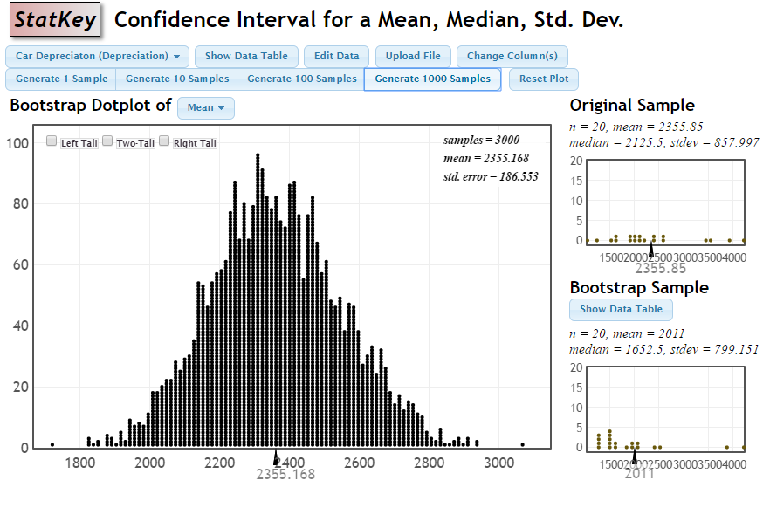
Bootstrap Distribution for Depreciation Means

Slide 26
How do we get a CI from the bootstrap distribution?
Method #1: Standard Error
Find the standard error (SE) as the standard deviation of the bootstrap statistics
Find an interval with
$$Original Statistic±2⋅SE$$

Slide 27
Standard Error
$2356±2∙\left(186.6\right)=(1983, , 2729$)

Slide 28
How do we get a CI from the bootstrap distribution?
Method #1: Standard Error
Find the standard error (SE) as the standard deviation of the bootstrap statistics
Find an interval with
$$Original Statistic±2⋅SE$$
Method #2: Percentile Interval
For a 95% interval, find the endpoints that cut off 2.5% of the bootstrap means from each tail, leaving 95% in the middle

Slide 29
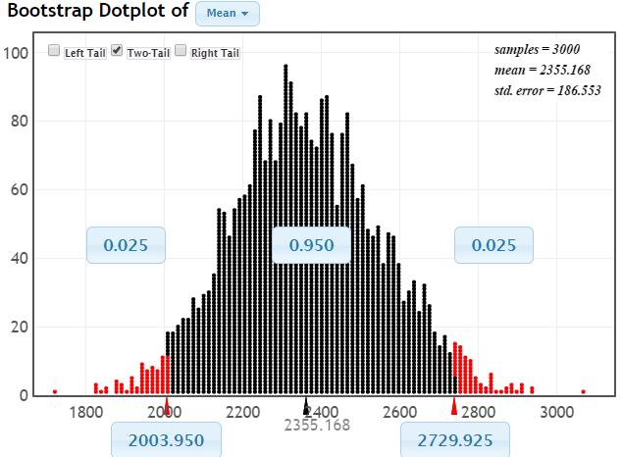
95% CI via Percentiles
Easily adjust to other confidence levels
Chop 2.5% in each tail
Keep 95% in middle
Chop 2.5% in each tail
We are 95% sure that the mean immediate depreciation for all 2015 car models is between $2004 and $2730

Slide 30
Bootstrap Confidence Intervals
Version 1 (Statistic ± 2 SE):
Great preparation for moving to
traditional methods
Version 2 (Percentiles):
Great at building understanding of
confidence level
Same process works for different parameters

Slide 31
Bootstrap Approach
Create a bootstrap distribution by simulating many samples from the original data, with replacement, and calculating the sample statistic for each new sample.
Estimate confidence interval using either statistic ± 2 SE or the middle 95% of the bootstrap distribution.

Slide 32
Have you used a dating app?
Example 2: Estimate the proportion of college-educated American adults to have ever used a dating site or dating app.
A survey conducted by the Pew Research Center in July 2015 asked a random sample of American adults if they had ever used an online dating site or a dating app. In the sample, 157 of the 823 college-educated respondents said yes.

Slide 33
Donating Blood to Grandma?
Example 3: What is the effect of getting an infusion of young blood?
Old mice were randomly assigned to receive blood from a young mouse or another old mouse. The mice receiving the young blood showed multiple signs of a reversal of brain aging. We look here at exercise endurance as measured by maximum runtime on a treadmill.

Slide 34
Synchronized Movement
How close do you feel to others in the room? Use a 7-point Likert scale where 7=extremely close and 1=not at all close. Record your answer (you don’t have to share it!)
Now dance!! Cha Cha Slide Dance!
NOW how close do you feel to others in the room? Use the same 7-point Likert scale. Record your answer. Calculate the difference: After – Before.
Example 4: How much does synchronized movement increase feelings of closeness?
Data from a study done with High School students in Brazil.
Tarr, Launay, Cohen, Dunbar, “Synchrony and exertion during dance independently raise pain threshold and encourage social bonding,” Biology Letters, 11(10), Oct 2015.

Slide 35
Summary: Bootstrap Confidence Intervals
Same process for all parameters! Enables big picture understanding
Reinforces the importance of considering whether sample is representative of population
Reinforces the concept of sampling variability
Very visual!
Low emphasis on algebra and formulas
Ties directly (and visually) to understanding confidence level

Slide 36
A Data-Driven Approach to Understanding Strength of Evidence

Slide 37
Example #5: Beer & Mosquitoes
Volunteers were randomly assigned to drink either a liter of beer or a liter of water.
Mosquitoes were caught in nets as they approached each volunteer and counted.
 | n | mean
Beer | 25 | 23.60
Water | 18 | 19.22
Does this provide convincing evidence that mosquitoes tend to be more attracted to beer drinkers or could this difference just be due to random chance?
Lefvre, T., et. al., “Beer Consumption Increases Human Attractiveness to Malaria Mosquitoes, ” PLoS ONE, 2010; 5(3): e9546.

Slide 38
Example #5: Beer & Mosquitoes
µ = mean number of attracted mosquitoes
H₀: μ_{B} = μ_{W}
H_{a}: μ_{B} > μ_{W}
Based on the sample data:
$${\overline{x}}_{B}−{\overline{x}}_{W}=23.60−19.22=4.38$$
Is this a “significant” difference?
How do we measure “significance”? ...

Slide 39
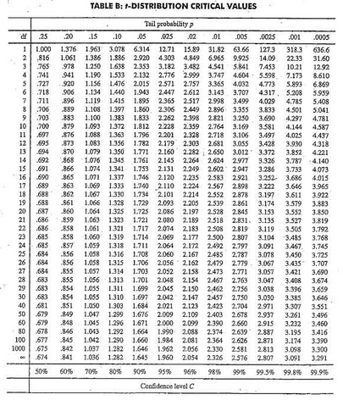
Traditional Approach
1. Check conditions
2. Which formula?
5. Which theoretical distribution?
$$t=\frac{{\overline{x}}_{B}−{\overline{x}}_{W}}{\sqrt{\frac{s_{B}^{2}}{n_{B}}+\frac{s_{W}^{2}}{n_{W}}}}$$
6. df?
7. Find p-value
8. Interpret a decision
What’s a p-value?!?
3. Calculate numbers and plug into formula
$$t=\frac{23.6−19.22}{\sqrt{\frac{{4.1}^{2}}{25}+\frac{{3.7}_{}^{2}}{18}}}$$
Where’s the data?!?
4. Chug with calculator
$$t=3.66$$
0.0005 < p-value < 0.001

Slide 40
Randomization Approach
Number of Mosquitoes
Two possible explanations:
Beer attracts mosquitos
No difference; random chance
Beer
27
20
21
26
27
31
24
19
23
24
28
19
24
29
20
17
31
20
25
28
21
27
21
18
20
Water
21
22
15
12
21
16
19
15
24
19
23
13
22
20
24
18
20
22
What might happen just by random chance, if there is no difference??
${\overline{x}}_{B}=23.6$0
$${\overline{x}}_{W}=19.22$$
Original Sample
$${\overline{x}}_{B}−{\overline{x}}_{W}=4.38$$

Slide 41
Randomization Approach
Number of Mosquitoes
To simulate samples under H₀ (no difference):
Re-randomize the values into Beer & Water groups
Beer
27
20
21
26
27
31
24
19
23
24
28
19
24
29
20
17
31
20
25
28
21
27
21
18
20
Water
21
22
15
12
21
16
19
15
24
19
23
13
22
20
24
18
20
22
27 19 21 24
20 24 18 19
21 29 20 23
26 20 21 13
27 27 22 22
31 31 15 20
24 20 12 24
19 25 21 18
23 28 16 20
24 21 19 22
28 27 15
${\overline{x}}_{B}=23.6$0
$${\overline{x}}_{W}=19.22$$
$${\overline{x}}_{B}−{\overline{x}}_{W}=4.38$$

Slide 42
Randomization Approach
Number of Mosquitoes
To simulate samples under H₀ (no difference):
Re-randomize the values into Beer & Water groups
Compute ${\overline{x}}_{B}−{\overline{x}}_{W}$
Beer
Water
24
20 24 18 19
21 29 20 23
26 20 21 13
27 27 22 22
31 31 15 20
24 20 12 24
19 25 21 18
23 28 16 20
24 21 19 22
28 27 15
27
19
21
20
24
19
20
24
31
13
18
24
25
21
18
15
21
16
28
22
19
27
20
23
22
21
20
26
31
19
23
15
22
12
24
29
20
27
21
17
24
28
Repeat this process 1000’s of times to see how “unusual” the original difference of 4.38 is.
$${\overline{x}}_{B}=21.76$$
$${\overline{x}}_{W}=22.50$$
StatKey
$${\overline{x}}_{B}−{\overline{x}}_{W}=−0.84$$

Slide 43
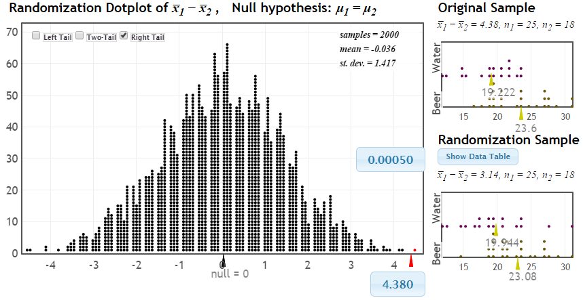
Randomization Test
p-value
Distribution of statistic if H₀ true
observed statistic
If there were no difference between beer and water, we would only see differences this extreme 0.05% of the time!

Slide 44
p-value: The chance of obtaining a statistic as extreme as that observed, just by random chance, if the null hypothesis is true
p-value: The chance of obtaining a statistic as extreme as that observed, just by random chance, if the null hypothesis is true
p-value: The chance of obtaining a statistic as extreme as that observed, just by random chance, if the null hypothesis is true
p-value: The chance of obtaining a statistic as extreme as that observed, just by random chance, if the null hypothesis is true
p-value: The chance of obtaining a statistic as extreme as that observed, just by random chance, if the null hypothesis is true

Slide 45
Randomization Approach
Create a randomization distribution by simulating many samples from the original data, assuming H₀ is true, and calculating the sample statistic for each new sample.
Estimate p-value directly as the proportion of these randomization statistics that exceed the original sample statistic.
Small p-value ⇒ Evidence against H_{o}

Slide 46
Example 6: Split or Steal?
http://www.youtube.com/watch?v=p3Uos2fzIJ0
 | Split | Steal | Total
Under 40 | 187 | 195 | 382
Over 40 | 116 | 76 | 192
Total | 303 | 271 | n=574
Van den Assem, M., Van Dolder, D., and Thaler, R., “Split or Steal? Cooperative Behavior When the Stakes Are Large,” 2/19/11.
Notes:
Watch the video… pause before the results, and ask students what they would do

Slide 47
Example #7: Malevolent Uniforms
Do sports teams with more “malevolent” uniforms get penalized more often?

Slide 48
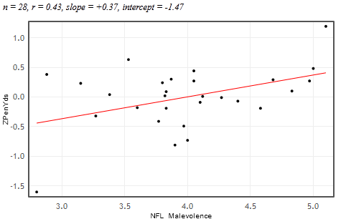
Example #7: Malevolent Uniforms
Sample Correlation
= 0.43
Do teams with more malevolent uniforms commit or get called for more penalties, or is the relationship just due to random chance?

Slide 49
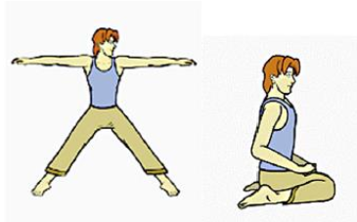
Example #8: Body Posture and Pain Tolerance
Stand up! Adopt a “Dominant” pose or a “Submissive” pose!
Bohns and Wiltermuth, “It hurts when I do this (or you do that): Posture and Pain Tolerance,” Journal of Experimental Social Psychology, May 26, 2011.

Slide 50
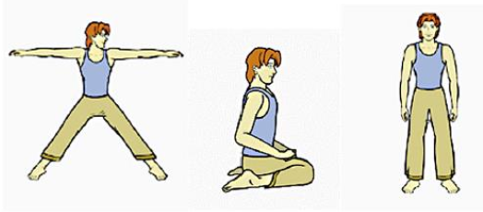
Posture/Pain: ANOVA
Dominant Submissive Control

Slide 51
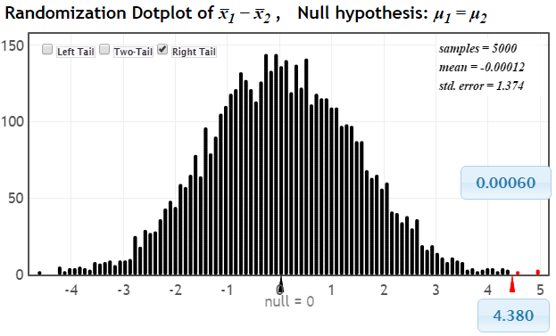
What about Traditional Inference?
Use formula for SE
Approximate the bootstrap/randomization distribution with a theoretical curve (CLT is easy!)
Notes:
M Lock

Slide 52
What about Traditional Inference?
Bootstrap CI: $Statistic ±2∙SE$
Standard distribution with confidence level
(conditions)
Formula for SE
Traditional CI: $\overline{x} ±t^{∗}∙\frac{s}{\sqrt{n}}$
This is quick and easy since the basic understanding and interpretation of CI’s is already done!
Notes:
M Lock

Slide 53
What about Traditional Inference?
Standardized test statistic:
$$z=\frac{Statistic−Null}{SE}$$
Traditional:
$$z=\frac{\hat{p}−p_{0}}{\sqrt{\frac{p_{0}(1−p_{0})}{n}}}$$
Need to know:
Formula for SE
Standard distribution (z or t) for p-value
Notes:
M Lock

Slide 54
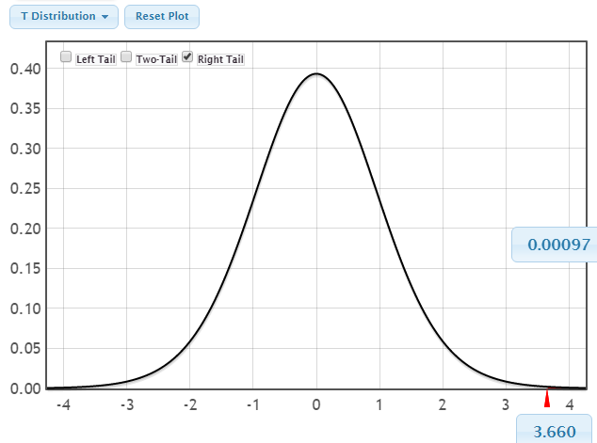
Beer & Mosquitoes (Traditional)
H₀: μ_{B} = μ_{W}
H_{a}: μ_{B} > μ_{W}
$$t=\frac{23.6−19.22}{\sqrt{\frac{{4.1}^{2}}{25}+\frac{{3.7}_{}^{2}}{18}}}=\frac{4.38}{1.20}=3.66$$
$$t_{17}$$
Same “tail” process as randomization to find p-value
Notes:
M Lock

Slide 55
Assessment
Can I use these methods
In a class that meets in a computer classroom?
In a traditional classroom?
In a large lecture class with weekly lab?
YES (Robin)
YES (Patti)
YES (Kari)
(See handouts for some assessment ideas)

Slide 56
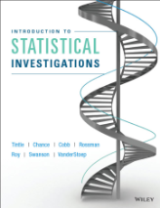
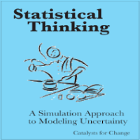
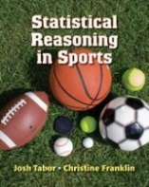
Implementation
1. Start small – insert some early simulation activities
OR
2. Jump right in!
Lock⁵ lock5stat.com
Tintle, et al math.hope.edu/isi
Catalst www.tc.umn.edu/~catalst
Tabor/Franklin www.highschool.bfwpub.com
Open Intro www.openintro.org

Slide 57
Technology Options
StatKey (alone)
StatKey + other (Minitab, JMP, Fathom, ...)
R
JMP
Minitab Express
StatCrunch

Slide 58
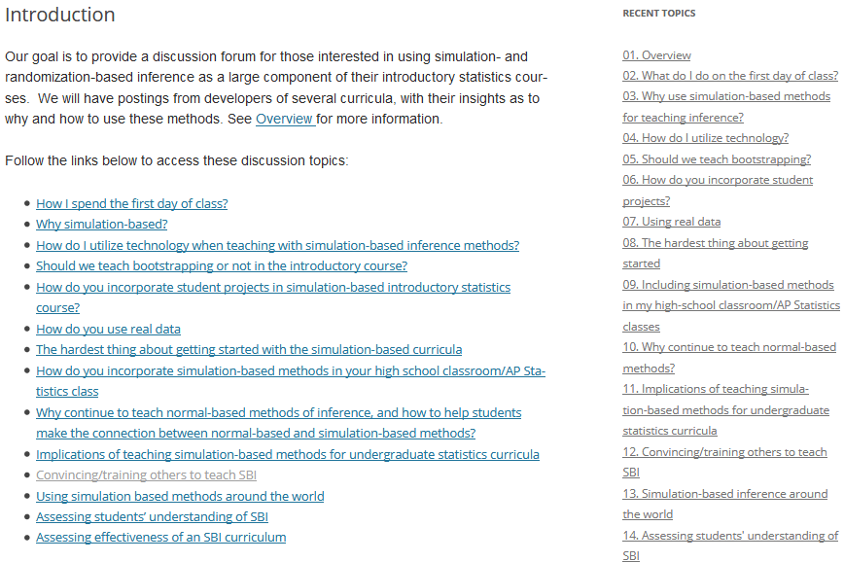
https://www.causeweb.org/sbi/

Slide 59
QUESTIONS?
Questions about assessment?
Questions about the methods?
Questions about implementation?
Questions on other topics?

