Slide 1
Connecting Simulation-Based Inference with Traditional Methods
Kari Lock Morgan, Penn State
Robin Lock, St. Lawrence University
Patti Frazer Lock, St. Lawrence University
USCOTS 2015

Slide 2
Overview
We use simulation-based methods to introduce the key ideas of inference
We still see value in students learning traditional methods
How do we connect A to B?
(and build more connections along the way)
Notes:
A

Slide 3
Three Transitions
Distribution: Simulation to Theoretical
Statistic: Original to Standardized
Standard Error: Simulation to Formula

Slide 4
Outline
Example 1: Testing a Difference in Proportions
Does hormone replacement therapy cause breast cancer?
Example 2: Testing a Proportion
Does the coin flip winner have an advantage in NFL overtimes?
Example 3: Interval for a Difference in Means
How much difference is there in the waggle dance of bees based on the attractiveness of a new nest site?
Example 4: Interval for a Mean
What’s the mean amount of mercury in fish from Florida lakes?

Slide 5
Hormone Replacement Therapy
Until a large clinical trial in 2002, hormone replacement therapy (HRT) was commonly prescribed to post-menopausal women
In the trial, 8506 women were randomized to take HRT, 8102 to placebo. 166 HRT and 124 placebo women developed invasive breast cancer
Does hormone replacement therapy cause increased risk of breast cancer?
Rossouw, J. et. al. “Risks and Benefits of Estrogen plus Progestin in Healthy Post-Menopausal Women: Principal Results from the Women’s Health Initiative Randomization Controlled Trial,” Journal of the American Medical Association, 2002, 288(3): 321-333.
Notes:
B

Slide 6
Simulation
How unlikely would this be, just by chance, if there were no difference between HRT and placebo regarding invasive breast cancer?
Let’s simulate to find out!
www.lock5stat.com/statkey
free
online (or offline as a chrome app)

Slide 7
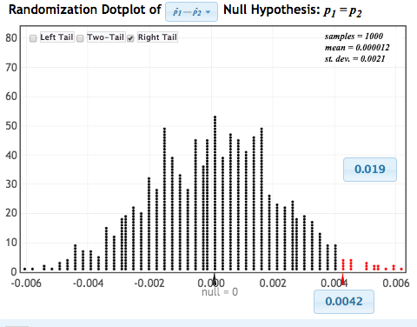
Randomization Test
Distribution of statistic if no difference (H₀ true)
p-value
observed statistic

Slide 8
Conclusion
If there were no difference between HRT and placebo regarding invasive breast cancer, we would only see differences this extreme about 2% of the time.
We have evidence that HRT increases risk of breast cancer
This result caused the trial to be terminated early, and changed routine health-care practice for post-menopausal women

Slide 9
Your Turn! NFL Overtimes
In the National Football League, a coin flip determines who gets the ball first in overtime.
The coin flip winner won 240 out of 428 overtime games $\hat{p}=0.56$1
Test H₀:p=0.5 vs. H_{a}: p>0.5
1. Use StatKey to do this with a randomization test
lock5stat.com/statkey

Slide 10
Three Transitions
Distribution: Simulation to Theoretical
Statistic: Original to Standardized
Standard Error: Simulation to Formula
Notes:
A

Slide 11
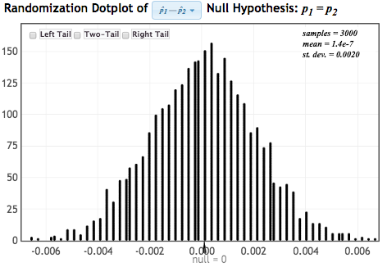
Normal Distribution
N(0, 0.002)
We can compare the original statistic to this Normal distribution to find the p-value!

Slide 12
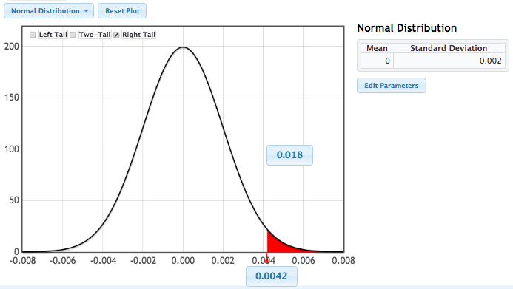
p-value from N(null, SE)
p-value
Same idea as randomization test, just using a smooth curve!
observed statistic

Slide 13
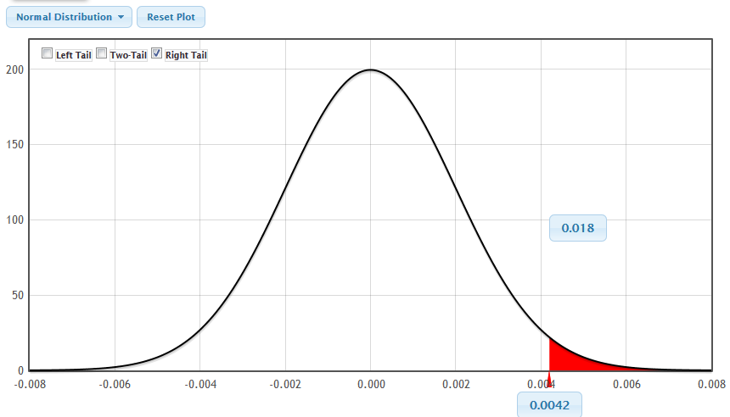
Seeing the Connection!
Randomization Distribution
Normal Distribution

Slide 14
Distribution Transition
Many simulated distributions have the same shape; let’s take advantage of this!
Replace dotplot with overlaid Normal distribution: N(null value, SE)
Compare statistic to N(null value, SE)
Possible topics to include here:
Central Limit Theorem?
Sample size requirements?
We use this intermediate transition primarily to make connections

Slide 15
Your Turn! NFL Overtimes
2. Normal Approximation
Use the normal distribution in StatKey
Edit the parameters so that the mean=0.50 (the null value) and standard deviation is the SE from your randomization distribution
Find the p-value as the (right tail) area above the original sample proportion (0.561)

Slide 16
Three Transitions
Distribution: Simulation to Theoretical
Statistic: Original to Standardized
Standard Error: Simulation to Formula
Notes:
B

Slide 17
Standardization Transition
Often, we standardize the statistic to have mean 0 and standard deviation 1
Can connect back to z-scores
statistic
null value
SE
What is the equivalent for the null distribution of the statistic?

Slide 18
Standardized Statistic
Hormone Replacement Therapy:
From original data: statistic = 0.0042
From null hypothesis: null value = 0
From randomization distribution: SE = 0.002
Compare to N(0,1) to find p-value…

Slide 19
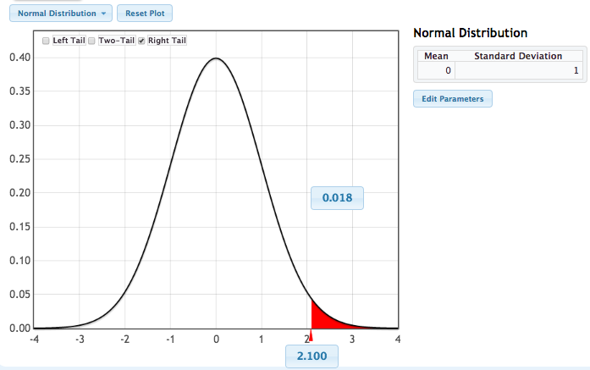
p-value from N(0,1)
Same idea as before, just using a standardized statistic!
p-value
standardized statistic

Slide 20
Standardized Statistic
Standardized test statistic general form:
Emphasizing this general form can help students see connections between different parameters
Students see the big picture rather than lots of disjoint formulas

Slide 21
Your Turn! NFL Overtimes
3. Standardization
Compute
$$z=\frac{statistic−null}{SE}$$
Use StatKey to find the p-value as the area above this z-statistic for a N(0,1) distribution
$$\hat{p}$$
$$p_{0}$$
from randomization

Slide 22
Three Transitions
Distribution: Simulation to Theoretical
Statistic: Original to Standardized
Standard Error: Simulation to Formula
Notes:
A

Slide 23
After standardizing…
From original data
From H₀
From randomization distribution
Compare z to N(0,1) for p-value
YES!!!
Can we find the SE without simulation?

Slide 24
Standard Error Formulas
Parameter | Standard Error
Proportion | $$\sqrt{\frac{\hat{p}\left(1−\hat{p}\right)}{n} }$$
Mean | $$\frac{s}{\sqrt{n}}$$
Diff. in Proportions | $$\sqrt{\frac{{\hat{p}}_{1}\left(1−{\hat{p}}_{1}\right)}{n_{1}}+\frac{{\hat{p}}_{2}\left(1−{\hat{p}}_{2}\right)}{n_{2}}}$$
Diff. in Means | $$\sqrt{\frac{s_{1}^{2}}{n_{1}}+\frac{s_{2}^{2}}{n_{2}}}$$

Slide 25
Standard Error Formula
Testing a difference in proportions, null assumes p₁ = p₂, so have to use pooled proportion:
Hormone replacement therapy:

Slide 26
Randomization Distribution

Slide 27
Fully Traditional
Now we can compute the standardized statistic using only formulas:
Compare to N(0,1) to find p-value…

Slide 28
p-value from N(0,1)
Exact same idea as before, just computing SE from formula
p-value
standardized statistic

Slide 29
Your Turn! NFL Overtimes
4. P-value using standard error via formula
Compute the standard error with
$$SE=\sqrt{\frac{p_{0}(1−p_{0})}{n}}$$
Find the z-statistic with
$$z=\frac{statistic−null}{SE}$$
Use StatKey to find the p-value as the area above this z-statistic for a N(0,1) distribution

Slide 30
Connecting Parameters
All of these ideas work for proportions, difference in proportions, means, difference in means, and more
Means are slightly more complicated
t-distribution
Null hypothesis for a difference in means can assume equal distributions or just equal means
Notes:
A

Slide 31
Honeybee Waggle Dance
https://www.youtube.com/watch?v=-7ijI-g4jHg
Honeybee scouts investigate new home or food source options; the scouts communicate the information to the hive with a “waggle dance”
The dance conveys direction and distance, but does it also convey quality?
Scientists took bees to an island with only two possible options for new homes: one of very high quality and one of low quality
They kept track of which potential home each scout visited, and the number of waggle dance circuits performed upon return to the hive
Notes:
B

Slide 32
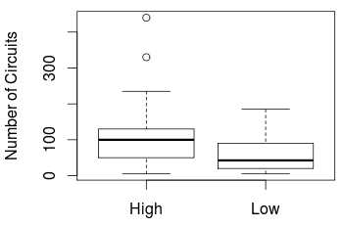
Honeybee Waggle Dance
Estimate the difference in mean number of circuits, between scouts describing a high quality site and scouts describing a low quality site.
$$n_{H}=33$$
$${\overline{x}}_{H}=112.42$$
$$s_{H}=93.0$$
$$n_{L}=18$$
$${\overline{x}}_{L}=61.67$$
$$s_{L}=55.7$$

Slide 33
Bootstrap Confidence Interval
How much variability is there in sample statistics measuring difference in mean number of circuits?
Simulate to find out!
We’d like to sample repeatedly from the population, but we can’t, so we do the next best thing: Bootstrap!
www.lock5stat.com/statkey

Slide 34
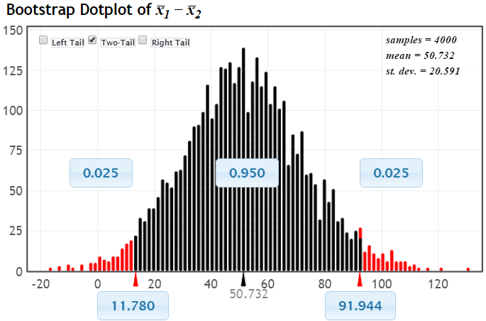
95% Bootstrap CI
Chop 2.5% in each tail
Keep 95% in middle
Chop 2.5% in each tail

Slide 35
Bootstrap CI
Version 1 (Statistic ± 2 SE):
Prepares for moving to traditional methods
Version 2 (Percentiles):
Builds understanding of confidence level
Same process applies to lots of parameters.

Slide 36
Your Turn! Florida Lakes
Fish were taken from a sample of n=53 Florida lakes to measure mercury levels.
Summary: $n=53 \overline{x}=0.527 s=0.341$
Find a confidence interval for the mean mercury level in all Florida lakes
Bootstrap CI
Use StatKey to make a bootstrap distribution and find the CI two ways:
Using $\overline{x}±2∗SE$
Using the middle 95% of the bootstraps
Switch to find a 90% CI
Compare

Slide 37
Three Transitions
Distribution: Simulation to Theoretical
Statistic: Original to Standardized
Standard Error: Simulation to Formula
Notes:
B

Slide 38
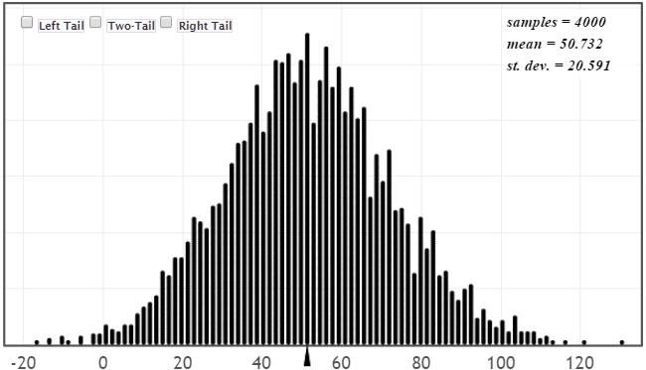
Normal Distribution
N(50.76,20.59)
${\overline{x}}_{H}−{\overline{x}}_{L}=$50.76

Slide 39
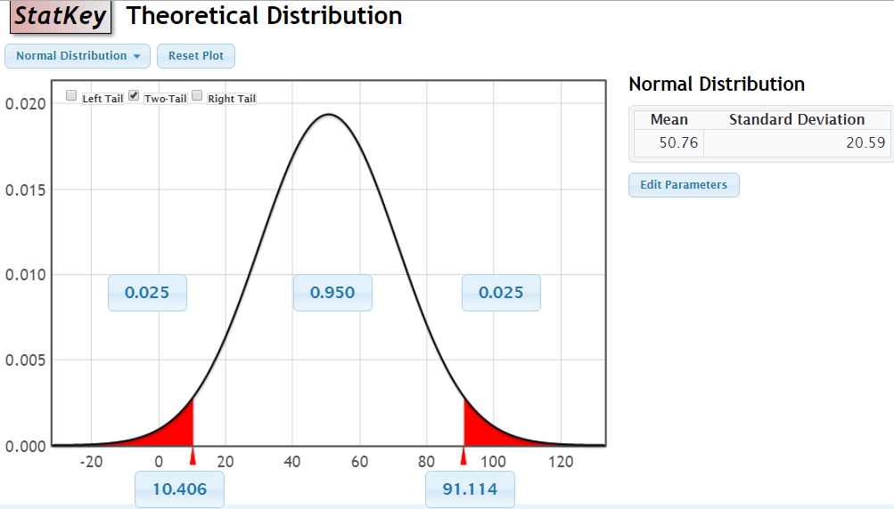
CI from N(statistic, SE)
Same idea as the bootstrap, just using a smooth curve!

Slide 40
Seeing the Connection!
Bootstrap Distribution
Normal Distribution

Slide 41
Your Turn! Florida Lakes
2. Normal Approximation
Use the normal distribution in StatKey
Edit the parameters so that
mean = the original mercury mean
std. dev. =SE from your bootstrap distribution
Choose “Two-tail” and adjust the percentage to get the bounds for the middle 90% of this distribution.

Slide 42
Three Transitions
Distribution: Simulation to Theoretical
Statistic: Original to Standardized
Standard Error: Simulation to Formula
Notes:
A

Slide 43
Standardization Transition
We already have
$$statistic±2⋅SE$$
To get a more precise value and reflect different confidence levels, replace the “2” with a %-tile from a standardized distribution
$$statistic±z^{∗}⋅SE$$
or
$$statistic±t^{∗}⋅SE$$
from N(0,1)
from t

Slide 44
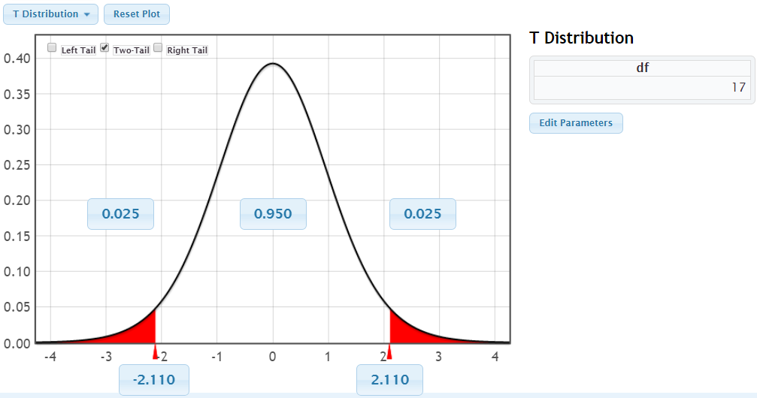
Standardized Endpoint
For a difference in means with n₁=33 and n₂=18, use a t-distribution with 18-1=17 d.f. and find t* to give 95% confidence (StatKey)
Same idea as the percentile method!
$$t^{∗}=2.110$$

Slide 45
CI using t* and Bootstrap SE
$$statistic±t^{∗}⋅SE$$
Original $\overline{x}$
From t₁₇
From bootstrap
$$50.76±2.110⋅20.59$$
$$50.76±43.44=(7.32, 94.20)$$
Same idea as the bootstrap standard error method, just replacing 2 with t*!

Slide 46
(Un)-standardization
In testing, we go to a standardized statistic
In intervals, we find (-t*, t*) for a standardized distribution, and return to the original scale
Un-standardization (reverse of z-scores):
What’s the equivalent for the distribution of the statistic? (bootstrap distribution)
statistic
± t*
SE

Slide 47
Your Turn! Florida Lakes
3. t-interval from bootstrap SE
Switch to the t-distribution (52 d.f.) in StatKey
Use “Two-tail” to find the upper endpoint (t*) for the middle 90% of the t-distribution
Compute the confidence interval using
$$\overline{x}±t^{∗}⋅SE$$
from randomization

Slide 48
Three Transitions
Distribution: Simulation to Theoretical
Statistic: Original to Standardized
Standard Error: Simulation to Formula
Notes:
B

Slide 49
Standard Error Formula
For a difference in two means
$$SE=\sqrt{\frac{s_{1}^{2}}{n_{1}}+\frac{s_{2}^{2}}{n_{2}}}$$
For Honeybee circuits data
$$SE=\sqrt{\frac{{93.0}^{2}}{33}+\frac{{55.7}^{2}}{18}}=20.84$$

Slide 50
Normal Distribution

Slide 51
Fully Traditional
Now we can compute the confidence interval using a formula for the SE:
$$statistic±t^{∗}⋅SE=50.76±2.11⋅20.84$$
$=50.76±43.97=(6.79, 94.73)$
$$\left({\overline{x}}_{H}−{\overline{x}}_{L}\right)±t^{∗}\sqrt{\frac{s_{H}^{2}}{n_{H}}+\frac{s_{L}^{2}}{n_{L}}}$$

Slide 52
Your Turn! Florida Lakes
4. t-interval from formula SE
Estimate the SE of the mean with
$$SE=\frac{s}{\sqrt{n}}$$
Compute the confidence interval using
$$\overline{x}±t^{∗}⋅SE$$
from original sample

Slide 53
Your Turn!
Try any test or interval via simulation in StatKey and via traditional methods
Do you get (approximately) the same standard error?
Do you get (approximately) the same p-value or interval?
Notes:
B

Slide 54
Simulation to Traditional
Bootstrap
Normal($\overline{x}, SE)$
A
B
$$\overline{x}±t^{∗}⋅\frac{s}{\sqrt{n}}$$
$$Statistic±t^{∗}⋅SE$$
Even if you only want your students to be able to do A and B, it helps understanding to build connections along the way!
Notes:
B

Slide 55
Thank you! QUESTIONS? Coming right up... Birds of a Feather
Kari Lock Morgan: klm47@psu.edu
Robin Lock: rlock@stlawu.edu
Patti Frazer Lock: plock@stlawu.edu
Slides posted at www.lock5stat.com

