Slide 1
Statistics:
Unlocking the Power of Data
Patti Frazer Lock
Cummings Professor of Mathematics
St. Lawrence University
plock@stlawu.edu
University of Kentucky
June 2015

Slide 2
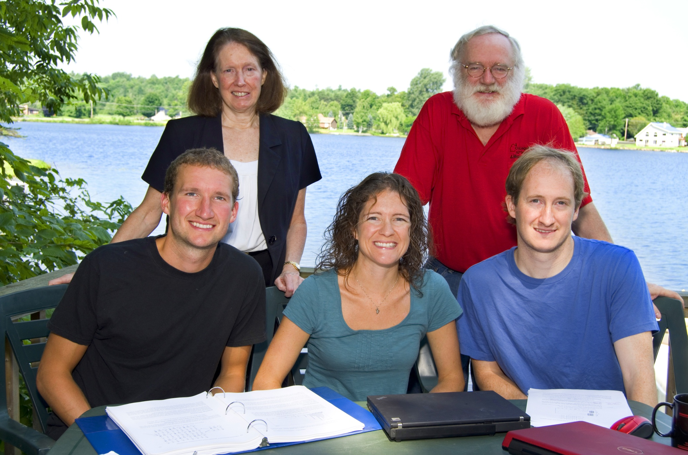
The Lock⁵ Team
Robin & Patti
St. Lawrence
Dennis
Iowa State/
Miami Dolphins
Kari
Harvard/
Penn State
Eric
UNC/
U Minnesota

Slide 3
Outline
Morning:
Key Concepts and Simulation Methods
Afternoon:
How it All Fits Together,
Instructor Resources,
Technology,
Assessment Ideas,
Q&A

Slide 4
Table of Contents
Chapter 1: Data Collection
  Sampling, experiments,…
Chapter 2: Data Description
Mean, median, histogram,…
Chapter 3: Confidence Intervals
Understanding and interpreting CI, bootstrap CI
Chapter 4: Hypothesis Tests
Understanding and interpreting HT, randomization HT
Chapters 5 & 6: Normal and t-based formulas
Short-cut formulas after full understanding

Slide 5
Table of Contents (continued)
Chapter 7: Chi-Square Tests
Chapter 8: Analysis of Variance
Chapter 9: Inference for Regression
Chapter 10: Multiple Regression
Chapter 11: Probability

Slide 6
Table of Contents
Chapter 1: Data Collection
  Sampling, experiments,…
Chapter 2: Data Description
Mean, median, histogram,…
Chapter 3: Confidence Intervals
Understanding and interpreting CI, bootstrap CI
Chapter 4: Hypothesis Tests
Understanding and interpreting HT, randomization HT
Chapters 5 & 6: Normal and t-based formulas
Short-cut formulas after full understanding

Slide 7
Simulation Methods
The Next Big Thing
Common Core State Standards in Mathematics
Increasingly important in DOING statistics
Outstanding for use in TEACHING statistics
Ties directly to the key ideas of statistical inference

Slide 8
“New” Simulation Methods?
"Actually, the statistician does not carry out this very simple and very tedious process, but his conclusions have no justification beyond the fact that they agree with those which could have been arrived at by this
elementary method."
-- Sir R. A. Fisher, 1936

Slide 9
First: bootstrap confidence intervals and the key concept of variation in sample statistics.
Second: randomization hypothesis tests and the key concept of strength of evidence.
Notes:
Bozz

Slide 10
First:
Bootstrap Confidence Intervals
Key Concept:
Variation in Sample Statistics

Slide 11
Sampling Distribution
Population
BUT, in practice we don’t see the “tree” or all of the “seeds” – we only have ONE seed
µ

Slide 12

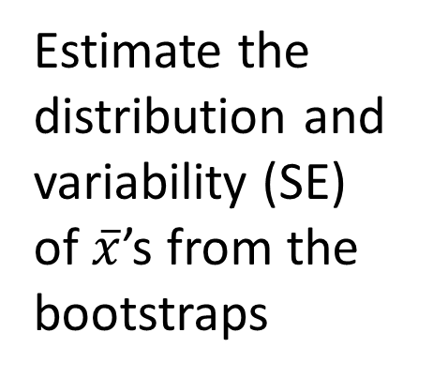
Bootstrap Distribution
What can we do with just one seed?
Bootstrap
“Population”
Estimate the distribution and variability (SE) of $\overline{x}$’s from the bootstraps
Grow a NEW tree!
$$\overline{x}$$
µ

Slide 13
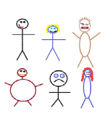
Suppose we have a random sample of 6 people:
Notes:
Patti

Slide 14
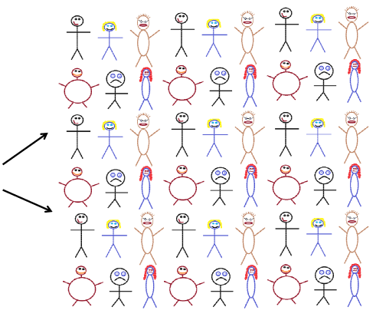
Original Sample
A simulated “population” to sample from
Notes:
Patti

Slide 15




Bootstrap Sample: Sample with replacement from the original sample, using the same sample size.
Original Sample
Bootstrap Sample
Notes:
Patti

Slide 16
Create a bootstrap sample by sampling with replacement from the original sample, using the same sample size.
Compute the relevant statistic for the bootstrap sample.
Do this many times!! Gather the bootstrap statistics all together to form a bootstrap distribution.
Notes:
Patti

Slide 17
BootstrapSample
Bootstrap Statistic
BootstrapSample
Bootstrap Statistic
Original Sample
Bootstrap Distribution
●
●
●
●
●
●
Sample Statistic
BootstrapSample
Bootstrap Statistic
Notes:
Patti

Slide 18
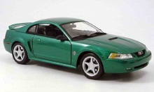
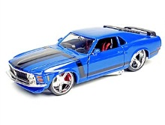
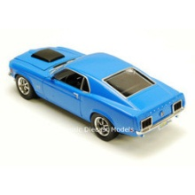
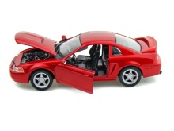
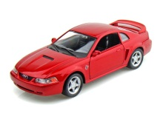
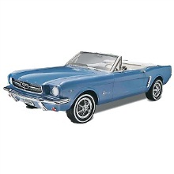
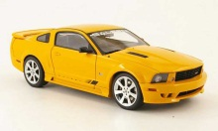
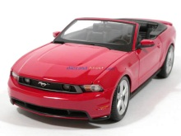
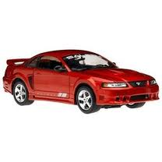
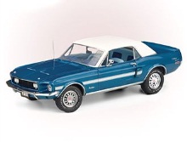
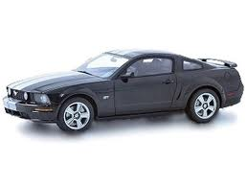
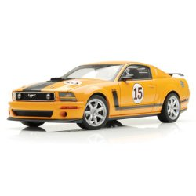
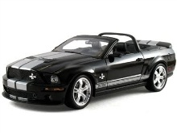
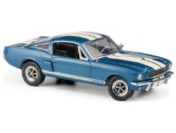
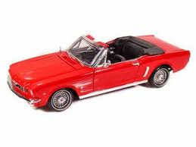
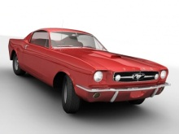
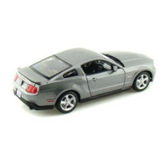
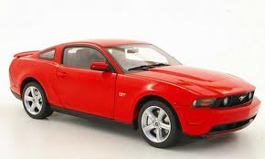
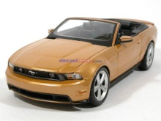
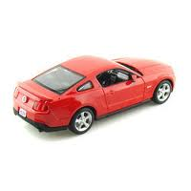
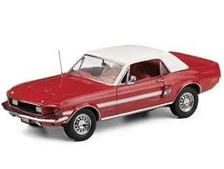
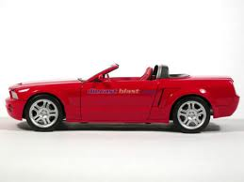
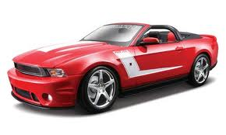
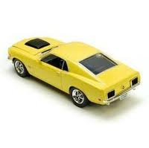
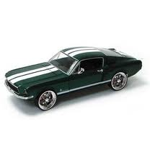

Example 1: Mustang Prices
Start with a random sample of 25 prices (in $1,000’s)
$$n=25 \overline{x}=15.98 s=11.11$$
Goal: Find an interval that is likely to contain the mean price for all Mustangs
Key concept: How much can we expect the sample means to vary just by random chance?

Slide 19
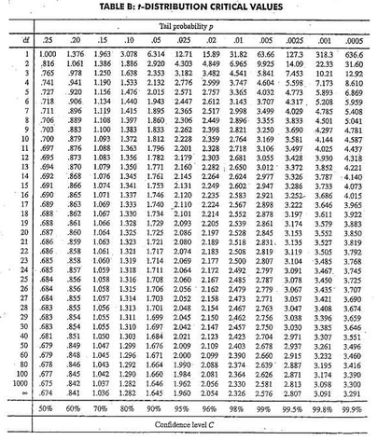
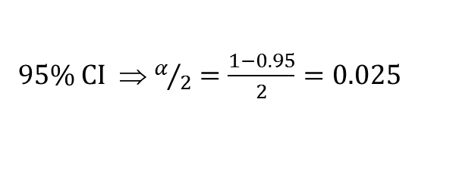

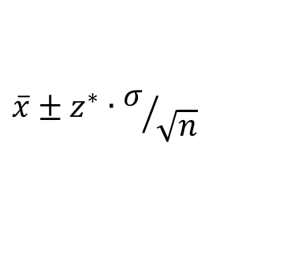
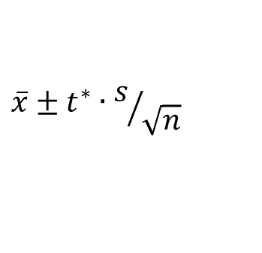
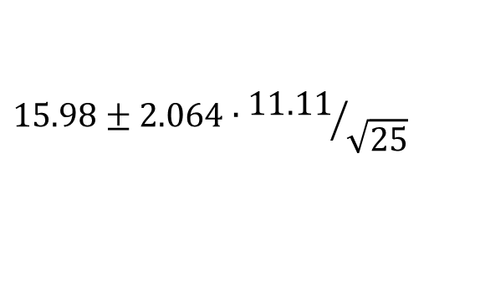

Traditional Inference
1. Check conditions
CI for a mean
2. Which formula?
$$\overline{x}±z^{∗}∙σ/{\sqrt{n}}$$
OR
$$\overline{x}±t^{∗}∙s/{\sqrt{n}}$$
3. Calculate summary stats
$n=25, \overline{x}=15.98$, $s=11.11$
4. Find t*
5. df?
95% CI ⇒ $α/2=\frac{1−0.95}{2}=0.025$
df=25$−$1=24
t*=2.064
6. Plug and chug
$$15.98±2.064∙{11.11}/{\sqrt{25}}$$
$$15.98±4.59=(11.39, 20.57)$$
7. Interpret in context

Slide 20
“We are 95% confident that the mean price of all used Mustang cars is between $11,390 and $20,570.”
We arrive at a good answer, but the process is not very helpful at building understanding of the key ideas.
Our students are often great visual learners. Bootstrapping helps us build on this visual intuition.

Slide 21
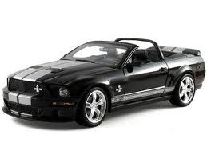

Original Sample
Bootstrap Sample
Repeat 1,000’s of times!
$$\overline{x}=15.98$$
$$\overline{x}=17.51$$
Notes:
Robin

Slide 22
We need technology!
StatKey
www.lock5stat.com
Free, easy-to-use, works on all devices
Can also be downloaded as Chrome app
Notes:
Patti

Slide 23
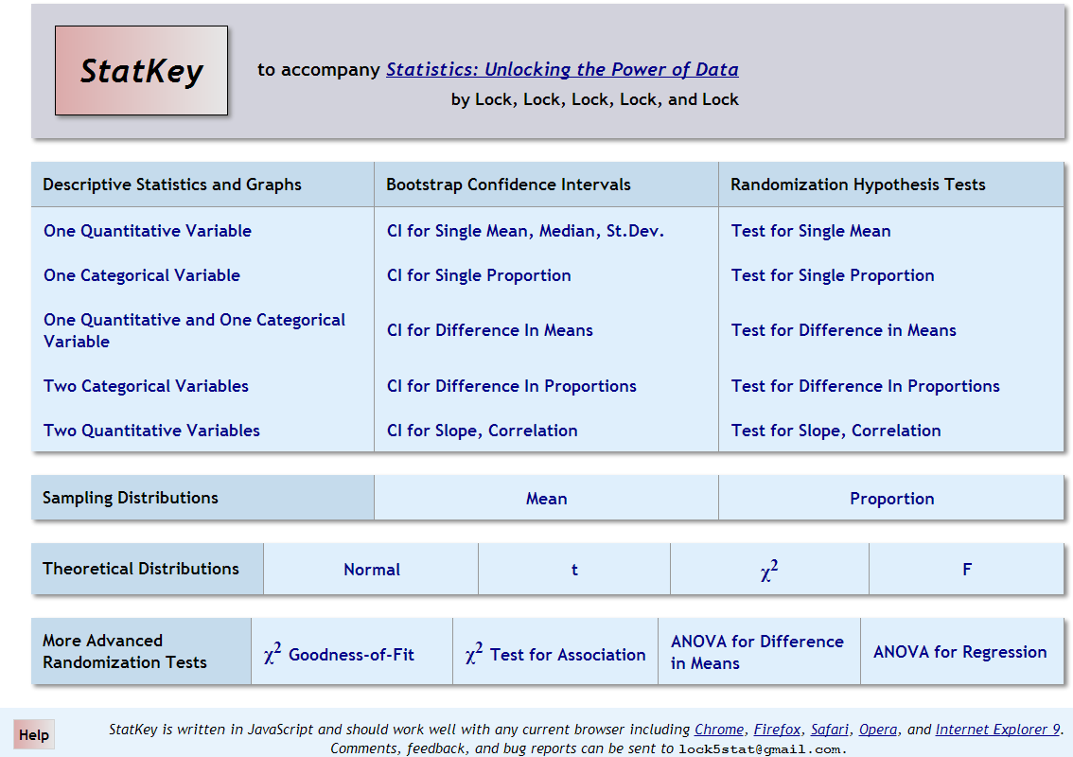
lock5stat.com/statkey

Slide 24
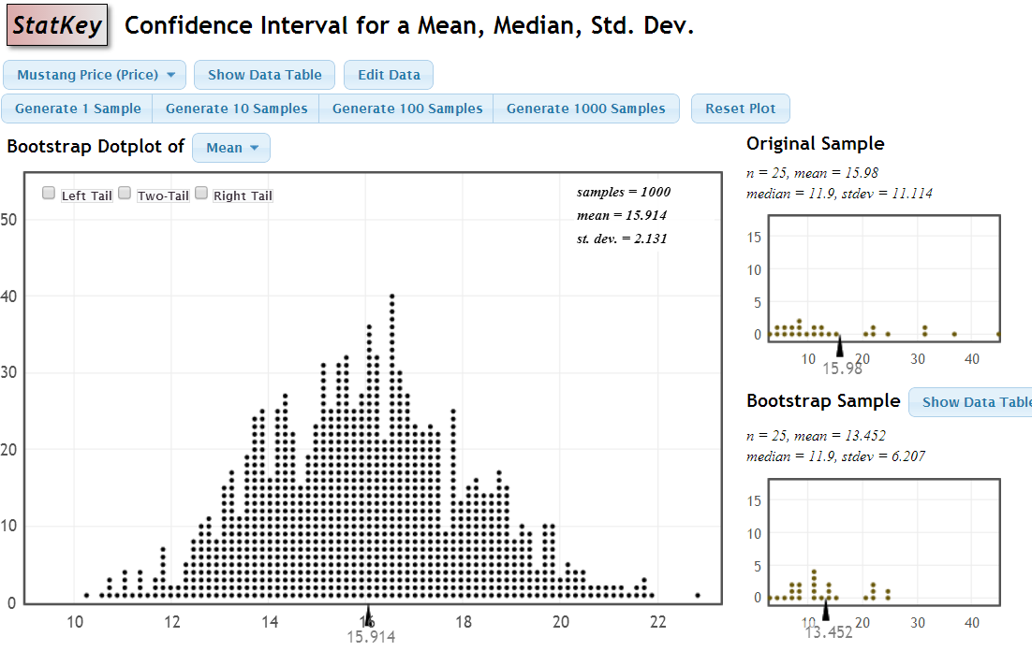
Bootstrap Distribution for Mustang Price Means

Slide 25
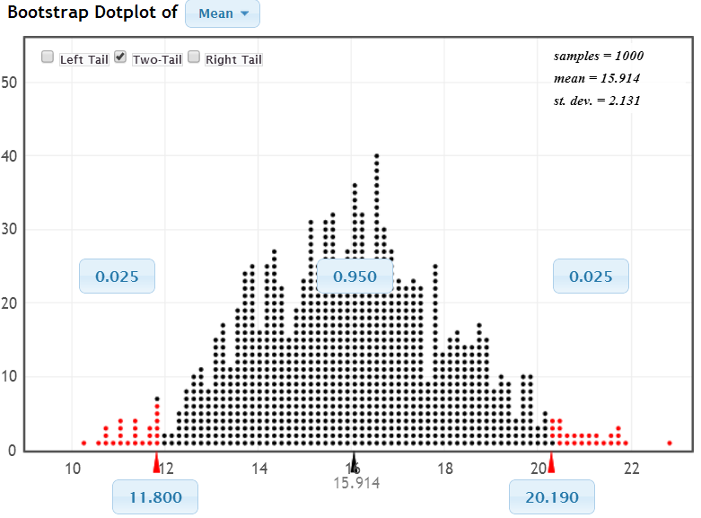
95% Confidence Interval
Chop 2.5% in each tail
Keep 95% in middle
Chop 2.5% in each tail
We are 95% sure that the mean price for Mustangs is between $11,800 and $20,190

Slide 26
StatKey
Sample Statistic
Standard Error
$Statistic ±2∙SE=15.98±2∙\left(2.131\right)=(11.72, 20.24$)

Slide 27
Bootstrap Confidence Intervals
Version 1 (Middle 95%):
Great at building understanding of
confidence intervals
Version 2 (Statistic ± 2 SE):
Great preparation for moving to
traditional methods
Same process works for different parameters
Notes:
Rups

Slide 28
Example 2: Cell Phones and Facebook
A random sample of 1,954 cell phone users showed that 782 of them used a social networking site on their phone. (pewresearch.org, accessed 6/2/14)
Find a 99% confidence interval for the proportion of cell phone users who use a social networking site on their phone.
www.lock5stat.com
Statkey

Slide 29
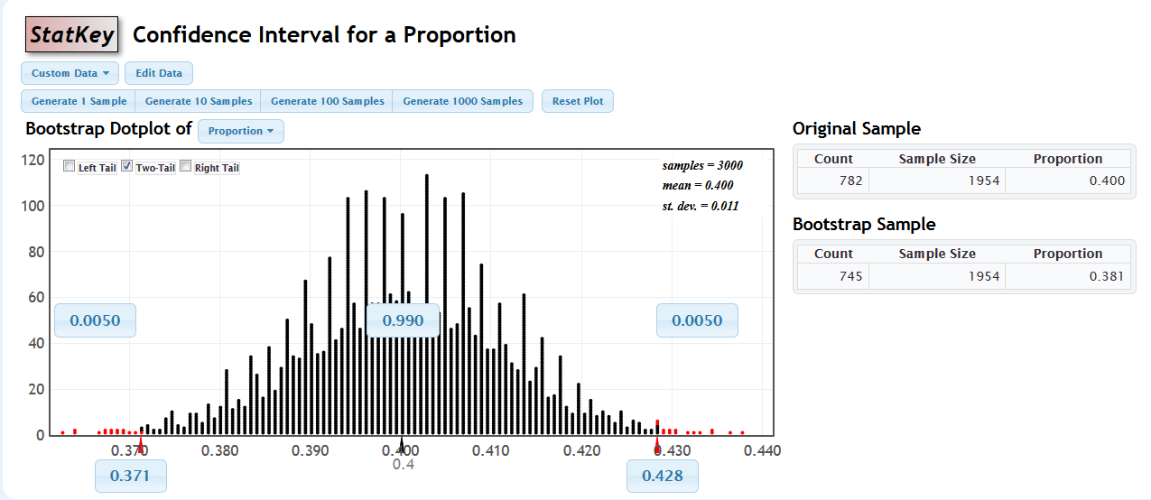
StatKey
We are 99% confident that the proportion of cell phone users who use a social networking site on their phone is between 37.1% and 42.8%%

Slide 30
Example 3: Diet Cola and Calcium
What is the difference in mean amount of calcium excreted between people who drink diet cola and people who drink water?
Find a 95% confidence interval for the difference in means.
www.lock5stat.com
Statkey

Slide 31
Example 3: Diet Cola and Calcium
www.lock5stat.com
Statkey
Select “CI for Difference in Means”
Use the menu at the top left to find the correct dataset.
Check out the sample: what are the sample sizes? Which group
excretes more in the sample?
Generate one bootstrap statistic. Compare it to the original.
Generate a full bootstrap distribution (1000 or more).
Use the “two-tailed” option to find a 95% confidence interval for
the difference in means.
What is your interval? Compare it with your neighbors.
Is zero (no difference) in the interval? (If not, we can be confident that there is a difference.)

Slide 32
Bootstrap confidence intervals:
Process is the same for all parameters
Process emphasizes the key concept of how statistics vary
Idea of a “confidence level” is obvious (students can see 95% vs 99% or 90%)
Results are very visual
Emphasis can be on interpreting the result instead of plugging numbers into formulas

Slide 33
Chapter 3: Confidence Intervals
At the end of this chapter, students should be able to understand and interpret confidence intervals (for a variety of different parameters)
(And be able to construct them using the bootstrap method) (which is the same method for all parameters)

Slide 34
Next:
Randomization Hypothesis Tests
Key Concept:
Strength of Evidence

Slide 35
P-value: The probability of seeing results as extreme as, or more extreme than, the sample results, if the null hypothesis is true.
Say what????

Slide 36
Example 1: Beer and Mosquitoes
Does consuming beer attract mosquitoes?
Experiment:
25 volunteers drank a liter of beer,
18 volunteers drank a liter of water
Randomly assigned!
Mosquitoes were caught in traps as they approached the volunteers.¹
¹ Lefvre, T., et. al., “Beer Consumption Increases Human Attractiveness to Malaria Mosquitoes, ” PLoS ONE, 2010; 5(3): e9546.

Slide 37
Beer and Mosquitoes
Number of Mosquitoes
Beer Water
27 21
20 22
21 15
26 12
27 21
31 16
24 19
19 15
23 24
24 19
28 23
19 13
24 22
29 20
20 24
17 18
31 20
20 22
25
28
21
27
21
18
20
Does drinking beer actually attract mosquitoes, or is the difference just due to random chance?
Beer mean = 23.6
Water mean
= 19.22
Beer mean – Water mean = 4.38

Slide 38
Traditional Inference
1. Check conditions
2. Which formula?
5. Which theoretical distribution?
6. df?
7. find p-value
3. Calculate numbers and plug into formula
4. Plug into calculator
0.0005 < p-value < 0.001

Slide 39
Simulation Approach
Number of Mosquitoes
Beer Water
27 21
20 22
21 15
26 12
27 21
31 16
24 19
19 15
23 24
24 19
28 23
19 13
24 22
29 20
20 24
17 18
31 20
20 22
25
28
21
27
21
18
20
Does drinking beer actually attract mosquitoes, or is the difference just due to random chance?
Beer mean = 23.6
Water mean
= 19.22
Beer mean – Water mean = 4.38

Slide 40
Simulation Approach
Number of Mosquitoes
Beer Water
27 21
20 22
21 15
26 12
27 21
31 16
24 19
19 15
23 24
24 19
28 23
19 13
24 22
29 20
20 24
17 18
31 20
20 22
25
28
21
27
21
18
20
Number of Mosquitoes
Beverage
27 21
20 22
21 15
26 12
27 21
31 16
24 19
19 15
23 24
24 19
28 23
19 13
24 22
29 20
20 24
17 18
31 20
20 22
25
28
21
27
21
18
20
Find out how extreme these results would be, if there were no difference between beer and water.
What kinds of results would we see, just by random chance?

Slide 41
Simulation Approach
Beer Water
Number of Mosquitoes
Beverage
20 22
21 15
26 12
27 21
31 16
24 19
19 15
23 24
24 19
28 23
19 13
24 22
29 20
20 24
17 18
31 20
20 22
25
28
21
27
21
18
20
Find out how extreme these results would be, if there were no difference between beer and water.
What kinds of results would we see, just by random chance?
27
21
21
27
24
19
23
24
31
13
18
24
25
21
18
12
19
18
28
22
19
27
20
23
22
20
26
31
19
23
15
22
12
24
29
20
27
29
17
25
20
28

Slide 42
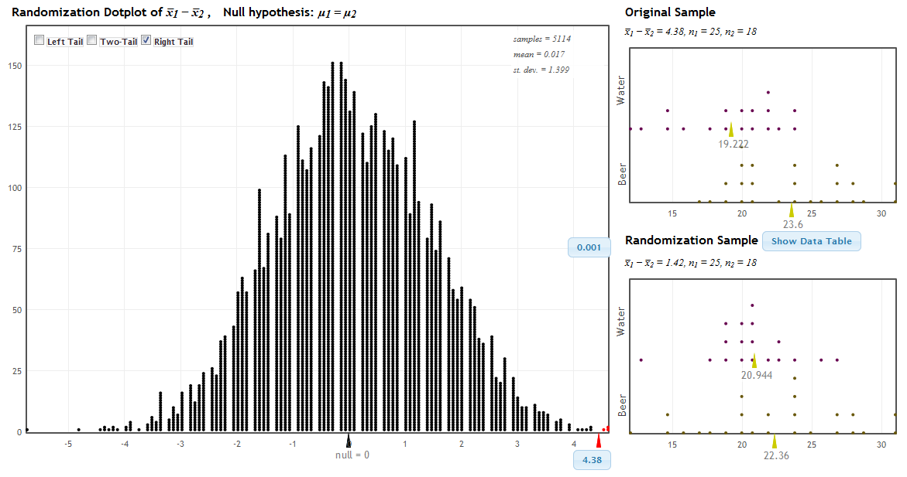
StatKey!
www.lock5stat.com
P-value

Slide 43
P-value
This is what we saw in the experiment.
This is what we are likely to see just by random chance if beer/water doesn’t matter.

Slide 44
P-value
This is what we saw in the sample data.
This is what we are likely to see just by random chance if the null hypothesis is true.

Slide 45
P-value: The probability of seeing results as extreme as, or more extreme than, the sample results, if the null hypothesis is true.
Yeah – that makes sense!

Slide 46
Traditional Inference
1. Which formula?
4. Which theoretical distribution?
5. df?
6. find p-value
2. Calculate numbers and plug into formula
3. Plug into calculator
0.0005 < p-value < 0.001

Slide 47
Beer and Mosquitoes
The Conclusion!
The results seen in the experiment are very unlikely to happen just by random chance (just 1 out of 1000!)
We have strong evidence that drinking beer does attract mosquitoes!

Slide 48
“Randomization” Samples
Key idea: Generate samples that are
based on the original sample
AND
consistent with some null hypothesis.

Slide 49
Example 2: Malevolent Uniforms
Do sports teams with more “malevolent” uniforms get penalized more often?

Slide 50
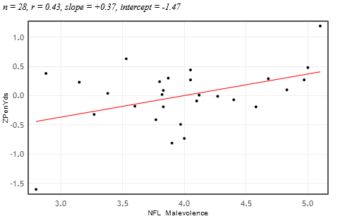


Example 2: Malevolent Uniforms
Sample Correlation
= 0.43
Do teams with more malevolent uniforms commit or get called for more penalties, or is the relationship just due to random chance?

Slide 51
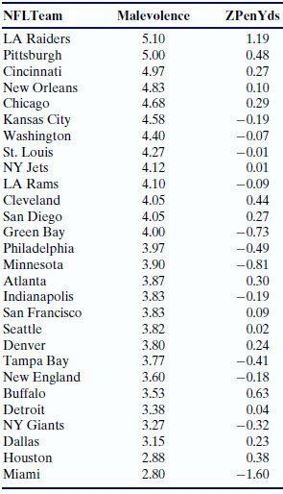
Simulation Approach
Sample Correlation = 0.43
Find out how extreme this correlation would be, if there is no relationship between uniform malevolence and penalties.
What kinds of results would we see, just by random chance?

Slide 52
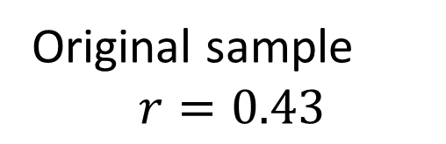
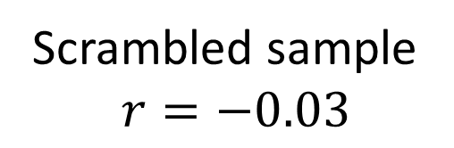
Randomization by Scrambling
Original sample
$$r=0.43$$
Scrambled sample
$$r=−0.03$$

Slide 53
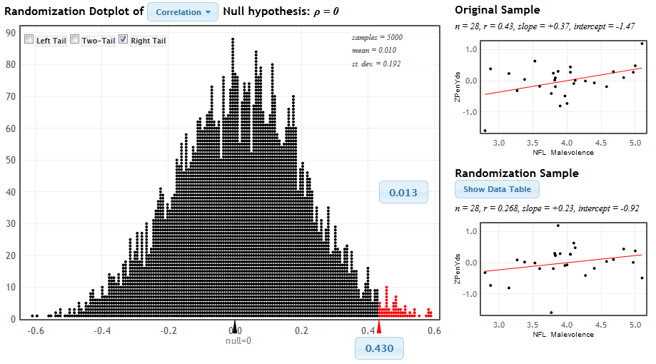
StatKey
www.lock5stat.com/statkey
P-value

Slide 54
Malevolent Uniforms
The Conclusion!
The results seen in the study are unlikely to happen just by random chance (just about 1 out of 100).
We have some evidence that teams with more malevolent uniforms get more penalties.

Slide 55
Example 3:
Light at Night and Weight Gain
Does leaving a light on at night affect weight gain? In particular, do mice with a light on at night gain more weight than mice with a normal light/dark cycle?
Find the p-value and use it to make a conclusion.
www.lock5stat.com
Statkey

Slide 56
Example 3:
Light at Night and Weight Gain
www.lock5stat.com
Statkey
Select “Test for Difference in Means”
Use the menu at the top left to find the correct dataset (Fat Mice).
Check out the sample: what are the sample sizes? Which group
gains more weight? (LL = light at night, LD = normal light/dark)
Generate one randomization statistic. Compare it to the original.
Generate a full randomization distribution (1000 or more).
Use the “right-tailed” option to find the p-value.
What is your p-value? Compare it with your neighbors.
Is the sample difference of 5 likely to be just by random chance?
What can we conclude about light at night and weight gain?

Slide 57
Randomization Hypothesis Tests:
Randomization method is not the same for all parameters (but StatKey use is)
Key idea: The randomization distribution shows what is likely by random chance if H₀ is true. (Don’t need any other details.)
We see how extreme the actual sample statistic is in this distribution.
More extreme
= small p-value
= unlikely to happen by random chance
= stronger evidence against H₀ and for H_{a}

Slide 58
Example 4: Split or Steal!!
Split or Steal?
Age group | Split | Steal | Total
Under 40 | 187 | 195 | 382
Over 40 | 116 | 76 | 192
Total | 303 | 271 | 574
Is there a significant difference in the proportions who choose “split” between younger players and older players?

Slide 59
Chapter 4: Hypothesis Tests
State null and alternative hypotheses (for many different parameters)
Understand the idea behind a hypothesis test (stick with the null unless evidence is strong for the alternative)
Understand a p-value (!)
State the conclusion in context
(Conduct a randomization hypothesis test)

Slide 60
How Does It All Fit Together?
Stay tuned
for this afternoon’s session!

