Slide 1
StatKey
Online Tools for Teaching a Modern Introductory Statistics Course
Kari Lock Morgan
Duke University
Eric F. Lock
Duke University
Dennis F. Lock
Iowa State University
Robin Lock
St. Lawrence University
Patti Frazer Lock
St. Lawrence University
USCOTS Breakout – May 2013
“lab” machines; Use Student Metadata0
(Wireless) Username: san060417 PW: 25565

Slide 2
What is it?
StatKey
A set of web-based, interactive, dynamic statistics tools designed for teaching simulation-based methods such as bootstrap intervals and randomization tests at an introductory level.
Freely available at www.lock5stat.com/statkey
No login required
Runs in (almost) any browser (incl. smartphones)
Google Chrome App available (no internet needed)
Standalone or supplement to existing technology

Slide 3




Who Developed StatKey?
The Lock⁵ author team to support a new text:
Statistics: Unlocking the Power of Data
Programming Team:
Wiley (2013)
Rich Sharp
Stanford
Ed Harcourt
St. Lawrence
Kevin Angstadt
St. Lawrence

Slide 4
StatKey
WHY?
Address concerns about accessibility of simulation-based methods at the intro level
Design an easy-to-use set of learning tools
Provide a no-cost technology option
Support our new textbook, while also being usable with other texts or on its own

Slide 5
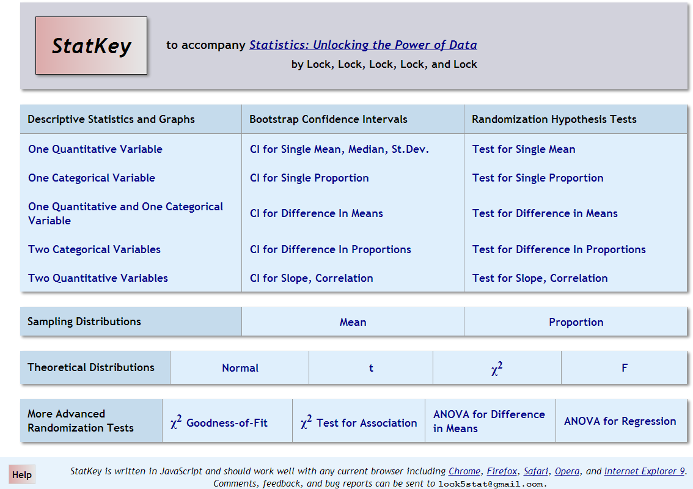

Slide 7
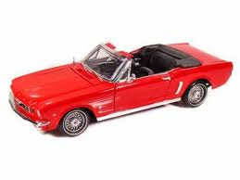
Example: What is the average price of a used Mustang car?
Select a random sample of n=25 Mustangs from a website (autotrader.com) and record the price (in $1,000’s) for each car.

Slide 8
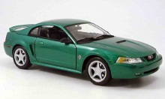
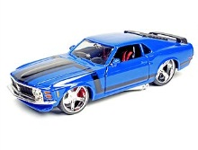
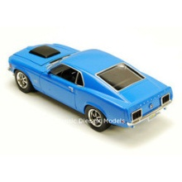
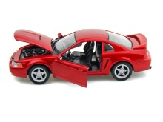
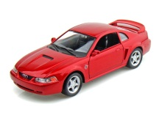
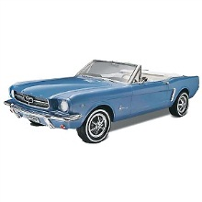
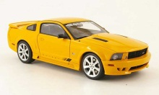
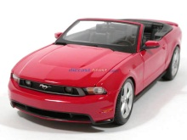
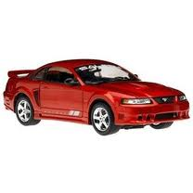
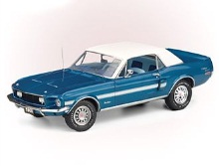
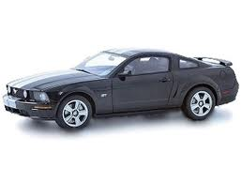
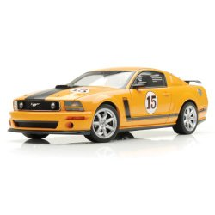
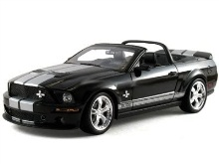
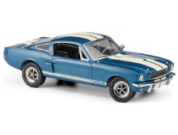
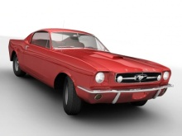
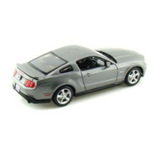
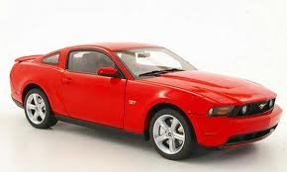
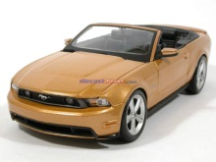
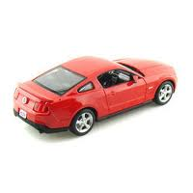
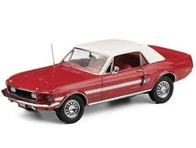
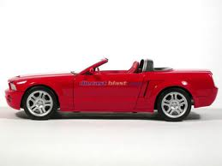
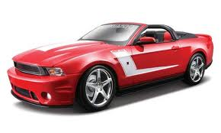
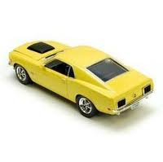
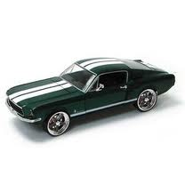

Sample of Mustangs:
$$n=25 \overline{x}=15.98 s=11.11$$
Our best estimate for the average price of used Mustangs is $15,980, but how accurate is that estimate?

Slide 9
Bootstrapping
“Let your data be your guide.”
Assume the “population” is many, many copies of the original sample.
Key idea: To see how a statistic behaves, we take many samples with replacement from the original sample using the same n.

Slide 10
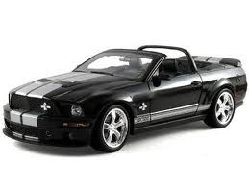
Original Sample
Bootstrap Sample

Slide 11
BootstrapSample
Bootstrap Statistic
BootstrapSample
Bootstrap Statistic
Original Sample
Bootstrap Distribution
●
●
●
●
●
●
Sample Statistic
BootstrapSample
Bootstrap Statistic

Slide 12
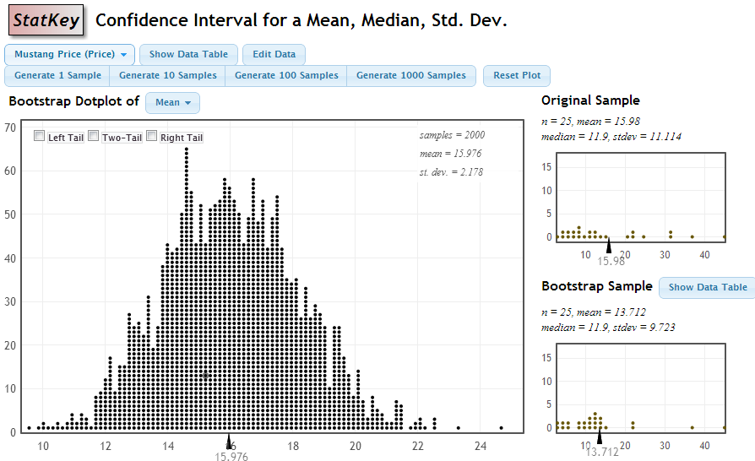

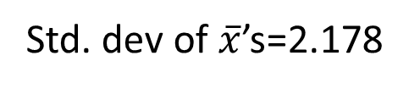
Bootstrap CI via SE
Std. dev of $\overline{x}$’s=2.178
SE = $\frac{s}{\sqrt{n}}=\frac{11.114}{\sqrt{25}}=2.2$
$$\overline{x}±2SE=15.98±2\left(2.178\right)=(11.62, 20.34)$$
Notes:
Robin

Slide 13
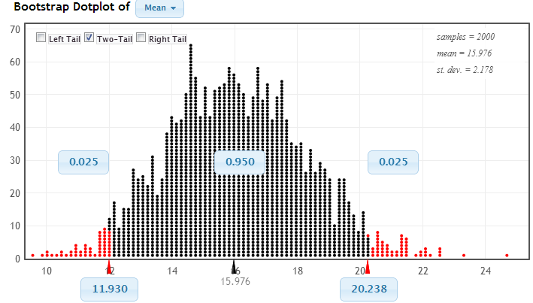
Bootstrap CI via Percentiles
Chop 2.5% in each tail
Keep 95% in middle
Chop 2.5% in each tail
We are 95% sure that the mean price for Mustangs is between $11,930 and $20,238

Slide 14
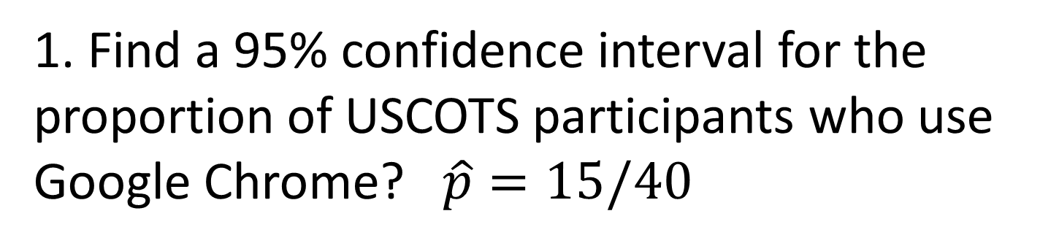
Your Turn
1. Find a 95% confidence interval for the proportion of USCOTS participants who use Google Chrome? $\hat{p}=15/40$
2. Find a 98% confidence interval for the slope of a regression line to predict Mustang price based on mileage.

Slide 15
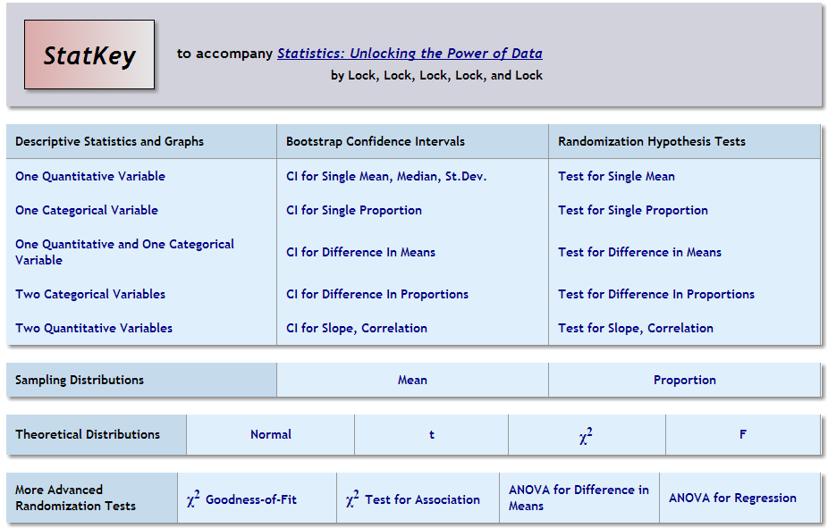

Slide 16
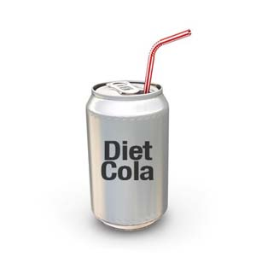
Example: Do people who drink diet cola excrete more calcium than people who drink water?
16 participants were randomly assigned to drink either diet cola or water, and their urine was collected and amount of calcium was measured.

Slide 17
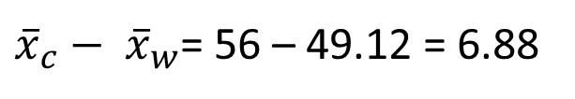
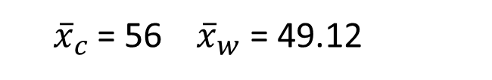
Original Sample
Diet cola (mg) | Water (mg)
48 | 45
50 | 46
55 | 46
56 | 48
58 | 48
58 | 53
61 | 53
62 | 54
Does drinking diet cola really leach calcium, or is the difference just due to random chance?
${\overline{x}}_{c}$ = 56 ${ \overline{x}}_{w}$ = 49.12
${\overline{x}}_{c}−{ \overline{x}}_{w}$= 56 – 49.12 = 6.88

Slide 18
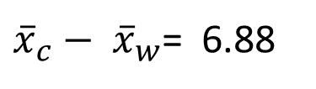
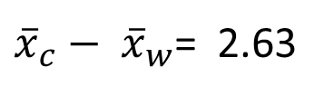
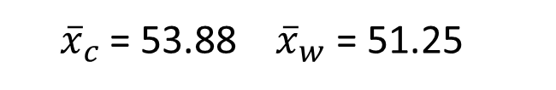
Simulated Sample
(random chance if the null hypothesis is true)
Original Sample
Diet cola | Water
48 | 45
50 | 46
55 | 46
56 | 48
58 | 48
58 | 53
61 | 53
62 | 54
Diet cola | Water
45 | 46
48 | 46
50 | 48
54 | 48
55 | 53
56 | 53
61 | 58
62 | 58
${\overline{x}}_{c}$ = 56 ${ \overline{x}}_{w}$ = 49.12
${\overline{x}}_{c}$ = 53.88 ${ \overline{x}}_{w}$ = 51.25
${\overline{x}}_{c}−{ \overline{x}}_{w}$= 6.88
${\overline{x}}_{c}−{ \overline{x}}_{w}$= 2.63

Slide 19
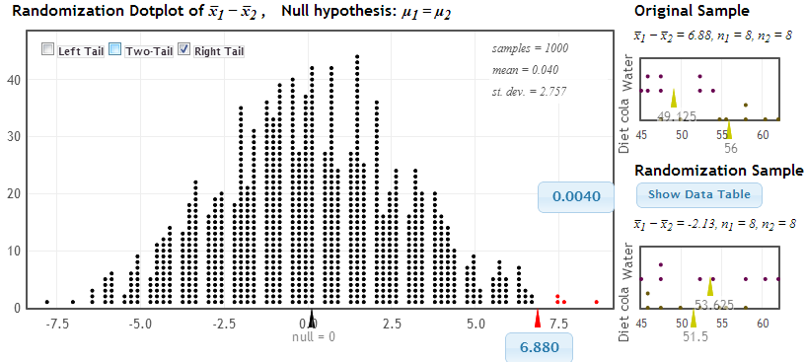
Distribution of Statistic Assuming Null is True
Proportion as extreme as observed statistic
p-value
observed statistic

Slide 20
Your Turn
1. In the British game show Golden Balls are older or younger participants more generous (more likely to split)?
http://www.youtube.com/watch?v=p3Uos2fzIJ0
2. Is there a positive association between malevolence of NFL uniforms and the number of penalty yards a team gets?

Slide 22
Example: Average enrollment in statistics graduate programs
We will look at sampling distributions for mean graduate student enrollment in statistics graduate programs.

Slide 23
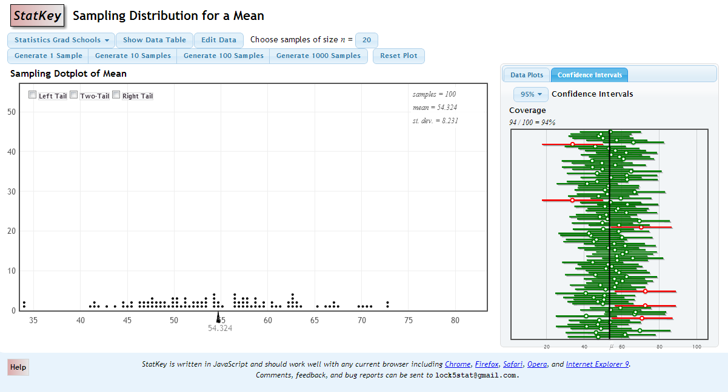
Sampling Distribution
Capture Rate

Slide 25
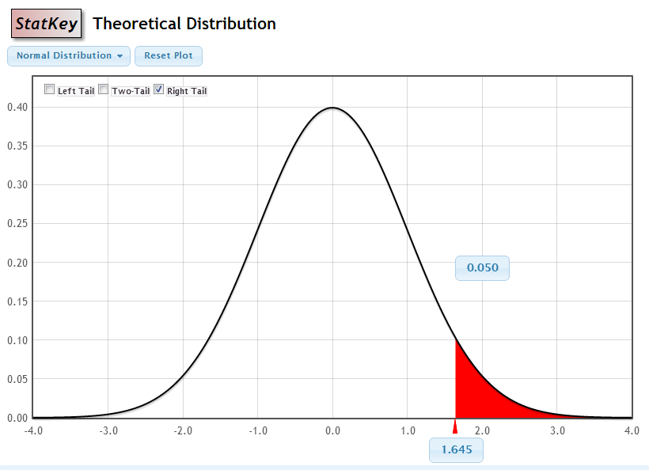
Theoretical Distributions
Easier than tables!

Slide 26
Pause for
Questions
??????

Slide 28
Your Turn
1. Explore on your own the options under “Descriptive Statistics and Graphs”.
2. Do ants have a preference for different types of sandwiches? (Randomization ANOVA)
3. Does temperature make a difference in hatching python eggs? (Randomization test for a two-way table)

