Slide 1
Introducing Inference with Bootstrap and Randomization Procedures
Dennis Lock
Statistics Education Meeting
October 30, 2012

Slide 2
Statistics: Unlocking The Power of Data
An introductory statistics book writing with my family
Robin H. Lock (St. Lawrence)
Patti F. Lock (St. Lawrence)
Kari Lock Morgan (Harvard/Duke)
Eric F. Lock (UNC/Duke)
introduces inference through simulation techniques
Release Date one week from today!!

Slide 3
Simulation Techniques
Randomization Hypothesis Tests
Sometimes call permutation tests
Bootstrap Confidence Intervals

Slide 4
Traditional Methods
Hypothesis Test:
Determine Null and Alternative Hypothesis
Use a formula to calculate a test statistic
Compare to “some” distribution assuming the Null Hypothesis is true
Use a Normal table, or computer software to find a p-value

Slide 5
Traditional Methods
Plugging numbers into formulas and relying on theory from mathematical statistics does little for conceptual understanding.
With a variety of formulae for each situation students get mired in the details, losing the big picture.
This is especially apparent with p-values!

Slide 6
Simulation Approach
Hypothesis Test:
Determine the Null and Alternative Hypothesis
Simulate randomization samples, assuming the Null Hypothesis is true
Calculate the statistic of interest for each simulated randomization
Find the proportion of simulated statistics as extreme or more extreme than the observed statistic

Slide 7
Simulation Approach: Example
Treating cocaine addiction¹
48 cocaine addicts seeking treatment
24 assigned randomly to two treatments:
Desipramine
Lithium
Two possible outcomes
Relapse
No Relapse
Typical difference in proportions
¹Gawin, F., et al., ‘‘Desipramine Facilitation of Initial Cocaine Abstinence,” Archives of General Psychiatry, 1989; 46(2): 117–121.

Slide 8
Simulation Approach: Example
 | Relapse | No Relapse
Desipramine | 10 | 14
Lithium | 18 | 6
$${\hat{p}}_{D}−{\hat{p}}_{L}=\frac{14}{24}−\frac{6}{24}=\frac{1}{3}$$
Hypothesis Test:
Determine the Null and Alternative Hypothesis
$$H_{0}:p_{D}=p_{L}$$
$$H_{a}:p_{D}>p_{L}$$

Slide 9
Simulation Approach: Example
Simulate randomization samples, assuming the Null Hypothesis is true
Key Idea:
We wish to generate samples that are:
Consistent with the Null Hypothesis
and
Based on the sample data
and c) consistent with the way the data was collected
If the null hypothesis is true then the treatment has no effect on the response. So we take our 28 relapse and 20 non-relapse counts and randomly assign them to one of two treatment groups.
Important point: This matches how the original data was collected!

Slide 10
Simulation Approach: Example
 | Relapse | No Relapse
Desipramine | 15 | 9
Lithium | 14 | 10
Calculate the statistic of interest for each simulated sample
$${\hat{p}}_{D}−{\hat{p}}_{L}=\frac{9}{24}−\frac{10}{24}=−\frac{1}{24}$$
We will repeat the randomization process many times using technology.

Slide 11
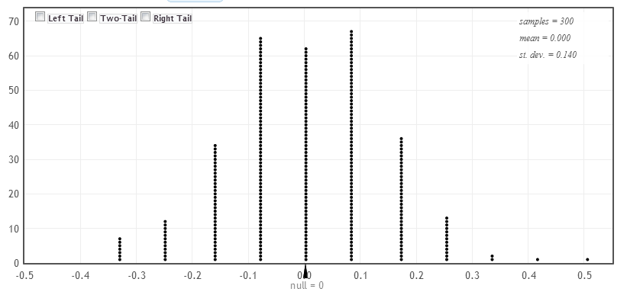
Simulation Approach: Example
Find the proportion of simulated statistics as extreme or more extreme than the observed statistic

Slide 12
Randomization Approach
Intrinsically connected to concepts
Same procedure applies to all statistics
No conditions to check

Slide 13
Simulation and Traditional
Simulation methods good for motivating conceptual understanding of inference
However, familiarity with traditional methods (t-test) is still expected after intro stat
Use simulation methods to introduce inference, and then teach the traditional methods as “short-cut formulas”

Slide 14
Reworked Stat 101
Descriptive Statistics – one and two samples
Data production (samples/experiments)
Bootstrap confidence intervals
Bootstrap confidence intervals
Normal distributions
Randomization-based hypothesis tests
Randomization-based hypothesis tests
Sampling distributions (mean/proportion)
Confidence intervals (means/proportions)
Hypothesis tests (means/proportions)

Slide 15
Inference Introduced
When do you get to inference?
Traditional: towards the end of the course
Still haven’t gotten to inference in 104, just finished writing the second exam
Agresti and Franklin p-value introduced?
Page 404!
Simulation: Early!
Students don’t need to know probability or the normal distribution before inference
Chapter 3: Confidence Intervals!
Lock5 p-value introduced?
Page 236!

Slide 16
Not a new idea!
"Actually, the statistician does not carry out this very simple and very tedious process, but his conclusions have no justification beyond the fact that they agree with those which could have been arrived at by this elementary method.“
Sir R. A. Fisher on permutation methods, 1936

Slide 17
Why don’t we teach this way?
We couldn’t!
It isn’t until recently we’ve had the computing power to make this process realistic.
Change is slow…

Slide 18
Why don’t we teach this way?
Vast majority of Introductory statistics students are going into a field other than statistics.
Traditional methods are how members of this field do statistics, so expected to be known!
Unfortunately this results in teaching statistics such that students can perform these tests
As long as they can compute a t-test we succeeded!

Slide 19
Technological Advances
As we’ve seen advances in computing the introductory stats course has adapted.
The big one: Automating computations!
This has also come about slowly
Example: We still teach
$r=\frac{\sum{(x_{i}−\overline{x})(y_{i}−\overline{y})}}{s_{x}s_{y}(n−1)}$, $m=r\frac{s_{y}}{s_{x}}$, $b=\overline{y}−m\overline{x}$
In my opinion these formula do little for conceptual understanding.
Another I wont discuss: Bayesian methods.

Slide 20
Technological Advances
"Automate calculation and graphics as much as possible.“
David S. Moore, 1992
Our text follows this idea
Formula’s are given for completeness but very briefly
Focuses on interpretation not calculation
Saves time!

Slide 21
Discussion of Sampling Distribution
“They get the answer right but do not understand.”
Following sampling distributions with bootstrap confidence intervals can help in this situation
Bootstrap distribution looks very similar to a sampling distribution!

Slide 22
Bootstrap Distribution
We assume the sample is representative of the population, so we can approximate the population as many copies of the original sample.
We take a sampling distribution with sample size n from this mock population.
This is done by:
Sampling n observations with replacement from the original distribution.
Computing the statistic of interest (bootstrap statistic)
Distribution of these statistics is a bootstrap distribution.

Slide 23
Using the Bootstrap Distribution
Teaching uses:
Simply observing the distribution (symmetric and bell shaped, etc.)
Using it to find a standard error for the statistic.
Empirical rule interval
These look like intervals they will see later
Percentiles!
Constructing confidence intervals with percentiles
These confidence intervals are very intuitive, rather then looking at values from a table!

Slide 24
Using the Bootstrap Distribution
Important note: We stick to only using the bootstrap on symmetric bell-shaped distributions.
Bootstrap CI’s can be used on other distributions, but this is beyond the scope of an intro stat course
Bias-corrected and accelerated intervals
“Reverse” percentile intervals
Many others

Slide 25
George Cobb Paper
“... the consensus curriculum is still an unwitting prisoner of history. What we teach is largely the technical machinery of numerical approximations based on the normal distribution and its many subsidiary cogs. This machinery was once necessary, because the conceptually simpler alternative based on permutations was computationally beyond our reach. Before computers statisticians had no choice. These days we have no excuse. Randomization-based inference makes a direct connection between data production and the logic of inference that deserves to be at the core of every introductory course.”
Professor George W. Cobb, from: “The Introductory Statistics Course: A Ptolemaic Curriculum”, 2007.

Slide 26
How extreme are these changes?
Not very!
The students come away with the same information they have now…
Plus hopefully much more understanding!
Simulation methods make up only 6 sections out of about 50!

Slide 27
Technology Applets
Having available technology to perform bootstrap and randomization procedures is a necessity!
This is possible in all of the major stat packages, and becoming easier in most of them (although still not ideal).
Enter StatKey!

Slide 28
StatKey!
StatKey is a series of applets designed for the book, but available freely to the public.
www.lock5stat.com/statkey
I’ve actually been using StatKey this semester to help explain sampling distributions in class.

Slide 29
USCOTS 2011
Unite States Conference on Teaching Statistics
Theme: “The next BIG thing” in statistics education
All attendees were polled, winner…
Using randomization methods in introductory statistics!

