Slide 1
Starting Inference with Bootstraps and Randomizations
Robin H. Lock, Burry Professor of Statistics
St. Lawrence University
Stat Chat
Macalester College, March 2011

Slide 2
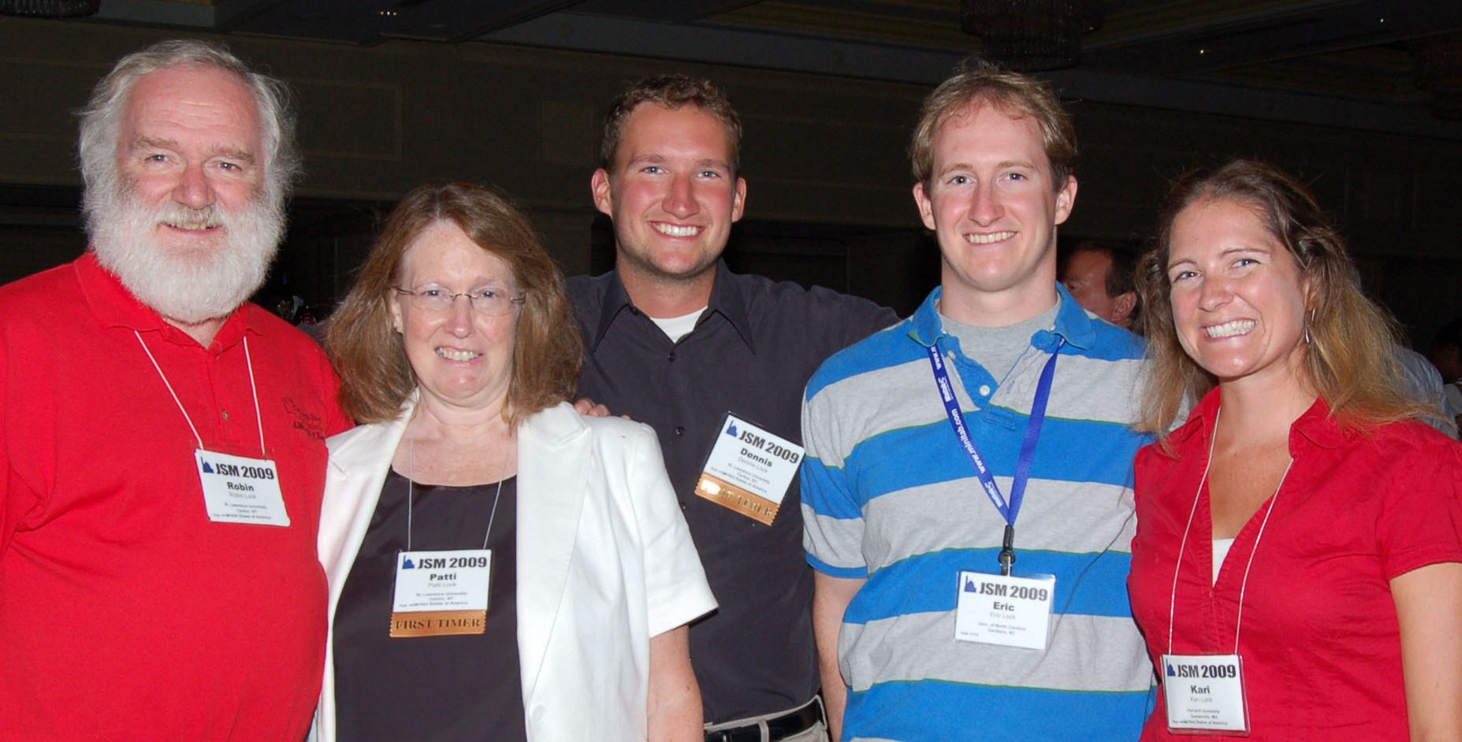
The Lock⁵ Team
Dennis
Iowa State
Kari
Harvard
Eric
UNC- Chapel Hill
Robin & Patti
St. Lawrence

Slide 3
Intro Stat at St. Lawrence
Four statistics faculty (3 FTE)
5/6 sections per semester
26-29 students per section
Only 100-level (intro) stat course on campus
Students from a wide variety of majors
Meet full time in a computer classroom
Software: Minitab and Fathom

Slide 4
Stat 101 - Traditional Topics
Descriptive Statistics – one and two samples
Normal distributions
Data production (samples/experiments)
Sampling distributions (mean/proportion)
Confidence intervals (means/proportions)
Hypothesis tests (means/proportions)
ANOVA for several means, Inference for regression, Chi-square tests

Slide 5
QUIZ
Choose an order to teach standard inference topics:
_____ Test for difference in two means
_____ CI for single mean
_____ CI for difference in two proportions
_____ CI for single proportion
_____ Test for single mean
_____ Test for single proportion
_____ Test for difference in two proportions
_____ CI for difference in two means

Slide 6
When do current texts first discuss confidence intervals and hypothesis tests?
 | Confidence Interval | Significance Test
Moore | pg. 359 | pg. 373
Agresti/Franklin | pg. 329 | pg. 400
DeVeaux/Velleman/Bock | pg. 486 | pg. 511
Devore/Peck | pg. 319 | pg. 365

Slide 7
Stat 101 - Revised Topics
Descriptive Statistics – one and two samples
Normal distributions
Bootstrap confidence intervals
Bootstrap confidence intervals
Data production (samples/experiments)
Data production (samples/experiments)
Randomization-based hypothesis tests
Randomization-based hypothesis tests
Sampling distributions (mean/proportion)
Normal distributions
Confidence intervals (means/proportions)
Hypothesis tests (means/proportions)
ANOVA for several means, Inference for regression, Chi-square tests

Slide 8
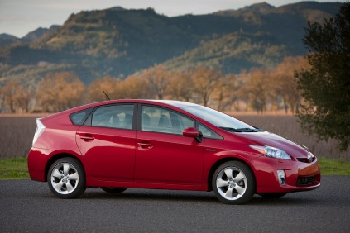
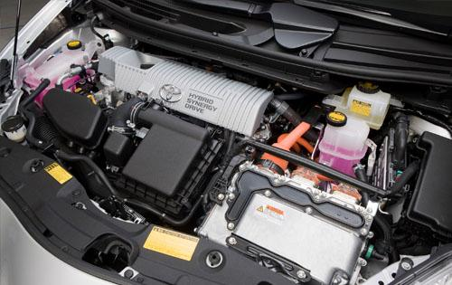
Toyota Prius – Hybrid Technology

Slide 9
Prerequisites for Bootstrap CI’s
Students should know about:
Parameters / sample statistics
Random sampling
Dotplot (or histogram)
Standard deviation and/or percentiles

Slide 10
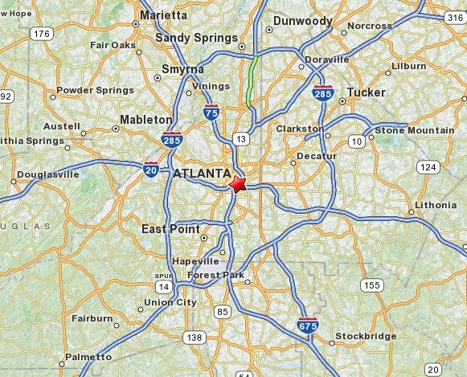
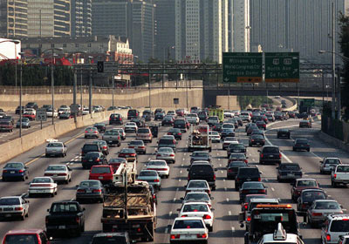
Example: Atlanta Commutes
What’s the mean commute time for workers in metropolitan Atlanta?
Data: The American Housing Survey (AHS) collected data from Atlanta in 2004.

Slide 11
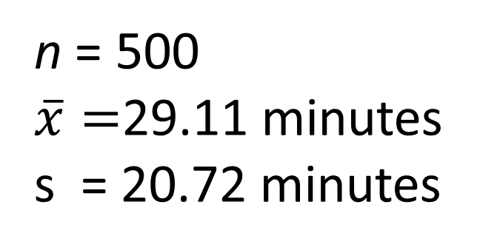
Sample of n=500 Atlanta Commutes
n = 500
$\overline{x}=$29.11 minutes
s = 20.72 minutes
Where might the “true” μ be?

Slide 12
“Bootstrap” Samples
Key idea: Sample with replacement from the original sample using the same n.
Assumes the “population” is many, many copies of the original sample.

Slide 13
Atlanta Commutes – Original Sample

Slide 14
Atlanta Commutes: Simulated Population
Sample from this “population”

Slide 15
Creating a Bootstrap Distribution
1. Compute a statistic of interest (original sample).
2. Create a new sample with replacement (same n).
3. Compute the same statistic for the new sample.
4. Repeat 2 & 3 many times, storing the results.
5. Analyze the distribution of collected statistics.
Try a demo with Fathom

Slide 16
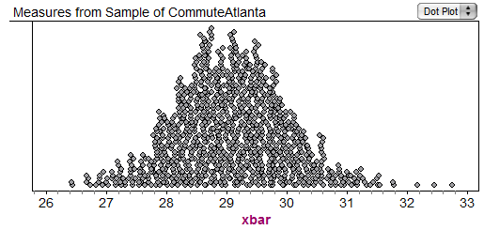
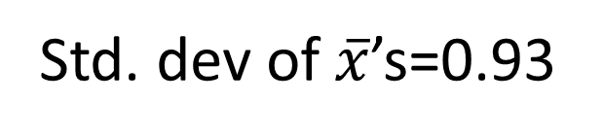
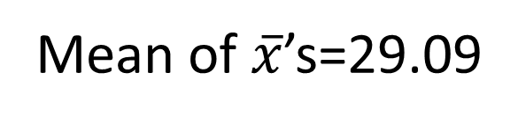
Bootstrap Distribution of 1000 Atlanta Commute Means
Mean of $\overline{x}$’s=29.09
Std. dev of $\overline{x}$’s=0.93

Slide 17
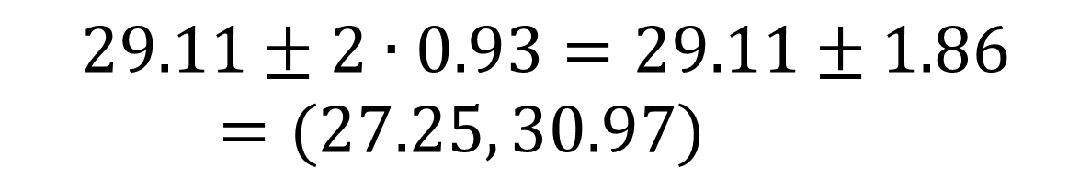

Using the Bootstrap Distribution to Get a Confidence Interval – Version #1
The standard deviation of the bootstrap statistics estimates the standard error of the sample statistic.
Quick interval estimate :
$$Original Statistic ±2∙SE$$
For the mean Atlanta commute time:
$$29.11±2∙0.93=29.11±1.86=(27.25, 30.97)$$

Slide 18
Quick Assessment
HW assignment (after one class on Sept. 29):
Use data from a sample of NHL players to find a confidence interval for the standard deviation of number of penalty minutes.

Slide 19
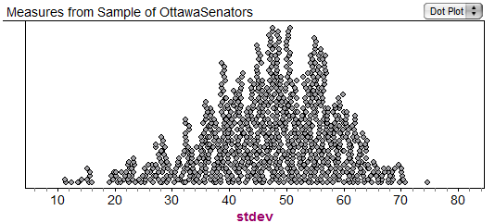

Example: Find a confidence interval for the standard deviation, σ, of hockey penalty minutes.
Original sample: s=49.1
$$49.1±2∙11.3$$
$$(26.5, 71.7)$$
Bootstrap distribution of sample std. dev’s
SE=11.3

Slide 20
Quick Assessment
HW assignment (after one class on Sept. 29):
Use data from a sample of NHL players to find a confidence interval for the standard deviation of number of penalty minutes.
Results:
9/26 did everything fine
6/26 got a reasonable bootstrap distribution, but messed up the interval, e.g. StdError( )
5/26 had errors in the bootstraps, e.g. n=1000
6/26 had trouble getting started, e.g. defining s( )

Slide 21
Using the Bootstrap Distribution to Get a Confidence Interval – Version #2
27.25
Keep 95% in middle
30.97
Chop 2.5% in each tail
Chop 2.5% in each tail
$$29.11±2∙0.93=(27.25, 30.97)$$

Slide 22
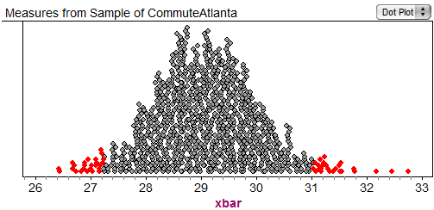
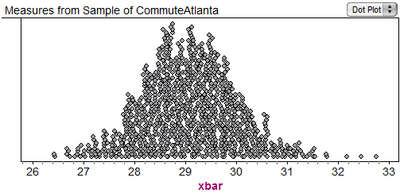
Using the Bootstrap Distribution to Get a Confidence Interval – Version #2
95% CI=(27.24,31.03)
27.24
31.03
Chop 2.5% in each tail
Chop 2.5% in each tail
Keep 95% in middle
For a 95% CI, find the 2.5%-tile and 97.5%-tile in the bootstrap distribution

Slide 23
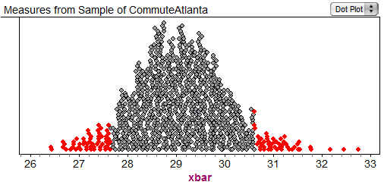
90% CI for Mean Atlanta Commute
90% CI=(27.60,30.61)
27.60
30.61
Chop 5% in each tail
Keep 90% in middle
Chop 5% in each tail
For a 90% CI, find the 5%-tile and 95%-tile in the bootstrap distribution

Slide 24
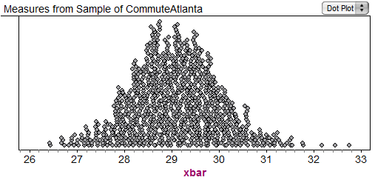
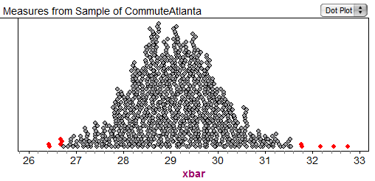
99% CI for Mean Atlanta Commute
99% CI=(26.73,31.65)
26.73
31.65
Keep 99% in middle
Chop 0.5% in each tail
Chop 0.5% in each tail
For a 99% CI, find the 0.5%-tile and 99.5%-tile in the bootstrap distribution

Slide 25
What About Hypothesis Tests?

Slide 26
“Randomization” Samples
Key idea: Generate samples that are
based on the original sample
AND
consistent with some null hypothesis.

Slide 27

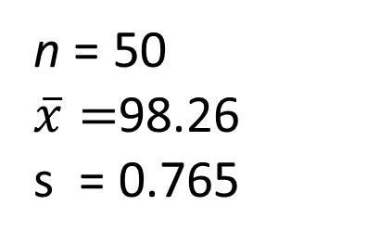
Example: Mean Body Temperature
Is the average body temperature really 98.6ºF?
H₀:μ=98.6
H_{a}:μ≠98.6
Data: A sample of n=50 body temperatures.
n = 50
$\overline{x}=$98.26
s = 0.765
Data from Allen Shoemaker, 1996 JSE data set article

Slide 28
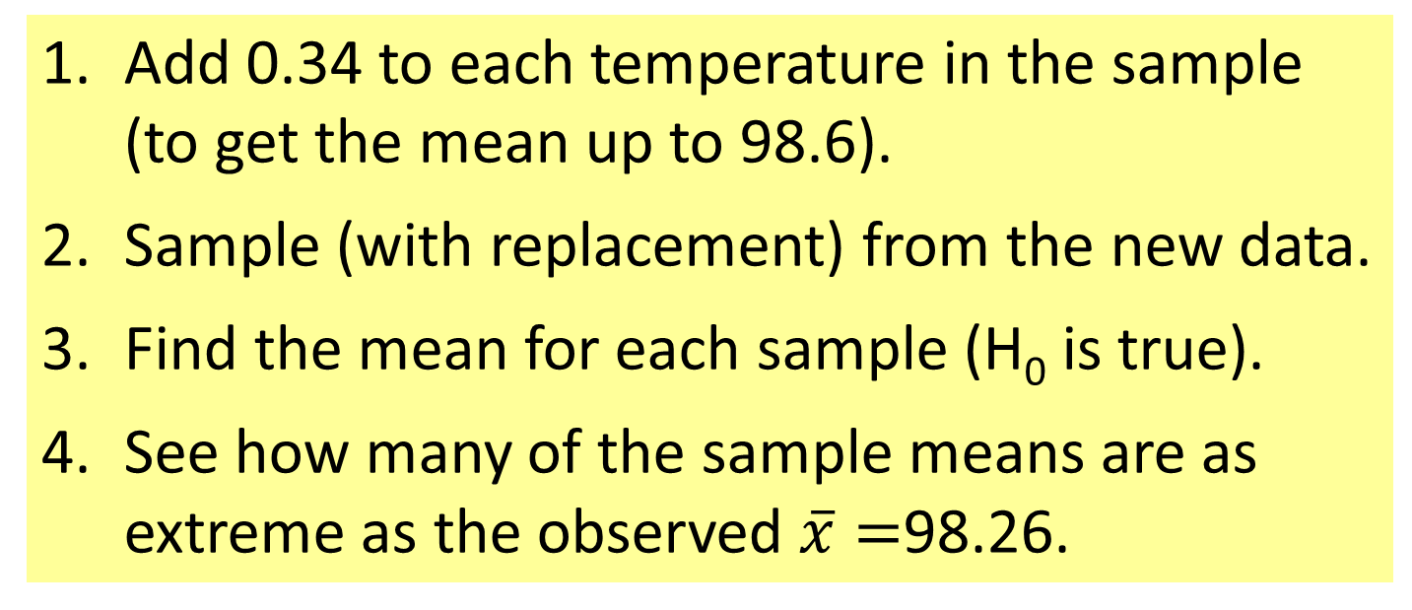
Randomization Samples
How to simulate samples of body temperatures to be consistent with H₀: μ=98.6?
Add 0.34 to each temperature in the sample (to get the mean up to 98.6).
Sample (with replacement) from the new data.
Find the mean for each sample (H₀ is true).
See how many of the sample means are as extreme as the observed $\overline{x}=$98.26.
Fathom Demo

Slide 29
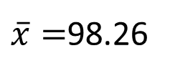
Randomization Distribution
$\overline{x}=$98.26
Looks pretty unusual…
p-value ≈ 1/1000 x 2 = 0.002

Slide 30
Choosing a Randomization Method
Example: Finger tap rates (Handbook of Small Datasets)
A=Caffeine | 246 | 248 | 250 | 252 | 248 | 250 | 246 | 248 | 245 | 250 | mean=248.3
B=No Caffeine | 242 | 245 | 244 | 248 | 247 | 248 | 242 | 244 | 246 | 241 | mean=244.7
H₀: μ_{A}=μ_{B} vs. H_{a}: μ_{A}>μ_{B}
Method #1: Randomly scramble the A and B labels and assign to the 20 tap rates.
Method #2: Add 1.8 to each B rate and subtract 1.8 from each A rate (to make both means equal to 246.5). Sample 10 values (with replacement) within each group.

Slide 31
Connecting CI’s and Tests
Randomization body temp means when μ=98.6
Bootstrap body temp means from the original sample
Fathom Demo

Slide 32
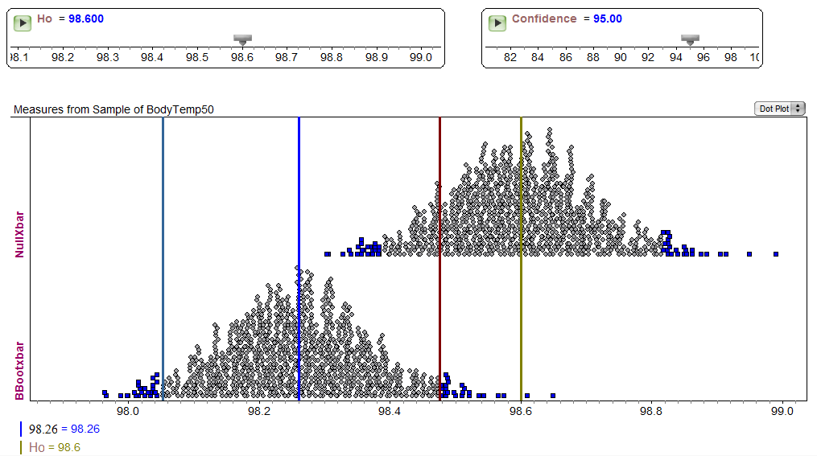
Fathom Demo: Test & CI

Slide 33
Intermediate Assessment
Exam #2: (Oct. 26) Students were asked to find and interpret a 95% confidence interval for the correlation between water pH and mercury levels in fish for a sample of Florida lakes – using both SE and percentiles from a bootstrap distribution.
Results:
17/26 did everything fine
4/26 had errors finding/using SE
2/26 had minor arithmetic errors
3/26 had errors in the bootstrap distribution

Slide 34
Transitioning to Traditional Inference
AFTER students have seen lots of bootstrap and randomization distributions…
Introduce the normal distribution (and later t)
Introduce “shortcuts” for estimating SE for proportions, means, differences, slope…

Slide 35
Final Assessment
Final exam: (Dec. 15) Find a 98% confidence interval using a bootstrap distribution for the mean amount of study time during final exams
Results:
26/26 had a reasonable bootstrap distribution
24/26 had an appropriate interval
23/26 had a correct interpretation

Slide 36
What About Technology?
Possible options?
Fathom/Tinkerplots
R
Minitab (macro)
JMP (script)
Web apps
Others?
xbar=function(x,i) mean(x[i])
b=boot(Time,xbar,1000)
Try a Hands-on Breakout Session at USCOTS!
Applet Demo

Slide 37
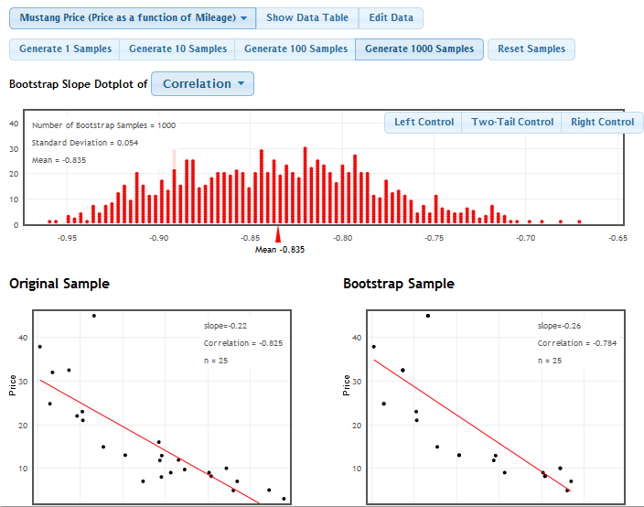

Slide 38
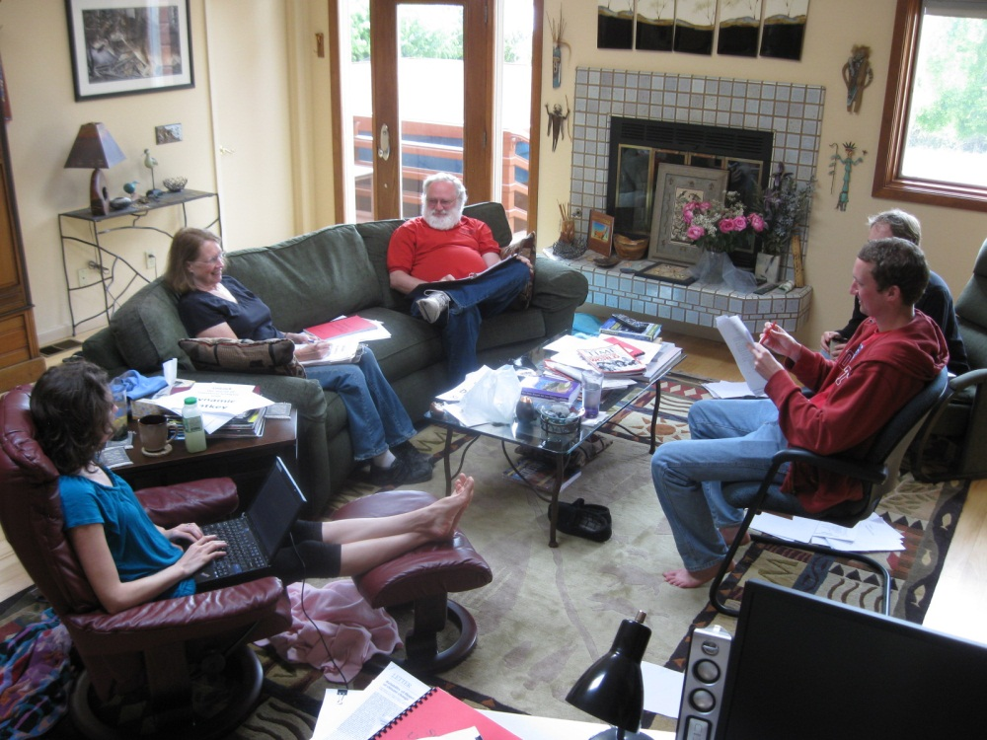
Support Materials?
We’re working on them…
Interested in class testing?
rlock@stlawu.edu

