Slide 1
StatKey
Online Tools for Teaching a Modern Introductory Statistics Course
Robin Lock
Burry Professor of Statistics
St. Lawrence University
rlock@stlawu.edu
Syracuse ASA Panel on Technology in Statistics Education
Onondaga Community College, November 2013

Slide 2
What is it?
StatKey
A set of web-based, interactive, dynamic statistics tools designed for teaching simulation-based methods such as bootstrap intervals and randomization tests at an introductory level.
Freely available at
lock5stat.com/statkey
Runs in (almost) any browser.
Also available as a Google Chrome App.

Slide 3

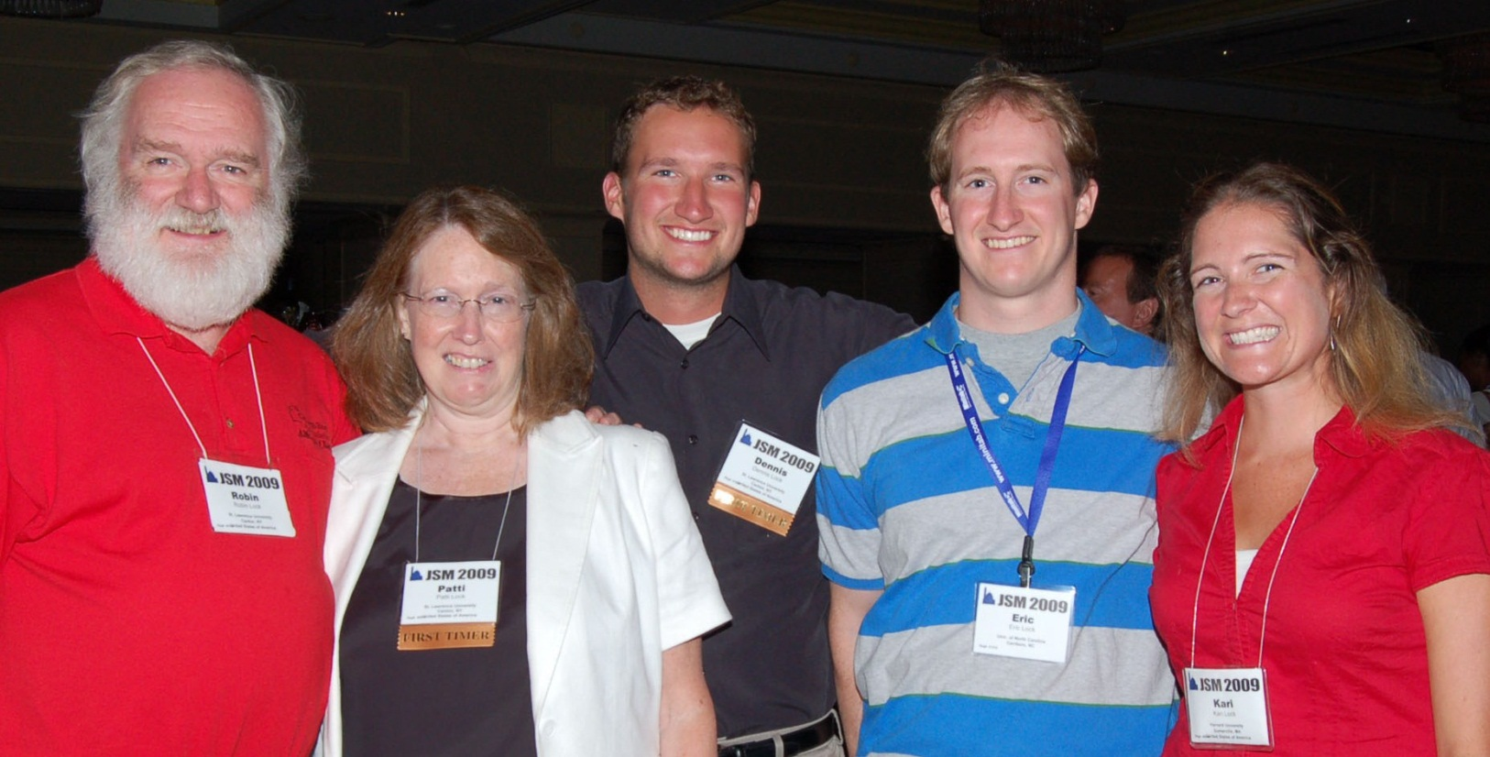
Who Developed StatKey?
The Lock⁵ author team to support a new text:
Statistics: Unlocking the Power of Data
Dennis
Iowa State
Kari
Harvard/Duke
Wiley (2013)
Eric
UNC/Duke
Robin & Patti
St. Lawrence

Slide 4



Programming Team
StatKey
Rich Sharp
Stanford
Kevin Angstadt
St. Lawrence
Ed Harcourt
St. Lawrence
StatKey is programmed in JavaScript

Slide 5
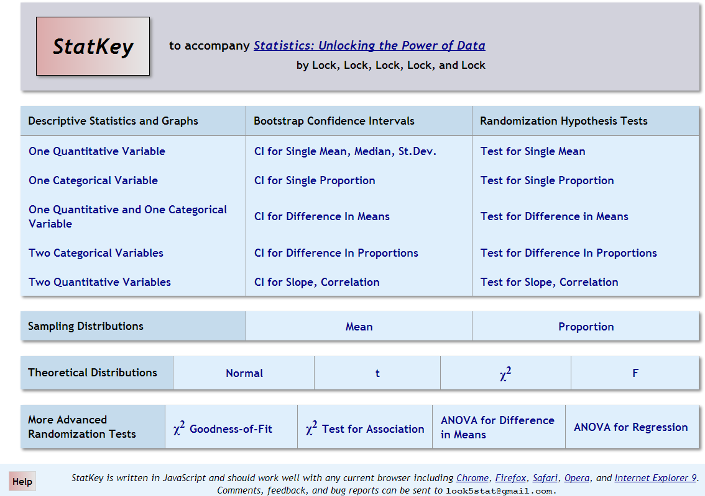

Slide 6
Examples
1. Does drinking beer attract mosquitoes?
(Randomization test to compare means)
2. Mean mercury in Florida lakes
(Bootstrap CI for a mean)
You can find videos of StatKey demonstrations similar to these examples at
https://sites.google.com/site/lock5stat/home/help-videos

Slide 7
Beer and Mosquitoes
Does consuming beer attract mosquitoes?
H₀: μ_{B}=μ_{W}
H₀: μ_{B}>μ_{W}
Experiment:
25 volunteers drank a liter of beer,
18 volunteers drank a liter of water
Randomly assigned!
Mosquitoes were caught in traps as they approached the volunteers.¹
¹ Lefvre, T., et. al., “Beer Consumption Increases Human Attractiveness to Malaria Mosquitoes, ” PLoS ONE, 2010; 5(3): e9546.
Beer mean = 23.6
Water mean = 19.22

Slide 8
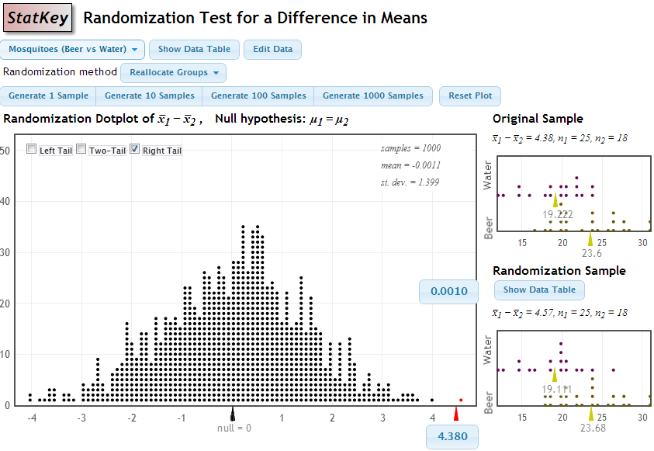
p-value = proportion of samples, when H₀ is true, that are as (or more) extreme as the original sample.
p-value

Slide 9
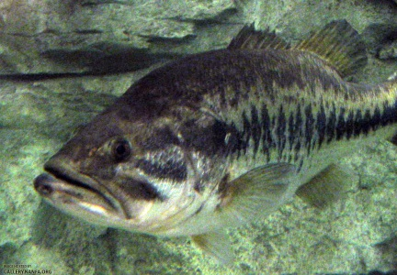

What is the average level of mercury in fish in Florida lakes?
Select fish from a random sample of 53 Florida lakes and record the mercury level.
$$n=53 \overline{x}=0.527 s=0.341$$
Key concept: How much can we expect such sample means to vary just by random chance?
Bootstrap!

Slide 10
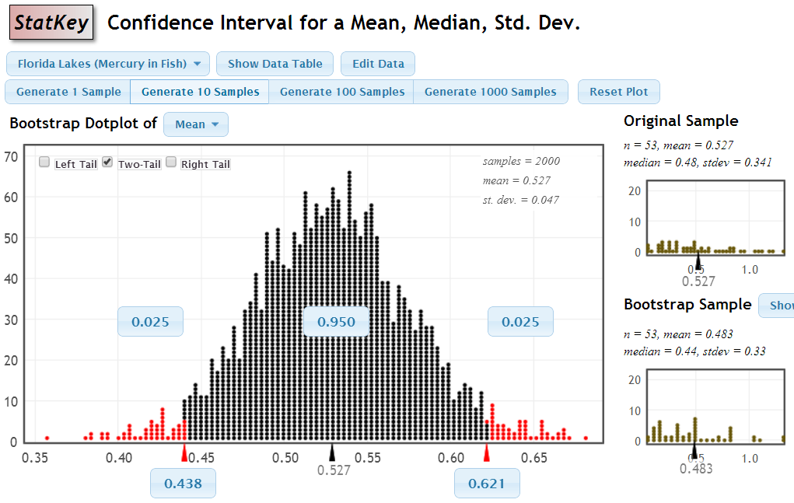
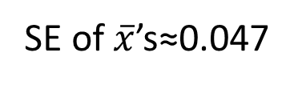
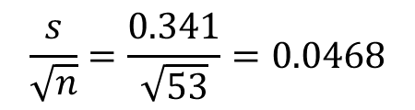
$$\frac{s}{\sqrt{n}}=\frac{0.341}{\sqrt{53}}=0.0468$$
SE of $\overline{x}$’s≈0.047
We are 95% sure that the mean mercury level in Florida lake fish between 0.438 and 0.621 ppm

Slide 11
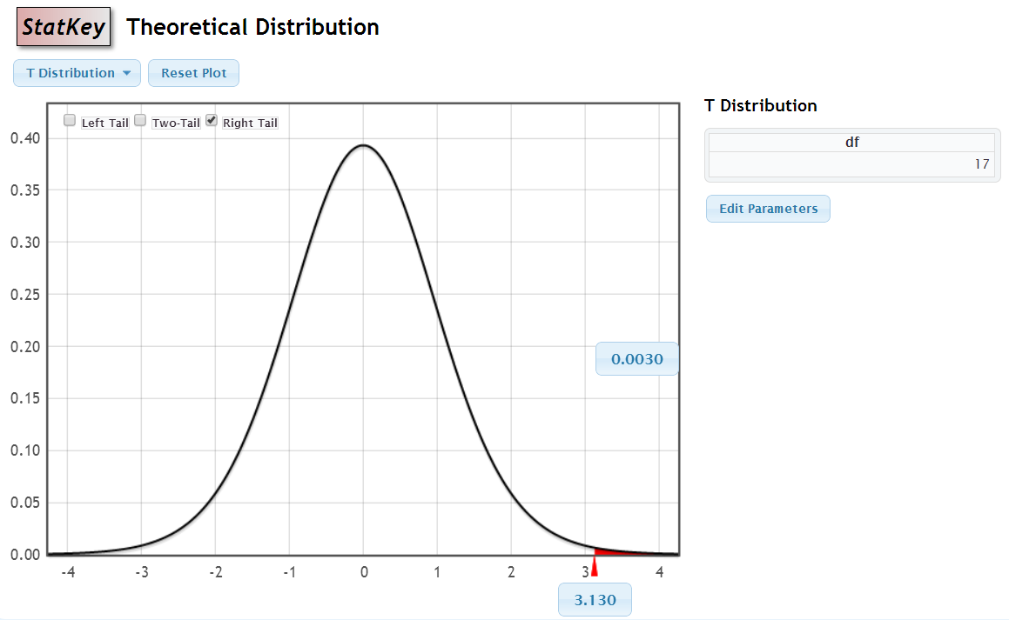
Paper Stat Tables
StatKey

Slide 12
StatKey
lock5stat.com/statkey
Give it a try!
Questions?
rlock@stlawu.edu

