Slide 1
How to Handle Intervals in a Simulation-Based Curriculum?
Robin Lock
Burry Professor of Statistics
St. Lawrence University
2015 Joint Statistics Meetings – Seattle, WA
August 2015

Slide 2

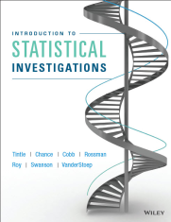
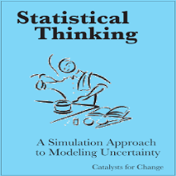
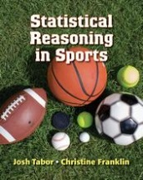
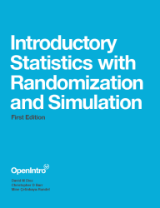
Simulation-Based Inference (SBI) Projects
Lock⁵ lock5stat.com
Tintle, et al math.hope.edu/isi
Catalst www.tc.umn.edu/~catalst
Tabor/Franklin www.highschool.bfwpub.com
Open Intro www.openintro.org

Slide 3

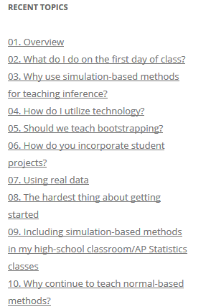
SBI Blog
www.causeweb.org/sbi/
How should we teach about intervals when using simulation-based inference?

Slide 4
Assumptions
1. We agree with George Cobb (TISE 2007):
“Randomization-based inference makes a direct connection between data production and the logic of inference that deserves to be at the core of every introductory course.”
2. Statistical inference has two main components:
Estimation (confidence interval)
Hypothesis test (p-value)

Slide 5
Assumptions
3. For a randomized experiment to compare two groups:
Hypothesis test via simulation?
⇒ Randomization (permutation) test
3. For a parameter based on a single sample:
Confidence interval via simulation?
⇒ ???

Slide 6
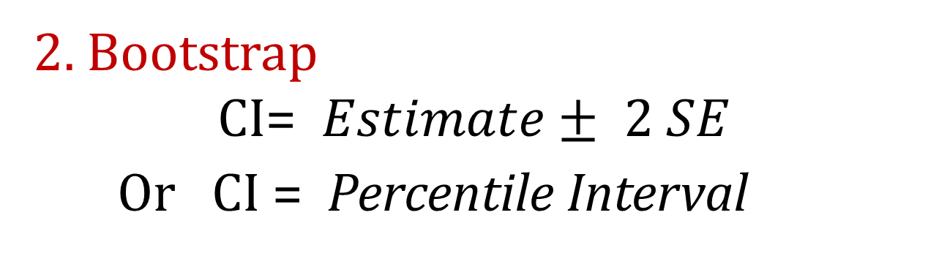
CI: Potential Initial Approaches
1. Invert hypothesis tests
CI =plausible parameter values that would not be rejected
2. Bootstrap
CI=$Estimate± 2 SE$
Or CI = Percentile Interval
3. Traditional formulas

Slide 7

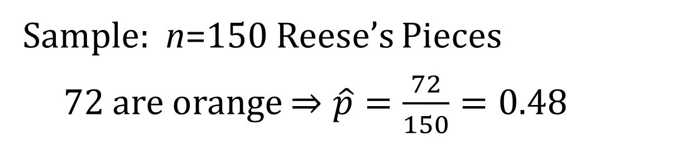
Example: Proportion of Orange Reese’s Pieces
Sample: n=150 Reese’s Pieces
72 are orange $⇒\hat{p}=\frac{72}{150}=0.48$
Key question: How accurate is a proportion estimated from 150 Reese’s pieces?

Slide 8
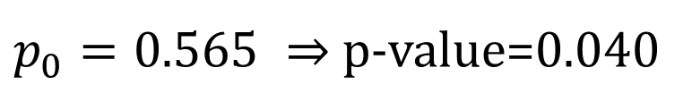
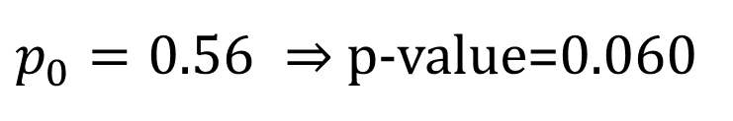
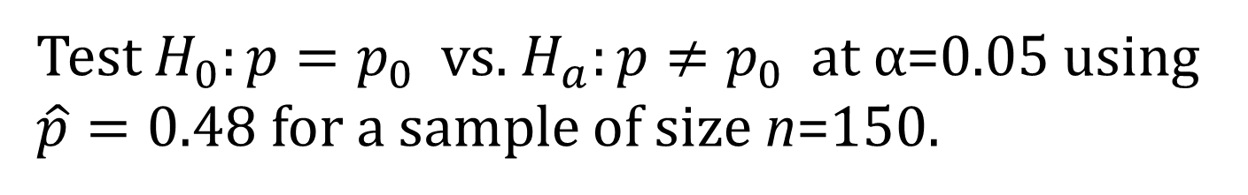
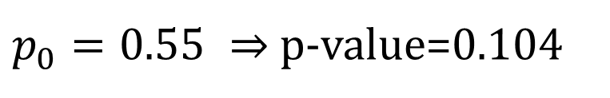
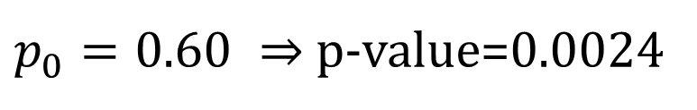
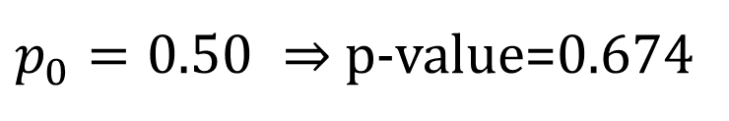
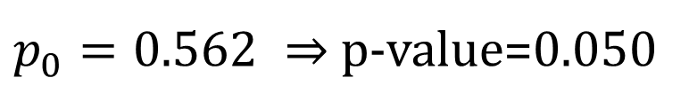
Invert the Test
Test $H_{0}:p=p_{0}$ vs. $H_{a}:p≠p_{0}$ at α=0.05 using $\hat{p}=0.48$ for a sample of size n=150.
Say $p_{0}$ is in the 95% CI for p ⇔ $H_{0}$is not rejected.
Guess/check:
$p_{0}=0.50 ⇒$ p-value=0.674
☺
95% CI for p
( , 0.562)
$p_{0}=0.60 ⇒$ p-value=0.0024
☹
$p_{0}=0.55 ⇒$ p-value=0.104
☺
Repeat for the lower tail or use symmetry
$p_{0}=0.56 ⇒$ p-value=0.060
☺
$p_{0}=0.565 ⇒$ p-value=0.040
☹
$p_{0}=0.562 ⇒$ p-value=0.050
☺

Slide 9
Invert the Test
Pros:
Reinforces ideas from hypothesis tests
Makes connection with CI as “plausible” values for the parameter
Cons:
Tedious (especially with randomization tests)-even with technology
Harder to make a direct connection with variability (SE) of the sample statistic
Requires tests first
How do we do a CI for a single mean?

Slide 10
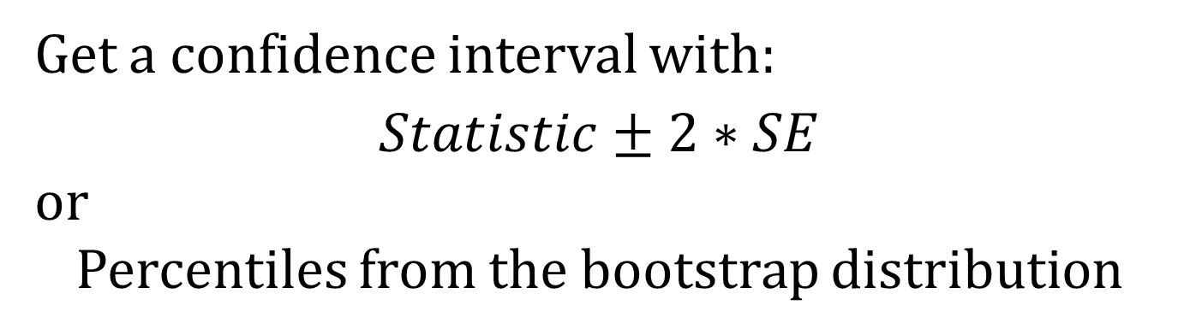
Bootstrap
Basic idea:
Sample (with replacement) from the original sample
Compute the statistic for each bootstrap sample
Repeat 1000’s of times to get bootstrap distribution
Estimate the SE of the statistic
Get a confidence interval with:
$$Statistic±2∗SE$$
or
Percentiles from the bootstrap distribution

Slide 11
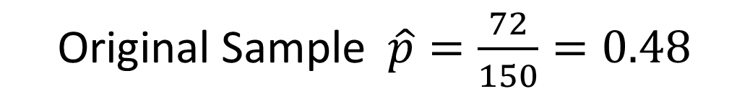
Simulated Reese’s Population
Notes:
Patti

Slide 12
BootstrapSample
Bootstrap Statistic
BootstrapSample
Bootstrap Statistic
Original Sample
Bootstrap Distribution
●
●
●
Many times
●
●
●
Sample Statistic
We need technology!
BootstrapSample
Bootstrap Statistic
Notes:
Patti

Slide 13
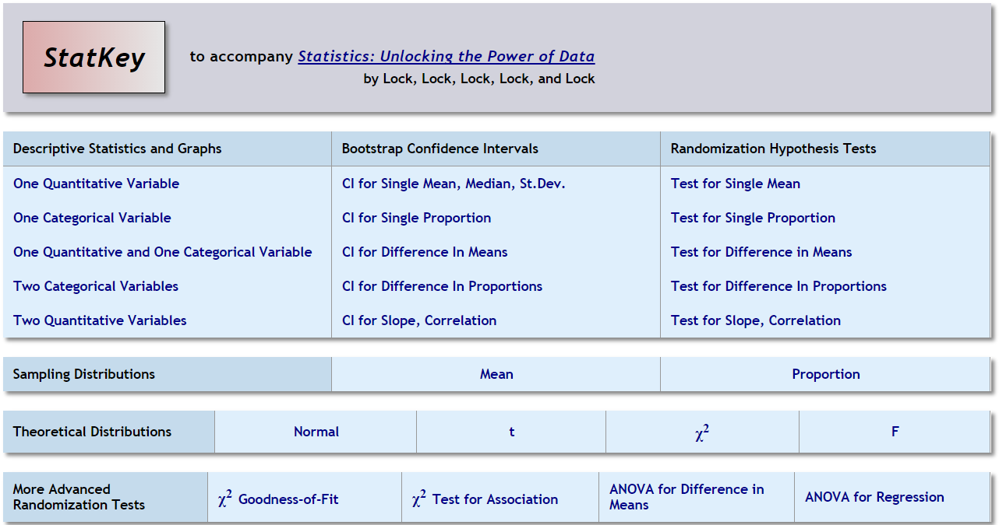
StatKey http://lock5stat.com/statkey

Slide 14
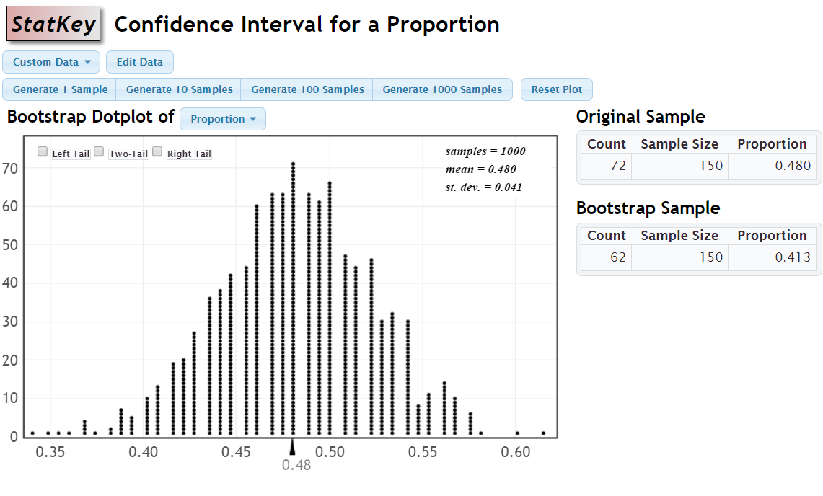
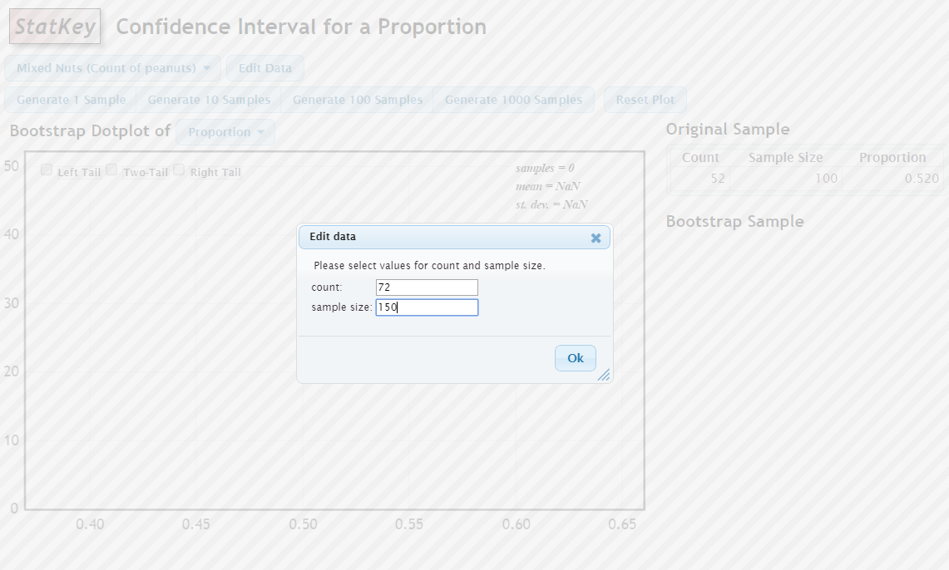
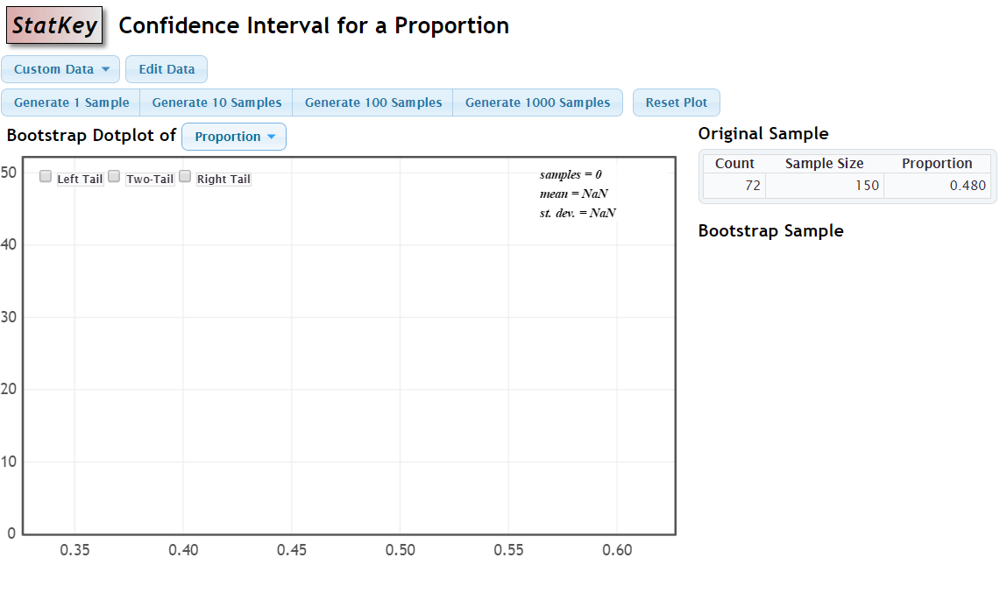
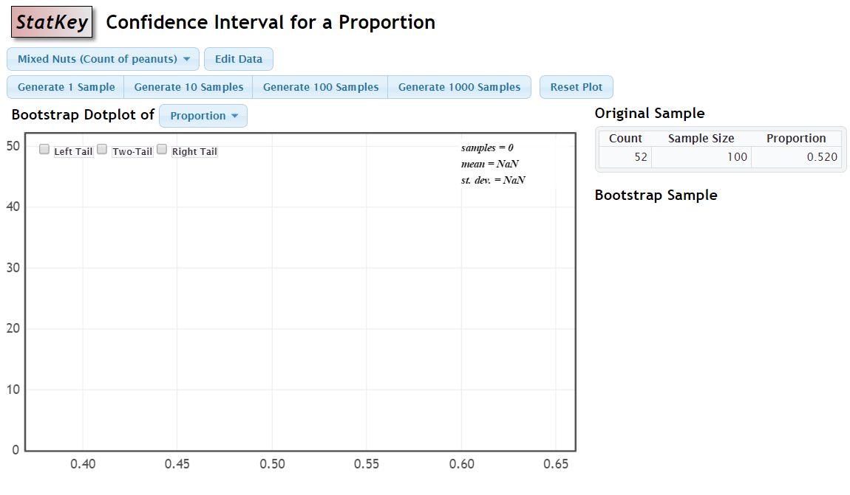
StatKey http://lock5stat.com/statkey

Slide 15
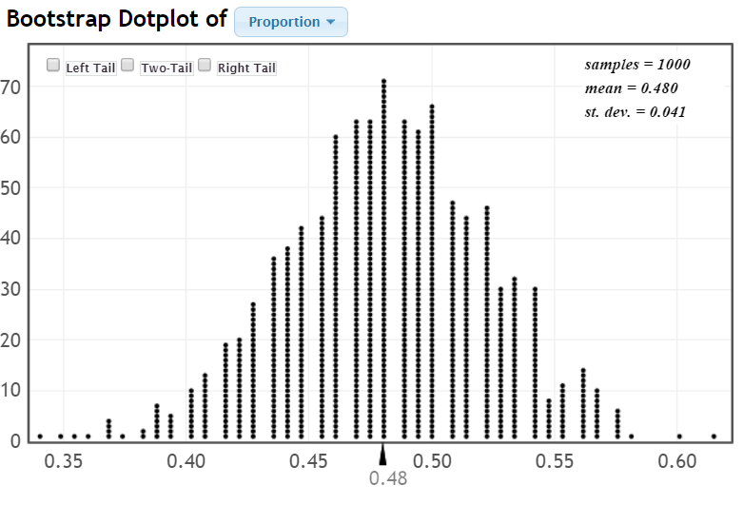
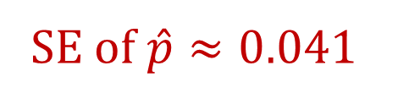
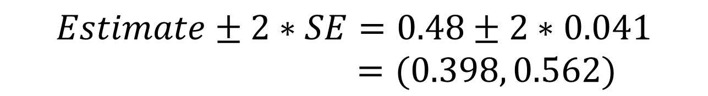
SE of $\hat{p}≈0.041$
$$Estimate±2∗SE=0.48±2∗0.041$$
$=(0.398, 0.562)$

Slide 16
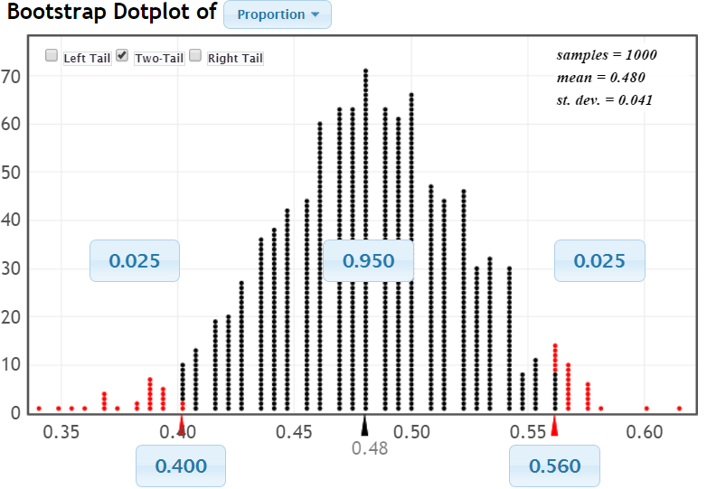
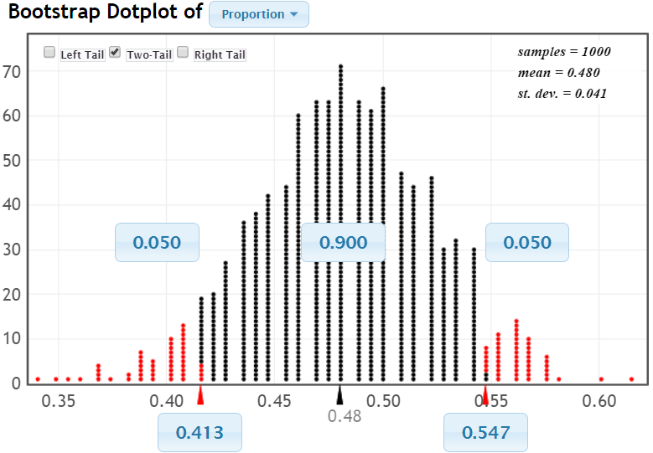
SE of $\hat{p}≈0.041$
$$Estimate±2∗SE=0.48±2∗0.041$$
$=(0.398, 0.562)$

Slide 17
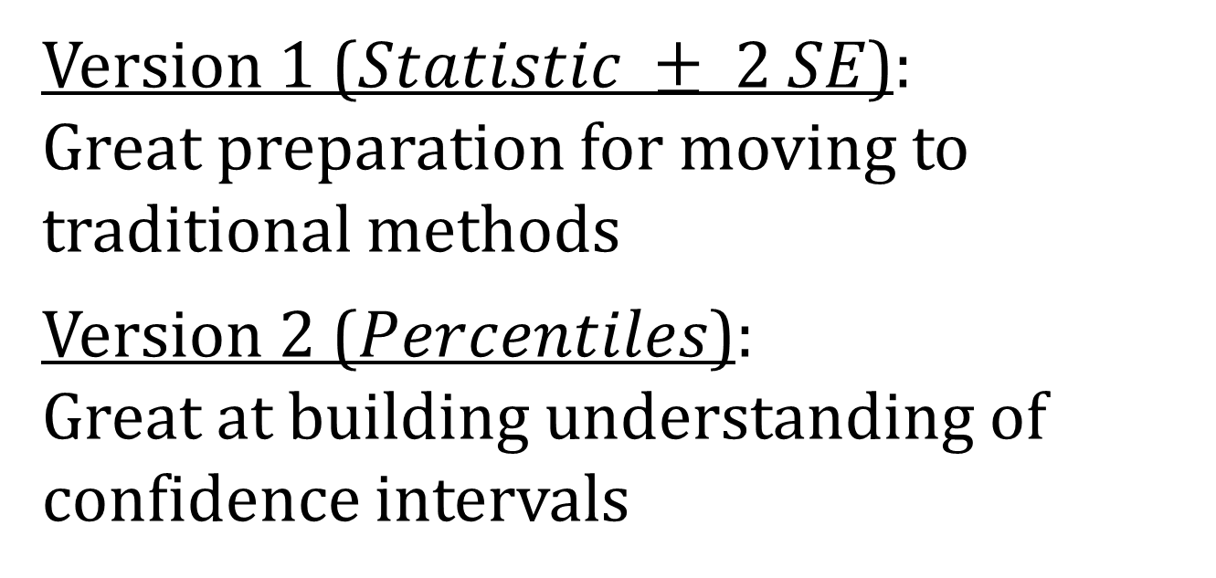
Bootstrap Confidence Intervals
Version 1 ($Statistic ± 2 SE$):
Great preparation for moving to
traditional methods
Version 2 ($Percentiles$):
Great at building understanding of
confidence intervals
Same process used for different parameters
Notes:
Rups

Slide 18
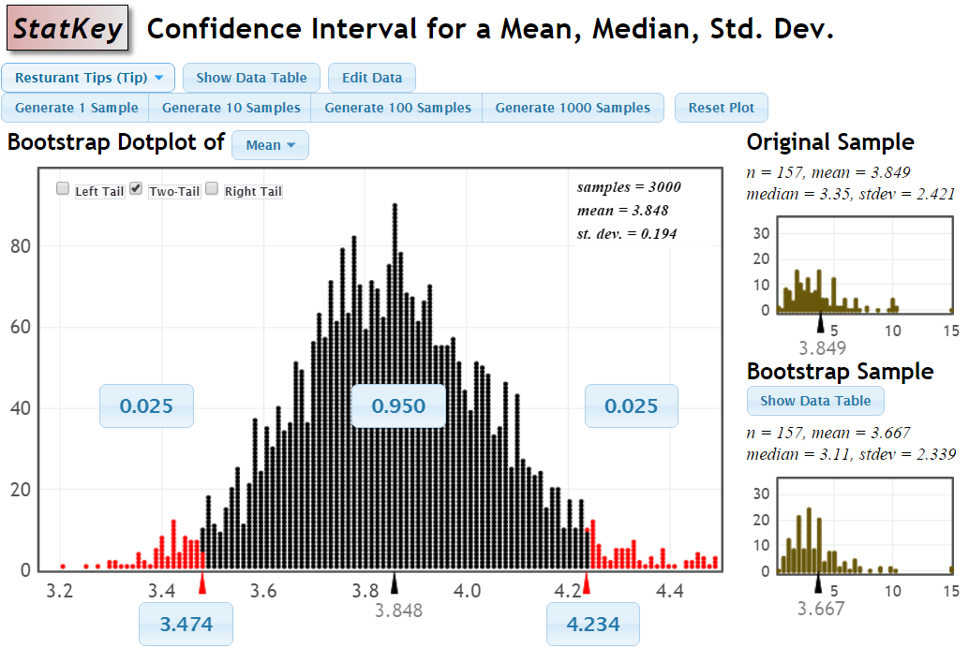
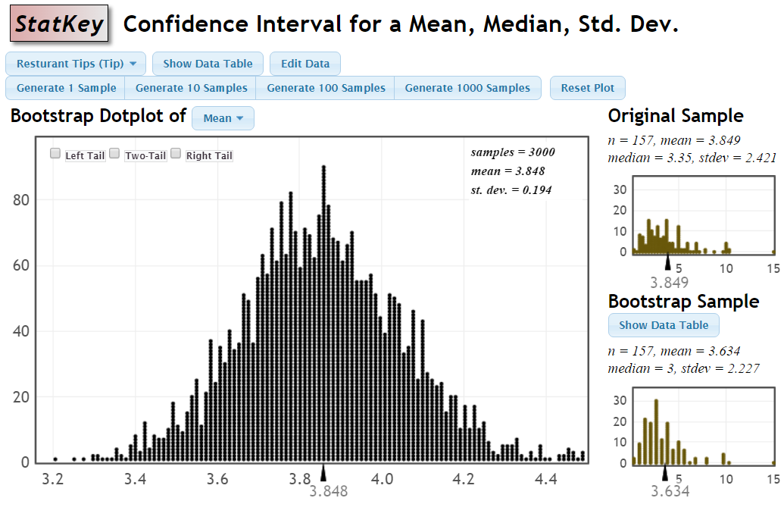
$$3.849±2⋅0.194=3.85±0.388=(3.46, 4.24)$$

Slide 19
Why
does the bootstrap work?

Slide 20
Sampling Distribution
Population
BUT, in practice we don’t see the “tree” or all of the “seeds” – we only have ONE seed
µ
Notes:
Robin

Slide 21

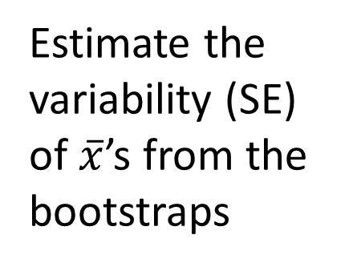
Bootstrap Distribution
What can we do with just one seed?
Estimate the variability (SE) of $\overline{x}$’s from the bootstraps
Bootstrap
“Population”
Grow a NEW tree!
$$\overline{x}$$
µ
Chris Wild: Use the bootstrap errors that we CAN see to estimate the sampling errors that we CAN’T see.
Notes:
Robin

Slide 22
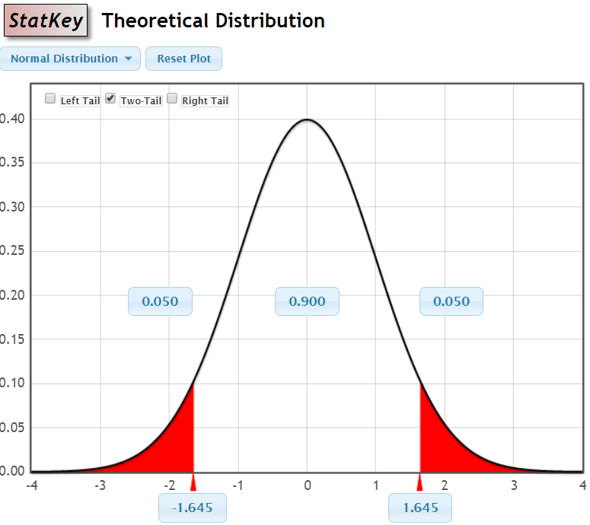

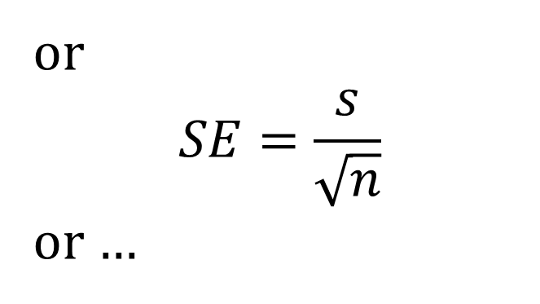
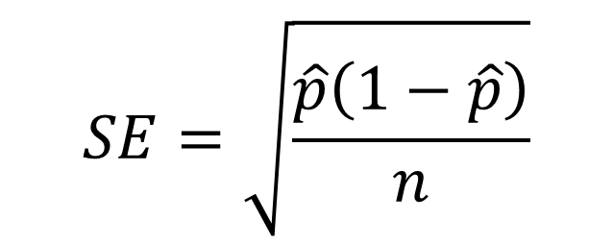
Transition to Traditional Formulas
$$Statistic±2∗SE$$
Use z* or t*
$$SE=\sqrt{\frac{\hat{p}\left(1−\hat{p}\right)}{n}}$$
or
$$SE=\frac{s}{\sqrt{n}}$$
or …

Slide 23
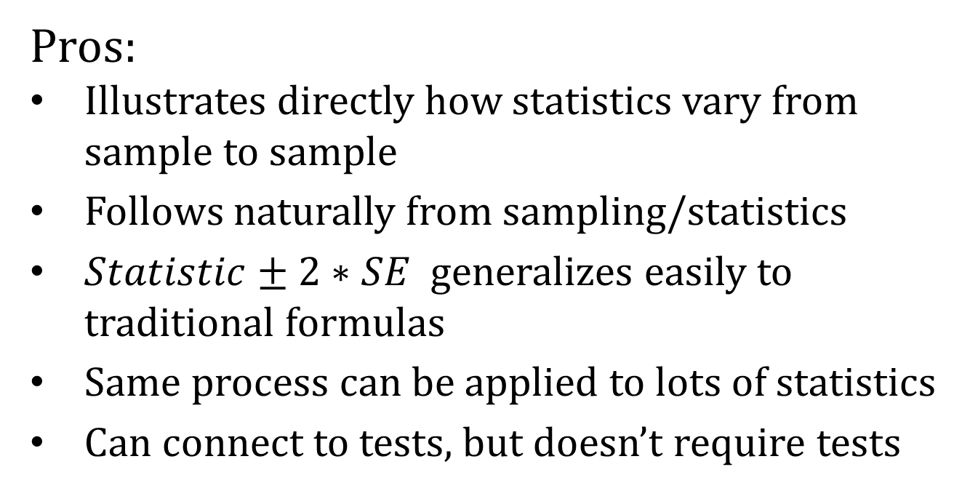
Bootstrap
Pros:
Illustrates directly how statistics vary from sample to sample
Follows naturally from sampling/statistics
$Statistic±2∗SE$ generalizes easily to traditional formulas
Same process can be applied to lots of statistics
Can connect to tests, but doesn’t require tests
Cons:
Requires software
Tedious to demonstrate “by hand”
Doesn’t always “work”

Slide 24
Want to Know More?
What Teachers Should Know about the Bootstrap: Resampling in the Undergraduate Statistics Curriculum
Tim Hesterberg
http://arxiv.org/abs/1411.5279
Thanks for listening
rlock@stlawu.edu

