Slide 1
What’s Changed in How My Students Find (and Think About) P-values
Robin Lock
St. Lawrence University
USCOTS 2013 - Opening Session

Slide 2
A Historical Comparison
Traditional: p-value in the year 10 BC*
vs.
Modern: p-value today
*BC = Before Cobb

Slide 3
Example: Beer and Mosquitoes
Does consuming beer attract mosquitoes?
Experiment*:
Volunteer were randomly assigned to drink a liter of either beer or water
Mosquitoes were caught in traps as they approached the volunteers.
 | n | mean | std. dev.
Beer | 25 | 23.60 | 4.1
Water | 18 | 19.22 | 3.7
H₀: μ_{B}=μ_{W}
H₀: μ_{B}>μ_{W}
*Lefvre, T., et. al., “Beer Consumption Increases Human Attractiveness to Malaria Mosquitoes, ” PLoS ONE, 2010; 5(3): e9546.

Slide 4
Traditional p-value
1. Pick a formula
$$t=\frac{{\overline{x}}_{B}−{\overline{x}}_{W}}{\sqrt{\frac{s_{B}^{2}}{n_{B}}+\frac{s_{W}^{2}}{n_{W}}}}$$
2. Plug & Chug
$$t=\frac{23.6−19.22}{\sqrt{\frac{{4.1}^{2}}{25}+\frac{{3.7}_{}^{2}}{18}}}=3.68$$
3. Pick a reference distribution
Where is my t-table?

Slide 5
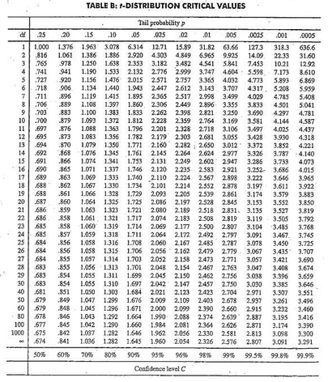
0.0005 < p-value < 0.001
d.f.
t=3.68

Slide 6
Oops! I forgot to check conditions...
Sample sizes are both less than 30, is the t-distribution even appropriate?
What if the data are heavily skewed?
...and, by the way, how does this method connect to the definition of a p-value?

Slide 7
p-value
The p-value is the proportion of samples, when H₀ is true, that would give results as (or more) extreme as the original sample.

Slide 8
Simulation Approach
“when H₀ is true” ⇒ It doesn’t matter whether the subject drank beer or water
Create randomization samples (under H₀) by randomly re-assigning the beer/water labels to the 43 mosquito counts.
Find the difference, ${\overline{x}}_{B}−{\overline{x}}_{W}$, for each sample.

Slide 9
Physical Simulation
Put the 43 mosquito counts on cards.
Shuffle and deal cards into two piles (25 beer and 18 water).
Compute the difference in means.
Repeat MANY times.

Slide 10
We Need Some Technology!
StatKey
www.lock5stat.com/statkey

Slide 11
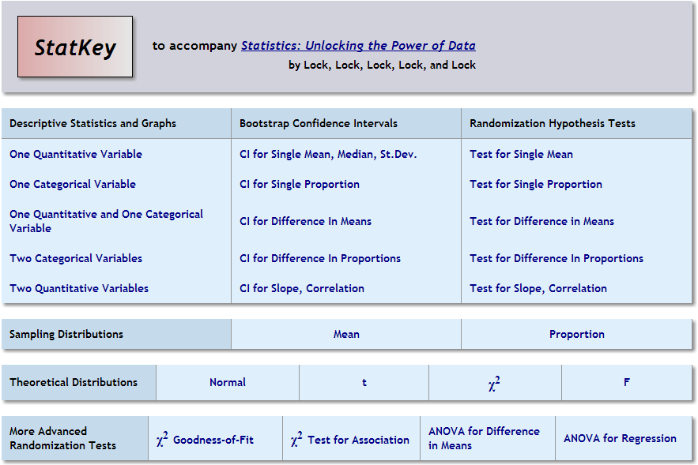

Slide 12
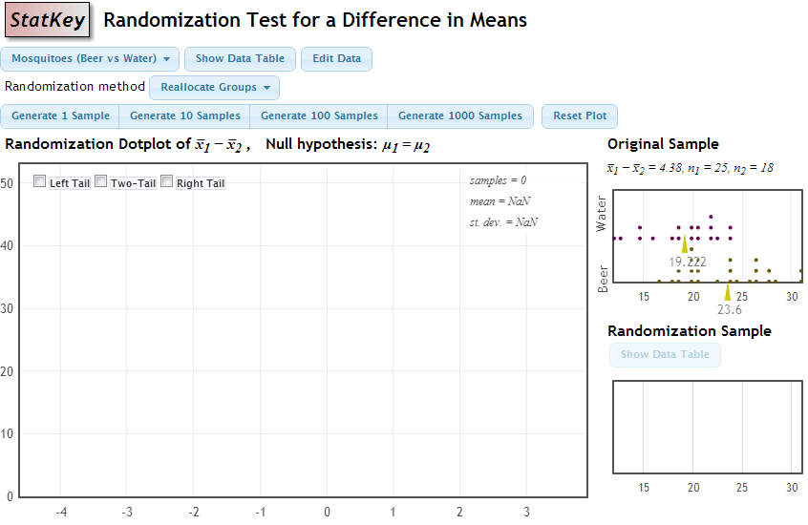

Slide 13
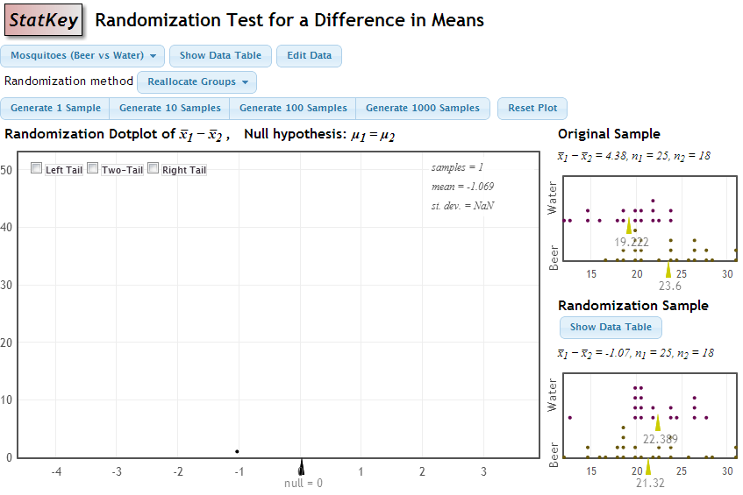

Slide 14
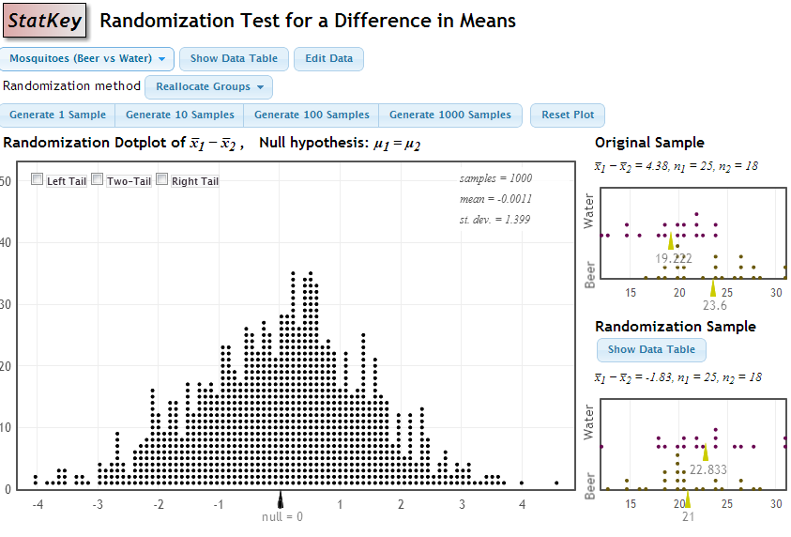

Slide 15
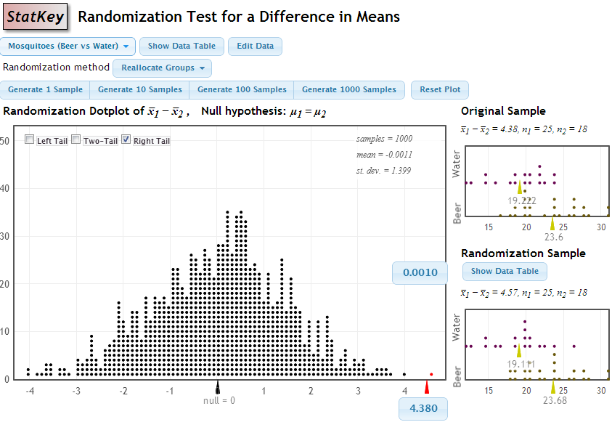
“as extreme as the original sample”

Slide 16
Background Required
Random shuffle
Compute sample means
Dotplot
Find a proportion by counting

Slide 17
Questions?
What about other parameters or different hypotheses?
What about checking conditions?
What about confidence intervals?
What was that address for StatKey?

Slide 18
www.lock5stat.com/statkey

Slide 19
p-value = proportion of samples, when H₀ is true, that are as (or more) extreme as the original sample.

Slide 20
p-value = proportion of samples, when H₀ is true, that are as (or more) extreme as the original sample.
p-value

