Slide 1
Bootstraps and Scrambles: Letting Data Speak for Themselves
Robin H. Lock
Burry Professor of Statistics
St. Lawrence University
rlock@stlawu.edu
Science Today
SUNY Oswego, March 31, 2010

Slide 2
Bootstrap CI’s & Randomization Tests
(1) What are they?
(2) Why are they being used more?
(3) Can these methods be used to introduce students to key ideas of statistical inference?

Slide 3
Example #1: Perch Weights
Suppose that we have collected a sample of 56 perch from a lake in Finland.
Estimate and find 95% confidence bounds for the mean weight of perch in the lake.
From the sample:
n=56 X=382.2 gms s=347.6 gms

Slide 4
Classical CI for a Mean (μ)
“Assume” population is normal, then
➔
For perch sample:
(289.1, 475.3)

Slide 5
Possible Pitfalls
What if the underlying population is NOT normal?
What if the sample size is small?
What is you have a different sample statistic?
What if the Central Limit Theorem doesn’t apply? (or you’ve never heard of it!)

Slide 6
Bootstrap
Basic idea: Simulate the sampling distribution of any statistic (like the mean) by repeatedly sampling from the original data.
Bootstrap distribution of perch means:
Sample 56 values (with replacement) from the original sample.
Compute the mean for bootstrap sample
Repeat MANY times.

Slide 7
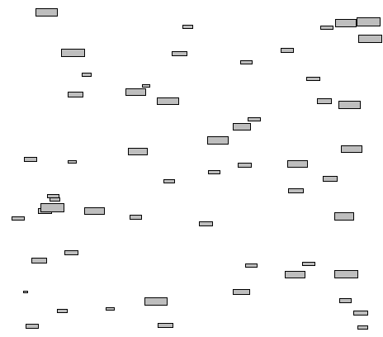
Original Sample (56 fish)

Slide 8

Bootstrap “population”
Sample and compute means from this “population”

Slide 9
Bootstrap Distribution of 1000 Perch Means

Slide 10
CI from Bootstrap Distribution
Method #1: Use bootstrap std. dev.
For 1000 bootstrap perch means: S_{boot}=45.8

Slide 11
CI from Bootstrap Distribution
Method #2: Use bootstrap quantiles
2.5%
2.5%
299.6
95% CI for μ
476.1

Slide 12
Example #2: Friendly Observers
Butler & Baumeister (1998)
Experiment: Subjects were tested for performance on a video game
Conditions:
Group A: An observer shares prize
Group B: Neutral observer
Response: (categorical)
Beat/Fail to Beat score threshold
Hypothesis: Players with an interested observer (Group A) will tend to perform less ably.

Slide 13
A Statistical Experiment
Start with 24 subjects
Divide at random into two groups
Record the data (Beat or No Beat)
Group A: Share
Group A: Share
Group B: Neutral
Group B: Neutral

Slide 14
Friendly Observer Results
 | Group A (share prize) | Group B (prize alone)
Beat Threshold
Failed to Beat Threshold
3
9
8
4
11
13
12 | 12
Is this difference “statistically significant”?

Slide 15
Friendly Observer - Simulation
1. Start with a pack of 24 cards.
11 Black (Beat) and 13 Red (Fail to Beat)
2. Shuffle the cards and deal 12 at random to form Group A.
3. Count the number of Black (Beat) cards in Group A.
4. Repeat many times to see how often a random assignment gives a count as small as the experimental count (3) to Group A.
Automate this

Slide 16
Friendly Observer – Fathom Computer Simulation
48/1000

Slide 17
Automate: Friendly Observers Applet
Allan Rossman & Beth Chance http://www.rossmanchance.com/applets/

Slide 18
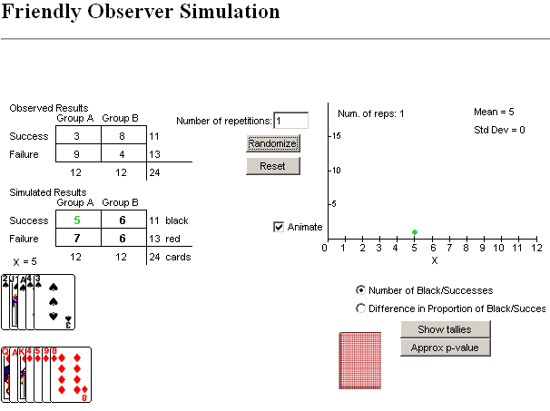
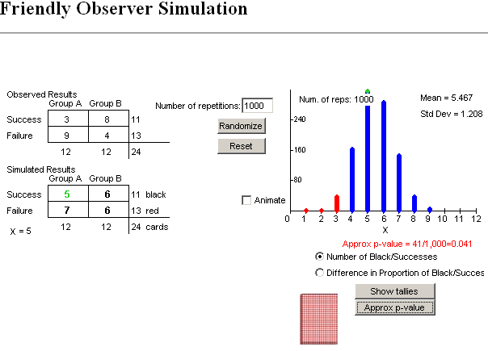
Observer’s Applet

Slide 19
Fisher’s Exact test
P( A Beat < 3)

Slide 20
Example #3: Lake Ontario Trout
X = fish age (yrs.)
Y = % dry mass of eggs
n = 21 fish
r = -0.45
Is there a significant negative association between age and % dry mass of eggs?
H_{o}:ρ=0 vs. H_{a}: ρ<0

Slide 21
Randomization Test for
Correlation
Randomize the PctDM values to be assigned to any of the ages (ρ=0).
Compute the correlation for the randomized sample.
Repeat MANY times.
See how often the randomization correlations exceed the originally observed r=-0.45.

Slide 22
Randomization Distribution of Sample Correlations when H_{o}:ρ=0
26/1000
r=-0.45

Slide 23
Confidence Interval for Correlation?
Construct a bootstrap distribution of correlations for samples of n=20 fish drawn with replacement from the original sample.

Slide 24
Bootstrap Distribution of Sample Correlations
r=-0.74
r=-0.08

Slide 25
Bootstrap/Randomization Methods
Require few (often no) assumptions/conditions on the underlying population distribution.
Avoid needing a theoretical derivation of sampling distribution.
Can be applied readily to lots of different statistics.
Are more intuitively aligned with the logic of statistical inference.

Slide 26
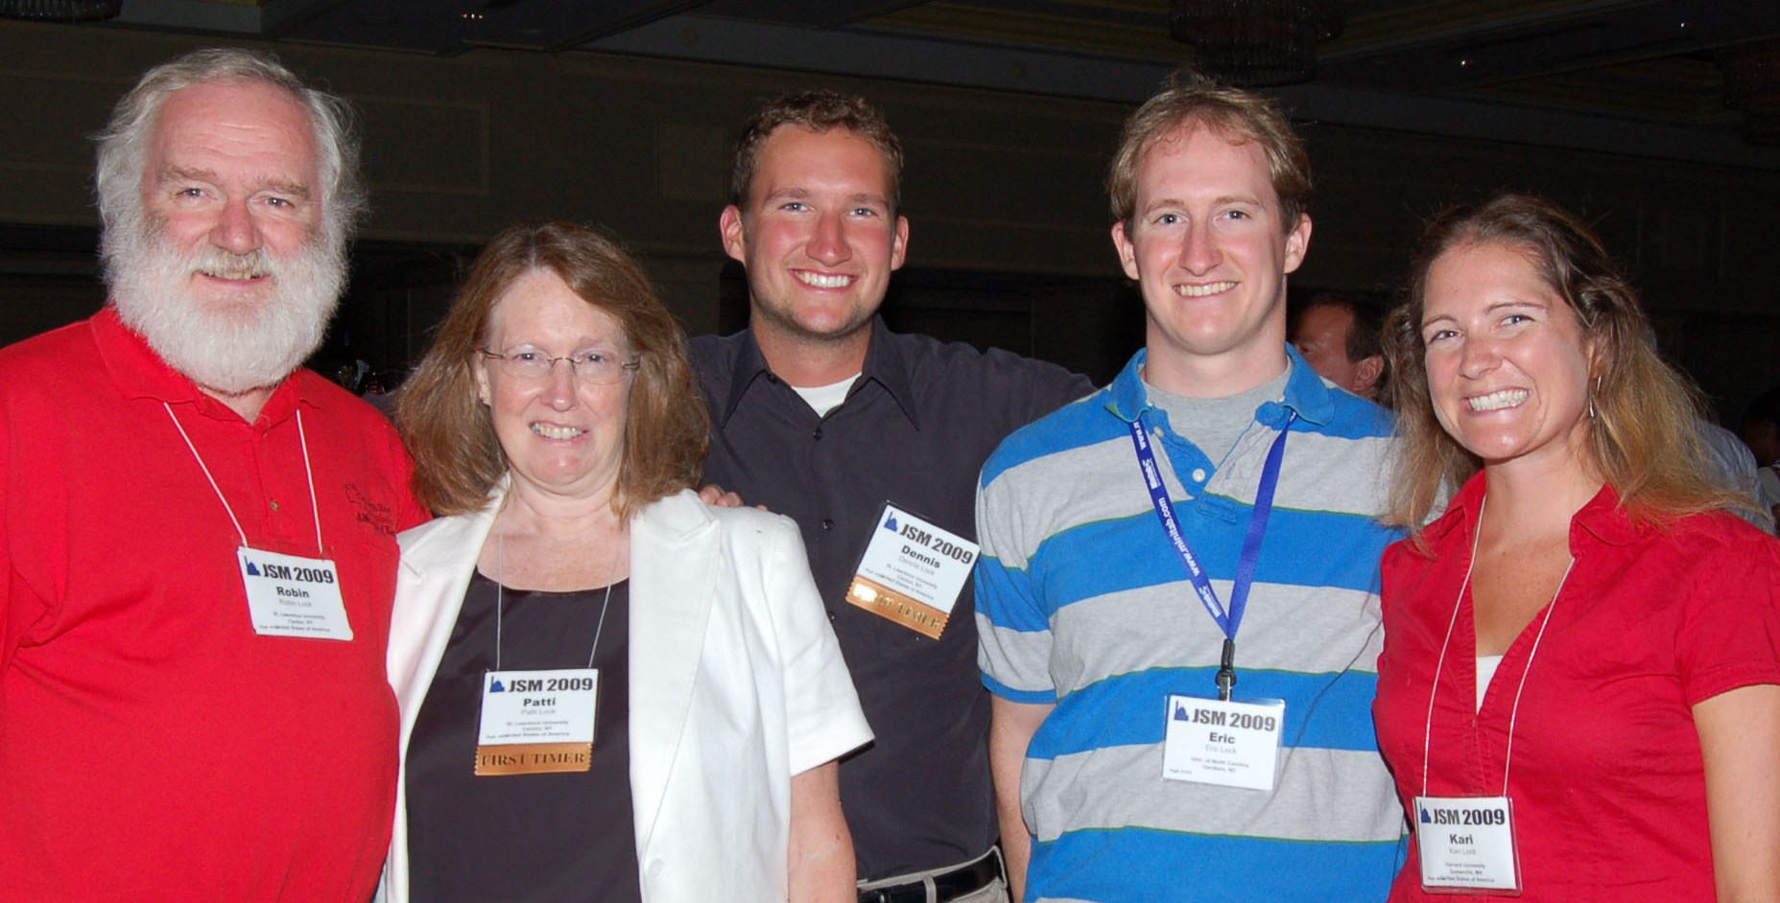
Can these methods really be used to introduce students to the core ideas of statistical inference?
Coming in 2012…
Statistics: Unlocking the Power of Data
by Lock, Lock, Lock, Lock and Lock

