Slide 1
Bootstrap Confidence Intervals
Patti Frazer Lock (plock@stlawu.edu)
Robin Lock (rlock@stlawu.edu)
BAPS at NCTM (Boston)
September 26, 2019
Notes:
Dennis

Slide 2

The Lock⁵ Team
Kari
[Harvard]
Penn State
Eric
[North Carolina]
Minnesota
Dennis
[Iowa State]
Buffalo Bills
Patti & Robin
St. Lawrence

Slide 3
Two Approaches to Inference
Traditional:
Assume some distribution (e.g. normal or t) to describe the behavior of sample statistics
Estimate parameters for that distribution from sample statistics
Calculate the desired quantities from the theoretical distribution
Simulation (SBI):
Generate many samples (by computer) to show the behavior of sample statistics
Calculate the desired quantities from the simulated distribution

Slide 4
Motivation
“... Before computers statisticians had no choice. These days we have no excuse. Randomization-based inference makes a direct connection between data production and the logic of inference that deserves to be at the core of every introductory course.”
-- Professor George Cobb, 2007
(TISE article at http://escholarship.org/uc/item/6hb3k0nz)
Notes:
bozz

Slide 5
Confidence Interval
Find an interval, based on a sample, which is likely to contain a population parameter.
Key question: How far is a sample statistic likely to fall from the population parameter?
Key tool: A sampling distribution looks at values of the statistic for lots of samples.
But can we really take lots of samples in practice???

Slide 6
Confidence Interval
Find an interval, based on a sample, which is likely to contain a population parameter.
Key question: How far is a sample statistic likely to fall from the population parameter?
How can we estimate the variability in a sampling distribution when we only have one sample?

Slide 7

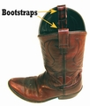
Bootstrapping
Brad Efron Stanford University
Assume the “population” is many, many copies of the original sample.
Key idea: Take many samples with replacement from the original sample using the same n to see how the statistic varies.

Slide 8
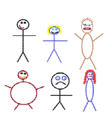
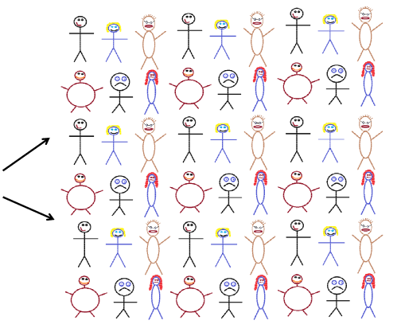




Finding a Bootstrap Sample
Original Sample (n=6)
A simulated “population” to sample from
One bootstrap sample
Notes:
Patti

Slide 9
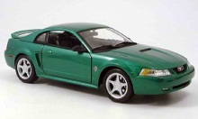
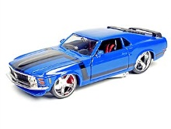
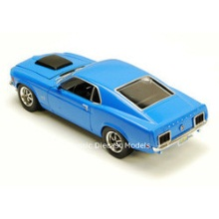
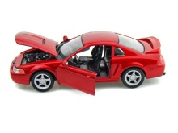
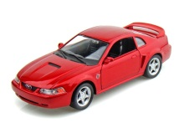
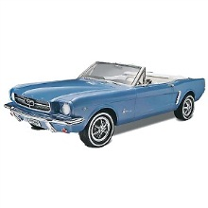
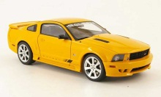
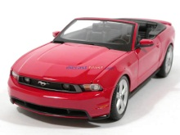
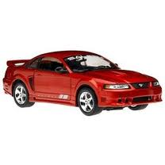
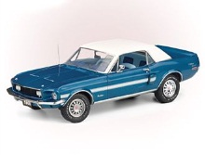
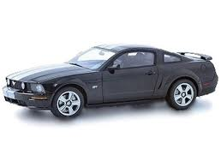
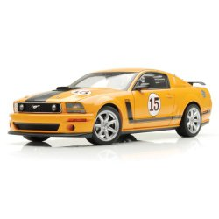
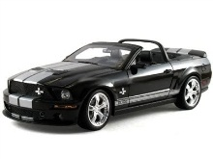
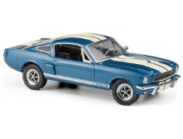
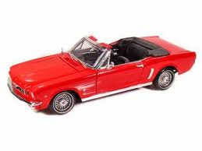

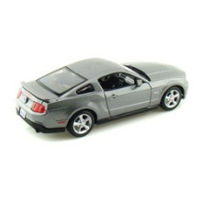
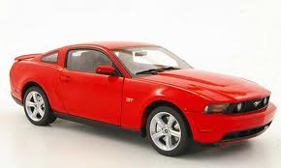
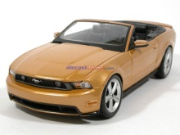
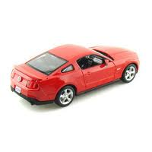
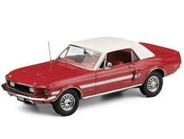
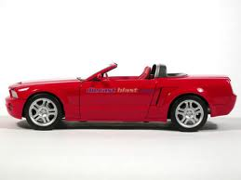
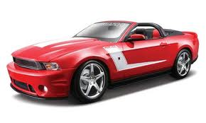
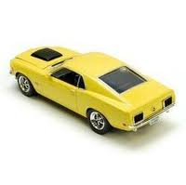
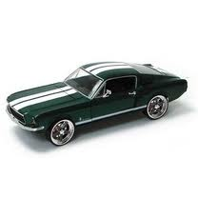

Example 1: Mustang Prices
Start with a random sample of 25 prices (in $1,000’s)
$$n=25 \overline{x}=15.98 s=11.11$$
Goal: Find an interval that is likely to contain the mean price for all Mustangs
Key concept: How much can we expect means for samples of size 25 to vary just by random chance?

Slide 10
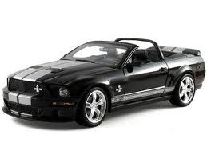


Original Sample
Bootstrap Sample
Repeat 1,000’s of times!
$$\overline{x}=15.98$$
$$\overline{x}=17.51$$
Notes:
Robin

Slide 11
BootstrapSample
Bootstrap Statistic
BootstrapSample
Bootstrap Statistic
Original Sample
Bootstrap Distribution
We need technology!
●
●
●
Many times
●
●
●
Sample Statistic
BootstrapSample
Bootstrap Statistic
Notes:
Patti

Slide 12
StatKey
www.lock5stat.com/statkey
Freely available web apps with no login required
Runs in (almost) any browser (incl. smartphones/tablets)
Google Chrome App available (no internet needed)
Designed by the Lock⁵ team with coding support from Ed Harcourt, Kevin Angstadt, Yuxi Zhang, and Richard Sharp
Notes:
Patti

Slide 13
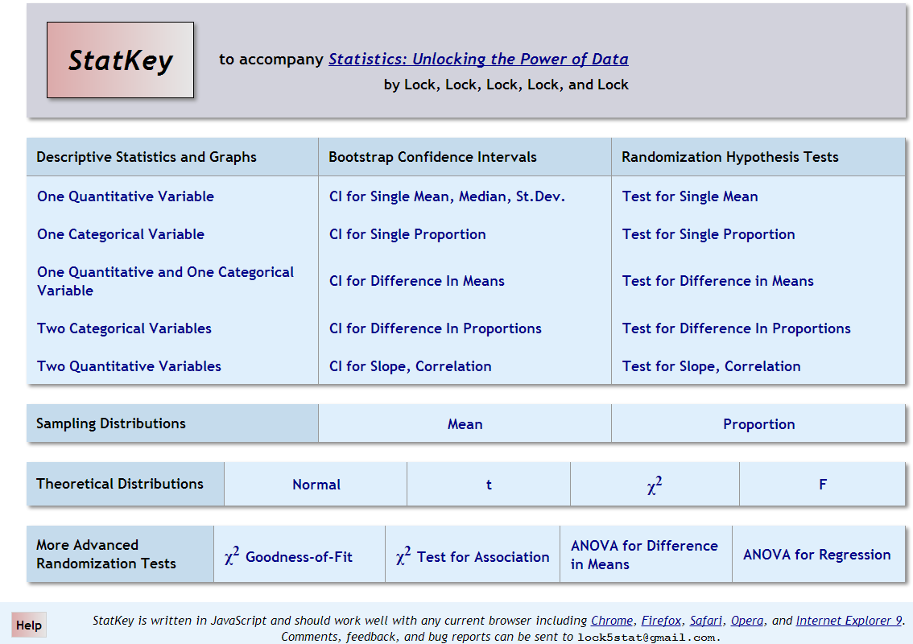
lock5stat.com/statkey

Slide 14
lock5stat.com/statkey

Slide 15
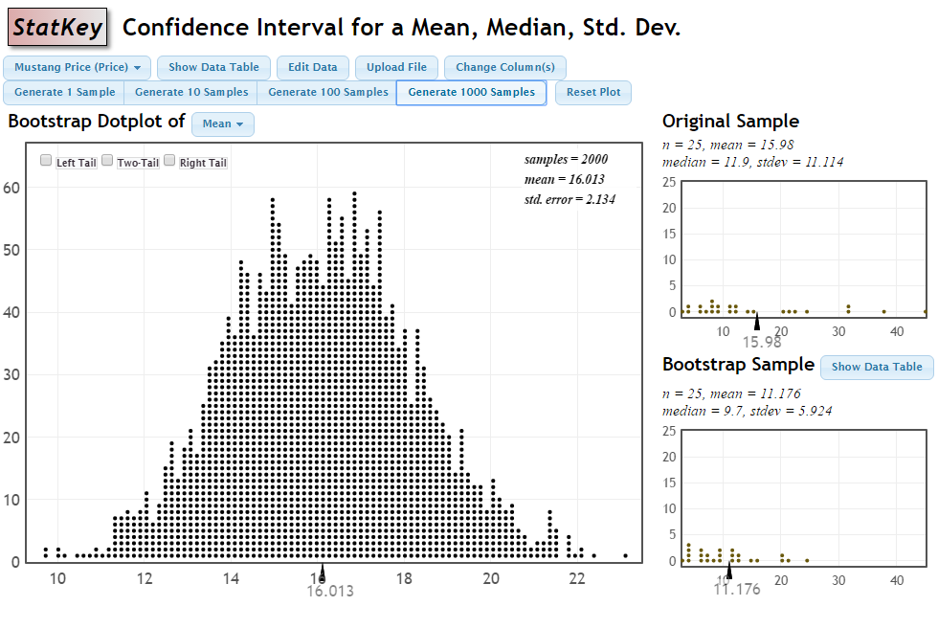
Bootstrap Distribution for Mustang Price Means

Slide 16
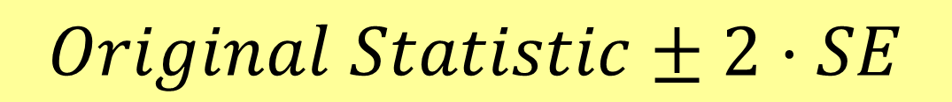
How do we get a CI from the bootstrap distribution?
Method #1: Standard Error
Find the standard error (SE) as the standard deviation of the bootstrap statistics
Find an interval with
$$Original Statistic±2⋅SE$$

Slide 17
Original Statistic
Standard Error
$Statistic ±2·SE=15.98±2∙\left(2.134\right)=(11.71, 20.25$)

Slide 18
How do we get a CI from the bootstrap distribution?
Method #1: Standard Error
Find the standard error (SE) as the standard deviation of the bootstrap statistics
Find an interval with
$$Original Statistic±2⋅SE$$
Method #2: Percentile Interval
For a 95% interval, find the endpoints that leave 95% in the middle

Slide 19
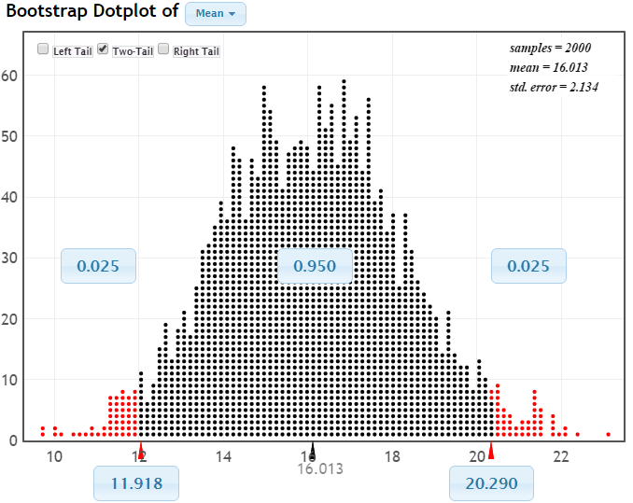
95% CI via Percentiles
Chop 2.5% in each tail
Keep 95% in middle
Chop 2.5% in each tail
We are 95% sure that the mean price for Mustangs is between $11,918 and $20,290

Slide 20
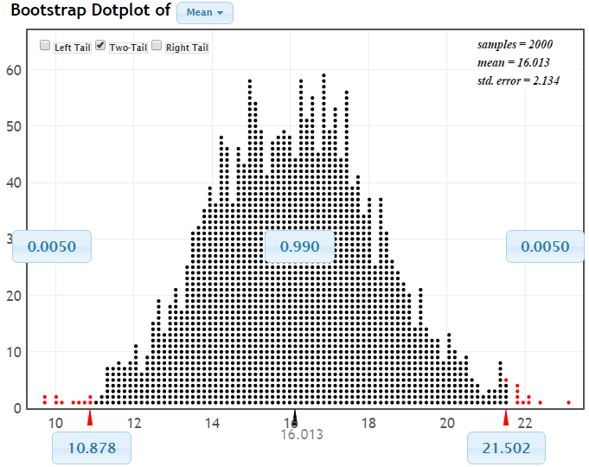
99% CI via Percentiles
Keep 99% in middle
Chop 0.5% in each tail
Chop 0.5% in each tail
We are 99% sure that the mean price for Mustangs is between $10,878 and $21,502

Slide 21
Bootstrap Confidence Intervals
Version 1 (Statistic ± 2 SE):
Great preparation for moving to
traditional methods
Version 2 (Percentiles):
Great at building understanding of
confidence level
Same process works for different parameters

Slide 22
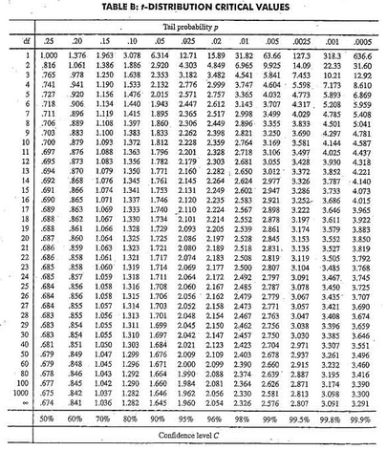
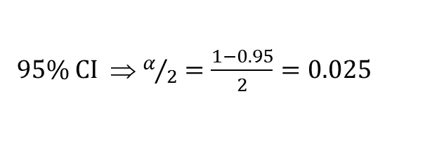

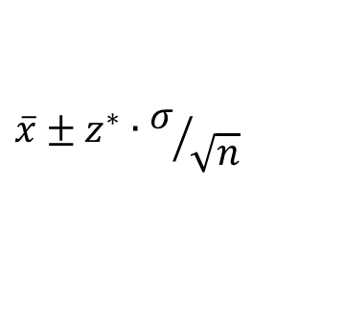
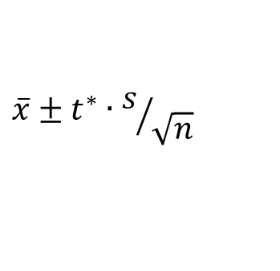
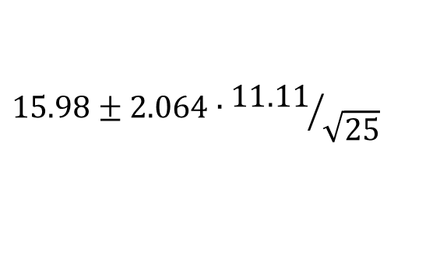

Traditional CI Inference
1. Check conditions
CI for a mean
2. Which formula?
$$\overline{x}±z^{∗}∙σ/{\sqrt{n}}$$
OR
$$\overline{x}±t^{∗}∙s/{\sqrt{n}}$$
3. Calculate summary stats
$n=25, \overline{x}=15.98$, $s=11.11$
4. Find t*
5. df?
95% CI ⇒ $α/2=\frac{1−0.95}{2}=0.025$
df=25$−$1=24
t*=2.064
6. Plug and chug
$$15.98±2.064∙{11.11}/{\sqrt{25}}$$
$$15.98±4.59=(11.39, 20.57)$$
7. Interpret in context

Slide 23

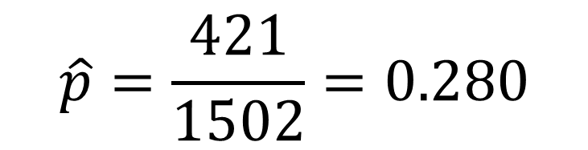
Example #2: What proportion of US adults are online “almost constantly”?
A sample of n=1502 US adults contains 421 who say they are “almost constantly” online.
$$\hat{p}=\frac{421}{1502}=0.280$$
How accurate is that sample proportion?
Find a 95% confidence interval for the proportion of all US adults who say they are “almost constantly” online.
Perrin A and Kumar M, “About three-in-ten U.S. adults say they are ‘almost constantly’ online,” pewresearch.org, July 25, 2019.

Slide 24
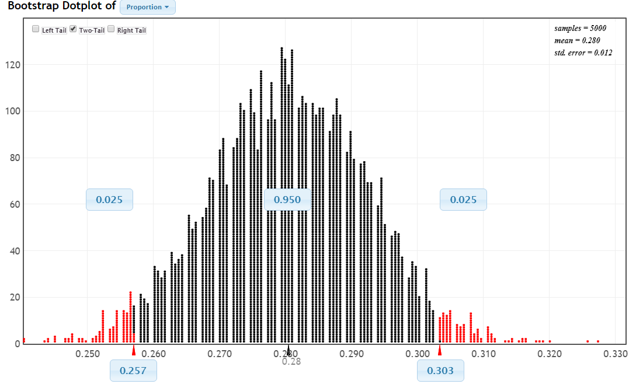
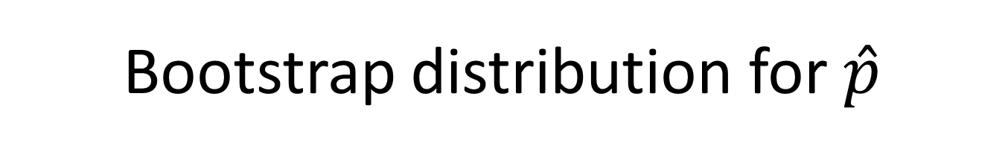



Bootstrap distribution for $\hat{p}$
$$0.280±2∗0.012$$
$$0.280±0.024$$
$$0.256 \text{to} 0.304$$
We are 95% sure that the proportion of US adults who say they are almost constantly online is between 0.257 and 0.303.

Slide 25
Example #3: What is the gender gap for salaries?
Data: Salaries for 217 females and 214 males from the 2010 American Community Survey (ACS).
$${\overline{x}}_{f}−{\overline{x}}_{m}=32.16−50.96=−18.80$$
Find a 90% confidence interval for the mean salary gap between females and males.
Take separate bootstrap samples from female and males, then compute the difference in means.

Slide 26
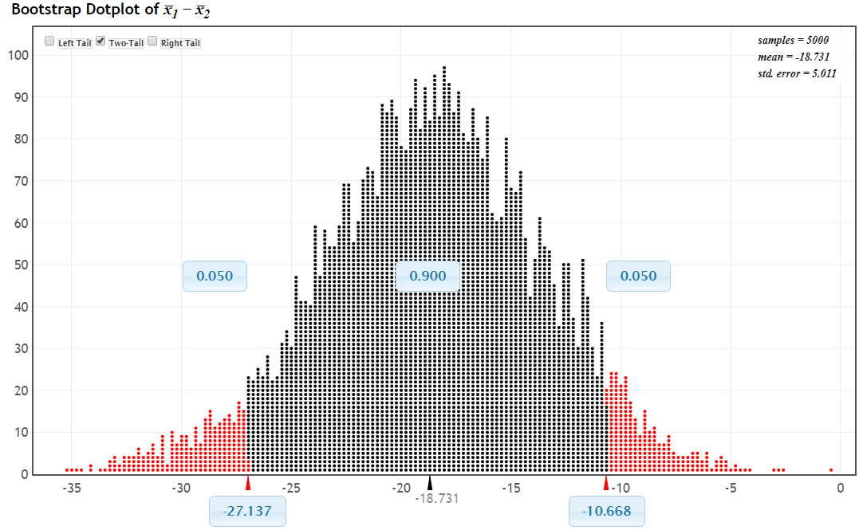
Bootstrap Distribution of Difference in Two Means
We are 90% sure that employed females in the US average between $27,137 and $10,668 less in annual salary than males.

Slide 27
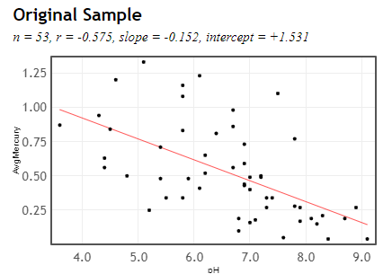
Example #4: Correlation between pH and mercury in Florida lakes
Data: Water samples (to measure pH) and mercury levels in fish (ppm) for 53 lakes in Florida.
Find a 95% confidence interval for the correlation between pH and mercury for all Florida lakes.

Slide 28
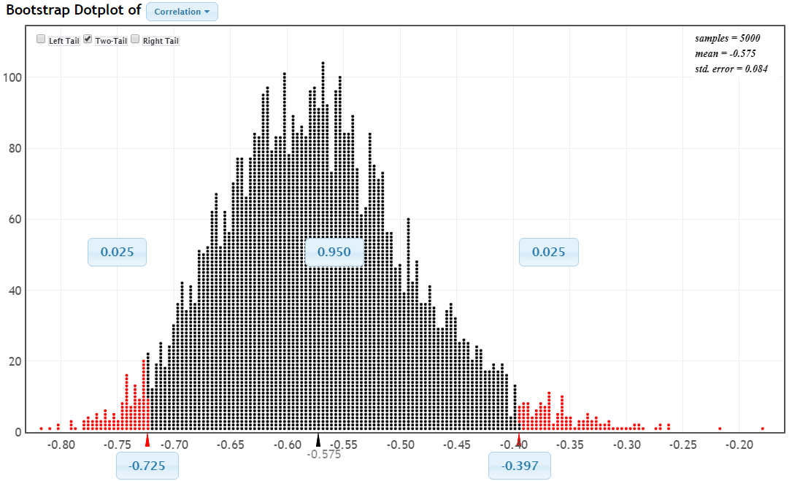
Bootstrap Distribution of Correlation
We are 95% sure that the correlation between pH and mercury levels in fish for all Florida lakes is between -0.725 and -0.397.

Slide 29
Why
does the bootstrap work?

Slide 30
Sampling Distribution
Population
BUT, in practice we don’t see the “tree” or all of the “seeds” – we only have ONE seed
µ
Notes:
Robin

Slide 31

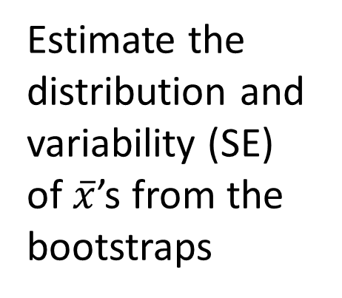
Bootstrap Distribution
What can we do with just one seed?
Estimate the distribution and variability (SE) of $\overline{x}$’s from the bootstraps
Bootstrap
“Population”
Grow a NEW tree!
$$\overline{x}$$
µ
Use the bootstrap errors that we CAN see to estimate the sampling errors that we CAN’T see.
Notes:
Robin

Slide 32
Golden Rule of Bootstraps
The bootstrap statistics are to the original statistic
as
the original statistic is to the population parameter.

Slide 33
Read More About Bootstrapping?
What Teachers Should Know About the Bootstrap: Resampling in the Undergraduate Statistics Curriculum
Tim Hesterberg (Google)
in December 2015 American Statistician
Or find another version at
https://arxiv.org/abs/1411.5279

Slide 34
Help Explaining Confidence Intervals?

Slide 35
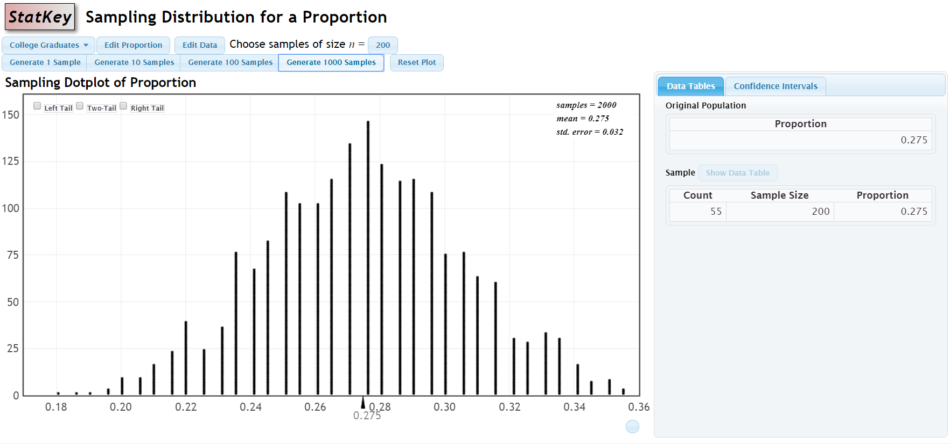
Help Explaining Confidence Intervals?

Slide 36
Questions or
Comments?
Patti Frazer Lock (plock@stlawu.edu)
Robin Lock (rlock@stlawu.edu)
lock5stat.com
Notes:
Dennis

