Slide 1
Math and Social Justice:
Some Great Class Activities
Patti Frazer Lock
Cummings Professor of Mathematics
St. Lawrence University
Canton, New York
Joint Mathematics Meetings
January 2020

Slide 2
Math and Social Justice: Senior Seminar
Spring semester, 2019
Math and Social Justice: Sophomore Seminar
To be taught: Spring Semester 2020
The specific activities for today:
One Module: First Year Program
Multiple times

Slide 3
Math and Social Justice:
Senior Seminar
First half: Topics in Math and Social Justice
Second half: Student-driven projects

Slide 4
Topics
Voting Theory
  Voting Methods
  Voting Theory
  Weighted Voting Systems
Apportionment
  Fair Division Methods
  Apportionment Methods (esp. in Congress)
  Gerrymandering
Measures of Inequality
  Gini Index
  Compensation ratios
Cooperation/Competition/Prejudice
  Game Theory: Prisoner’s Dilemma
  Effect of prejudice on group dynamics
Statistics and Social Justice
  Racism and soccer referees
  Racism and the courts
  Racism and police
  Elementary education in India
  Toxic waste sites and cancer
  Stats4Good, etc

Slide 5
Game Theory:
Prisoner’s Dilemma
Two players:
Each player must decide to Cooperate (be nice)
Or
Defect (not be nice!)

Slide 6
Game Theory:
Prisoner’s Dilemma
Great 3-minute video:
Goldenball: Split or Steal
Both cooperate: Split big pot of money!
One defects, one cooperates: Defector gets ALL the money!
Both defect: No one gets any money.

Slide 7
GAME #1: Understand Prisoner’s Dilemma
Two fingers = Cooperate
One finger = Defect
Rules:
Both cooperate: Each gets 3 points.
One of each: Defector gets 5 points,
Cooperator gets 0.
Both defect: Each loses a point.
Pair up and play 10 rounds!
Winner gets Reese’s Peanut Butter Cups!

Slide 8
Game Theory:
Iterated Prisoner’s Dilemma
Good strategy: Tit-for-Tat
Start out cooperating.
Then respond with whatever your opponent did on the last move.

Slide 9
Game #2: Play against many
Two fingers = Cooperate
One finger = Defect
One round at a time. Play as many rounds as you can with as many different people as you can. Wander the room!
We won’t keep score but there are rules…

Slide 10
The Players
Angel: Always cooperate.
Sociopath: Always defect.
Benign Player: “Tit for Tat”. Start out cooperating with everyone. If someone defects against you, you will defect against them if you play against them again.

Slide 11
Describe the long term outcome if:
The population is all angels.
The population is all sociopaths.
The population is all benign players.
The population is half benign players and half angels.
The population is all benign players except for one sociopath.

Slide 12
Game #3: One adjustment
Two fingers = Cooperate
One finger = Defect
One round at a time. Play as many rounds as you can with as many different people as you can. Wander the room!
We won’t keep score but there are rules…

Slide 13
The Players
Angel: Always cooperate.
Sociopath: Always defect.
Benign Player: “Tit for Tat”. Start out cooperating with everyone. If someone defects against you, you will defect against them if you play against them again.
Benign Bigot: Like Benign Player (Tit for Tat), but can’t tell people of the opposite sex apart.
OR: Can’t tell people apart if they have a different gender orientation than you do.
OR: Assign students to group A and group B using red/blue stickers, and tell them they can’t tell people of the other group apart.

Slide 14
Describe the long-term outcome if:
The population is all benign bigots.
The population is half benign bigots and half angels.
The population is all benign bigots except for one sociopath.

Slide 15
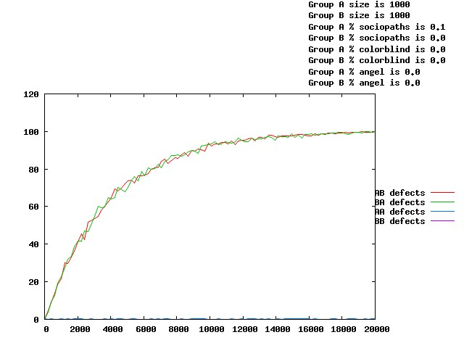
2000 people, in two groups A and B.
One sociopath, 1999 benign bigots.
What happens?
Percent of group to group defections over time:
A little malice goes a long way.

Slide 16
Note #1: Almost everyone in the population is a good person who really wants to cooperate with everyone. The people in each group have no animosity toward the other group.
– They just see them as “the other” group.

Slide 17
Note 2: There was just one sociopath in a population of 2000 people!
Let’s talk about the sociopath …
possibly just accidentally or inadvertently defected.
maybe didn’t even defect and someone just misunderstood.

Slide 18
A little malice goes a long way.
One sociopath in a group in which everyone else wants to cooperate:
Result is complete group to group defection.

Slide 19
What can we do about this?
Option 1: Throw some angels into the mix.
(Studied. Not very effective.)
Option 2: Throw the sociopath in jail.
(Already too late.)
Option 3: ?????

Slide 20
1 sociopath. 1,999 benign others. What would the outcome be if the groups didn’t stereotype?
(A little malice would NOT go a long way.)

Slide 21
What can we do about this?
Option 1: Throw some angels into the mix.
(Studied. Not very effective.)
Option 2: Throw the sociopath in jail.
(Already too late.)
Option 3: Teach people to not see others as “the other”.
Very effective!!!

Slide 22
From “A Note on Modeling Prejudice”, by Alan Lockard and Ed Harcourt, 2009:
“The underlying problem is not one of malice, but of identification. Given that prejudice is an extremely effective, if not entirely accurate, means of economizing on information, our model provides an explanation for how a benign attitude toward “others” at the micro level can yield intergroup animus at the macro level.”

Slide 23
Thanks for listening!
plock@stlawu.edu
www.lock5stat.com

