Slide 1
Engaging the Students:
Using Clickers in Math Classrooms at all Levels
Patti Frazer Lock
St. Lawrence University
plock@stlawu.edu
MAA Seaway Section Meeting
April, 2018

Slide 2
Outline
Introduction and Background
Test drive the system!
Ways to use clickers
Discussion of student reaction and impact on learning and instructor reaction
Specific Examples:
  Calculus
  Intro Stat
  Upper Level

Slide 3
Clickers
Several systems available. I’ve used at least three; currently use iClickers.
Multiple-choice questions are usually on a PowerPoint slide or equivalent. (but don’t have to be)
  Some clickers offer more flexibility (more options or short answer)
Students use wireless “clickers” to answer.
  Apps are available for using a smartphone or laptop
Clickers are assigned to students, and the software automatically keeps a complete record of results on all questions for the instructor.

Slide 4
My experience
I’ve used clickers since at least 2005.
Used in
Calculus I
Calculus II
Calculus III
Intro Stats
Bridge to Higher Mathematics
Abstract Algebra (Group Theory)
Graph Theory
First Year Seminars

Slide 5
Let’s go!
Turn your clicker on!
To sign in to this class:
Hold the power button down until the power light flashes.
Press A, then press A again.
The “Vote Status” light should turn green.

Slide 6
Multiple ways for students to register for a given class: [Only done once]
Online
Through your learning management system
In class
This is the most fun!

Slide 7
First, we register the clickers. This requires you to
Read your name (they will be alphabetical)
When your name passes the first line, a letter will appear. Enter the letter indicated next to your name (A, B, C, D, or E).
If you do this correctly, a second letter will appear. Enter the second letter indicated next to your name.
If you miss it the first time around, it will scroll around again (and again, and again…. So relax!)
If you mess up, press DD.
Assigned names!

Slide 8
Can you use your clicker?
A. Yes
B. No
C. I don’t know
D. I don’t have a clicker
E. What is a clicker?
iClicker

Slide 9
What is the name of the planet that is fourth in distance from the Sun in the Solar System?
A. Earth
B. Mars
C. Jupiter
D. Starship Enterprise
E. Venus
iClicker

Slide 10
iClicker
Who won the Super Bowl this year?
A. New England
B. Brazil
C. Miami
Philadelphia
E. Notre Dame

Slide 11
Have you watched “Game of Thrones”?
A. Never
B. Some
C. Almost all
D. All
iClicker

Slide 12
Who shot the sheriff? (But did not shoot the deputy.)
A. You did
B. I did
C. Ramona did
D. Jack and Diane did
E. Natasha did
iClicker

Slide 13
“Take It to the Limit” is a great song to play in Calc 1. Who sings it?
A. Jackson Browne
B. The Doobie Brothers
C. Chicago
D. REO Speedwagon
E. The Eagles
iClicker

Slide 14
How many of the following social media sites have you used in the last week?
FaceBook, Twitter, Instagram, Snapchat
A. 0
B. 1
C. 2
D. 3
E. 4
iClicker

Slide 15
Should students majoring in math be required to take an Intro Stat class?
A. No
B. Yes
C. Depends on their future plans
D. Depends on the course
E. Only if it doesn’t reduce their theoretical exposure
iClicker

Slide 16
Should students majoring in math be required to take an applied data analysis class?
A. No
B. Yes
C. Depends on their future plans
D. Depends on the course
E. Only if it doesn’t reduce their theoretical exposure
iClicker

Slide 17
Which of the following is NOT a parody by Weird Al Yankovic?
A. Word Crimes (from Blurred Lines)
B. You don’t take your showers (from You don’t bring me flowers)
C. Gee, I’m a Nerd (from Free as a Bird)
D. I think I’m a Clone Now (from I think we’re alone now)
E. I Bought the Sandwich (from I Shot the Sheriff)
iClicker
Notes:
The parody of Numb is actually called “Green Eggs and Ham”

Slide 18
iClicker
What do you want to ask? Come up with a question!

Slide 19
How I use Clickers
Questions are Fast, Easy, asked in Real Time.
  Are you paying attention? Have you processed what we just talked about? Do you understand this concept or definition?
  Are you staying engaged? Is your brain turned on? Stick with us here!
“Clicker grade” counts! But minimally!
  Clicker responses count for about 5% of final grade, with about 75% of that for participation and 25% for accuracy.
  I am generous with the clicker grade! (Important for instructor sanity)
  This was just one of multiple modes of assessment (quizzes, exams, group work, projects, homework, …)

Slide 20
Other Ways to use Clickers
Introduction, or preview, of topic
Check to see whether you need to spend more time on topic before going on
Review
Make sure they get basic ideas, either in class or from reading
Quick quiz at beginning of class (have they done the homework? Have they done the reading?)
Promote class discussion and class engagement (ask opinion questions – make them commit!)
Ask a more difficult question, give them time to talk in groups, ask the question again
More interesting (and fast) way to take attendance!
Peer review of student presentations
Straw poll of opinions

Slide 21
My worries before starting:
multiple-choice questions maybe not best;
technology so impersonal;
students might not like the time pressure; …
Student reaction:
Students loved using the clickers!
-- I think the clicker questions are a great way for the instructor to see if any more time should be spent on the topic. It helped me understand the material better as well.
-- Clicker questions make the atmosphere fun and competitive … its a great idea to use them.
-- The clickers made it fun!
-- Clicker questions helped me stay engaged.
Very occasionally:
-- I tend to process things slowly and I don’t like the time pressure of the clickers.

Slide 22
Clickers were liked by:
loud students and quiet students
smart students and not-so-smart students
competitive students and not-at-all competitive students

Slide 23
Outcomes from my experience
Improved learning?
Improved student engagement with the material?
Improved instructor ability to measure class understanding?
Made course more fun for the students (and me)?
Increased interaction (both student-student and student-professor)?
Yes, especially in certain areas
Yes!
Usually results were as expected, but not always
Definitely!
Definitely!

Slide 24
Advantages
More laughing in class (not to be underestimated!)
More focus on conceptual understanding
Feedback from all students
Increased student engagement and focus during class
Improved faculty awareness of actual student comprehension
Assessment and record-keeping automated
Variety is good! Multiple modes of assessment are good!
Great for large lecture classes (give minute quizzes, take attendance, all records kept automatically, easy feedback from all students, easy to take pulse of the class, easy to engage all students)
Also great for smaller classes!

Slide 25
Disadvantages
Professor time (This is not too bad, though, since the system is very easy to use, and questions are already available for some texts. And questions can be used over and over in future semesters.)
  Generous grading is important! Minimalist grading is important!
Class time (Time spent on this is time not spent doing other things such as another example, another group problem, etc. But it is a very nice way to add more variety to the class. I generally spent 0 - 15 minutes on clicker questions in a class.)
Expense (Students purchase individual clickers for $25-50. The cost of receivers and software is about $500-1000?)

Slide 26
Biggest advantage:
Clickers provide an additional way to keep all students active, thinking, and engaged throughout class.

Slide 27
Education Research
The 15 minute rule
Cell phones/laptops in class
Assessment matters! (both directions)
Try not to go more than 15 minutes in a class without having the students DO something.
Students in my class are required to buy clickers. I don’t allow cell phones or laptops to be used.
Clicker grade should count, but not much!! And be generous! (Be nice to yourself)

Slide 28
For Calculus and Precalculus:
These clicker questions for Calculus come primarily from ConcepTests available for Calculus, Multivariable Calculus, Applied Calculus, and Functions Modeling Change by Hughes-Hallett, McCallum, Connally, et.al. Available online as PowerPoint slides ready to go from John Wiley and Sons.
Disclaimer: I am an author on these texts and on the ConcepTest supplements.
(That’s how I got into the clicker business.)

Slide 29

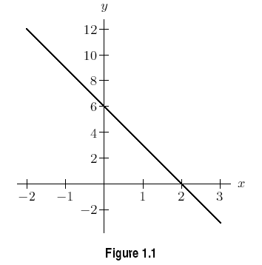
iClicker

Slide 30
iClicker
To extract T tons of ore from a copper mine, the cost is C dollars. If C is a linear function of T, the units of the slope of the line are:
1. Tons
2. Dollars
3. Tons/dollar
4. Dollars/ton
Since C = f(T), slope is $\frac{ΔC}{ΔT}$ so units are C-units over T-units

Slide 31
iClicker
A lake has a concentration of 85 mg/l of pollutants in it, and the concentration goes down by 4.6% each year. A possible formula for the concentration C as a function of the number of years t is
A. C = 85 – 4.6t
B. C = 85 – 0.046t
C = 85(0.954) ^{t}
C = 85(1.046) ^{t}
E. C = 85 e^{0.046t}
Constant percent change per year => Exponential (and note that it is decreasing)

Slide 32
iClicker
A lake has a concentration of 85 mg/l of pollutants in it, and the concentration goes down by 4.6 mg/l each year. A possible formula for the concentration C as a function of the number of years t is
A. C = 85 – 4.6t
B. C = 85 – 0.046t
C = 85(0.954) ^{t}
C = 85(1.046) ^{t}
E. C = 85 e^{0.046t}
Constant absolute change per year => Linear

Slide 33
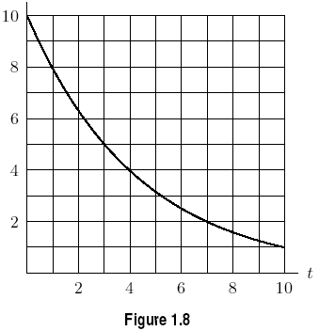

iClicker
A. 2
B. 3
C. 5
D. 8
E. 10

Slide 34
iClicker
The solution to 9 = 5 (2^{x}) is
A. 9 Ln (5/2)
2 Ln (9/5)
2 Ln (5/9)
Ln (9/5)/Ln (2)
Ln (9)/ 5 Ln (2)

Slide 35
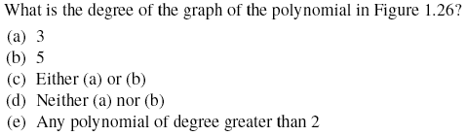
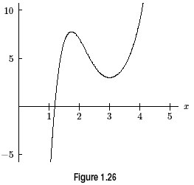
iClicker
Talk about it!

Slide 36
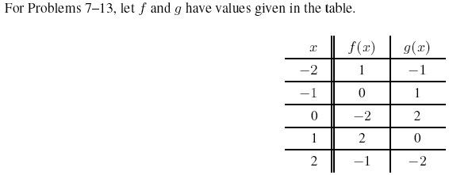
iClicker
(A) -2
(B) -1
(C) 0
(D) 1
(E) 2
f(0)
-2

Slide 37
iClicker
At a rock concert, the noise level in decibels (dB) is a function of the distance (in feet) from the performers. If the rate of change of noise level as distance goes from 100 ft to 300 ft is M, this means:
The noise level is M at 300 ft.
The noise level is M at 100 ft.
The noise level changes by M units as we go from 100 ft to 300 ft.
The noise level changes by M units for every foot we go farther away from the performers.
The noise level changes by M units for every 200 feet we go farther away from the performers.
Rate of change gives change in noise level per unit distance.

Slide 38
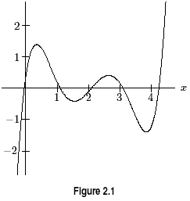
iClicker
The graph of y = f(x) is shown.
Is f ‘ (1) positive or negative?
(A) Positive
(B) Negative

Slide 39
iClicker
The graph of y = f(x) is shown.
Is f ‘ (2) positive or negative?
(A) Positive
(B) Negative

Slide 40
iClicker
The graph of y = f(x) is shown.
Is f ‘ (4) positive or negative?
(A) Positive
(B) Negative

Slide 41
iClicker
The graph of y = f(x) is shown.
Is f (3) positive or negative?
(A) Positive
(B) Negative
Trick Question!

Slide 42
iClicker
Q represents the quantity of tar in gallons in a sink hole at time t days. We have Q=f(t). Also
f(30) = 27 and f ′(30) = 15.
The units of 30 are:
Gallons
Days
Gallons/Day
Days/Gallon
Gallons per 30 days
f(t) = Q
f(time in days) = quantity in gallons
f(30) = 27

Slide 43
iClicker
Q represents the quantity of tar in gallons in a sink hole at time t days. We have Q=f(t). Also
f(30) = 27 and f ′(30) = 15.
The units of 27 are:
Gallons
Days
Gallons/Day
Days/Gallon
Gallons per 30 days
f(t) = Q
f(time in days) = quantity in gallons
f(30) = 27

Slide 44
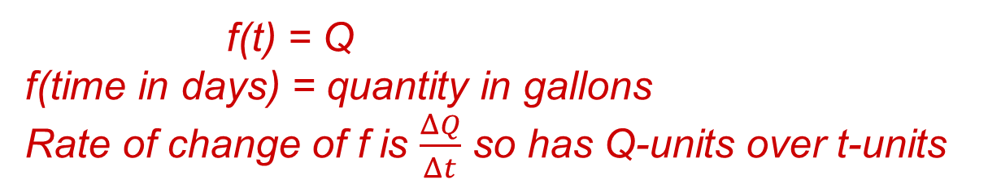
iClicker
Q represents the quantity of tar in gallons in a sink hole at time t days. We have Q=f(t). Also
f(30) = 27 and f ′(30) = 15.
The units of 15 are:
Gallons
Days
Gallons/Day
Days/Gallon
Gallons per 30 days
f(t) = Q
f(time in days) = quantity in gallons
Rate of change of f is $\frac{ΔQ}{Δt}$ so has Q-units over t-units

Slide 45
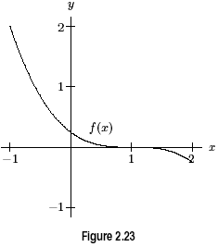
In the graph shown, at x = 0 the signs of the function and the first and second derivatives, in order, are:
–, +, +
–, –, –
(c) –, +, –
(d) +, –, –
(e) +, –, +
iClicker
function derivative second derivative
y-coordinate slope concavity

Slide 46

iClicker
Talk about it!
At one time, f' > 0 => f increasing
For all time, f'' < 0 => f concave down

Slide 47
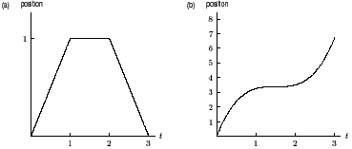
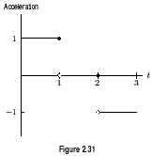
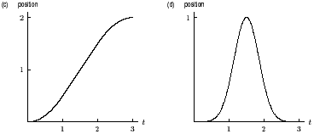
iClicker
(A)
(B)
(C)
(D)
Which of these is a possible corresponding graph of position?
Graph of Acceleration
Concave up
Acceleration => f'' => concavity
Linear
Concave down

Slide 48
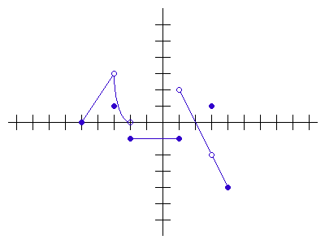
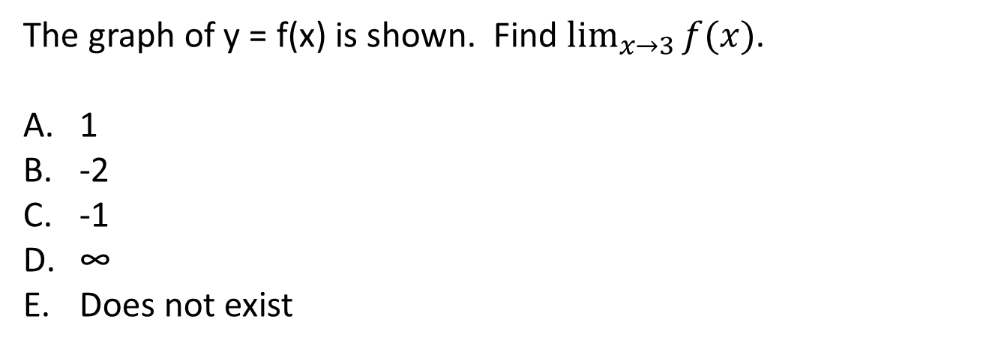
The graph of y = f(x) is shown. Find $\lim_{x→3}{f(x)}$.
1
-2
-1
∞
Does not exist

Slide 49
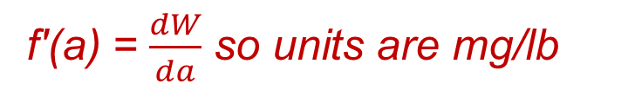
iClicker
If W = f(a) = a² + 3a, with W in mg and a in lbs, then f ′(2) =
(A) 7 mg/lb
(B) 5 mg/lb
(C) 15 mg
5 lb/mg
7 lb/mg
f'(a) = 2a + 3, so f'(2) = 7
f'(a) = $\frac{dW}{da}$ so units are mg/lb

Slide 50
iClicker
If f(x) = (x² + 1)⁵, then f ′(x) =
(A) (2x)⁵
(B) 5(2x)⁴
(C) 10x(x² + 1)⁴
(D) 5(2x³ + 2x)⁴

Slide 51
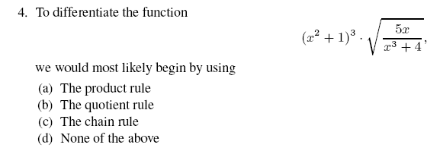
iClicker

Slide 52
iClicker
Assume b gives the average blood pressure of a patient following a dose a of a drug. We wish to find the dose that minimizes average blood pressure. To find the answer analytically, we expect to:
(A) Find db/da, substitute a = 0, and evaluate.
(B) Find db/da, substitute b = 0, and evaluate.
(C) Find da/db, set it equal to 0, and solve for a.
(D) Find db/da, set it equal to 0, and solve for a.
(E) Find db/da, set it equal to 0, and solve for b.
Minimize b with respect to a => appropriate derivative is db/da
To find critical points, we set the derivative equal to zero and solve for the independent variable.

Slide 53
iClicker
Assume b gives the average blood pressure of a patient following a dose a of a drug. We wish to find the dose that minimizes average blood pressure. To find the answer analytically, we expect to:
(A) Find db/da, substitute b = 0, and evaluate.
(B) Find db/da, set it equal to 0, and solve for a.
(C) Find da/db, substitute a = 0, and evaluate.
(D) Find db/da, substitute a = 0, and evaluate.
(E) Find db/da, set it equal to 0, and solve for b.

Slide 54
iClicker
Assume D gives the density of an object based on its length L along a continuum. We wish to find the length that maximizes density. To find the answer analytically, we expect to:
(A) Find dD/dL, set it equal to 0, and solve for L.
(B) Find dL/dD, set it equal to 0, and solve for L.
(C) Find dD/dL, set it equal to 0, and solve for D.
Find dL/dD, set it equal to 0, and solve for D.
Find dD/dL, substitute L = 0, and evaluate.

Slide 55
iClicker
Assume D gives the density of an object based on its length L along a continuum. We wish to find the length that maximizes density. To find the answer analytically, we expect to:
(A) Find dD/dL, substitute L = 0, and evaluate.
(B) Find dD/dL, substitute D = 0, and evaluate.
(C) Find dD/dL, set it equal to 0, and solve for L.
(D) Find dD/dL, set it equal to 0, and solve for D.
(E) Find dL/dD, substitute D = 0, and evaluate.

Slide 56
iClicker
If f(x) is measured in pounds and x is measured in feet, then
is measured in:
(A) Feet
(B) Pounds/Foot
(C) Pounds
(D) Pounds times Feet
f-units times x-units
Pounds times Feet

Slide 57
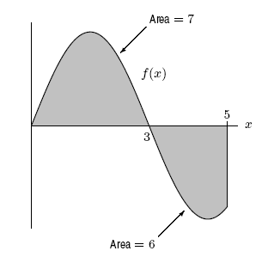
iClicker
The graph of y = f(x) is shown. What is
1
6
7
13
-1
Integral is signed area = area above – area below

Slide 58
iClicker
The graph of y = f(x) is shown. What is the total area shaded?
1
6
7
13
-1
Area is a physical quantity and is always positive

Slide 59
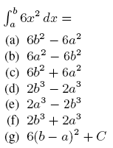
iClicker

Slide 60
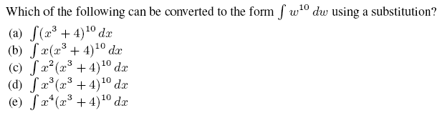
iClicker

Slide 61
iClicker
A quantity Q decreases by 8% per unit time and increases by 5 units of Q per unit time. Which of the following gives a differential equation modeling this situation?
(a) (b) (c)
(d) (e)
Quantity Q is changing over time t => appropriate derivative is dQ/dt
Each time unit, Q is going down by 8% times current quantity and is going up by 5.
Rate of change is negative 0.08Q and positive 5.

Slide 62
Write some for Calculus?
Come up with some fast and easy ones! (To the student: Are you paying attention?)
And/or
Some thought-provoking ones.

Slide 63
From Intro Stats:
These clicker questions for Intro Stats come from the Instructor Resources for Statistics: Unlocking the Power of Data by Lock, Lock, Lock, Lock, and Lock. Available online as PowerPoint slides ready to go from John Wiley and Sons.
Disclaimer: I am an author on this text and on the Clicker question supplements.

Slide 64
iClicker
A recent headline stated “Exercise reduces risk of Alzheimers” in reporting on a study of elderly people that recorded how much each exercised and then whether or not the person got Alzheimer’s disease over the next 10 years. Does the headline imply causation? Can we conclude causation from the study?
Yes, Yes
Yes, No
No, Yes
No, No
What the heck is causation?
“Exercise reduces risk of Alzheimers” => implies causation
Not a randomized experiment => cannot conclude causation

Slide 65
iClicker
Do you believe there is only one true love for each person?
Yes
No
Don’t know
Response | Frequency | Relative Frequency
Yes | 735 | 0.28
No | 1812 | 0.69
Don’t know | 78 | 0.03
Pew Research, random sample of 2625 US adults.

Slide 66

iClicker
Fake version of Physician’s Health Study
 | Aspirin | Placebo | Total
Heart Attack | 10 | 40 | 50
Stroke | 20 | 30 | 50
Neither | 70 | 30 | 100
Total | 100 | 100 | 200
What percent of heart attack victims took aspirin?
10%
20%
30%
50%
70%
$$\frac{Heart attack victims who took aspirin}{Heart attack victims}=\frac{10}{50}=0.20$$

Slide 67
iClicker
The variables are year (categorical) and number of times a week the student goes off-campus (quantitative).
We see that
There is no association between the variables
There is an association and seniors are more likely to go off-campus
There is an association and seniors are less likely to go off campus

Slide 68
iClicker
The variables are year (categorical) and number of times a week the student goes off-campus (quantitative).
We see that
Every group has outliers.
Only sophomores have outliers
Only seniors have outliers
Seniors and Juniors have outliers

Slide 69
iClicker
The group with the largest standard deviation is:
First Years
Sophomores
Juniors
Seniors

Slide 70
Descriptive Statistics
  Think of a topic or question you would like to use data to help you answer.
  What would the cases be?
  What would the variables be?
  (Limit to one or two variables)
Notes:
have them come up with lots of possible variable(s) to analyze

Slide 71
iClicker
  For your classmate’s study, how would you visualize and summarize the variable or relationship between variables?
  bar chart/pie chart, proportions, frequency table/relative frequency table
  dotplot/histogram/boxplot, mean/median, sd/range/IQR, five number summary
  side-by-side or segmented bar charts, two-way table, proportions
  side-by-side boxplot, stats by group
  scatterplot, correlation, regression
Notes:
have them come up with lots of possible variable(s) to analyze

Slide 72
iClicker
A 98% confidence interval for mean pulse rate is 65 to 71. The interpretation “I am 98% sure that all students will have pulse rates between 65 and 71.” is
Correct
Incorrect
The confidence interval is about the population mean, not all students!

Slide 73
iClicker
A 98% confidence interval for mean pulse rate is 65 to 71. The interpretation “I am 98% sure that the mean pulse rate for this sample of students will fall between 65 and 71” is
Correct
Incorrect
The confidence interval is about the population mean, not the sample mean!

Slide 74
iClicker
A 98% confidence interval for mean pulse rate is 65 to 71. The interpretation “I am 98% sure that the mean pulse rate for the population of all students will fall between 65 and 71” is
Correct
Incorrect

Slide 75
iClicker
A 98% confidence interval for mean pulse rate is 65 to 71. The interpretation “98% of the pulse rates for students at this college will fall between 65 and 71” is
Correct
Incorrect
The confidence interval is about the population mean, not all students!

Slide 76
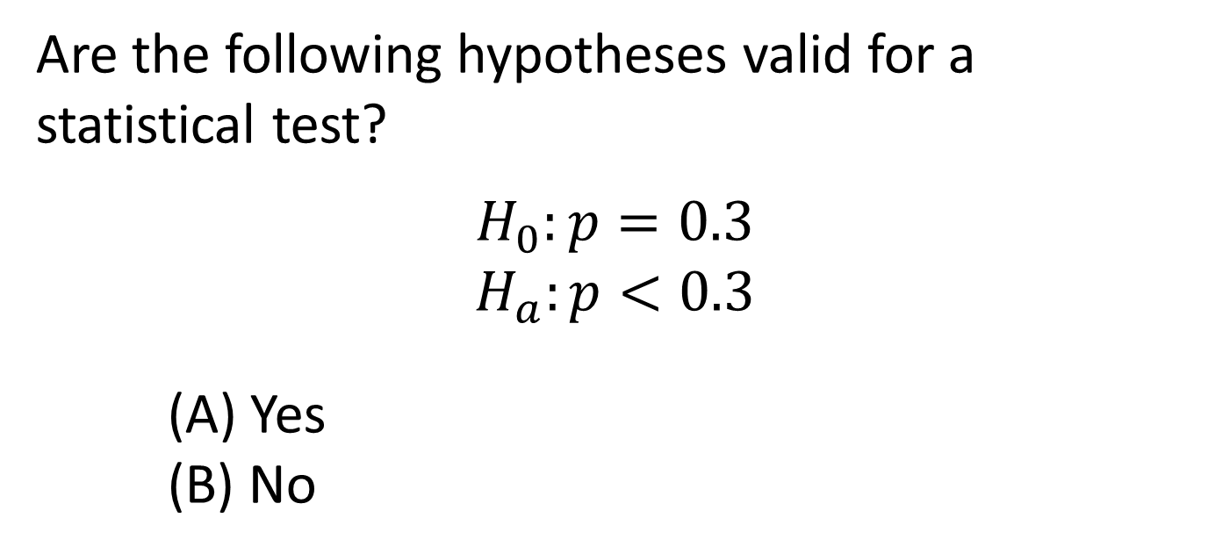
iClicker
Are the following hypotheses valid for a statistical test?
$$H_{0}:p=0.3$$
$$H_{a}:p<0.3$$
(A) Yes
(B) No
Yes!

Slide 77
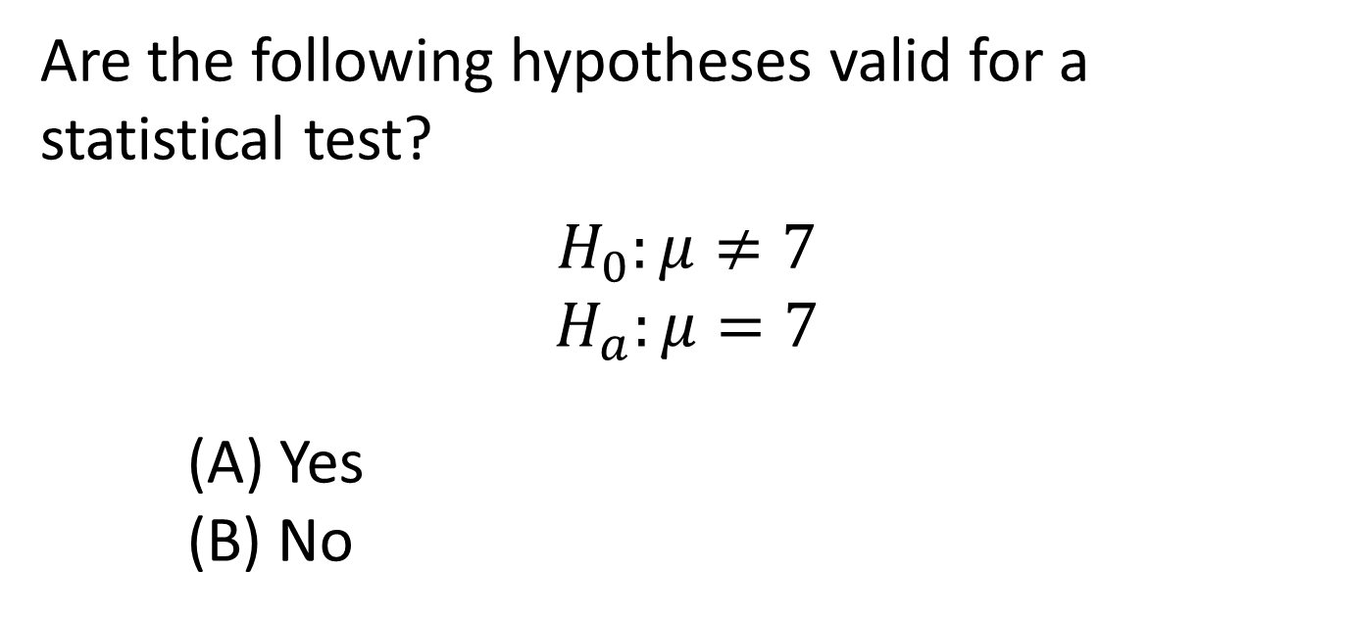
iClicker
Are the following hypotheses valid for a statistical test?
$$H_{0}:μ≠7$$
$$H_{a}:μ=7$$
(A) Yes
(B) No
No! “Equals” must be in H₀.

Slide 78
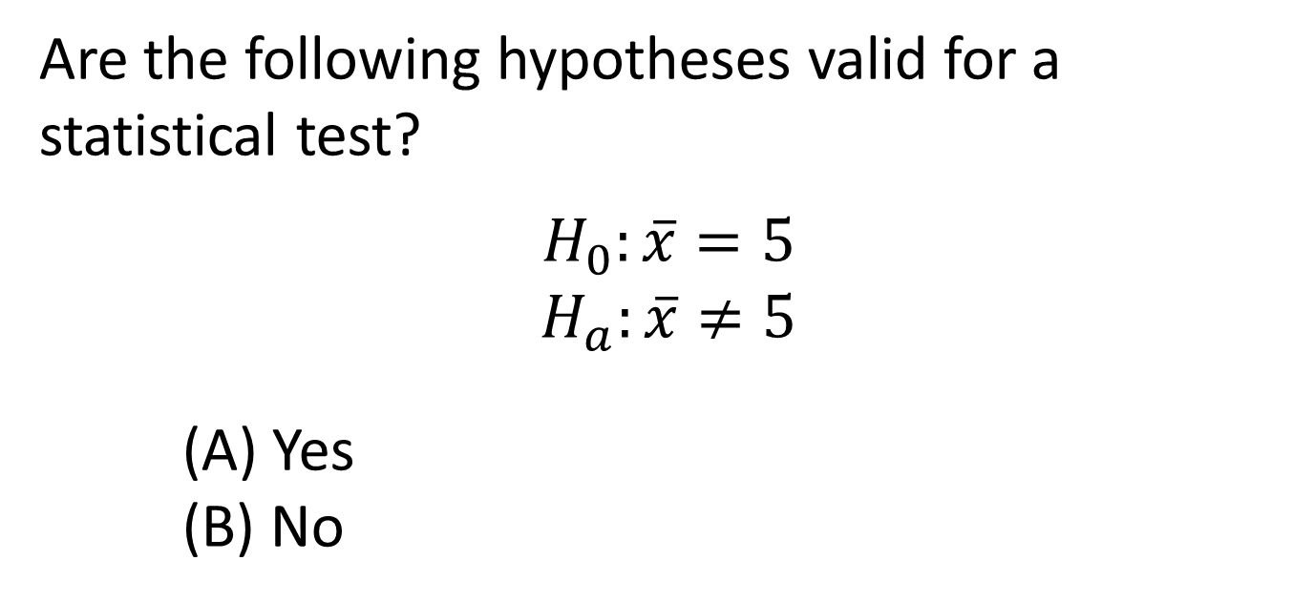
iClicker
Are the following hypotheses valid for a statistical test?
$$H_{0}:\overline{x}=5$$
$$H_{a}:\overline{x}≠5$$
(A) Yes
(B) No
No! Hypotheses are always in terms of population parameters not sample statistics.

Slide 79
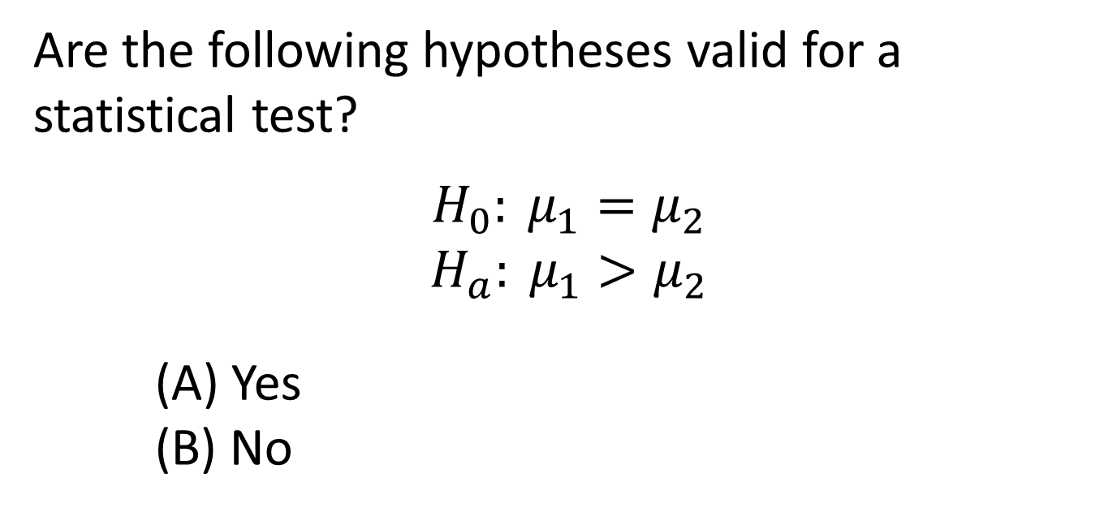
iClicker
Are the following hypotheses valid for a statistical test?
$$H_{0}: μ_{1}=μ_{2}$$
$$H_{a}: μ_{1}>μ_{2}$$
(A) Yes
(B) No
Yes!

Slide 80
iClicker
Which of the following p-values gives the strongest evidence against H₀ ?
A. 0.005 B. 0.03 C. 0.08 D. 0.42 E. 0.79
The smaller the p-value, the stronger the evidence against the null hypothesis and in support of the alternative hypothesis!

Slide 81
iClicker
How many of the following p-values are significant at the 5% level?
0.005 0.03 0.08 0.42 0.79
A. 1 B. 2 C. 3 D. 4 E. 0 or 5

Slide 82
iClicker
In a hypothesis test of
H₀ : μ = 10 vs H_{a} : μ < 10
With a p-value of 0.002, we conclude:
Reject H₀
Do not reject H₀
Reject H_{a}
Do not reject H_{a}

Slide 83
iClicker
In a hypothesis test of
H₀ : μ = 10 vs H_{a} : μ < 10
With a p-value of 0.002, we conclude:
There is evidence that μ = 10
There is evidence that μ < 10
There is no evidence of anything.

Slide 84
iClicker
In a hypothesis test of
H₀ : μ = 10 vs H_{a} : μ < 10
With a p-value of 0.31, we conclude:
Reject H₀
Do not reject H₀
Reject H_{a}
Do not reject H_{a}

Slide 85
iClicker
In a hypothesis test of
H₀ : μ = 10 vs H_{a} : μ < 10
With a p-value of 0.31, we conclude:
There is evidence that μ = 10
There is evidence that μ < 10
There is no evidence of anything.

Slide 86
iClicker
Is the following question best assessed using a confidence interval, a hypothesis test, or is statistical inference not relevant?
What percent of US voters support instituting a national K-12 math curriculum?
Confidence interval
Hypothesis test
Statistical inference is not relevant

Slide 87
iClicker
Is the following question best assessed using a confidence interval, a hypothesis test, or is statistical inference not relevant?
Do basketball players hit a higher proportion of free throws when they are playing at home than when they are playing away?
Confidence interval
Hypothesis test
Statistical inference is not relevant

Slide 88
iClicker
Is the following question best assessed using a confidence interval, a hypothesis test, or is statistical inference not relevant?
Do a majority of adults riding a bicycle wear a helmet?
Confidence interval
Hypothesis test
Statistical inference is not relevant

Slide 89
iClicker
Is the following question best assessed using a confidence interval, a hypothesis test, or is statistical inference not relevant?
On average, were the 23 players on the 2010 Canadian Olympic hockey team older than the 23 players on the 2010 US Olympic hockey team?
Confidence interval
Hypothesis test
Statistical inference is not relevant
Trick question!

Slide 90
iClicker
In a random sample of 500 US citizens, 280 plan to vote in the upcoming election. We want to test to see if this provides evidence that the proportion of US citizens who plan to vote is greater than half.
Is this test:
Right-tailed
Left-tailed
Two-tailed
No-tailed
H₀ : p = 0.5
H_{a} : p > 0.5

Slide 91

iClicker
In a random sample of 500 US citizens, 280 plan to vote in the upcoming election. We want to test to see if this provides evidence that the proportion of US citizens who plan to vote is greater than half.
What is the sample proportion in this test:
0.5
250
56
0.56
0.28
$$\hat{p}=\frac{280}{500}=0.56$$

Slide 92

iClicker
In a random sample of 500 US citizens, 280 plan to vote in the upcoming election. We want to test to see if this provides evidence that the proportion of US citizens who plan to vote is greater than half.
What is the standard error for the test?
0.0222
0.0365
0.02236
0.04
0.06
$$SE=\sqrt{\frac{p(1−p)}{n}}=\sqrt{\frac{0.5(0.5)}{500}}=0.02236$$
Remember to use the null value and not the sample statistic for p

Slide 93

iClicker
In a random sample of 500 US citizens, 280 plan to vote in the upcoming election. We want to test to see if this provides evidence that the proportion of US citizens who plan to vote is greater than half.
What is the test statistic?
2.703
25.225
25.045
2.683
0.05
$$z=\frac{Statistic−Null}{SE}=\frac{0.56−0.5}{0.02236}=2.683$$

Slide 94
iClicker
In a random sample of 500 US citizens, 280 plan to vote in the upcoming election. We want to test to see if this provides evidence that the proportion of US citizens who plan to vote is greater than half.
What is the p-value? [test statistic is z = 2.683]
0.0072
0.0036
0.036
0.072
0.05
Find the area beyond the test statistic z = 2.683 in the right tail of a standard normal distribution.

Slide 95
iClicker
In a random sample of 500 US citizens, 280 plan to vote in the upcoming election. We want to test to see if this provides evidence that the proportion of US citizens who plan to vote is greater than half.
What is the conclusion? [p-value = 0.0036]
Reject H₀ and conclude that more than half of US citizens plan to vote.
Reject H₀ and conclude that it is not true that more than half of US citizens plan to vote.
Do not reject H₀ and conclude that more than half of US citizens plan to vote.
Do not reject H₀ and conclude that it is not true that more than half of US citizens plan to vote.

Slide 96
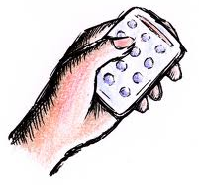

Split or Steal?
http://www.youtube.com/watch?v=p3Uos2fzIJ0
Both choose “split”: split the jackpot
Both choose “steal”: both get nothing
One “steal,” one “split: stealer gets everything
What would you do???
(a) Split
(b) Steal
Van den Assem, M., Van Dolder, D., and Thaler, R., “Split or Steal? Cooperative Behavior When the Stakes Are Large,” 2/19/11.
Notes:
Watch the video… pause before the results, and ask students what they would do

Slide 97
iClicker
What do you think happens?
Both steal
He steals
She steals
Both split
 | Male | Female | Total
SPLIT | 140 | 163 | 303
STEAL | 129 | 142 | 271
Total | 269 | 305 | 574

Slide 98
One Proportion or Two?
You want to…
compare the proportion of students who use a Windows-based PC to the proportion who use a Mac.
This is…
  Inference for one proportion
  Inference for two proportions
This is one categorical variable: type of computer used

Slide 99
One Proportion or Two?
You want to…
compare the proportion of students who study abroad between those attending public universities and those at private universities.
This is…
  Inference for one proportion
  Inference for two proportions
This is two categorical variables: study abroad or not, and public or private university

Slide 100
One Proportion or Two?
You want to…
compare the proportion of in-state students at a university to the proportion from outside the state.
This is…
  Inference for one proportion
  Inference for two proportions
This is one categorical variable: in-state or out-of-state

Slide 101
One Proportion or Two?
You want to…
compare the proportion of in-state students who get financial aid to the proportion of out-of-state students who get financial aid
This is…
  Inference for one proportion
  Inference for two proportions
This is two categorical variables: in-state or out-of-state, and financial aid or not

Slide 102
Paired Data or Separate Samples?
Should data from the following situation be analyzed as paired data or separate samples?
To study the effect of sitting with a laptop computer on one’s lap on scrotal temperature, 29 men have their scrotal temperature tested before and then after sitting with a laptop for one hour.
Paired Data
Separate Samples

Slide 103
Paired Data or Separate Samples?
Should data from the following situation be analyzed as paired data or separate samples?
A study investigating the effect of exercise on brain activity recruits sets of identical twins in middle age, in which one twin is randomly assigned to engage in regular exercise and the other doesn’t exercise.
Paired Data
Separate Samples

Slide 104
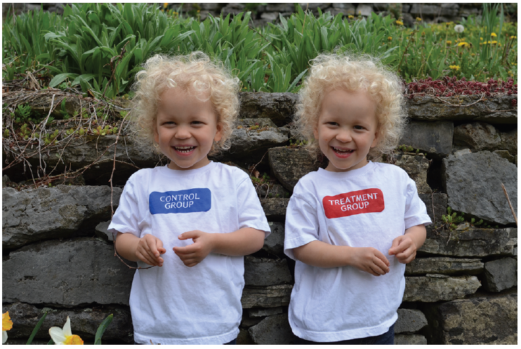
Identical Twin Studies

Slide 105
Paired Data or Separate Samples?
Should data from the following situation be analyzed as paired data or separate samples?
In a study to determine whether the color red increases how attractive men find women, one group of men rate the attractiveness of a woman after seeing her picture on a red background and another group of men rate the same woman after seeing her picture on a white background.
Paired Data
Separate Samples

Slide 106
Paired Data or Separate Samples?
Should data from the following situation be analyzed as paired data or separate samples?
To measure the effectiveness of a new teaching method for math in elementary school, each student in a class getting the new instructional method is matched with a student in a separate class on IQ, family income, math ability level the previous year, reading level, and all demographic characteristics. At the end of the year, math ability levels are measured.
Paired Data
Separate Samples

Slide 107
From the Bridge course….
(Clicker questions for the Bridge course, the Group Theory course, and the Graph Theory course were written by me for my courses as I went along. I’m happy to share them with anyone who wants them. )

Slide 108

Assume A = ( – ∞, 3) and B = [2, 5].
What is A ∩ B ?
( – ∞, 2) (2) ( – ∞, 2] (3) ( – ∞, 5) (4) ( – ∞, 5]
(5) (2, 3) (6) [2, 3) (7) ( 2, 3] (8) [2, 3]
(9) (3, 5] (10) [ 3, 5]

Slide 109
If a divides b and a divides c, then a divides b – c.
What is the first line of the proof?
If a divides b, then a divides b – c.
If a divides b, then a divides c.
Assume a divides b – c.
Assume a divides b and a divides c.
Assume a does not divide b and a does not divide c.

Slide 110
If a divides b and a divides c, then a divides b – c.
What is the next line of the proof?
Then a must divide b – c.
Then a does not divide b – c.
Then b = ka and c = ka for some integer k.
Then b = ka and c = ja for some integers j and k.
Then a = kb and a = kc for some integer k.
Then a = kb and a = jc for some integers j and k.

Slide 111
If a divides b and a divides c, then a divides b – c.
What is the next line of the proof?
Then b – c = ka.
Then division is distributive so a divides b – c.
Then a divides b – c.
Then k – j = …
Then b – c = …
Then a = …

Slide 112
If a divides b and a divides c, then a divides b – c.
What is the last line of the proof?
Then a divides b – c.
Then a does not divide b – c.
Then b = ka and c = ka for some integer k.
Then b = ka and c = ja for some integers j and k.
Then a = kb and a = kc for some integer k.
Then a = kb and a = jc for some integers j and k.

Slide 113
“If A ⊆ B, then A ∪ C ⊆ B ∪ C.” What is the best first sentence of a formal direct proof?
Assume A ∪ C.
Assume A ⊆ B.
Let x ∈ B ∪ C .
Let x ∈ A.
Let x ∈ A ⊆ B .
Let A = {1, 2, 3, 4} and B = {2, 4, 6}

Slide 114
“If A ⊆ B, then A ∪ C ⊆ B ∪ C.” What is the best second sentence of this proof?
Assume A ∪ C.
Assume A ⊆ B.
Let x ∈ A ∪ C .
Let x ∈ A.
Let x ∈ B ∪ C .
Let A = {1, 2, 3, 4} and B = {2, 4, 6}

Slide 115
Assume f: A → B and g: B → C are functions.
Which are defined?
(1) f ° g (2) g ° f (3) both (4) neither

Slide 116
Assume f: A → B and g: B → C are functions.
What is the domain of g ° f ?
A (2) B (3) C (4) f (5) g
B ° A (7) B ° C (8) f ° g (9) g ° f
(10 or 0) A ∪ B

Slide 117
Let A = {1,2,3,4} and B = {a,b,c}. Define the relation f from A to B by f = {(1,b), (2,a), (3,c), (4,b)}.
Is f a function? (1) Yes (2) No

Slide 118
Let A = {1,2,3,4} and B = {a,b,c}. Define the relation f from A to B by f = {(1,b), (2,a), (3,c), (4,b)}.
Is f onto? (1) Yes (2) No

Slide 119
Let A = {1,2,3,4} and B = {a,b,c}. Define the relation f from A to B by f = {(1,b), (2,a), (3,c), (4,b)}.
Is f one-to-one? (1) Yes (2) No

Slide 120
Define f: R × R → R by f(x,y) = x ⋅ y. (f is multiplication).
Is f a function? (1) Yes (2) No

Slide 121
Define f: R × R → R by f(x,y) = x ⋅ y. (f is multiplication).
Is f onto? (1) Yes (2) No

Slide 122
Define f: R × R → R by f(x,y) = x ⋅ y. (f is multiplication).
Is f one-to-one? (1) Yes (2) No

Slide 123
From the Group Theory course….
(Again, questions homegrown and available to any who want them.)

Slide 124
Is (Z⁺, +) a group?
Yes
No

Slide 125
Why is (Z⁺, +) not a group?
(a) I have no idea. What the heck is a group?
(b) + is not a binary operation on this set
(c) + is not associative
(d) There is no identity (and hence no inverses)
(e) There is an identity but there are no inverses
(f) All of the above (except (a))

Slide 126
If group G is cyclic, then G is abelian.
What is the first line in this proof?
Assume G is an abelian group.
Assume G is a cyclic group.
Assume a * b = b * a.
Notes:
Proving “If G is cyclic, then G is abelian.”

Slide 127
If group G is cyclic, then G is abelian.
What is the next line in this proof?
Then G is abelian.
Then G contains inverses.
Then a * b = b * a for all a, b in G.
Then G = <x> for some x in G.
Notes:
Proving “If G is cyclic, then G is abelian.”

Slide 128
If group G is cyclic, then G is abelian.
What is the next line in this proof?
Choose any two elements of G.
Then G has finite order.
Then a * b = b * a for all a, b in G.
Choose any element x and its inverse.
Notes:
Proving “If G is cyclic, then G is abelian.”

Slide 129
If group G is cyclic, then G is abelian.
What is the last line in this proof?
Thus G is abelian.
Thus G contains inverses.
Therefore G is cyclic.
Then G has primary order.
Notes:
Proving “If G is cyclic, then G is abelian.”

Slide 130
If group G is cyclic, then G is abelian.
What is the second to last line in this proof?
Then G is cyclic.
Then G has finite order.
Then a * b = b * a for all a, b in G.
Choose any element x and its inverse.
Notes:
Proving “If G is cyclic, then G is abelian.”

Slide 131
If H is the subgroup <3> in Z₁₂, then H2 =
5 (b) 14
{3, 6, 9, 0} ∪ {2} (d) {5, 8, 11, 2}
(e) {5, 6, 9, 0} (f) {3, 2, 5}

Slide 132
Let H be a normal subgroup of a group G.
We can define ϕ: G → G/H by:
ϕ(ab) = ϕ(a)ϕ(b)
ϕ(a) = Ha
ϕ(Ha) = a
ϕ(ab) = Hab
(e) ϕ(ab) = HaHb

Slide 133
From the Graph Theory course….
(Again, questions homegrown and available to any who want them.)

Slide 134
iClicker
How many of the following are cycle graphs C_{n}?
(A) 1
(B) 2
(C) 3
(D) 4
(E) 5

Slide 135
iClicker
Every u-v walk contains a u-v path.
What is the first line of this proof?
A). Let v₁v₂…v_{n} be a u-v walk.
B). Let v₁v₂…v_{n} be a u-v path.
C). Assume that if P is a u-v walk, then P contains a u-v path.
Notes:
Theorem: Every u-v walk contains a u-v path.

Slide 136
iClicker
A graph G is bipartite if and only if every cycle has an even number of edges. (Forward direction)
What is the first line of this proof?
A). Assume G is bipartite.
B). Assume G has no odd cycles.
C). Let C be an odd cycle.
Notes:
Theorem: A graph G is bipartite if and only if it contains no odd cycles. (Forward direction)

Slide 137
iClicker
A graph G is bipartite if and only if every cycle has an even number of edges. (Forward direction)
What is the next line of this proof?
A). Assume C is an even cycle.
B). Assume G has no odd cycles.
C). Let C be an odd cycle.
D). Let C be any cycle.
E). Assume that there are no even cycles.
Notes:
Theorem: A graph G is bipartite if and only if it contains no odd cycles. (Forward direction)

Slide 138
iClicker
A graph G is bipartite if and only if every cycle has an even number of edges. (Backward direction)
What is the first line of this proof?
A). Assume G is bipartite.
B). Assume every cycle in G has an even number of edges.
C). Let C be an odd cycle.
D). Let A and B be two vertex sets.
E). Let C be an even cycle.
Notes:
Theorem: A graph G is bipartite if and only if it contains no odd cycles. (Backward direction)

Slide 139
iClicker
How many regions does the given graph have?
5
6
7
8
9

Slide 140
And some fun ones where all answers get credit…..

Slide 141
Do you believe Severus Snape is good or evil?
Good
Evil
Who the heck is Severus Snape???

Slide 142
Thank you!
plock@stlawu.edu
www.lock5stat.com

