Slide 1
Bootstrapping:
Let Your Data Be Your Guide
Robin H. Lock
Burry Professor of Statistics
St. Lawrence University
MAA Seaway Section Meeting
Hamilton College, April 2012

Slide 2
Questions to Address
What is bootstrapping?
How/why does it work?
Can it be made accessible to intro statistics students?
Can it be used as the way to introduce students to key ideas of statistical inference?

Slide 3
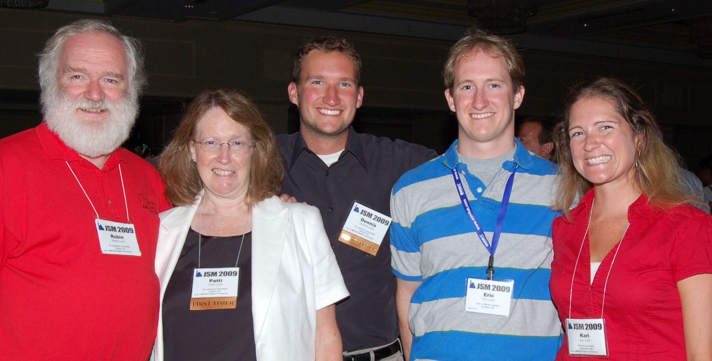
The Lock⁵ Team
Dennis
St. Lawrence
Iowa State
Kari
Williams
Harvard
Duke
Robin
SUNY Oneonta
St. Lawrence
Eric
Hamilton
UNC- Chapel Hill
Patti
Colgate
St. Lawrence

Slide 4
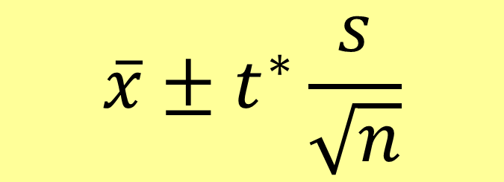
Quick Review:
Confidence Interval for a Mean
$$\overline{x}±t^{∗}\frac{s}{\sqrt{n}}$$
Estimate ± Margin of Error
Estimate ± (Table)*(Standard Error)
What’s the “right” table?
How do we estimate the standard error?

Slide 5

Common Difficulties
Example: Suppose n=15 and the underlying population is skewed with outliers?
⇒ t-distribution doesn’t apply
Example: Find a confidence interval for the standard deviation in a population.
$$s ± ??$$
What is the distribution?
What is the standard error for s?

Slide 6
Traditional Approach:
Sampling Distributions
Take LOTS of samples (size n) from the population and compute the statistic of interest for each sample.
Recognize the form of the distribution
Estimate the standard error of the statistic
BUT, in practice, is it feasible to take lots of samples from the population?
What can we do if we ONLY have one sample?

Slide 7

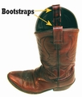
Alternate Approach:
Bootstrapping
“Let your data be your guide.”
Brad Efron – Stanford University

Slide 8
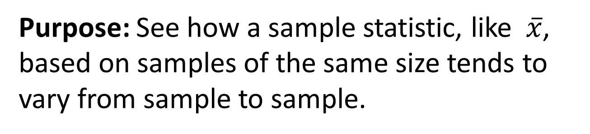
“Bootstrap” Samples
Key idea: Sample with replacement from the original sample using the same n.
Assumes the “population” is many, many copies of the original sample.
Purpose: See how a sample statistic, like $\overline{x}$, based on samples of the same size tends to vary from sample to sample.

Slide 9
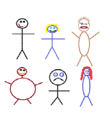
Suppose we have a random sample of 6 people:
Notes:
Patti

Slide 10
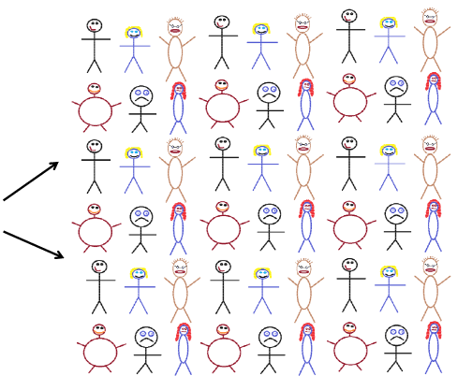
Original Sample
A simulated “population” to sample from
Notes:
Patti

Slide 11




Bootstrap Sample: Sample with replacement from the original sample, using the same sample size.
Original Sample
Bootstrap Sample
Notes:
Patti

Slide 12
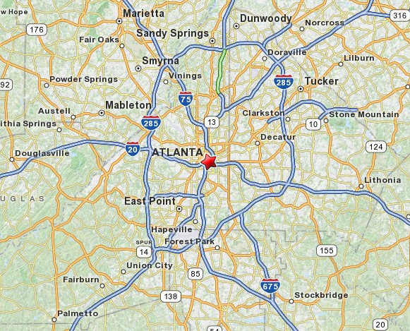
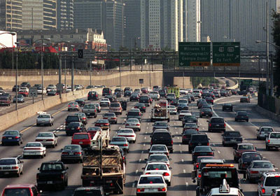
Example: Atlanta Commutes
What’s the mean commute time for workers in metropolitan Atlanta?
Data: The American Housing Survey (AHS) collected data from Atlanta in 2004.

Slide 13
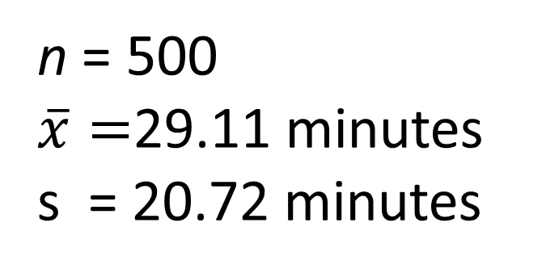
Sample of n=500 Atlanta Commutes
n = 500
$\overline{x}=$29.11 minutes
s = 20.72 minutes
Where is the “true” mean (µ)?

Slide 14
BootstrapSample
Bootstrap Statistic
BootstrapSample
Bootstrap Statistic
Original Sample
Bootstrap Distribution
.
.
.
.
.
.
Sample Statistic
BootstrapSample
Bootstrap Statistic
Notes:
Patti

Slide 15
We need technology!
StatKey
www.lock5stat.com
Notes:
Patti

Slide 16
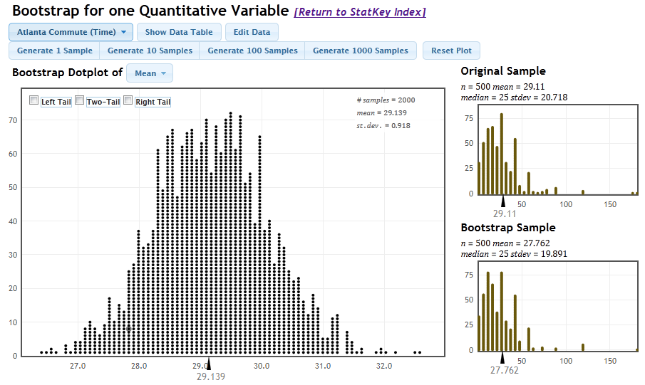
StatKey
One to Many Samples
Three Distributions

Slide 17
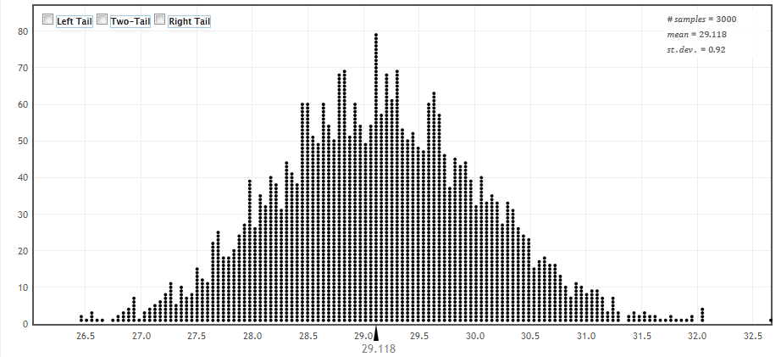
How can we get a confidence interval from a bootstrap distribution?
Method #1: Use the standard deviation of the bootstrap statistics as a “yardstick”
Notes:
Rups

Slide 18

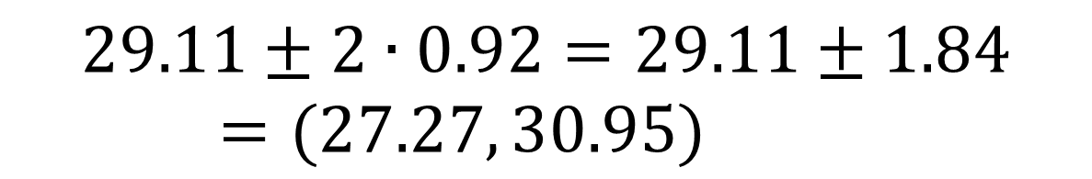
Using the Bootstrap Distribution to Get a Confidence Interval – Version #1
The standard deviation of the bootstrap statistics estimates the standard error of the sample statistic.
Quick interval estimate :
$$Original Statistic ±2∙SE$$
For the mean Atlanta commute time:
$$29.11±2∙0.92=29.11±1.84=(27.27, 30.95)$$
Notes:
Rups

Slide 19
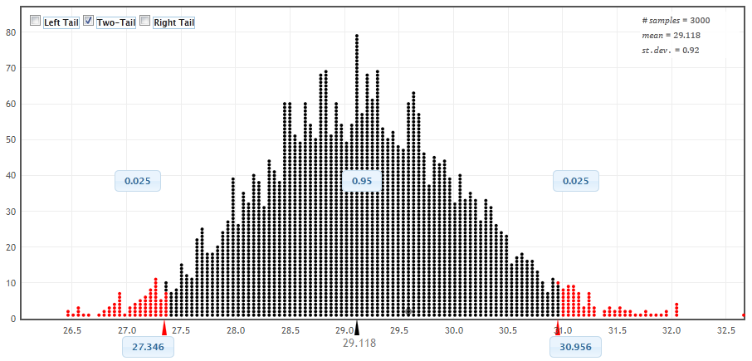
Using the Bootstrap Distribution to Get a Confidence Interval – Version #2
95% CI=(27.35,30.96)
Chop 2.5% in each tail
Keep 95% in middle
Chop 2.5% in each tail
For a 95% CI, find the 2.5%-tile and 97.5%-tile in the bootstrap distribution
Notes:
Rups

Slide 20
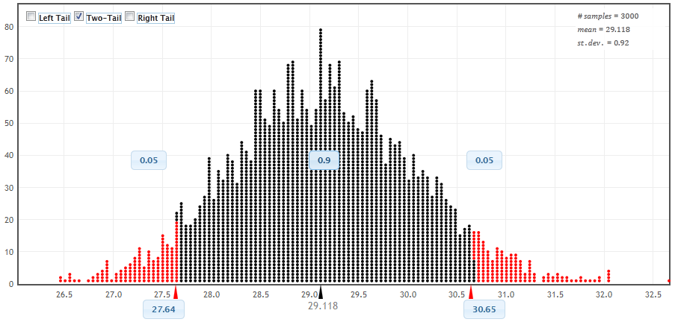
90% CI for Mean Atlanta Commute
90% CI=(27.64,30.65)
Chop 5% in each tail
Keep 90% in middle
Chop 5% in each tail
For a 90% CI, find the 5%-tile and 95%-tile in the bootstrap distribution
Notes:
Rups

Slide 21
Bootstrap Confidence Intervals
Version 1 (Statistic ± 2 SE):
Great preparation for moving to
traditional methods
Version 2 (Percentiles):
Great at building understanding of
confidence intervals
Notes:
Rups

Slide 22
Sampling Distribution
Population
BUT, in practice we don’t see the “tree” or all of the “seeds” – we only have ONE seed
µ

Slide 23
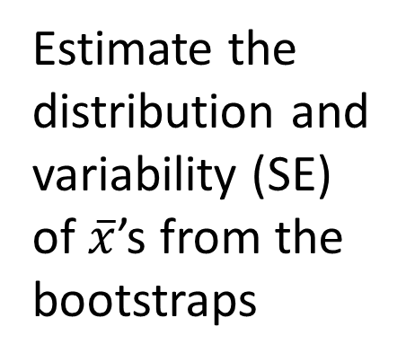

Bootstrap Distribution
What can we do with just one seed?
Bootstrap
“Population”
Estimate the distribution and variability (SE) of $\overline{x}$’s from the bootstraps
Grow a NEW tree!
$$\overline{x}$$
µ

Slide 24
Golden Rule of Bootstraps
The bootstrap statistics are to the original statistic
as
the original statistic is to the population parameter.

Slide 25
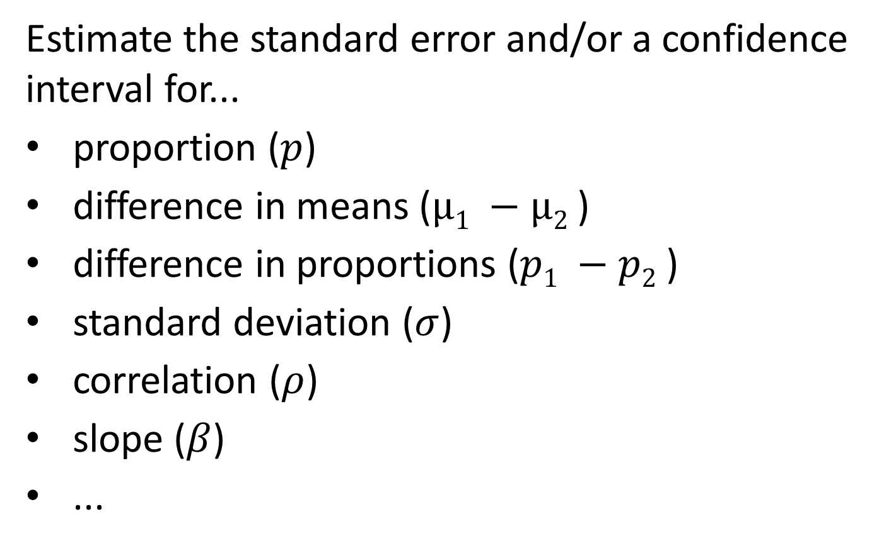
What about Other Parameters?
Estimate the standard error and/or a confidence interval for...
proportion ($p$)
difference in means ($µ1 −µ2$)
difference in proportions ($p1 −p2$)
standard deviation ($σ$)
correlation ($ρ$)
slope ($β$)
...
Generate samples with replacement
Calculate sample statistic
Repeat...

Slide 26
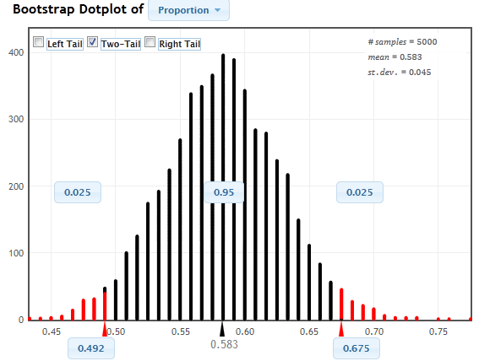
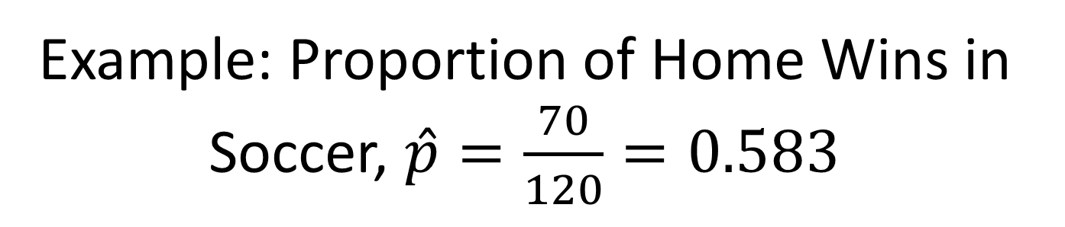
Example: Proportion of Home Wins in Soccer, $\hat{p}=\frac{70}{120}=0.583$

Slide 27
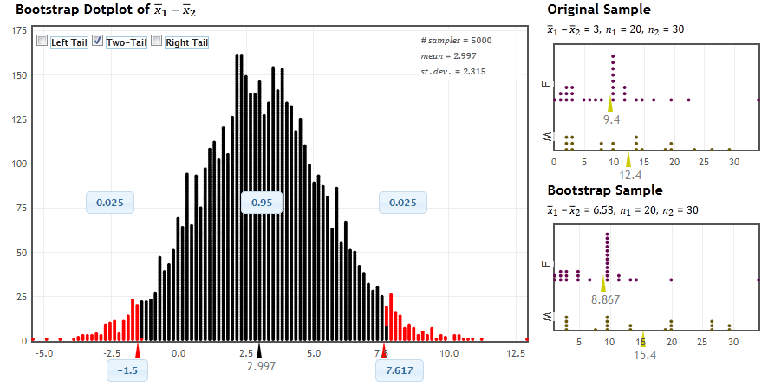
Example: Difference in Mean Hours of Exercise per Week, by Gender

Slide 28
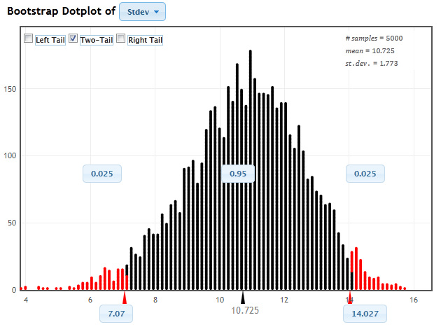
Example: Standard Deviation of Mustang Prices

Slide 29

Example: Find a 95% confidence interval for the correlation between size of bill and tips at a restaurant.
Data: n=157 bills at First Crush Bistro (Potsdam, NY)
r=0.915

Slide 30
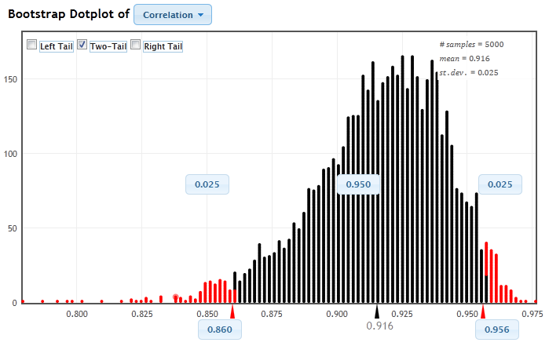

Bootstrap correlations
0.055
0.041
$$r=0.915$$
95% (percentile) interval for correlation is (0.860, 0.956)
BUT, this is not symmetric…

Slide 31

Method #3: Reverse Percentiles
Golden rule of bootstraps:
Bootstrap statistics are to the original statistic as the original statistic is to the population parameter.
0.055
0.041
$$r=0.915$$
$Lower bound = 0.915−0.041=0.874$
$Upper bound = 0.915+0.055=0.970$

Slide 32
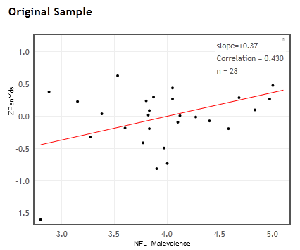


Bootstrap CI for Correlation
Ex: NFL uniform “malevolence” vs. Penalty yards
StatKey
r = 0.430

Slide 33
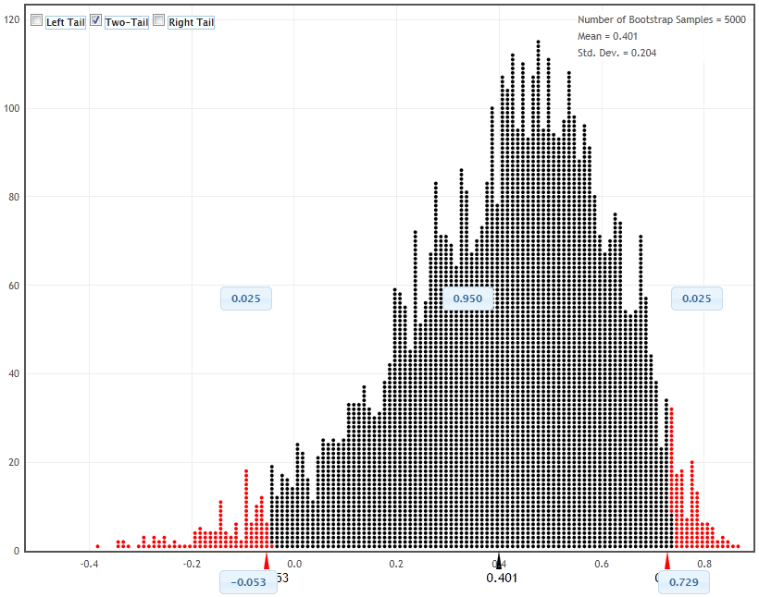
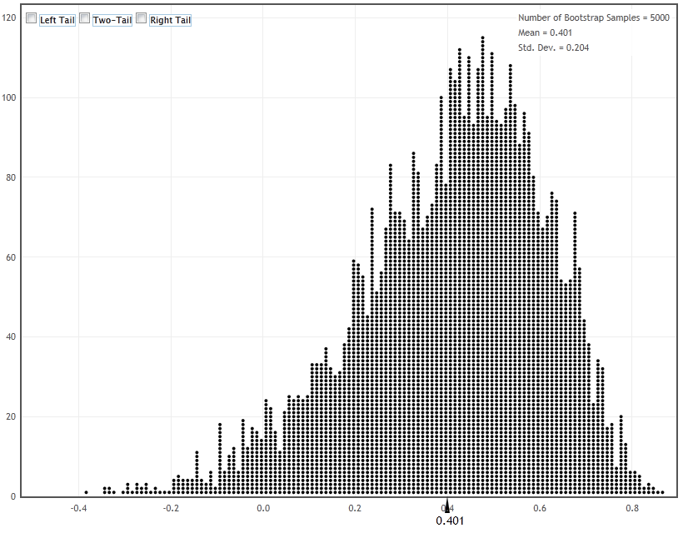
-0.053
0.729
0.430

Slide 34
Method #3: Reverse Percentiles
Golden rule of bootstraps:
Bootstrap statistics are to the original statistic as the original statistic is to the population parameter.
0.483
0.299
-0.053
0.430
0.729
“Reverse” Percentile Interval:
Lower: 0.430 – 0.299 = 0.131
Upper: 0.430 + 0.483 = 0.913

Slide 35
Even Fancier Adjustments...
Bias-Corrected Accelerated (BCa):
Adjusts percentiles to account for bias and skewness in the bootstrap distribution
Other methods:
ABC intervals (Approximate Bootstrap Confidence)
Bootstrap tilting
These are generally implemented in statistical software (e.g. R)

Slide 36
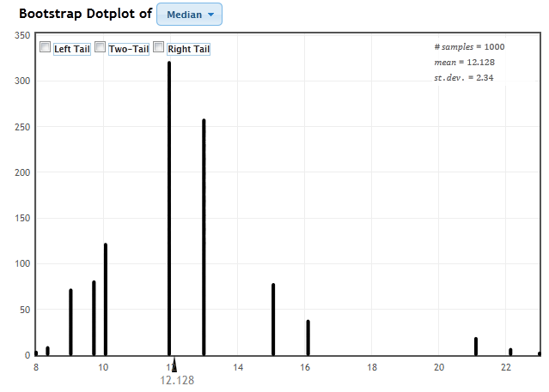
Bootstrap CI’s are NOT Foolproof
Example: Find a bootstrap distribution for the median price of Mustangs, based on a sample of 25 cars at online sites.
Always plot your bootstraps!

Slide 37
What About Resampling Methods in Hypothesis Tests?

Slide 38
“Randomization” Samples
Key idea: Generate samples that are
based on the original sample
AND
consistent with some null hypothesis.

Slide 39

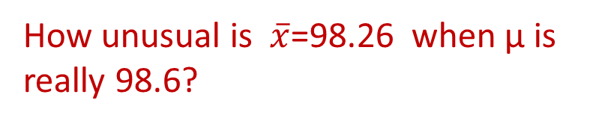
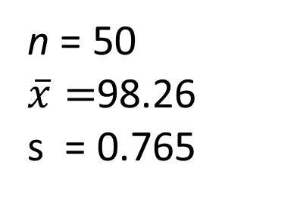
Example: Mean Body Temperature
Is the average body temperature really 98.6ºF?
H₀:μ=98.6
H_{a}:μ≠98.6
Data: A sample of n=50 body temperatures.
n = 50
$\overline{x}=$98.26
s = 0.765
How unusual is $\overline{x}$=98.26 when μ is really 98.6?
Data from Allen Shoemaker, 1996 JSE data set article

Slide 40
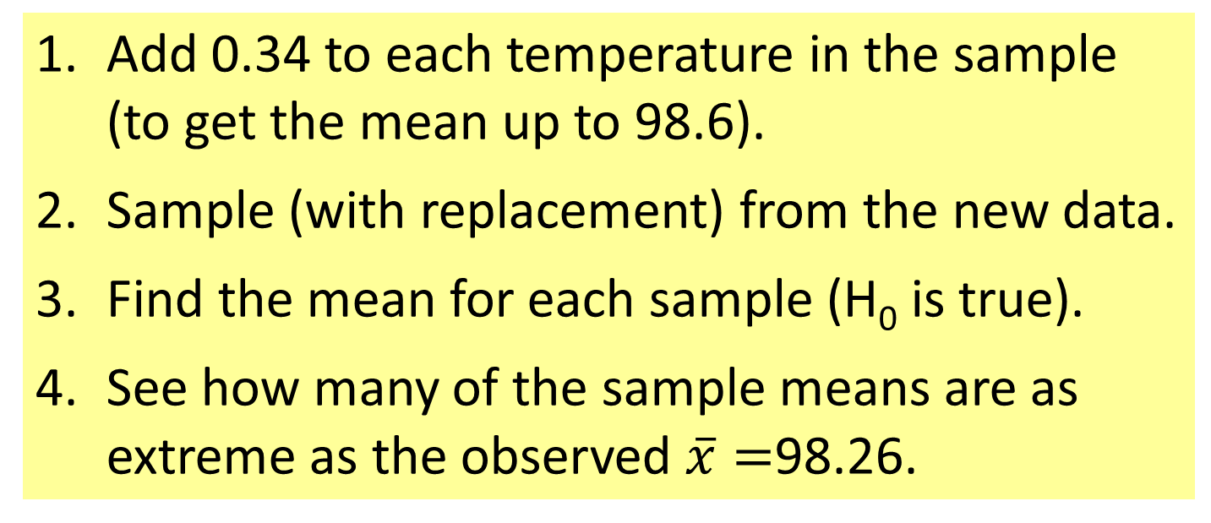
Randomization Samples
How to simulate samples of body temperatures to be consistent with H₀: μ=98.6?
Add 0.34 to each temperature in the sample (to get the mean up to 98.6).
Sample (with replacement) from the new data.
Find the mean for each sample (H₀ is true).
See how many of the sample means are as extreme as the observed $\overline{x}=$98.26.
StatKey Demo

Slide 41
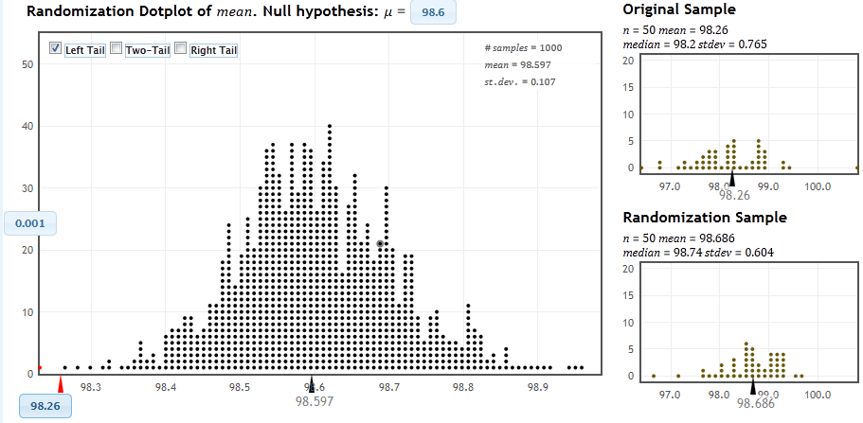
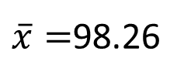
Randomization Distribution
$\overline{x}=$98.26
p-value ≈ 1/1000 x 2 = 0.002

Slide 42
Connecting CI’s and Tests
Randomization body temp means when μ=98.6
Bootstrap body temp means from the original sample
Fathom Demo

Slide 43
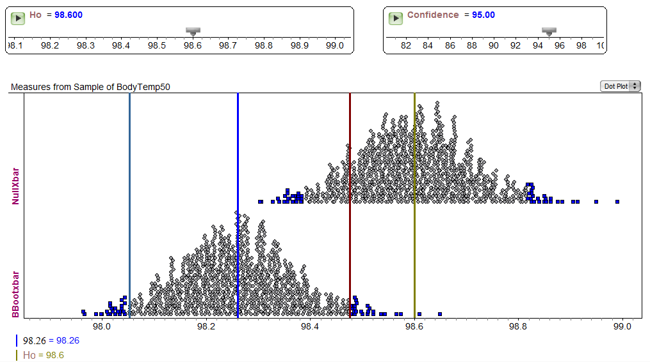
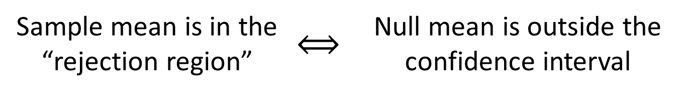
Fathom Demo: Test & CI
Sample mean is in the “rejection region” | $$⟺$$ | Null mean is outside the confidence interval
Notes:
Rups

Slide 44
“... despite broad acceptance and rapid growth in enrollments, the consensus curriculum is still an unwitting prisoner of history. What we teach is largely the technical machinery of numerical approximations based on the normal distribution and its many subsidiary cogs. This machinery was once necessary, because the conceptually simpler alternative based on permutations was computationally beyond our reach. Before computers statisticians had no choice. These days we have no excuse. Randomization-based inference makes a direct connection between data production and the logic of inference that deserves to be at the core of every introductory course.”
-- Professor George Cobb, 2007

Slide 45
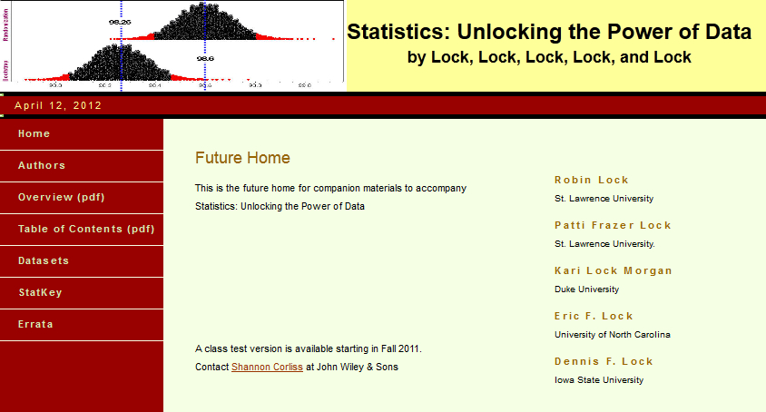
Materials for Teaching Bootstrap/Randomization Methods?
www.lock5stat.com rlock@stlawu.edu

