Slide 1
Give your data the boot:
What is bootstrapping? and
Why does it matter?
Patti Frazer Lock and Robin H. Lock
St. Lawrence University
MAA Seaway Section Meeting
Plattsburgh, October 2010

Slide 2
Bootstrap confidence intervals and
randomization hypothesis tests
provide an alternate way to
DO and to TEACH
statistical inference.

Slide 3
Why
bootstrap intervals and
randomization tests?

Slide 4
Five
Top Ten Reasons for using simulation-based inference

Slide 5
5. Maintain student interest by foreshadowing inference from day 1 and getting to the key ideas of inference very early in the course.
When do current texts first discuss intervals and tests?
Confidence Interval | Significance Test
pg. 359 | pg. 373
pg. 329 | pg. 400
pg. 486 | pg. 511
pg. 319 | pg. 365

Slide 6
4. Develop students’ intuitive understanding of the key ideas of statistical inference.
Current model in intro stats:
Descriptive stats
Sampling and design
Probability distributions
Statistical inference formulas
The underlying concepts behind intervals and tests are hard. Is this the best way to build understanding?

Slide 7
3. Help students understand the global picture for intervals and tests, rather than memorize a list of formulas.
We’d like students to see the general pattern rather than a string of (what can appear to them to be) unrelated formulas.

Slide 8
2. Flexibility!!!
Few underlying assumptions
Works for any parameter
Same methods apply to many situations

Slide 9

1. It’s the way of the past and the future.
"Actually, the statistician does not carry out this very simple and very tedious process, but his conclusions have no justification beyond the fact that they agree with those which could have been arrived at by this
elementary method."
-- Sir R. A. Fisher, 1936

Slide 10
… and the future.
“... despite broad acceptance and rapid growth in enrollments, the consensus curriculum is still an unwitting prisoner of history. What we teach is largely the technical machinery of numerical approximations based on the normal distribution and its many subsidiary cogs. This machinery was once necessary, because the conceptually simpler alternative based on permutations was computationally beyond our reach. Before computers statisticians had no choice. These days we have no excuse. Randomization-based inference makes a direct connection between data production and the logic of inference that deserves to be at the core of every introductory course.”
-- Professor George Cobb, 2007

Slide 11
Top Five Reasons to use simulation-based inference:
5. Maintain interest by getting to inference early.
4. Develop understanding of the key ideas.
3. Help students understand the global picture.
2. Flexibility.
It’s the way of the past and the future.

Slide 12
What
is a bootstrap?
and
How does it give an interval?

Slide 13

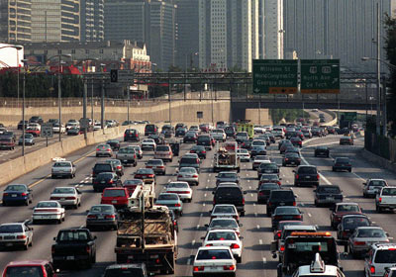
Example: Atlanta Commutes
What’s the mean commute time for workers in metropolitan Atlanta?
Data: The American Housing Survey (AHS) collected data from Atlanta in 2004.

Slide 14
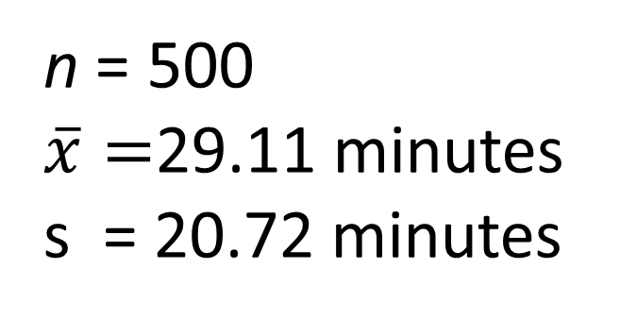
Sample of n=500 Atlanta Commutes
n = 500
$\overline{x}=$29.11 minutes
s = 20.72 minutes
Where is “true” μ?

Slide 15
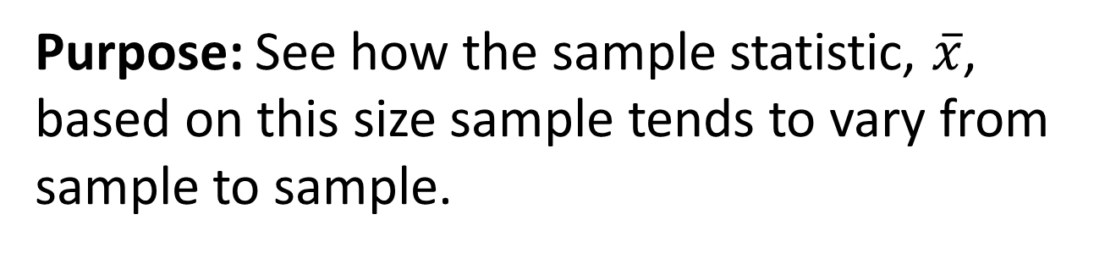
“Bootstrap” Samples
Key idea: Sample with replacement from the original sample using the same n.
Assumes the “population” is many, many copies of the original sample.
Purpose: See how the sample statistic, $\overline{x}$, based on this size sample tends to vary from sample to sample.

Slide 16
Creating a Bootstrap Distribution (using Fathom)
1. Start with the sample in a collection.
2. Define the statistic of interest (as a measure).
3. Create a sample with replacement (same n).
4. Collect the measures for lots of samples.
5. Analyze the distribution of collected measures.

Slide 17
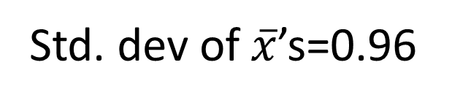
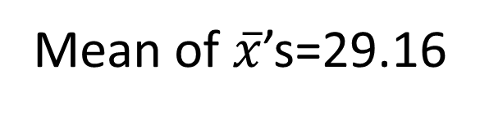
Bootstrap Distribution of 1000 Atlanta Commute Means
Mean of $\overline{x}$’s=29.16
Std. dev of $\overline{x}$’s=0.96

Slide 18
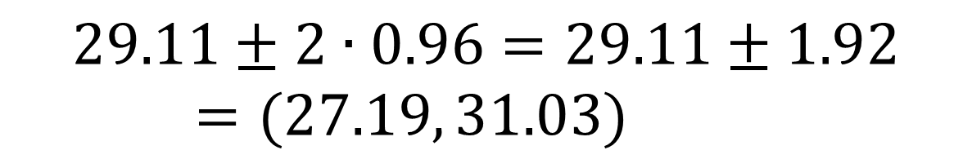

Using the Bootstrap Distribution to Get a Confidence Interval – Version #1
The standard deviation of the bootstrap statistics estimates the standard error of the sample statistic.
Quick interval estimate :
$$Original Statistic ±2∙SE$$
For the mean Atlanta commute time:
$$29.11±2∙0.96=29.11±1.92=(27.19, 31.03)$$

Slide 19
Using the Bootstrap Distribution to Get a Confidence Interval – Version #2
27.19
31.03
Keep 95% in middle
Chop 2.5% in each tail
Chop 2.5% in each tail
$$29.11±2∙0.96=(27.19, 31.03)$$

Slide 20
Using the Bootstrap Distribution to Get a Confidence Interval – Version #2
95% CI=(27.33,31.00)
27.33
31.00
Keep 95% in middle
Chop 2.5% in each tail
Chop 2.5% in each tail
For a 95% CI, find the 2.5%-tile and 97.5%-tile in the bootstrap distribution

Slide 21
90% CI for Mean Atlanta Commute
90% CI=(27.52,30.68)
27.52
30.68
Keep 90% in middle
Chop 5% in each tail
Chop 5% in each tail
For a 90% CI, find the
5%-tile and 95%-tile in the bootstrap distribution

Slide 22
99% CI for Mean Atlanta Commute
99% CI=(27.02,31.82)
27.02
31.82
Keep 99% in middle
Chop 0.5% in each tail
Chop 0.5% in each tail
For a 99% CI, find the 0.5%-tile and 99.5%-tile in the bootstrap distribution

Slide 23
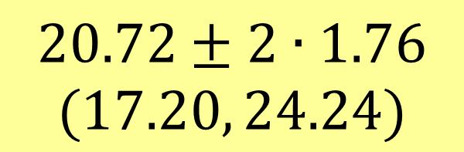
Other Parameters?
Find a 95% confidence interval for the standard deviation, σ, of Atlanta commute times.
Original sample: s=20.72
$$20.72±2∙1.76$$
$$(17.20, 24.24)$$

Slide 24
Other Parameters?
Find a 98% confidence interval for the correlation between time and distance of Atlanta commutes.
Original sample: r =0.807
(0.71, 0.87)

Slide 25
Questions?
For more info:
Patti Frazer Lock plock@stlawu.edu
Robin Lock rlock@stlawu.edu

