Slide 1
Using Randomization Methods to Build Conceptual Understanding of Statistical Inference:
Day 2
Lock, Lock, Lock Morgan, Lock, and Lock
MAA Minicourse- Joint Mathematics Meetings
Baltimore, MD
January 2014
Notes:
Bozz

Slide 2
Schedule: Day 2
Saturday, 1/18, 1:00 – 3:00 pm
5. More on Randomization Tests
How do we generate randomization distributions for various statistical tests?
How do we assess student understanding when using this approach?
6. Connecting Intervals and Tests
7. Connecting Simulation Methods to Traditional
8. Technology Options
Other software for simulatiions (Minitab, Fathom, R, Excel, ...)
Bascis summary stats/graphs with StatKey
A more advanced randmization with StatKey
9. Wrap-up
How has this worked in the classroom?
Participant comments and questions
10. Evaluations
Notes:
Denn

Slide 3
Cocaine Addiction
In a randomized experiment on treating cocaine addiction, 48 people were randomly assigned to take either Desipramine (a new drug), or Lithium (an existing drug)
The outcome variable is whether or not a patient relapsed
Is there convincing evidence to conclude that Desipramine is better than Lithium at treating cocaine addiction?
Notes:
Bozz

Slide 4
R
R
R
R
R
R
R
R
R
R
R
R
R
R
R
R
R
R
R
R
R
R
R
R
R
R
R
R
R
R
R
R
R
R
R
R
R
R
R
R
R
R
R
R
R
R
R
R
1. Randomly assign units to treatment groups
Desipramine
Lithium
R
R
R
R
R
R
R
R
R
R
R
R
R
R
R
R
R
R
R
R
R
R
R
R
R
R
R
R
R
R
R
R
R
R
R
R
R
R
R
R
R
R
R
R
Notes:
Bozz

Slide 5
2. Observe relapse counts in each group
3. Compare the proportions who relapse
R = Relapse
N = No Relapse
1. Randomly assign units to treatment groups
Desipramine
Lithium
R
R
R
R
R
R
R
R
R
R
R
R
R
R
R
R
R
R
R
R
R
R
R
R
R
R
R
R
R
R
R
R
N
R
N
R
R
R
R
R
R
R
R
R
R
R
R
R
N
R
N
R
N
N
N
N
N
N
N
N
R
R
R
R
R
R
R
R
R
R
R
R
N
N
N
N
N
N
N
N
N
N
N
N
N
N
N
N
N
N
N
N
N
N
N
N
10 relapse, 14 no relapse
18 relapse, 6 no relapse
Is this convincing evidence?
Notes:
Bozz

Slide 6
Randomization Test
Assume the null hypothesis is true
Simulate new randomizations
For each, calculate the statistic of interest
Find the proportion of these simulated statistics that are as extreme as your observed statistic
Notes:
Bozz

Slide 7
R
R
R
R
R
R
R
R
R
R
R
R
R
R
R
R
N
N
R
R
R
R
R
R
N
N
N
N
N
N
R
R
R
R
R
R
N
N
N
N
N
N
N
N
N
N
N
N
10 relapse, 14 no relapse
18 relapse, 6 no relapse
Notes:
Bozz

Slide 8
R
R
R
R
R
R
R
R
R
R
R
R
R
R
R
R
N
N
R
R
R
R
R
R
N
N
N
N
N
N
R
R
R
R
R
R
N
N
N
N
N
N
N
N
N
N
N
N
Simulate another randomization
Desipramine
Lithium
R
N
R
N
N
N
N
R
R
R
R
R
R
R
N
R
R
N
N
N
R
N
R
R
R
N
N
R
N
R
R
N
R
N
N
N
R
R
R
N
R
R
R
R
16 relapse, 8 no relapse
12 relapse, 12 no relapse
Notes:
Bozz

Slide 9
Simulate another randomization
Desipramine
Lithium
R
R
R
R
R
R
R
R
R
R
R
R
R
N
R
R
N
N
R
R
R
R
R
R
R
R
N
R
N
R
R
R
R
R
R
R
R
N
R
N
R
R
N
N
N
N
N
N
17 relapse, 7 no relapse
11 relapse, 13 no relapse
Notes:
Bozz

Slide 10
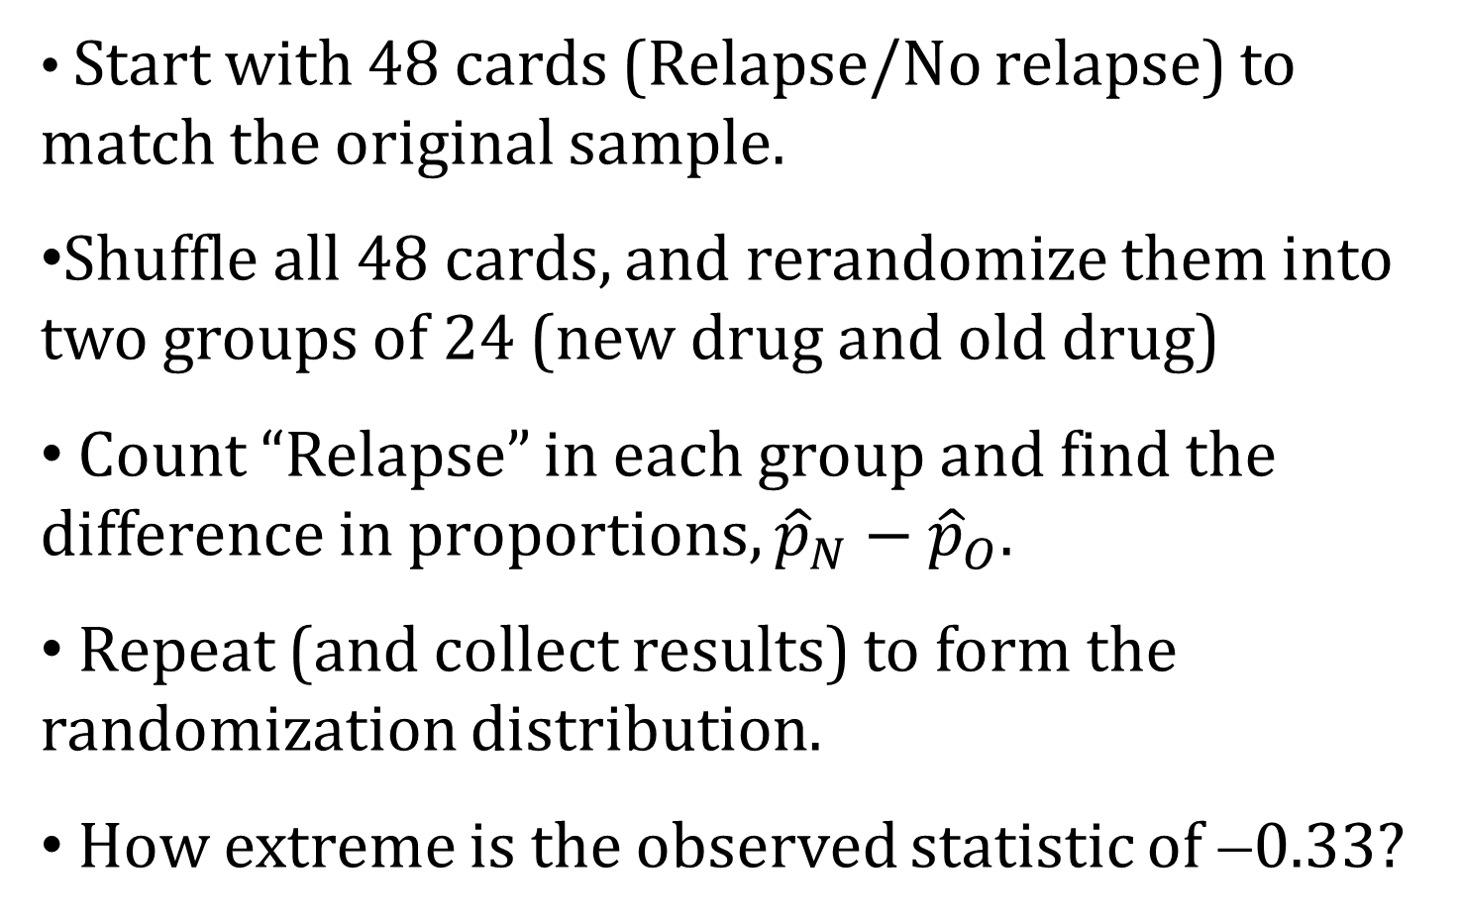
Physical Simulation
Start with 48 cards (Relapse/No relapse) to match the original sample.
Shuffle all 48 cards, and rerandomize them into two groups of 24 (new drug and old drug)
Count “Relapse” in each group and find the difference in proportions, ${\hat{p}}_{N}−{\hat{p}}_{O}$.
Repeat (and collect results) to form the randomization distribution.
How extreme is the observed statistic of −0.33?

Slide 11
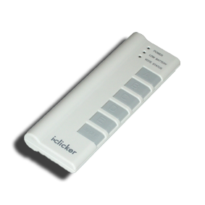
The observed difference in proportions was -0.33. How unlikely is this if there is no difference in the drugs? To begin to get a sense of this: How many of you had a randomly simulated difference in proportions this extreme?
Was your simulated difference in proportions more extreme than the sample statistic (that is, was it less than or equal to -0.33)?
Yes
No
Notes:
Denn

Slide 12
Cocaine Addiction
  A randomization sample must:
  Use the data that we have
  (That’s why we didn’t change any of the results on the cards)
  AND
  Match the null hypothesis
  (That’s why we assumed the drug didn’t matter and combined the cards)
Notes:
Patti

Slide 13
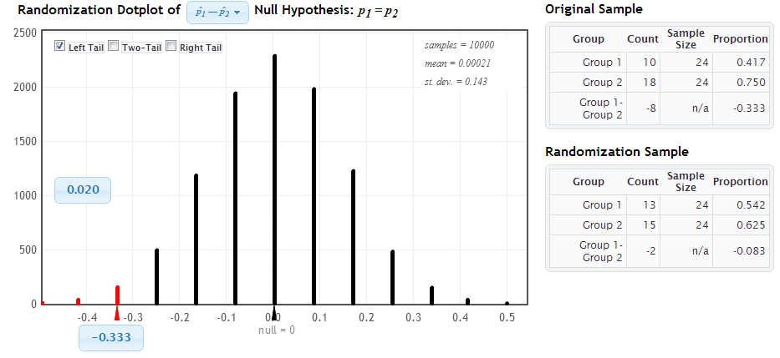
StatKey
Distribution of Statistic Assuming Null is True
Proportion as extreme as observed statistic
observed statistic
The probability of getting results as extreme or more extreme than those observed if the null hypothesis is true, is about .02.
p-value
Notes:
Patti

Slide 14
How can we do a randomization test for a correlation?
Notes:
Denn

Slide 15
Is the number of penalties given to an NFL team positively correlated with the “malevolence” of the team’s uniforms?
Notes:
Denn

Slide 16
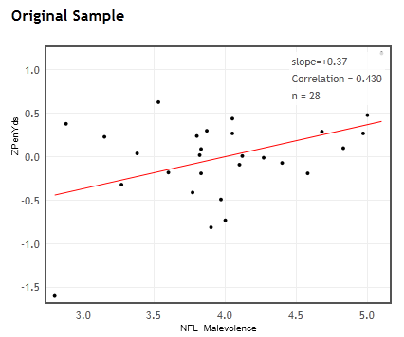


Ex: NFL uniform “malevolence” vs. Penalty yards
r = 0.430
n = 28
Is there evidence that the population correlation is positive?
Notes:
Denn

Slide 17
Key idea: Generate samples that are
(a) consistent with the null hypothesis
(b) based on the sample data.
H₀ : ρ = 0
r = 0.43, n = 28
How can we use the sample data, but ensure that the correlation is zero?
Notes:
Denn

Slide 18
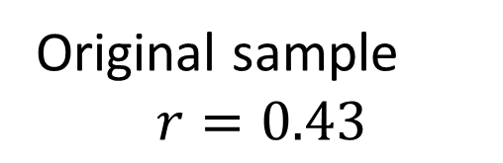
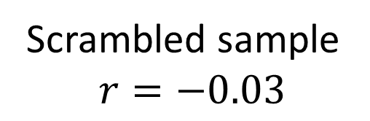
Randomization by Scrambling
Original sample
$$r=0.43$$
Scrambled sample
$$r=−0.03$$

Slide 19
Randomize one of the variables!
Let’s look at StatKey.
Notes:
Denn

Slide 20
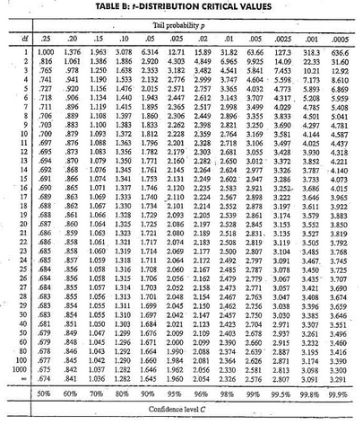
Traditional Inference
1. Which formula?
4. Which theoretical distribution?
5. df?
6. find p-value
2. Calculate numbers and plug into formula
3. Plug into calculator
0.01 < p-value < 0.02
Notes:
Denn

Slide 21
How can we do a randomization test for a mean?
Notes:
Rups

Slide 22

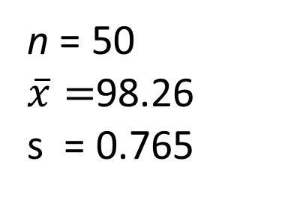
Example: Mean Body Temperature
Is the average body temperature really 98.6ºF?
H₀:μ=98.6
H_{a}:μ≠98.6
Data: A random sample of n=50 body temperatures.
n = 50
$\overline{x}=$98.26
s = 0.765
Data from Allen Shoemaker, 1996 JSE data set article
Notes:
Rups

Slide 23
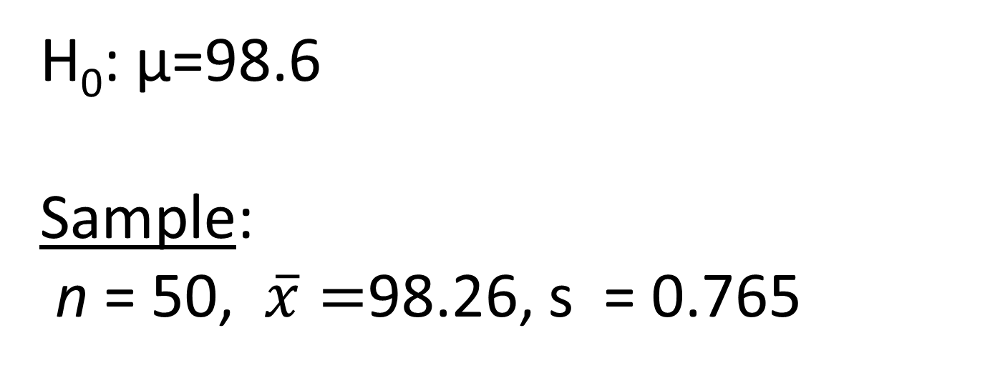
Key idea: Generate samples that are
(a) consistent with the null hypothesis
(b) based on the sample data.
How to simulate samples of body temperatures to be consistent with H₀: μ=98.6?
Notes:
Rups

Slide 24
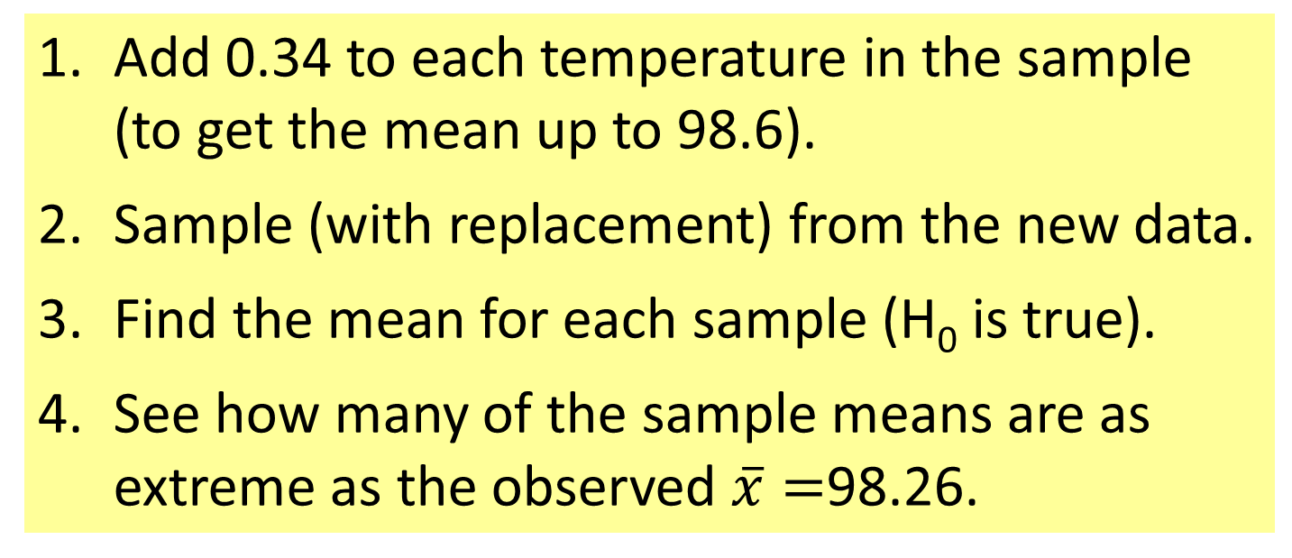
Randomization Samples
How to simulate samples of body temperatures to be consistent with H₀: μ=98.6?
Add 0.34 to each temperature in the sample (to get the mean up to 98.6).
Sample (with replacement) from the new data.
Find the mean for each sample (H₀ is true).
See how many of the sample means are as extreme as the observed $\overline{x}=$98.26.
Notes:
Rups

Slide 25
Let’s try
it on
StatKey.
Notes:
Kari/Rups

Slide 26
Playing with StatKey!
See the orange pages in the folder.
Notes:
Kari/Rups

Slide 27
Choosing a Randomization Method
Example: Word recall
A=Sleep | 14 | 18 | 11 | 13 | 18 | 17 | 21 | 9 | 16 | 17 | 14 | 15 | mean=15.25
B=Caffeine | 12 | 12 | 14 | 13 | 6 | 18 | 14 | 16 | 10 | 7 | 15 | 10 | mean=12.25
H₀: μ_{A}=μ_{B} vs. H_{a}: μ_{A}≠μ_{B}
Reallocate
Option 1: Randomly scramble the A and B labels and assign to the 24 word recalls.
Resample
Option 2: Combine the 24 values, then sample (with replacement) 12 values for Group A and 12 values for Group B.

Slide 28
Question
In Intro Stat, how critical is it for the method of randomization to reflect the way data were collected?
A. Essential
B. Relatively important
C. Desirable, but not imperative
D. Minimal importance
E. Ignore the issue completely

Slide 29
How do we assess student understanding of these methods
(even on in-class exams without computers)?
See the blue pages in the folder.
Notes:
Kari/Rups

Slide 30
Connecting CI’s and Tests
Randomization body temp means when μ=98.6
Bootstrap body temp means from the original sample
What’s the difference?
Notes:
Rups

Slide 31
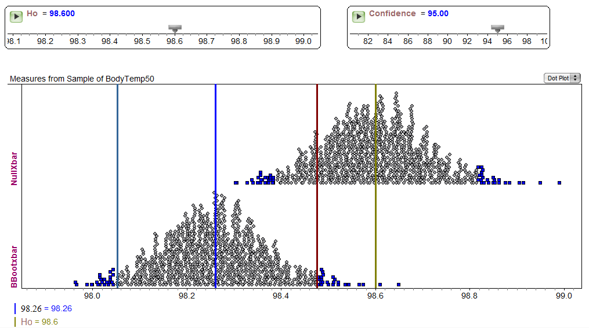
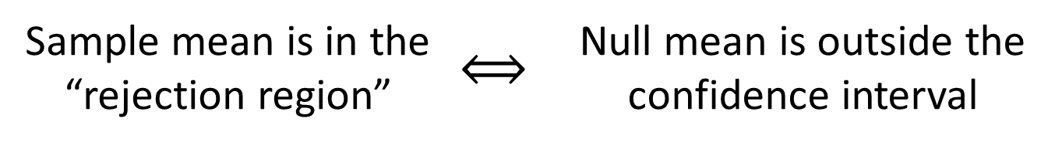
Fathom Demo: Test & CI
Sample mean is in the “rejection region” | $$⟺$$ | Null mean is outside the confidence interval
Notes:
Rups

Slide 32
What about Traditional Methods?
Notes:
Patti

Slide 33
Transitioning to Traditional Inference
AFTER students have seen lots of bootstrap distributions and randomization distributions…
Students should be able to
Find, interpret, and understand a confidence interval
Find, interpret, and understand a p-value
Notes:
M Lock

Slide 34
Bootstrap and Randomization Distributions
Correlation: Malevolent uniforms
Slope :Restaurant tips
All bell-shaped distributions!
What do you notice?
Mean :Body Temperatures
Diff means: Finger taps
Proportion : Owners/dogs
Mean : Atlanta commutes
Notes:
M Lock

Slide 35
The students are primed and ready to learn about the normal distribution!
Notes:
M Lock

Slide 36
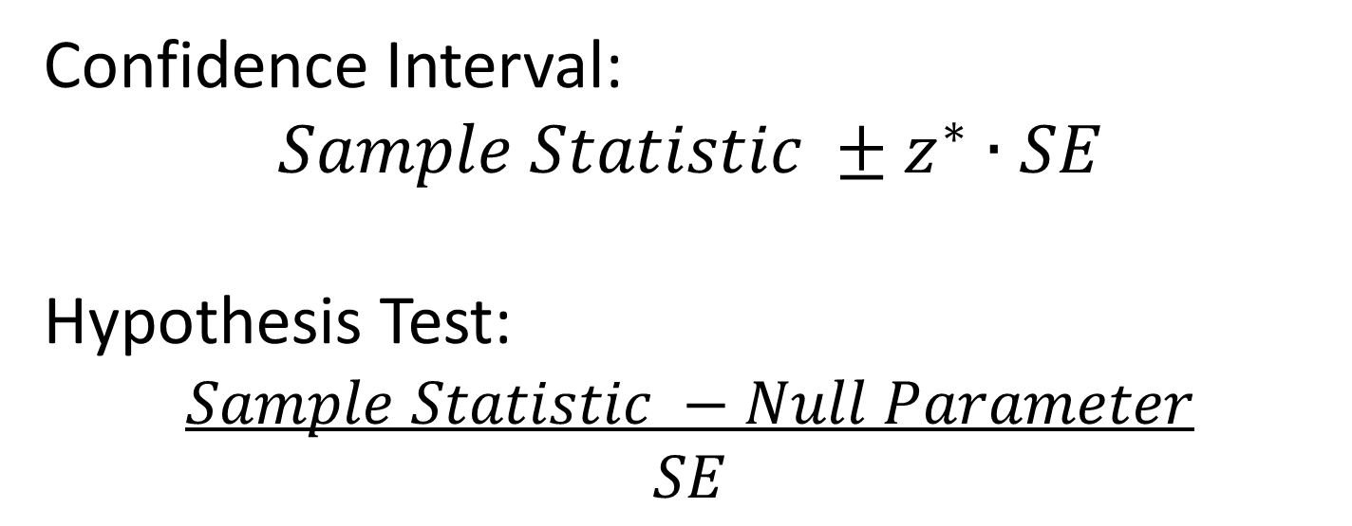
Transitioning to Traditional Inference
Introduce the normal distribution (and later t)
Introduce “shortcuts” for estimating SE for proportions, means, differences, slope…
Confidence Interval:
$$Sample Statistic ±z^{∗}∙SE$$
Hypothesis Test:
$$Sample Statistic −Null Parameter$$
$$SE$$
Notes:
M Lock

Slide 37
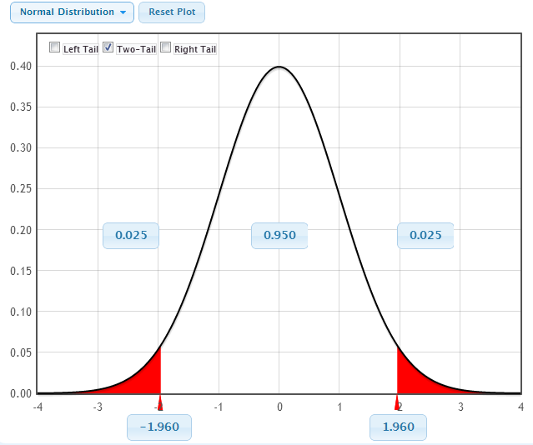
Confidence Intervals
95%
-z*
z*
Notes:
Patti

Slide 38
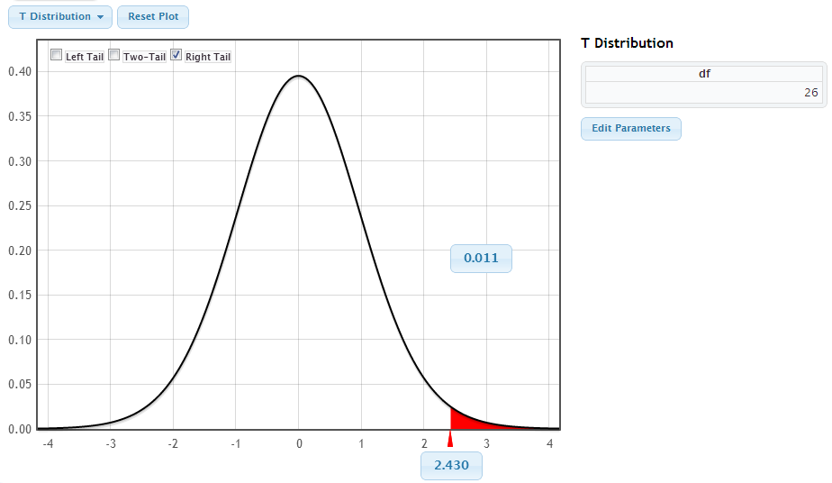
Hypothesis Tests
95%
Area is p-value
Test statistic
Notes:
M Lock

Slide 39
Yes! Students see the general pattern and not just individual formulas!
Confidence Interval:
$$Sample Statistic ±z^{∗}∙SE$$
Hypothesis Test:
$$Sample Statistic −Null Parameter$$
$$SE$$
Notes:
M Lock

Slide 40
Other Technology Options
Your binder includes information for doing several simulation examples using
Minitab (macros)
R (defined functions)
Excel (PopTools ad-in)
Fathom (drag/drop/menus)
Matlab (commands)
SAS (commands)
Notes:
All

Slide 41
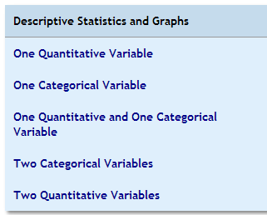
More StatKey
Basic Statistics/Graphics
Notes:
All

Slide 42
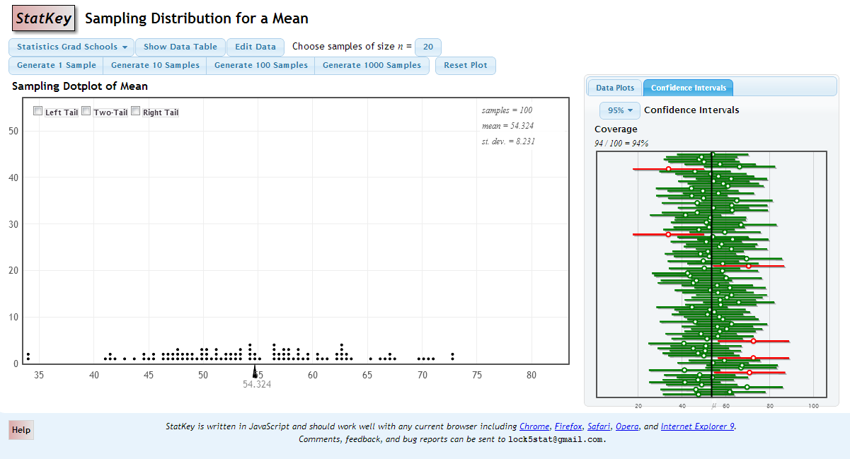
Sampling Distribution
Capture Rate

Slide 43
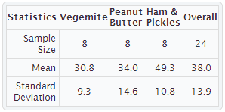
Example: Sandwich Ants
Experiment:
Place pieces of sandwich on the ground, count how many ants are attracted. Does it depend on filing?
Favourite Experiments: An Addendum to What is the Use of Experiments Conducted by Statistics Students? Margaret Mackisack
http://www.amstat.org/publications/jse/v2n1/mackisack.supp.html

Slide 44
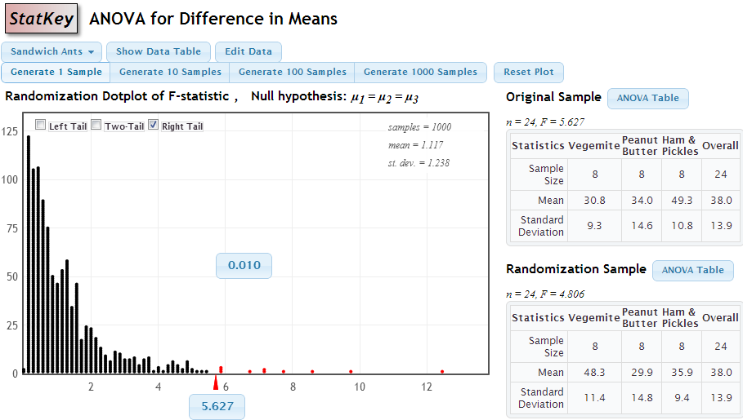

Slide 45
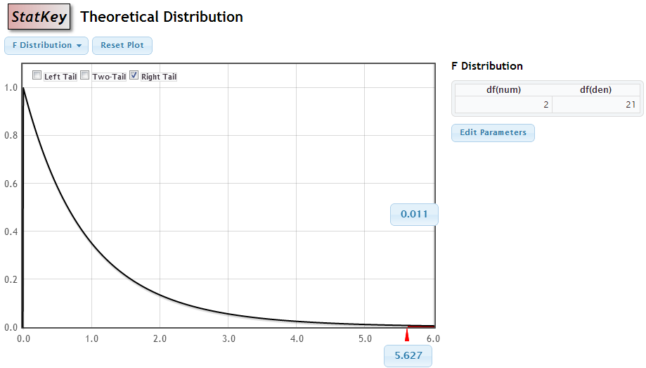

Slide 46
Student Preferences
Which way of doing inference gave you a better conceptual understanding of confidence intervals and hypothesis tests?
Bootstrapping and Randomization | Formulas and Theoretical Distributions
113 | 51
69% | 31%
Notes:
Kari

Slide 47
Student Preferences
Which way did you prefer to learn inference (confidence intervals and hypothesis tests)?
Bootstrapping and Randomization | Formulas and Theoretical Distributions
105 | 60
64% | 36%
 | Simulation | Traditional
AP Stat | 31 | 36
No AP Stat | 74 | 24
Notes:
Kari

Slide 48
Student Behavior
Students were given data on the second midterm and asked to compute a confidence interval for the mean
How they created the interval:
Bootstrapping | t.test in R | Formula
94 | 9 | 9
84% | 8% | 8%
Notes:
They had spent 6 classes on simulation methods over a month ago and the 7 most recent classes using theoretical distributions
they had just had to use the formulas on the in-class exam the day before

Slide 49
A Student Comment
" I took AP Stat in high school and I got a 5. It was mainly all equations, and I had no idea of the theory behind any of what I was doing.
Statkey and bootstrapping really made me understand the concepts I was learning, as opposed to just being able to just spit them out on an exam.”
- one of Kari’s students
Notes:
Kari

Slide 50
Thank you for joining us!
More information is available on www.lock5stat.com
Feel free to contact any of us with any comments or questions.

