Slide 1
Using Randomization Methods to Build Conceptual Understanding of Statistical Inference:
Day 2
Lock, Lock, Lock, Lock, and Lock
Minicourse- Joint Mathematics Meetings
Boston, MA
January 2012

Slide 2
Cocaine Addiction
In a randomized experiment on treating cocaine addiction, 48 people were randomly assigned to take either Desipramine (a new drug), or Lithium (an existing drug)
The outcome variable is whether or not a patient relapsed
Is Desipramine significantly better than Lithium at treating cocaine addiction?

Slide 3
R
R
R
R
R
R
R
R
R
R
R
R
R
R
R
R
R
R
R
R
R
R
R
R
R
R
R
R
R
R
R
R
R
R
R
R
R
R
R
R
R
R
R
R
R
R
R
R
1. Randomly assign units to treatment groups
Desipramine
Lithium
R
R
R
R
R
R
R
R
R
R
R
R
R
R
R
R
R
R
R
R
R
R
R
R
R
R
R
R
R
R
R
R
R
R
R
R
R
R
R
R
R
R
R
R

Slide 4
2. Conduct experiment
3. Observe relapse counts in each group
R = Relapse
N = No Relapse
1. Randomly assign units to treatment groups
Desipramine
Lithium
R
R
R
R
R
R
R
R
R
R
R
R
R
R
R
R
R
R
R
R
R
R
R
R
R
R
R
R
R
R
R
R
N
R
N
R
R
R
R
R
R
R
R
R
R
R
R
R
N
R
N
R
N
N
N
N
N
N
N
N
R
R
R
R
R
R
R
R
R
R
R
R
N
N
N
N
N
N
N
N
N
N
N
N
N
N
N
N
N
N
N
N
N
N
N
N
10 relapse, 14 no relapse
18 relapse, 6 no relapse

Slide 5
Randomization Test
Assume the null hypothesis is true
Simulate new randomizations
For each, calculate the statistic of interest
Find the proportion of these simulated statistics that are as extreme as your observed statistic

Slide 6
R
R
R
R
R
R
R
R
R
R
R
R
R
R
R
R
N
N
R
R
R
R
R
R
N
N
N
N
N
N
R
R
R
R
R
R
N
N
N
N
N
N
N
N
N
N
N
N
10 relapse, 14 no relapse
18 relapse, 6 no relapse

Slide 7
R
R
R
R
R
R
R
R
R
R
R
R
R
R
R
R
N
N
R
R
R
R
R
R
N
N
N
N
N
N
R
R
R
R
R
R
N
N
N
N
N
N
N
N
N
N
N
N
Simulate another randomization
Desipramine
Lithium
R
N
R
N
N
N
N
R
R
R
R
R
R
R
N
R
R
N
N
N
R
N
R
R
R
N
N
R
N
R
R
N
R
N
N
N
R
R
R
N
R
R
R
R
16 relapse, 8 no relapse
12 relapse, 12 no relapse

Slide 8
Simulate another randomization
Desipramine
Lithium
R
R
R
R
R
R
R
R
R
R
R
R
R
N
R
R
N
N
R
R
R
R
R
R
R
R
N
R
N
R
R
R
R
R
R
R
R
N
R
N
R
R
N
N
N
N
N
N
17 relapse, 7 no relapse
11 relapse, 13 no relapse

Slide 9
Simulate!
Combine everyone into one group, and rerandomize them into the two groups
Compute your difference in proportions
Create the randomization distribution
How extreme is the observed statistic of -0.33?
Use StatKey for more simulations

Slide 10
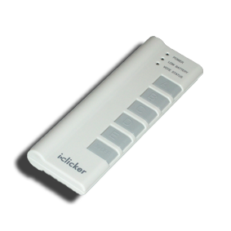
The observed difference in proportions was -0.33. How unlikely is this if there is no difference in the drugs? To begin to get a sense of this: How many of you had a randomly simulated difference in proportions this extreme?
Was your simulated difference in proportions more extreme than the sample statistic (that is, was it less than or equal to -0.33)?
Yes
No
Notes:
Denn

Slide 11
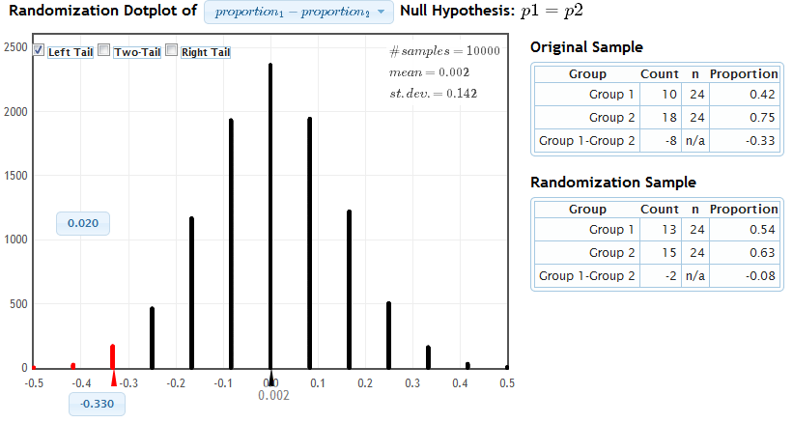
StatKey
Proportion as extreme as observed statistic
observed statistic
The probability of getting results as extreme or more extreme than those observed if the null hypothesis is true, is about .02.
p-value

Slide 12
Cocaine Addiction
You want to know what would happen
  by random chance (the random allocation to treatment groups)
  if the null hypothesis is true (there is no difference between the drugs)
  Why did you re-deal your cards?
  Why did you leave the outcomes (relapse or no relapse) unchanged on each card?

Slide 13
How can we do a randomization test for a mean?
Notes:
Bozz

Slide 14

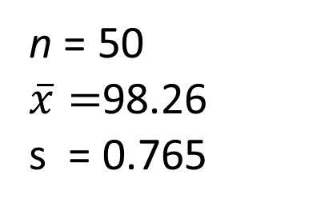
Example: Mean Body Temperature
Is the average body temperature really 98.6ºF?
H₀:μ=98.6
H_{a}:μ≠98.6
Data: A random sample of n=50 body temperatures.
n = 50
$\overline{x}=$98.26
s = 0.765
Data from Allen Shoemaker, 1996 JSE data set article
Notes:
Bozz

Slide 15
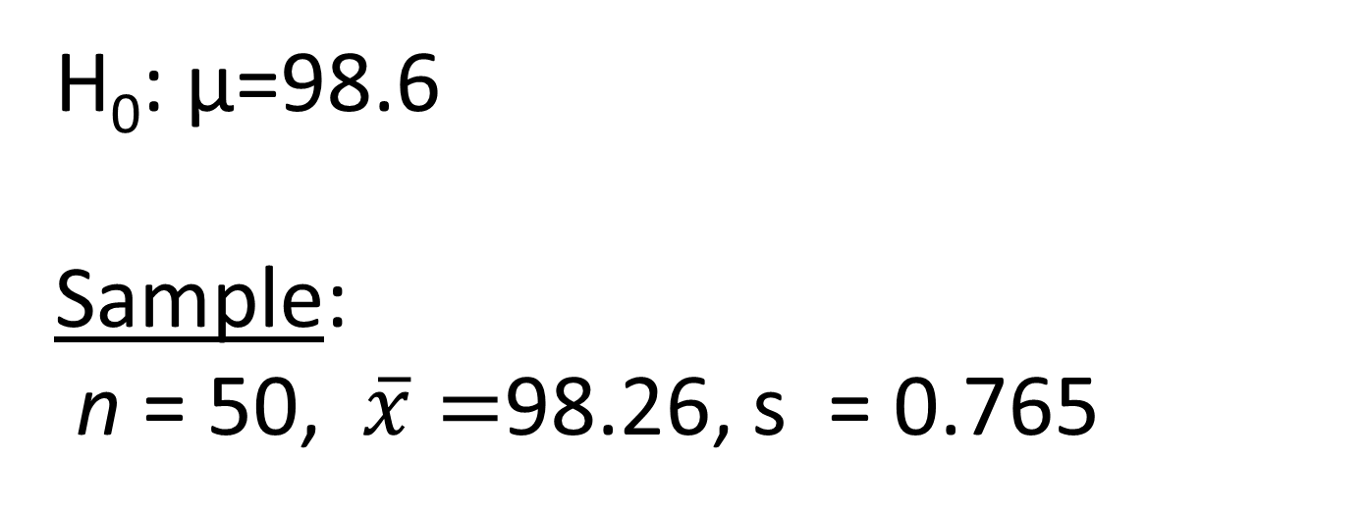
Key idea: Generate samples that are
(a) consistent with the null hypothesis
(b) based on the sample data.
How to simulate samples of body temperatures to be consistent with H₀: μ=98.6?
Notes:
Bozz

Slide 16
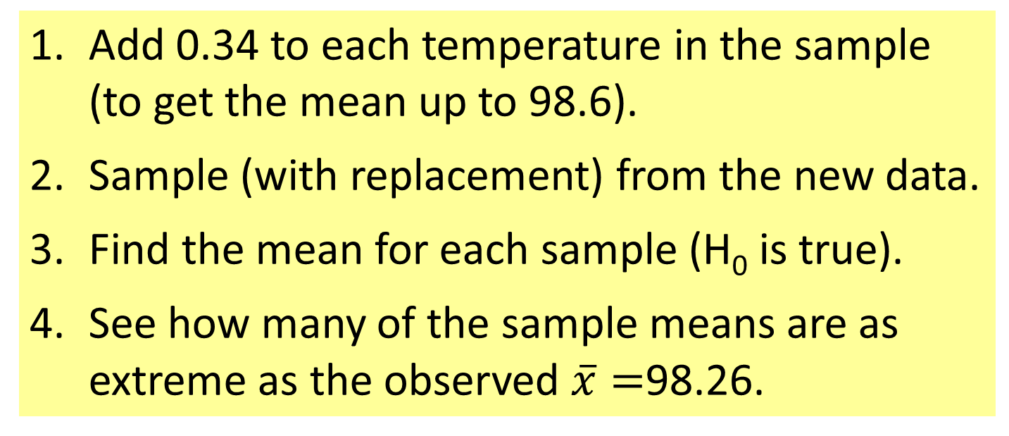
Randomization Samples
How to simulate samples of body temperatures to be consistent with H₀: μ=98.6?
Add 0.34 to each temperature in the sample (to get the mean up to 98.6).
Sample (with replacement) from the new data.
Find the mean for each sample (H₀ is true).
See how many of the sample means are as extreme as the observed $\overline{x}=$98.26.
Notes:
Bozz

Slide 17
Let’s try
it on
StatKey.
Notes:
Bozz

Slide 18
How can we do a randomization test for a correlation?
Notes:
Denn

Slide 19
Is the number of penalties given to an NFL team positively correlated with the “malevolence” of the team’s uniforms?
Notes:
Denn

Slide 20
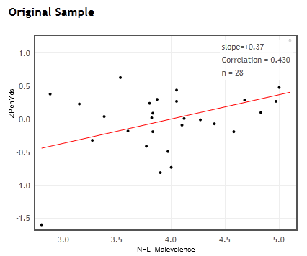


Ex: NFL uniform “malevolence” vs. Penalty yards
r = 0.430
n = 28
Is there evidence that the population correlation is positive?
Notes:
Denn

Slide 21
Key idea: Generate samples that are
(a) consistent with the null hypothesis
(b) based on the sample data.
H₀ : ρ = 0
r = 0.43, n = 28
How can we use the sample data, but ensure that the correlation is zero?
Notes:
Denn

Slide 22
Randomize one of the variables!
Let’s look at StatKey.
Notes:
Denn

Slide 23
Playing with StatKey!
See the orange pages in the folder.
Notes:
Denn introduces

Slide 24
Choosing a Randomization Method
Example: Word recall
A=Sleep | 14 | 18 | 11 | 13 | 18 | 17 | 21 | 9 | 16 | 17 | 14 | 15 | mean=15.25
B=Caffeine | 12 | 12 | 14 | 13 | 6 | 18 | 14 | 16 | 10 | 7 | 15 | 10 | mean=12.25
H₀: μ_{A}=μ_{B} vs. H_{a}: μ_{A}≠μ_{B}
Reallocate
Option 1: Randomly scramble the A and B labels and assign to the 24 word recalls.
Resample
Option 2: Combine the 24 values, then sample (with replacement) 12 values for Group A and 12 values for Group B.

Slide 25
Question
In Intro Stat, how critical is it for the method of randomization to reflect the way data were collected?
A. Essential
B. Relatively important
C. Desirable, but not imperative
D. Minimal importance
E. Ignore the issue completely

Slide 26
How do we assess student understanding of these methods
(even on in-class exams without computers)?
See the blue pages in the folder.
Notes:
Bozz introduces.

Slide 27
Collecting More Data from You!

Slide 28
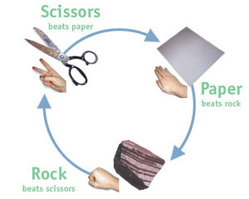
Rock-Paper-Scissors (Roshambo)
Play a game!
Can we use statistics to help us win?

Slide 29
Rock-Paper-Scissors
Which did you throw?
  A). Rock
  B). Paper
  C). Scissors

Slide 30
Rock-Paper-Scissors
Are the three options thrown equally often on the first throw?
In particular, is the proportion throwing Rock equal to 1/3?

Slide 31
What about Traditional Methods?
Notes:
Patti

Slide 32
Intro Stat – Revised the Topics
Data production (samples/experiments)
Descriptive Statistics – one and two samples
Bootstrap confidence intervals
Randomization-based hypothesis tests
Normal/sampling distributions
Confidence intervals (means/proportions)
Hypothesis tests (means/proportions)
ANOVA for several means, Inference for regression, Chi-square tests
Notes:
Rups

Slide 33
Transitioning to Traditional Inference
AFTER students have seen lots of bootstrap distributions and randomization distributions…
Students should be able to
Find, interpret, and understand a confidence interval
Find, interpret, and understand a p-value
Notes:
M Lock

Slide 34
Bootstrap and Randomization Distributions
Correlation: Malevolent uniforms
Slope :Restaurant tips
All bell-shaped distributions!
What do you notice?
Mean :Body Temperatures
Diff means: Finger taps
Proportion : Owners/dogs
Mean : Atlanta commutes
Notes:
M Lock

Slide 35
The students are primed and ready to learn about the normal distribution!
Notes:
M Lock

Slide 36
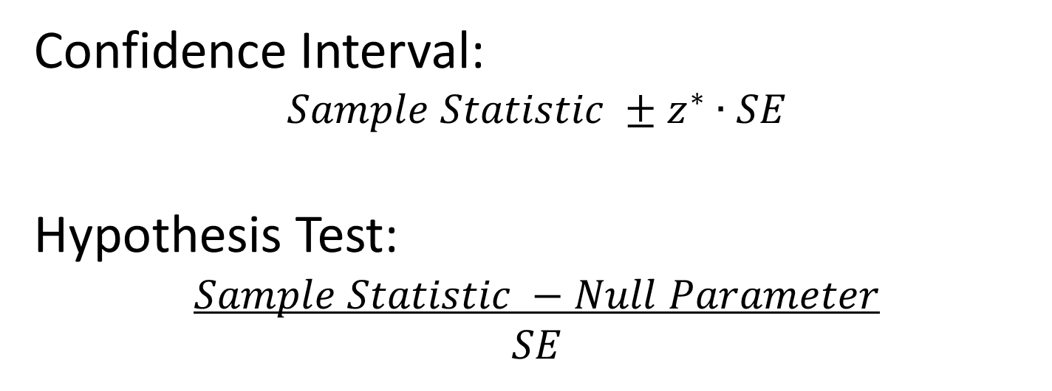
Transitioning to Traditional Inference
Introduce the normal distribution (and later t)
Introduce “shortcuts” for estimating SE for proportions, means, differences, slope…
Confidence Interval:
$$Sample Statistic ±z^{∗}∙SE$$
Hypothesis Test:
$$Sample Statistic −Null Parameter$$
$$SE$$
Notes:
M Lock

Slide 37
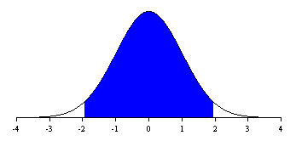
Confidence Intervals
95%
-z*
z*

Slide 38
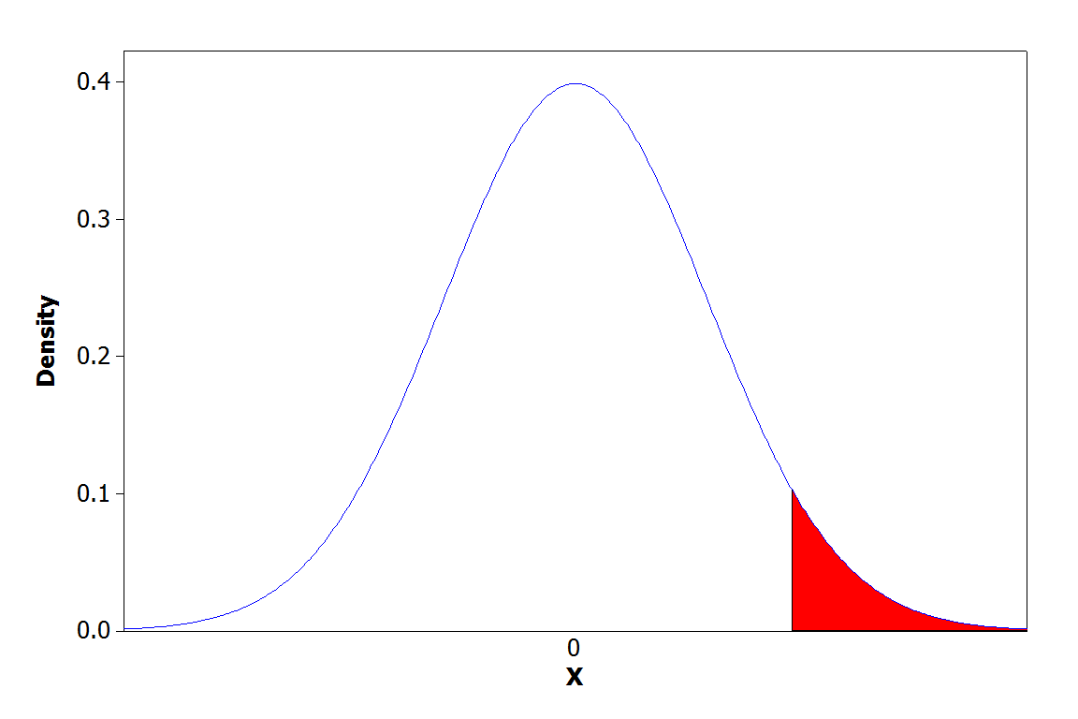
Hypothesis Tests
95%
Area is p-value
Test statistic
Notes:
M Lock

Slide 39
Yes! Students see the general pattern and not just individual formulas!
Confidence Interval:
$$Sample Statistic ±z^{∗}∙SE$$
Hypothesis Test:
$$Sample Statistic −Null Parameter$$
$$SE$$
Notes:
M Lock

Slide 40
Connecting CI’s and Tests
Randomization body temp means when μ=98.6
Bootstrap body temp means from the original sample
What’s the difference?
Notes:
Rups

Slide 41
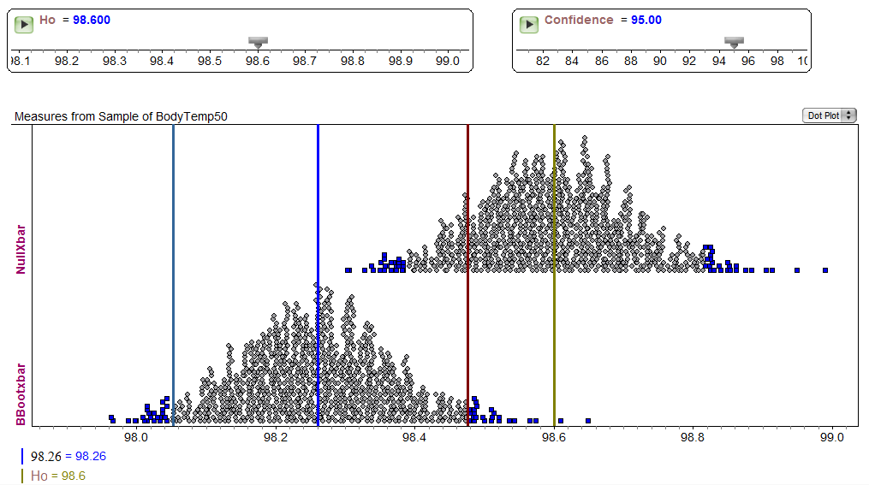
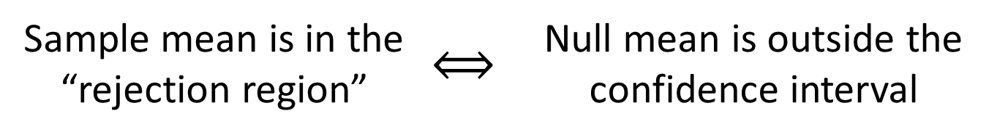
Fathom Demo: Test & CI
Sample mean is in the “rejection region” | $$⟺$$ | Null mean is outside the confidence interval
Notes:
Rups

Slide 42
Technology Sessions
Choose Two!
(The folder includes information on using Minitab, R, Excel, Fathom, Matlab, and SAS.)
Notes:
Rups

Slide 43
Student Preferences
Which way did you prefer to learn inference (confidence intervals and hypothesis tests)?
Bootstrapping and Randomization | Formulas and Theoretical Distributions
39 | 19
67% | 33%
Notes:
Kari

Slide 44
Student Preferences
Which way do you prefer to do inference?
Bootstrapping and Randomization | Formulas and Theoretical Distributions
42 | 16
72% | 28%
Notes:
Kari

Slide 45
Student Preferences
Which way of doing inference gave you a better conceptual understanding of confidence intervals and hypothesis tests?
Bootstrapping and Randomization | Formulas and Theoretical Distributions
42 | 16
72% | 27%
Notes:
Kari

Slide 46
Student Preferences
LEARN inference | Simulation | Traditional
AP Stat | 13 | 15
No AP Stat | 26 | 4
DO inference | Simulation | Traditional
AP Stat | 18 | 10
No AP Stat | 24 | 6
UNDERSTAND | Simulation | Traditional
AP Stat | 17 | 11
No AP Stat | 25 | 5
Notes:
Kari (or leave out)

Slide 47
Thank you for joining us!
More information is available on www.lock5stat.com
Feel free to contact any of us with any comments or questions.

