Slide 1
Using Randomization Methods to Build Conceptual Understanding in Statistical Inference:
Day 1
Lock, Lock, Lock Morgan, Lock, and Lock
MAA Minicourse – Joint Mathematics Meetings
Baltimore, MD
January 2014
Notes:
Dennis

Slide 2
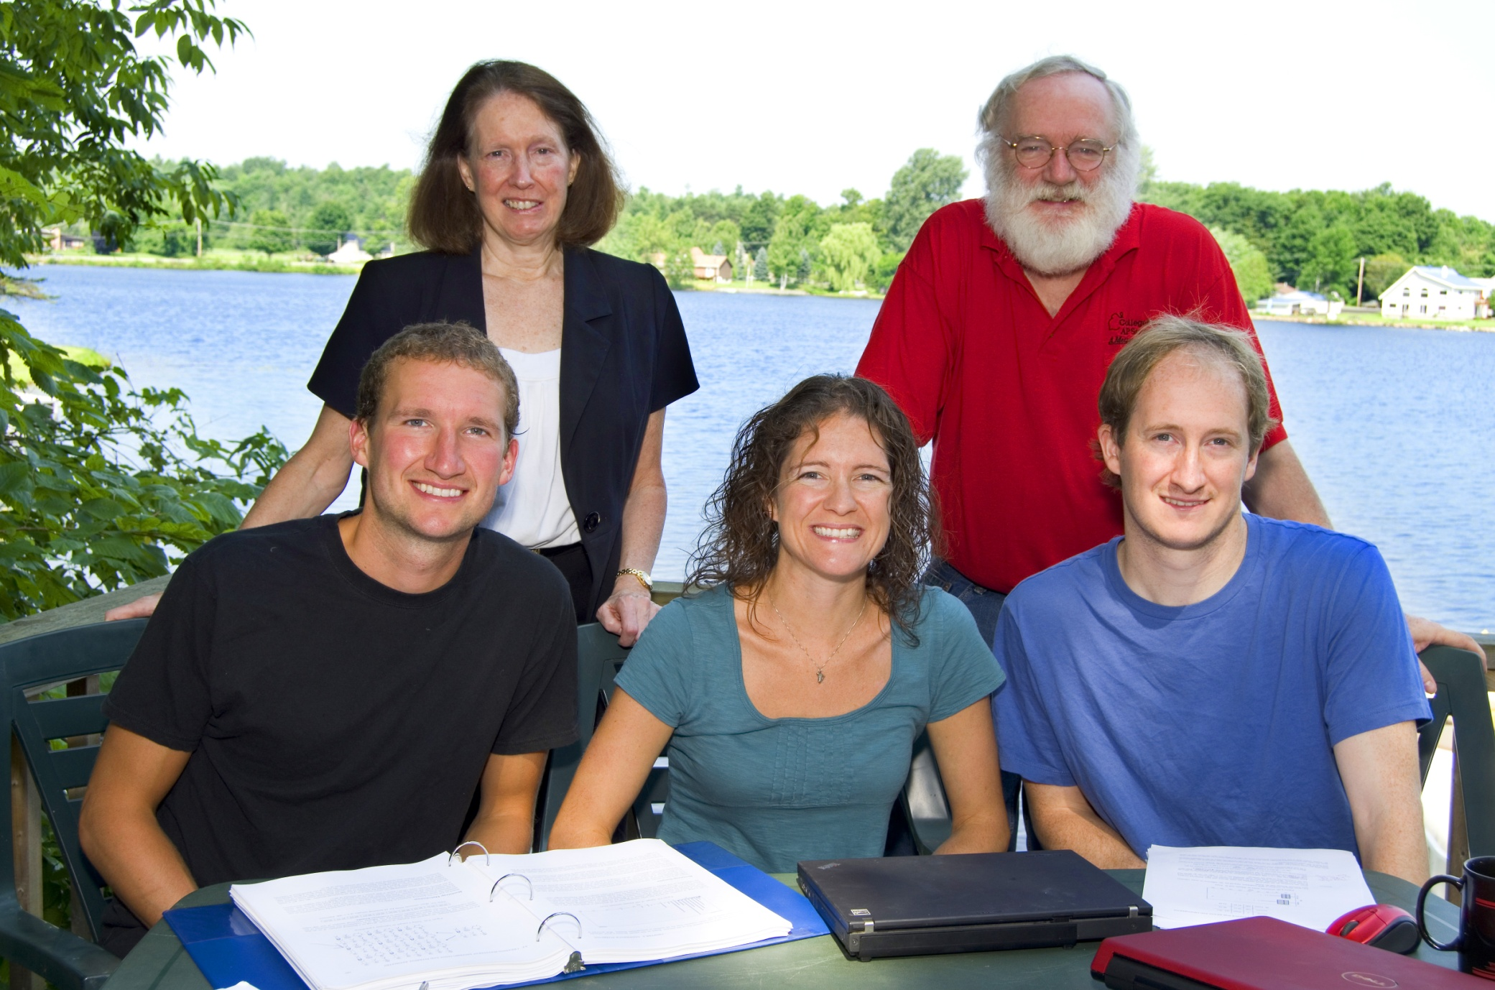
The Lock⁵ Team
Robin & Patti
St. Lawrence
Dennis
Iowa State
Kari
Harvard/Duke
Eric
UNC/Duke

Slide 3
Introductions:
Name
Institution
Notes:
Dennis

Slide 4
Schedule: Day 1
Thursday, 1/16, 1:00 – 3:00 pm
1. Introductions and Overview
2. Bootstrap Confidence Intervals
What is a bootstrap distribution?
How do we use bootstrap distributions to build understanding of confidence intervals?
How do we assess student understanding when using this approach?
3. Getting Started on Randomization Tests
What is a randomization distribution?
How do we use randomization distributions to build understanding of p-values?
4. Minute Papers
Notes:
Denn

Slide 5
Schedule: Day 2
Saturday, 1/18, 1:00 – 3:00 pm
5. More on Randomization Tests
How do we generate randomization distributions for various statistical tests?
How do we assess student understanding when using this approach?
6. Connecting Intervals and Tests
7. Connecting Simulation Methods to Traditional
8. Technology Options
Other software for simulations (Minitab, Fathom, R, Excel, ...)
Basic summary stats/graphs with StatKey
More advanced randomization with StatKey
9. Wrap-up
How has this worked in the classroom?
Participant comments and questions
10. Evaluations
Notes:
Denn

Slide 6
Why use Randomization Methods?
Notes:
Bozz

Slide 7
These methods are great for teaching statistics…
(the methods tie directly to the key ideas of statistical inference so help build conceptual understanding)
Notes:
Bozz

Slide 8
And these methods are becoming increasingly important for doing statistics.
Notes:
Bozz

Slide 9
It is the way of the past…
"Actually, the statistician does not carry out this very simple and very tedious process [the randomization test], but his conclusions have no justification beyond the fact that they agree with those which could have been arrived at by this elementary method."
-- Sir R. A. Fisher, 1936
Notes:
Bozz

Slide 10
… and the way of the future
“... the consensus curriculum is still an unwitting prisoner of history. What we teach is largely the technical machinery of numerical approximations based on the normal distribution and its many subsidiary cogs. This machinery was once necessary, because the conceptually simpler alternative based on permutations was computationally beyond our reach. Before computers statisticians had no choice. These days we have no excuse. Randomization-based inference makes a direct connection between data production and the logic of inference that deserves to be at the core of every introductory course.”
-- Professor George Cobb, 2007
(see full TISE article by Cobb in your binder)
Notes:
bozz

Slide 11
Common Core H.S. Standards
Statistics: Making Inferences & Justifying Conclusions
HSS-IC.A.1 Understand statistics as a process for making inferences about population parameters based on a random sample from that population.
HSS-IC.A.2 Decide if a specified model is consistent with results from a given data-generating process, e.g., using simulation.
HSS-IC.B.3 Recognize the purposes of and differences among sample surveys, experiments, and observational studies; explain how randomization relates to each.
HSS-IC.B.4 Use data from a sample survey to estimate a population mean or proportion; develop a margin of error through the use of simulation models for random sampling.
HSS-IC.B.5 Use data from a randomized experiment to compare two treatments; use simulations to decide if differences between parameters are significant.
Statistics: Making Inferences & Justifying Conclusions
HSS-IC.A.1 Understand statistics as a process for making inferences about population parameters based on a random sample from that population.
HSS-IC.A.2 Decide if a specified model is consistent with results from a given data-generating process, e.g., using simulation.
HSS-IC.B.3 Recognize the purposes of and differences among sample surveys, experiments, and observational studies; explain how randomization relates to each.
HSS-IC.B.4 Use data from a sample survey to estimate a population mean or proportion; develop a margin of error through the use of simulation models for random sampling.
HSS-IC.B.5 Use data from a randomized experiment to compare two treatments; use simulations to decide if differences between parameters are significant.
Notes:
bozz

Slide 12
Question
Do you teach Intro Stat?
A. Very regularly (most semesters)
B. Regularly (most years)
C. Occasionally
D. Never (or not yet)
Notes:
Kari

Slide 13
Question
How familiar are you with simulation methods such as bootstrap confidence intervals and randomization tests?
A. Very
B. Somewhat
C. A little
D. Not at all
E. Never heard of them before!
Notes:
Kari

Slide 14
Question
Have you used such randomization methods in teaching Intro Stat?
A. Yes, as a significant part of the course
B. Yes, as a minor part of the course
C. No
D. What are randomization methods?
Notes:
Kari

Slide 15
Question
Have you used randomization methods in any statistics class that you teach?
A. Yes, as a significant part of a course
B. Yes, as a minor part of a course
C. No
D. What are randomization methods?
Notes:
Bozz

Slide 16
Intro Stat – Revise the Topics
Descriptive Statistics – one and two samples
Descriptive Statistics – one and two samples
Normal distributions
Bootstrap confidence intervals
Bootstrap confidence intervals
Data production (samples/experiments)
Data production (samples/experiments)
Randomization-based hypothesis tests
Randomization-based hypothesis tests
Sampling distributions (mean/proportion)
Normal distributions
Confidence intervals (means/proportions)
Hypothesis tests (means/proportions)
ANOVA for several means, Inference for regression, Chi-square tests
Notes:
Bozz

Slide 17
We need a snack!
Notes:
Bozz

Slide 18
What proportion of Reese’s Pieces are Orange?
Find the proportion that are orange for your “sample”.
Key Question: How accurate is that sample proportion likely to be?
Notes:
Bozz

Slide 19
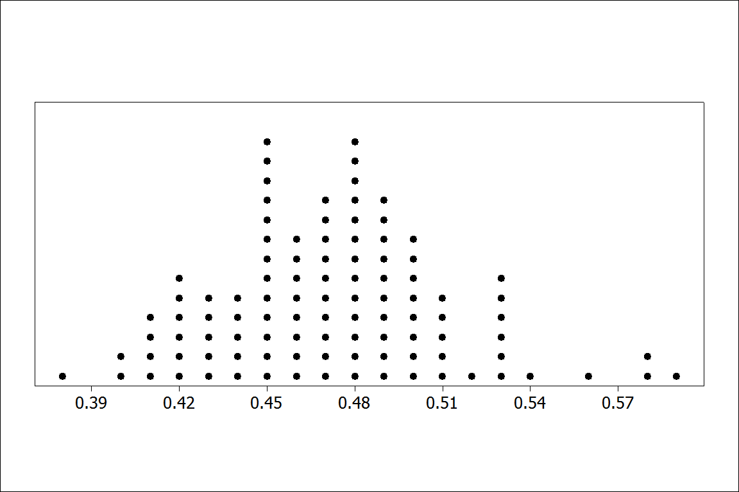
Proportion orange in 100 samples of size n=100
BUT – In practice, can we really take lots of samples from the same population?
Notes:
Bozz

Slide 20
Bootstrap
Distributions
Or: How do we get a sense of a sampling distribution when we only have ONE sample?
Notes:
Patti

Slide 21
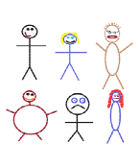
Suppose we have a random sample of 6 people:
Notes:
Patti

Slide 22
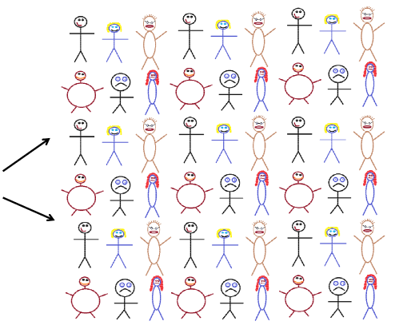
Original Sample
Create a “sampling distribution” using this as our simulated population
Notes:
Patti

Slide 23




Bootstrap Sample: Sample with replacement from the original sample, using the same sample size.
Original Sample
Bootstrap Sample
Notes:
Patti

Slide 24
Simulated Reese’s Population
Notes:
Patti

Slide 25
Create a bootstrap sample by sampling with replacement from the original sample.
Compute the relevant statistic for the bootstrap sample.
Do this many times!! Gather the bootstrap statistics all together to form a bootstrap distribution.
Notes:
Patti

Slide 26
BootstrapSample
Bootstrap Statistic
BootstrapSample
Bootstrap Statistic
Original Sample
Bootstrap Distribution
●
●
●
●
●
●
Sample Statistic
BootstrapSample
Bootstrap Statistic
Notes:
Patti

Slide 27
Example: What is the average price of a used Mustang car?
Select a random sample of n=25 Mustangs from a website (autotrader.com) and record the price (in $1,000’s) for each car.
Notes:
Patti

Slide 28
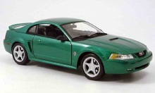

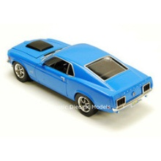
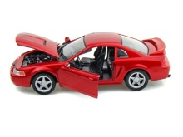
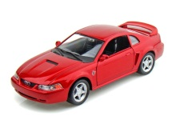
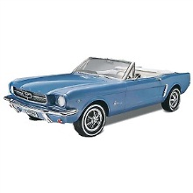
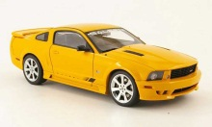

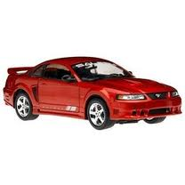

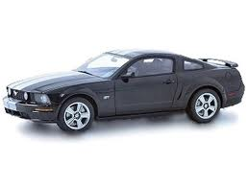
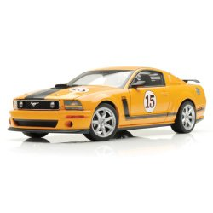
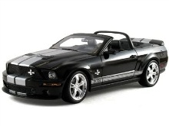
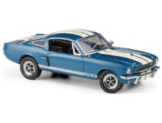
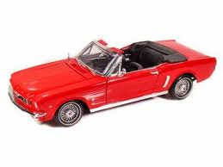

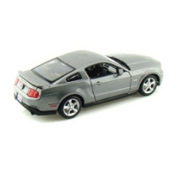
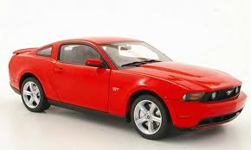

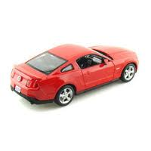
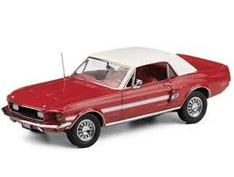
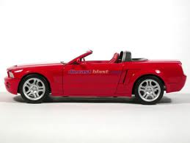
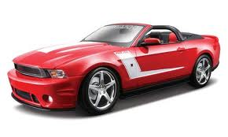
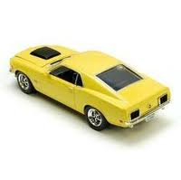
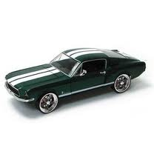

Sample of Mustangs:
$$n=25 \overline{x}=15.98 s=11.11$$
Our best estimate for the average price of used Mustangs is $15,980, but how accurate is that estimate?
Notes:
Patti

Slide 29
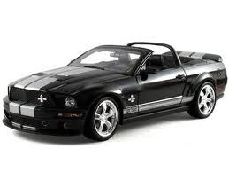


Original Sample
Bootstrap Sample
Repeat 1,000’s of times!
$$\overline{x}=15.98$$
$$\overline{x}=17.51$$
Notes:
Robin

Slide 30
We need technology!
Introducing
StatKey
www.lock5stat.com/statkey
Notes:
Patti

Slide 31
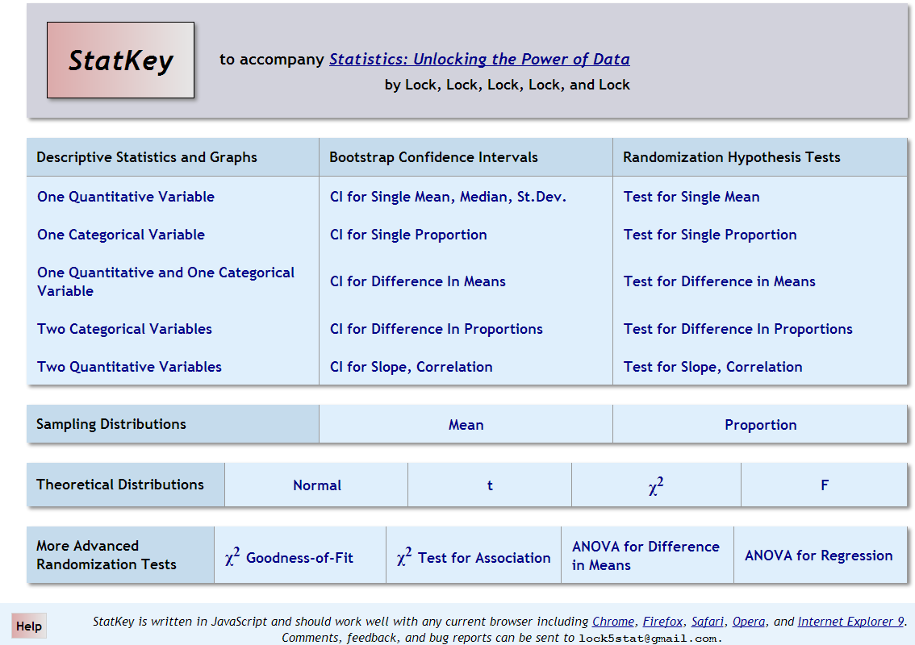

Slide 32
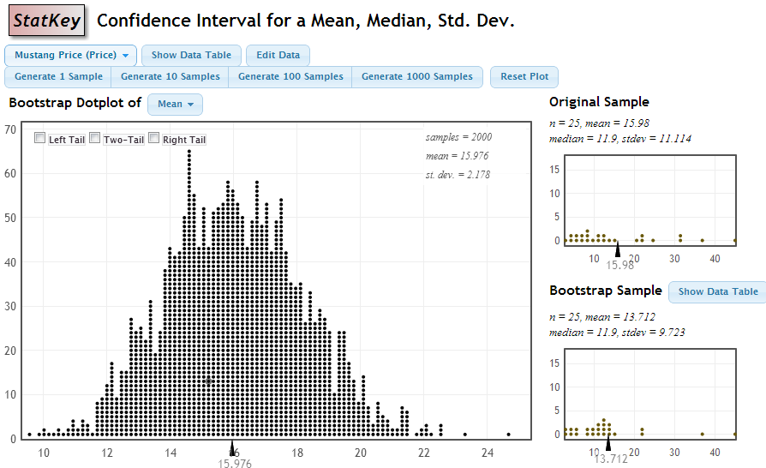
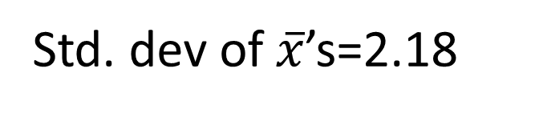
StatKey
Std. dev of $\overline{x}$’s=2.18
Notes:
Robin

Slide 33

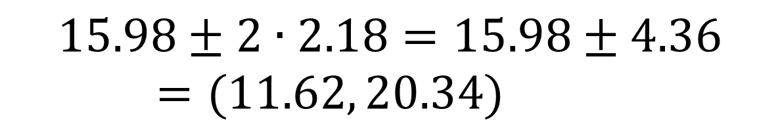
Using the Bootstrap Distribution to Get a Confidence Interval – Method #1
The standard deviation of the bootstrap statistics estimates the standard error of the sample statistic.
Quick interval estimate :
$$Original Statistic ±2∙SE$$
For the mean Mustang prices:
$$15.98±2∙2.18=15.98±4.36=(11.62, 20.34)$$
Notes:
Robin

Slide 34
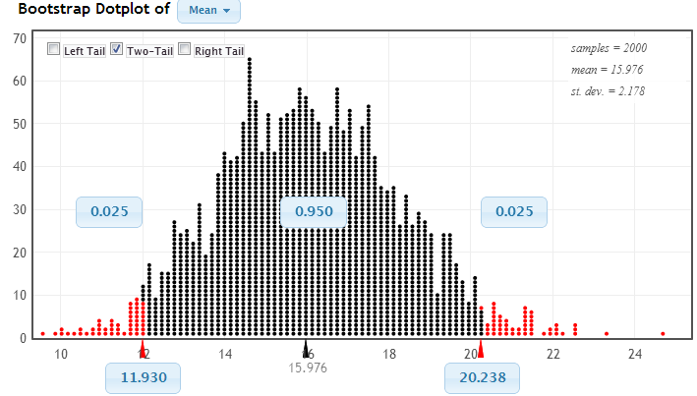
Using the Bootstrap Distribution to Get a Confidence Interval – Method #2
Chop 2.5% in each tail
Keep 95% in middle
Chop 2.5% in each tail
We are 95% sure that the mean price for Mustangs is between $11,930 and $20,238
Notes:
Robin

Slide 35
Bootstrap Confidence Intervals
Version 1 (Statistic ± 2 SE):
Great preparation for moving to
traditional methods
Version 2 (Percentiles):
Great at building understanding of
confidence intervals
Notes:
Rups

Slide 36
Playing with StatKey!
See the purple pages in the folder.
Notes:
Rups introduces

Slide 37
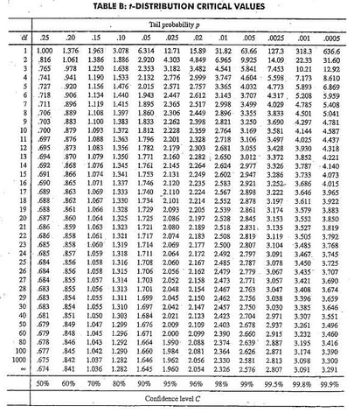
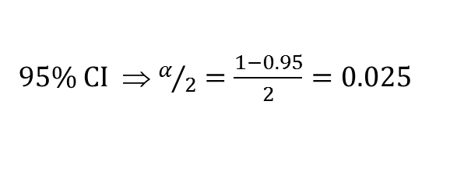

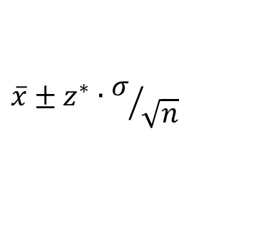

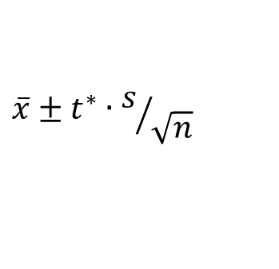
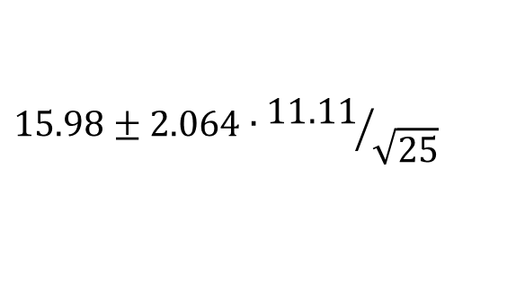

Traditional Inference
CI for a mean
1. Which formula?
$$\overline{x}±z^{∗}∙σ/{\sqrt{n}}$$
OR
$$\overline{x}±t^{∗}∙s/{\sqrt{n}}$$
2. Calculate summary stats
$n=25, \overline{x}=15.98$, $s=11.11$
3. Find t*
4. df?
95% CI ⇒ $α/2=\frac{1−0.95}{2}=0.025$
df=25$−$1=24
t*=2.064
5. Plug and chug
$$15.98±2.064∙{11.11}/{\sqrt{25}}$$
$$15.98±4.59=(11.39, 20.57)$$
6. Interpret in context
7. Check conditions
Notes:
Denn

Slide 38
We want to collect some data from you. What should we ask you for our one quantitative question and our one categorical question?
Notes:
Denn

Slide 39
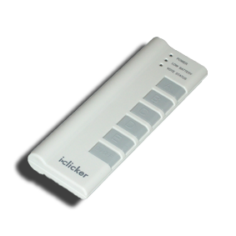
What quantitative data should we collect from you?
What was the class size of the Intro Stat course you taught most recently?
How many years have you been teaching Intro Stat?
What was the travel time, in hours, for your trip to Boston for JMM?
Including this one, how many times have you attended the January JMM?
???
Notes:
Denn

Slide 40
What categorical data should we collect from you?
Did you fly or drive to these meetings?
Have you attended any previous JMM meetings?
Have you ever attended a JSM meeting?
???
???
Notes:
Denn

Slide 41
Why
does the bootstrap work?
Notes:
Robin

Slide 42
Sampling Distribution
Population
BUT, in practice we don’t see the “tree” or all of the “seeds” – we only have ONE seed
µ
Notes:
Robin

Slide 43

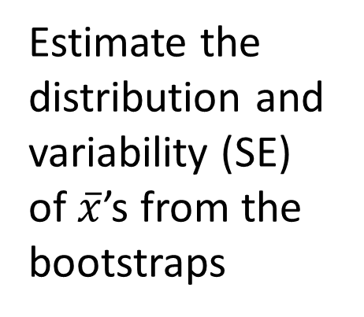
Bootstrap Distribution
What can we do with just one seed?
Estimate the distribution and variability (SE) of $\overline{x}$’s from the bootstraps
Bootstrap
“Population”
Grow a NEW tree!
$$\overline{x}$$
µ
Use the bootstrap errors that we CAN see to estimate the sampling errors that we CAN’T see.
Notes:
Robin

Slide 44
Golden Rule of Bootstraps
The bootstrap statistics are to the original statistic
as
the original statistic is to the population parameter.

Slide 45
How do we assess student understanding of these methods
(even on in-class exams without computers)?
See the green pages in the folder.
Notes:
Robin

Slide 46
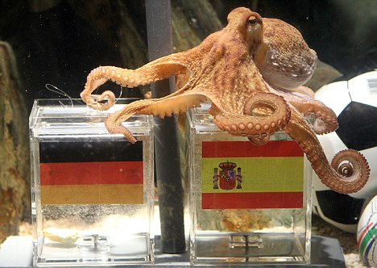
Paul the Octopus
http://www.youtube.com/watch?v=3ESGpRUMj9E
http://www.cnn.com/2010/SPORT/football/07/08/germany.octopus.explainer/index.html
Notes:
Dennis

Slide 47
Paul the Octopus
Paul the Octopus predicted 8 World Cup games, and predicted them all correctly
Is this evidence that Paul actually has psychic powers?
How unusual would this be if he were just randomly guessing (with a 50% chance of guessing correctly)?
How could we figure this out?
Notes:
Dennis

Slide 48
Simulate!
Each coin flip = a guess between two teams
Heads = correct, Tails = incorrect
Flip a coin 8 times and count the number of heads. Remember this number!
Did you get all 8 heads?
(a) Yes
(b) No
Notes:
Denn

Slide 49
Hypotheses
Let p denote the proportion of games that Paul guesses correctly (of all games he may have predicted)
H₀ : p = 1/2
H_{a} : p > 1/2
Notes:
Bozz

Slide 50
Randomization Distribution
A randomization distribution is the distribution of sample statistics we would observe, just by random chance, if the null hypothesis were true
A randomization distribution is created by simulating many samples, assuming H₀ is true, and calculating the sample statistic each time
Notes:
Bozz

Slide 51
Randomization Distribution
Let’s create a randomization distribution for Paul the Octopus!
On a piece of paper, set up an axis for a dotplot, going from 0 to 8
Create a randomization distribution using each other’s simulated statistics
For more simulations, we use StatKey
Notes:
Bozz

Slide 52
p-value
The p-value is the probability of getting a statistic as extreme (or more extreme) as that observed, just by random chance, if the null hypothesis is true
This can be calculated directly from the randomization distribution!
Notes:
Bozz

Slide 53
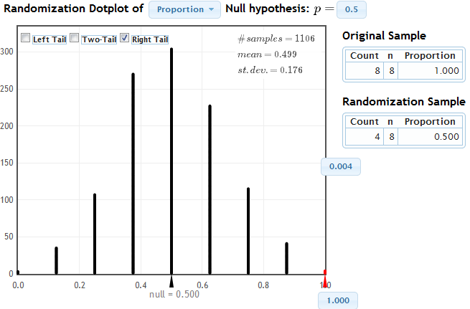
StatKey
Notes:
Patti

Slide 54
Randomization Test
Create a randomization distribution by simulating assuming the null hypothesis is true
The p-value is the proportion of simulated statistics as extreme as the original sample statistic
Notes:
Patti

Slide 55
Coming Attractions - Saturday
How do we create randomization distributions for other parameters?
How do we assess student understanding?
Connecting intervals and tests
Connecting simulations to traditional methods
More StatKey and other technology options
Experiences in the classroom
Notes:
Robin

