Slide 1
Using Randomization Methods to Build Conceptual Understanding in Statistical Inference:
Day 1
Lock, Lock, Lock, Lock, and Lock
MAA Minicourse – Joint Mathematics Meetings
San Diego, CA
January 2013
Notes:
Dennis

Slide 2
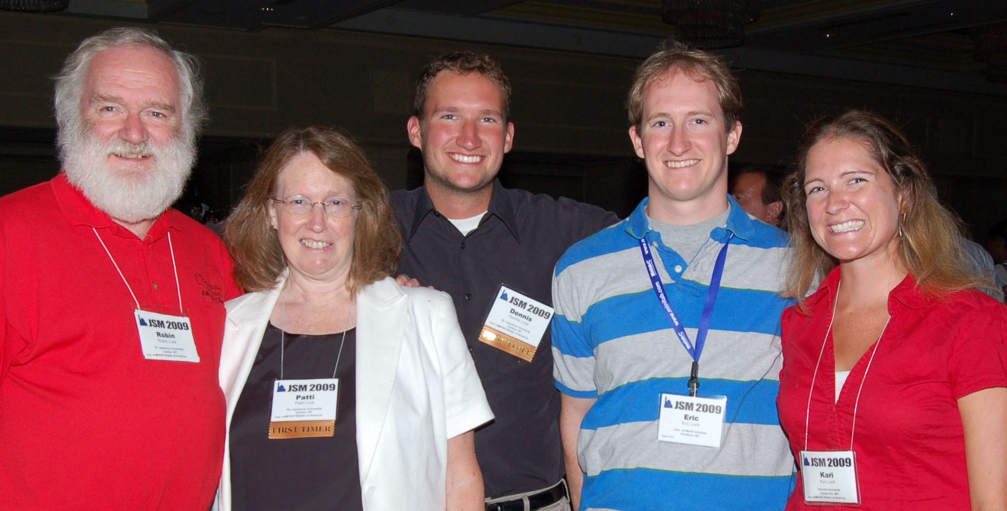
The Lock⁵ Team
Dennis
Iowa State
Kari
Duke
Robin
St. Lawrence
Eric
Duke
Patti
St. Lawrence
Notes:
Dennis

Slide 3
Introductions:
Name
Institution
Notes:
Dennis

Slide 4
Schedule: Day 1
Wednesday, 1/9, 9:00 – 11:00 am
1. Introductions and Overview
2. Bootstrap Confidence Intervals
What is a bootstrap distribution?
How do we use bootstrap distributions to build understanding of confidence intervals?
How do we assess student understanding when using this approach?
3. Getting Started on Randomization Tests
What is a randomization distribution?
How do we use randomization distributions to build understanding of p-values?
4. Minute Papers
Notes:
Denn

Slide 5
Schedule: Day 2
Friday, 1/11, 9:00 – 11:00 am
5. More on Randomization Tests
How do we generate randomization distributions for various statistical tests?
How do we assess student understanding when using this approach?
6. Connecting Intervals and Tests
7. Connecting Simulation Methods to Traditional
8. Technology Options
Brief software demonstration (Minitab, Fathom, R, Excel, ...)
– pick one!
9. Wrap-up
How has this worked in the classroom?
Participant comments and questions
10. Evaluations
Notes:
Denn

Slide 6
Why use Randomization Methods?
Notes:
Bozz

Slide 7
These methods are great for teaching statistics…
(the methods tie directly to the key ideas of statistical inference so help build conceptual understanding)
Notes:
Bozz

Slide 8
And these methods are becoming increasingly important for doing statistics.
Notes:
Bozz

Slide 9
It is the way of the past…
"Actually, the statistician does not carry out this very simple and very tedious process [the randomization test], but his conclusions have no justification beyond the fact that they agree with those which could have been arrived at by this elementary method."
-- Sir R. A. Fisher, 1936
Notes:
Bozz

Slide 10
… and the way of the future
“... the consensus curriculum is still an unwitting prisoner of history. What we teach is largely the technical machinery of numerical approximations based on the normal distribution and its many subsidiary cogs. This machinery was once necessary, because the conceptually simpler alternative based on permutations was computationally beyond our reach. Before computers statisticians had no choice. These days we have no excuse. Randomization-based inference makes a direct connection between data production and the logic of inference that deserves to be at the core of every introductory course.”
-- Professor George Cobb, 2007
(see full TISE article by Cobb in your binder)
Notes:
bozz

Slide 11
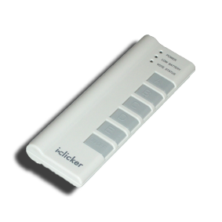
Question
Do you teach Intro Stat?
A. Very regularly (most semesters)
B. Regularly (most years)
C. Occasionally
D. Rarely (every few years)
E. Never (or not yet)
Notes:
Kari

Slide 12
Question
How familiar are you with simulation methods such as bootstrap confidence intervals and randomization tests?
A. Very
B. Somewhat
C. A little
D. Not at all
E. Never heard of them before!
Notes:
Kari

Slide 13
Question
Have you used randomization methods in Intro Stat?
A. Yes, as a significant part of the course
B. Yes, as a minor part of the course
C. No
D. What are randomization methods?
Notes:
Kari

Slide 14
Question
Have you used randomization methods in any statistics class that you teach?
A. Yes, as a significant part of the course
B. Yes, as a minor part of the course
C. No
D. What are randomization methods?
Notes:
Bozz

Slide 15
Intro Stat – Revise the Topics
Descriptive Statistics – one and two samples
Descriptive Statistics – one and two samples
Normal distributions
Bootstrap confidence intervals
Bootstrap confidence intervals
Data production (samples/experiments)
Data production (samples/experiments)
Randomization-based hypothesis tests
Randomization-based hypothesis tests
Sampling distributions (mean/proportion)
Normal distributions
Confidence intervals (means/proportions)
Hypothesis tests (means/proportions)
ANOVA for several means, Inference for regression, Chi-square tests
Notes:
Bozz

Slide 16
We need a snack!
Notes:
Bozz

Slide 17
What proportion of Reese’s Pieces are Orange?
Find the proportion that are orange for your “sample”.
Notes:
Bozz

Slide 18
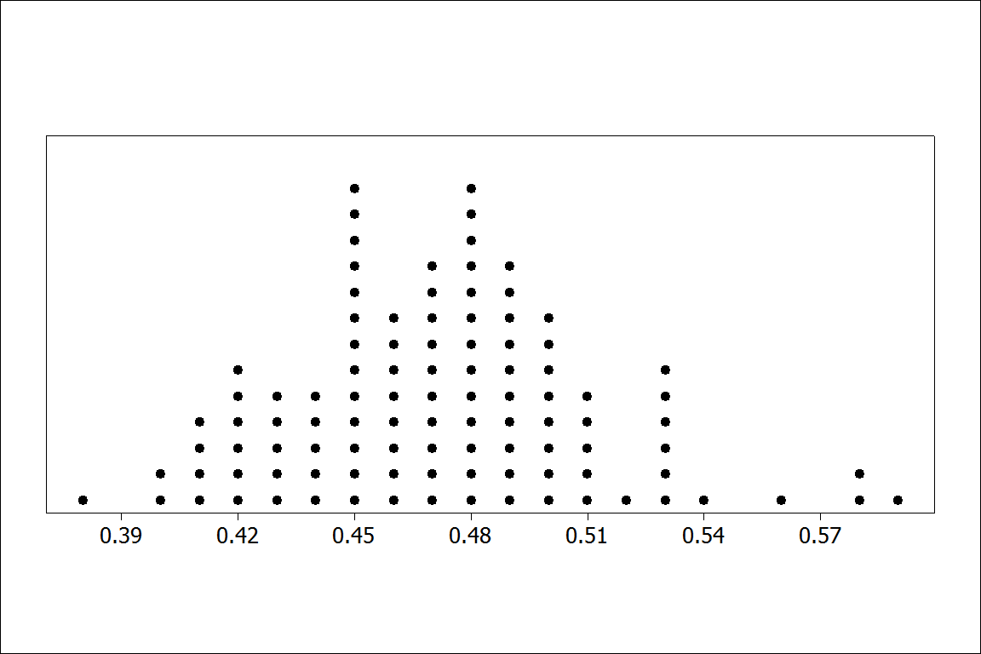
Proportion orange in 100 samples of size n=100
BUT – In practice, can we really take lots of samples from the same population?
Notes:
Bozz

Slide 19
Bootstrap
Distributions
Or: How do we get a sense of a sampling distribution when we only have ONE sample?
Notes:
Patti

Slide 20
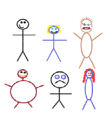
Suppose we have a random sample of 6 people:
Notes:
Patti

Slide 21
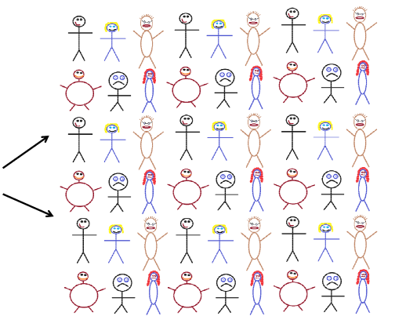
Original Sample
Create a “sampling distribution” using this as our simulated population
Notes:
Patti

Slide 22




Bootstrap Sample: Sample with replacement from the original sample, using the same sample size.
Original Sample
Bootstrap Sample
Notes:
Patti

Slide 23
Simulated Reese’s Population
Notes:
Patti

Slide 24
Create a bootstrap sample by sampling with replacement from the original sample.
Compute the relevant statistic for the bootstrap sample.
Do this many times!! Gather the bootstrap statistics all together to form a bootstrap distribution.
Notes:
Patti

Slide 25
BootstrapSample
Bootstrap Statistic
BootstrapSample
Bootstrap Statistic
Original Sample
Bootstrap Distribution
●
●
●
●
●
●
Sample Statistic
BootstrapSample
Bootstrap Statistic
Notes:
Patti

Slide 26
Example: What is the average price of a used Mustang car?
Select a random sample of n=25 Mustangs from a website (autotrader.com) and record the price (in $1,000’s) for each car.
Notes:
Patti

Slide 27
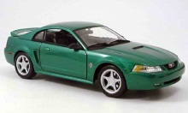

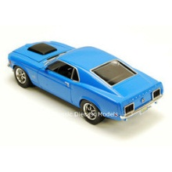
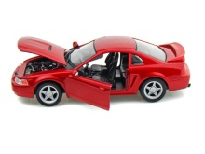
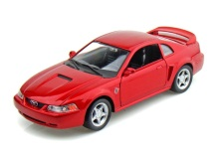
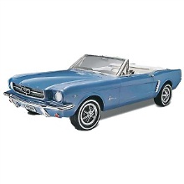


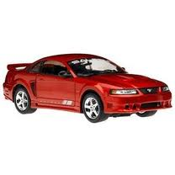

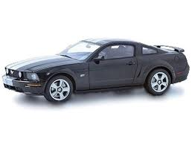
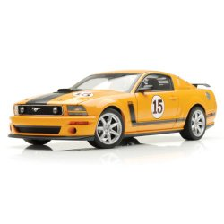
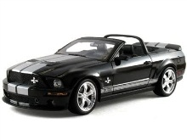
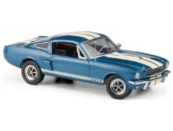
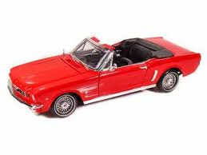

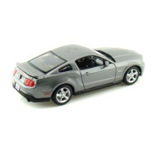


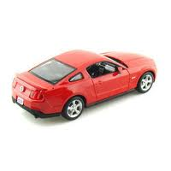
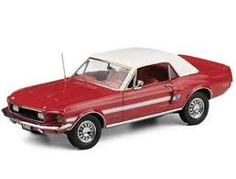
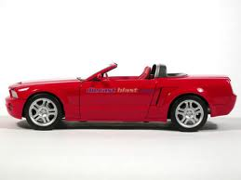

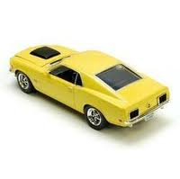
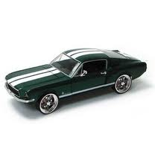

Sample of Mustangs:
$$n=25 \overline{x}=15.98 s=11.11$$
Our best estimate for the average price of used Mustangs is $15,980, but how accurate is that estimate?
Notes:
Patti

Slide 28
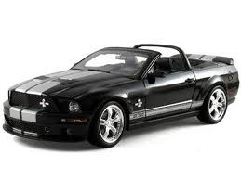
Original Sample
Bootstrap Sample
Notes:
Patti

Slide 29
We need technology!
Introducing
StatKey.
www.lock5stat.com/statkey
Notes:
Patti

Slide 30
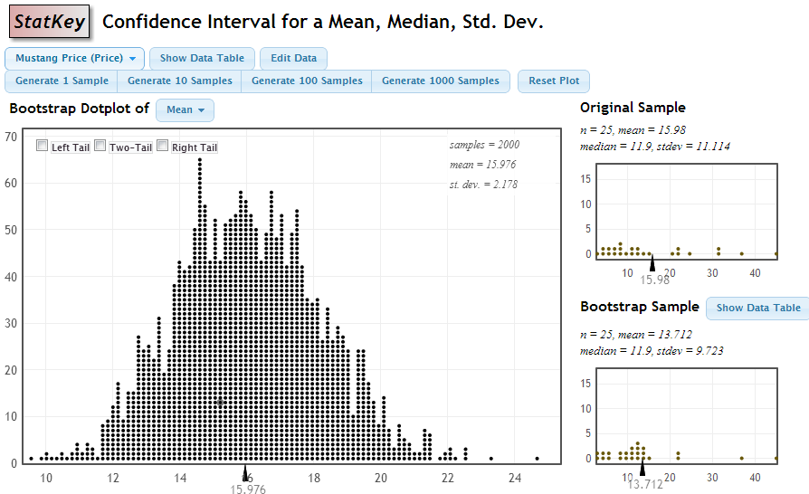
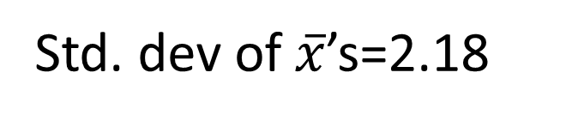
StatKey
Std. dev of $\overline{x}$’s=2.18
Notes:
Robin

Slide 31

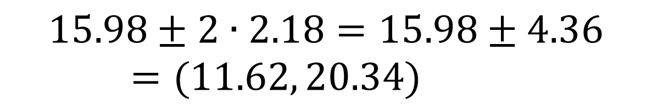
Using the Bootstrap Distribution to Get a Confidence Interval – Method #1
The standard deviation of the bootstrap statistics estimates the standard error of the sample statistic.
Quick interval estimate :
$$Original Statistic ±2∙SE$$
For the mean Mustang prices:
$$15.98±2∙2.18=15.98±4.36=(11.62, 20.34)$$
Notes:
Robin

Slide 32
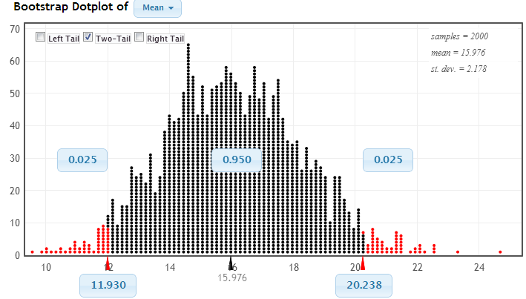
Using the Bootstrap Distribution to Get a Confidence Interval – Method #2
Chop 2.5% in each tail
Keep 95% in middle
Chop 2.5% in each tail
We are 95% sure that the mean price for Mustangs is between $11,930 and $20,238
Notes:
Robin

Slide 33
Bootstrap Confidence Intervals
Version 1 (Statistic ± 2 SE):
Great preparation for moving to
traditional methods
Version 2 (Percentiles):
Great at building understanding of
confidence intervals
Notes:
Rups

Slide 34
Playing with StatKey!
See the purple pages in the folder.
Notes:
Rups introduces

Slide 35
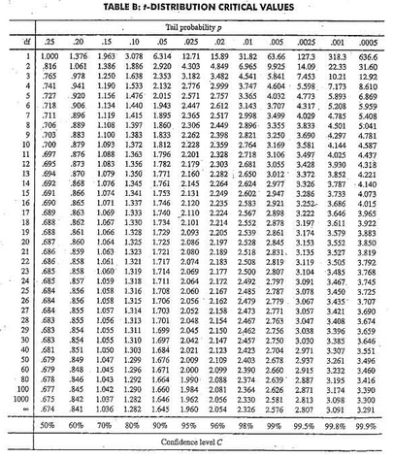
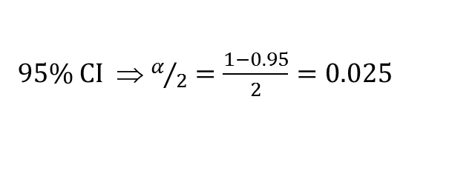

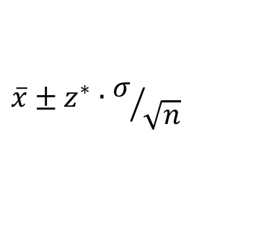

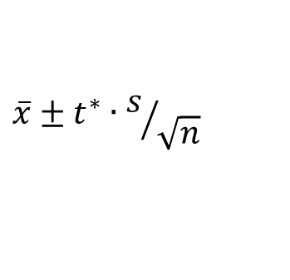
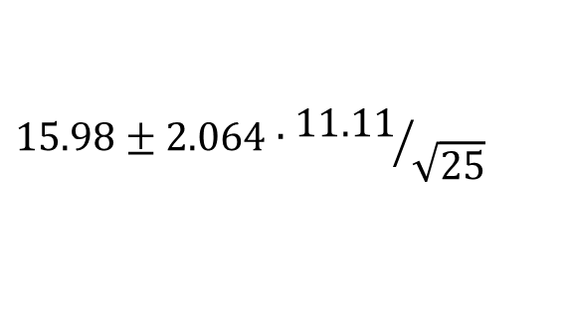

Traditional Inference
CI for a mean
1. Which formula?
$$\overline{x}±z^{∗}∙σ/{\sqrt{n}}$$
OR
$$\overline{x}±t^{∗}∙s/{\sqrt{n}}$$
2. Calculate summary stats
$n=25, \overline{x}=15.98$, $s=11.11$
3. Find t*
4. df?
95% CI ⇒ $α/2=\frac{1−0.95}{2}=0.025$
df=25$−$1=24
t*=2.064
5. Plug and chug
$$15.98±2.064∙{11.11}/{\sqrt{25}}$$
$$15.98±4.59=(11.39, 20.57)$$
6. Interpret in context
7. Check conditions
Notes:
Denn

Slide 36
We want to collect some data from you. What should we ask you for our one quantitative question and our one categorical question?
Notes:
Denn

Slide 37
What quantitative data should we collect from you?
What was the class size of the Intro Stat course you taught most recently?
How many years have you been teaching Intro Stat?
What was the travel time, in hours, for your trip to Boston for JMM?
Including this one, how many times have you attended the January JMM?
???
Notes:
Denn

Slide 38
What categorical data should we collect from you?
Did you fly or drive to these meetings?
Have you attended any previous JMM meetings?
Have you ever attended a JSM meeting?
???
???
Notes:
Denn

Slide 39
Why
does the bootstrap work?
Notes:
Robin

Slide 40
Sampling Distribution
Population
BUT, in practice we don’t see the “tree” or all of the “seeds” – we only have ONE seed
µ
Notes:
Robin

Slide 41

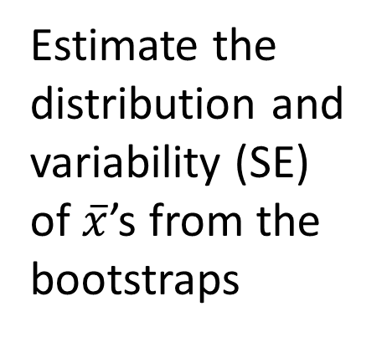
Bootstrap Distribution
What can we do with just one seed?
Bootstrap
“Population”
Estimate the distribution and variability (SE) of $\overline{x}$’s from the bootstraps
Grow a NEW tree!
$$\overline{x}$$
µ
Notes:
Robin

Slide 42
Golden Rule of Bootstraps
The bootstrap statistics are to the original statistic
as
the original statistic is to the population parameter.
Notes:
Robin

Slide 43
How do we assess student understanding of these methods
(even on in-class exams without computers)?
See the green pages in the folder.
Notes:
Robin

Slide 44
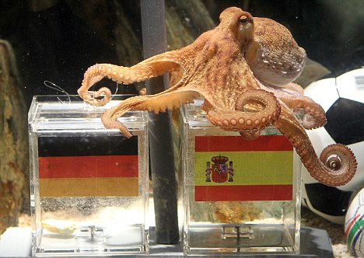
Paul the Octopus
http://www.youtube.com/watch?v=3ESGpRUMj9E
http://www.cnn.com/2010/SPORT/football/07/08/germany.octopus.explainer/index.html
Notes:
Dennis

Slide 45
Paul the Octopus
Paul the Octopus predicted 8 World Cup games, and predicted them all correctly
Is this evidence that Paul actually has psychic powers?
How unusual would this be if he were just randomly guessing (with a 50% chance of guessing correctly)?
How could we figure this out?
Notes:
Dennis

Slide 46
Simulate!
Each coin flip = a guess between two teams
Heads = correct, Tails = incorrect
Flip a coin 8 times and count the number of heads. Remember this number!
Did you get all 8 heads?
(a) Yes
(b) No
Notes:
Denn

Slide 47
Hypotheses
Let p denote the proportion of games that Paul guesses correctly (of all games he may have predicted)
H₀ : p = 1/2
H_{a} : p > 1/2
Notes:
Bozz

Slide 48
Randomization Distribution
A randomization distribution is the distribution of sample statistics we would observe, just by random chance, if the null hypothesis were true
A randomization distribution is created by simulating many samples, assuming H₀ is true, and calculating the sample statistic each time
Notes:
Bozz

Slide 49
Randomization Distribution
Let’s create a randomization distribution for Paul the Octopus!
On a piece of paper, set up an axis for a dotplot, going from 0 to 8
Create a randomization distribution using each other’s simulated statistics
For more simulations, we use StatKey
Notes:
Bozz

Slide 50
p-value
The p-value is the probability of getting a statistic as extreme (or more extreme) as that observed, just by random chance, if the null hypothesis is true
This can be calculated directly from the randomization distribution!
Notes:
Bozz

Slide 51
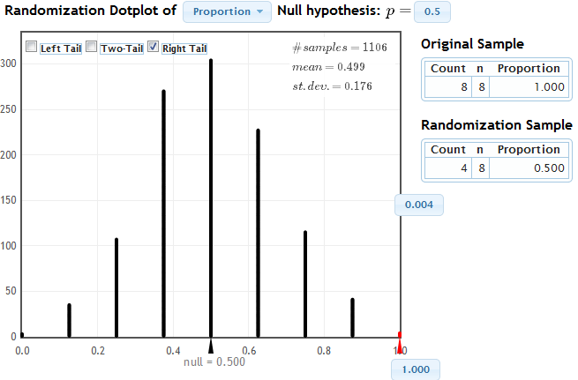
StatKey
Notes:
Patti

Slide 52
Randomization Test
Create a randomization distribution by simulating assuming the null hypothesis is true
The p-value is the proportion of simulated statistics as extreme as the original sample statistic
Notes:
Patti

Slide 53
Coming Attractions - Friday
How do we create randomization distributions for other parameters?
How do we assess student understanding?
Connecting intervals and tests
Connecting simulations to traditional methods
Technology for using simulation methods
Experiences in the classroom
Notes:
Robin

