Slide 1
Using Randomization Methods to Build Conceptual Understanding in Statistical Inference:
Day 1
Lock, Lock, Lock, Lock, and Lock
Minicourse – Joint Mathematics Meetings
Boston, MA
January 2012
WiFi: marriotconference, password: 1134ams
Notes:
Bozz

Slide 2
Introductions:
Name
Institution
Notes:
Bozz

Slide 3
Schedule: Day 1
Wednesday, 1/4, 4:45 – 6:45 pm
1. Introductions and Overview
2. Bootstrap Confidence Intervals
What is a bootstrap distribution?
How do we use bootstrap distributions to build understanding of confidence intervals?
How do we assess student understanding when using this approach?
3. Getting Started on Randomization Tests
What is a randomization distribution?
How do we use randomization distributions to build understanding of p-values?
How do these methods fit with traditional methods?
4. Minute Papers
Notes:
Denn

Slide 4
Schedule: Day 2
Friday, 1/6, 3:30 – 5:30 pm
5. More on Randomization Tests
How do we generate randomization distributions for various statistical tests?
How do we assess student understanding when using this approach?
6. Connecting Intervals and Tests
7. Technology Options
Short software demonstrations (Minitab, Fathom, R, Excel, ...)
– pick two!
8. Wrap-up
How has this worked in the classroom?
Participant comments and questions
9. Evaluations
Notes:
Denn

Slide 5
Why use Randomization Methods?
Notes:
Patti

Slide 6
These methods are great for teaching statistics…
(the methods tie directly to the key ideas of statistical inference so help build conceptual understanding)
Notes:
Patti

Slide 7
And these methods are becoming increasingly important for doing statistics.
(Attend the Gibbs Lecture tonight!)
Notes:
Patti

Slide 8
It is the way of the past…
"Actually, the statistician does not carry out this very simple and very tedious process [the randomization test], but his conclusions have no justification beyond the fact that they agree with those which could have been arrived at by this elementary method."
-- Sir R. A. Fisher, 1936
Notes:
Patti

Slide 9
… and the way of the future
“... the consensus curriculum is still an unwitting prisoner of history. What we teach is largely the technical machinery of numerical approximations based on the normal distribution and its many subsidiary cogs. This machinery was once necessary, because the conceptually simpler alternative based on permutations was computationally beyond our reach. Before computers statisticians had no choice. These days we have no excuse. Randomization-based inference makes a direct connection between data production and the logic of inference that deserves to be at the core of every introductory course.”
-- Professor George Cobb, 2007
Notes:
Patti

Slide 10
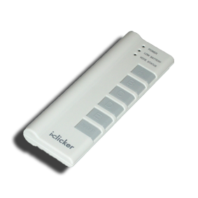
Question
Can you use your clicker?
A. Yes
B. No
C. Not sure
D. I don’t have a clicker
Notes:
Kari

Slide 11
Question
How frequently do you teach Intro Stat?
A. Regularly
B. Occasionally
C. Rarely/Never
Notes:
Kari

Slide 12
Question
How familiar are you with simulation methods such as bootstrap confidence intervals and randomization tests?
A. Very
B. Somewhat
C. A Little / Not at all
Notes:
Kari

Slide 13
Question
Have you used randomization methods in any statistics class that you teach?
A. Yes, as a significant part of the course
B. Yes, as a minor part of the course
C. No
Notes:
Kari

Slide 14
Question
Have you used randomization methods in Intro Stat?
A. Yes, as a significant part of the course
B. Yes, as a minor part of the course
C. No
Notes:
Kari

Slide 15
Intro Stat – Revise the Topics
Descriptive Statistics – one and two samples
Normal distributions
Bootstrap confidence intervals
Bootstrap confidence intervals
Data production (samples/experiments)
Data production (samples/experiments)
Randomization-based hypothesis tests
Randomization-based hypothesis tests
Sampling distributions (mean/proportion)
Normal/sampling distributions
Confidence intervals (means/proportions)
Hypothesis tests (means/proportions)
ANOVA for several means, Inference for regression, Chi-square tests
Notes:
Rups

Slide 16
It’s close to 5 pm;
We need a snack!
Notes:
Bozz

Slide 17
What proportion of Reese’s Pieces are Orange?
Find the proportion that are orange for your box.
Notes:
Bozz

Slide 18
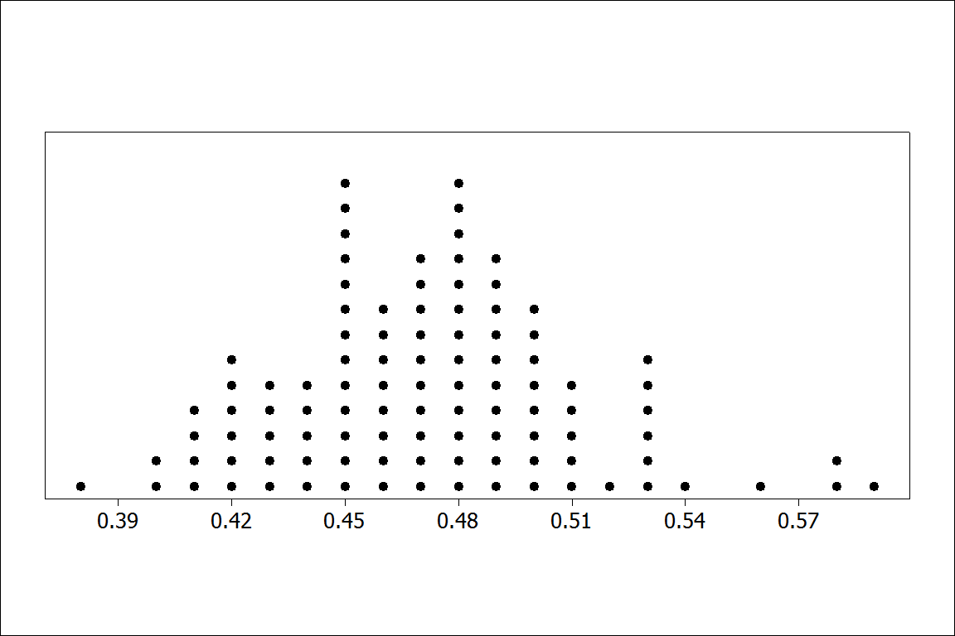
Notes:
Bozz

Slide 19
Bootstrap
Distributions
Or: How do we get a sense of a sampling distribution when we only have ONE sample?
Notes:
Patti

Slide 20
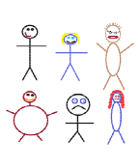
Suppose we have a random sample of 6 people:
Notes:
Patti

Slide 21
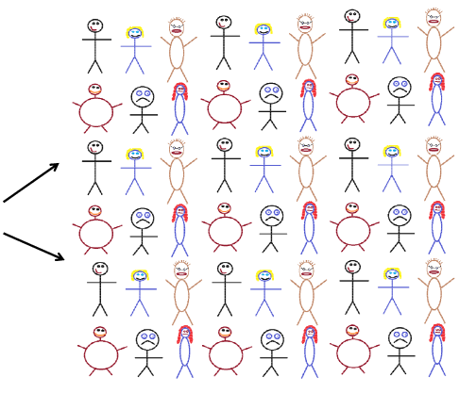
Original Sample
Create a “sampling distribution” using this as our simulated population
Notes:
Patti

Slide 22




Bootstrap Sample: Sample with replacement from the original sample, using the same sample size.
Original Sample
Bootstrap Sample
Notes:
Patti

Slide 23
Simulated Reese’s Population
Notes:
Patti

Slide 24
Create a bootstrap sample by sampling with replacement from the original sample.
Compute the relevant statistic for the bootstrap sample.
Do this many times!! Gather the bootstrap statistics all together to form a bootstrap distribution.
Notes:
Patti

Slide 25
BootstrapSample
Bootstrap Statistic
BootstrapSample
Bootstrap Statistic
Original Sample
Bootstrap Distribution
.
.
.
.
.
.
Sample Statistic
BootstrapSample
Bootstrap Statistic
Notes:
Patti

Slide 26
We need technology!
Introducing
StatKey.
Notes:
Patti

Slide 27
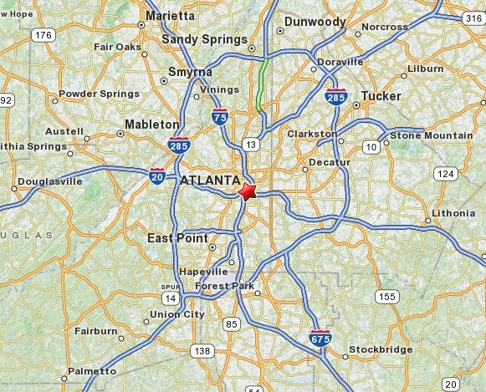
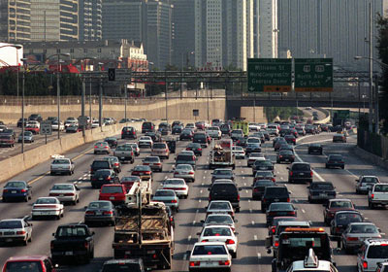
Example: Atlanta Commutes
What’s the mean commute time for workers in metropolitan Atlanta?
Data: The American Housing Survey (AHS) collected data from Atlanta in 2004.
Notes:
Patti

Slide 28
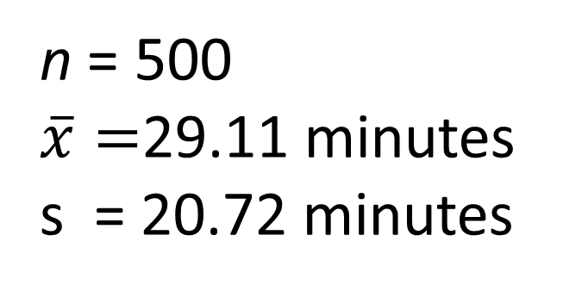
Sample of n=500 Atlanta Commutes
n = 500
$\overline{x}=$29.11 minutes
s = 20.72 minutes
Where might the “true” μ be?
Notes:
Patti

Slide 29
StatKey
can be found at
www.lock5stat.com
Notes:
Patti

Slide 30
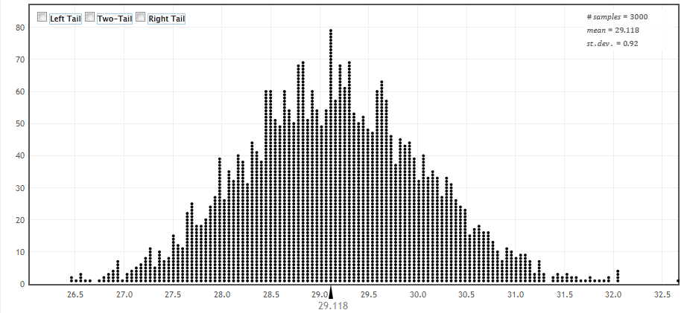
How can we get a confidence interval from a bootstrap distribution?
Method #1: Use the standard deviation of the bootstrap statistics as a “yardstick”
Notes:
Rups

Slide 31

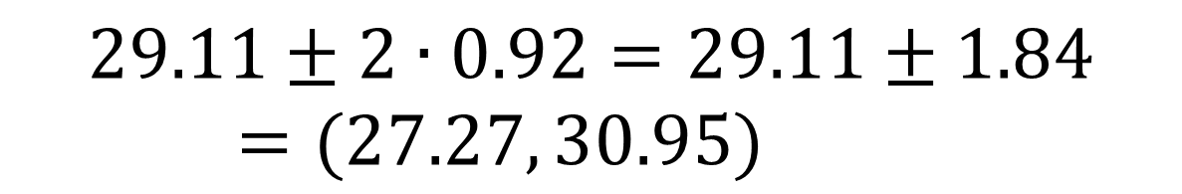
Using the Bootstrap Distribution to Get a Confidence Interval – Version #1
The standard deviation of the bootstrap statistics estimates the standard error of the sample statistic.
Quick interval estimate :
$$Original Statistic ±2∙SE$$
For the mean Atlanta commute time:
$$29.11±2∙0.92=29.11±1.84=(27.27, 30.95)$$
Notes:
Rups

Slide 32
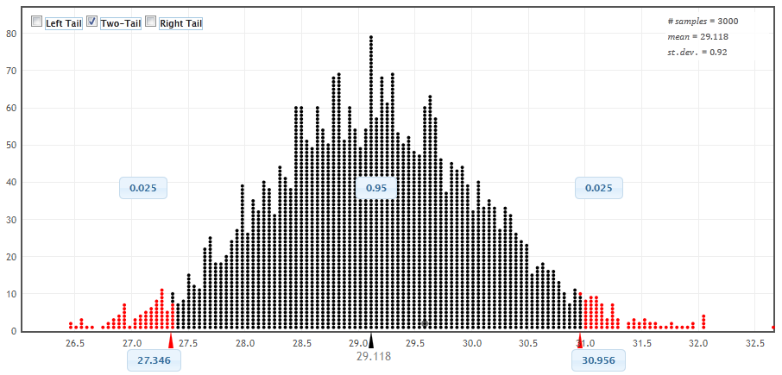
Using the Bootstrap Distribution to Get a Confidence Interval – Version #2
95% CI=(27.35,30.96)
Chop 2.5% in each tail
Keep 95% in middle
Chop 2.5% in each tail
For a 95% CI, find the 2.5%-tile and 97.5%-tile in the bootstrap distribution
Notes:
Rups

Slide 33
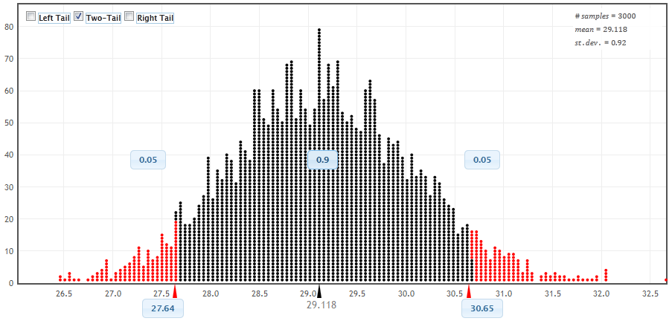
90% CI for Mean Atlanta Commute
90% CI=(27.64,30.65)
Chop 5% in each tail
Keep 90% in middle
Chop 5% in each tail
For a 90% CI, find the 5%-tile and 95%-tile in the bootstrap distribution
Notes:
Rups

Slide 34
Bootstrap Confidence Intervals
Version 1 (Statistic ± 2 SE):
Great preparation for moving to
traditional methods
Version 2 (Percentiles):
Great at building understanding of
confidence intervals
Notes:
Rups

Slide 35
Playing with StatKey!
See the purple pages in the folder.
Notes:
Rups introduces

Slide 36
We want to collect some data from you. What should we ask you for our one quantitative question and our one categorical question?
Notes:
Denn

Slide 37
What quantitative data should we collect from you?
What was the class size of the Intro Stat course you taught most recently?
How many years have you been teaching Intro Stat?
What was the travel time, in hours, for your trip to Boston for JMM?
Including this one, how many times have you attended the January JMM?
???
Notes:
Denn

Slide 38
What categorical data should we collect from you?
Did you fly or drive to these meetings?
Have you attended any previous JMM meetings?
Have you ever attended a JSM meeting?
???
???
Notes:
Denn

Slide 39
How do we assess student understanding of these methods
(even on in-class exams without computers)?
See the green pages in the folder.
Notes:
Denn introduces

Slide 40
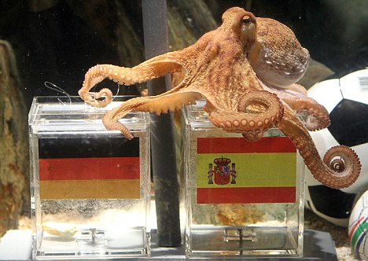
Paul the Octopus
http://www.youtube.com/watch?v=3ESGpRUMj9E
http://www.cnn.com/2010/SPORT/football/07/08/germany.octopus.explainer/index.html
Notes:
Kari

Slide 41
Paul the Octopus
Paul the Octopus predicted 8 World Cup games, and predicted them all correctly
Is this evidence that Paul actually has psychic powers?
How unusual would this be if he were just randomly guessing (with a 50% chance of guessing correctly)?
How could we figure this out?
Notes:
Kari

Slide 42
Simulate!
Each coin flip = a guess between two teams
Heads = correct, Tails = incorrect
Flip a coin 8 times and count the number of heads. Remember this number!
Did you get all 8 heads?
(a) Yes
(b) No
Notes:
Kari

Slide 43
Hypotheses
Let p denote the proportion of games that Paul guesses correctly (of all games he may have predicted)
H₀ : p = 1/2
H_{a} : p > 1/2
Notes:
Kari

Slide 44
Randomization Distribution
A randomization distribution is the distribution of sample statistics we would observe, just by random chance, if the null hypothesis were true
A randomization distribution is created by simulating many samples, assuming H₀ is true, and calculating the sample statistic each time
Notes:
Kari

Slide 45
Randomization Distribution
Let’s create a randomization distribution for Paul the Octopus!
On a piece of paper, set up an axis for a dotplot, going from 0 to 8
Create a randomization distribution using each other’s simulated statistics
For more simulations, we use StatKey
Notes:
Kari

Slide 46
p-value
The p-value is the probability of getting a statistic as extreme (or more extreme) as that observed, just by random chance, if the null hypothesis is true
This can be calculated directly from the randomization distribution!
Notes:
Kari

Slide 47
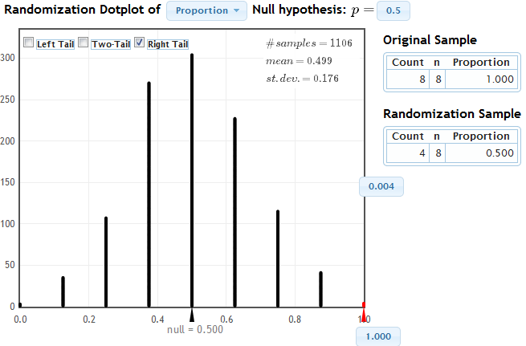
StatKey
Notes:
Kari

Slide 48
Randomization Test
Create a randomization distribution by simulating assuming the null hypothesis is true
The p-value is the proportion of simulated statistics as extreme as the original sample statistic
Notes:
Kari

Slide 49
Coming Attractions - Friday
How do we create randomization distributions for other parameters?
How do we assess student understanding?
Connecting intervals and tests
Technology for using simulation methods
Experiences in the classroom
Notes:
Bozz

