Slide 1
Statistical Inference Using Scrambles and Bootstraps
Robin Lock
Burry Professor of Statistics
St. Lawrence University
MAA Allegheny Mountain
2014 Section Spring Meeting
Westminster College

Slide 2
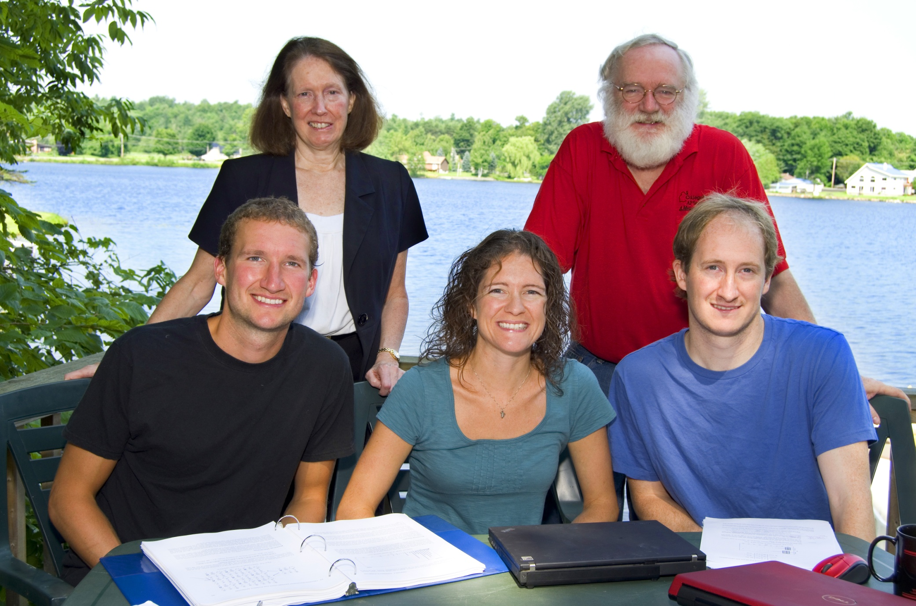
The Lock⁵ Team
Robin & Patti
St. Lawrence
Dennis
Iowa State
Kari
Harvard/Duke
Eric
UNC/Duke/UMinn

Slide 3
What is Statistical Inference?
Hypothesis Test
Is an effect observed in a sample true for a population or just due to random chance?
Confidence Interval
Based on the data in a sample, find a range of plausible values for a quantity in a population.

Slide 4

Example #1: Beer & Mosquitoes
Volunteers were randomly assigned to drink either a liter of beer or a liter of water.
Mosquitoes were caught in nets as they approached each volunteer and counted .
 | n | mean
Beer | 25 | 23.60
Water | 18 | 19.22
Does this provide convincing evidence that mosquitoes tend to be more attracted to beer drinkers or could this difference be just due to random chance?
Hypothesis Test

Slide 5
Example #2: Mustang Prices
A student selected a random sample of n=25 Mustang (cars) from an internet site and recorded the prices in $1,000’s.
Price (in $1,000’s)
 | n | mean | std. dev.
Price | 25 | 15.98 | 11.11
Find a range of plausible values where the mean price for all Mustangs at this website is likely to be.
Confidence Interval

Slide 6
Two Approaches to Inference
Traditional:
Assume some distribution (e.g. normal or t) to describe the behavior of sample statistics
Estimate parameters for that distribution from sample statistics
Calculate the desired quantities from the theoretical distribution
Simulation:
Generate many samples (by computer) to show the behavior of sample statistics
Calculate the desired quantities from the simulation distribution

Slide 7
“New” Simulation Methods?
"Actually, the statistician does not carry out this very simple and very tedious process, but his conclusions have no justification beyond the fact that they agree with those which could have been arrived at by this
elementary method."
-- Sir R. A. Fisher, 1936

Slide 8
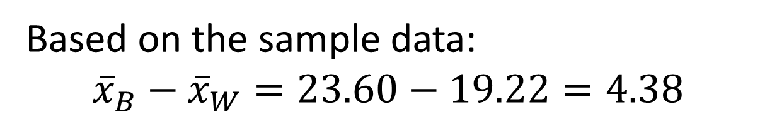
Example #1: Beer & Mosquitoes
µ = mean number of attracted mosquitoes
H₀: μ_{B} = μ_{W}
H_{a}: μ_{B} > μ_{W}
Competing claims about the population means
Based on the sample data:
$${\overline{x}}_{B}−{\overline{x}}_{W}=23.60−19.22=4.38$$
Is this a “significant” difference?
P-value: The proportion of samples, when H₀ is true, that would give results as (or more) extreme as the original sample.

Slide 9
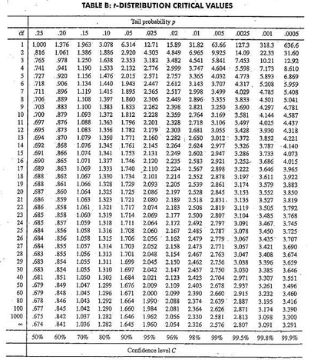

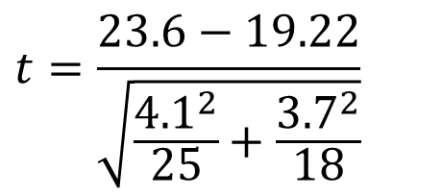
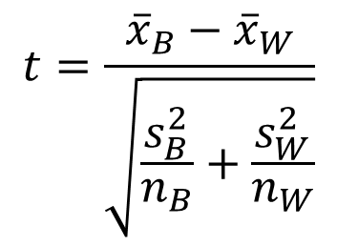
Traditional Inference
1. Check conditions
2. Which formula?
5. Which theoretical distribution?
$$t=\frac{{\overline{x}}_{B}−{\overline{x}}_{W}}{\sqrt{\frac{s_{B}^{2}}{n_{B}}+\frac{s_{W}^{2}}{n_{W}}}}$$
6. df?
7. Find p-value
8. Interpret a decision
3. Calculate numbers and plug into formula
$$t=\frac{23.6−19.22}{\sqrt{\frac{{4.1}^{2}}{25}+\frac{{3.7}_{}^{2}}{18}}}$$
4. Chug with calculator
$$t=3.68$$
0.0005 < p-value < 0.001

Slide 10
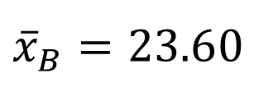
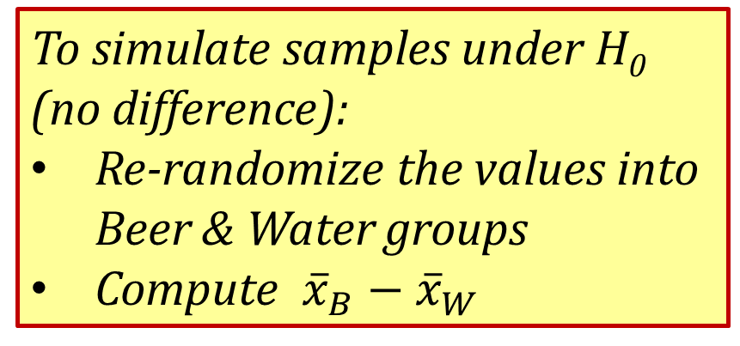


Simulation Approach
Number of Mosquitoes
To simulate samples under H₀ (no difference):
Re-randomize the values into Beer & Water groups
Compute ${\overline{x}}_{B}−{\overline{x}}_{W}$
Beer
27
20
21
26
27
31
24
19
23
24
28
19
24
29
20
17
31
20
25
28
21
27
21
18
20
Water
21
22
15
12
21
16
19
15
24
19
23
13
22
20
24
18
20
22
${\overline{x}}_{B}=23.6$0
$${\overline{x}}_{W}=19.22$$
Original Sample
$${\overline{x}}_{B}−{\overline{x}}_{W}=4.38$$

Slide 11
Simulation Approach
Number of Mosquitoes
To simulate samples under H₀ (no difference):
Beer
27
20
21
26
27
31
24
19
23
24
28
19
24
29
20
17
31
20
25
28
21
27
21
18
20
Water
21
22
15
12
21
16
19
15
24
19
23
13
22
20
24
18
20
22
27 19 21 24
20 24 18 19
21 29 20 23
26 20 21 13
27 27 22 22
31 31 15 20
24 20 12 24
19 25 21 18
23 28 16 20
24 21 19 22
28 27 15
${\overline{x}}_{B}=23.6$0
$${\overline{x}}_{W}=19.22$$
$${\overline{x}}_{B}−{\overline{x}}_{W}=4.38$$

Slide 12



Simulation Approach
Number of Mosquitoes
To simulate samples under H₀ (no difference):
Re-randomize the values into Beer & Water groups
Compute ${\overline{x}}_{B}−{\overline{x}}_{W}$
Beer
Water
24
20 24 18 19
21 29 20 23
26 20 21 13
27 27 22 22
31 31 15 20
24 20 12 24
19 25 21 18
23 28 16 20
24 21 19 22
28 27 15
27
19
21
20
24
19
20
24
31
13
18
24
25
21
18
15
21
16
28
22
19
27
20
23
22
21
20
26
31
19
23
15
22
12
24
29
20
27
21
17
24
28
Repeat this process 1000’s of times to see how “unusual” is the original difference of 4.38.
$${\overline{x}}_{B}=21.76$$
$${\overline{x}}_{W}=22.50$$
$${\overline{x}}_{B}−{\overline{x}}_{W}=−0.84$$

Slide 13
We need technology!
StatKey
www.lock5stat.com/statkey
Freely available web apps with no login required
Runs in (almost) any browser (incl. smartphones/tablets)
Google Chrome App available (no internet needed)
Standalone or supplement to existing technology
Notes:
Patti

Slide 14
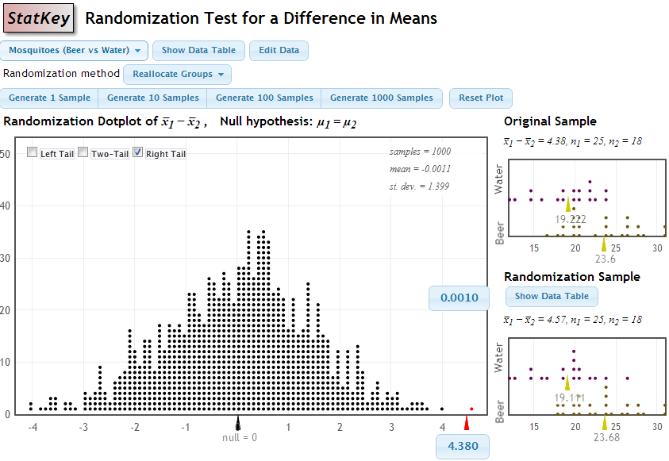
p-value = proportion of samples, when H₀ is true, that are as (or more) extreme as the original sample.
p-value

Slide 15
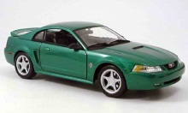

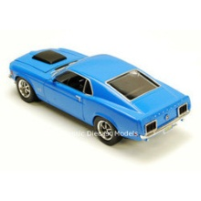
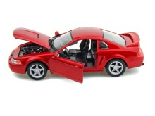
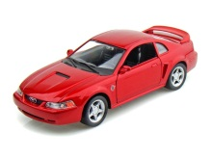
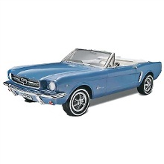


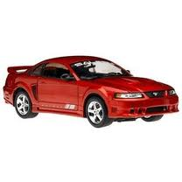

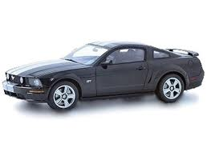
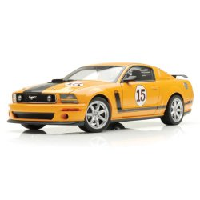
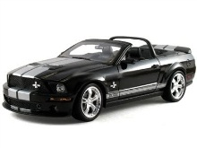
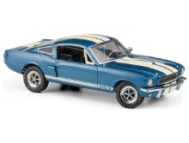
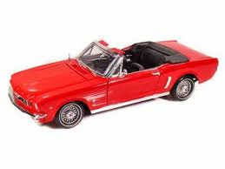

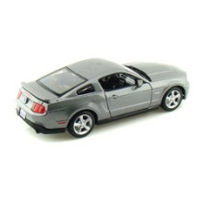
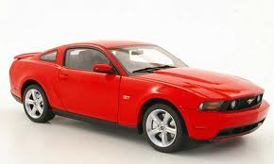

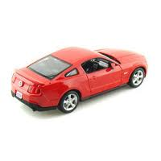
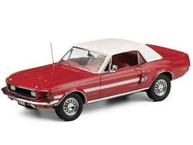
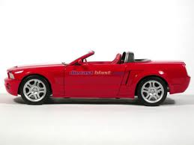
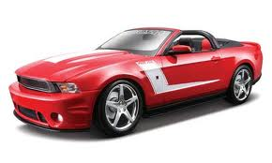
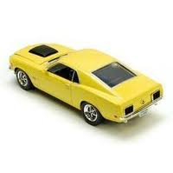
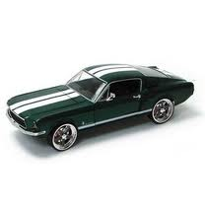

Example #2: Mustang Prices
Start with a random sample of 25 prices (in $1,000’s)
$$n=25 \overline{x}=15.98 s=11.11$$
Goal: Find an interval that is likely to contain the mean price for all Mustangs
Key concept: How much can we expect the sample means to vary just by random chance?

Slide 16
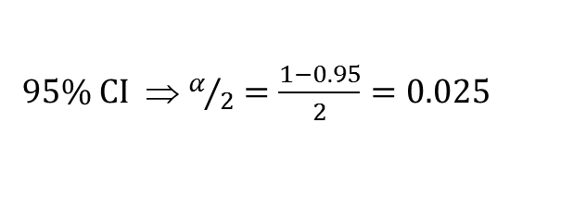

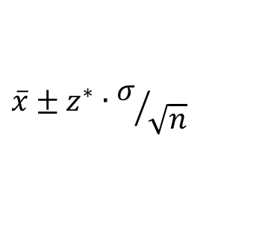

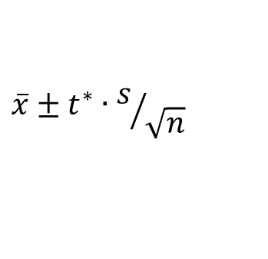
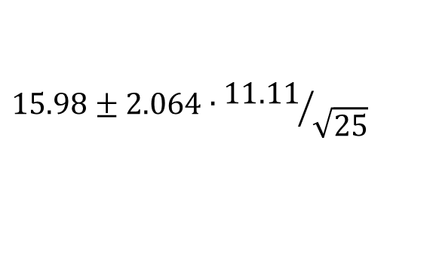

Traditional Inference
1. Check conditions
CI for a mean
2. Which formula?
$$\overline{x}±z^{∗}∙σ/{\sqrt{n}}$$
OR
$$\overline{x}±t^{∗}∙s/{\sqrt{n}}$$
3. Calculate summary stats
$n=25, \overline{x}=15.98$, $s=11.11$
4. Find t*
5. df?
95% CI ⇒ $α/2=\frac{1−0.95}{2}=0.025$
df=25$−$1=24
t*=2.064
6. Plug and chug
$$15.98±2.064∙{11.11}/{\sqrt{25}}$$
$$15.98±4.59=(11.39, 20.57)$$
7. Interpret in context

Slide 17
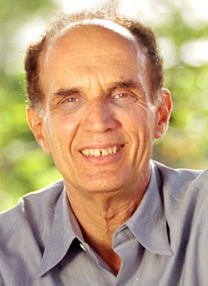
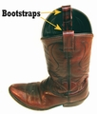
Bootstrapping
Brad Efron
Stanford University
“Let your data be your guide.”
To create a bootstrap distribution:
Assume the “population” is many, many copies of the original sample.
Simulate many samples from the population by sampling with replacement from the original sample

Slide 18
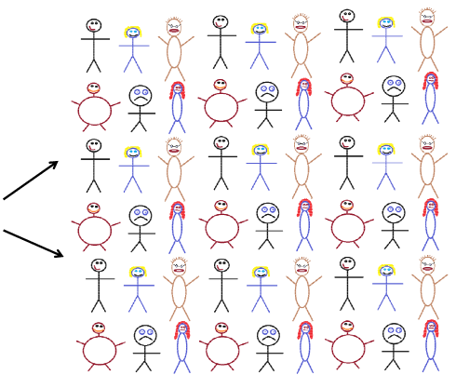
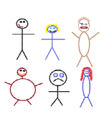




Finding a Bootstrap Sample
Original Sample (n=6)
A simulated “population” to sample from
Bootstrap Sample
(sample with replacement from the original sample)
Notes:
Patti

Slide 19
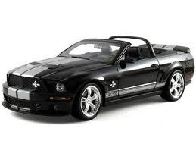

Original Sample
Bootstrap Sample
Repeat 1,000’s of times!
$$\overline{x}=15.98$$
$$\overline{x}=17.51$$
Notes:
Robin

Slide 20
BootstrapSample
Bootstrap Statistic
BootstrapSample
Bootstrap Statistic
Original Sample
Bootstrap Distribution
●
●
●
●
●
●
StatKey
Sample Statistic
BootstrapSample
Bootstrap Statistic

Slide 21
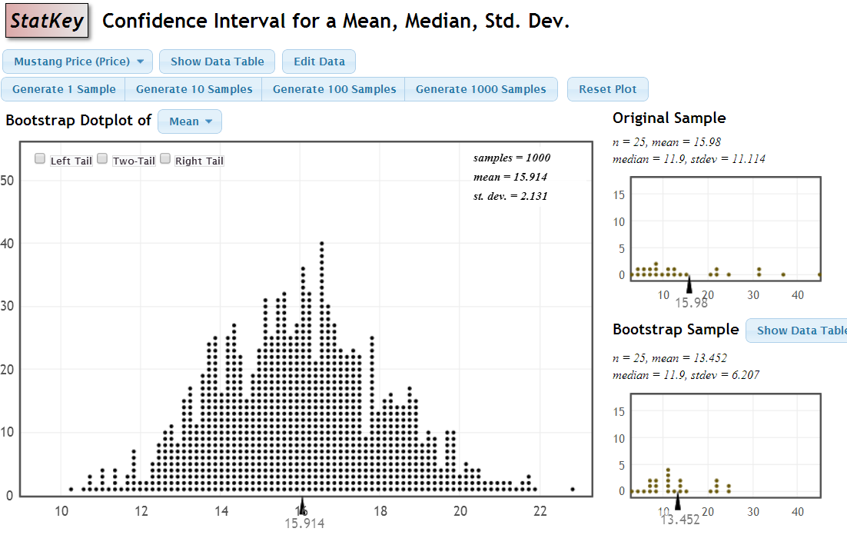
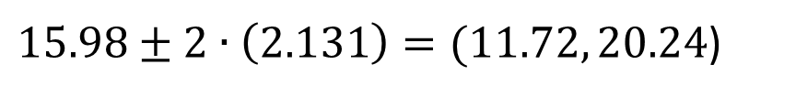

StatKey
Standard Error
$$\frac{s}{\sqrt{n}}=\frac{11.114}{\sqrt{25}}=2.2$$
$15.98±2∙\left(2.131\right)=(11.72, 20.24$)

Slide 22
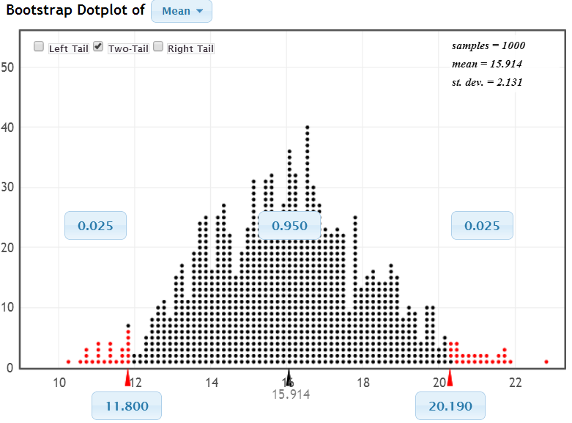
A 95% Confidence Level
Chop 2.5% in each tail
Keep 95% in middle
Chop 2.5% in each tail
We are 95% sure that the mean price for Mustangs is between $11,800 and $20,190

Slide 23
The same method is used for any statistic, including new statistics that are being defined in areas like genetics.
This is very powerful for practioners!
(and appreciated by students – especially visual learners)
Notes:
Denn

Slide 24
Why
does the bootstrap work?

Slide 25
Sampling Distribution
Population
BUT, in practice we don’t see the “tree” or all of the “seeds” – we only have ONE seed
µ
Notes:
Robin

Slide 26

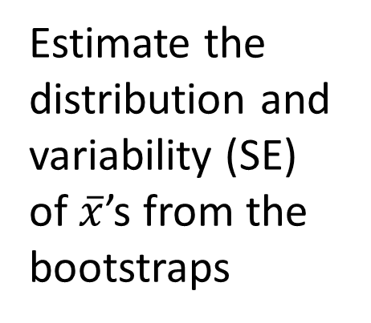
Bootstrap Distribution
What can we do with just one seed?
Estimate the distribution and variability (SE) of $\overline{x}$’s from the bootstraps
Bootstrap
“Population”
Grow a NEW tree!
$$\overline{x}$$
µ
Use the bootstrap errors that we CAN see to estimate the sampling errors that we CAN’T see.
Notes:
Robin

Slide 27
Golden Rule of Bootstraps
The bootstrap statistics are to the original statistic
as
the original statistic is to the population parameter.

Slide 28
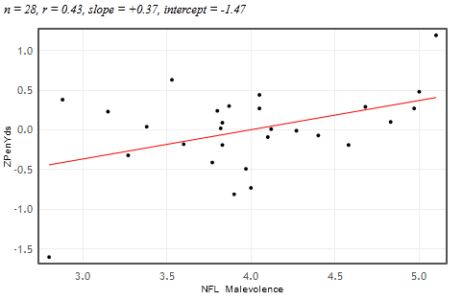


Example #3: Malevolent Uniforms
Do football teams with more malevolent uniforms tend to get more penalty yards?
Sample Correlation
r = 0.43
H₀: ρ = 0
H_{a}: ρ > 0

Slide 29
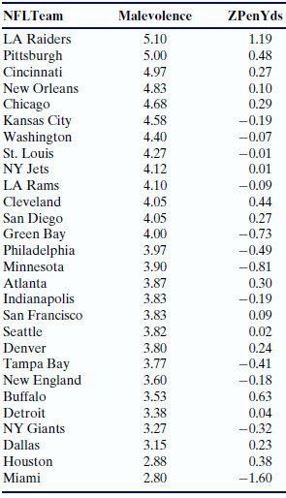
Simulation Approach
Sample Correlation = 0.43
Find out how extreme this correlation would be, if there is no relationship between uniform malevolence and penalties.
i.e., What kinds of results (correlations) would we see, just by random chance?

Slide 30
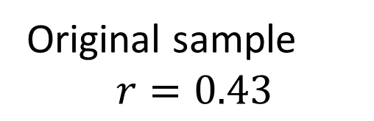
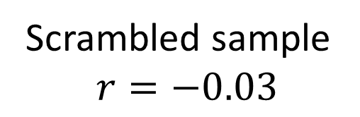
Randomization by Scrambling
Original sample
$$r=0.43$$
Scrambled sample
$$r=−0.03$$
Repeat 1000’s of times
StatKey

Slide 31
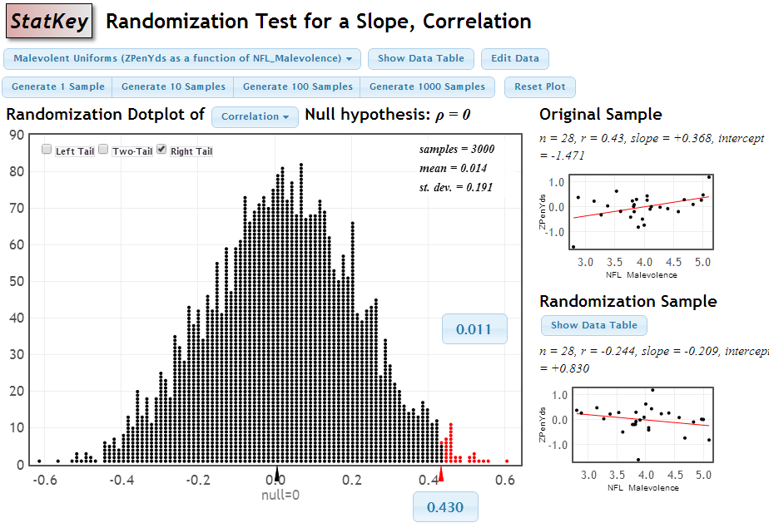
P-value
Small p-value ⇒ Strong evidence of a positive association between uniform malevolence and penalty yards.

Slide 32
How does everything fit together?
We use simulation methods to build understanding of the key statistical ideas.
We then cover traditional normal and t-based procedures as “short-cut formulas”.
Students continue to see all the standard methods but with a deeper understanding of the meaning.

Slide 33
Intro Stat – Revise the Topics
Descriptive Statistics – one and two samples
Descriptive Statistics – one and two samples
Normal distributions
Bootstrap confidence intervals
Bootstrap confidence intervals
Data production (samples/experiments)
Data production (samples/experiments)
Randomization-based hypothesis tests
Randomization-based hypothesis tests
Sampling distributions (mean/proportion)
Normal distributions
Confidence intervals (means/proportions)
Hypothesis tests (means/proportions)
ANOVA for several means, Inference for regression, Chi-square tests
Notes:
Bozz

Slide 34
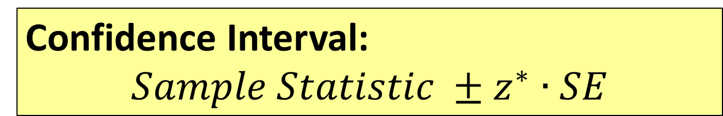
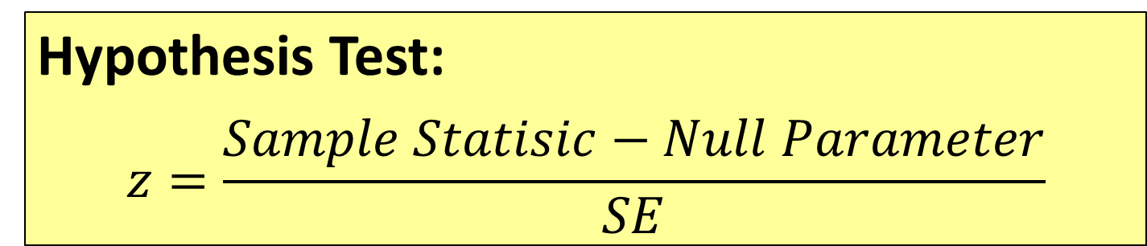
Transitioning to
Traditional Inference
Hypothesis Test:
$$z=\frac{Sample Statisic−Null Parameter}{SE}$$
Confidence Interval:
$$Sample Statistic ±z^{∗}∙SE$$
Notes:
M Lock

Slide 35
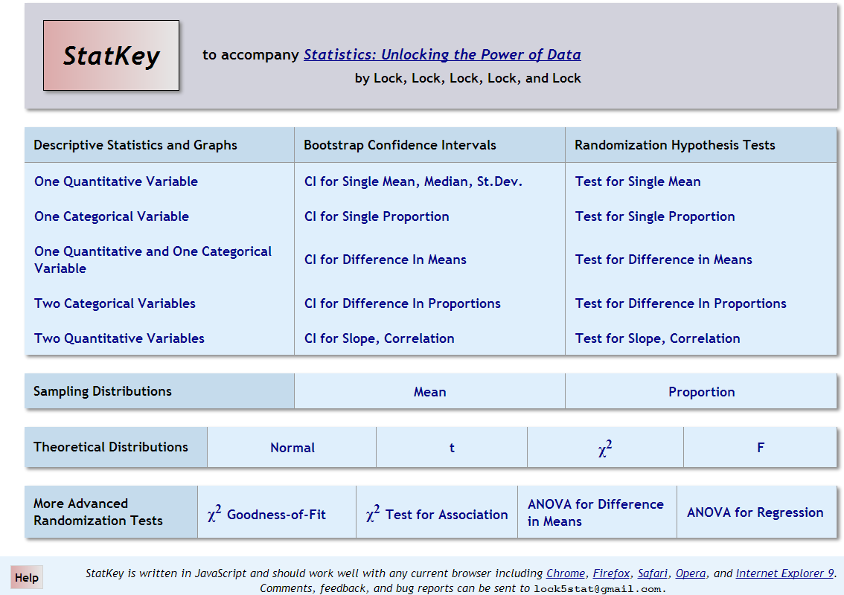

Slide 36
The Next Big Thing...
“... the consensus curriculum is still an unwitting prisoner of history. What we teach is largely the technical machinery of numerical approximations based on the normal distribution and its many subsidiary cogs. This machinery was once necessary, because the conceptually simpler alternative based on permutations was computationally beyond our reach. Before computers statisticians had no choice. These days we have no excuse. Randomization-based inference makes a direct connection between data production and the logic of inference that deserves to be at the core of every introductory course.”
-- Professor George Cobb, 2007

Slide 37
Thanks for listening!
rlock@stlawu.edu
www.lock5stat.com

