Slide 1
Introducing Statistical Inference with Resampling Methods
(Part 1)
Allan Rossman, Cal Poly – San Luis Obispo
Robin Lock, St. Lawrence University

Slide 2
George Cobb (TISE, 2007)
“What we teach is largely the technical machinery of numerical approximations based on the normal distribution and its many subsidiary cogs. This machinery was once necessary, because the conceptually simpler alternative based on permutations was computationally beyond our reach….

Slide 3
George Cobb (cont)
… Before computers statisticians had no choice. These days we have no excuse. Randomization-based inference makes a direct connection between data production and the logic of inference that deserves to be at the core of every introductory course.”

Slide 4
Overview
We accept Cobb’s argument
But, how do we go about implementing his suggestion?
What are some questions that need to be addressed?

Slide 5
Some Key Questions
How should topics be sequenced?
How should we start resampling?
How to handle interval estimation?
One “crank” or two (or more)?
Which statistic(s) to use?
What about technology options?

Slide 6
Format – Back and Forth
Pick a question
  One of us responds
  The other offers a contrasting answer
  Possible rebuttal
Repeat
  No break in middle
Leave time for audience questions
Warning: We both talk quickly (hang on!)
  Slides will be posted at: www.rossmanchance.com/jsm2013/

Slide 7
How should topics be sequenced?
What order for various parameters (mean, proportion, ...) and data scenarios (one sample, two sample, ...)?
Significance (tests) or estimation (intervals) first?
When (if ever) should traditional methods appear?

Slide 8
How should topics be sequenced?
Breadth first
  Start with data production
  Summarize with statistics and graphs
  Interval estimation (via bootstrap)
  Significance tests (via randomizations)
  Traditional approximations
  More advanced inference

Slide 9
How should topics be sequenced?
ANOVA, two-way tables, regression
More advanced
normal, t-intervals and tests
Traditional methods
hypotheses, randomization, p-value, ...
Significance tests
bootstrap distribution, standard error, CI, ...
Interval estimation
mean, proportion, differences, slope, ...
Data summary
experiment, random sample, ...
Data production

Slide 10
How should topics be sequenced?
1. Ask a research question
Depth first:
Study one scenario from beginning to end of statistical investigation process
Repeat (spiral) through various data scenarios as the course progresses
2. Design a study
and collect data
3. Explore the
data
4. Draw
inferences
5. Formulate conclusions
6. Look back and ahead

Slide 11
How should topics be sequenced?
One proportion
  Descriptive analysis
  Simulation-based test
  Normal-based approximation
  Confidence interval (simulation-, normal-based)
One mean
Two proportions, Two means, Paired data
Many proportions, many means, bivariate data

Slide 12
How should we start resampling?
Give an example of where/how your students might first see inference based on resampling methods
Notes:
Robin

Slide 13
How should we start resampling?
From the very beginning of the course
  To answer an interesting research question
Example: Do people tend to use “facial prototypes” when they encounter certain names?

Slide 14
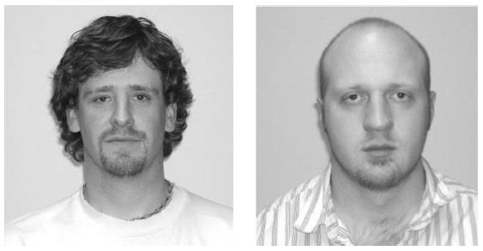
How should we start resampling?
Which name do you associate with the face on the left: Bob or Tim?
Winter 2013 students: 46 Tim, 19 Bob

Slide 15
How should we start resampling?
Are you convinced that people have genuine tendency to associate “Tim” with face on left?
Two possible explanations
  People really do have genuine tendency to associate “Tim” with face on left
  People choose randomly (by chance)
How to compare/assess plausibility of these competing explanations?
  Simulate!

Slide 16
How should we start resampling?
Why simulate?
  To investigate what could have happened by chance alone (random choices), and so …
  To assess plausibility of “choose randomly” hypothesis by assessing unlikeliness of observed result
How to simulate?
  Flip a coin! (simplest possible model)
  Use technology

Slide 17
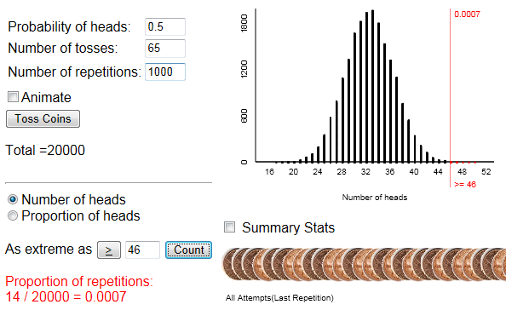
How should we start resampling?
Very strong evidence that people do tend to put Tim on the left
  Because the observed result would be very surprising if people were choosing randomly

Slide 18

How should we start resampling?
Bootstrap interval estimate for a mean
Example: Sample of prices (in $1,000’s) for n=25 Mustang (cars) from an online car site.
$$n=25 \overline{x}=15.98 s=11.11$$
How accurate is this sample mean likely to be?
Notes:
Allan

Slide 19
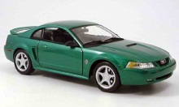

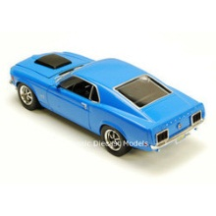
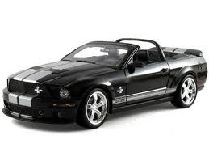
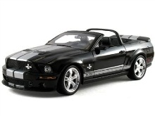
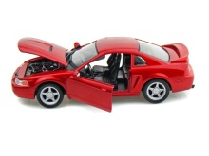
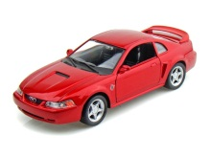
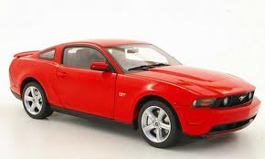
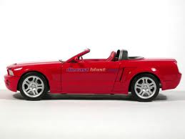
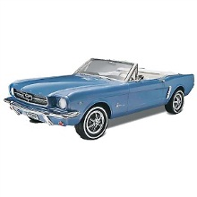

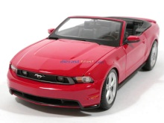
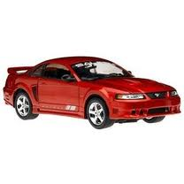

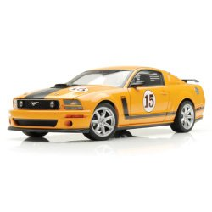
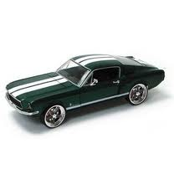
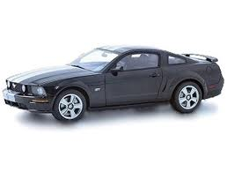
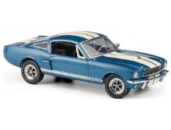
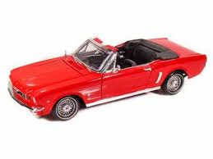

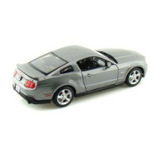
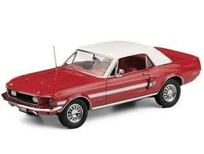

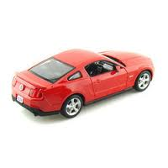
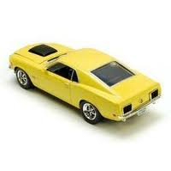
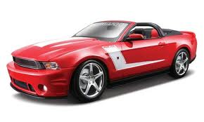


Original Sample
Bootstrap Sample
$$\overline{x}=15.98$$
$$\overline{x}=17.51$$
Notes:
Robin

Slide 20
BootstrapSample
Bootstrap Statistic
BootstrapSample
Bootstrap Statistic
Original Sample
Bootstrap Distribution
●
●
●
●
●
●
Sample Statistic
BootstrapSample
Bootstrap Statistic
Notes:
Robin

Slide 21
We need technology!
StatKey
www.lock5stat.com/statkey
Notes:
Patti

Slide 22
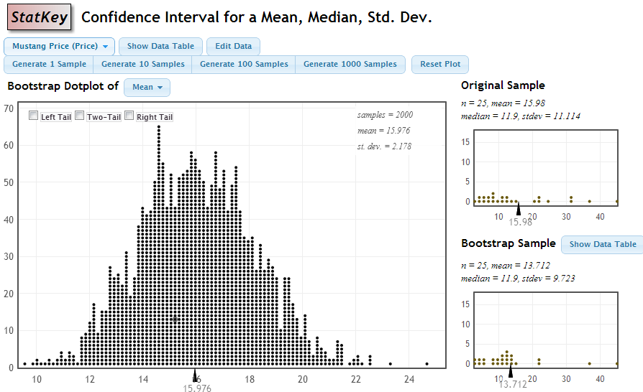
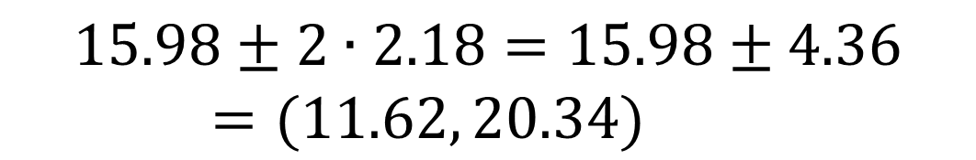
$$15.98±2∙2.18=15.98±4.36=(11.62, 20.34)$$
Notes:
Robin

Slide 23
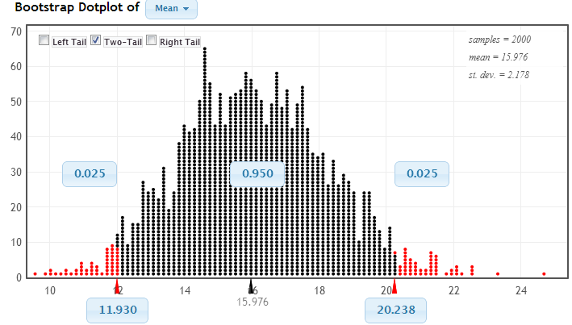
Chop 2.5% in each tail
Keep 95% in middle
Chop 2.5% in each tail
We are 95% sure that the mean price for Mustangs is between $11,930 and $20,238
Notes:
Robin

Slide 24
How to handle interval estimation?
Bootstrap? Traditional formula? Other?
Some combination? In what order?
Notes:
Allan

Slide 25
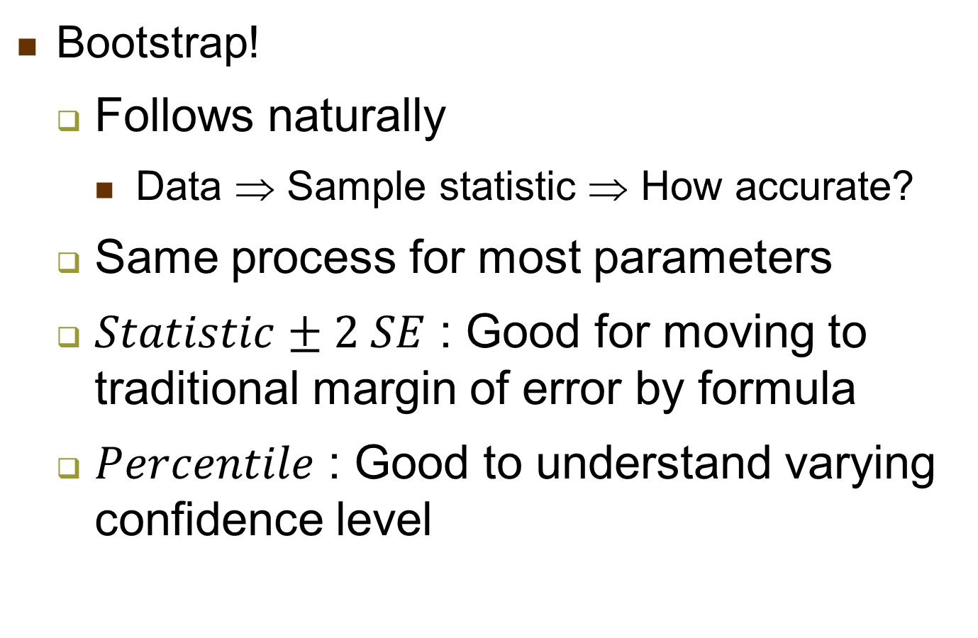
How to handle interval estimation?
Bootstrap!
  Follows naturally
    Data ⇒ Sample statistic ⇒ How accurate?
  Same process for most parameters
  $Statistic±2 SE$ : Good for moving to traditional margin of error by formula
  $Percentile$ : Good to understand varying confidence level
Notes:
Allan

Slide 26
Sampling Distribution
Population
BUT, in practice we don’t see the “tree” or all of the “seeds” – we only have ONE seed
µ
Notes:
Robin

Slide 27

Bootstrap Distribution
What can we do with just one seed?
Bootstrap
“Population”
Chris Wild - USCOTS 2013
Use bootstrap errors that we CAN see to estimate sampling errors that we CAN’T see.
Grow a NEW tree!
$$\overline{x}$$
µ
Notes:
Robin

Slide 28
How to handle interval estimation?
At first: plausible values for parameter
  Those not rejected by significance test
  Those that do not put observed value of statistic in tail of null distribution
Notes:
Allan

Slide 29
How to handle interval estimation?
Example: Facial prototyping (cont)
  Statistic: 46 of 65 (0.708) put Tim on left
  Parameter: Long-run probability that a person would associate “Tim” with face on left
  We reject the value 0.5 for this parameter
  What about 0.6, 0.7, 0.8, 0.809, …?
    Conduct many (simulation-based) tests
  Confident that the probability that a student puts Tim with face on left is between .585 and .809
Notes:
Allan

Slide 30
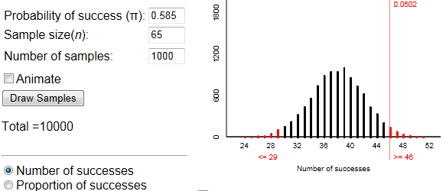
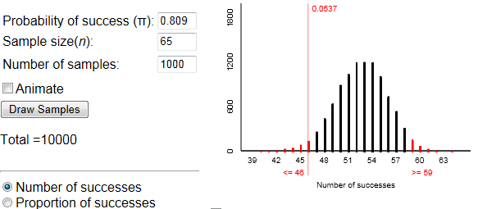
How to handle interval estimation?
Notes:
Allan

Slide 31
How to handle interval estimation?
Then: statistic ± 2 × SE(of statistic)
  Where SE could be estimated from simulated null distribution
  Applicable to other parameters
Then theory-based (z, t, …) using technology
  By clicking button

Slide 32
Introducing Statistical Inference with Resampling Methods
(Part 2)
Robin Lock, St. Lawrence University
Allan Rossman, Cal Poly – San Luis Obispo

Slide 33
One Crank or Two?
What’s a crank?
A mechanism for generating simulated samples by a random procedure that meets some criteria.

Slide 34
One Crank or Two?
Randomized experiment: Does wearing socks over shoes increase confidence while walking down icy incline?
How unusual is such an extreme result, if there were no effect of footwear on confidence?
 | Socks over shoes | Usual footwear
Appeared confident | 10 | 8
Did not | 4 | 7
Proportion who appeared confident | .714 | .533
Notes:
Allan

Slide 35
One Crank or Two?
How to simulate experimental results under null model of no effect?
  Mimic random assignment used in actual experiment to assign subjects to treatments
  By holding both margins fixed (the crank)
 | Socks over shoes | Usual footwear | Total
Confident | 10 | 8 | 18 | Black
Not | 4 | 7 | 11 | Red
Total | 14 | 15 | 29 | 29 cards
Notes:
Allan

Slide 36
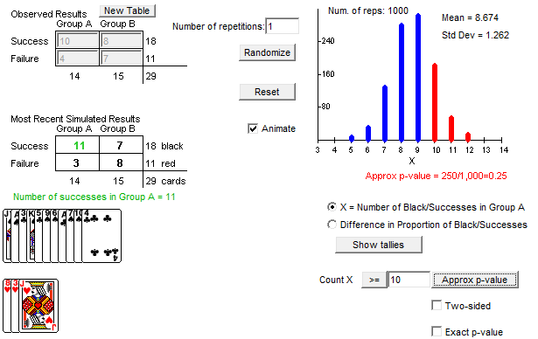
One Crank or Two?
Not much evidence of an effect
  Observed result not unlikely to occur by chance alone

Slide 37
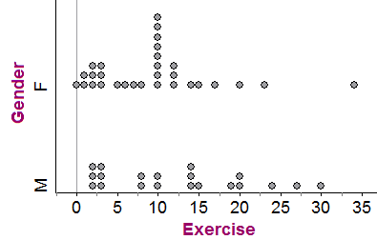
One Crank or Two?
Two cranks
Example: Compare the mean weekly exercise hours between male & female students

Slide 38
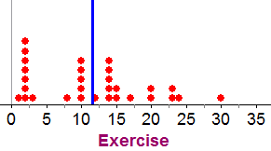
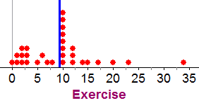
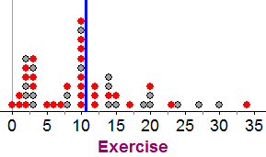
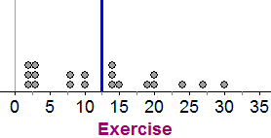
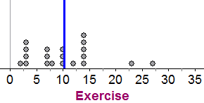






One Crank or Two?
$${\overline{x}}_{f}=11.5$$
$${\overline{x}}_{f}=9.4$$
30 F’s
$$\overline{x}=10.6$$
$${\overline{x}}_{f}−{\overline{x}}_{m}=1.25$$
$${\overline{x}}_{m}=12.4$$
$${\overline{x}}_{m}=10.25$$
20 M’s
Resample
(with replacement)
Combine samples

Slide 39
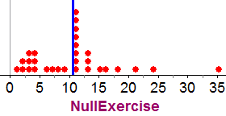
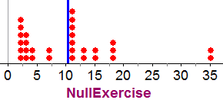
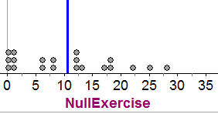
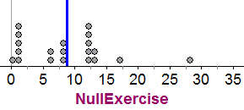





One Crank or Two?
$${\overline{x}}_{f}=10.6$$
30 F’s
$${\overline{x}}_{f}=10.3$$
$${\overline{x}}_{f}=9.4$$
$${\overline{x}}_{f}−{\overline{x}}_{m}=1.5$$
$${\overline{x}}_{m}=10.6$$
$${\overline{x}}_{m}=12.4$$
$${\overline{x}}_{m}=8.8$$
20 M’s
Resample
(with replacement)
Shift samples

Slide 40
One Crank or Two?
Example: independent random samples
How to simulate sample data under null that popn proportion was same in both years?
  Crank 2: Generate independent random binomials (fix column margin)
  Crank 1: Re-allocate/shuffle as above (fix both margins, break association)
 | 1950 | 2000 | Total
Born in CA | 219 | 258 | 477
Born elsewhere | 281 | 242 | 523
Total | 500 | 500 | 1000
Notes:
Allan

Slide 41
One Crank or Two?
For mathematically inclined students: Use both cranks, and emphasize distinction between them
  Choice of crank reinforces link between data production process and determination of p-value and scope of conclusions
For Stat 101 students: Use just one crank (shuffling to break the association)
Notes:
Allan

Slide 42
Which statistic to use?
Speaking of 2×2 tables ...
What statistic should be used for the simulated randomization distribution?
  With one degree of freedom, there are many candidates!
Notes:
Allan

Slide 43

Which statistic to use?
#1 – the difference in proportions
${\hat{p}}_{1}−$ ${\hat{p}}_{2}$
... since that’s the parameter being estimated

Slide 44
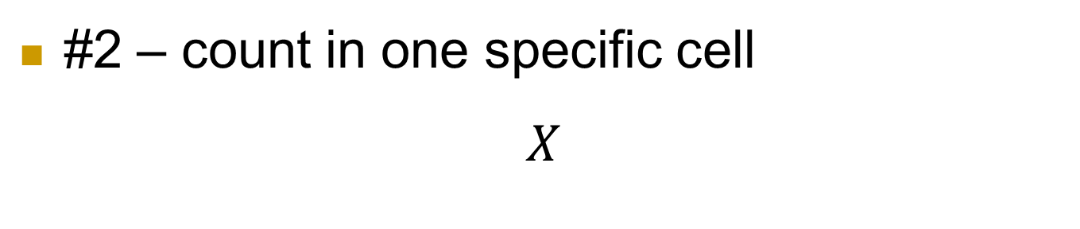
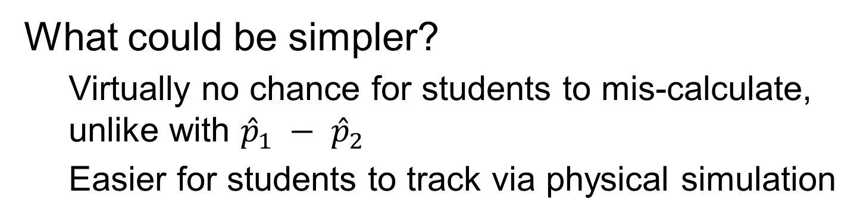
Which statistic to use?
#2 – count in one specific cell
$$X$$
What could be simpler?
  Virtually no chance for students to mis-calculate, unlike with ${\hat{p}}_{1} − {\hat{p}}_{2}$
  Easier for students to track via physical simulation
Notes:
Allan

Slide 45
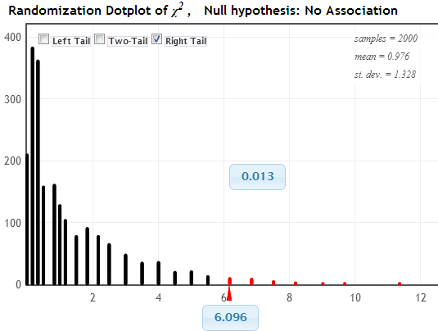
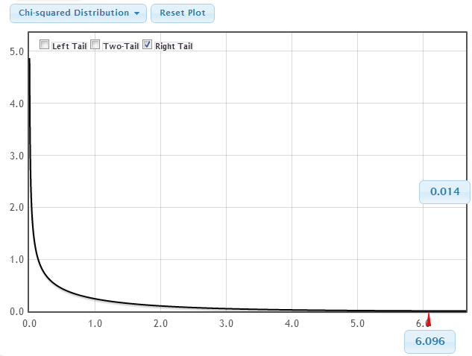
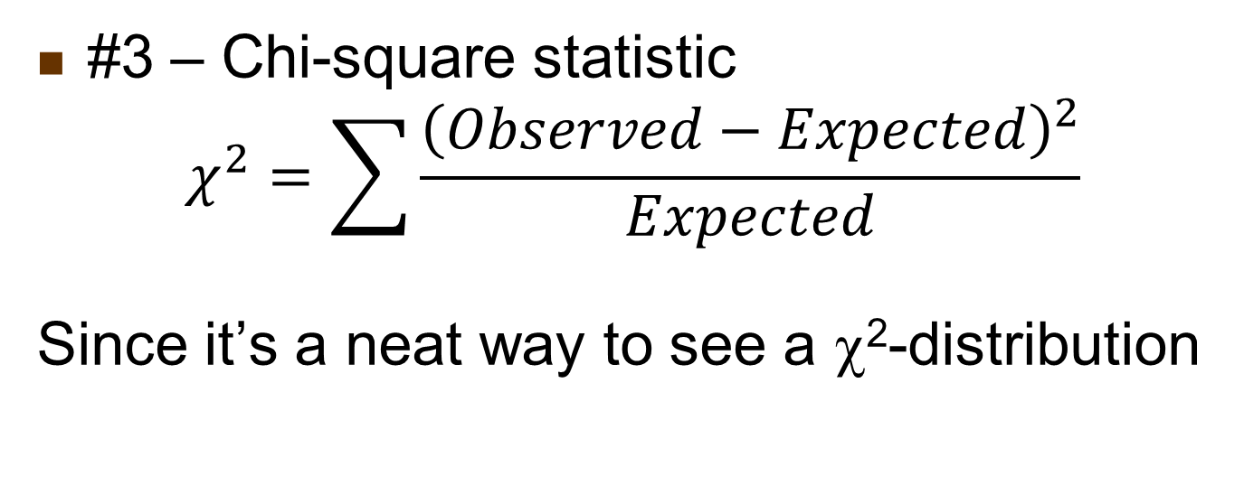
Which statistic to use?
#3 – Chi-square statistic
$$χ^{2}=\sum{\frac{{\left(Observed−Expected\right)}^{2}}{Expected}}$$
Since it’s a neat way to see a χ²-distribution

Slide 46
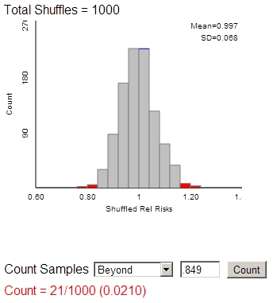
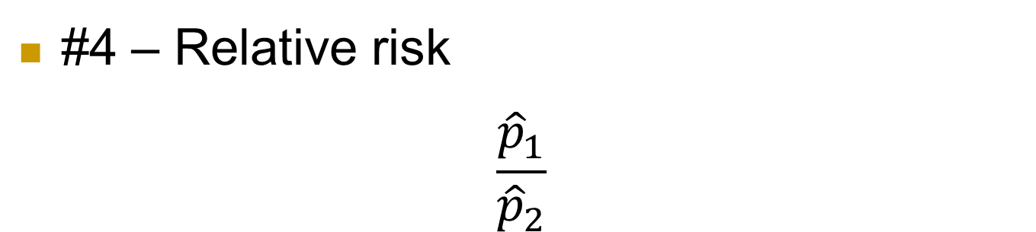
Which statistic to use?
#4 – Relative risk
$$\frac{{\hat{p}}_{1}}{{\hat{p}}_{2}}$$
Notes:
Allan

Slide 47
Which statistic to use?
More complicated scenarios than 2×2 tables
  Comparing multiple groups
    With categorical or quantitative response variable
  Why restrict attention to chi-square or F-statistic?
  Let students suggest more intuitive statistics
    E.g., mean of (absolute) pairwise differences in group proportions/means
Notes:
Allan

Slide 48
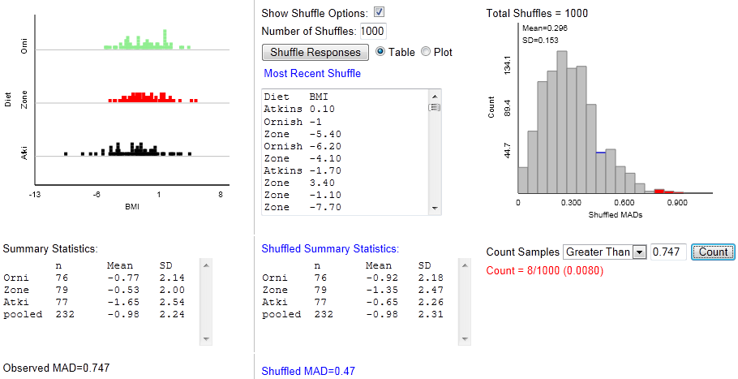
Which statistic to use?

Slide 49
What about technology options?
Notes:
Allan

Slide 50
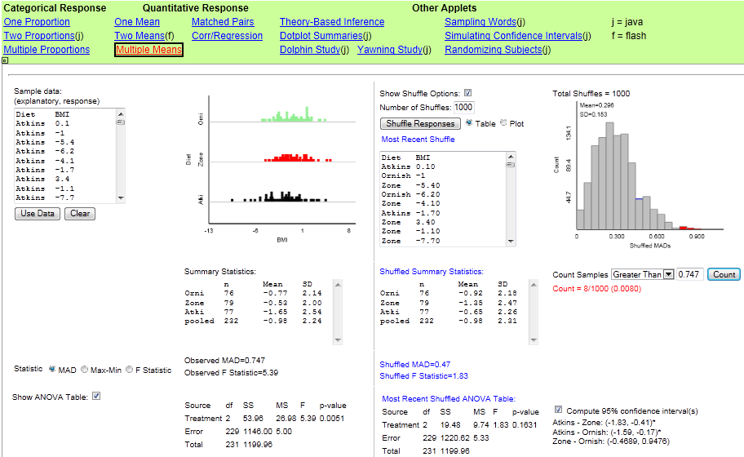
What about technology options?
Notes:
Allan

Slide 51
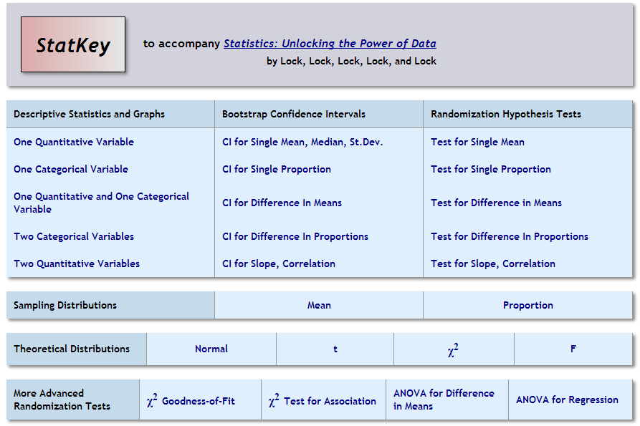
What about technology options?

Slide 52

One to Many Samples
Three Distributions
Interact with tails

Slide 53
What about technology options?
Rossman/Chance applets
  www.rossmanchance.com/iscam2/
  ISCAM (Investigating Statistical Concepts, Applications, and Methods)
  www.rossmanchance.com/ISIapplets.html
  ISI (Introduction to Statistical Investigations)
StatKey
  www.lock5stat.com/statkey
  Statistics: Unlocking the Power of Data
rlock@stlawu.edu arossman@calpoly.edu
www.rossmanchance.com/jsm2013/
lock5stat.com/talks/RossmanLockJSM2013.pptx
Notes:
Allan

Slide 54
Questions?
rlock@stlawu.edu arossman@calpoly.edu
Thanks!

