Slide 1
Models and Modeling in Introductory Statistics
Robin H. Lock
Burry Professor of Statistics
St. Lawrence University
2012 Joint Statistics Meetings
San Diego, August 2012

Slide 2
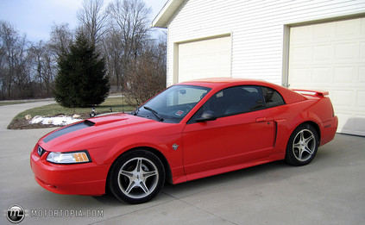
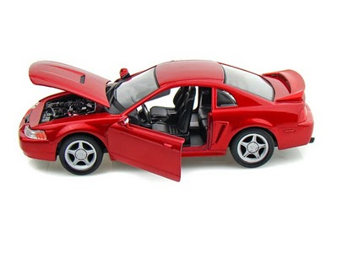

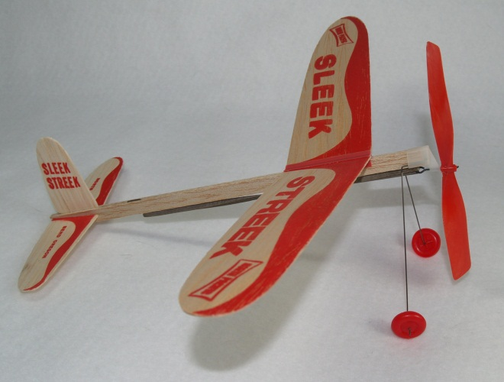
What is a Model?

Slide 3
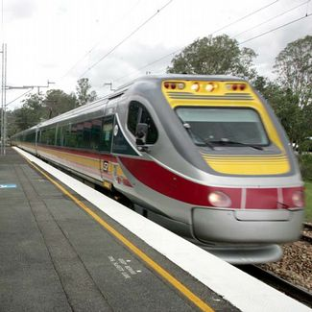
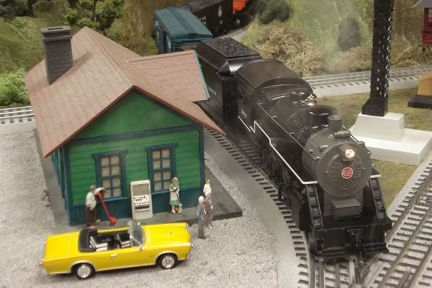
What is a Model?
A simplified abstraction that approximates important features of a more complicated system

Slide 4
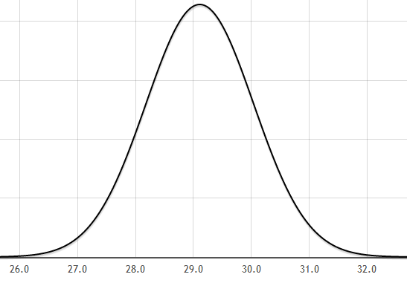
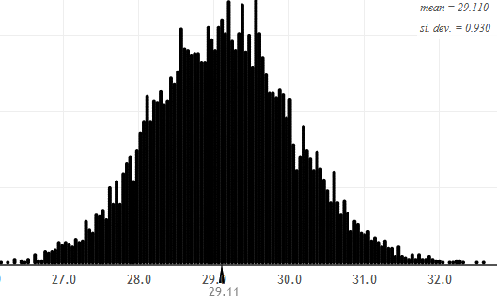
Traditional Statistical Models
Y∼N(μ,σ)
Population
Often depends on non-trivial mathematical ideas.

Slide 5
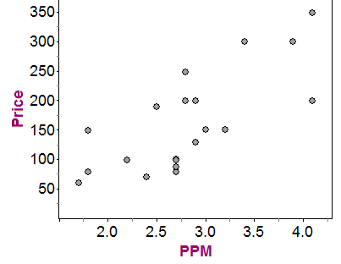
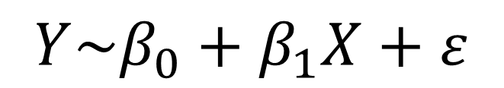
Traditional Statistical Models
$$Y\sim β_{0}+β_{1}X+ε$$
Relationship
Response (Y)
Predictor (X)

Slide 6
“Empirical” Statistical Models
A representative sample looks like a mini-version of the population.
⇒ Model a population with many copies of the sample.
Bootstrap
Sample with replacement from an original sample to study the behavior of a statistic.

Slide 7
“Empirical” Statistical Models
Hypothesis testing: Assess the behavior of a sample statistic, when the population meets a specific criterion.
⇒ Create a Null Model in order to sample from a population that satisfies H₀
Randomization

Slide 8
Traditional vs. Empirical
Both types of model are important, BUT
Empirical models (bootstrap/randomization) are
More accessible at early stages of a course
More closely tied to underlying statistical concepts
Less dependent on abstract mathematics

Slide 9

Example: Mustang Prices
Data: Sample prices for n=25 Mustangs
$$\overline{x}=15.98 s=11.11$$
Estimate the average price of used Mustangs and provide an interval to reflect the accuracy of the estimate.

Slide 10
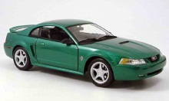

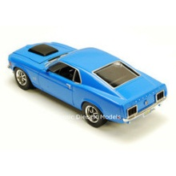
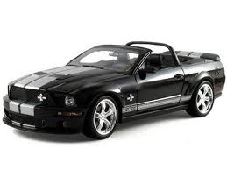
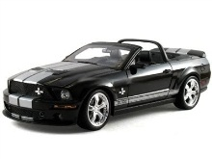


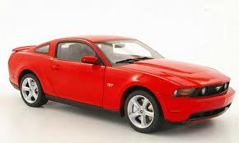
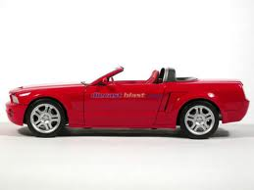
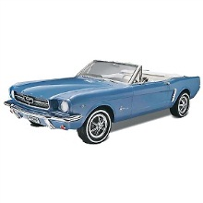


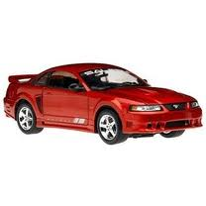

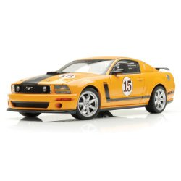
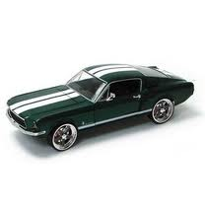
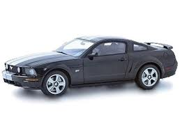
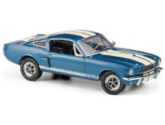
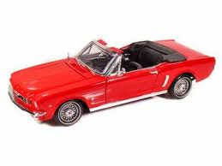

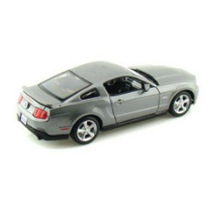
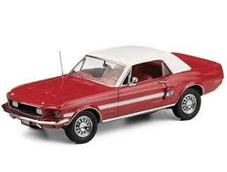

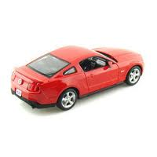
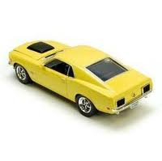
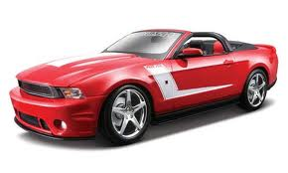
Original Sample
Bootstrap Sample

Slide 11
BootstrapSample
Bootstrap Statistic
BootstrapSample
Bootstrap Statistic
Original Sample
Bootstrap Distribution
.
.
.
.
.
.
Sample Statistic
BootstrapSample
Bootstrap Statistic
Notes:
Patti

Slide 12
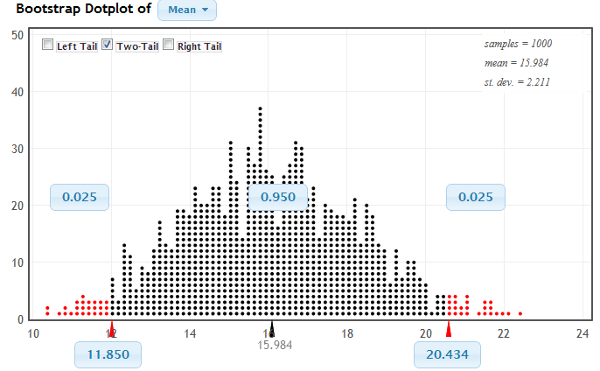
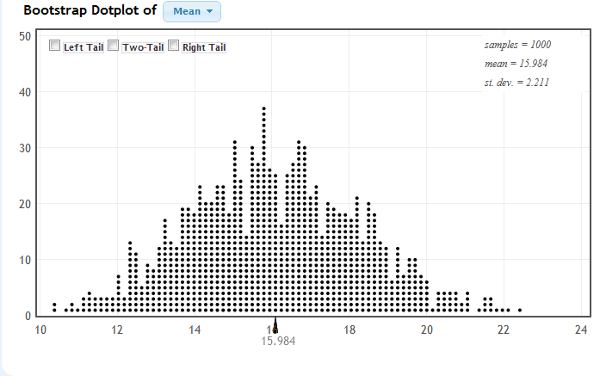
Bootstrap Distribution:
Mean Mustang Prices

Slide 13
Background?
What do students need to know about before doing a bootstrap interval?
Random sampling
Sample statistics (mean, std. dev., %-tile)
Display a distribution (dotplot)
Parameter vs. statistic

Slide 14
Traditional Sampling Distribution
Population
BUT, in practice we don’t see the “tree” or all of the “seeds” – we only have ONE seed
µ

Slide 15
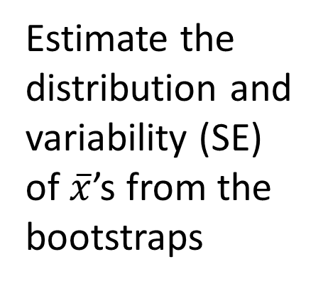

Bootstrap Distribution
What can we do with just one seed?
Bootstrap
“Population”
Estimate the distribution and variability (SE) of $\overline{x}$’s from the bootstraps
Grow a NEW tree!
$$\overline{x}$$
µ

Slide 16
Golden Rule of Bootstraps
The bootstrap statistics are to the original statistic
as
the original statistic is to the population parameter.

Slide 17
Round 2

Slide 18
Course Order
Data production
Data description (numeric/graphs)
Interval estimates (bootstrap model)
Randomization tests (null model)
Traditional inference for means and proportions (normal/t model)
Higher order inference (chi-square, ANOVA, linear regression model)

Slide 19
Traditional models need mathematics,
Empirical models need technology!

Slide 20
Some technology options:
R (especially with Mosaic)
Fathom/Tinkerplots
StatCrunch
JMP
StatKey
www.lock5stat.com
Notes:
Patti

Slide 21
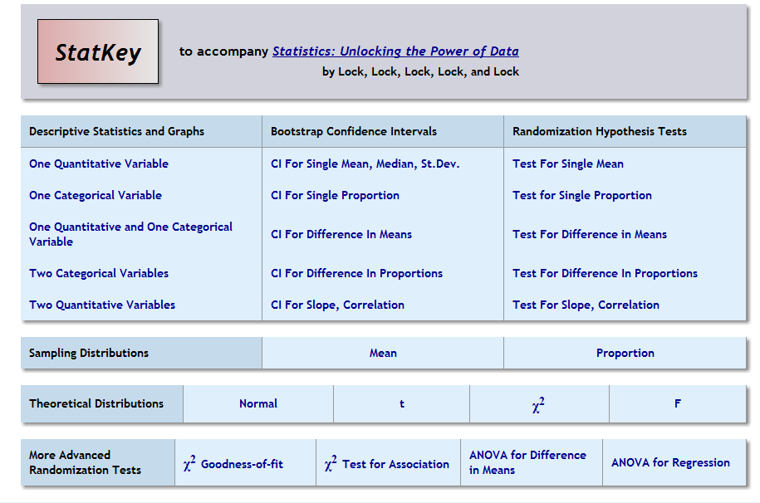

Slide 22
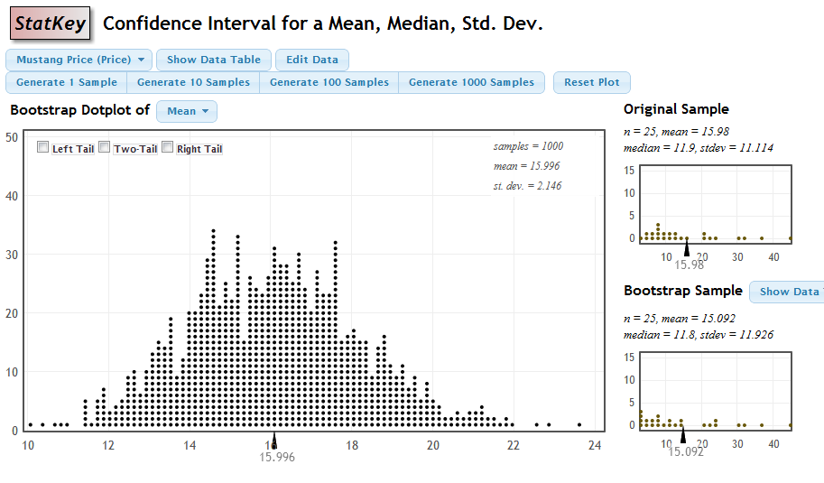
Built-in data
Enter new data
One to Many Samples
Three Distributions

Slide 23
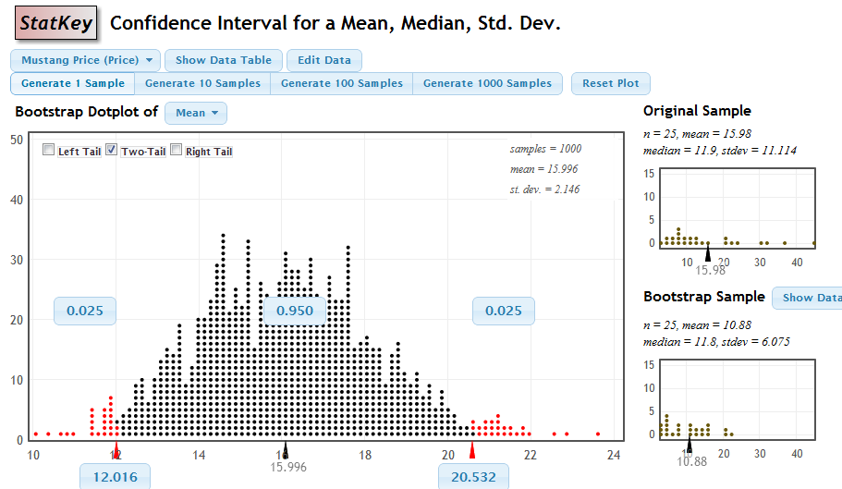
Distribution Summary Stats
Interact with tails

Slide 24
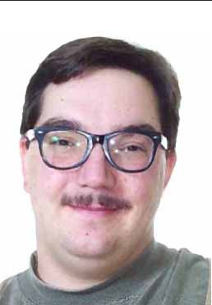
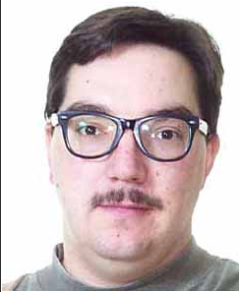
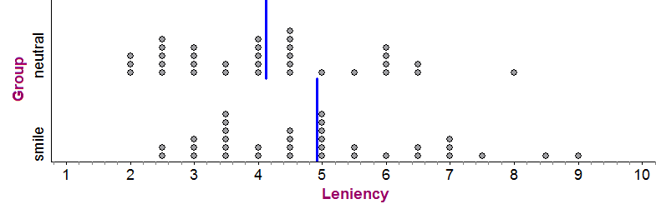
Smiles and Leniency
Does smiling affect leniency in a college disciplinary hearing?
4.12
4.91
Null Model: Expression has no affect on leniency
LeFrance, M., and Hecht, M. A., “Why Smiles Generate Leniency,” Personality and Social Psychology Bulletin, 1995; 21:

Slide 25
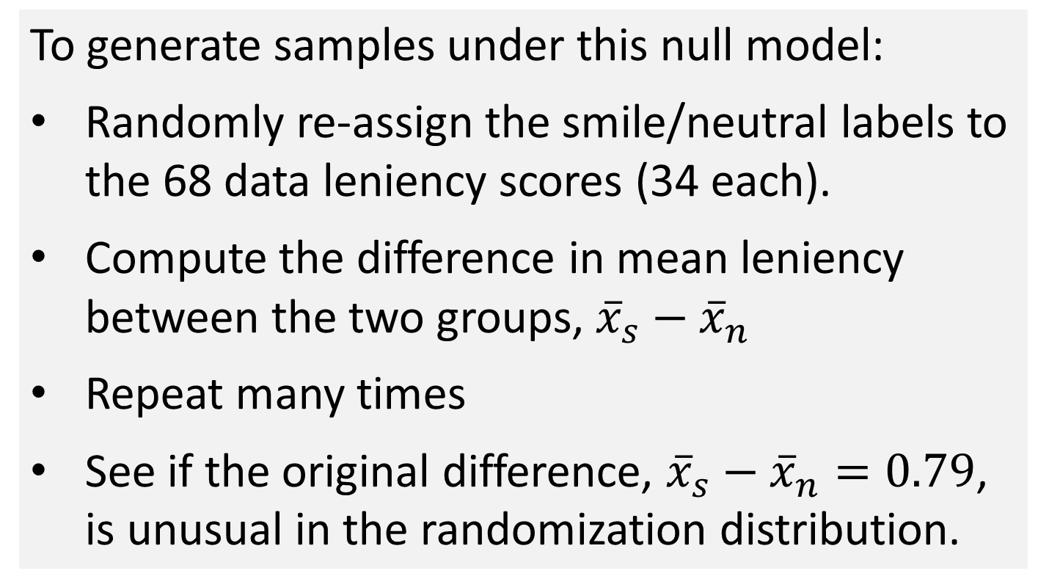
Smiles and Leniency
Null Model: Expression has no affect on leniency
To generate samples under this null model:
Randomly re-assign the smile/neutral labels to the 68 data leniency scores (34 each).
Compute the difference in mean leniency between the two groups, ${\overline{x}}_{s}−{\overline{x}}_{n}$
Repeat many times
See if the original difference, ${\overline{x}}_{s}−{\overline{x}}_{n}=0.79$, is unusual in the randomization distribution.

Slide 26
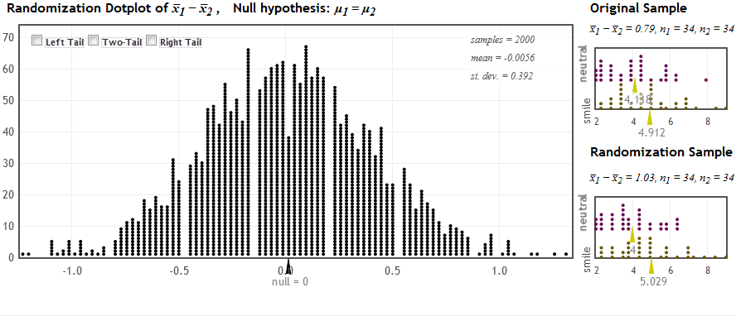
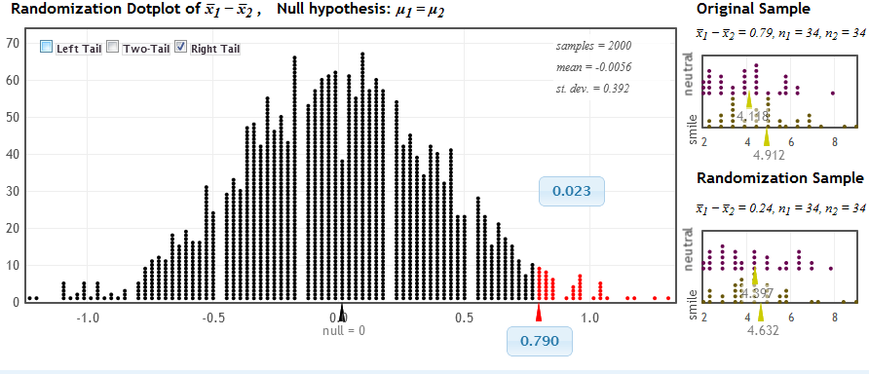
StatKey
p-value = 0.023

Slide 27
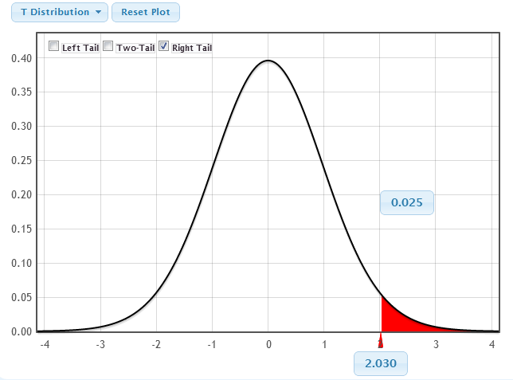
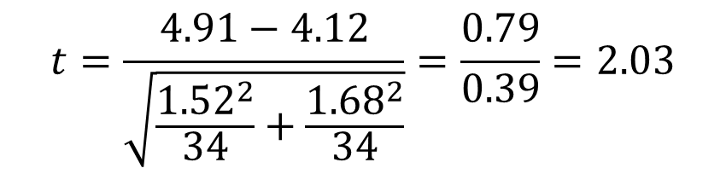
Traditional t-test
H₀:μ_{s} = μ_{n}
H₀:μ_{s} > μ_{n}
$$t=\frac{4.91−4.12}{\sqrt{\frac{{1.52}^{2}}{34}+\frac{{1.68}^{2}}{34}}}=\frac{0.79}{0.39}=2.03$$

Slide 28
Round 3

Slide 29
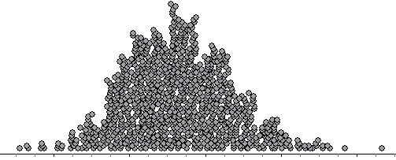
Assessment?
Construct a bootstrap distribution of sample means for the SPChange variable. The result should be relatively bell-shaped as in the graph below. Put a scale (show at least five values) on the horizontal axis of this graph to roughly indicate the scale that you see for the bootstrap means.
Estimate SE? Find CI from SE? Find CI from percentiles?

Slide 30
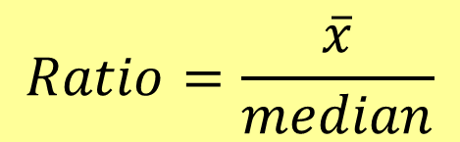
Assessment?
From 2009 AP Stat: Given summary stats, test skewness
$$Ratio=\frac{\overline{x}}{median}$$
Ratio=1.04 for the original sample
Given 100 such ratios for samples drawn from a symmetric distribution
Find and interpret a p-value

Slide 31
Implementation Issues
Good technology is critical
Missed having “experienced” student support the first couple of semesters

Slide 32
Round 4

Slide 33
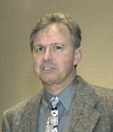
Why Did I Get Involved with Teaching Bootstrap/Randomization Models?
It’s all George’s fault...
"Introductory Statistics:
A Saber Tooth Curriculum?"
Banquet address at the first (2005) USCOTS
George Cobb

Slide 34
Models in Introductory Statistics
Introduce inference with “empirical models” based on simulations from the sample data (bootstraps/randomizations),
then approximate with models based on traditional distributions.

