Slide 1
Introducing Inference with Simulation Methods; Implementation at Duke University
Kari Lock Morgan
Department of Statistical Science, Duke University
kari@stat.duke.edu
Joint Statistical Meetings, San Diego
7/31/12

Slide 2
Methods of Inference
Simulation Methods (bootstrap, randomization)
intrinsically connected to the concepts
minimal background knowledge needed
same procedure applies to all statistics
no conditions to check
Traditional Methods (normal, t-distribution)
familiarity expected after intro stat
Use simulation methods to introduce inference, and then teach the traditional methods as “short-cut formulas”

Slide 3
Topics
Introduction to Data
Collecting data
Describing data
Introduction to Inference
Confidence intervals (bootstrap)
Hypothesis tests (randomization)
Normal and t-based methods
Chi-square and ANOVA
Randomization and theoretical approaches
Regression

Slide 4
Sleep versus Caffeine
Students were given words to memorize, then randomly assigned to take either a 90 min nap, or a caffeine pill. 2 ½ hours later, they were tested on their recall ability.
${\overline{x}}_{s}−$ ${\overline{x}}_{c}=3$ words
Is sleep better than caffeine for memory?
Mednick, Cai, Kanady, and Drummond (2008). “Comparing the benefits of caffeine, naps and placebo on verbal, motor and perceptual memory,” Behavioral Brain Research, 193, 79-86.

Slide 5
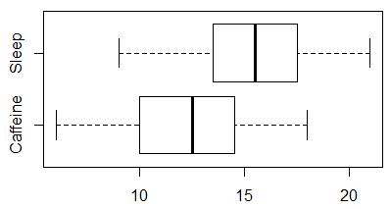
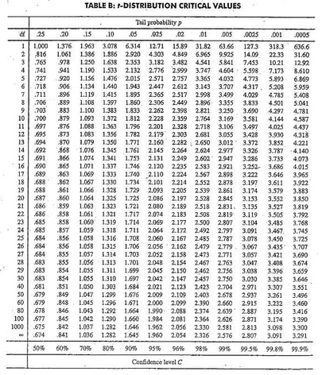
Traditional Inference
Conditions Met?
2. Which formula?
5. Which theoretical distribution?
6. df?
3. Calculate numbers and plug into formula
7. find p-value
0.025 < p-value < 0.05
> pt(2.14, 11, lower.tail=FALSE)
[1] 0.02780265
4. Plug into calculator

Slide 6
Simulation Inference
How extreme would a sample difference of 3 be, if there were no difference between sleep and caffeine for word recall?
What kind of differences would we observe, just by random chance?
Simulate many randomizations, assuming no difference
Calculate the p-value as the proportion of simulated randomizations that yield differences as extreme as the observed 3

Slide 7
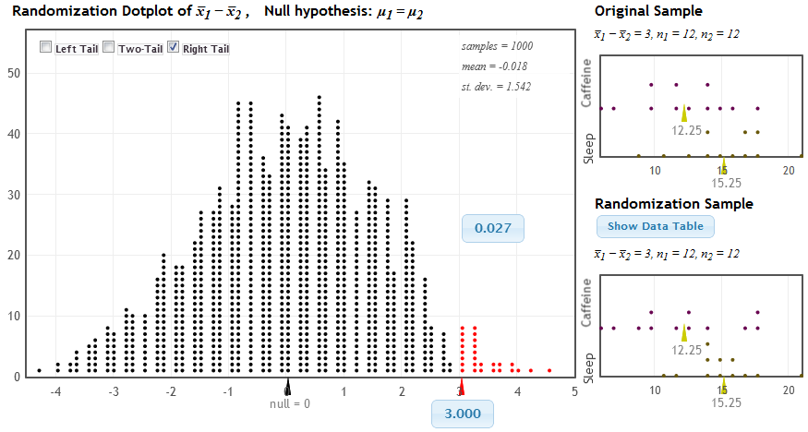
Randomization Test
StatKey at www.lock5stat.com
Distribution of Statistic Assuming Null is True
Proportion as extreme as observed statistic
p-value
observed statistic

Slide 8
Theoretical Approach
Normal and t-based inference after bootstrapping and randomization:
Students have seen the normal distribution repeatedly – CLT easy!
Same idea, just using formula for SE and comparing to theoretical distribution
Can go very quickly through this!

Slide 9
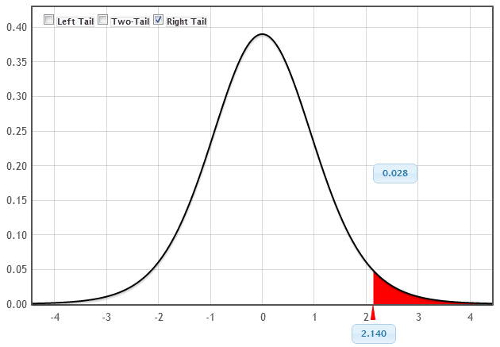
Theoretical Approach
p-value
t-statistic

Slide 10
Chi-Square and ANOVA
Introduce new statistic - χ² or F
Students know that these can be compared to either a randomization distribution or a theoretical distribution
Students are comfortable using either method, and see the connection!
If conditions are met, the randomization and theoretical distributions are the same!

Slide 11
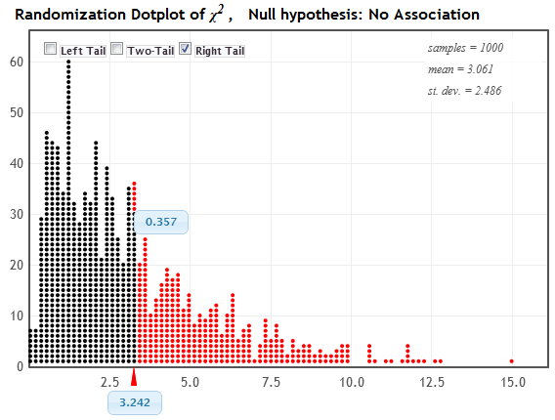
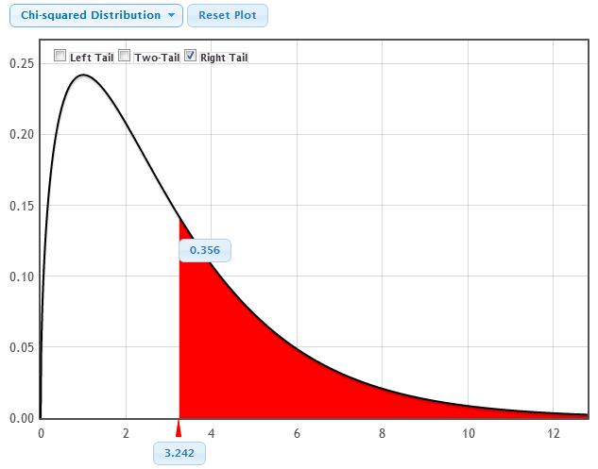
Chi-Square Statistic
Randomization Distribution
p-value = 0.357
Chi-Square Distribution (3 df)
χ² statistic = 3.242
p-value = 0.356
χ² statistic = 3.242

Slide 12
Bootstrapping
From just one sample, we’d like to assess the variability of sample statistics
Imagine the population is many, many copies of the original sample (assuming… ?)
Sample repeatedly from this mock population, by sampling with replacement from the original sample
What is the average human body temperature?

Slide 13
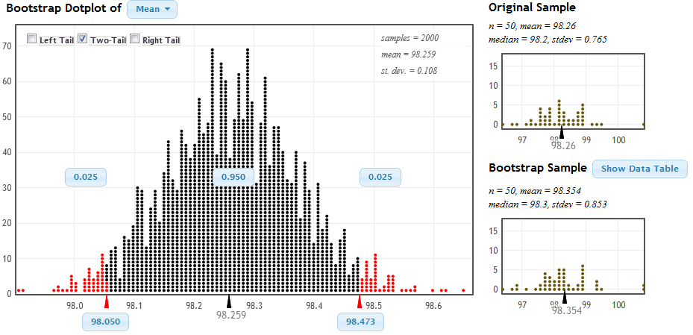
Bootstrap CI
Distribution of Bootstrap Statistics
SE = 0.108
98.26 ± 2 ⋅ 0.108
(98.044, 98.476)
Middle 95% of bootstrap statistics
StatKey at www.lock5stat.com

Slide 14
Student Preferences
Which way did you prefer to learn inference (confidence intervals and hypothesis tests)?
Bootstrapping and Randomization | Formulas and Theoretical Distributions
105 | 60
64% | 36%
 | Simulation | Traditional
AP Stat | 31 | 36
No AP Stat | 74 | 24

Slide 15
Student Behavior
Students were given data on the second midterm and asked to compute a confidence interval for the mean
How they created the interval:
Bootstrapping | t.test in R | Formula
94 | 9 | 9
84% | 8% | 8%
Notes:
They had spent 6 classes on simulation methods over a month ago and the 7 most recent classes using theoretical distributions
they had just had to use the formulas on the in-class exam the day before

Slide 16
A Student Comment
" I took AP Stat in high school and I got a 5. It was mainly all equations, and I had no idea of the theory behind any of what I was doing. Statkey and bootstrapping really made me understand the concepts I was learning, as opposed to just being able to just spit them out on an exam.”
- one of my students

Slide 17
Further Information
Want more information on teaching with this approach?
www.lock5stat.com
Questions?
kari@stat.duke.edu

