Slide 1
Early Inference:
Using Randomization to Introduce Hypothesis Tests
Kari Lock, Harvard University
Eric Lock, UNC Chapel Hill
Dennis Lock, Iowa State
Joint Mathematics Meetings
New Orleans, 1/9/11

Slide 2
Traditional Hypothesis Testing
In many introductory statistics classes now, too many students may see hypothesis tests as a series of steps and often meaningless formulas
With a different formula for each test (proportions, means, etc.), students often get mired in the details and fail to see the big picture
Following formulas and looking up a p-value in a table does nothing to help reinforce conceptual understanding

Slide 3
p-value
p-value: The probability of getting results as extreme, or more extreme, than those observed, if the null hypothesis is true
To calculate a p-value, we need a distribution for results we would observe if the null hypothesis were true
The only difference between traditional and randomization based approaches to hypothesis testing is how this distribution is obtained

Slide 4
Distribution Under H₀
Traditional Approach: Calculate a test statistic which should follow a known distribution if the null hypothesis is true (under some assumptions)
Randomization Approach: Decide on a statistic of interest. Simulate many randomizations assuming the null hypothesis is true, and calculate this statistic for each randomization

Slide 5
Example: Cocaine Addiction
In a randomized experiment on treating cocaine addiction, 48 people were randomly assigned to take either Desipramine (a new drug), or Lithium (an existing drug)
The outcome variable is whether or not a patient relapsed
Is Desipramine significantly better than Lithium at treating cocaine addiction?

Slide 6
R
R
R
R
R
R
R
R
R
R
R
R
R
R
R
R
R
R
R
R
R
R
R
R
R
R
R
R
R
R
R
R
R
R
R
R
R
R
R
R
R
R
R
R
R
R
R
R
1. Randomly assign units to treatment groups
New Drug
Old Drug
R
R
R
R
R
R
R
R
R
R
R
R
R
R
R
R
R
R
R
R
R
R
R
R
R
R
R
R
R
R
R
R
R
R
R
R
R
R
R
R
R
R
R
R

Slide 7
2. Conduct Experiment
3. Observe Outcome Data
R = Relapse
N = No Relapse
1. Randomly assign units to treatment groups
New Drug
Old Drug
R
R
R
R
R
R
R
R
R
R
R
R
R
R
R
R
R
R
R
R
R
R
R
R
R
R
R
R
R
R
R
R
N
R
N
R
R
R
R
R
R
R
R
R
R
R
R
R
N
R
N
R
N
N
N
N
N
N
N
N
R
R
R
R
R
R
R
R
R
R
R
R
N
N
N
N
N
N
N
N
N
N
N
N
N
N
N
N
N
N
N
N
N
N
N
N
10 relapse, 14 no relapse
18 relapse, 6 no relapse

Slide 8
Randomization Test
If the null hypothesis is true (if there is no difference in treatments), then the outcomes would not change under a different randomization
Simulate a new randomization, keeping the outcomes fixed (as if the null were true!)
For each simulated randomization, calculate the statistic of interest
Find the proportion of these simulated statistics that are as extreme (or more extreme) than your observed statistic

Slide 9
R
R
R
R
R
R
R
R
R
R
R
R
R
R
R
R
N
N
R
R
R
R
R
R
N
N
N
N
N
N
R
R
R
R
R
R
N
N
N
N
N
N
N
N
N
N
N
N
10 relapse, 14 no relapse
18 relapse, 6 no relapse

Slide 10
R
R
R
R
R
R
R
R
R
R
R
R
R
R
R
R
N
N
R
R
R
R
R
R
N
N
N
N
N
N
R
R
R
R
R
R
N
N
N
N
N
N
N
N
N
N
N
N
Simulate another randomization
New Drug
Old Drug
R
N
R
N
N
N
N
R
R
R
R
R
R
R
N
R
R
N
N
N
R
N
R
R
R
N
N
R
N
R
R
N
R
N
N
N
R
R
R
N
R
R
R
R
16 relapse, 8 no relapse
12 relapse, 12 no relapse

Slide 11
Simulate another randomization
New Drug
Old Drug
R
R
R
R
R
R
R
R
R
R
R
R
R
N
R
R
N
N
R
R
R
R
R
R
R
R
N
R
N
R
R
R
R
R
R
R
R
N
R
N
R
R
N
N
N
N
N
N
17 relapse, 7 no relapse
11 relapse, 13 no relapse

Slide 12
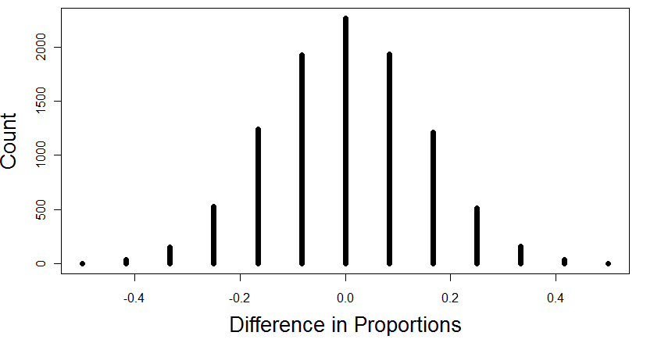
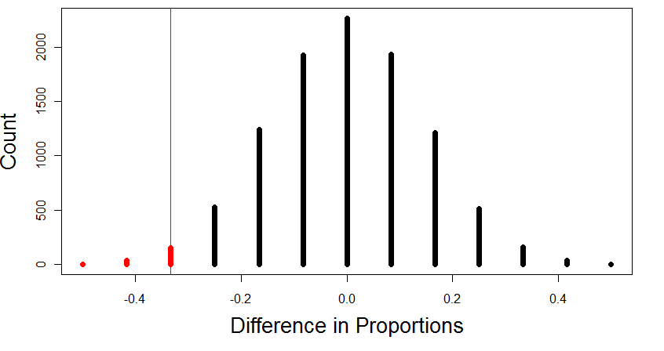
Distribution if H₀ is True
10000 Simulated Randomizations
The probability of getting results as extreme or more extreme than those observed if the null hypothesis is true, is about .0193.
p-value

Slide 13
Flexibility
I just illustrated the randomization test for a difference in proportions, but the exact same idea holds for other parameters!

Slide 14
In-Class Activity
Does 5 seconds of exercise increase pulse rate?
Randomly assign half the students to exercise for 5 seconds, then measure everyone’s pulse
Have the students record all the pulse rates on their own sets of index cards
Calculate the observed difference in means
Have each student randomly split their cards into two groups, calculate the difference in means, and contribute to a class dotplot
Use a computer to continue building up the randomization distribution
Calculate the p-value

Slide 15
Randomization-Based Inference is useful for teaching statistics…
The whole idea of a randomization test is centered around the definition of a p-value
  How extreme would the observed results be if the null hypothesis were true?
  Can they be explained just by random chance?
Very little background is needed, so the core ideas of inference can be introduced early in the course, and remain central throughout the course

Slide 16
… and for doing statistics!
Introductory statistics courses now (especially AP Statistics) place a lot of emphasis on checking the conditions for traditional hypothesis tests
However, students aren’t given any tools to use if the conditions aren’t satisfied!
Randomization-based inference has no conditions, and always applies (even with non-normal data and small samples!)

Slide 17
It is the way of the past…
"Actually, the statistician does not carry out this very simple and very tedious process [the randomization test], but his conclusions have no justification beyond the fact that they agree with those which could have been arrived at by this elementary method."
-- Sir R. A. Fisher, 1936

Slide 18
… and the way of the future
“... the consensus curriculum is still an unwitting prisoner of history. What we teach is largely the technical machinery of numerical approximations based on the normal distribution and its many subsidiary cogs. This machinery was once necessary, because the conceptually simpler alternative based on permutations was computationally beyond our reach. Before computers statisticians had no choice. These days we have no excuse. Randomization-based inference makes a direct connection between data production and the logic of inference that deserves to be at the core of every introductory course.”
-- Professor George Cobb, 2007

Slide 19
Thank you!
lock@stat.harvard.edu
www.people.fas.harvard.edu/~klock

