Slide 1
A Fiddler on the Roof:
Tradition vs. Modern Methods in Teaching Inference
Patti Frazer Lock
Robin H. Lock
St. Lawrence University
Joint Mathematics Meetings
January 2013

Slide 2
Simulation methods provide an exciting new method for teaching statistical inference!

Slide 3
Let’s look at hypothesis tests.

Slide 4
Example: Beer and Mosquitoes
Does consuming beer attract mosquitoes?
Experiment:
25 volunteers drank a liter of beer,
18 volunteers drank a liter of water
Randomly assigned!
Mosquitoes were caught in traps as they approached the volunteers.¹
¹ Lefvre, T., et. al., “Beer Consumption Increases Human Attractiveness to Malaria Mosquitoes, ” PLoS ONE, 2010; 5(3): e9546.

Slide 5
Beer and Mosquitoes
Number of Mosquitoes
Beer Water
27 21
20 22
21 15
26 12
27 21
31 16
24 19
19 15
23 24
24 19
28 23
19 13
24 22
29 20
20 24
17 18
31 20
20 22
25
28
21
27
21
18
20
Does drinking beer actually attract mosquitoes, or is the difference just due to random chance?
Beer mean = 23.6
Water mean
= 19.22
Beer mean – Water mean = 4.38

Slide 6
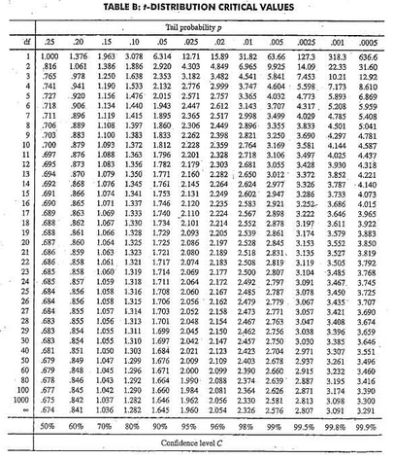
Traditional Inference
1. State hypotheses
2. Check conditions
3. Compute t.s.
4. Compute p-value
Which formula?
Distribution?
df?
p-value?
0.0005 < p-value < 0.001
5. Conclusion
Calculate numbers and plug into formula
Plug into calculator

Slide 7
Simulation Approach
Number of Mosquitoes
Beer Water
27 21
20 22
21 15
26 12
27 21
31 16
24 19
19 15
23 24
24 19
28 23
19 13
24 22
29 20
20 24
17 18
31 20
20 22
25
28
21
27
21
18
20
Does drinking beer actually attract mosquitoes, or is the difference just due to random chance?
Beer mean = 23.6
Water mean
= 19.22
Beer mean – Water mean = 4.38

Slide 8
Simulation Approach
Number of Mosquitoes
Beer Water
27 21
20 22
21 15
26 12
27 21
31 16
24 19
19 15
23 24
24 19
28 23
19 13
24 22
29 20
20 24
17 18
31 20
20 22
25
28
21
27
21
18
20
Number of Mosquitoes
Beverage
27 21
20 22
21 15
26 12
27 21
31 16
24 19
19 15
23 24
24 19
28 23
19 13
24 22
29 20
20 24
17 18
31 20
20 22
25
28
21
27
21
18
20
Find out how extreme these results would be, if there were no difference between beer and water.
What kinds of results would we see, just by random chance?

Slide 9
Simulation Approach
Beer Water
Number of Mosquitoes
Beverage
20 22
21 15
26 12
27 21
31 16
24 19
19 15
23 24
24 19
28 23
19 13
24 22
29 20
20 24
17 18
31 20
20 22
25
28
21
27
21
18
20
Find out how extreme these results would be, if there were no difference between beer and water.
What kinds of results would we see, just by random chance?
27
21
21
27
24
19
23
24
31
13
18
24
25
21
18
12
19
18
28
22
19
27
20
23
22
20
26
31
19
23
15
22
12
24
29
20
27
29
17
25
20
28
$${\overline{x}}_{B}−{\overline{x}}_{W}=21.63−23.00=−1.37$$
Now repeat this thousands of times!

Slide 10
This is an intro Statistics course, we can’t spend a lot of time teaching Computer Programming techniques.

Slide 11
We need technology!
StatKey
www.lock5stat.com
Notes:
Patti

Slide 12
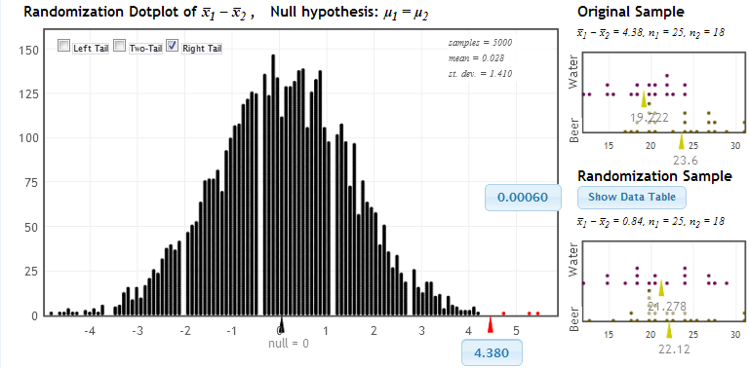
StatKey!
www.lock5stat.com
P-value
Notes:
Fix size

Slide 13
P-value: The probability of seeing results as extreme as, or more extreme than, the sample results, if the null hypothesis is true.
That makes sense!!

Slide 14
All I need to do a test are the summary statistics.

Slide 15
But, what about Confidence Intervals?

Slide 16
Example: What is the average price of a used Mustang car?
Select a random sample of n=25 Mustangs from a website (autotrader.com) and record the price (in $1,000’s) for each car.

Slide 17
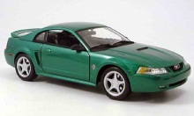
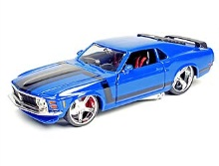
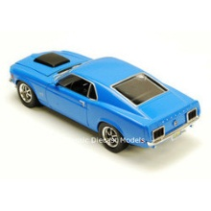
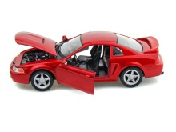
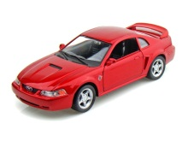
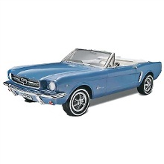
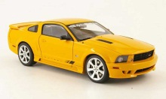
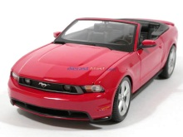
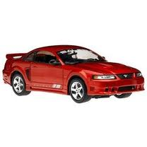
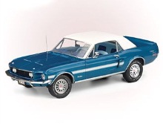
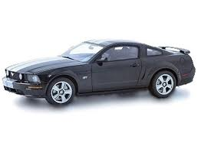
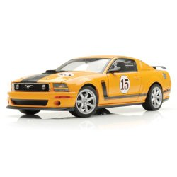
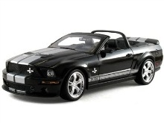
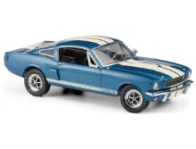
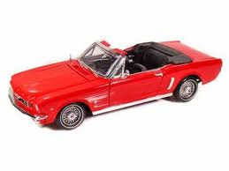
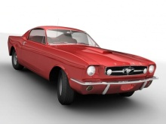
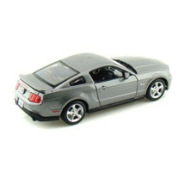
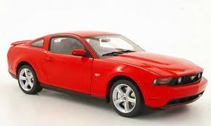
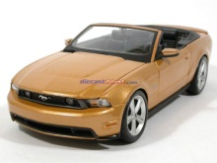
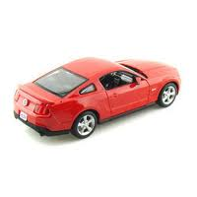
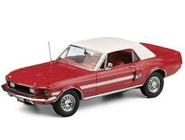
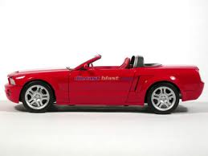
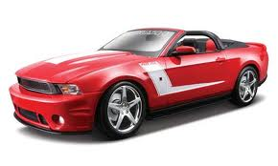
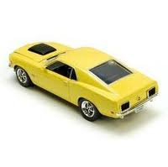
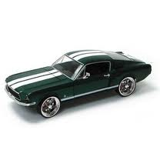

Sample of Mustangs:
$$n=25 \overline{x}=15.98 s=11.11$$
Our best estimate for the average price of used Mustangs is $15,980, but how accurate is that estimate?

Slide 18
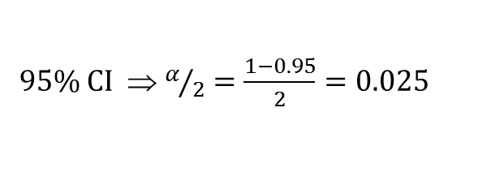

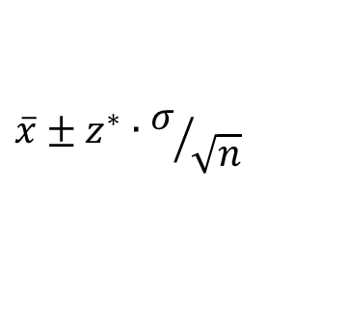

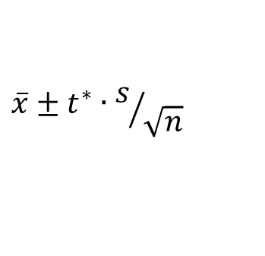
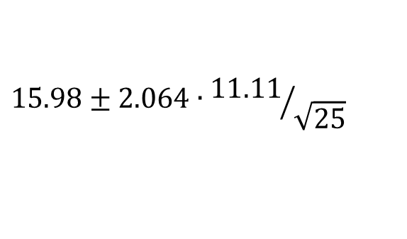

Traditional Inference
CI for a mean
1. Which formula?
$$\overline{x}±z^{∗}∙σ/{\sqrt{n}}$$
OR
$$\overline{x}±t^{∗}∙s/{\sqrt{n}}$$
2. Check conditions
3. Calculate summary stats
$n=25, \overline{x}=15.98$, $s=11.11$
4. Find t*
df?
95% CI ⇒ $α/2=\frac{1−0.95}{2}=0.025$
df=25$−$1=24
t*=2.064
5. Plug and chug
$$15.98±2.064∙{11.11}/{\sqrt{25}}$$
$$15.98±4.59=(11.39, 20.57)$$
6. Interpret in context

Slide 19
Simulation Approach
Our best estimate for the average price of used Mustangs is $15,980, but how accurate is that estimate?
We simulate a sampling distribution using bootstrap statistics!

Slide 20
Bootstrapping
“Let your data be your guide.”
Assume the “population” is many, many copies of the original sample.
A bootstrap sample is found by sampling with replacement from the original sample, using the same sample size.

Slide 21
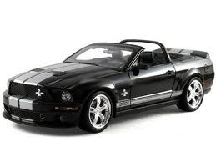
Original Sample
Bootstrap Sample

Slide 22
StatKey
Notes:
Patti

Slide 23
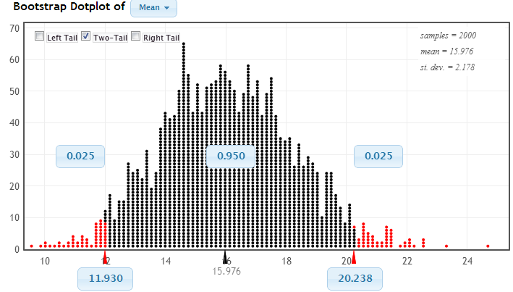
Using the Bootstrap Distribution to Find a Confidence Interval
Chop 2.5% in each tail
Keep 95% in middle
Chop 2.5% in each tail
We are 95% sure that the mean price for Mustangs is between $11,930 and $20,238

Slide 24
Sampling distributions are a critical concept. Are you replacing them with this newfangled idea?

Slide 25
But we need a theoretical basis to make valid statistical conclusions.

Slide 26
An “old” justification
"Actually, the statistician does not carry out this very simple and very tedious process, but his conclusions have no justification beyond the fact that they agree with those which could have been arrived at by this
elementary method."
-- Sir R. A. Fisher, 1936

Slide 27
A more recent justification:
“... Randomization-based inference makes a direct connection between data production and the logic of inference that deserves to be at the core of every introductory course.”
-- Professor George Cobb, 2007

Slide 28
But my students are expected to know what a t-test is when they leave my course.

Slide 29
Let’s build conceptual understanding with these new methods and then show them the standard formulas.

Slide 30
OK – you’ve made
good points.
But what about a textbook?

Slide 31
Thanks for joining us!
plock@stlawu.edu
rlock@stlawu.edu
www.lock5stat.com

