Slide 1
Big Data Visualization in Intro Stats (in 15 minutes!)
Patti Frazer Lock
St. Lawrence University
Joint Mathematics Meetings
January 2017
With help from: Robin Lock, Kari Lock Morgan, Eric Lock, Dennis Lock

Slide 2
My Assumptions
Want students to see how creative and effective and fun data visualization can be.
Data visualization and multiple variables are increasingly important.
But: Hard to fit more material into Intro Stats.
My Solution
Give students a sense of what is possible, in just 15 minutes of class time.

Slide 3
Background
This comes early, at the end of the material on Describing Data.
We introduce Multiple Regression at the end of the course.
We added this material following the ASA Guidelines.
It was very fun to add it!
(Next slide starts the student slides.)

Slide 4
Moving beyond
Histograms and Scatterplots
In this age of Big Data, we need more ways to visualize data.
Especially when we have multiple variables!
Guiding Principle: Facility quick and accurate interpretation of data.
Allows plenty of room for creativity.
Includes elements of statistics, computer graphics, and artistic design.

Slide 5
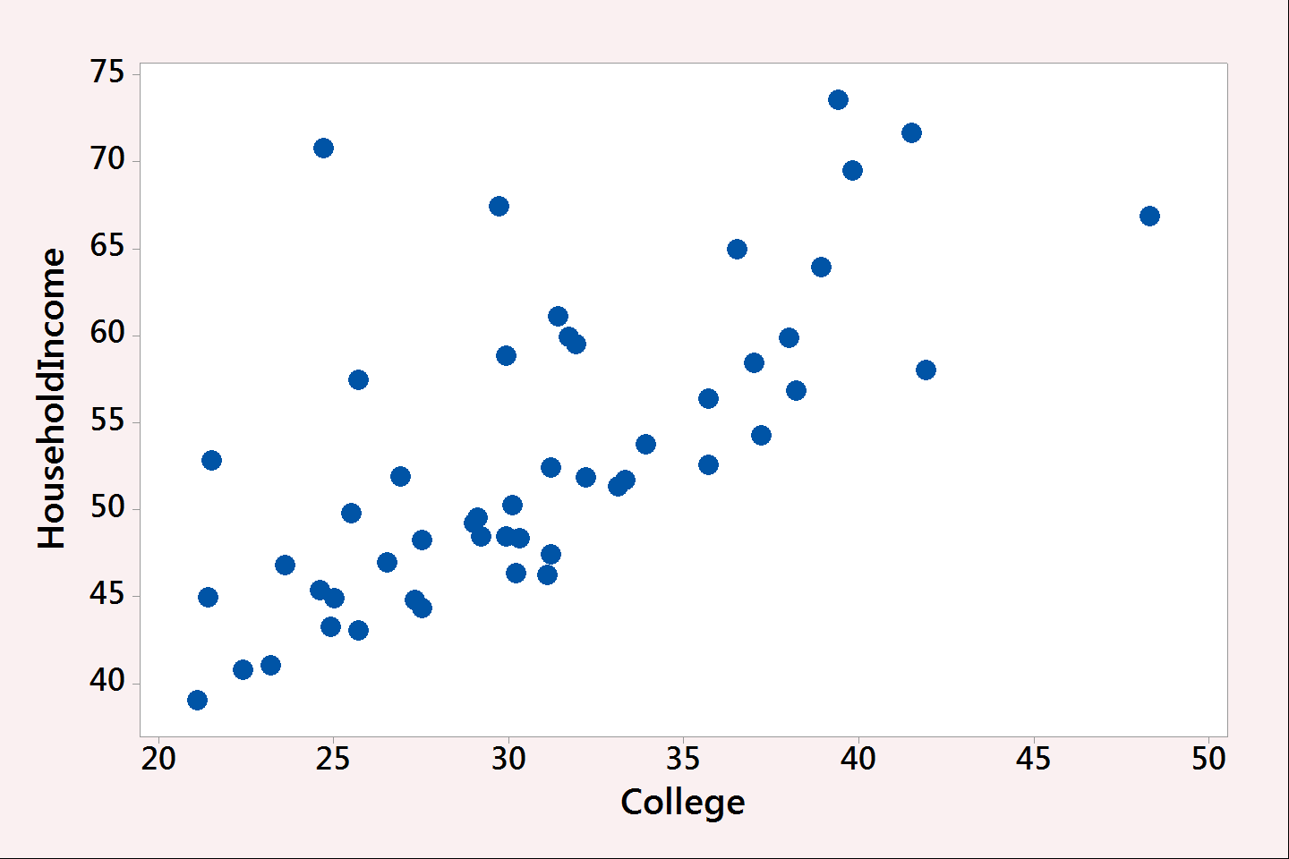
Scatterplot: Two Quantitative Variables
Percent to graduate college. Median Household Income.
For 50 US States.

Slide 6
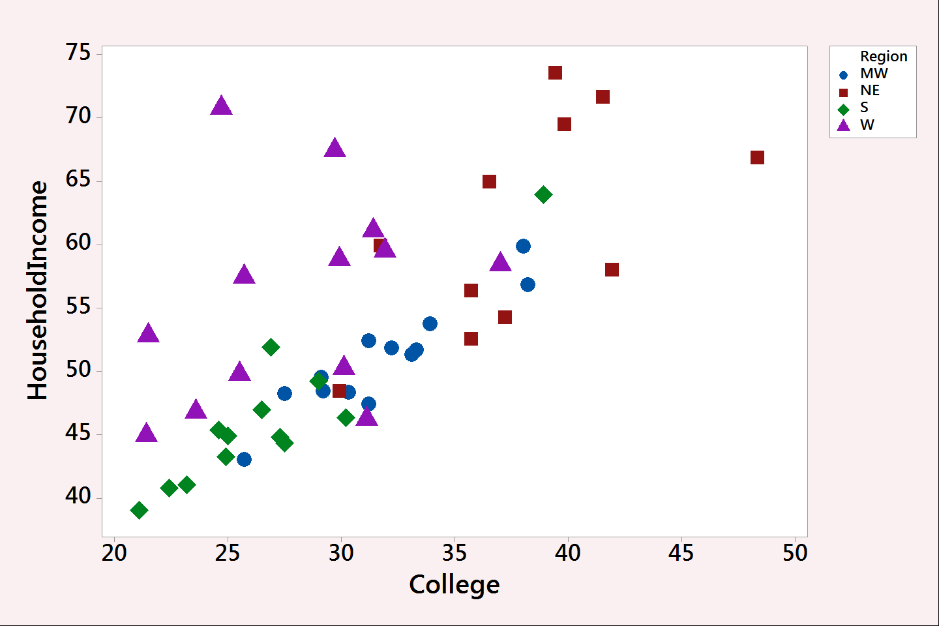
Scatterplot: Add a Third Variable
Categorical variable: Region of the country.

Slide 7
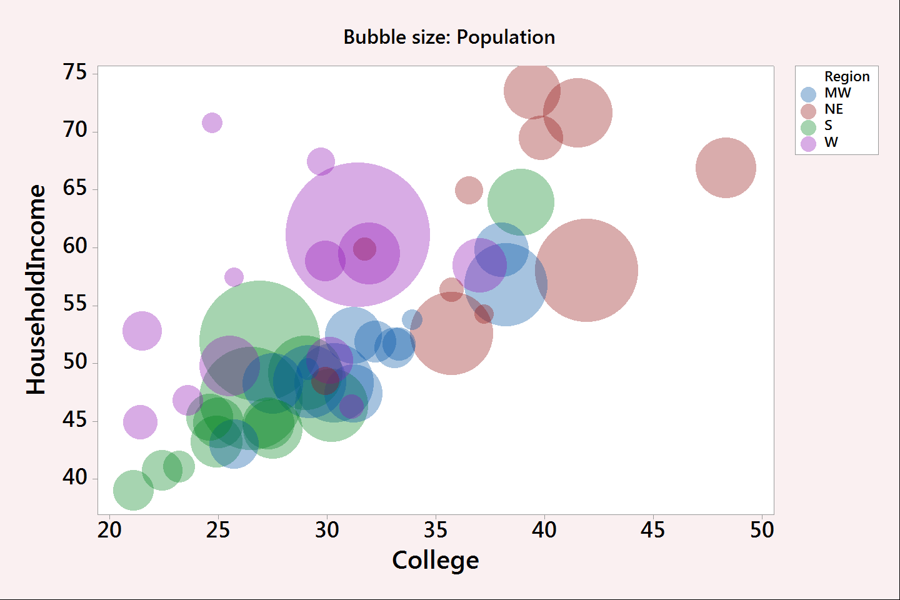
Scatterplot: Add a Fourth Variable!
Quantitative variable: Population.

Slide 8
But we want more!
Make it INTERACTIVE!
Make it DYNAMIC!
www.gapminder.com/tools

Slide 9
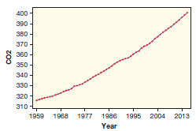
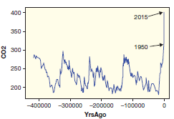
Data Over Time: CO₂ Levels

Slide 10
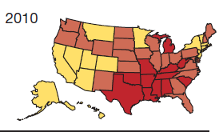
Geographic Data: Obesity
Geographic Data Over Time
http://stateofobesity.org/adult-obesity/

Slide 11
Let’s Get More Creative!
A Day in the Life: 1000 American adults
flowingdata.com

Slide 12
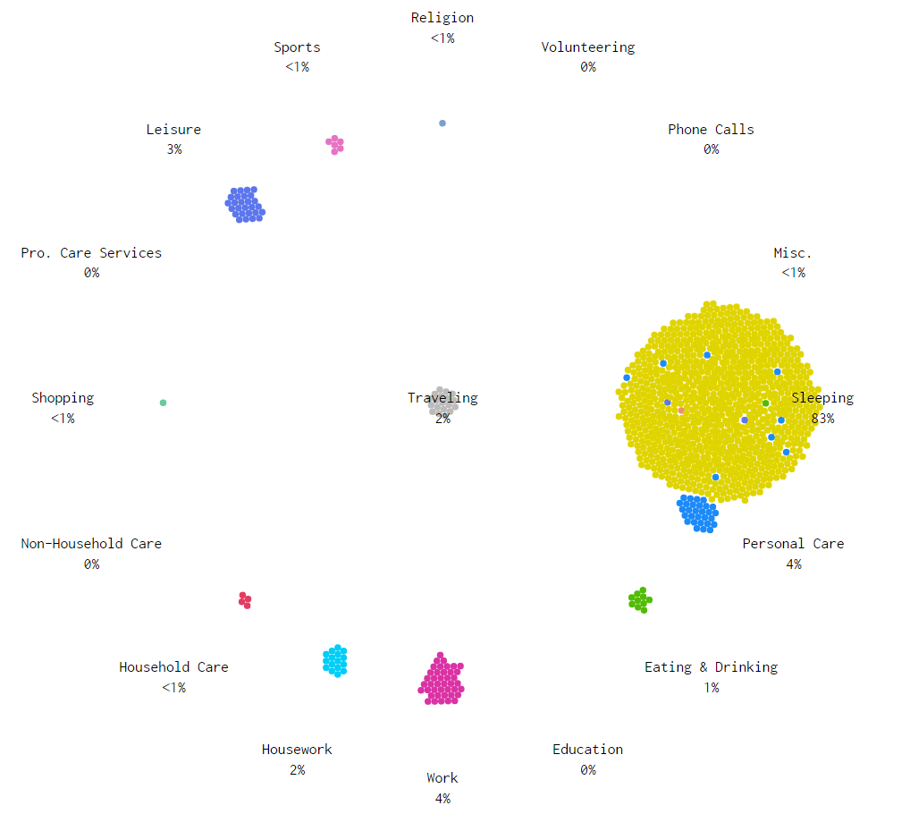
5:45 am

Slide 13
Let’s Get Creative!
A Day in the Life: 1000 American adults
flowingdata.com
http://flowingdata.com/2015/12/15/a-day-in-the-life-of-americans/

Slide 14
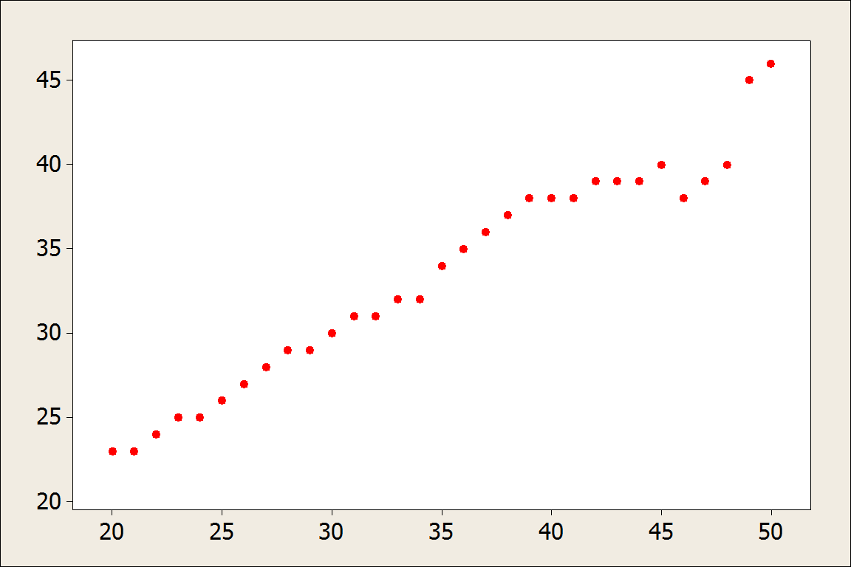
OKCupid: What age do users find most attractive?
X-axis: age of OK Cupid heterosexual females
Y-axis: average age of males they rated most attractive

Slide 15
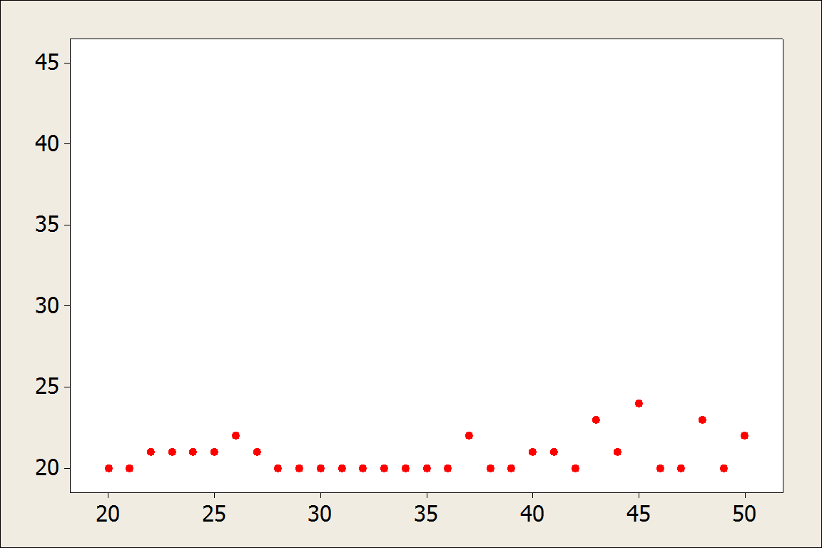
OKCupid: What age do users find most attractive?
X-axis: age of OK Cupid heterosexual males
Y-axis: average age of females they rated most attractive

Slide 16
Pretty successful and pretty fun!
These slides available at www.lock5stat.com
Thanks for listening!

