Slide 1
Simulating with StatKey
Kari Lock Morgan
Department of Statistical Science
Duke University
kari@stat.duke.edu
Joint Mathematical Meetings, San Diego
1/11/13

Slide 2
StatKey
A set of web-based, interactive, dynamic statistics tools designed for teaching simulation-based methods at an introductory level.
Freely available at www.lock5stat.com/statkey
No login required
Runs in (almost) any browser (incl. smartphones)
Google Chrome App available (no internet needed)
Standalone or supplement to existing technology

Slide 3

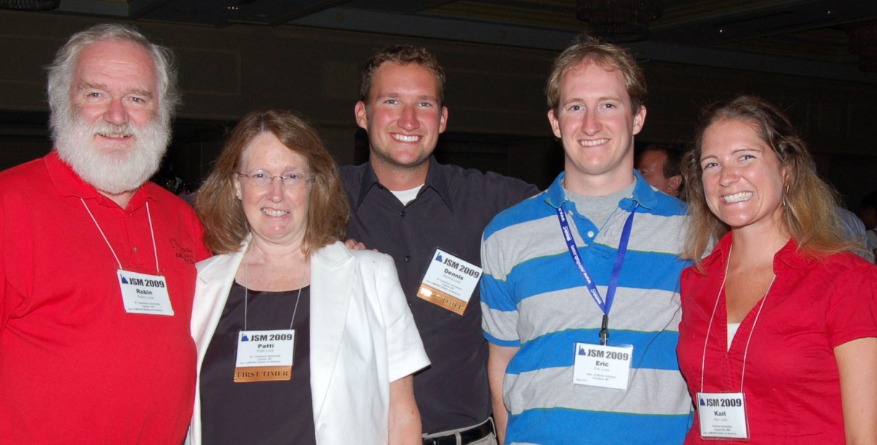
StatKey
Developed by the Lock⁵ team to accompany our new book, Statistics: Unlocking the Power of Data (although can be used with any book)
Programmed by Rich Sharp (Stanford), Ed Harcourt and Kevin Angstadt (St. Lawrence)
Dennis
Iowa State
Kari
Duke
Eric
Duke
Robin & Patti
St. Lawrence
Wiley (2013)

Slide 4
StatKey
WHY?
Address instructor concerns about accessibility of simulation-based methods at the intro level
Design an easy-to-use set of learning tools accessible to everyone
Provide a no-cost technology option for any environment OR as a supplement to existing technology
Support our new textbook, while also being usable with other texts or on its own

Slide 5
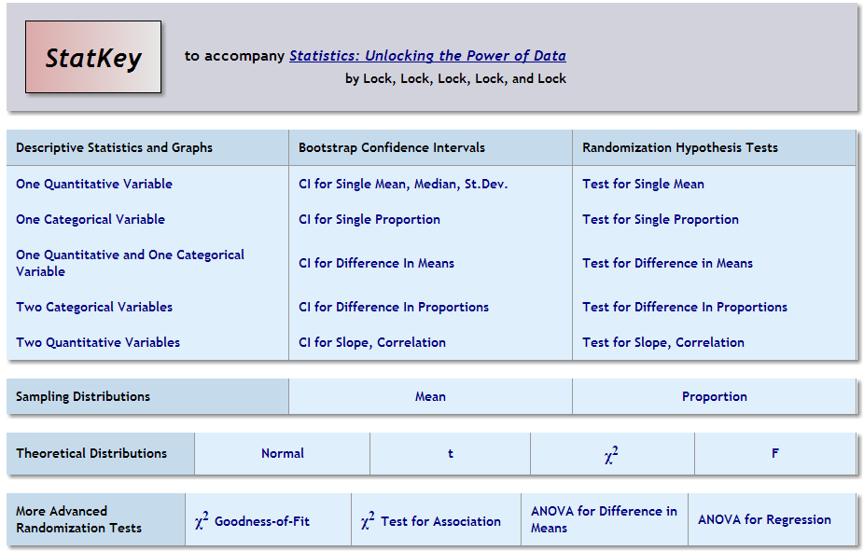

Slide 7
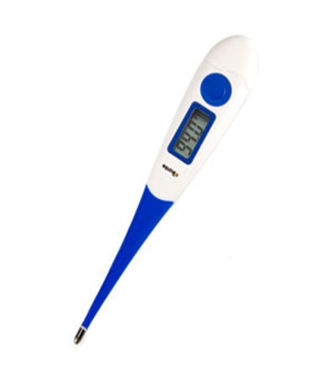
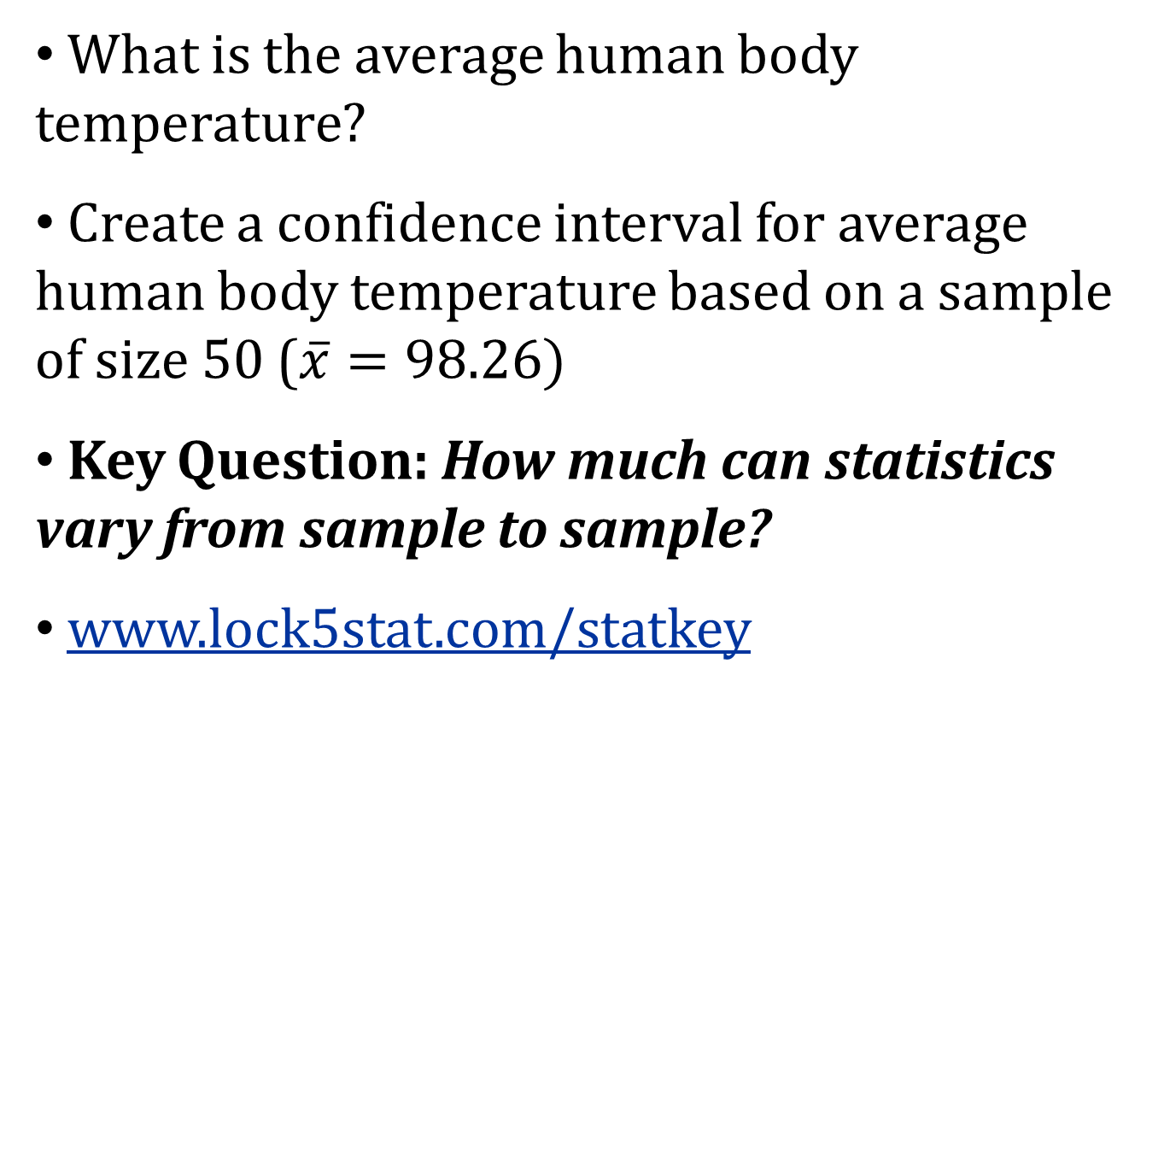
Bootstrap Confidence Interval
What is the average human body temperature?
Create a confidence interval for average human body temperature based on a sample of size 50 ($\overline{x}=98.26)$
Key Question: How much can statistics vary from sample to sample?
www.lock5stat.com/statkey

Slide 8
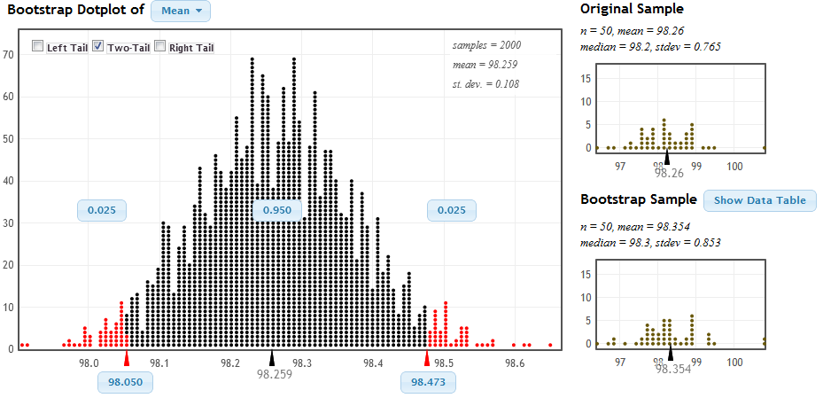
Bootstrapping

Slide 9
Bootstrap Confidence Interval
Distribution of Bootstrap Statistics
SE = 0.108
98.26 ± 2 ⋅ 0.108
(98.044, 98.476)
Middle 95% of bootstrap statistics

Slide 10
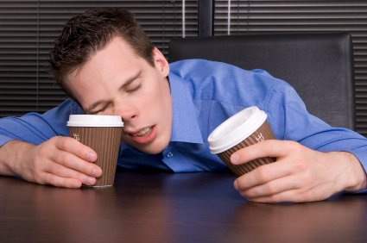
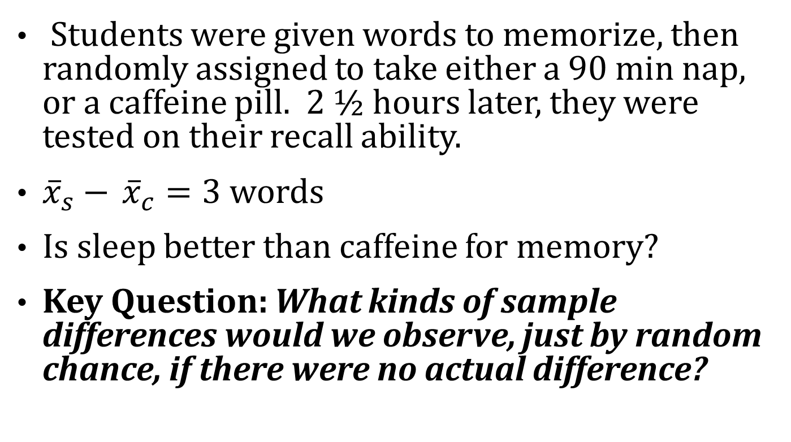
Randomization Test
Students were given words to memorize, then randomly assigned to take either a 90 min nap, or a caffeine pill. 2 ½ hours later, they were tested on their recall ability.
${\overline{x}}_{s}−$ ${\overline{x}}_{c}=3$ words
Is sleep better than caffeine for memory?
Key Question: What kinds of sample differences would we observe, just by random chance, if there were no actual difference?
Mednick, Cai, Kanady, and Drummond (2008). “Comparing the benefits of caffeine, naps and placebo on verbal, motor and perceptual memory,” Behavioral Brain Research, 193, 79-86.

Slide 12
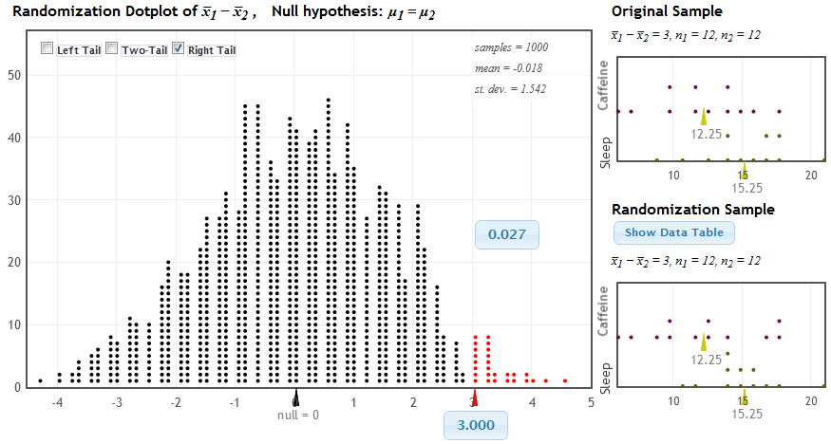
Randomization Test
Distribution of Statistic Assuming Null is True
Proportion as extreme as observed statistic
p-value
observed statistic

Slide 13


Malevolent Uniforms
NFL Teams
Is there a significant association between the malevolence of a team’s uniform and penalty yards?
r = 0.43

Slide 14
StatKey Pedagogical Features
Ability to simulate one to many samples
Helps students distinguish and keep straight the original data, a single simulated data set, and the distribution of simulated statistics
Students have to interact with the bootstrap/randomization distribution – they have to know what to do with it
Consistent interface for bootstrap intervals, randomization tests, theoretical distributions

Slide 15
Theoretical Distributions
Sleep versus Caffeine:
  t-distribution
  df = 11

Slide 17
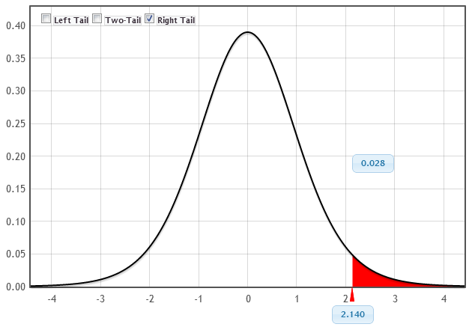
Theoretical Distributions
MUCH more intuitive and easier to use than tables!!!
p-value
t-statistic

Slide 18
Chi-Square and ANOVA
Chi-square tests
  Goodness-of-fit or test for association
  Gives χ² statistic, as well as observed and expected counts for each cell
  Randomization test or χ² distribution
ANOVA
  Difference in means or regression
  Gives entire ANOVA table
  Randomization test or F-distribution

Slide 20
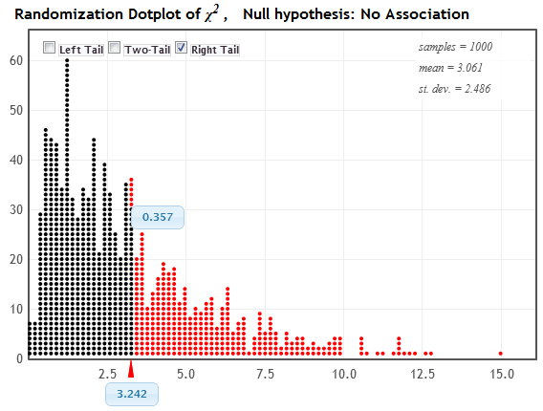
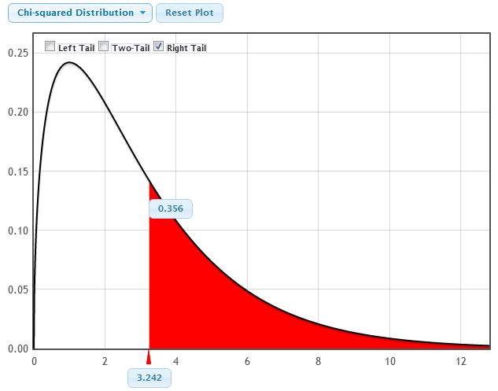
Chi-Square Statistic
Randomization Distribution
p-value = 0.357
Chi-Square Distribution (3 df)
χ² statistic = 3.242
p-value = 0.356
χ² statistic = 3.242

Slide 21
Sampling Distributions
Simulate a sampling distribution
Generate confidence intervals for each simulated statistic, keep track of coverage rate

Slide 23
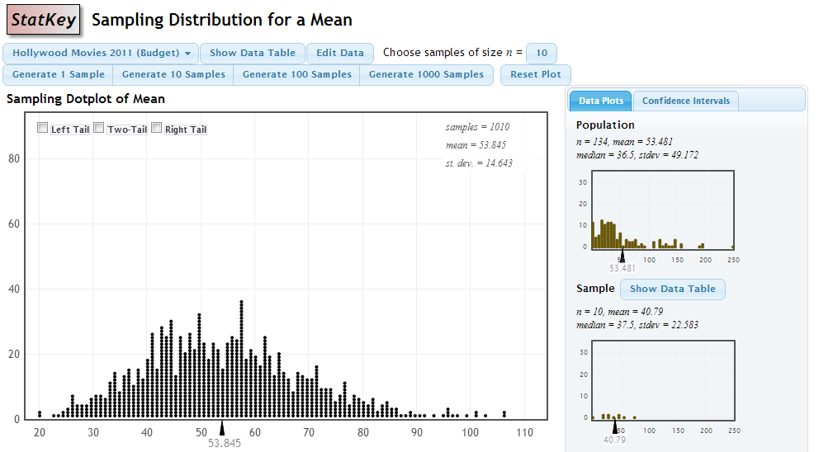
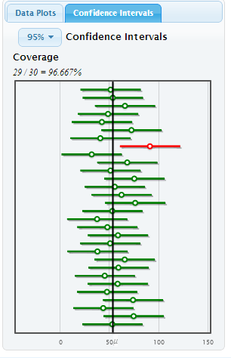
Sampling Distributions

Slide 24
Descriptive Statistics
StatKey also does descriptive statistics (summary statistics, visualization) for any one or two variables

Slide 26
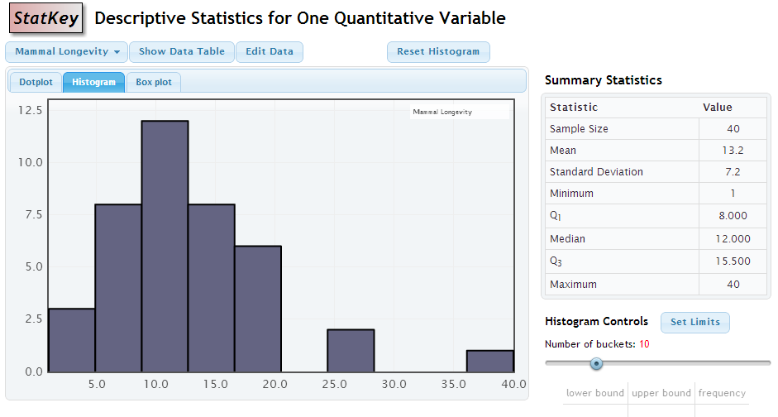
Descriptive Statistics

Slide 27
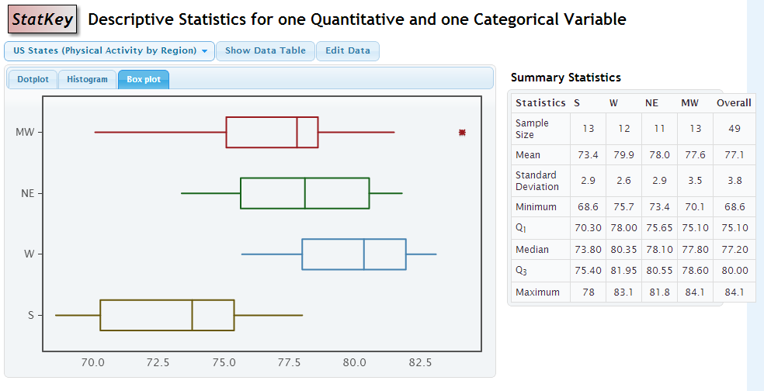
Descriptive Statistics

Slide 28
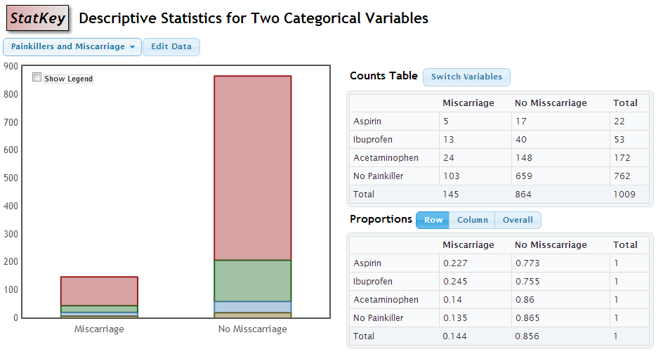
Descriptive Statistics

Slide 29
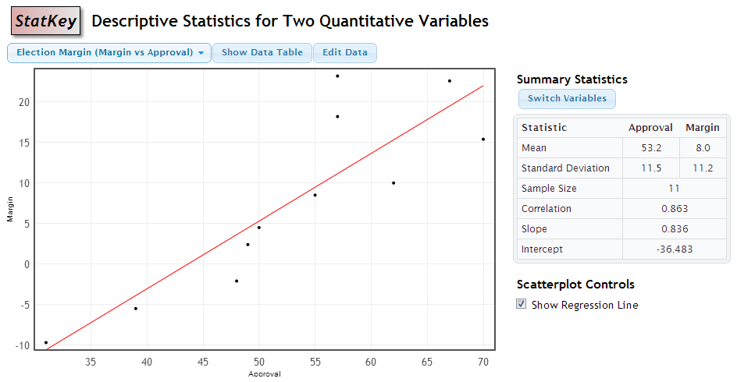
Descriptive Statistics

Slide 30
Google Chrome App
No internet?
StatKey can be downloaded as a google chrome app which runs without an internet connection

Slide 31
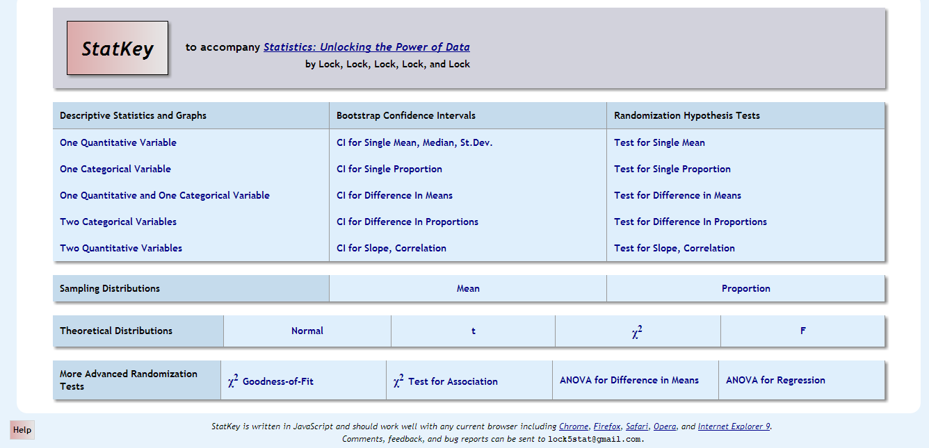
Help
Help page, including instructional videos

Slide 32
Suggestions? Comments? Questions?
You can email me at kari@stat.duke.edu, or the whole Lock⁵ team at lock5stat@gmail.com

