Slide 1
Randomization and Bootstrap Methods in the Introductory Statistics Course
Kari Lock Morgan Robin Lock
Duke University St. Lawrence University
kari@stat.duke.edu rlock@stlawu.edu
Panel at 2013 Joint Mathematics Meetings
San Diego, CA

Slide 2
Revised Curriculum
Data production (samples/experiments)
Descriptive Statistics – one and two samples
Bootstrap confidence intervals
Randomization-based hypothesis tests
Normal and t-based inference
Chi-square, ANOVA, Regression

Slide 3
Why start with Bootstrap CI’s?
Minimal prerequisites:
Population parameter vs. sample statistic
Random sampling
Dotplot (or histogram)
Standard deviation and/or percentiles
Natural progression/question
Sample estimate ==> How accurate is the estimate?
Same method of randomization in most cases
Sample with replacement from original sample
Intervals are more useful?
A good debate for another session…

Slide 4
What new content is needed to teach bootstrapping?

Slide 5
Bootstrapping
Key ideas:
Sample with replacement from the original sample using the same sample size.
Compute the sample statistic.
Collect lots of such bootstrap statistics.
Use the distribution of bootstrap statistics to assess the sampling variability of the statistic.
Why does this work?

Slide 6
Sampling Distribution
Population
BUT, in practice we don’t see the “tree” or all of the “seeds” – we only have ONE seed
µ
Notes:
Robin

Slide 7
Bootstrap Distribution
What can we do with just one seed?
Bootstrap
“Population”
Estimate the distribution and variability (SE) of $\overline{x}$’s from the bootstraps
Grow a NEW tree!
$$\overline{x}$$
µ
Notes:
Robin

Slide 8
Golden Rule of Bootstraps
The bootstrap statistics are to the original statistic
as
the original statistic is to the population parameter.
Notes:
Robin

Slide 9
How does teaching with randomization/bootstrap methods change technology needs?

Slide 10
Desirable Technology Features
Ability to simulate one to many samples
Visual display of results
Help students distinguish and keep straight the original data, a single simulated data set, and the distribution of simulated statistics
Allow students to interact with the bootstrap/randomization distribution
Consistent interface for different parameters, tests, and intervals

Slide 11
StatKey
www.lock5stat.com
Notes:
Patti

Slide 12
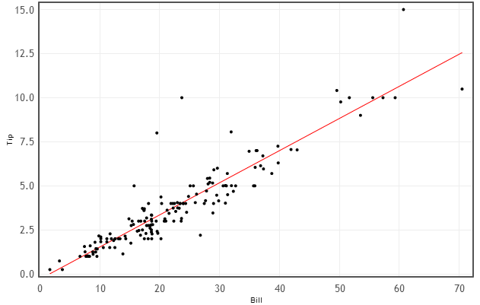
Example: Find a 95% confidence interval for the slope when using the size of bill to predict tip at a restaurant.
Data: n=157 bills at First Crush Bistro (Potsdam, NY)
$$\hat{Tip}=−0.292+0.182∙Bill$$
r=0.915

Slide 13
Example: Mustang Prices
Data: Sample of 25 Mustangs listed on Autotrader.com
Find a confidence interval for the slope of a regression line to predict prices of used Mustangs based on their mileage.

Slide 14
How does the use of randomization/bootstrap methods for statistical inference change the assessments used?

Slide 15
Assessment with Technology
Given a question and corresponding data:
Generate and interpret a CI
Generate a p-value and make a conclusion
How is this assessment different?
Answers will vary slightly
Tip: ask students to include a screenshot of their bootstrap/randomization distribution
OR provide a distribution and ask students to label the x-axis according to their bootstrap/randomization distribution

Slide 16
Assessment: Projects
Relatively early in the course, students can do confidence intervals and hypotheses tests for many different parameters!
Can find their own data and pick their own parameter of interest

Slide 17
Assessment: Free Response
Give students context and a picture of a bootstrap distribution and ask them to…
Explain how to generate one of the dots
Estimate the sample statistic
Estimate the standard error
Use these estimates to calculate a 95% CI
OR have them estimate a 90% (or other) CI
Interpret the CI in context

Slide 18
Assessment: Free Response
Give students context, the sample statistic, and a picture of a randomization distribution and ask them to…
State the null and alternative hypotheses
Explain how to generate one of the dots
Estimate the p-value
Use the p-value to evaluate strength of evidence against H₀ / for H_{a}
Use the p-value to make a formal decision
Make a conclusion in context

Slide 19
Assessment Tips
Show bootstrap or randomization distributions as dotplots with a manageable number of dots
OR have students circle relevant part of distribution

Slide 20
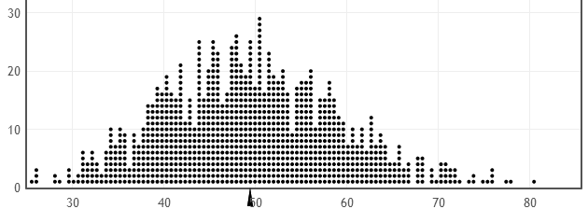
Assessment: Dotplots
Bootstrap distribution, 1000 statistics:
98% CI:
CI ≈ 30 to 75
Randomization distribution, 100 statistics:
stat = 69
lower-tail test
p=value = 0.02

Slide 21
Assessment: Multiple Choice
You have sample data on weight consisting of these data values: 121, 136, 160, 185, 203
Is each of the following a valid bootstrap sample?
121, 121, 160, 185, 203 (a) Yes (b) No
121, 121, 136, 160, 185, 203 (a) Yes (b) No
121, 160, 185, 203 (a) Yes (b) No
121, 142, 160, 185, 190 (a) Yes (b) No

Slide 22
Assessment: Multiple Choice
If would changing the following aspects of the study or analysis, change the confidence interval:
Increase the sample size?
Increase the number of bootstrap samples?
Increase the confidence level?
(a) It would get wider
(b) It would get narrower
(c) It would stay about the same
Can do similar questions for SE, p-value, etc.

Slide 23
Assessment: Multiple Choice
Randomizing in a randomized experiment breaks the link between
(a) explanatory and response variables
(b) explanatory and confounding variables
(c) response and confounding variables
Re-randomizing (reallocating) in a randomization test breaks the link between
(a) explanatory and response variables
(b) explanatory and confounding variables
(c) response and confounding variables

Slide 24
Assessment: Connecting with Traditional
Once students have learned formulas for standard errors….
Give context, summary statistics, and an unlabeled bootstrap/randomization distribution, then ask students to label at least 3 points on the x-axis

Slide 25
Conceptual Assessment
Almost all conceptual assessment items used in the past regarding confidence intervals and hypothesis tests still work!
The concepts we want our students to understand are the same!

Slide 26
Thanks for listening!

