Slide 1
Early Inference: Using Bootstraps to Introduce Confidence Intervals
Robin H. Lock, Burry Professor of Statistics
Patti Frazer Lock, Cummings Professor of Mathematics
St. Lawrence University
Joint Mathematics Meetings
New Orleans, January 2011

Slide 2
Intro Stat at St. Lawrence
Four statistics faculty (3 FTE)
5/6 sections per semester
26-29 students per section
Only 100-level (intro) stat course on campus
Students from a wide variety of majors
Meet full time in a computer classroom
Software: Minitab and Fathom

Slide 3
Stat 101 - Traditional Topics
Descriptive Statistics – one and two samples
Normal distributions
Data production (samples/experiments)
Sampling distributions (mean/proportion)
Confidence intervals (means/proportions)
Hypothesis tests (means/proportions)
ANOVA for several means, Inference for regression, Chi-square tests

Slide 4
When do current texts first discuss confidence intervals and hypothesis tests?
 | Confidence Interval | Significance Test
Moore | pg. 359 | pg. 373
Agresti/Franklin | pg. 329 | pg. 400
DeVeaux/Velleman/Bock | pg. 486 | pg. 511
Devore/Peck | pg. 319 | pg. 365

Slide 5
Stat 101 - Revised Topics
Descriptive Statistics – one and two samples
Normal distributions
Bootstrap confidence intervals
Bootstrap confidence intervals
Data production (samples/experiments)
Data production (samples/experiments)
Randomization-based hypothesis tests
Sampling distributions (mean/proportion)
Normal distributions
Confidence intervals (means/proportions)
Hypothesis tests (means/proportions)
ANOVA for several means, Inference for regression, Chi-square tests

Slide 6
Prerequisites for Bootstrap CI’s
Students should know about:
Parameters / sample statistics
Random sampling
Dotplot (or histogram)
Standard deviation and/or percentiles

Slide 7
What
is a bootstrap?
and
How does it give an interval?

Slide 8
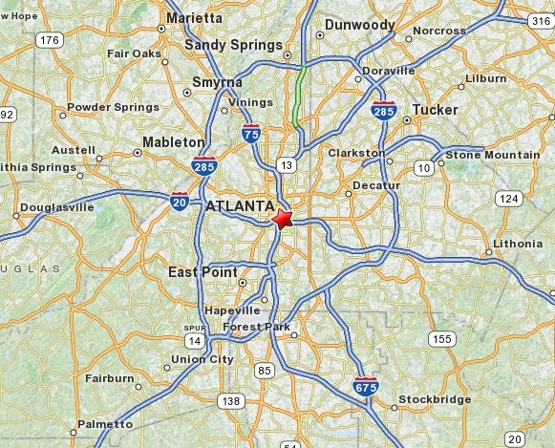
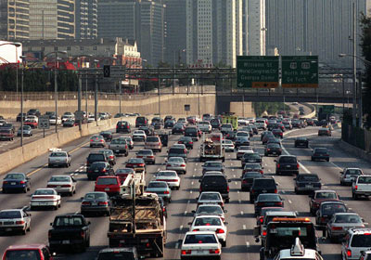
Example: Atlanta Commutes
What’s the mean commute time for workers in metropolitan Atlanta?
Data: The American Housing Survey (AHS) collected data from Atlanta in 2004.

Slide 9
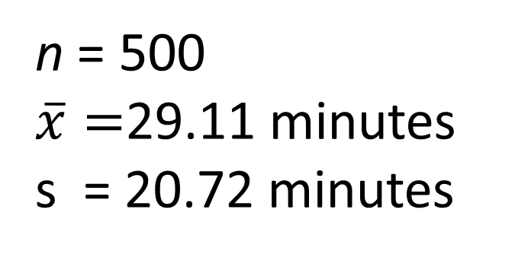
Sample of n=500 Atlanta Commutes
n = 500
$\overline{x}=$29.11 minutes
s = 20.72 minutes
Where might the “true” μ be?

Slide 10
“Bootstrap” Samples
Key idea: Sample with replacement from the original sample using the same n.
Assumes the “population” is many, many copies of the original sample.

Slide 11
Atlanta Commutes – Original Sample

Slide 12
Atlanta Commutes: Simulated Population
Sample from this “population”

Slide 13
Creating a Bootstrap Distribution
Bootstrap sample
Bootstrap statistic
1. Compute a statistic of interest (original sample).
2. Create a new sample with replacement (same n).
3. Compute the same statistic for the new sample.
4. Repeat 2 & 3 many times, storing the results.
5. Analyze the distribution of collected statistics.
Bootstrap distribution
Important point: The basic process is the same for ANY parameter/statistic.

Slide 14
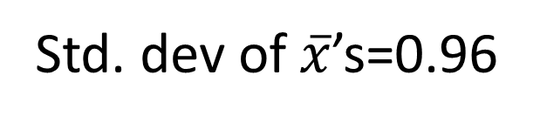
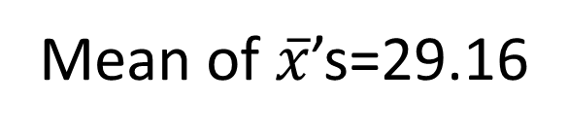
Bootstrap Distribution of 1000 Atlanta Commute Means
Mean of $\overline{x}$’s=29.16
Std. dev of $\overline{x}$’s=0.96

Slide 15
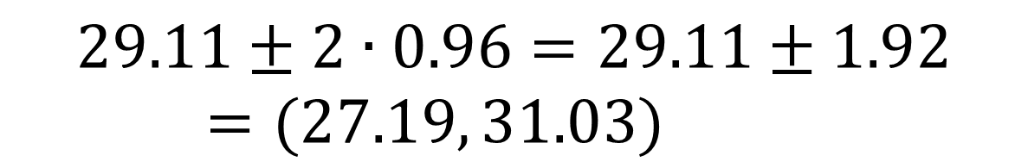

Using the Bootstrap Distribution to Get a Confidence Interval – Version #1
The standard deviation of the bootstrap statistics estimates the standard error of the sample statistic.
Quick interval estimate :
$$Original Statistic ±2∙SE$$
For the mean Atlanta commute time:
$$29.11±2∙0.96=29.11±1.92=(27.19, 31.03)$$

Slide 16
Quick Assessment
HW assignment (after one class on Sept. 29):
Use data from a sample of NHL players to find a confidence interval for the standard deviation of number of penalty minutes.

Slide 17
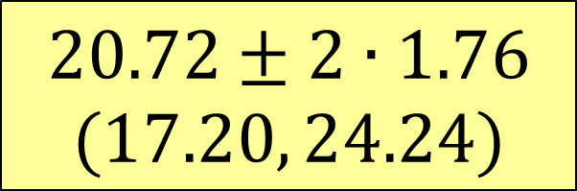
Example: Find a confidence interval for the standard deviation, σ, of Atlanta commute times.
Original sample: s=20.72
$$20.72±2∙1.76$$
$$(17.20, 24.24)$$
Bootstrap distribution of sample std. dev’s
SE=1.76

Slide 18
Quick Assessment
HW assignment (after one class on Sept. 29):
Use data from a sample of NHL players to find a confidence interval for the standard deviation of number of penalty minutes.
Results:
9/26 did everything fine
6/26 got a reasonable bootstrap distribution, but messed up the interval, e.g. StdError( )
5/26 had errors in the bootstraps, e.g. n=1000
6/26 had trouble getting started, e.g. defining s( )

Slide 19
Using the Bootstrap Distribution to Get a Confidence Interval – Version #2
27.19
31.03
Keep 95% in middle
Chop 2.5% in each tail
Chop 2.5% in each tail
$$29.11±2∙0.96=(27.19, 31.03)$$

Slide 20
Using the Bootstrap Distribution to Get a Confidence Interval – Version #2
95% CI=(27.33,31.00)
27.33
31.00
Keep 95% in middle
Chop 2.5% in each tail
Chop 2.5% in each tail
For a 95% CI, find the 2.5%-tile and 97.5%-tile in the bootstrap distribution

Slide 21
90% CI for Mean Atlanta Commute
90% CI=(27.52,30.68)
27.52
30.68
Keep 90% in middle
Chop 5% in each tail
Chop 5% in each tail
For a 90% CI, find the
5%-tile and 95%-tile in the bootstrap distribution

Slide 22
99% CI for Mean Atlanta Commute
99% CI=(27.02,31.82)
27.02
31.82
Keep 99% in middle
Chop 0.5% in each tail
Chop 0.5% in each tail
For a 99% CI, find the 0.5%-tile and 99.5%-tile in the bootstrap distribution

Slide 23
Intermediate Assessment
Exam #2: (Oct. 26) Students were asked to find a 95% confidence interval for the correlation between water pH and mercury levels in fish for a sample of Florida lakes – using both SE and percentiles from a bootstrap distribution.

Slide 24
Example: Find a 95% confidence interval for the correlation between time and distance of Atlanta commutes.
Original sample: r =0.807
(0.72, 0.87)

Slide 25
Intermediate Assessment
Exam #2: (Oct. 26) Students were asked to find a 95% confidence interval for the correlation between water pH and mercury levels in fish for a sample of Florida lakes – using both SE and percentiles from a bootstrap distribution.
Results:
17/26 did everything fine
4/26 had errors finding/using SE
2/26 had minor arithmetic errors
3/26 had errors in the bootstrap distribution

Slide 26
Transitioning to Traditional Intervals
AFTER students have seen lots of bootstrap distributions (and randomization distributions)…
Introduce the normal distribution (and later t)
Introduce “shortcuts” for estimating SE for proportions, means, differences, slope…

Slide 27
Advantages: Bootstrap CI’s
Requires minimal prerequisite machinery
Requires minimal conditions
Same process works for lots of parameters
Helps illustrate the concept of an interval
Explicitly shows variability for different samples
Possible disadvantages:
Requires good technology
It’s not the way we’ve always done it

Slide 28
What About Technology?
Possible options?
Fathom
R
Minitab (macro)
JMP (script)
Web apps
Others?
xbar=function(x,i) mean(x[i])
b=boot(Margin,xbar,1000)

Slide 29
Miscellaneous Observations
We were able to get to CI’s (and tests) sooner
More issues using technology than expected
Students had fewer difficulties using normals
Interpretations of intervals improved
Students were able to apply the ideas later in the course, e.g. a regression project at the end that asked for a bootstrap CI for slope
Had to trim a couple of topics, e.g. multiple regression

Slide 30
Final Assessment
Final exam: (Dec. 15) Find a 98% confidence interval using a bootstrap distribution for the mean amount of study time during final exams
Results:
26/26 had a reasonable bootstrap distribution
24/26 had an appropriate interval
23/26 had a correct interpretation

Slide 31
Support Materials?
We’re working on them…
Interested in class testing?
rlock@stlawu.edu or plock@stlawu.edu

