Slide 1
StatKey:
Online Tools for Bootstrap Intervals and Randomization Tests
Kari Lock Morgan
Department of Statistical Science
Duke University
Joint work with
Robin Lock, Patti Frazer Lock, Eric Lock, Dennis Lock
ICOTS
7/17/14

Slide 2
StatKey
A set of web-based, interactive, dynamic statistics tools designed for teaching simulation-based methods at an introductory level.
Freely available at www.lock5stat.com/statkey
No login required
Runs in (almost) any browser (incl. smartphones)
Google Chrome App available (no internet needed)
Standalone or supplement to existing technology

Slide 3


StatKey
Developed by the Lock⁵ team
Developed for our book, Statistics: Unlocking the Power of Data (although can be used with any book)
Programmed by Rich Sharp (Stanford), Ed Harcourt and Kevin Angstadt (St. Lawrence)
Robin & Patti
St. Lawrence
Dennis
Miami Dolphins
Eric
U Minnesota
Wiley (2013)
Kari
Duke / Penn State

Slide 4
StatKey Goals
Free
Convenient
Very easy-to-use
Helps promote understanding
For those who want to use simulation methods, technology should not be a limiting factor!

Slide 5
StatKey
WHY?
Address instructor concerns about accessibility of simulation-based methods at the intro level
Design an easy-to-use set of learning tools accessible to everyone
Provide a no-cost technology option for any environment OR as a supplement to existing technology
Make sure everyone

Slide 6
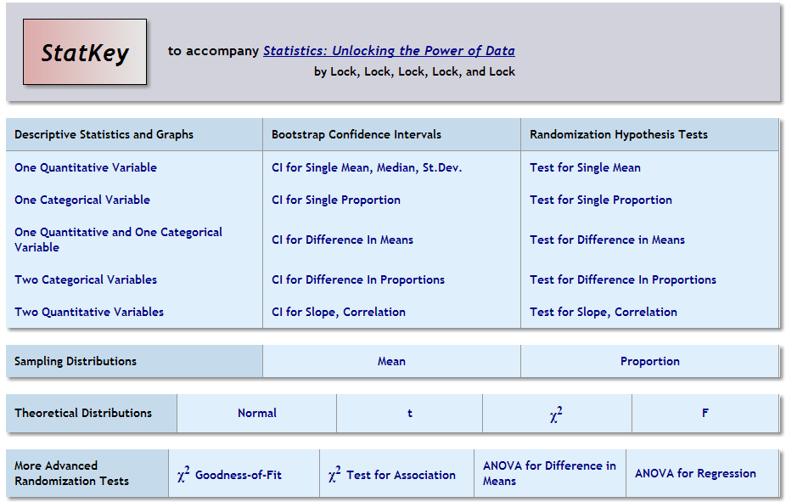

Slide 8
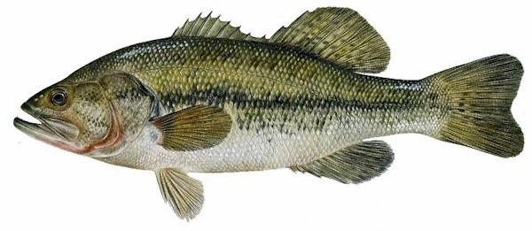
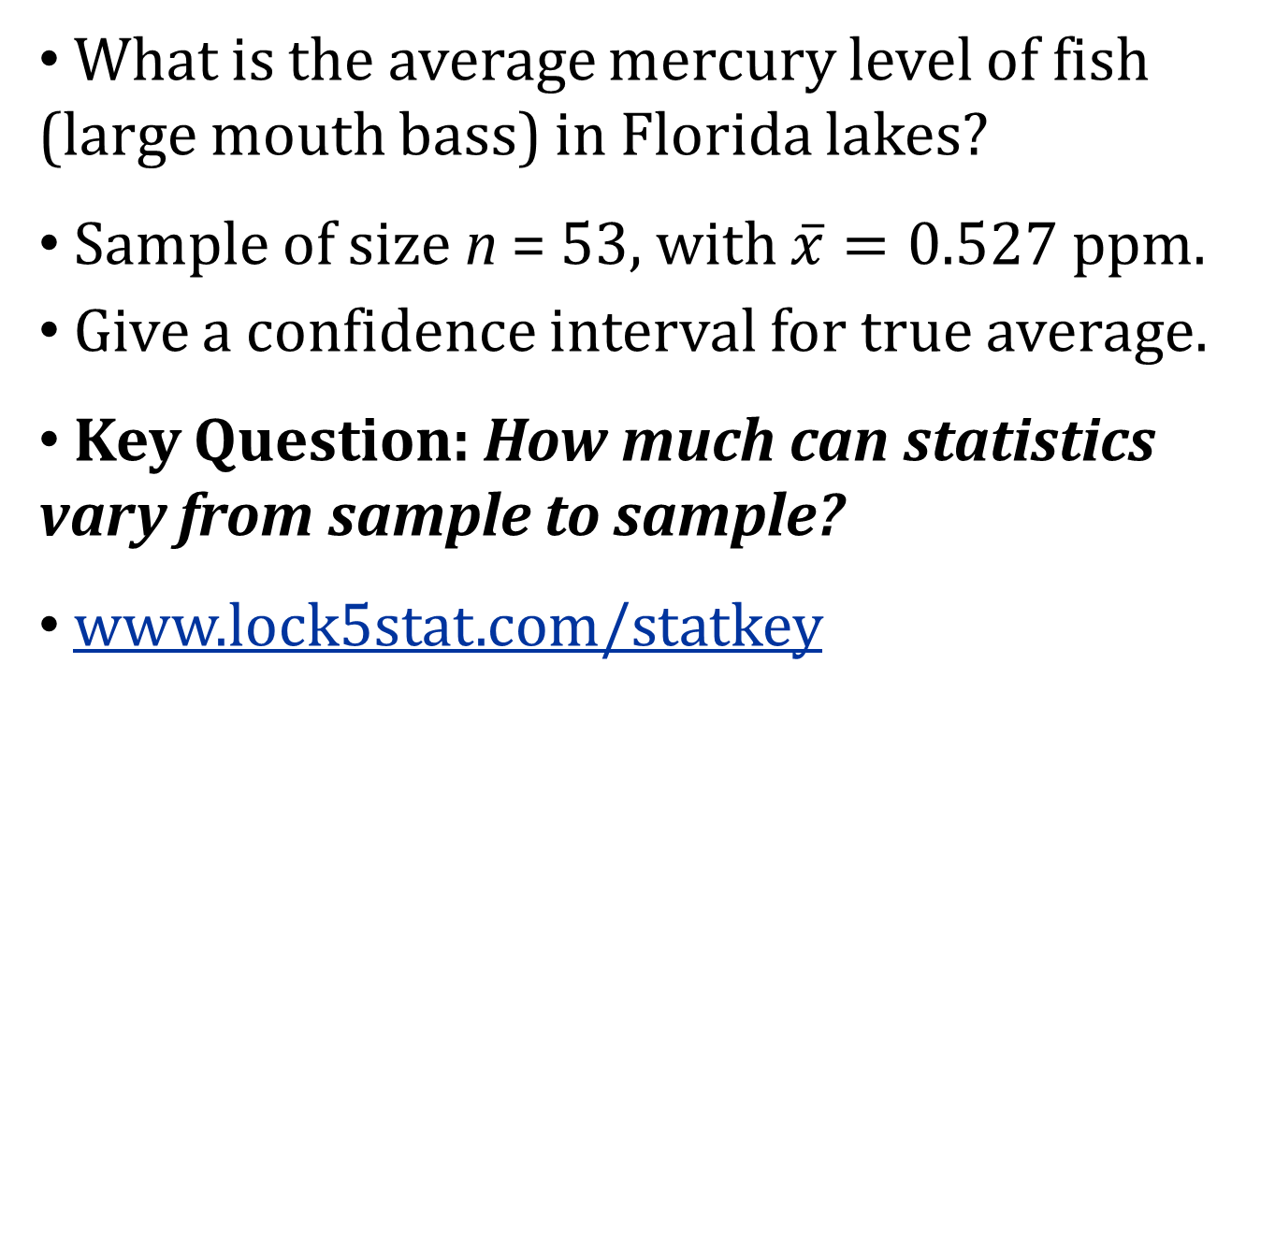
Bootstrap Confidence Interval
What is the average mercury level of fish (large mouth bass) in Florida lakes?
Sample of size n = 53, with $\overline{x}=0.527$ ppm.
Give a confidence interval for true average.
Key Question: How much can statistics vary from sample to sample?
www.lock5stat.com/statkey
Lange, T., Royals, H. and Connor, L. (2004). Mercury accumulation in largemouth bass (Micropterus salmoides) in a Florida Lake. Archives of Environmental Contamination and Toxicology, 27(4), 466-471.
Notes:
FDA action level: 1ppm
Canada: 0.5ppm

Slide 9
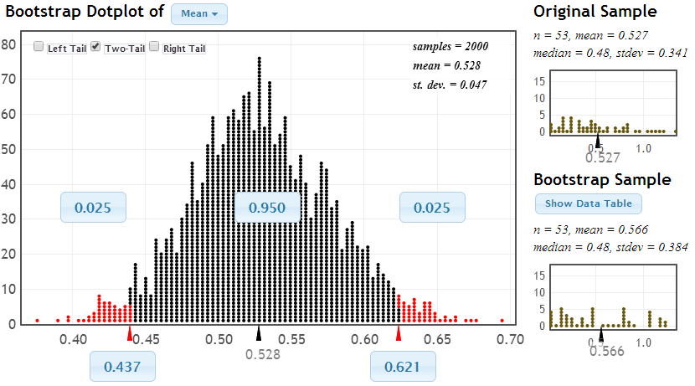
Bootstrap Confidence Interval
Original Sample
One Simulated Sample
Distribution of Simulated Statistics

Slide 10
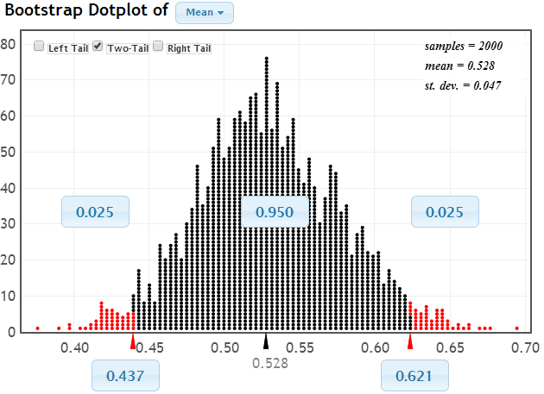

Bootstrap Confidence Interval
Distribution of Bootstrap Statistics
SE = 0.047
$$\frac{s}{\sqrt{n}}=\frac{0.341}{\sqrt{53}}=0.047$$
0.527 ± 2 ⋅ 0.047
(0.433, 0.621)
Middle 95% of bootstrap statistics

Slide 11
CI for Proportion
Have you used simulation-based methods (bootstrap confidence intervals or randomization tests) in your teaching?

Slide 13
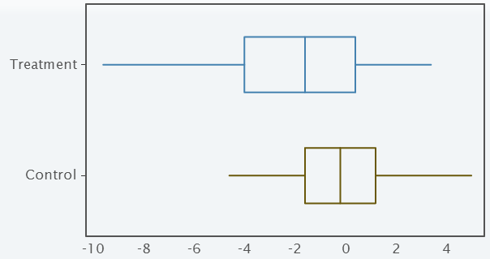
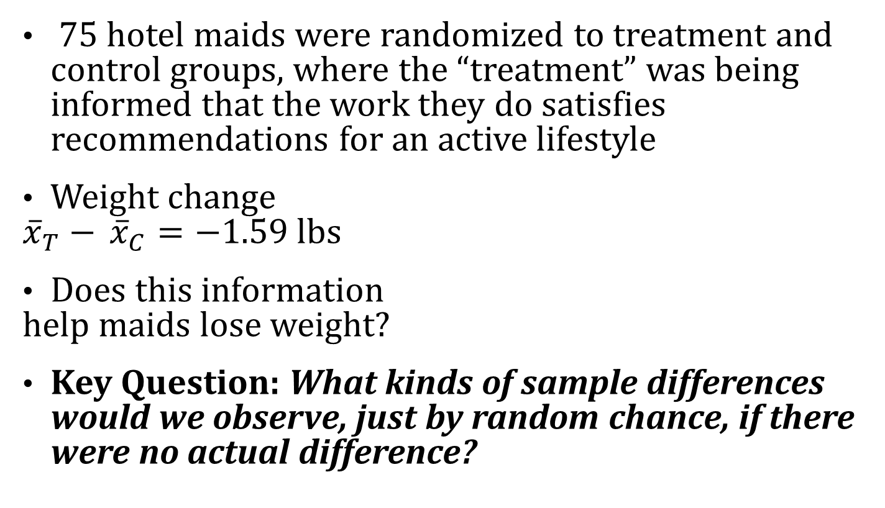
Randomization Test
75 hotel maids were randomized to treatment and control groups, where the “treatment” was being informed that the work they do satisfies recommendations for an active lifestyle
Weight change
${\overline{x}}_{T}−$ ${\overline{x}}_{C}=−1.59$ lbs
Does this information
help maids lose weight?
Key Question: What kinds of sample differences would we observe, just by random chance, if there were no actual difference?
Crum, A. and Langer, E., (2007). Mind-Set Matters: Exercise and the Placebo Effect. Psychological Science, 18, 165-171.

Slide 14
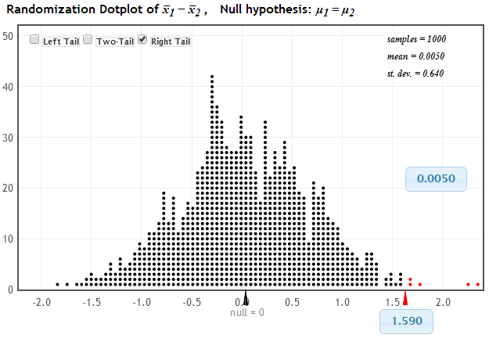
Randomization Test
Distribution of Statistic Assuming Null is True
Proportion as extreme as observed statistic
p-value
observed statistic

Slide 15


Malevolent Uniforms
NFL Teams
Do NFL teams with more malevolent uniforms get more penalty yards?
r = 0.43

Slide 16
StatKey Pedagogical Features
Ability to simulate one to many samples
Helps students distinguish and keep straight the original data, a single simulated data set, and the distribution of simulated statistics
Students have to interact with the bootstrap/randomization distribution – they have to know what to do with it
Consistent interface for bootstrap intervals, randomization tests, theoretical distributions

Slide 18
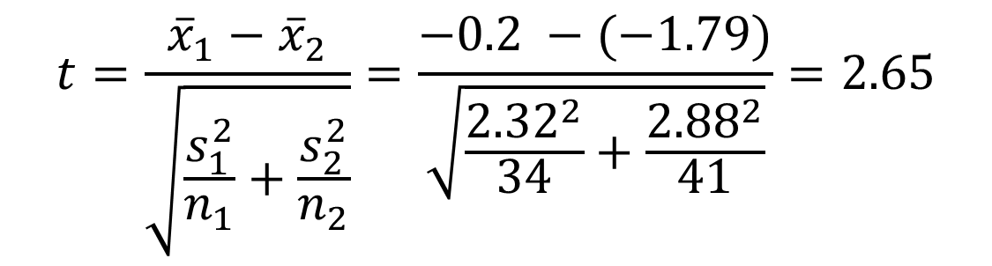
Theoretical Distributions
Maid weight loss example:
  t-distribution
  df = 33
$$t=\frac{{\overline{x}}_{1}−{\overline{x}}_{2}}{\sqrt{\frac{s_{1}^{2}}{n_{1}}+\frac{s_{2}^{2}}{n_{2}}}}=\frac{−0.2 −(−1.79)}{\sqrt{\frac{{2.32}^{2}}{34}+\frac{{2.88}^{2}}{41}}}=2.65$$

Slide 19
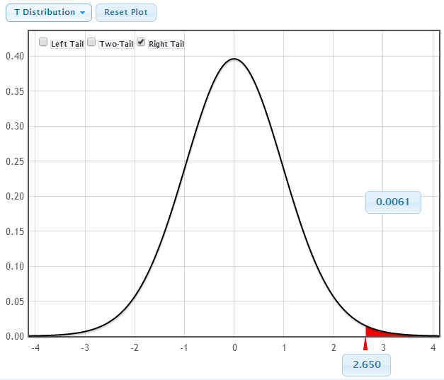
Theoretical Distributions
p-value
MUCH more intuitive and easier to use than tables!!!
t-statistic

Slide 21
Chi-Square and ANOVA
Chi-square tests
  Goodness-of-fit or test for association
  Gives χ² statistic, as well as observed and expected counts for each cell
  Randomization test or χ² distribution
ANOVA
  Difference in means or regression
  Gives entire ANOVA table
  Randomization test or F-distribution

Slide 22
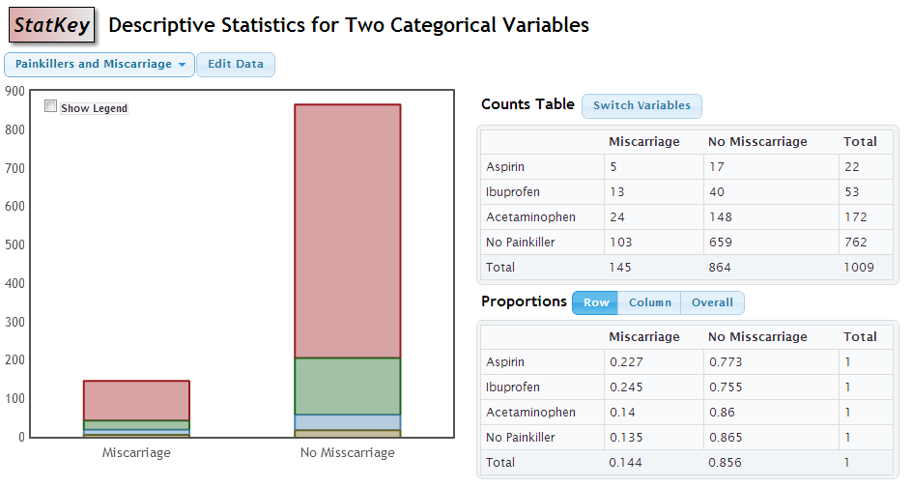
Chi-Square Test for Association
Is there an association between type of painkiller taken during pregnancy and miscarriage?

Slide 23
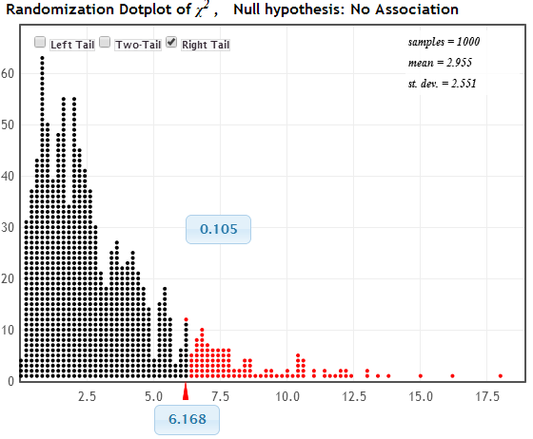
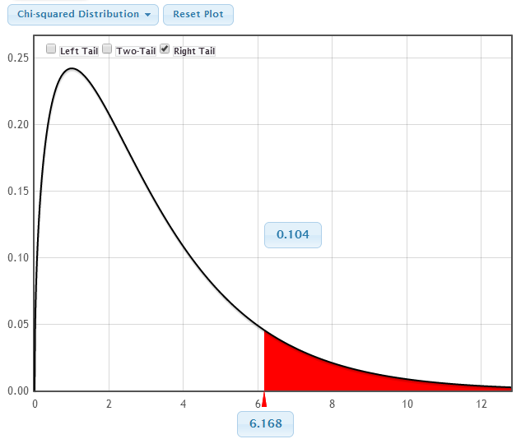
Chi-Square Test
Randomization Distribution
Chi-Square Distribution (3 df)
p-value = 0.105
p-value = 0.104
χ² = 6.168
χ² = 6.168

Slide 24
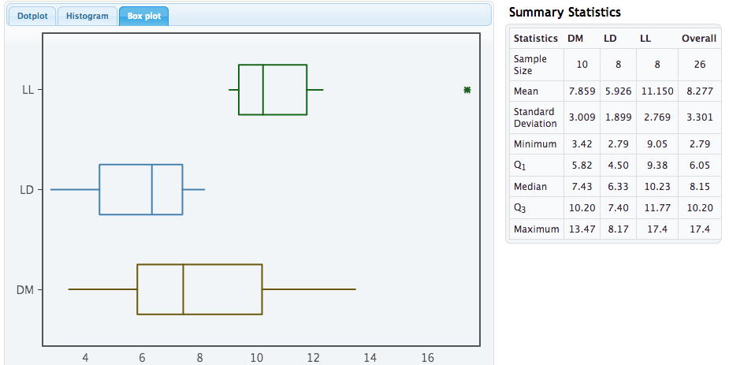
ANOVA for Difference in Means
Does exposure to light at night make you fatter? (does it make mice fatter?)

Slide 26
Sampling Distributions
Simulate a sampling distribution
Generate confidence intervals for each simulated statistic, keep track of coverage rate
Population data: Finishing times for the 2008 Men’s Olympic marathon

Slide 27
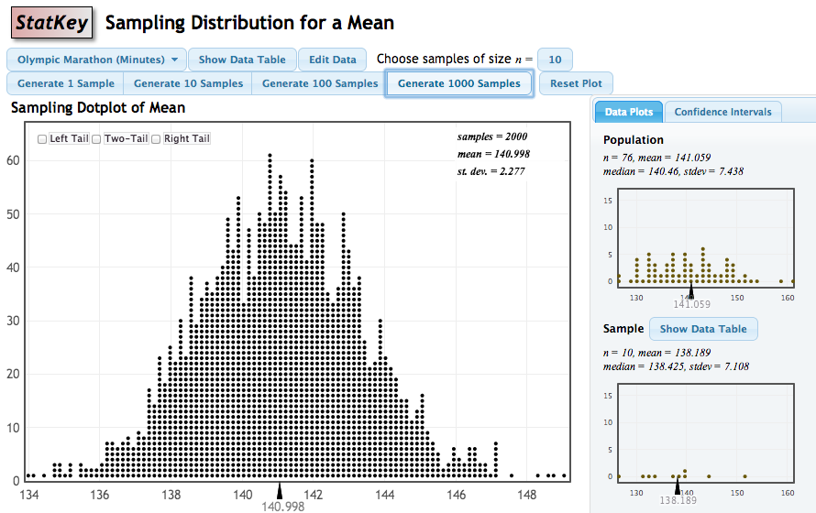
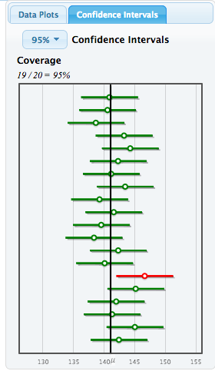
Sampling Distributions

Slide 29
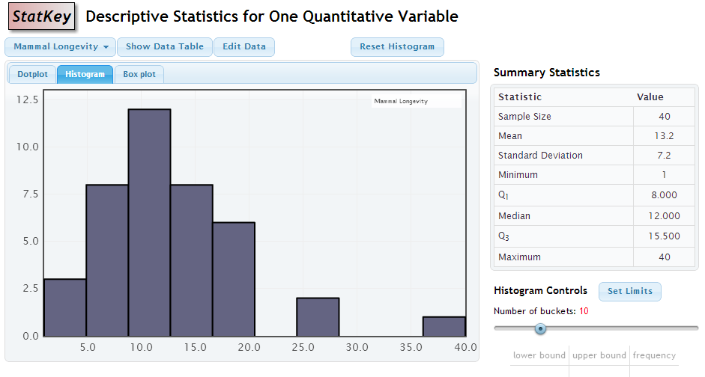
Descriptive Statistics

Slide 30
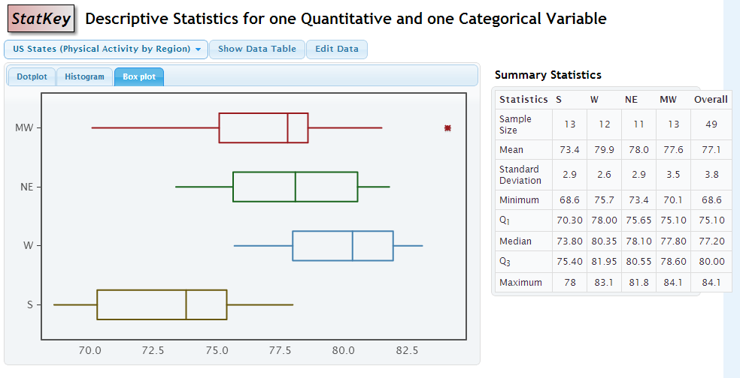
Descriptive Statistics

Slide 31
Descriptive Statistics

Slide 32
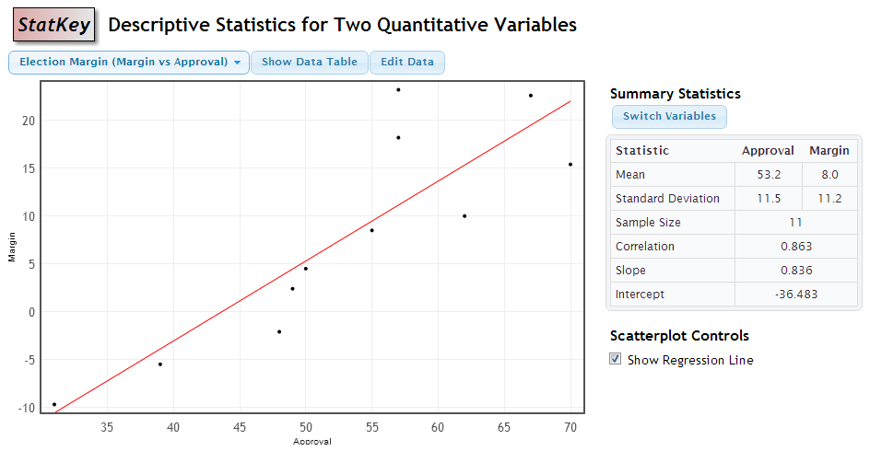
Descriptive Statistics

Slide 33
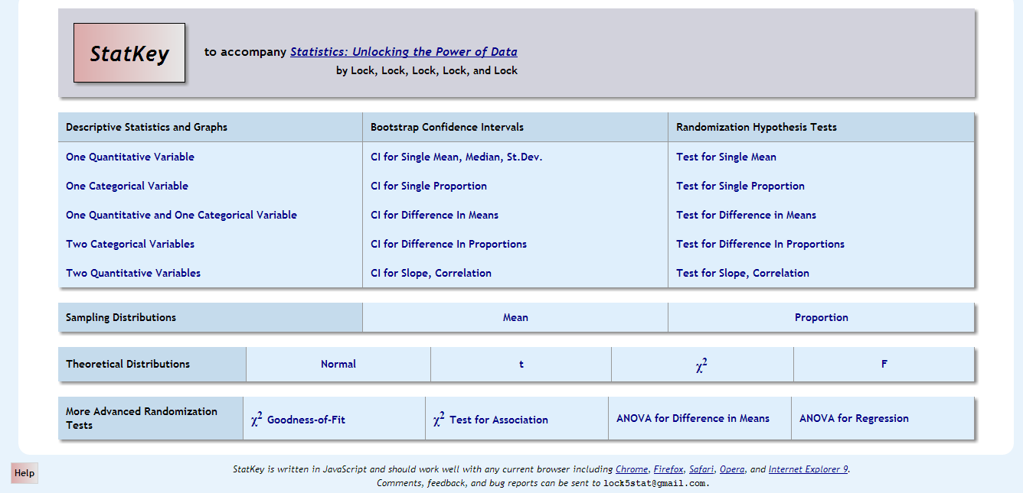
Help
Help page, including instructional videos

Slide 34
Suggestions? Comments? Questions?
You can email me at klm47@psu.edu or the whole Lock⁵ team at lock5stat@gmail.com

