Slide 1

Connecting Intuitive Simulation-Based Inference to Traditional Methods
Robin Lock, St. Lawrence University
Patti Frazer Lock, St. Lawrence University
Kari Lock Morgan, Pennsylvania State University
ICOTS 10 – Kyoto , Japan
July 9, 2018

Slide 2
Assumptions/Conditions
We start with simulation-based inference (SBI): bootstrap intervals, randomization tests.
We cover lots of parameter situations (mean, proportion, differences, correlation, slope, …).
We want students (eventually) to see traditional methods.
We need good software to make SBI methods accessible to students.

Slide 3
Software?
StatKey
Freely available web apps
http://lock5stat.com/statkey
http://www.rossmanchance.com/applets/
http://www.rossmanchance.com/ISIapplets.html
Statistics packages:
R, JMP, Minitab Express, …

Slide 4
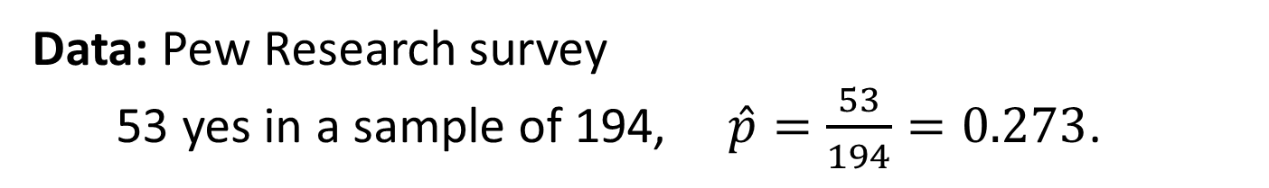
Example #1: Online Dating Apps
What proportion of 18-24 year olds (young adults) in the U.S. have used an online dating app?
Data: Pew Research survey
53 yes in a sample of 194, $\hat{p}=\frac{53}{194}=0.273$.
Task: Find a 95% CI for the proportion
Method: Create a bootstrap distribution of sample proportions by sampling with replacement from the original sample
http://www.pewinternet.org/2016/02/11/15-percent-of-american-adults-have-used-online-dating-sites-or-mobile-dating-apps/

Slide 5
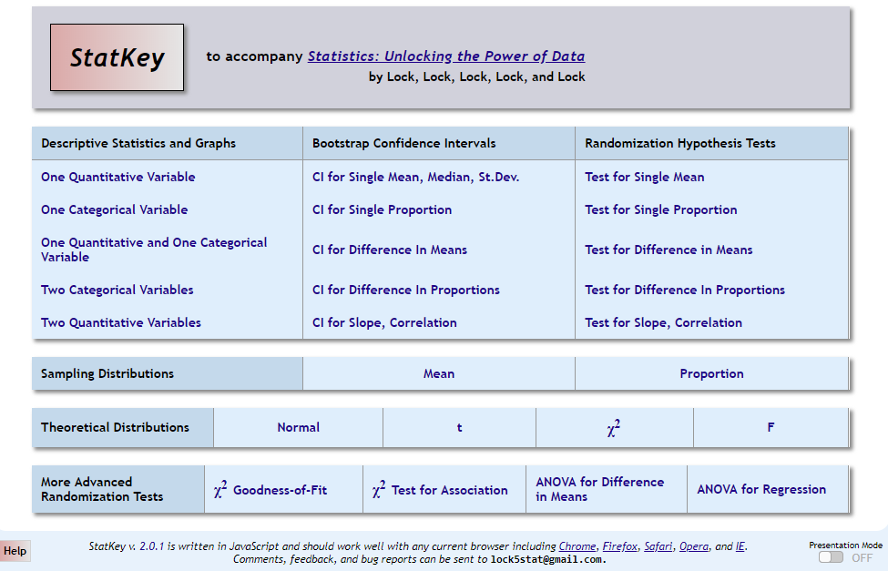
lock5stat.com/statkey

Slide 6
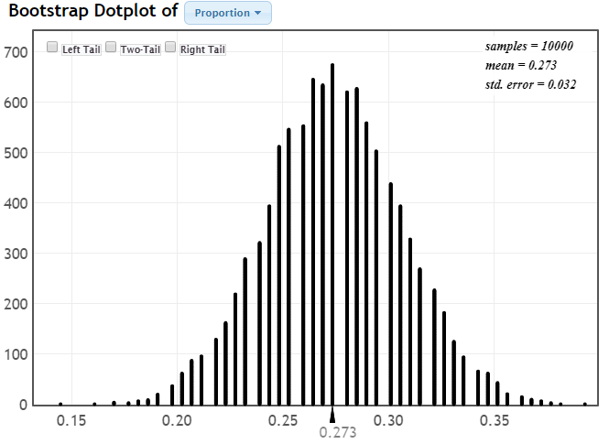

Slide 7
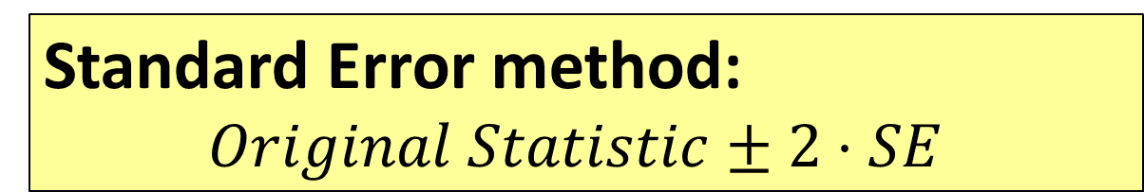
95% Confidence Interval from a Bootstrap Distribution
Percentile method:
Find the endpoints of the middle 95% of the bootstrap statistics.
Standard Error method:
$Original Statistic±2⋅SE$
Standard deviation of the bootstrap statistics

Slide 8
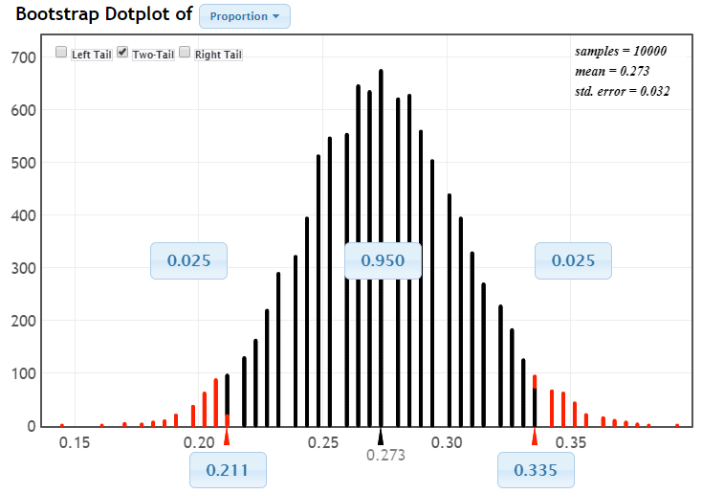
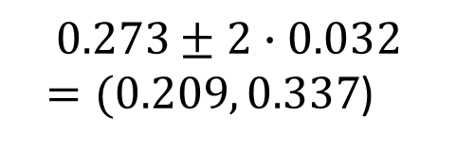
$$0.273±2∙0.032$$
$=(0.209, 0.337$)

Slide 9
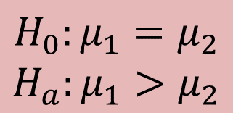

Example #2: : Does Mind-Set Matter?
Female hotel maids were randomly divided into two groups.
Group #1 was informed that their duties count a exercise
Group #2 was not given this information
Weight loss was measured.
 | n | mean | std. dev
Group #1 (Informed) | 41 | 1.79 | 2.88
Group #2 (Uninformed) | 34 | 0.20 | 2.32
$$H_{0}:μ_{1}=μ_{2}$$
$$H_{a}:μ_{1}>μ_{2}$$
$${\overline{x}}_{1}−{\overline{x}}_{2}=1.59$$
Task: Does this provide enough evidence to conclude that the mean weight loss is higher when informed?
Method: Create a randomization distribution of differences in means when being informed has no effect (H₀ is true)
Crum, A. and Langer, E. (2007) “Mind-Set Matters: Exercise and the Placebo Effect” Psychological Science, 18:165-171

Slide 10
lock5stat.com/statkey

Slide 11
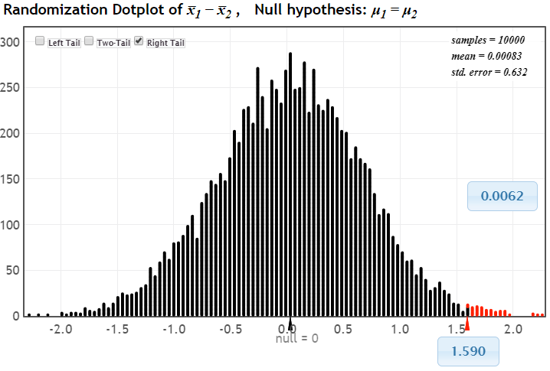
p-value
Distribution of statistic if no difference (H₀ true)
observed statistic

Slide 12
Transition to Traditional
Step #1: Smooth Curve:
Simulation distribution to general curve
Step #2: Standardized Statistic:
Original statistic to standardized value
Step #3: Standard Error Formula:
Simulation SE to formula SE

Slide 13
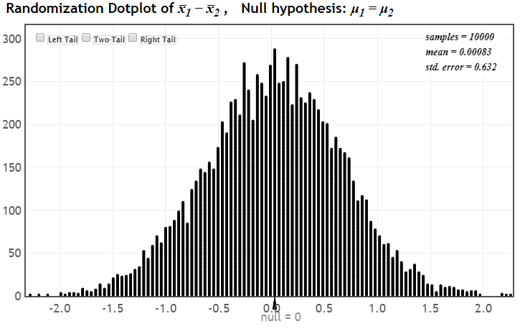
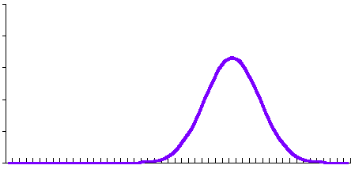
Step #1: Mind-Set Matters
N(0, 0.632)
Compare the original statistic to this Normal distribution to find the p-value.

Slide 14
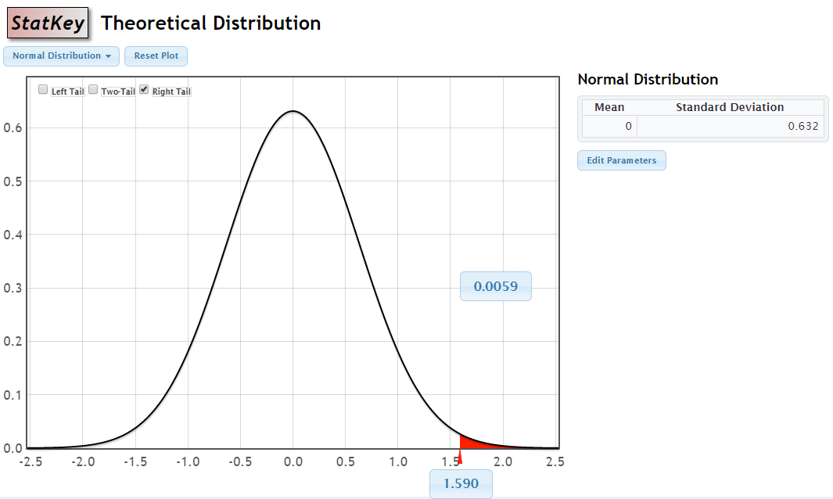
p-value from N(null, SE)
Same idea as randomization test, just using a smooth curve!
p-value
observed statistic

Slide 15
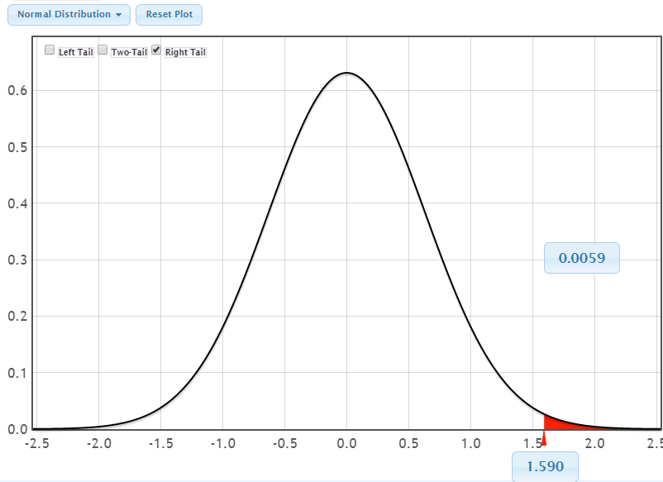
Seeing the Connection!
Randomization Distribution
Normal Distribution

Slide 16
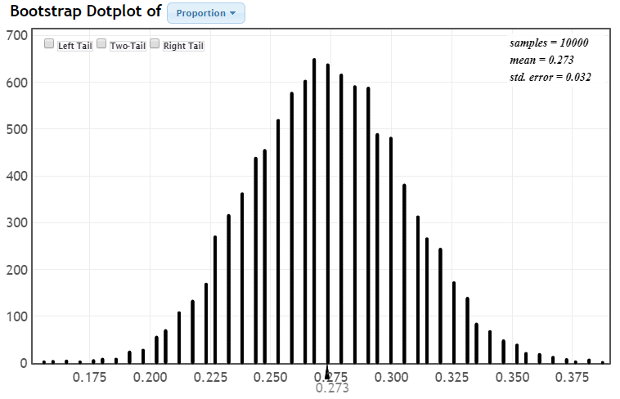

Step #1 Online Dating
N(0.273, 0.032)
$$\hat{p}=0.273$$

Slide 17
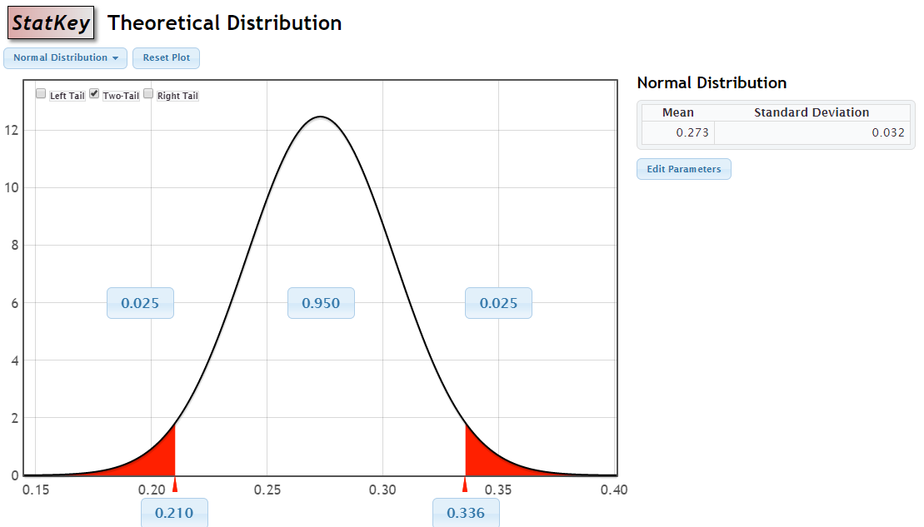
CI from N(statistic, SE)
Same idea as the bootstrap, just using a smooth curve!

Slide 18
Transition to Traditional
Step #1: Smooth Curve:
Simulation distribution to general curve
Step #2: Standardize Statistic:
Original statistic to standardized value
Step #3: Standard Error Formula:
Simulation SE to by formula SE

Slide 19

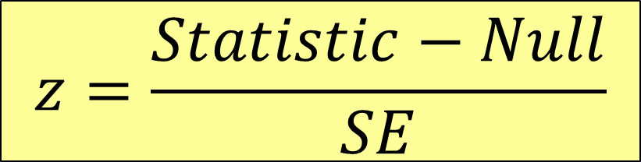
Step #2: Standardize Statistic
Convert to “number of SE’s” and use N(0,1)
$$z=\frac{Statistic−Null}{SE}$$
For tests:
(standardize)
For intervals:
$$Statistic±z^{∗}⋅SE$$
(unstandardize)
(For now) SE comes from the randomization or bootstrap distribution

Slide 20
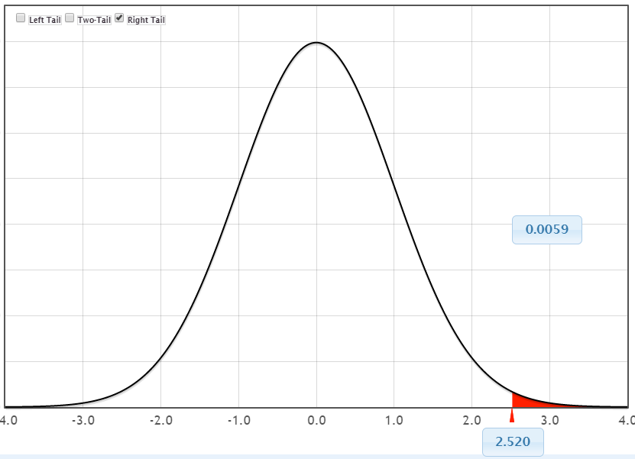
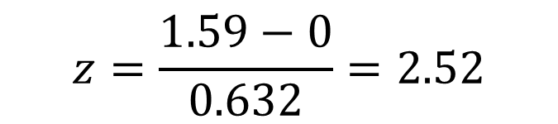
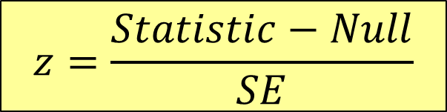
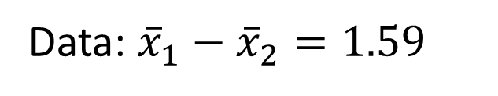

Step #2: Mind-Set Matters
$$H_{0}:μ_{1}=μ_{2} ⇒μ_{1}−μ_{2}=0$$
$$z=\frac{Statistic−Null}{SE}$$
Data: ${\overline{x}}_{1}−{\overline{x}}_{2}=1.59$
$$z=\frac{1.59−0}{0.632}=2.52$$
N(0,1)
p-value

Slide 21
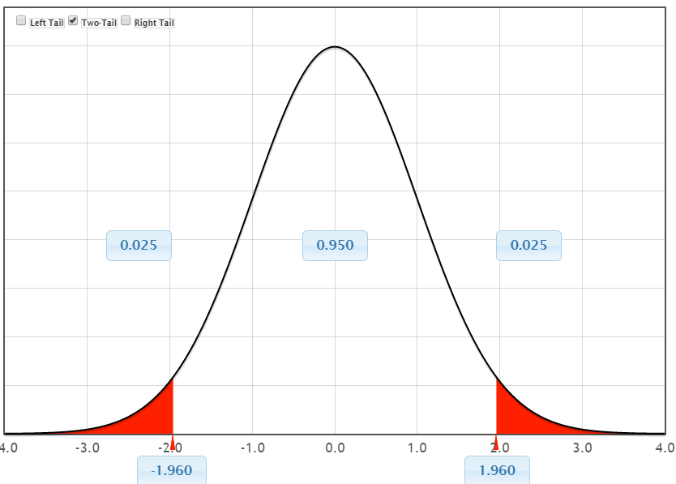

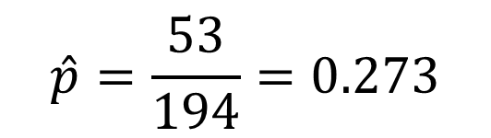
Step #2: Online Dating
N(0,1)
$$\hat{p}=\frac{53}{194}=0.273$$
$$\hat{p}±z^{∗}⋅SE$$
$$0.273±1.96⋅0.032=0.273±0.063=(0.210 \text{to} 0.336)$$

Slide 22
Step #2: Standardize Statistic
Convert to “number of SE’s” and use N(0,1)
$$z=\frac{Statistic−Null}{SE}$$
For tests:
(standardize)
For intervals:
$$Statistic±z^{∗}⋅SE$$
(unstandardize)
Wouldn’t it be nice to find the SE’s without needing any simulations?

Slide 23
Transition to Traditional
Step #1: Smooth Curve:
Simulation distribution to general curve
Step #2: Standardize Statistic:
Original statistic to standardized value
Step #3: Standard Error Formula:
Simulation SE to by formula SE

Slide 24
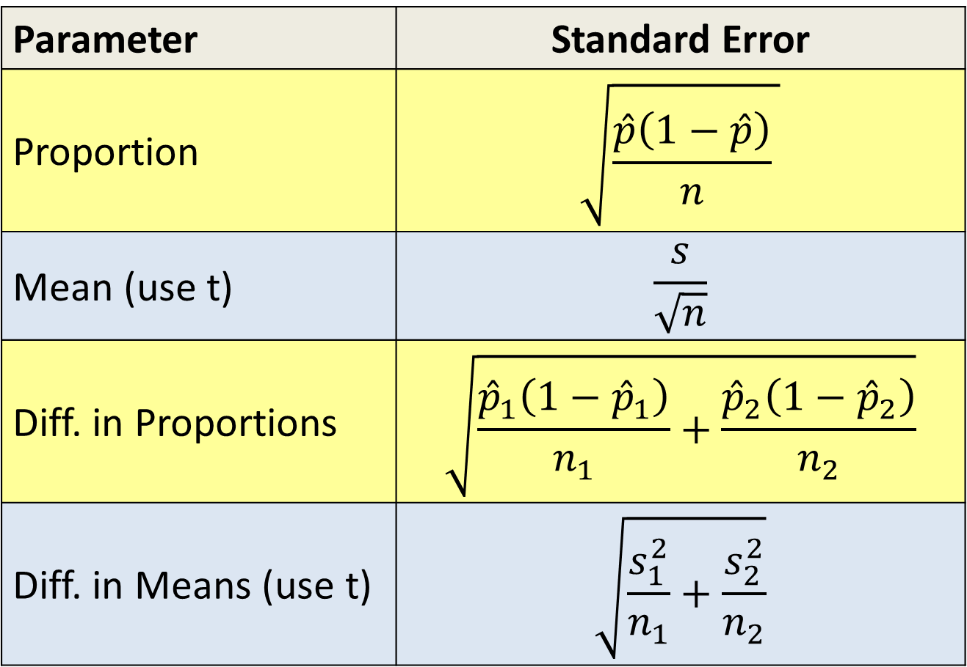
Standard Error Formulas
Parameter | Standard Error
Proportion | $$\sqrt{\frac{\hat{p}\left(1−\hat{p}\right)}{n} }$$
Mean (use t) | $$\frac{s}{\sqrt{n}}$$
Diff. in Proportions | $$\sqrt{\frac{{\hat{p}}_{1}\left(1−{\hat{p}}_{1}\right)}{n_{1}}+\frac{{\hat{p}}_{2}\left(1−{\hat{p}}_{2}\right)}{n_{2}}}$$
Diff. in Means (use t) | $$\sqrt{\frac{s_{1}^{2}}{n_{1}}+\frac{s_{2}^{2}}{n_{2}}}$$

Slide 25
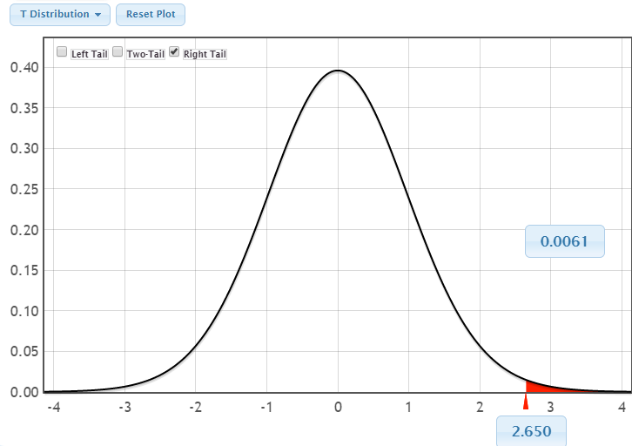
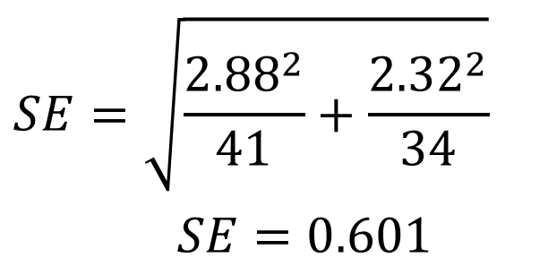
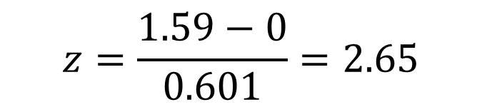
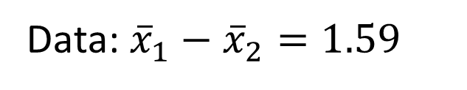
Step #3: Mind-Set Matters
$$H_{0}:μ_{1}=μ_{2} ⇒μ_{1}−μ_{2}=0$$
$$z=\frac{Statistic−Null}{SE}$$
Data: ${\overline{x}}_{1}−{\overline{x}}_{2}=1.59$
$$z=\frac{1.59−0}{0.601}=2.65$$
$$SE=\sqrt{\frac{{2.88}^{2}}{41}+\frac{{2.32}^{2}}{34}}$$
$SE=0.601$
t₃₃
p-value

Slide 26
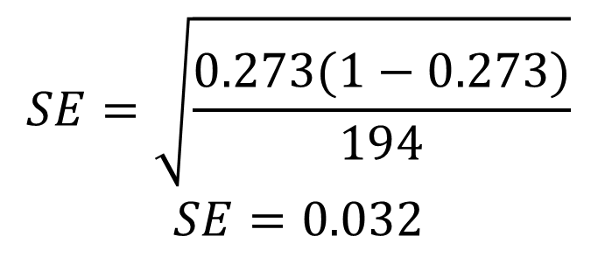
Step #3: Online Dating
N(0,1)
$$SE=\sqrt{\frac{0.273(1−0.273)}{194}}$$
$$SE=0.032$$
$$\hat{p}=\frac{53}{194}=0.273$$
$$\hat{p}±z^{∗}⋅SE$$
$$0.273±1.96⋅0.032=0.273±0.063=(0.210 \text{to} 0.336)$$

Slide 27
Transition to Traditional
Step #1: Smooth Curve:
Simulation distribution to general curve
Step #2: Standardize Statistic:
Original statistic to standardized value
Step #3: Standard Error Formula:
Simulation SE to by formula SE
Note: These steps are designed for making the transition, not for routinely calculating p-values or intervals.

Slide 28
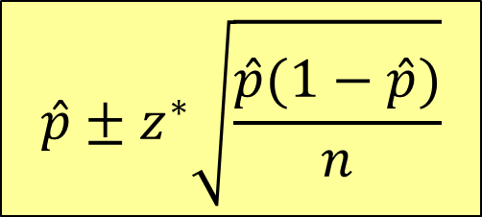


Simulation to Traditional
Bootstrap
$$\text{Normal}(\hat{p}, SE)$$
A
B
$$\hat{p}±z^{∗}\sqrt{\frac{\hat{p}(1−\hat{p})}{n}}$$
$$Statistic±z^{∗}⋅SE$$
Even if you only want your
students to be able to go from A to B, it helps understanding to build connections along the way!
Notes:
B

Slide 29
Observation
Important point: The fundamental concepts of inference have already been established (via simulation)
Once the transition has been made, traditional methods can go VERY quickly!
Two questions:
What’s a formula for SE?
What are conditions for a theoretical distribution to apply?

Slide 30
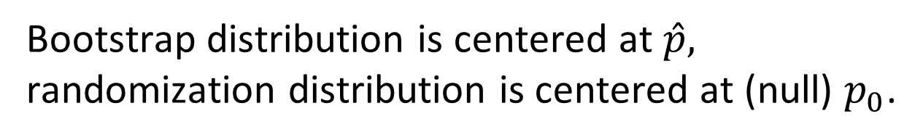
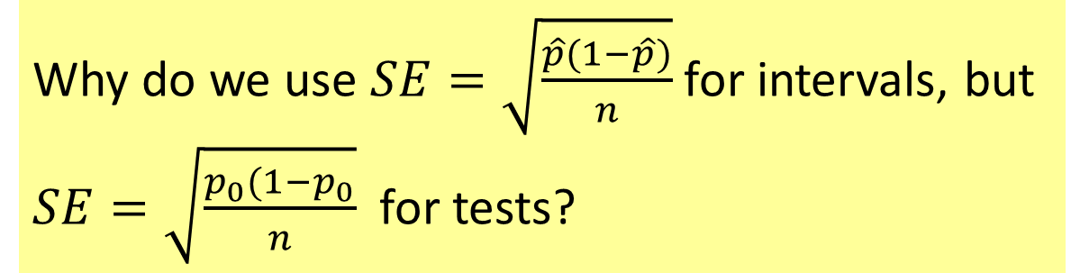
Observation
Why do we use $SE=\sqrt{\frac{\hat{p}(1−\hat{p})}{n}}$ for intervals, but $SE=\sqrt{\frac{p_{0}(1−p_{0}}{n}}$ for tests?
Bootstrap distribution is centered at $\hat{p},$ randomization distribution is centered at (null) $p_{0}$.

Slide 31
Thank you!
QUESTIONS?
Robin Lock: rlock@stlawu.edu
Patti Frazer Lock: plock@stlawu.edu
Kari Lock Morgan: klm47@psu.edu
Slides posted at www.lock5stat.com

