Slide 1
Building Conceptual Understanding of Statistical Inference
Patti Frazer Lock
Cummings Professor of Mathematics
St. Lawrence University
plock@stlawu.edu
Glendale – High School Math Collaborative
January 2013

Slide 2
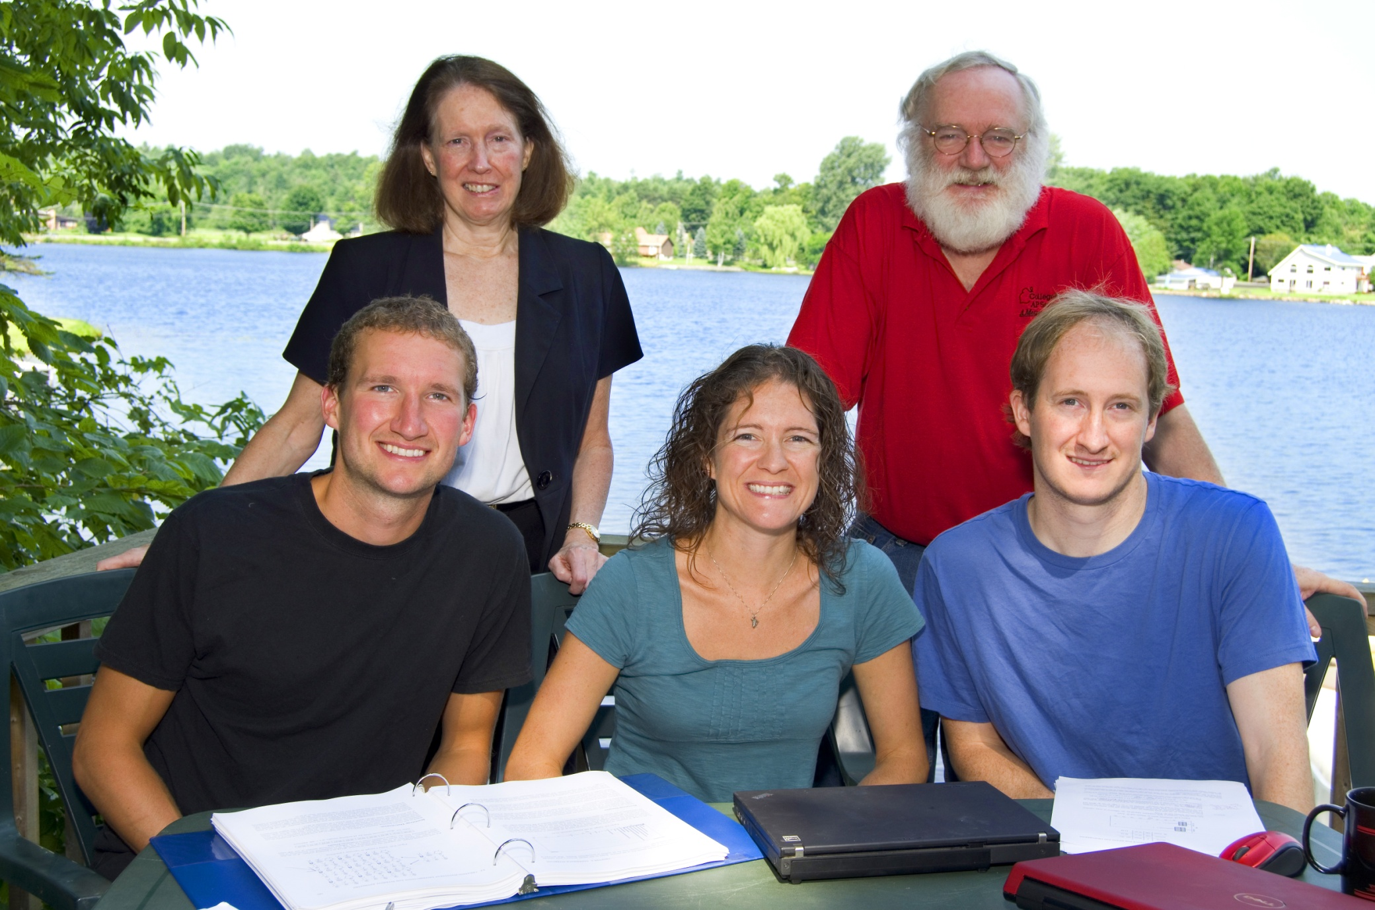
The Lock⁵ Team
Robin & Patti
St. Lawrence
Dennis
Iowa State
Kari
Harvard/Duke
Eric
UNC/Duke

Slide 3
Statistics
Increasingly important for our students (and us)
An expanding part of the high school (and college) curriculum

Slide 4
This Presentation
General overview of the key ideas of statistical inference
Introduction to new simulation methods in statistics
Free resources to use in teaching statistics or math

Slide 5
New Simulation Methods
“The Next Big Thing”
Common Core State Standards in Mathematics
Outstanding for helping students understand the key ideas of statistics
Increasingly important in statistical analysis

Slide 6
“New” Simulation Methods?
"Actually, the statistician does not carry out this very simple and very tedious process, but his conclusions have no justification beyond the fact that they agree with those which could have been arrived at by this
elementary method."
-- Sir R. A. Fisher, 1936

Slide 7
We need a snack!
Notes:
Bozz

Slide 8
What proportion of Reese’s Pieces are Orange?
Find the proportion that are orange for your “sample”.

Slide 9
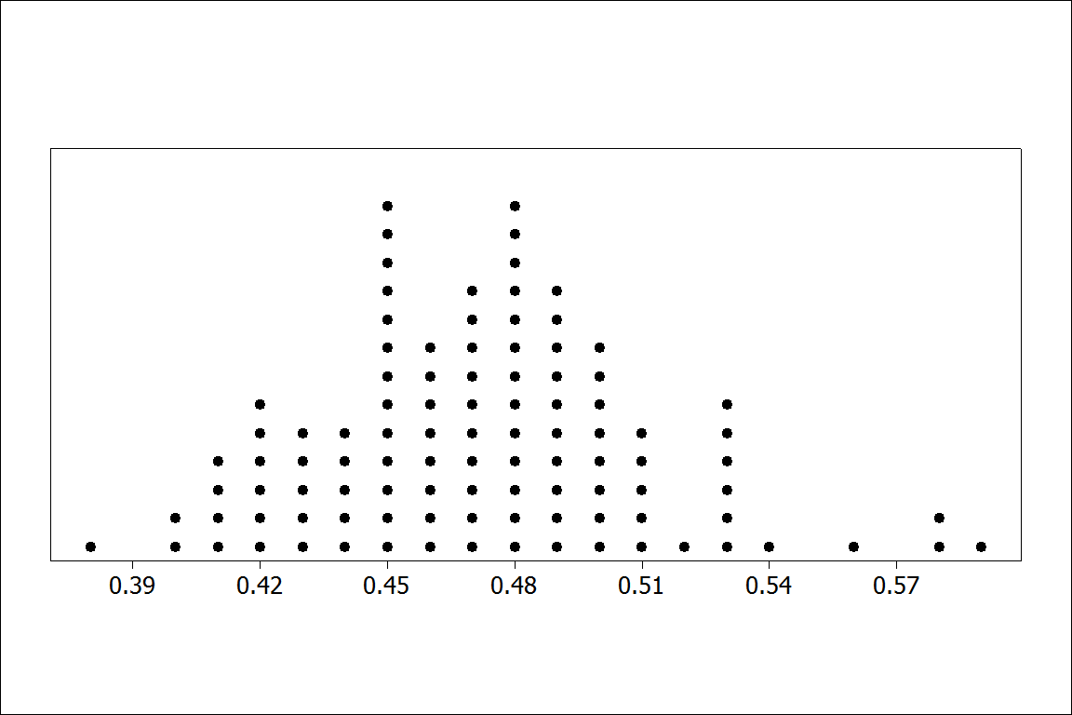
Proportion orange in 100 samples of size n=100
BUT – In practice, can we really take lots of samples from the same population?
Notes:
Bozz

Slide 10
Statistical Inference
Using information from a sample to infer information about a larger population.
Two main areas:
Confidence Intervals (to estimate)
Hypothesis Tests (to make a decision)
Notes:
Bozz

Slide 11
First:
Confidence Intervals

Slide 12
Example 1: What is the average price of a used Mustang car?
We select a random sample of n=25 Mustangs from a website (autotrader.com) and record the price (in $1,000’s) for each car.

Slide 13
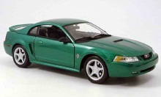
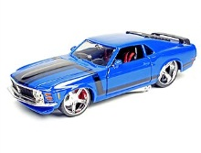
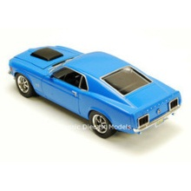
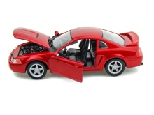
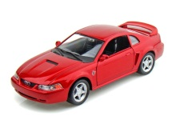
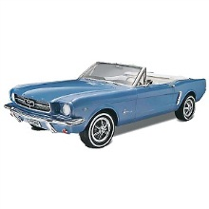
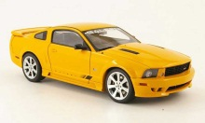
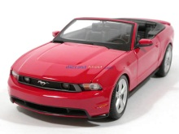
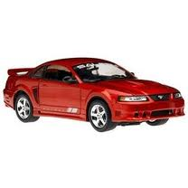
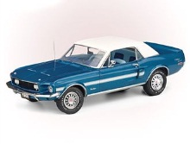
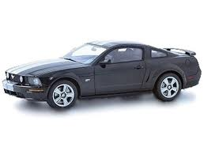
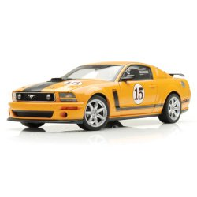
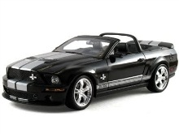
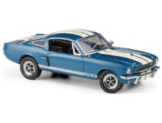
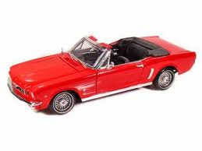
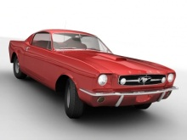
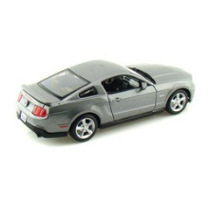
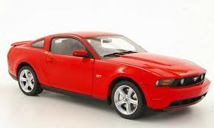
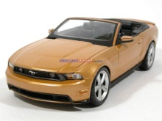
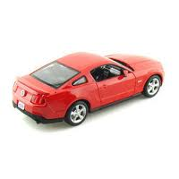
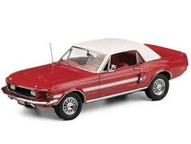
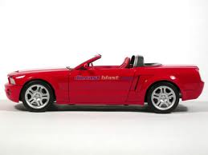
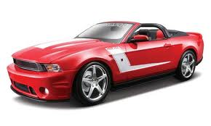
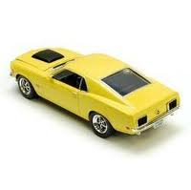
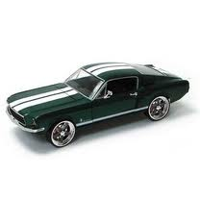

Sample of Mustangs:
$$n=25 \overline{x}=15.98 s=11.11$$
Our best estimate for the average price of used Mustangs is $15,980, but how accurate is that estimate?

Slide 14
Our best estimate for the average price of used Mustangs is $15,980, but how accurate is that estimate?
We would like some kind of margin of error or a confidence interval.
Key concept: How much can we expect the sample means to vary just by random chance?

Slide 15
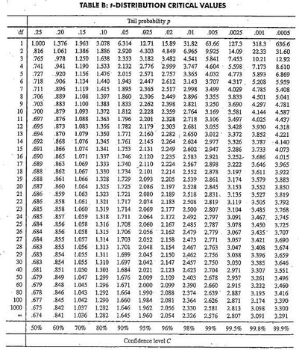
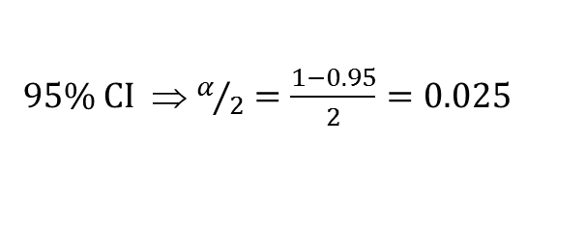

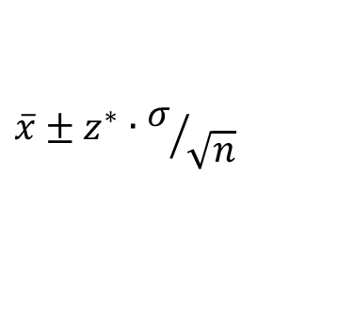

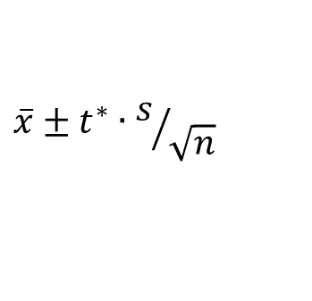
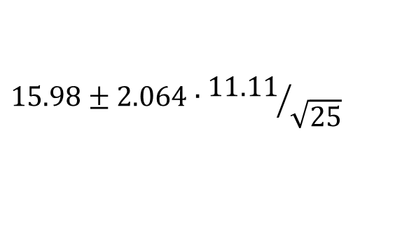

Traditional Inference
1. Check conditions
CI for a mean
2. Which formula?
$$\overline{x}±z^{∗}∙σ/{\sqrt{n}}$$
OR
$$\overline{x}±t^{∗}∙s/{\sqrt{n}}$$
3. Calculate summary stats
$n=25, \overline{x}=15.98$, $s=11.11$
4. Find t*
5. df?
95% CI ⇒ $α/2=\frac{1−0.95}{2}=0.025$
df=25$−$1=24
t*=2.064
6. Plug and chug
$$15.98±2.064∙{11.11}/{\sqrt{25}}$$
$$15.98±4.59=(11.39, 20.57)$$
7. Interpret in context

Slide 16
“We are 95% confident that the mean price of all used Mustang cars is between $11,390 and $20,570.”
We arrive at a good answer, but the process is not very helpful at building understanding of the key ideas.
In addition, our students are often great visual learners but some get nervous about formulas and algebra. Can we find a way to use their visual intuition?

Slide 17
Bootstrapping
“Let your data be your guide.”
Assume the “population” is many, many copies of the original sample.

Slide 18
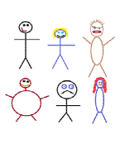
Suppose we have a random sample of 6 people:
Notes:
Patti

Slide 19
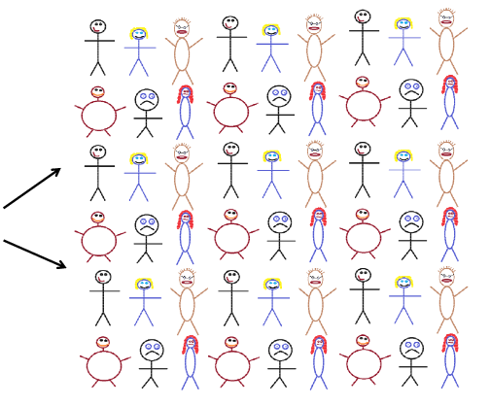
Original Sample
A simulated “population” to sample from
Notes:
Patti

Slide 20




Bootstrap Sample: Sample with replacement from the original sample, using the same sample size.
Original Sample
Bootstrap Sample
Notes:
Patti

Slide 21
How would we take a bootstrap sample from one Reese’s Pieces bag?

Slide 22
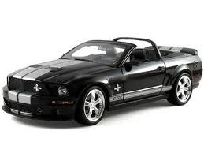
Original Sample
Bootstrap Sample

Slide 23
BootstrapSample
Bootstrap Statistic
BootstrapSample
Bootstrap Statistic
Original Sample
Bootstrap Distribution
●
●
●
●
●
●
Sample Statistic
BootstrapSample
Bootstrap Statistic

Slide 24
We need technology!
StatKey
www.lock5stat.com
Notes:
Patti

Slide 25
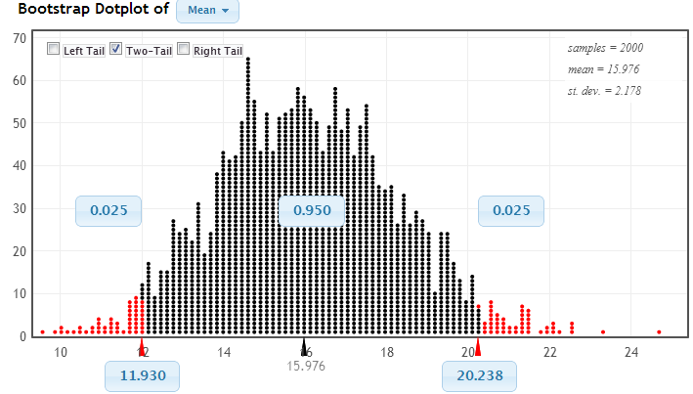
Using the Bootstrap Distribution to Get a 95% Confidence Interval
Chop 2.5% in each tail
Keep 95% in middle
Chop 2.5% in each tail
We are 95% sure that the mean price for Mustangs is between $11,930 and $20,238

Slide 26
Example 2: Let’s collect some data from you. What yes/no question shall we ask you?
We will use you as a sample to estimate the proportion of all secondary math teachers in southern California that would say yes to this question.
Notes:
Have you ever taken a statistics course?

Slide 27
Why
does the bootstrap work?

Slide 28
Sampling Distribution
Population
BUT, in practice we don’t see the “tree” or all of the “seeds” – we only have ONE seed
µ

Slide 29
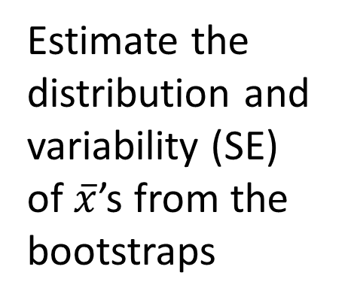

Bootstrap Distribution
What can we do with just one seed?
Bootstrap
“Population”
Estimate the distribution and variability (SE) of $\overline{x}$’s from the bootstraps
Grow a NEW tree!
$$\overline{x}$$
µ

Slide 30
Example 3: Diet Cola and Calcium
What is the difference in mean amount of calcium excreted between people who drink diet cola and people who drink water?
Find a 95% confidence interval for the difference in means.

Slide 31
Example 3: Diet Cola and Calcium
www.lock5stat.com
Statkey
Select “CI for Difference in Means”
Use the menu at the top left to find the correct dataset.
Check out the sample: what are the sample sizes? Which group
excretes more in the sample?
Generate one bootstrap statistic. Compare it to the original.
Generate a full bootstrap distribution (1000 or more).
Use the “two-tailed” option to find a 95% confidence interval for
the difference in means.
What is your interval? Compare it with your neighbors.
Is zero (no difference) in the interval? (If not, we can be confident that there is a difference.)

Slide 32
What About Hypothesis Tests?

Slide 33
P-value: The probability of seeing results as extreme as, or more extreme than, the sample results, if the null hypothesis is true.
Say what????

Slide 34
Example 1: Beer and Mosquitoes
Does consuming beer attract mosquitoes?
Experiment:
25 volunteers drank a liter of beer,
18 volunteers drank a liter of water
Randomly assigned!
Mosquitoes were caught in traps as they approached the volunteers.¹
¹ Lefvre, T., et. al., “Beer Consumption Increases Human Attractiveness to Malaria Mosquitoes, ” PLoS ONE, 2010; 5(3): e9546.

Slide 35
Beer and Mosquitoes
Number of Mosquitoes
Beer Water
27 21
20 22
21 15
26 12
27 21
31 16
24 19
19 15
23 24
24 19
28 23
19 13
24 22
29 20
20 24
17 18
31 20
20 22
25
28
21
27
21
18
20
Does drinking beer actually attract mosquitoes, or is the difference just due to random chance?
Beer mean = 23.6
Water mean
= 19.22
Beer mean – Water mean = 4.38

Slide 36
Traditional Inference
1. Check conditions
2. Which formula?
5. Which theoretical distribution?
6. df?
7. find p-value
3. Calculate numbers and plug into formula
4. Plug into calculator
0.0005 < p-value < 0.001

Slide 37
Simulation Approach
Number of Mosquitoes
Beer Water
27 21
20 22
21 15
26 12
27 21
31 16
24 19
19 15
23 24
24 19
28 23
19 13
24 22
29 20
20 24
17 18
31 20
20 22
25
28
21
27
21
18
20
Does drinking beer actually attract mosquitoes, or is the difference just due to random chance?
Beer mean = 23.6
Water mean
= 19.22
Beer mean – Water mean = 4.38

Slide 38
Simulation Approach
Number of Mosquitoes
Beer Water
27 21
20 22
21 15
26 12
27 21
31 16
24 19
19 15
23 24
24 19
28 23
19 13
24 22
29 20
20 24
17 18
31 20
20 22
25
28
21
27
21
18
20
Number of Mosquitoes
Beverage
27 21
20 22
21 15
26 12
27 21
31 16
24 19
19 15
23 24
24 19
28 23
19 13
24 22
29 20
20 24
17 18
31 20
20 22
25
28
21
27
21
18
20
Find out how extreme these results would be, if there were no difference between beer and water.
What kinds of results would we see, just by random chance?

Slide 39
Simulation Approach
Beer Water
Number of Mosquitoes
Beverage
20 22
21 15
26 12
27 21
31 16
24 19
19 15
23 24
24 19
28 23
19 13
24 22
29 20
20 24
17 18
31 20
20 22
25
28
21
27
21
18
20
Find out how extreme these results would be, if there were no difference between beer and water.
What kinds of results would we see, just by random chance?
27
21
21
27
24
19
23
24
31
13
18
24
25
21
18
12
19
18
28
22
19
27
20
23
22
20
26
31
19
23
15
22
12
24
29
20
27
29
17
25
20
28

Slide 40
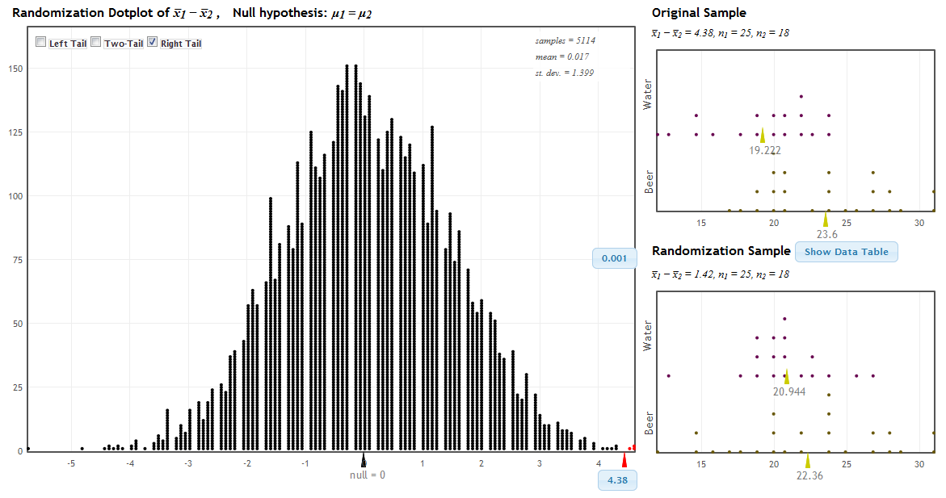
StatKey!
www.lock5stat.com
P-value

Slide 41
Traditional Inference
1. Which formula?
4. Which theoretical distribution?
5. df?
6. find p-value
2. Calculate numbers and plug into formula
3. Plug into calculator
0.0005 < p-value < 0.001

Slide 42
Beer and Mosquitoes
The Conclusion!
The results seen in the experiment are very unlikely to happen just by random chance (just 1 out of 1000!)
We have strong evidence that drinking beer does attract mosquitoes!

Slide 43
“Randomization” Samples
Key idea: Generate samples that are
based on the original sample
AND
consistent with some null hypothesis.

Slide 44
Example 2: Cocaine Addiction
In a randomized experiment on treating cocaine addiction, 48 people were randomly assigned to take either Desipramine (a new drug), or Lithium (an existing drug)
The outcome variable is whether or not a patient relapsed
Is Desipramine significantly better than Lithium at treating cocaine addiction?
Notes:
Bozz

Slide 45
R
R
R
R
R
R
R
R
R
R
R
R
R
R
R
R
R
R
R
R
R
R
R
R
R
R
R
R
R
R
R
R
R
R
R
R
R
R
R
R
R
R
R
R
R
R
R
R
1. Randomly assign units to treatment groups
Desipramine
Lithium
R
R
R
R
R
R
R
R
R
R
R
R
R
R
R
R
R
R
R
R
R
R
R
R
R
R
R
R
R
R
R
R
R
R
R
R
R
R
R
R
R
R
R
R
Notes:
Bozz

Slide 46
2. Conduct experiment
3. Observe relapse counts in each group
R = Relapse
N = No Relapse
1. Randomly assign units to treatment groups
Desipramine
Lithium
R
R
R
R
R
R
R
R
R
R
R
R
R
R
R
R
R
R
R
R
R
R
R
R
R
R
R
R
R
R
R
R
N
R
N
R
R
R
R
R
R
R
R
R
R
R
R
R
N
R
N
R
N
N
N
N
N
N
N
N
R
R
R
R
R
R
R
R
R
R
R
R
N
N
N
N
N
N
N
N
N
N
N
N
N
N
N
N
N
N
N
N
N
N
N
N
10 relapse, 14 no relapse
18 relapse, 6 no relapse
Notes:
Bozz

Slide 47
R
R
R
R
R
R
R
R
R
R
R
R
R
R
R
R
N
N
R
R
R
R
R
R
N
N
N
N
N
N
R
R
R
R
R
R
N
N
N
N
N
N
N
N
N
N
N
N
10 relapse, 14 no relapse
18 relapse, 6 no relapse
Notes:
Bozz

Slide 48
R
R
R
R
R
R
R
R
R
R
R
R
R
R
R
R
N
N
R
R
R
R
R
R
N
N
N
N
N
N
R
R
R
R
R
R
N
N
N
N
N
N
N
N
N
N
N
N
Simulate another randomization
Desipramine
Lithium
R
N
R
N
N
N
N
R
R
R
R
R
R
R
N
R
R
N
N
N
R
N
R
R
R
N
N
R
N
R
R
N
R
N
N
N
R
R
R
N
R
R
R
R
16 relapse, 8 no relapse
12 relapse, 12 no relapse
Notes:
Bozz

Slide 49
Simulate another randomization
Desipramine
Lithium
R
R
R
R
R
R
R
R
R
R
R
R
R
N
R
R
N
N
R
R
R
R
R
R
R
R
N
R
N
R
R
R
R
R
R
R
R
N
R
N
R
R
N
N
N
N
N
N
17 relapse, 7 no relapse
11 relapse, 13 no relapse
Notes:
Bozz

Slide 50
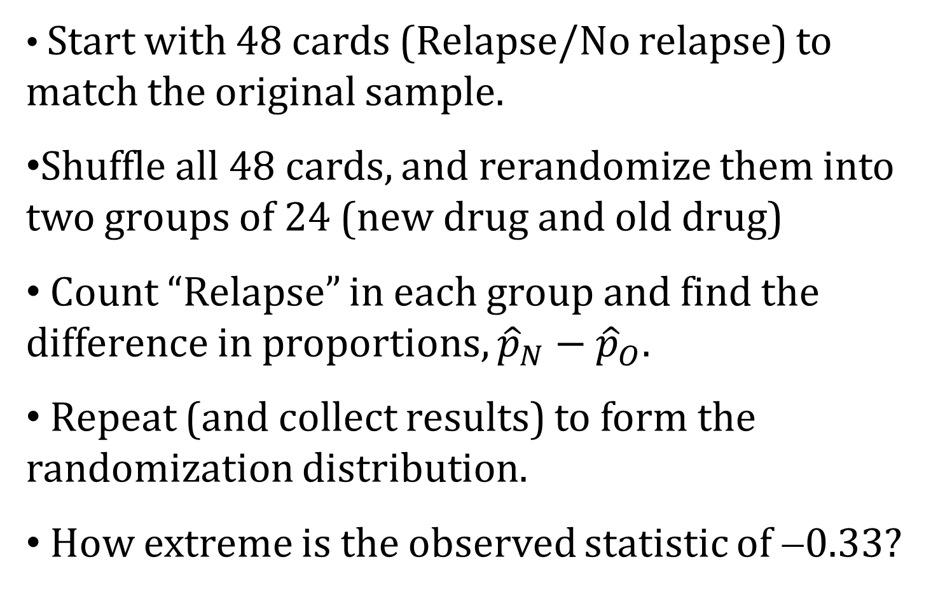
Physical Simulation
Start with 48 cards (Relapse/No relapse) to match the original sample.
Shuffle all 48 cards, and rerandomize them into two groups of 24 (new drug and old drug)
Count “Relapse” in each group and find the difference in proportions, ${\hat{p}}_{N}−{\hat{p}}_{O}$.
Repeat (and collect results) to form the randomization distribution.
How extreme is the observed statistic of −0.33?

Slide 51
Example 3: Malevolent Uniforms
Do sports teams with more “malevolent” uniforms get penalized more often?

Slide 52
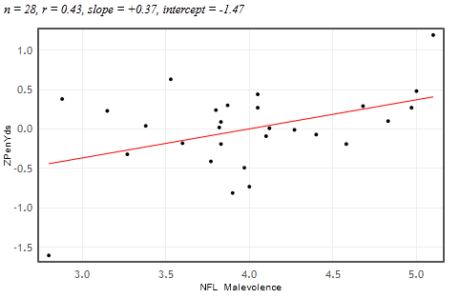


Example 3: Malevolent Uniforms
Sample Correlation
= 0.43
Do teams with more malevolent uniforms commit more penalties, or is the relationship just due to random chance?

Slide 53
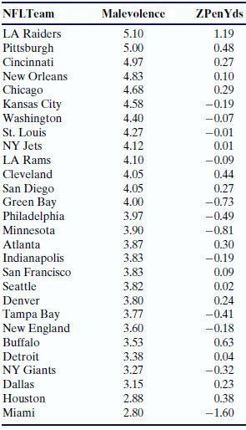
Simulation Approach
Sample Correlation = 0.43
Find out how extreme this correlation would be, if there is no relationship between uniform malevolence and penalties.
What kinds of results would we see, just by random chance?

Slide 54
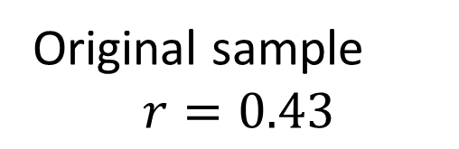
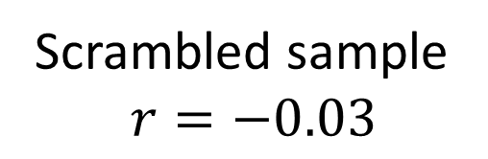
Randomization by Scrambling
Original sample
$$r=0.43$$
Scrambled sample
$$r=−0.03$$

Slide 55
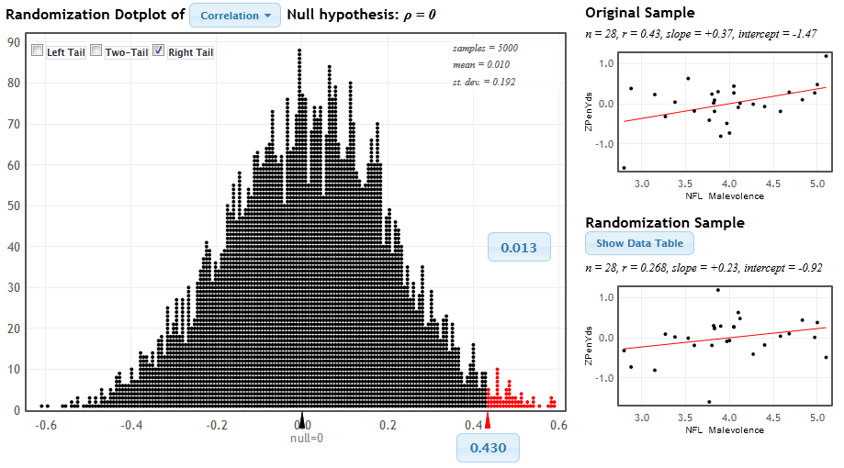
StatKey
www.lock5stat.com/statkey
P-value

Slide 56
Malevolent Uniforms
The Conclusion!
The results seen in the study are unlikely to happen just by random chance (just about 1 out of 100).
We have some evidence that teams with more malevolent uniforms get more penalties.

Slide 57
P-value: The probability of seeing results as extreme as, or more extreme than, the sample results, if the null hypothesis is true.
Yeah – that makes sense!

Slide 58
Example 4:
Light at Night and Weight Gain
Does leaving a light on at night affect weight gain? In particular, do mice with a light on at night gain more weight than mice with a normal light/dark cycle?
Find the p-value and use it to make a conclusion.

Slide 59
Example 4:
Light at Night and Weight Gain
www.lock5stat.com
Statkey
Select “Test for Difference in Means”
Use the menu at the top left to find the correct dataset (Fat Mice).
Check out the sample: what are the sample sizes? Which group
gains more weight? (LL = light at night, LD = normal light/dark)
Generate one randomization statistic. Compare it to the original.
Generate a full randomization (1000 or more).
Use the “right-tailed” option to find the p-value.
What is your p-value? Compare it with your neighbors.
Is the sample difference of 5 likely to be just by random chance?
What can we conclude about light at night and weight gain?

Slide 60
Simulation Methods
These randomization-based methods tie directly to the key ideas of statistics.
They are ideal for building conceptual understanding of the key ideas.
Students are very visual learners and really appreciate the visual nature of these methods.
Not only are these methods great for teaching statistics, but they are increasingly being used for doing statistics.

Slide 61
How does everything fit together?
We use these methods to build understanding of the key ideas.
We then cover traditional normal and t-tests as “short-cut formulas”.
Students continue to see all the standard methods but with a deeper understanding of the meaning.

Slide 62
It is the way of the past…
"Actually, the statistician does not carry out this very simple and very tedious process, but his conclusions have no justification beyond the fact that they agree with those which could have been arrived at by this elementary method."
-- Sir R. A. Fisher, 1936

Slide 63
… and the way of the future
“... the consensus curriculum is still an unwitting prisoner of history. What we teach is largely the technical machinery of numerical approximations based on the normal distribution and its many subsidiary cogs. This machinery was once necessary, because the conceptually simpler alternative based on permutations was computationally beyond our reach. Before computers statisticians had no choice. These days we have no excuse. Randomization-based inference makes a direct connection between data production and the logic of inference that deserves to be at the core of every introductory course.”
-- Professor George Cobb, 2007

Slide 64
Additional Resources
www.lock5stat.com
Statkey
Descriptive Statistics
Sampling Distributions (Reese’s Pieces!)
Normal and t-Distributions

Slide 65
Thanks for joining me!
plock@stlawu.edu
www.lock5stat.com

