Slide 1
Building Conceptual Understanding of Statistical Inference
Patti Frazer Lock
Cummings Professor of Mathematics
St. Lawrence University
plock@stlawu.edu
Glendale Community College
January 2013

Slide 2
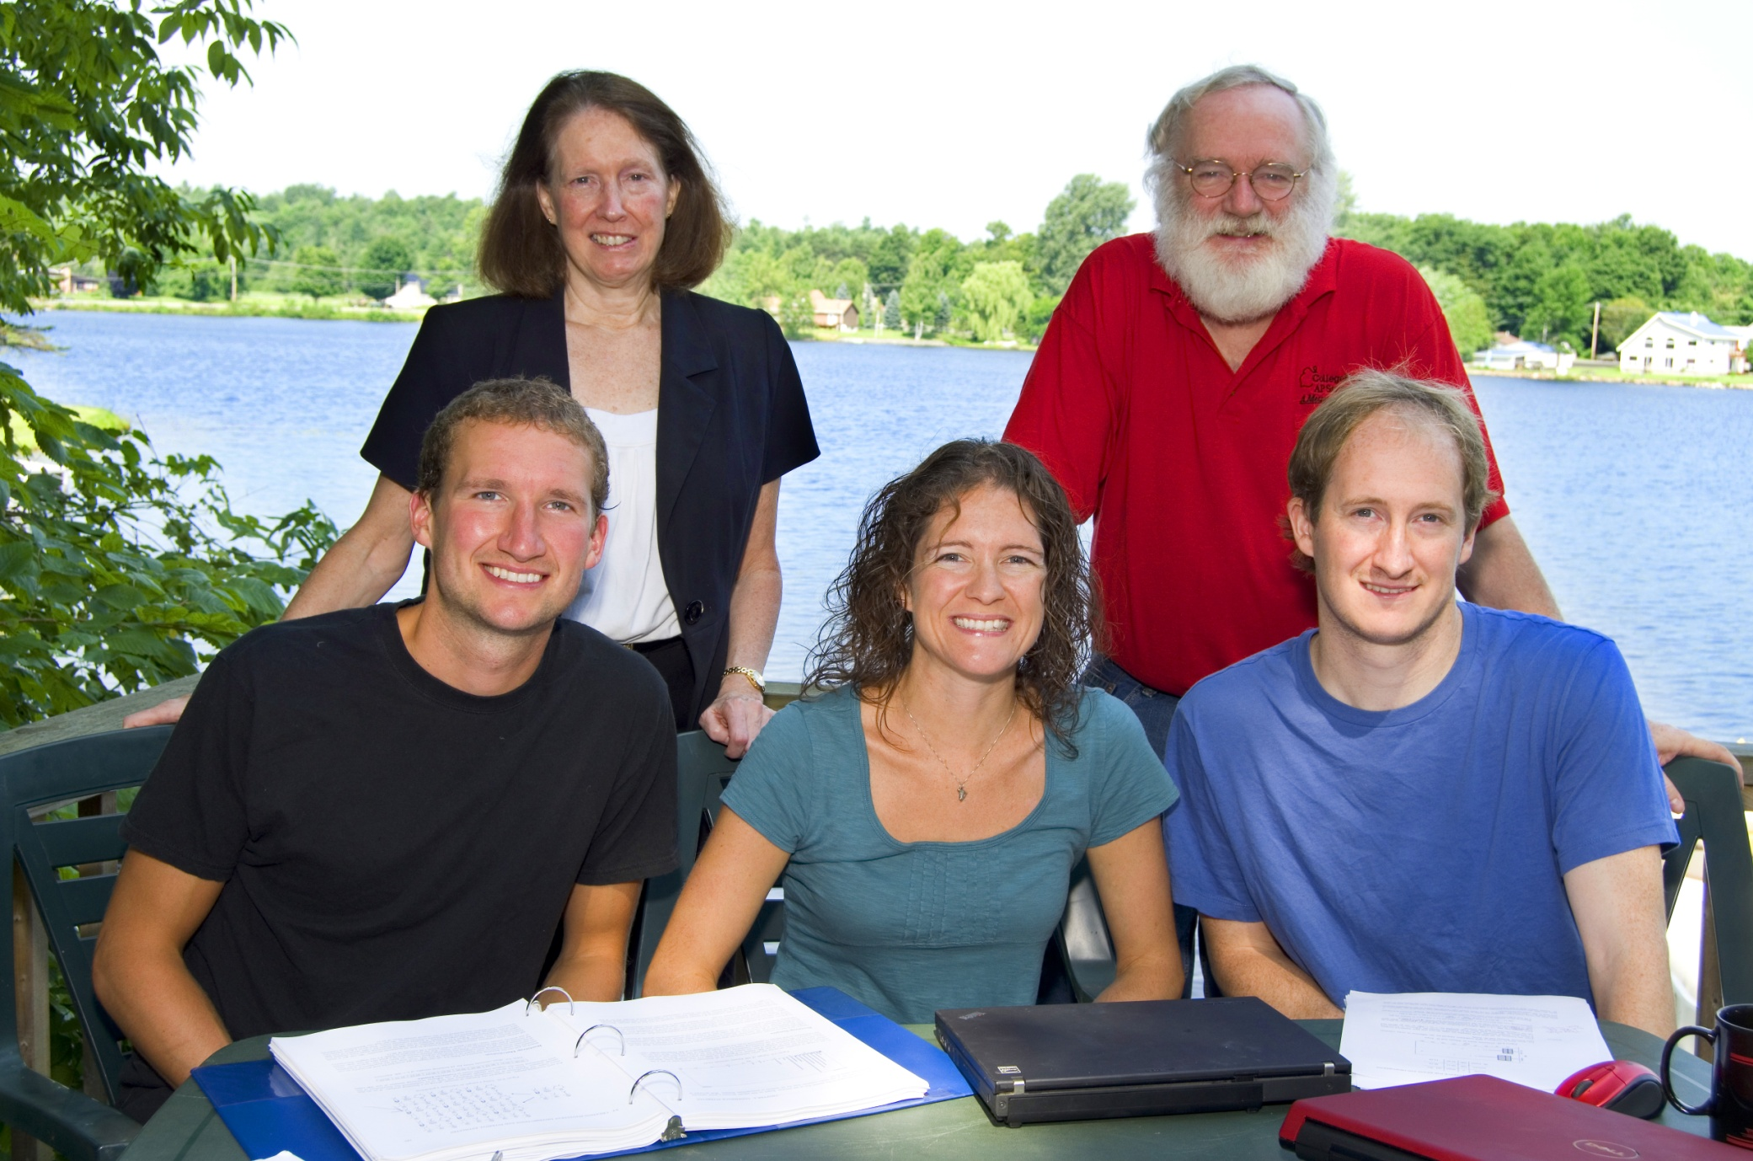
The Lock⁵ Team
Robin & Patti
St. Lawrence
Dennis
Iowa State
Kari
Harvard/Duke
Eric
UNC/Duke

Slide 3
New Simulation Methods
“The Next Big Thing”
United States Conference on Teaching Statistics, May 2011
Common Core State Standards in Mathematics
Increasingly used in the disciplines

Slide 4
New Simulation Methods
Increasingly important in DOING statistics
Outstanding for use in TEACHING statistics
Help students understand the key ideas of statistical inference

Slide 5
“New” Simulation Methods?
"Actually, the statistician does not carry out this very simple and very tedious process, but his conclusions have no justification beyond the fact that they agree with those which could have been arrived at by this
elementary method."
-- Sir R. A. Fisher, 1936

Slide 6
Bootstrap Confidence Intervals
and
Randomization Hypothesis Tests

Slide 7
First:
Bootstrap Confidence Intervals

Slide 8
Example 1: What is the average price of a used Mustang car?
Select a random sample of n=25 Mustangs from a website (autotrader.com) and record the price (in $1,000’s) for each car.

Slide 9
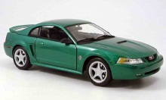
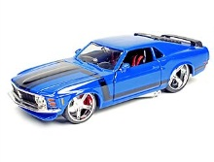
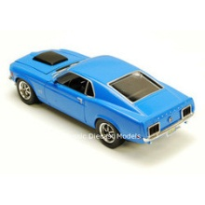
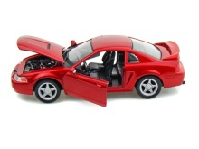
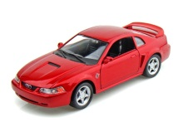
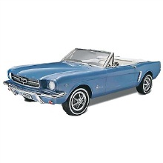
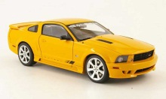
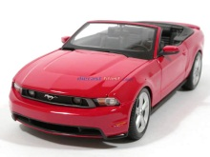
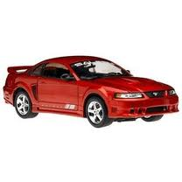
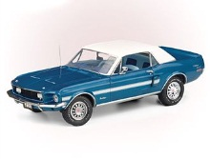
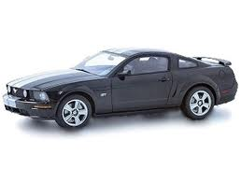
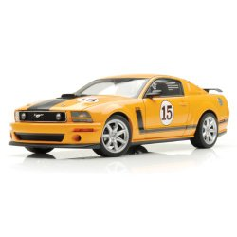
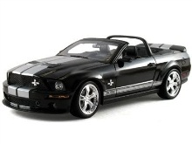
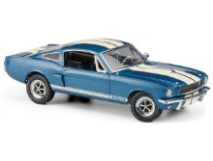
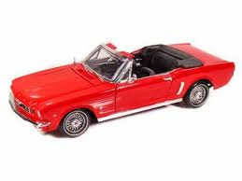
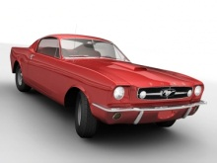
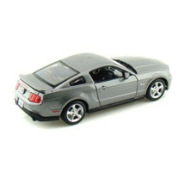
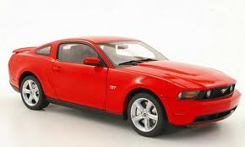
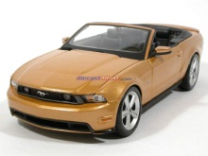
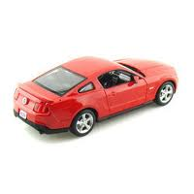
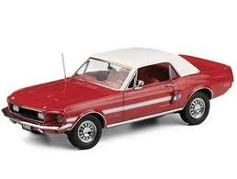
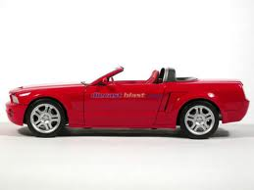
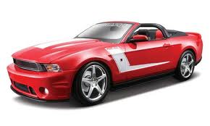
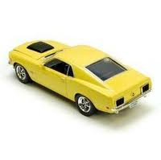
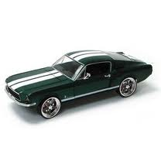

Sample of Mustangs:
$$n=25 \overline{x}=15.98 s=11.11$$
Our best estimate for the average price of used Mustangs is $15,980, but how accurate is that estimate?

Slide 10
Our best estimate for the average price of used Mustangs is $15,980, but how accurate is that estimate?
We would like some kind of margin of error or a confidence interval.
Key concept: How much can we expect the sample means to vary just by random chance?

Slide 11
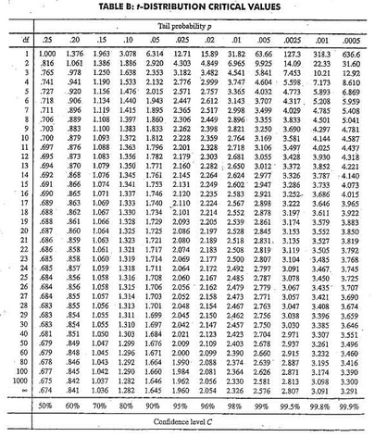
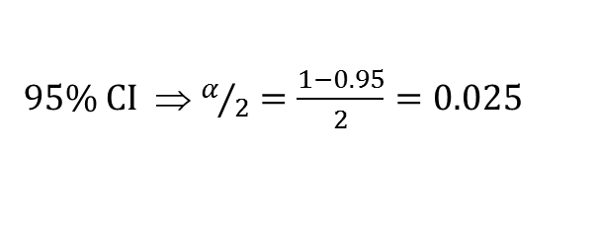

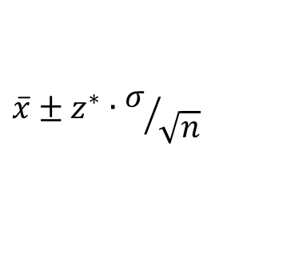

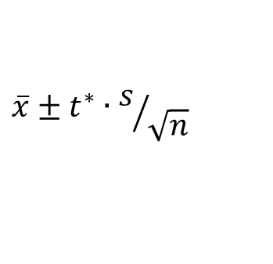
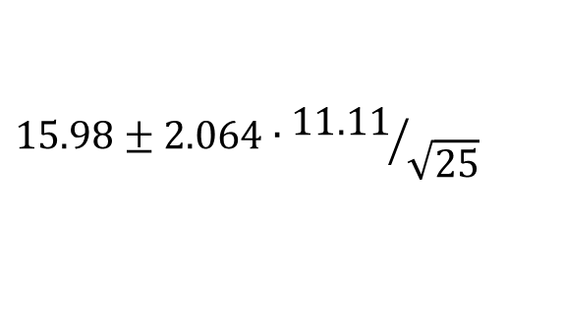

Traditional Inference
1. Check conditions
CI for a mean
2. Which formula?
$$\overline{x}±z^{∗}∙σ/{\sqrt{n}}$$
OR
$$\overline{x}±t^{∗}∙s/{\sqrt{n}}$$
3. Calculate summary stats
$n=25, \overline{x}=15.98$, $s=11.11$
4. Find t*
5. df?
95% CI ⇒ $α/2=\frac{1−0.95}{2}=0.025$
df=25$−$1=24
t*=2.064
6. Plug and chug
$$15.98±2.064∙{11.11}/{\sqrt{25}}$$
$$15.98±4.59=(11.39, 20.57)$$
7. Interpret in context

Slide 12
“We are 95% confident that the mean price of all used Mustang cars is between $11,390 and $20,570.”
We arrive at a good answer, but the process is not very helpful at building understanding of the key ideas.
In addition, our students are often great visual learners but get nervous about formulas and algebra. Can we find a way to use their visual intuition?

Slide 13
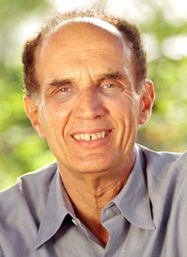
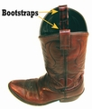
Bootstrapping
Brad Efron Stanford University
“Let your data be your guide.”
Assume the “population” is many, many copies of the original sample.
Key idea: To see how a statistic behaves, we take many samples with replacement from the original sample using the same n.

Slide 14
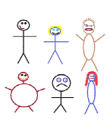
Suppose we have a random sample of 6 people:
Notes:
Patti

Slide 15
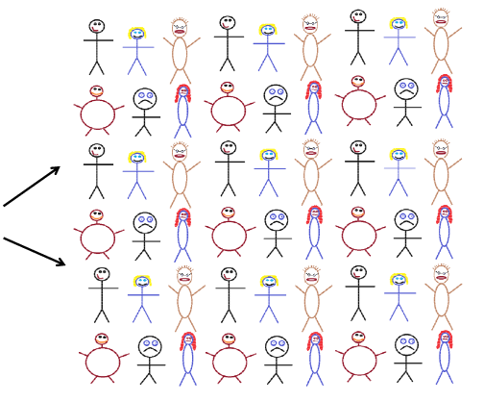
Original Sample
A simulated “population” to sample from
Notes:
Patti

Slide 16




Bootstrap Sample: Sample with replacement from the original sample, using the same sample size.
Original Sample
Bootstrap Sample
Notes:
Patti

Slide 17
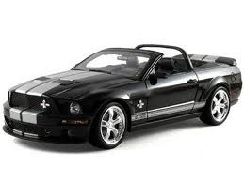
Original Sample
Bootstrap Sample

Slide 18
BootstrapSample
Bootstrap Statistic
BootstrapSample
Bootstrap Statistic
Original Sample
Bootstrap Distribution
●
●
●
●
●
●
Sample Statistic
BootstrapSample
Bootstrap Statistic

Slide 19
We need technology!
StatKey
www.lock5stat.com
Notes:
Patti

Slide 20
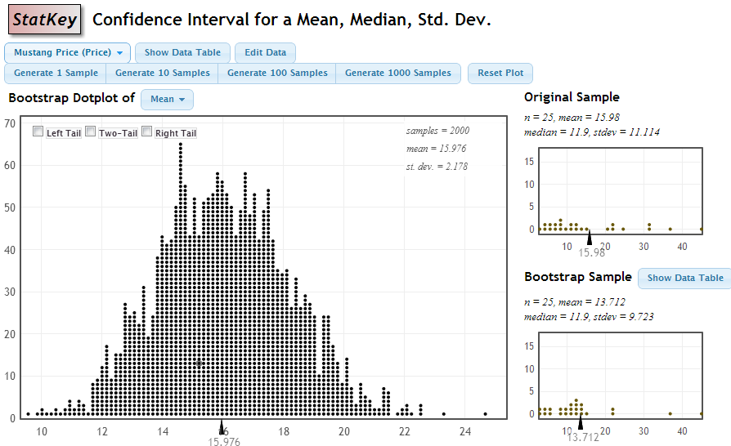

StatKey
Standard Error
$$\frac{s}{\sqrt{n}}=\frac{11.11}{\sqrt{25}}=2.2$$

Slide 21
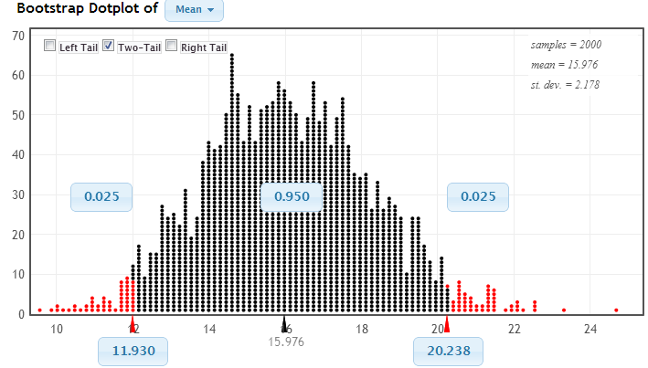
Using the Bootstrap Distribution to Get a Confidence Interval
Chop 2.5% in each tail
Keep 95% in middle
Chop 2.5% in each tail
We are 95% sure that the mean price for Mustangs is between $11,930 and $20,238

Slide 22
Example 2: Collect data from you.
What is the length of your commute to work, in minutes?

Slide 23
Example 3: Collect data from you.
Did you teach intro stats at GCC this past Fall semester?

Slide 24
Why
does the bootstrap work?

Slide 25
Sampling Distribution
Population
BUT, in practice we don’t see the “tree” or all of the “seeds” – we only have ONE seed
µ

Slide 26
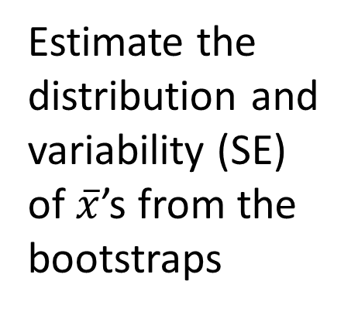

Bootstrap Distribution
What can we do with just one seed?
Bootstrap
“Population”
Estimate the distribution and variability (SE) of $\overline{x}$’s from the bootstraps
Grow a NEW tree!
$$\overline{x}$$
µ

Slide 27
Golden Rule of Bootstraps
The bootstrap statistics are to the original statistic
as
the original statistic is to the population parameter.

Slide 28
Example 4: Diet Cola and Calcium
What is the difference in mean amount of calcium excreted between people who drink diet cola and people who drink water?
Find a 95% confidence interval for the difference in means.
To connect, use AIMS with password
AIMS3700

Slide 29
Example 4: Diet Cola and Calcium
www.lock5stat.com
Statkey
Select “CI for Difference in Means”
Use the menu at the top left to find the correct dataset.
Check out the sample: what are the sample sizes? Which group
excretes more in the sample?
Generate one bootstrap statistic. Compare it to the original.
Generate a full bootstrap distribution (1000 or more).
Use the “two-tailed” option to find a 95% confidence interval for
the difference in means.
What is your interval? Compare it with your neighbors.
Is zero (no difference) in the interval? (If not, we can be confident that there is a difference.)

Slide 30
What About Hypothesis Tests?

Slide 31
P-value: The probability of seeing results as extreme as, or more extreme than, the sample results, if the null hypothesis is true.
Say what????

Slide 32
Example 1: Beer and Mosquitoes
Does consuming beer attract mosquitoes?
Experiment:
25 volunteers drank a liter of beer,
18 volunteers drank a liter of water
Randomly assigned!
Mosquitoes were caught in traps as they approached the volunteers.¹
¹ Lefvre, T., et. al., “Beer Consumption Increases Human Attractiveness to Malaria Mosquitoes, ” PLoS ONE, 2010; 5(3): e9546.

Slide 33
Beer and Mosquitoes
Number of Mosquitoes
Beer Water
27 21
20 22
21 15
26 12
27 21
31 16
24 19
19 15
23 24
24 19
28 23
19 13
24 22
29 20
20 24
17 18
31 20
20 22
25
28
21
27
21
18
20
Does drinking beer actually attract mosquitoes, or is the difference just due to random chance?
Beer mean = 23.6
Water mean
= 19.22
Beer mean – Water mean = 4.38

Slide 34
Traditional Inference
1. Check conditions
2. Which formula?
5. Which theoretical distribution?
6. df?
7. find p-value
3. Calculate numbers and plug into formula
4. Plug into calculator
0.0005 < p-value < 0.001

Slide 35
Simulation Approach
Number of Mosquitoes
Beer Water
27 21
20 22
21 15
26 12
27 21
31 16
24 19
19 15
23 24
24 19
28 23
19 13
24 22
29 20
20 24
17 18
31 20
20 22
25
28
21
27
21
18
20
Does drinking beer actually attract mosquitoes, or is the difference just due to random chance?
Beer mean = 23.6
Water mean
= 19.22
Beer mean – Water mean = 4.38

Slide 36
Simulation Approach
Number of Mosquitoes
Beer Water
27 21
20 22
21 15
26 12
27 21
31 16
24 19
19 15
23 24
24 19
28 23
19 13
24 22
29 20
20 24
17 18
31 20
20 22
25
28
21
27
21
18
20
Number of Mosquitoes
Beverage
27 21
20 22
21 15
26 12
27 21
31 16
24 19
19 15
23 24
24 19
28 23
19 13
24 22
29 20
20 24
17 18
31 20
20 22
25
28
21
27
21
18
20
Find out how extreme these results would be, if there were no difference between beer and water.
What kinds of results would we see, just by random chance?

Slide 37
Simulation Approach
Beer Water
Number of Mosquitoes
Beverage
20 22
21 15
26 12
27 21
31 16
24 19
19 15
23 24
24 19
28 23
19 13
24 22
29 20
20 24
17 18
31 20
20 22
25
28
21
27
21
18
20
Find out how extreme these results would be, if there were no difference between beer and water.
What kinds of results would we see, just by random chance?
27
21
21
27
24
19
23
24
31
13
18
24
25
21
18
12
19
18
28
22
19
27
20
23
22
20
26
31
19
23
15
22
12
24
29
20
27
29
17
25
20
28

Slide 38
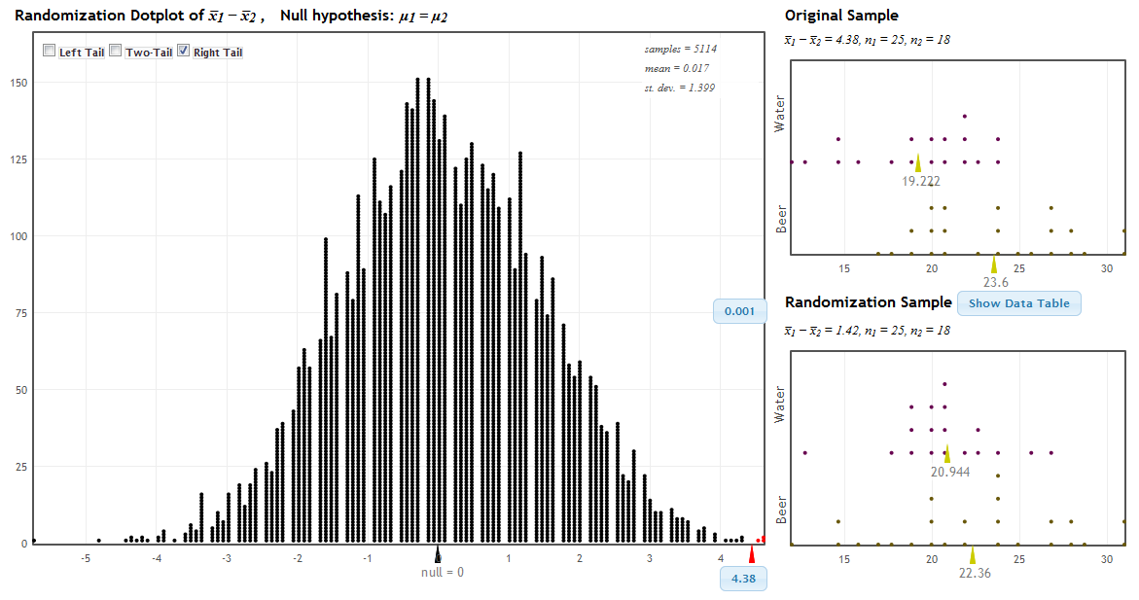
StatKey!
www.lock5stat.com
P-value

Slide 39
Traditional Inference
1. Which formula?
4. Which theoretical distribution?
5. df?
6. find p-value
2. Calculate numbers and plug into formula
3. Plug into calculator
0.0005 < p-value < 0.001

Slide 40
Beer and Mosquitoes
The Conclusion!
The results seen in the experiment are very unlikely to happen just by random chance (just 1 out of 1000!)
We have strong evidence that drinking beer does attract mosquitoes!

Slide 41
“Randomization” Samples
Key idea: Generate samples that are
based on the original sample
AND
consistent with some null hypothesis.

Slide 42
Example 2: Malevolent Uniforms
Do sports teams with more “malevolent” uniforms get penalized more often?

Slide 43
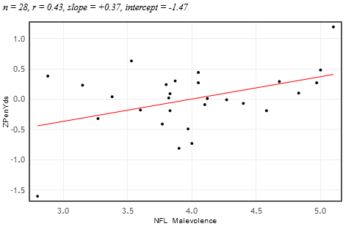


Example 2: Malevolent Uniforms
Sample Correlation
= 0.43
Do teams with more malevolent uniforms commit more penalties, or is the relationship just due to random chance?

Slide 44
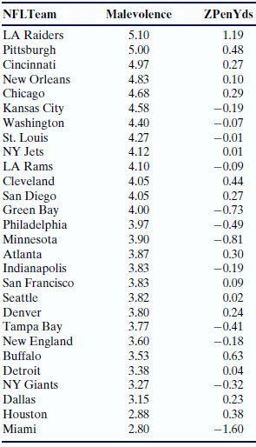
Simulation Approach
Sample Correlation = 0.43
Find out how extreme this correlation would be, if there is no relationship between uniform malevolence and penalties.
What kinds of results would we see, just by random chance?

Slide 45
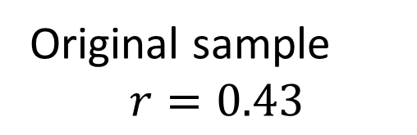
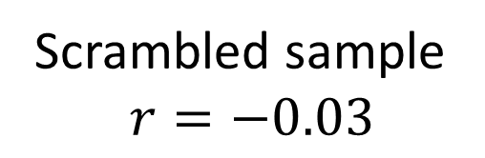
Randomization by Scrambling
Original sample
$$r=0.43$$
Scrambled sample
$$r=−0.03$$

Slide 46
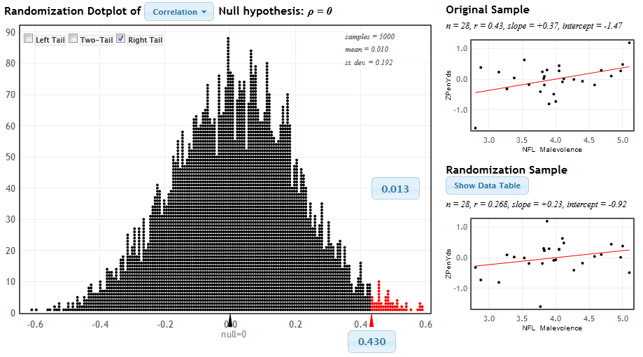
StatKey
www.lock5stat.com/statkey
P-value

Slide 47
Malevolent Uniforms
The Conclusion!
The results seen in the study are unlikely to happen just by random chance (just about 1 out of 100).
We have some evidence that teams with more malevolent uniforms get more penalties.

Slide 48
P-value: The probability of seeing results as extreme as, or more extreme than, the sample results, if the null hypothesis is true.
Yeah – that makes sense!

Slide 49
Example 3:
Light at Night and Weight Gain
Does leaving a light on at night affect weight gain? In particular, do mice with a light on at night gain more weight than mice with a normal light/dark cycle?
Find the p-value and use it to make a conclusion.

Slide 50
Example 3:
Light at Night and Weight Gain
www.lock5stat.com
Statkey
Select “Test for Difference in Means”
Use the menu at the top left to find the correct dataset (Fat Mice).
Check out the sample: what are the sample sizes? Which group
gains more weight? (LL = light at night, LD = normal light/dark)
Generate one randomization statistic. Compare it to the original.
Generate a full randomization (1000 or more).
Use the “right-tailed” option to find the p-value.
What is your p-value? Compare it with your neighbors.
Is the sample difference of 5 likely to be just by random chance?
What can we conclude about light at night and weight gain?

Slide 51
Simulation Methods
These randomization-based methods tie directly to the key ideas of statistical inference.
They are ideal for building conceptual understanding of the key ideas.
Not only are these methods great for teaching statistics, but they are increasingly being used for doing statistics.

Slide 52
How does everything fit together?
We use these methods to build understanding of the key ideas.
We then cover traditional normal and t-tests as “short-cut formulas”.
Students continue to see all the standard methods but with a deeper understanding of the meaning.

Slide 53
Intro Stat – Revise the Topics
Descriptive Statistics – one and two samples
Descriptive Statistics – one and two samples
Normal distributions
Bootstrap confidence intervals
Bootstrap confidence intervals
Data production (samples/experiments)
Data production (samples/experiments)
Randomization-based hypothesis tests
Randomization-based hypothesis tests
Sampling distributions (mean/proportion)
Normal distributions
Confidence intervals (means/proportions)
Hypothesis tests (means/proportions)
Probability OR ANOVA for several means, Inference for regression, Chi-square tests
Notes:
Bozz

Slide 54
It is the way of the past…
"Actually, the statistician does not carry out this very simple and very tedious process, but his conclusions have no justification beyond the fact that they agree with those which could have been arrived at by this elementary method."
-- Sir R. A. Fisher, 1936

Slide 55
… and the way of the future
“... the consensus curriculum is still an unwitting prisoner of history. What we teach is largely the technical machinery of numerical approximations based on the normal distribution and its many subsidiary cogs. This machinery was once necessary, because the conceptually simpler alternative based on permutations was computationally beyond our reach. Before computers statisticians had no choice. These days we have no excuse. Randomization-based inference makes a direct connection between data production and the logic of inference that deserves to be at the core of every introductory course.”
-- Professor George Cobb, 2007

Slide 56
Additional Resources
www.lock5stat.com
Statkey
Descriptive Statistics
Sampling Distributions
Normal and t-Distributions

Slide 57
Thanks for joining me!
plock@stlawu.edu
www.lock5stat.com

