Slide 1
Introducing Inference with Bootstrapping and Randomization
Kari Lock Morgan
Department of Statistical Science, Duke University
kari@stat.duke.edu
with Robin Lock, Patti Frazer Lock, Eric Lock, Dennis Lock
ECOTS
5/16/12

Slide 2
Traditional Methods
Hypothesis Testing:
  Use a formula to calculate a test statistic
  This follows a known distribution if the null hypothesis is true (under some conditions)
  Use a table or software to find the area in the tail of this theoretical distribution

Slide 3
Traditional Methods
Plugging numbers into formulas and relying on deep theory from mathematical statistics does little for conceptual understanding
With a different formula for each situation, students can get mired in the details and fail to see the big picture

Slide 4
Simulation Approach
Hypothesis Testing:
  Decide on a statistic of interest
  Simulate randomizations, assuming the null hypothesis is true
  Calculate the statistic of interest for each simulated randomization
  Find the proportion of simulated statistics as extreme or more extreme than the observed statistic

Slide 5
Simulation Methods
Intrinsically connected to concepts
Same procedure applies to all statistics
No conditions to check
Minimal background knowledge needed

Slide 6
Simulation and Traditional?
Simulation methods good for motivating conceptual understanding of inference
However, familiarity with traditional methods (t-test) is still expected after intro stat
Use simulation methods to introduce inference, and then teach the traditional methods as “short-cut formulas”

Slide 7
Topics
Introduction to Data
  Collecting data
  Describing data
Introduction to Inference
  Confidence intervals (bootstrap)
  Hypothesis tests (randomization)
Normal and t-based methods
  Normal distribution
  Inference for means and proportions
ANOVA, Chi-Square, Regression

Slide 8
Mind-set Matters
In 2007, Dr. Ellen Langer tested her hypothesis that “mind-set matters”
She recruited 84 hotel maids and randomly assigned half to a treatment and half to control
The “treatment” was informing them that their work satisfies recommendations for an active lifestyle
After 8 weeks, the informed group had lost 1.59 more pounds, on average, than the control group
Is this difference statistically significant?
Crum, A.J. and Langer, E.J. (2007). “Mind-Set Matters: Exercise and the Placebo Effect,” Psychological Science, 18:165-171.

Slide 9
Randomization Test on StatKey
www.lock5stat.com/statkey
Test for difference in means
Choose “Weight Change vs Informed” from “Custom Dataset” drop down menu (upper right)
Generate randomization samples by clicking “Generate 1000 Samples” a few times
Click the box next to “Right tail” to pull up the proportion in the right tail
Edit the end point to match the observed statistic by clicking on the blue box on the x-axis

Slide 10
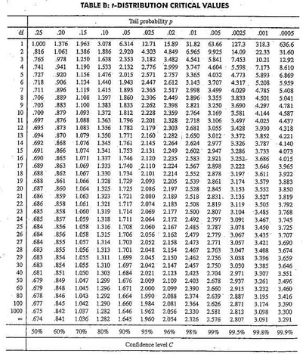

t-distribution

Slide 11
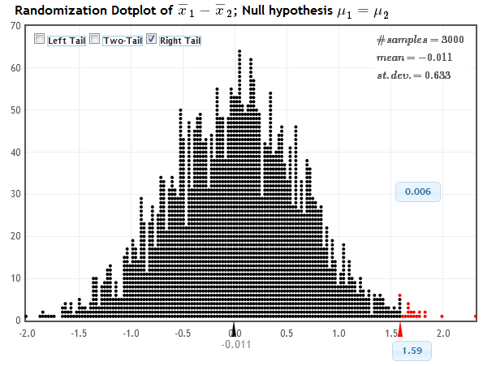
StatKey
Distribution of Statistic Assuming Null is True
Proportion as extreme as observed statistic
observed statistic
The probability of getting results as extreme or more extreme than those observed if the null hypothesis is true, is about .006.
p-value

Slide 12
p-value
The p-value is the probability of getting a statistic as extreme (or more extreme) than the observed statistic, just by random chance, if the null hypothesis is true.
Which part do students find most confusing?
probability
statistic as extreme (or more extreme) than the observed statistic
just by random chance
if the null hypothesis is true

Slide 13
Bootstrapping
From just one sample, we’d like to assess the variability of sample statistics
Imagine the population is many, many copies of the original sample (what do you have to assume?)
Sample repeatedly from this mock population
This is done by sampling with replacement from the original sample

Slide 14
Bootstrap Confidence Interval
Are you convinced?
What proportion of statistics professors who watch this talk are planning on using simulation to introduce inference?
Let’s use you as our sample, and then bootstrap to create a confidence interval!
Are you planning on using simulation to introduce inference?
  Yes
  No
www.lock5stat.com/statkey

Slide 15
Bootstrap CI on StatKey
www.lock5stat.com/statkey
Confidence interval for single proportion
Click “Edit Data” and enter the data
Generate many bootstrap samples by clicking “Generate 1000 Samples” a few times
Click the box next to “Two-tail”
Edit the blue 0.95 in the middle to the desired level of confidence
Find the corresponding CI bounds on the x-axis

Slide 16
Student Preferences
Which way did you prefer to learn inference (confidence intervals and hypothesis tests)?
Bootstrapping and Randomization | Formulas and Theoretical Distributions
105 | 60
64% | 36%
 | Simulation | Traditional
AP Stat | 31 | 36
No AP Stat | 74 | 24

Slide 17
Student Behavior
Students were given data on the second midterm and asked to compute a confidence interval for the mean
How they created the interval:
Bootstrapping | t.test in R | Formula
94 | 9 | 9
84% | 8% | 8%

Slide 18
A Student Comment
" I took AP Stat in high school and I got a 5. It was mainly all equations, and I had no idea of the theory behind any of what I was doing.
Statkey and bootstrapping really made me understand the concepts I was learning, as opposed to just being able to just spit them out on an exam.”
- one of my students

Slide 19
Further Information
Want more information on teaching with this approach?
www.lock5stat.com
Questions?
kari@stat.duke.edu

