Slide 1
Bootstraps and Scrambles:
Letting a Dataset Speak for Itself
Robin H. Lock Patti Frazer Lock ‘75
Burry Professor of Statistics Cummings Professor of Mathematics
St. Lawrence University St. Lawrence University
Colgate University
October 11, 2012

Slide 2
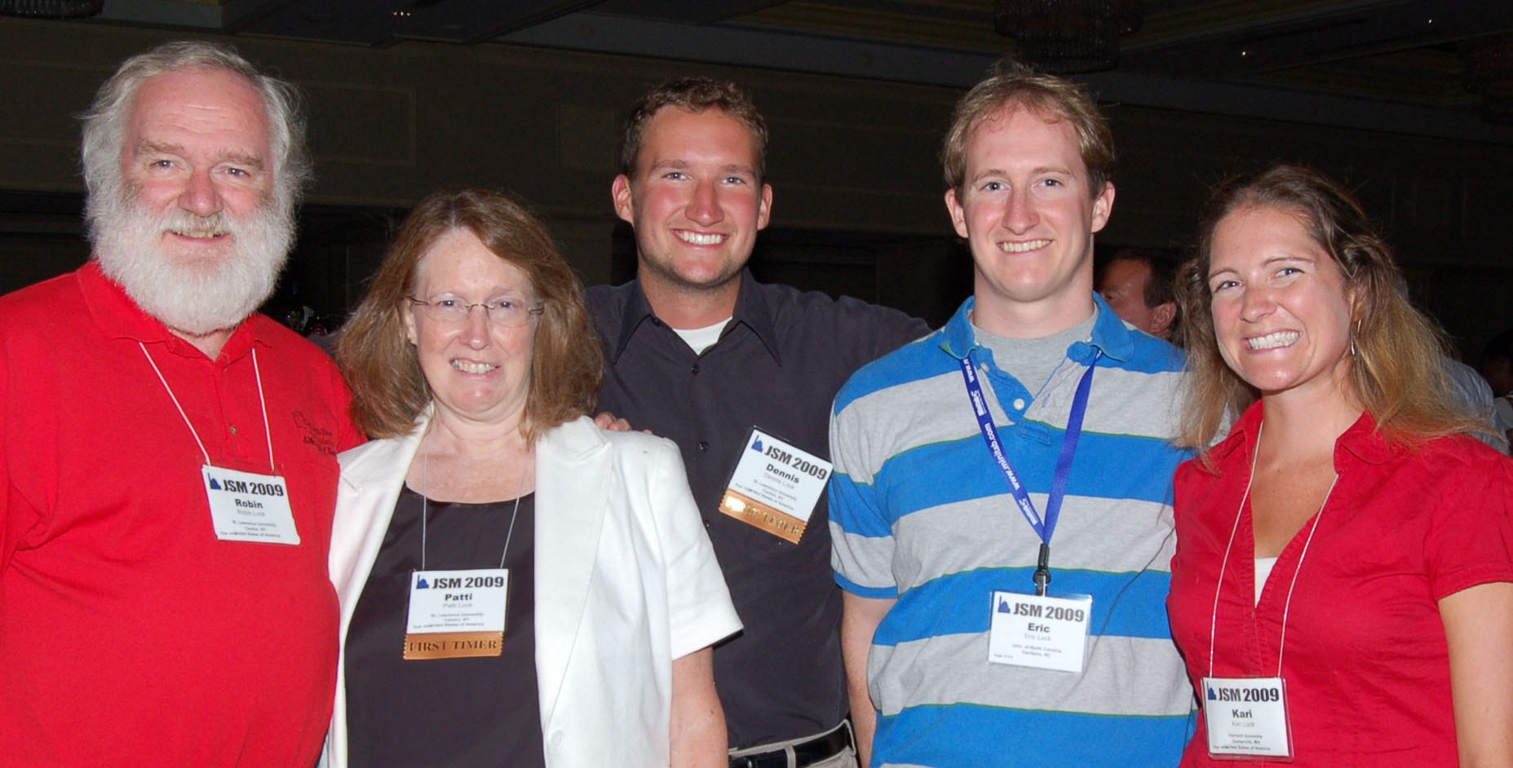
The Lock⁵ Team
Dennis
Iowa State
Kari
Harvard/Duke
Eric
UNC/Duke
Robin & Patti
St. Lawrence
Statistics: Unlocking the Power of Data, Wiley, 2013

Slide 3
“Modern” Re-sampling Methods?
"Actually, the statistician does not carry out this very simple and very tedious process, but his conclusions have no justification beyond the fact that they agree with those which could have been arrived at by this
elementary method."
-- Sir R. A. Fisher, 1936

Slide 4
Bootstrap Confidence Intervals
and
Randomization Hypothesis Tests

Slide 5
Example 1: What is the average price of a used Mustang car?
Select a random sample of n=25 Mustangs from a website (autotrader.com) and record the price (in $1,000’s) for each car.

Slide 6
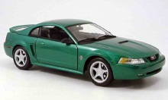
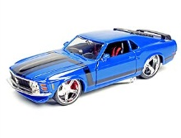
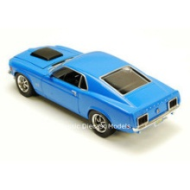
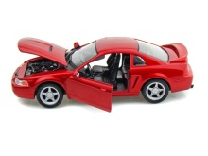
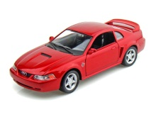
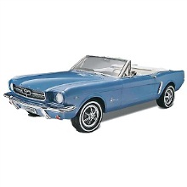
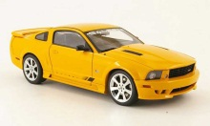
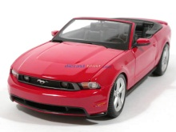
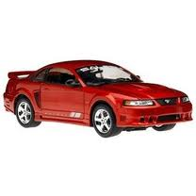
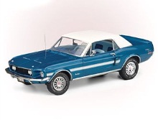
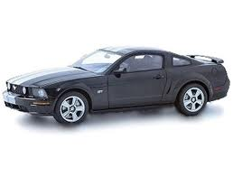
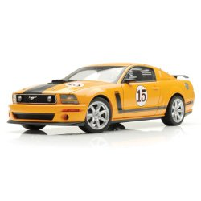
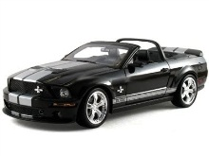
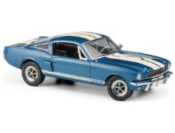
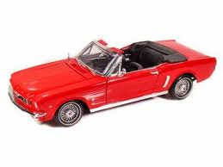

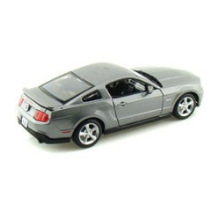
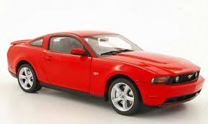
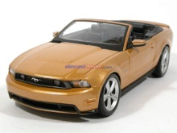
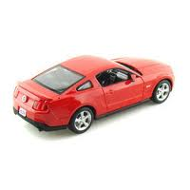
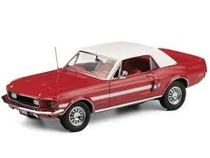
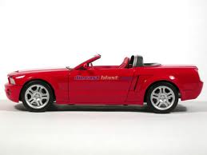
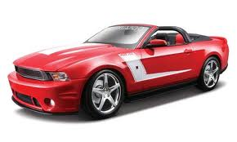
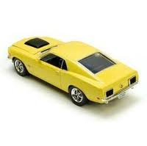
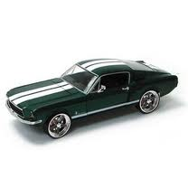

Sample of Mustangs:
$$n=25 \overline{x}=15.98 s=11.11$$
Our best estimate for the average price of used Mustangs is $15,980, but how accurate is that estimate?

Slide 7
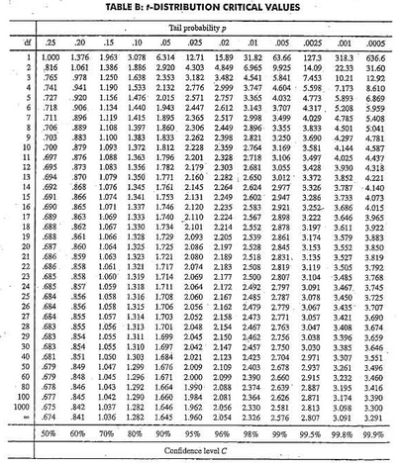
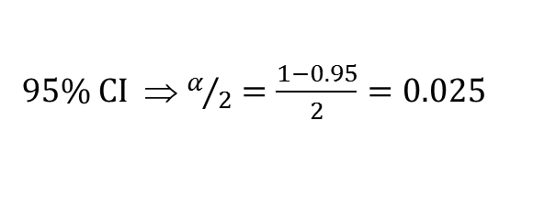

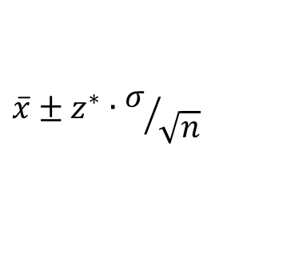

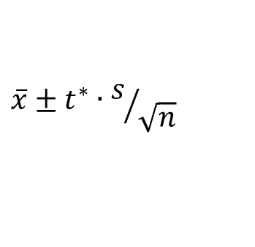
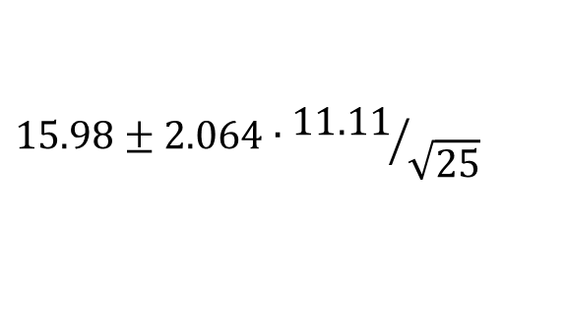

Traditional Inference
CI for a mean
1. Which formula?
$$\overline{x}±z^{∗}∙σ/{\sqrt{n}}$$
OR
$$\overline{x}±t^{∗}∙s/{\sqrt{n}}$$
2. Calculate summary stats
$n=25, \overline{x}=15.98$, $s=11.11$
3. Find t*
4. df?
95% CI ⇒ $α/2=\frac{1−0.95}{2}=0.025$
df=25$−$1=24
t*=2.064
5. Plug and chug
$$15.98±2.064∙{11.11}/{\sqrt{25}}$$
$$15.98±4.59=(11.39, 20.57)$$
6. Interpret in context
7. Check conditions

Slide 8
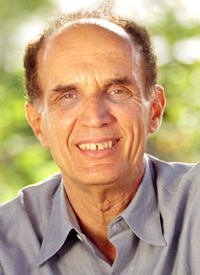
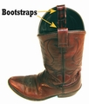
Bootstrapping
Brad Efron Stanford University
“Let your data be your guide.”
Assume the “population” is many, many copies of the original sample.
Key idea: To see how a statistic behaves, we take many samples with replacement from the original sample using the same n.

Slide 9
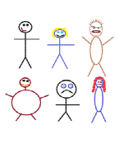
Suppose we have a random sample of 6 people:
Notes:
Patti

Slide 10
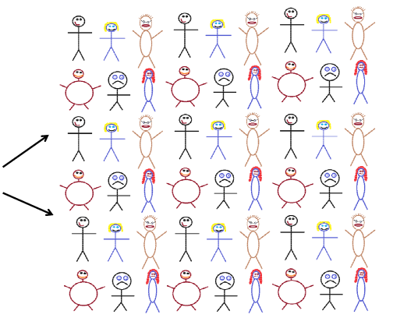




Original Sample
Bootstrap Sample
A simulated “population” to sample from
Notes:
Patti

Slide 11
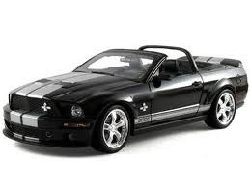
Original Sample
Bootstrap Sample

Slide 12
Creating a Bootstrap Distribution
Bootstrap sample
Bootstrap statistic
1. Compute a statistic of interest (original sample).
2. Create a new sample with replacement (same n).
3. Compute the same statistic for the new sample.
4. Repeat 2 & 3 many times, storing the results.
Bootstrap distribution
Important point: The basic process is the same for ANY parameter/statistic.

Slide 13
BootstrapSample
Bootstrap Statistic
BootstrapSample
Bootstrap Statistic
Original Sample
Bootstrap Distribution
●
●
●
●
●
●
Sample Statistic
BootstrapSample
Bootstrap Statistic

Slide 14
We need technology!
StatKey
www.lock5stat.com
Notes:
Patti

Slide 15
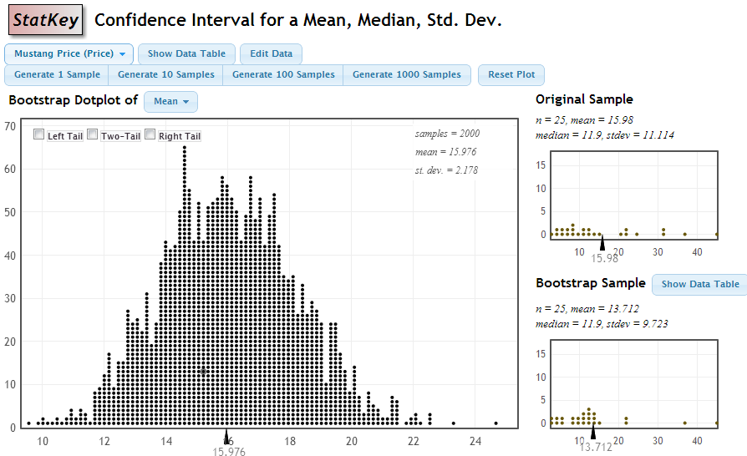
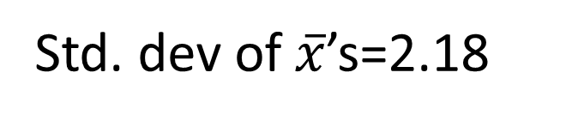
StatKey
Std. dev of $\overline{x}$’s=2.18

Slide 16
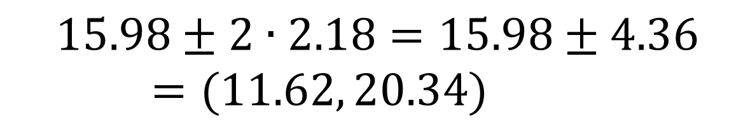
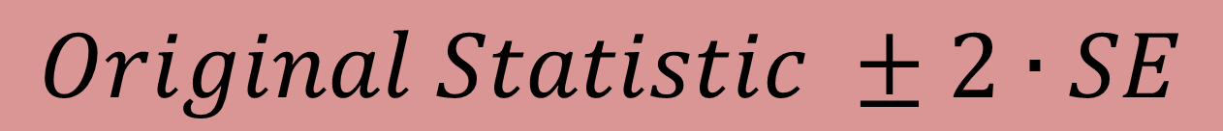
Using the Bootstrap Distribution to Get a Confidence Interval – Method #1
The standard deviation of the bootstrap statistics estimates the standard error of the sample statistic.
Quick interval estimate :
$$Original Statistic ±2∙SE$$
For the mean Mustang prices:
$$15.98±2∙2.18=15.98±4.36=(11.62, 20.34)$$

Slide 17
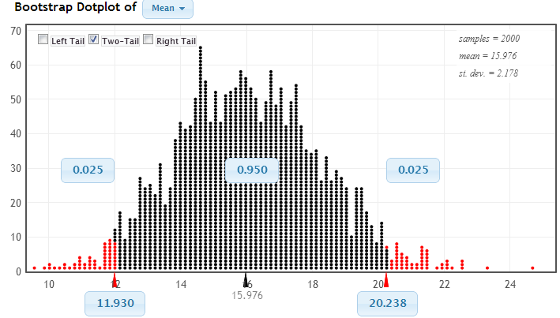
Using the Bootstrap Distribution to Get a Confidence Interval – Method #2
Chop 2.5% in each tail
Keep 95% in middle
Chop 2.5% in each tail
We are 95% sure that the mean price for Mustangs is between $11,930 and $20,238

Slide 18
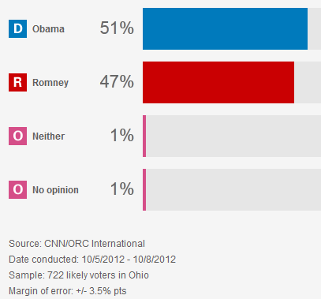
Example #2 : According to a recent CNN poll of n=722 likely voters in Ohio:
368 choose Obama (51%)
339 choose Romney (47%)
15 choose otherwise (2%)
http://www.cnn.com/POLITICS/pollingcenter/polls/3250
Find a 95% confidence interval for the proportion of Obama supporters in Ohio.

Slide 19
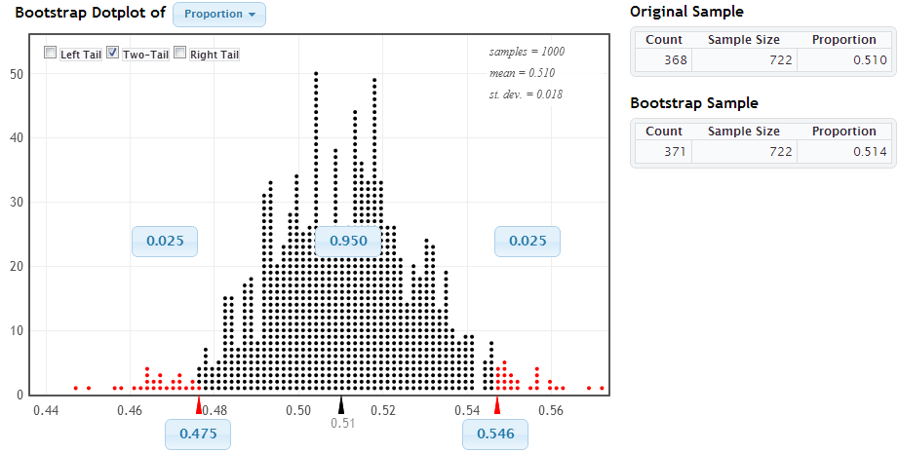

StatKey
$$0.51±2\left(0.18\right)$$
$$0.51±0.036$$
$$(0.474, 0.546)$$

Slide 20
Why
does the bootstrap work?

Slide 21
Sampling Distribution
Population
BUT, in practice we don’t see the “tree” or all of the “seeds” – we only have ONE seed
µ

Slide 22
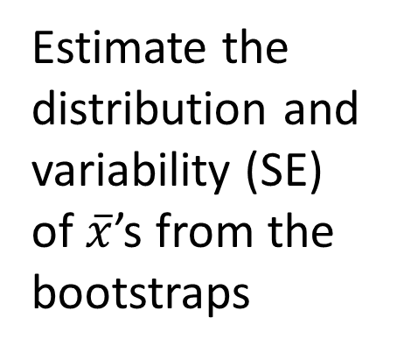

Bootstrap Distribution
What can we do with just one seed?
Bootstrap
“Population”
Estimate the distribution and variability (SE) of $\overline{x}$’s from the bootstraps
Grow a NEW tree!
$$\overline{x}$$
µ

Slide 23
Golden Rule of Bootstraps
The bootstrap statistics are to the original statistic
as
the original statistic is to the population parameter.

Slide 24
What About Hypothesis Tests?

Slide 25
P-value: The probability of seeing results as extreme as, or more extreme than, the sample results, if the null hypothesis is true.
Say what????

Slide 26
Example 1: Beer and Mosquitoes
Does consuming beer attract mosquitoes?
Experiment:
25 volunteers drank a liter of beer,
18 volunteers drank a liter of water
Randomly assigned!
Mosquitoes were caught in traps as they approached the volunteers.¹
¹ Lefvre, T., et. al., “Beer Consumption Increases Human Attractiveness to Malaria Mosquitoes, ” PLoS ONE, 2010; 5(3): e9546.

Slide 27
Beer and Mosquitoes
Number of Mosquitoes
Beer Water
27 21
20 22
21 15
26 12
27 21
31 16
24 19
19 15
23 24
24 19
28 23
19 13
24 22
29 20
20 24
17 18
31 20
20 22
25
28
21
27
21
18
20
Does drinking beer actually attract mosquitoes, or is the difference just due to random chance?
Beer mean = 23.6
Water mean
= 19.22
Beer mean – Water mean = 4.38

Slide 28
Traditional Inference
1. Which formula?
4. Which theoretical distribution?
5. df?
6. find p-value
2. Calculate numbers and plug into formula
3. Plug into calculator
0.0005 < p-value < 0.001

Slide 29
Simulation Approach
Number of Mosquitoes
Beer Water
27 21
20 22
21 15
26 12
27 21
31 16
24 19
19 15
23 24
24 19
28 23
19 13
24 22
29 20
20 24
17 18
31 20
20 22
25
28
21
27
21
18
20
Does drinking beer actually attract mosquitoes, or is the difference just due to random chance?
Beer mean = 23.6
Water mean
= 19.22
Beer mean – Water mean = 4.38

Slide 30
Simulation Approach
Number of Mosquitoes
Beer Water
27 21
20 22
21 15
26 12
27 21
31 16
24 19
19 15
23 24
24 19
28 23
19 13
24 22
29 20
20 24
17 18
31 20
20 22
25
28
21
27
21
18
20
Find out how extreme these results would be, if there were no difference between beer and water.
What kinds of results would we see, just by random chance?

Slide 31
Simulation Approach
Number of Mosquitoes
Beer Water
27 21
20 22
21 15
26 12
27 21
31 16
24 19
19 15
23 24
24 19
28 23
19 13
24 22
29 20
20 24
17 18
31 20
20 22
25
28
21
27
21
18
20
Number of Mosquitoes
Beverage
27 21
20 22
21 15
26 12
27 21
31 16
24 19
19 15
23 24
24 19
28 23
19 13
24 22
29 20
20 24
17 18
31 20
20 22
25
28
21
27
21
18
20
Find out how extreme these results would be, if there were no difference between beer and water.
What kinds of results would we see, just by random chance?

Slide 32
Simulation Approach
Beer Water
Number of Mosquitoes
Beverage
20 22
21 15
26 12
27 21
31 16
24 19
19 15
23 24
24 19
28 23
19 13
24 22
29 20
20 24
17 18
31 20
20 22
25
28
21
27
21
18
20
Find out how extreme these results would be, if there were no difference between beer and water.
What kinds of results would we see, just by random chance?
27
21
21
27
24
19
23
24
31
13
18
24
25
21
18
12
19
18
28
22
19
27
20
23
22
20
26
31
19
23
15
22
12
24
29
20
27
29
17
25
20
28

Slide 33
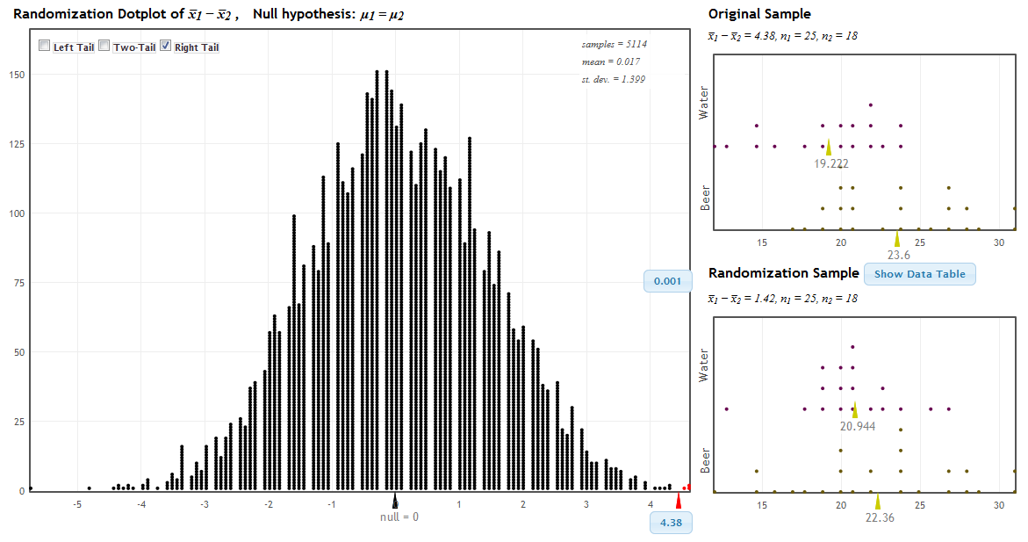
StatKey!
www.lock5stat.com
P-value

Slide 34
Traditional Inference
1. Which formula?
4. Which theoretical distribution?
5. df?
6. find p-value
2. Calculate numbers and plug into formula
3. Plug into calculator
0.0005 < p-value < 0.001

Slide 35
Beer and Mosquitoes
The Conclusion!
The results seen in the experiment are very unlikely to happen just by random chance (just 1 out of 1000!)
We have strong evidence that drinking beer does attract mosquitoes!

Slide 36
“Randomization” Samples
Key idea: Generate samples that are
based on the original sample
AND
consistent with some null hypothesis.

Slide 37
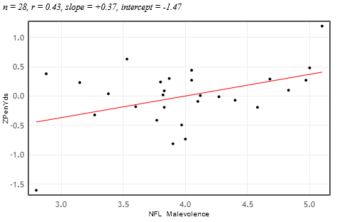


Example 2: Malevolent Uniforms
Sample Correlation
= 0.43
Do teams with more malevolent uniforms commit more penalties, or is the relationship just due to random chance?

Slide 38
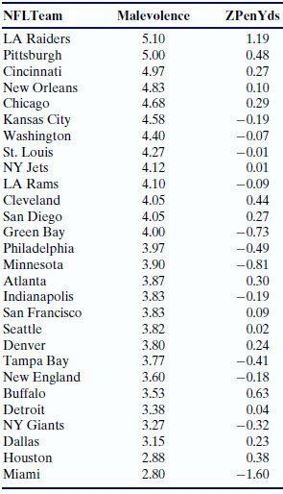
Simulation Approach
Sample Correlation = 0.43
Find out how extreme this correlation would be, if there is no relationship between uniform malevolence and penalties.
What kinds of results would we see, just by random chance?

Slide 39
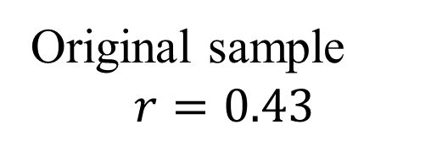
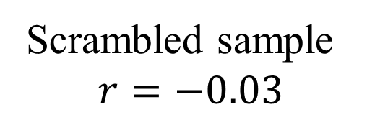
Randomization by Scrambling
Original sample
$$r=0.43$$
Scrambled sample
$$r=−0.03$$

Slide 40
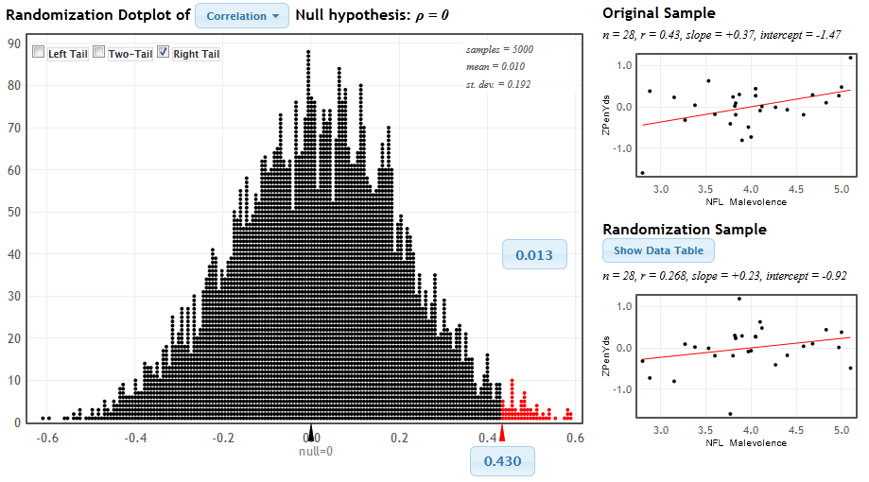
StatKey
www.lock5stat.com/statkey
P-value

Slide 41
Malevolent Uniforms
The Conclusion!
The results seen in the study are unlikely to happen just by random chance (just about 1 out of 100!)
We have some evidence that teams with more malevolent uniforms get more penalties!

Slide 42
P-value: The probability of seeing results as extreme as, or more extreme than, the sample results, if the null hypothesis is true.
Yeah – that makes sense!

Slide 43
Summary
These randomization-based methods tie directly to the key ideas of statistical inference.
They are ideal for building conceptual understanding of the key ideas.
Not only are these methods great for teaching statistics, but they are increasingly being used for doing statistics.

Slide 44
It is the way of the past…
"Actually, the statistician does not carry out this very simple and very tedious process [the randomization test], but his conclusions have no justification beyond the fact that they agree with those which could have been arrived at by this elementary method."
-- Sir R. A. Fisher, 1936

Slide 45
… and the way of the future
“... the consensus curriculum is still an unwitting prisoner of history. What we teach is largely the technical machinery of numerical approximations based on the normal distribution and its many subsidiary cogs. This machinery was once necessary, because the conceptually simpler alternative based on permutations was computationally beyond our reach. Before computers statisticians had no choice. These days we have no excuse. Randomization-based inference makes a direct connection between data production and the logic of inference that deserves to be at the core of every introductory course.”
-- Professor George Cobb, 2007

Slide 46
Thanks for joining us!
plock@stlawu.edu
rlock@stlawu.edu
www.lock5stat.com

