Slide 1
Using Simulation Methods to Introduce Inference
Kari Lock Morgan
Department of Statistical Science
Duke University
In collaboration with
Robin Lock, Patti Frazer Lock, Eric Lock, Dennis Lock
CAUSE Webinar
12/13/11

Slide 2
Simulation Methods
Inference: confidence intervals and hypothesis tests
Simulation methods: bootstrapping and randomization
I’ll focus on randomization tests, because Chris Wild just gave a great CAUSE webinar on bootstrapping:
http://www.causeweb.org/webinar/activity/2011-11/

Slide 3
Hypothesis Testing
To generate a distribution assuming H₀ is true:
Traditional Approach: Calculate a test statistic which should follow a known distribution if the null hypothesis is true (under some conditions)
Randomization Approach: Decide on a statistic of interest. Simulate many randomizations assuming the null hypothesis is true, and calculate this statistic for each randomization

Slide 4
Traditional Hypothesis Testing
With a different formula for each test, students often get mired in the details and fail to see the big picture
Plugging numbers into formulas does little to help reinforce conceptual understanding

Slide 5
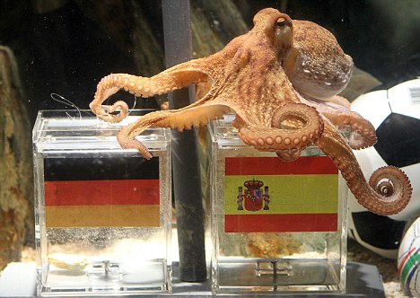
Paul the Octopus
http://www.youtube.com/watch?v=3ESGpRUMj9E

Slide 6
Paul the Octopus
Paul the Octopus predicted 8 World Cup games, and predicted them all correctly
Is this evidence that Paul actually has psychic powers?
How unusual would this be if he was just randomly guessing (with a 50% chance of guessing correctly)?
How could we figure this out?

Slide 7
Simulate with Students
Students each flip a coin 8 times, and count the number of heads
Count the number of students with all 8 heads by a show of hands (will probably be 0)
If Paul was just guessing, it would be very unlikely for him to get all 8 correct!
How unlikely? Simulate many times!!!

Slide 8
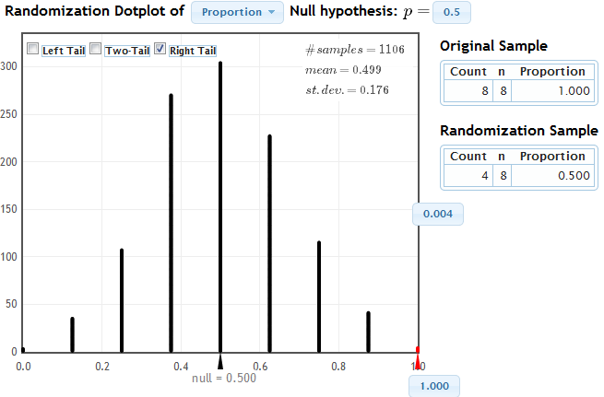
Simulate with StatKey
www.lock5stat.com/statkey

Slide 9
Cocaine Addiction
In a randomized experiment on treating cocaine addiction, 48 people were randomly assigned to take either Desipramine (a new drug), or Lithium (an existing drug)
The outcome variable is whether or not a patient relapsed
Is Desipramine significantly better than Lithium at treating cocaine addiction?

Slide 10
R
R
R
R
R
R
R
R
R
R
R
R
R
R
R
R
R
R
R
R
R
R
R
R
R
R
R
R
R
R
R
R
R
R
R
R
R
R
R
R
R
R
R
R
R
R
R
R
1. Randomly assign units to treatment groups
New Drug
Old Drug
R
R
R
R
R
R
R
R
R
R
R
R
R
R
R
R
R
R
R
R
R
R
R
R
R
R
R
R
R
R
R
R
R
R
R
R
R
R
R
R
R
R
R
R

Slide 11
2. Conduct experiment
3. Observe relapse counts in each group
R = Relapse
N = No Relapse
1. Randomly assign units to treatment groups
New Drug
Old Drug
R
R
R
R
R
R
R
R
R
R
R
R
R
R
R
R
R
R
R
R
R
R
R
R
R
R
R
R
R
R
R
R
N
R
N
R
R
R
R
R
R
R
R
R
R
R
R
R
N
R
N
R
N
N
N
N
N
N
N
N
R
R
R
R
R
R
R
R
R
R
R
R
N
N
N
N
N
N
N
N
N
N
N
N
N
N
N
N
N
N
N
N
N
N
N
N
10 relapse, 14 no relapse
18 relapse, 6 no relapse

Slide 12
Randomization Test
Assume the null hypothesis is true
Simulate new randomizations
For each, calculate the statistic of interest
Find the proportion of these simulated statistics that are as extreme as your observed statistic

Slide 13
R
R
R
R
R
R
R
R
R
R
R
R
R
R
R
R
N
N
R
R
R
R
R
R
N
N
N
N
N
N
R
R
R
R
R
R
N
N
N
N
N
N
N
N
N
N
N
N
10 relapse, 14 no relapse
18 relapse, 6 no relapse

Slide 14
R
R
R
R
R
R
R
R
R
R
R
R
R
R
R
R
N
N
R
R
R
R
R
R
N
N
N
N
N
N
R
R
R
R
R
R
N
N
N
N
N
N
N
N
N
N
N
N
Simulate another randomization
New Drug
Old Drug
R
N
R
N
N
N
N
R
R
R
R
R
R
R
N
R
R
N
N
N
R
N
R
R
R
N
N
R
N
R
R
N
R
N
N
N
R
R
R
N
R
R
R
R
16 relapse, 8 no relapse
12 relapse, 12 no relapse

Slide 15
Simulate another randomization
New Drug
Old Drug
R
R
R
R
R
R
R
R
R
R
R
R
R
N
R
R
N
N
R
R
R
R
R
R
R
R
N
R
N
R
R
R
R
R
R
R
R
N
R
N
R
R
N
N
N
N
N
N
17 relapse, 7 no relapse
11 relapse, 13 no relapse

Slide 16
Simulate with Students
Give students index cards labeled R (28 cards) and N (20 cards)
Have them deal the cards into 2 groups
Compute the difference in proportions
Contribute to a class dotplot for the randomization distribution

Slide 17
Cocaine Addiction
You want to know what would happen
  by random chance (the random allocation to treatment groups)
  if the null hypothesis is true (there is no difference between the drugs)
  Why did you re-deal your cards?
  Why did you leave the outcomes (relapse or no relapse) unchanged on each card?

Slide 18
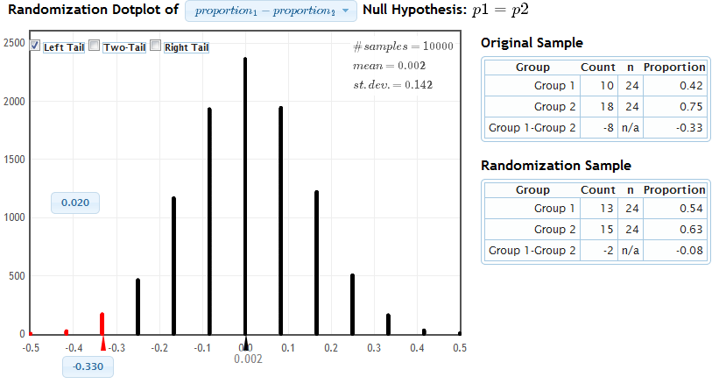
Simulate with StatKey
www.lock5stat.com/statkey
Proportion as extreme as observed statistic
observed statistic
The probability of getting results as extreme or more extreme than those observed if the null hypothesis is true, is about .02.
p-value

Slide 19
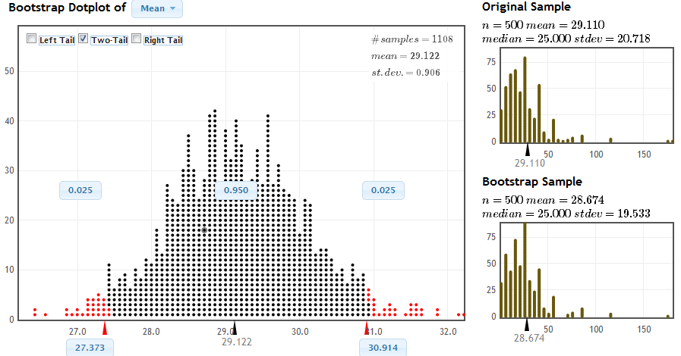
Bootstrapping
www.lock5stat.com/statkey
Middle 95% of bootstrap statistics: (27.4, 30.9)

Slide 20
Simulation vs Traditional
Simulation methods
  intrinsically connected to concepts
  same procedure applies to all statistics
  no conditions to check
  minimal background knowledge needed
Traditional methods (normal and t based)
  familiarity expected after intro stats
  needed for future statistics classes
  only summary statistics are needed
  insight from standard error

Slide 21
Simulation AND Traditional?
Currently, we introduce inference with simulation methods, then cover the traditional methods
Students have seen the normal distribution appear repeatedly via simulation; use this common shape to motivate traditional inference
“Shortcut” formulas give the standard error, avoiding the need for thousands of simulations
Students already know the concepts, so can go relatively fast through the mechanics

Slide 22
Student Preferences
Which way did you prefer to learn inference (confidence intervals and hypothesis tests)?
Bootstrapping and Randomization | Formulas and Theoretical Distributions
39 | 19
67% | 33%

Slide 23
Student Preferences
Which way do you prefer to do inference?
Bootstrapping and Randomization | Formulas and Theoretical Distributions
42 | 16
72% | 28%

Slide 24
Student Preferences
Which way of doing inference gave you a better conceptual understanding of confidence intervals and hypothesis tests?
Bootstrapping and Randomization | Formulas and Theoretical Distributions
42 | 16
72% | 27%

Slide 25
Student Preferences
LEARN inference | Simulation | Traditional
AP Stat | 13 | 15
No AP Stat | 26 | 4
DO inference | Simulation | Traditional
AP Stat | 18 | 10
No AP Stat | 24 | 6
UNDERSTAND | Simulation | Traditional
AP Stat | 17 | 11
No AP Stat | 25 | 5

Slide 26
Student Preferences
Student Preferences |  | LEARN inference
 |  | Simulation | Traditional
DO inference | Simulation | 33 | 9
 | Traditional | 6 | 10
Student Preferences |  | UNDERSTAND inference
 |  | Simulation | Traditional
DO inference | Simulation | 34 | 8
 | Traditional | 8 | 8
Student Preferences |  | UNDERSTAND inference
 |  | Simulation | Traditional
LEARN inference | Simulation | 34 | 5
 | Traditional | 8 | 11

Slide 27
A comment received today
" I took AP Stat in high school and I got a 5. It was mainly all equations, and I had no idea of the theory behind any of what I was doing.
Statkey and bootstrapping really made me understand the concepts I was learning, as opposed to just being able to just spit them out on an exam.”
- one of my students

Slide 28
It is the way of the past…
"Actually, the statistician does not carry out this very simple and very tedious process [the randomization test], but his conclusions have no justification beyond the fact that they agree with those which could have been arrived at by this elementary method."
-- Sir R. A. Fisher, 1936

Slide 29
… and the way of the future
“... the consensus curriculum is still an unwitting prisoner of history. What we teach is largely the technical machinery of numerical approximations based on the normal distribution and its many subsidiary cogs. This machinery was once necessary, because the conceptually simpler alternative based on permutations was computationally beyond our reach. Before computers statisticians had no choice. These days we have no excuse. Randomization-based inference makes a direct connection between data production and the logic of inference that deserves to be at the core of every introductory course.”
-- Professor George Cobb, 2007
kari@stat.duke.edu

