Slide 1
What Can We Do When Conditions Aren’t Met?
Robin H. Lock, Burry Professor of Statistics
St. Lawrence University
BAPS at 2014 JSM
Boston, August 2014

Slide 2
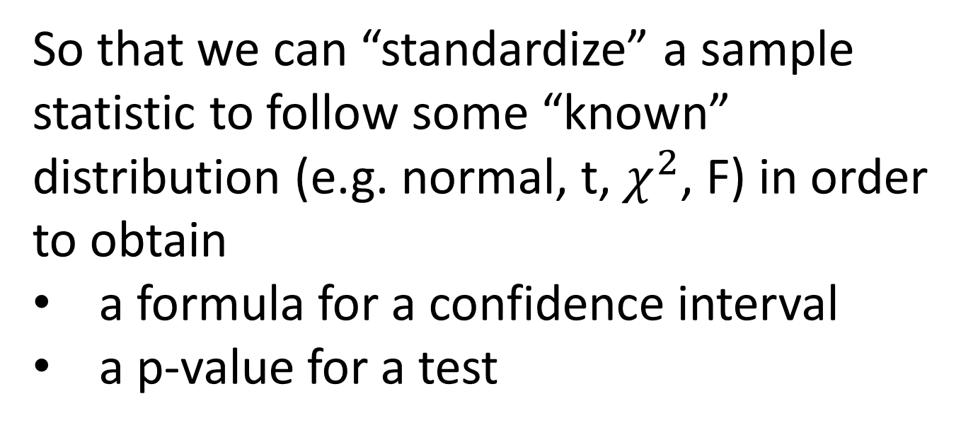
Why Do We Have “Conditions”?
So that we can “standardize” a sample statistic to follow some “known” distribution (e.g. normal, t, $χ^{2}$, F) in order to obtain
a formula for a confidence interval
a p-value for a test

Slide 3
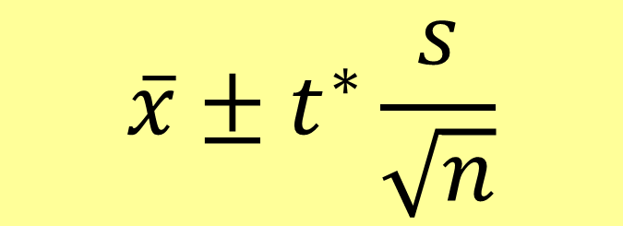
CI for a Mean
$$\overline{x}±t^{∗}\frac{s}{\sqrt{n}}$$
To use t* the sample should be from a normal distribution (especially if n is small).
But what if it’s a small sample that is clearly skewed, has outliers, …?

Slide 4
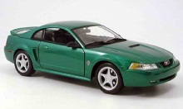
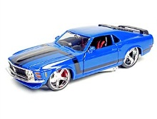
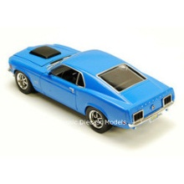
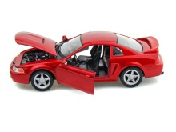
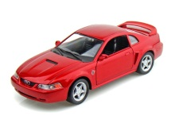
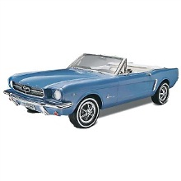
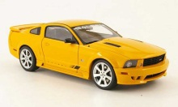

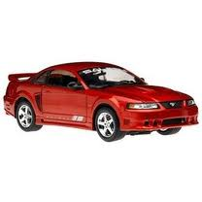

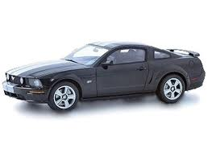
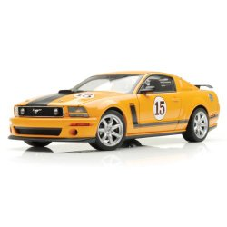
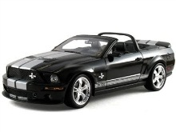
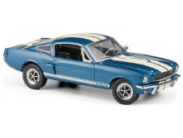
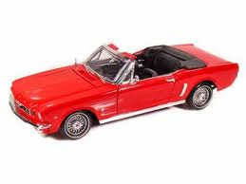

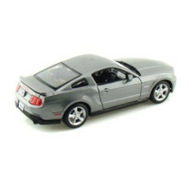
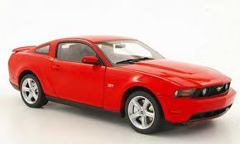

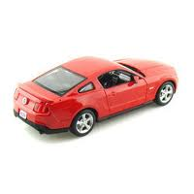
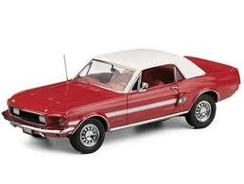
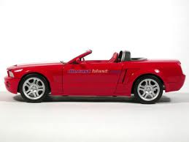
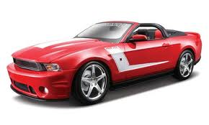
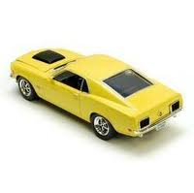
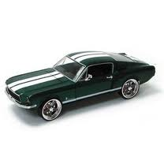


Example #1: Mean Mustang Price
Start with a random sample of 25 prices (in $1,000’s) from the web.
$$n=25 \overline{x}=15.98 s=11.11$$
Task: Find a 95% confidence interval for the mean Mustang price
$$\overline{x}±t^{∗}⋅s/\sqrt{n}$$
Problem: n<30 and the data look right skewed.
Is a t-distribution appropriate?

Slide 5


Example #2: Std. Dev. of Mustang Prices
Given the sample of 25 Mustang prices …
$$n=25 \overline{x}=15.98 s=11.11$$
Task: Find a 90% CI for the standard deviation of Mustang prices
$$s ± ? ⋅ ?$$
Problems:
What’s the standard error (SE) for s?
What’s the appropriate reference distribution?

Slide 6

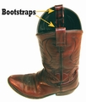
Bootstrapping
Brad Efron
Stanford University
“Let your data be your guide.”
Basic Idea:
Use simulated samples, based only the original sample data, to approximate the sampling distribution and standard error of the statistic.
Estimate the SE without using a known “formula”
Remove conditions on the underlying distribution
Also provides a way to introduce the key ideas!

Slide 7
Common Core H.S. Standards
Statistics: Making Inferences & Justifying Conclusions
HSS-IC.A.1 Understand statistics as a process for making inferences about population parameters based on a random sample from that population.
HSS-IC.A.2 Decide if a specified model is consistent with results from a given data-generating process, e.g., using simulation.
HSS-IC.B.3 Recognize the purposes of and differences among sample surveys, experiments, and observational studies; explain how randomization relates to each.
HSS-IC.B.4 Use data from a sample survey to estimate a population mean or proportion; develop a margin of error through the use of simulation models for random sampling.
HSS-IC.B.5 Use data from a randomized experiment to compare two treatments; use simulations to decide if differences between parameters are significant.
Statistics: Making Inferences & Justifying Conclusions
HSS-IC.A.1 Understand statistics as a process for making inferences about population parameters based on a random sample from that population.
HSS-IC.A.2 Decide if a specified model is consistent with results from a given data-generating process, e.g., using simulation.
HSS-IC.B.3 Recognize the purposes of and differences among sample surveys, experiments, and observational studies; explain how randomization relates to each.
HSS-IC.B.4 Use data from a sample survey to estimate a population mean or proportion; develop a margin of error through the use of simulation models for random sampling.
HSS-IC.B.5 Use data from a randomized experiment to compare two treatments; use simulations to decide if differences between parameters are significant.
Notes:
bozz

Slide 8
Bootstrapping
Brad Efron
Stanford University
“Let your data be your guide.”
To create a bootstrap distribution:
Assume the “population” is many, many copies of the original sample.
Simulate many “new” samples from the population by sampling with replacement from the original sample.
Compute the sample statistic for each bootstrap sample.

Slide 9
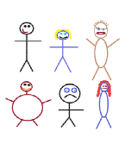
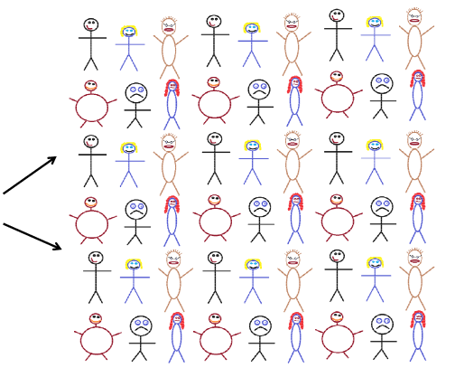




Finding a Bootstrap Sample
Original Sample (n=6)
A simulated “population” to sample from
Bootstrap Sample
(sample with replacement from the original sample)
Notes:
Patti

Slide 10
BootstrapSample
Bootstrap Statistic
BootstrapSample
Bootstrap Statistic
Original Sample
Bootstrap Distribution
●
●
●
Many times
●
●
●
Sample Statistic
BootstrapSample
Bootstrap Statistic
Notes:
Patti

Slide 11
Example #1: Mean Mustang Price
Start with a random sample of 25 prices (in $1,000’s) from the web.
$$n=25 \overline{x}=15.98 s=11.11$$
Goal: Find an interval that is likely to contain the mean price for all Mustangs for sale on the web.
Key concept: How much can we expect the sample means to vary just by random chance?

Slide 12
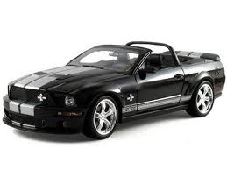


Original Sample
Bootstrap Sample
Repeat 1,000’s of times!
$$\overline{x}=15.98$$
$$\overline{x}=17.51$$
Notes:
Robin

Slide 13
We need technology!
StatKey
www.lock5stat.com/statkey
Freely available web apps with no login required
Runs in (almost) any browser (incl. smartphones/tablets)
Google Chrome App available (no internet needed)
Standalone or supplement to existing technology
Notes:
Patti

Slide 14
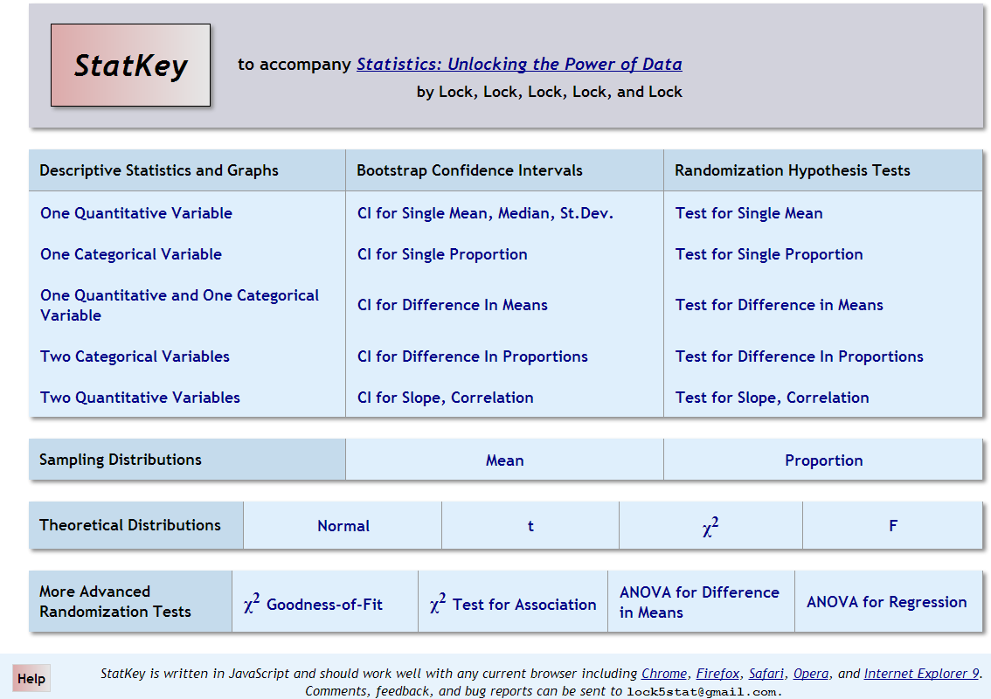

Slide 15
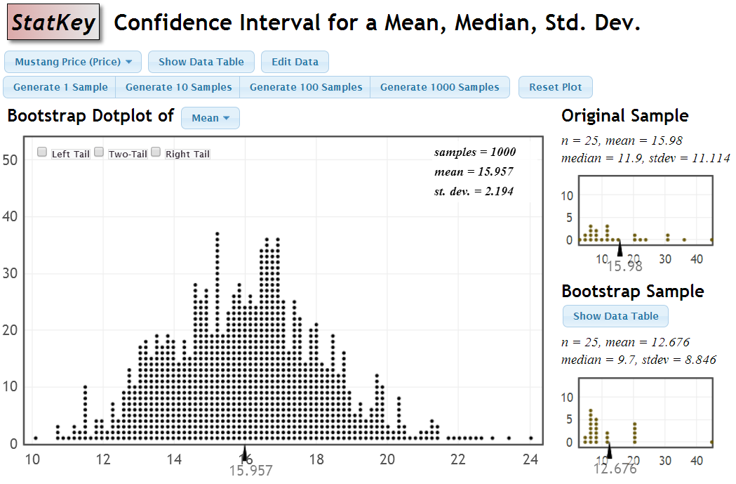
Bootstrap Distribution for Mustang Price Means
One to Many Samples
Three Distributions

Slide 16
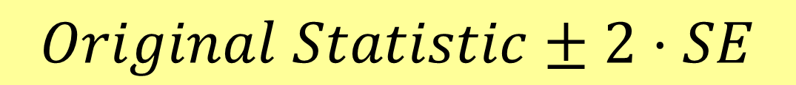
How do we get a CI from the bootstrap distribution?
Method #1: Standard Error
Find the standard error (SE) as the standard deviation of the bootstrap statistics
Find an interval with
$$Original Statistic±2⋅SE$$

Slide 17
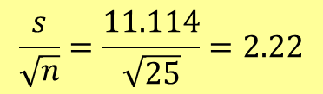
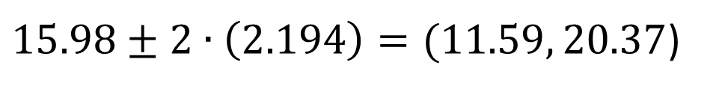
$$\frac{s}{\sqrt{n}}=\frac{11.114}{\sqrt{25}}=2.22$$
Standard Error
$15.98±2∙\left(2.194\right)=(11.59, 20.37$)

Slide 18
How do we get a CI from the bootstrap distribution?
Method #1: Standard Error
Find the standard error (SE) as the standard deviation of the bootstrap statistics
Find an interval with
$$Original Statistic±2⋅SE$$
Method #2: Percentile Interval
For a 95% interval, find the endpoints that cut off 2.5% of the bootstrap means from each tail, leaving 95% in the middle

Slide 19
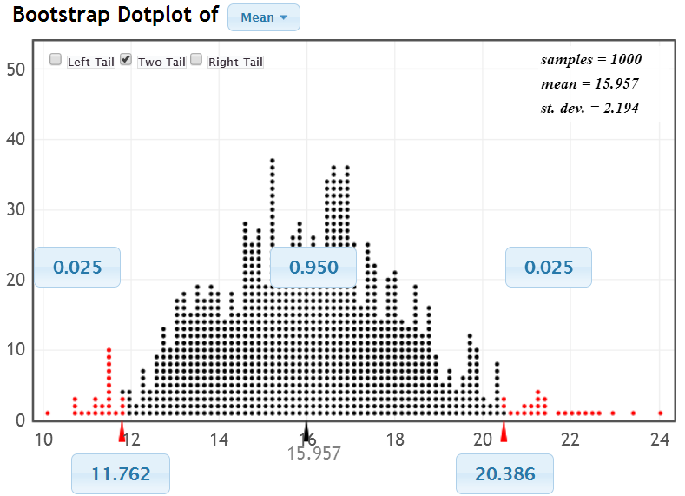
95% Confidence Interval
Chop 2.5% in each tail
Keep 95% in middle
Chop 2.5% in each tail
We are 95% sure that the mean price for Mustangs is between $11,762 and $20,386

Slide 20
Bootstrap Confidence Intervals
Version 1 (Statistic ± 2 SE):
Great preparation for moving to
traditional methods
Version 2 (Percentiles):
Great at building understanding of
confidence level
Either method requires few prerequisites.
Same process works for different parameters!
Notes:
Rups

Slide 21
Example #2: Std. Dev. Mustang Price
Find a 90% confidence interval for the standard deviation of the prices of all Mustangs for sale at this website.
Price (in $1,000’s)
 | n | mean | std. dev.
Price | 25 | 15.98 | 11.11
What changes?
Record the sample standard deviation for each of the bootstrap samples.

Slide 22
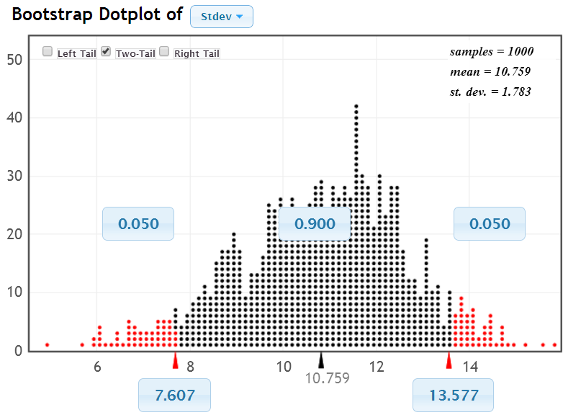
90% CI for Std. Dev. of Mustang Prices
We are 90% sure that the standard deviation of all Mustang prices at this website is between 7.61 and 13.58 (thousand dollars).

Slide 23
What About Technology?
Other possible options?
Fathom
R
Minitab (macros)
JMP
StatCrunch
Others?
xbar=function(x,i) mean(x[i])
x=boot(Time,xbar,1000)
x=do(1000)*sd(sample(Price,25,replace=TRUE))

Slide 24
Why
does the bootstrap work?

Slide 25
Sampling Distribution
Population
BUT, in practice we don’t see the “tree” or all of the “seeds” – we only have ONE seed
µ

Slide 26
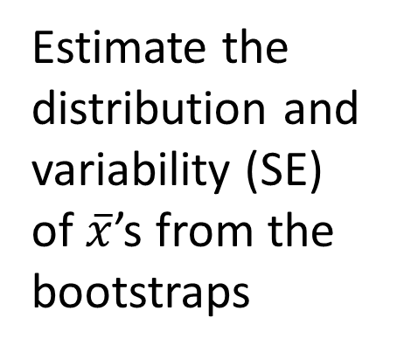

Bootstrap Distribution
What can we do with just one seed?
Bootstrap
“Population”
Estimate the distribution and variability (SE) of $\overline{x}$’s from the bootstraps
Grow a NEW tree!
$$\overline{x}$$
µ

Slide 27
Golden Rule of Bootstraps
The bootstrap statistics are to the original statistic
as
the original statistic is to the population parameter.

Slide 28
What About Hypothesis Tests?

Slide 29
Randomization Approach
Create a randomization distribution by simulating many samples from the original data, assuming H₀ is true, and calculating the sample statistic for each new sample.
Estimate p-value directly as the proportion of these randomization statistics that exceed the original sample statistic.
Notes:
Bozz

Slide 30

Example #3: Beer & Mosquitoes
Volunteers¹ were randomly assigned to drink either a liter of beer or a liter of water.
Mosquitoes were caught in nets as they approached each volunteer and counted .
 | n | mean
Beer | 25 | 23.60
Water | 18 | 19.22
Does this provide convincing evidence that mosquitoes tend to be more attracted to beer drinkers or could this difference be just due to random chance?
¹ Lefvre, T., et. al., “Beer Consumption Increases Human Attractiveness to Malaria Mosquitoes, ” PLoS ONE, 2010; 5(3): e9546.

Slide 31
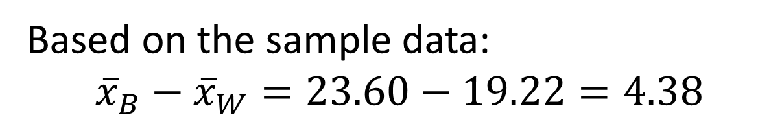
Example #3: Beer & Mosquitoes
µ = mean number of attracted mosquitoes
H₀: μ_{B} = μ_{W}
H_{a}: μ_{B} > μ_{W}
Competing claims about the population means
Based on the sample data:
$${\overline{x}}_{B}−{\overline{x}}_{W}=23.60−19.22=4.38$$
Is this a “significant” difference?
How do we measure “significance”? ...

Slide 32
KEY IDEA
P-value: The proportion of samples,
when H₀ is true, that would give results as (or more) extreme as the original sample.
Say what????

Slide 33
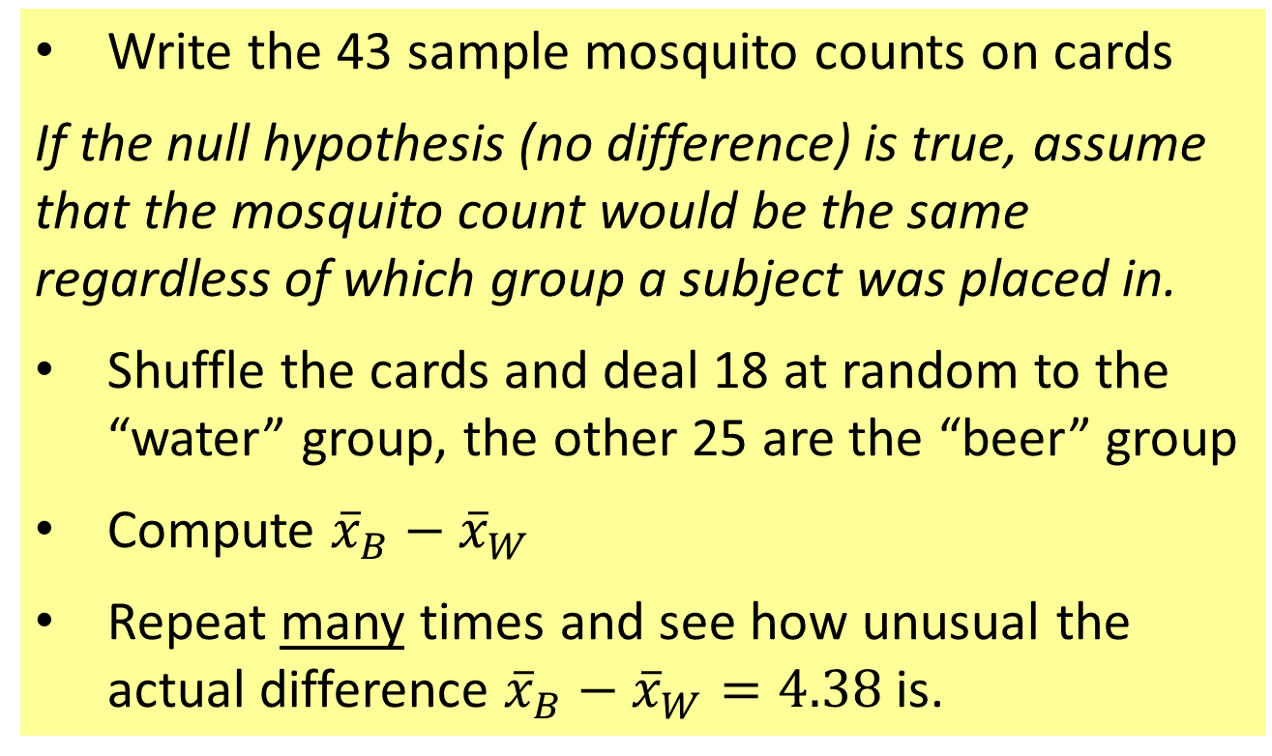
Physical Simulation
Write the 43 sample mosquito counts on cards
If the null hypothesis (no difference) is true, assume that the mosquito count would be the same regardless of which group a subject was placed in.
Shuffle the cards and deal 18 at random to the “water” group, the other 25 are the “beer” group
Compute ${\overline{x}}_{B}−{\overline{x}}_{W}$
Repeat many times and see how unusual the actual difference ${\overline{x}}_{B}−{\overline{x}}_{W}=4.38$ is.

Slide 34
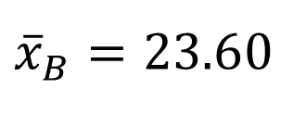


Randomization Approach
Number of Mosquitoes
To simulate samples under H₀ (no difference):
Re-randomize the values into Beer & Water groups
Beer
27
20
21
26
27
31
24
19
23
24
28
19
24
29
20
17
31
20
25
28
21
27
21
18
20
Water
21
22
15
12
21
16
19
15
24
19
23
13
22
20
24
18
20
22
${\overline{x}}_{B}=23.6$0
$${\overline{x}}_{W}=19.22$$
Original Sample
$${\overline{x}}_{B}−{\overline{x}}_{W}=4.38$$

Slide 35
Randomization Approach
Number of Mosquitoes
To simulate samples under H₀ (no difference):
Re-randomize the values into Beer & Water groups
Beer
27
20
21
26
27
31
24
19
23
24
28
19
24
29
20
17
31
20
25
28
21
27
21
18
20
Water
21
22
15
12
21
16
19
15
24
19
23
13
22
20
24
18
20
22
27 19 21 24
20 24 18 19
21 29 20 23
26 20 21 13
27 27 22 22
31 31 15 20
24 20 12 24
19 25 21 18
23 28 16 20
24 21 19 22
28 27 15
${\overline{x}}_{B}=23.6$0
$${\overline{x}}_{W}=19.22$$
$${\overline{x}}_{B}−{\overline{x}}_{W}=4.38$$

Slide 36

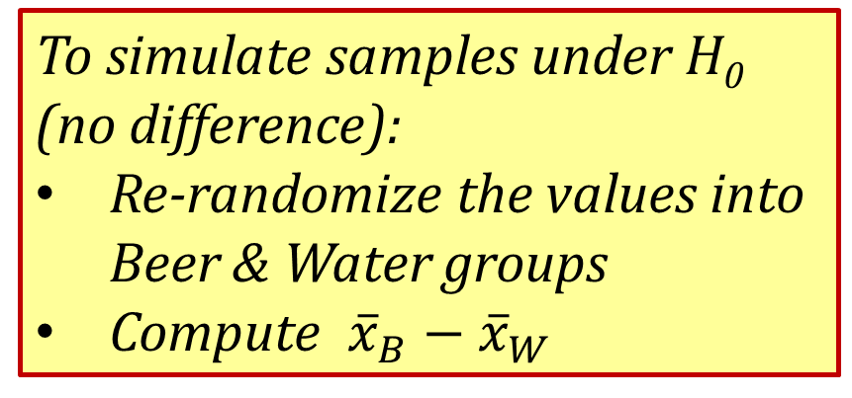


Randomization Approach
Number of Mosquitoes
To simulate samples under H₀ (no difference):
Re-randomize the values into Beer & Water groups
Compute ${\overline{x}}_{B}−{\overline{x}}_{W}$
Beer
Water
24
20 24 18 19
21 29 20 23
26 20 21 13
27 27 22 22
31 31 15 20
24 20 12 24
19 25 21 18
23 28 16 20
24 21 19 22
28 27 15
27
19
21
20
24
19
20
24
31
13
18
24
25
21
18
15
21
16
28
22
19
27
20
23
22
21
20
26
31
19
23
15
22
12
24
29
20
27
21
17
24
28
Repeat this process 1000’s of times to see how “unusual” is the original difference of 4.38.
$${\overline{x}}_{B}=21.76$$
$${\overline{x}}_{W}=22.50$$
StatKey
$${\overline{x}}_{B}−{\overline{x}}_{W}=−0.84$$

Slide 37
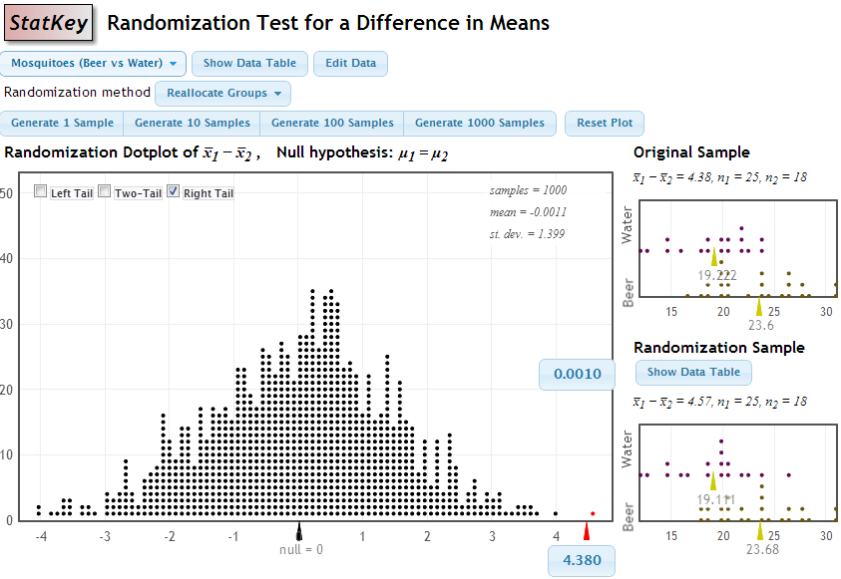

p-value = proportion of samples, when H₀ is true, that are as (or more) extreme as the original sample.
$${\overline{x}}_{B}−{\overline{x}}_{B}=23.60−19.22=4.38$$
p-value

Slide 38

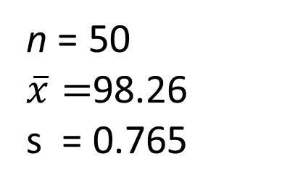
Example #4: Mean Body Temperature
Is the average body temperature really 98.6ºF?
H₀:μ=98.6
H_{a}:μ≠98.6
Data: A sample of n=50 body temperatures.
n = 50
$\overline{x}=$98.26
s = 0.765
Data from Allen Shoemaker, 1996 JSE data set article

Slide 39
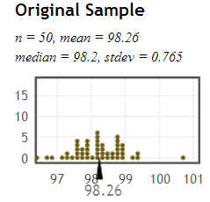

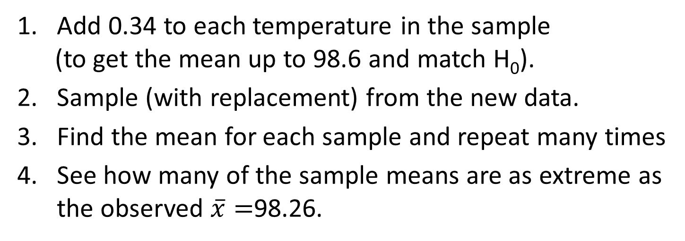
Key idea: For a randomization distribution we need to generate samples that are
(a) consistent with the null hypothesis
(b) based on the sample data.
$$H_{0}:μ=98.6$$
How to simulate samples of body temps to be consistent with H₀: μ=98.6?
Add 0.34 to each temperature in the sample
(to get the mean up to 98.6 and match H₀).
Sample (with replacement) from the new data.
Find the mean for each sample and repeat many times
See how many of the sample means are as extreme as the observed $\overline{x}=$98.26.
StatKey
Notes:
Rups

Slide 40
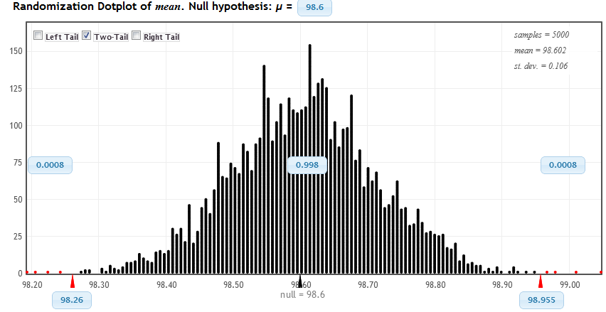
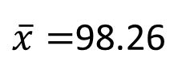
Randomization Distribution
$\overline{x}=$98.26
Looks pretty unusual…
two-tail p-value ≈ 4/5000 x 2 = 0.0016

Slide 41
Bootstrap vs. Randomization Distributions
Bootstrap Distribution | Randomization Distribution
Our best guess at the distribution of sample statistics | Our best guess at the distribution of sample statistics, if H₀ were true
Centered around the observed sample statistic | Centered around the null hypothesized value
Simulate samples by resampling from the original sample | Simulate samples assuming H₀ is true
Key difference: a randomization distribution assumes H₀ is true, while a bootstrap distribution does not

Slide 42
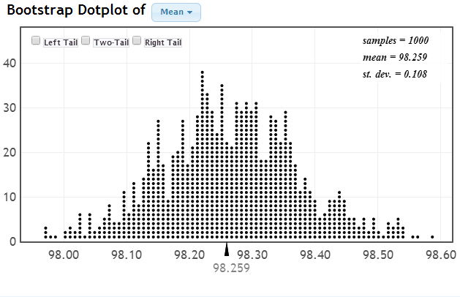
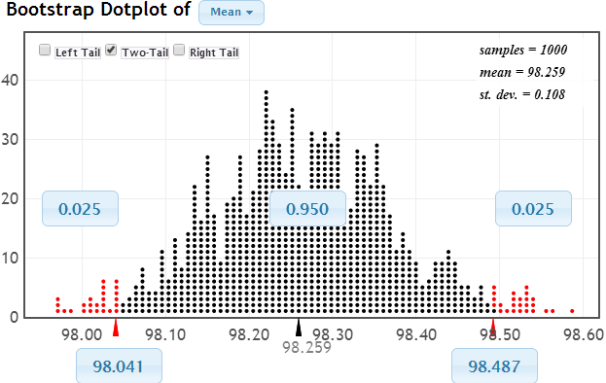
Body Temperature - Bootstrap
Resample with replacement from the original sample ($\overline{x}=92.26):$

Slide 43
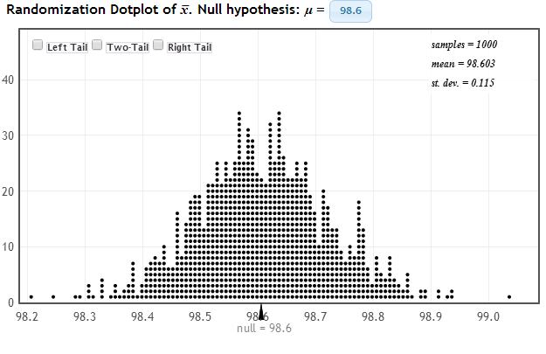
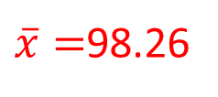

Body Temperature-Randomization
Sample with replacement from the original sample AFTER adding 0.34 to each value to match $H_{0}:μ=98.6$
What’s the difference between these two distributions?
$\overline{x}=$98.26

Slide 44


Body Temperature
Bootstrap Distribution
98.26
98.6
Randomization Distribution
H₀: μ = 98.6
H_{a}: μ ≠ 98.6
Notes:
Talk about the fact that the null hypothesized value is in the extremes of the bootstrap distribution, so the sample statistic is in the extremes of the randomization distribution

Slide 45

Body Temperature
Bootstrap Distribution
98.26
98.4
Randomization Distribution
H₀: μ = 98.4
H_{a}: μ ≠ 98.4
Notes:
Talk about the fact that the null hypothesized value is not in the extremes of the bootstrap distribution, so the sample statistic is not in the extremes of the randomization distribution

Slide 46

Materials for Teaching Bootstrap/Randomization Methods?
www.lock5stat.com rlock@stlawu.edu

