Slide 1
What Can We Do When Conditions Aren’t Met?
Robin H. Lock, Burry Professor of Statistics
St. Lawrence University
BAPS at 2012 JSM
San Diego, August 2012

Slide 2
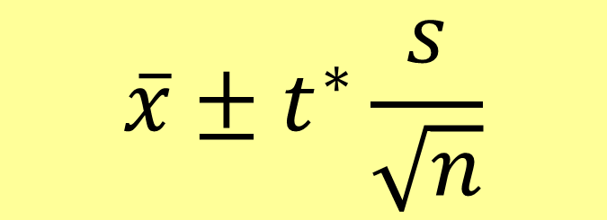
Example #1: CI for a Mean
$$\overline{x}±t^{∗}\frac{s}{\sqrt{n}}$$
To use t* the sample should be from a normal distribution.
But what if it’s a small sample that is clearly skewed, has outliers, …?

Slide 3


Example #2: CI for a Standard Deviation
$$s ± ??$$
What is the standard error? distribution?
Example #3: CI for a Correlation
$$r ± ??$$
What is the standard error? distribution?

Slide 4

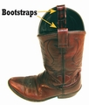
Alternate Approach:
Bootstrapping
“Let your data be your guide.”
Brad Efron – Stanford University

Slide 5
What
is a bootstrap?
and
How does it give an interval?

Slide 6
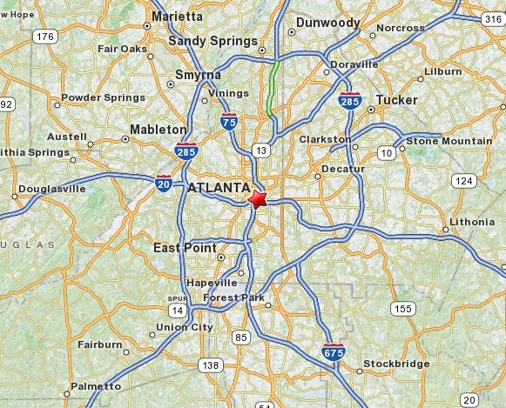
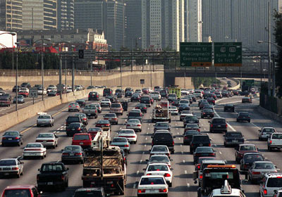
Example #1: Atlanta Commutes
What’s the mean commute time for workers in metropolitan Atlanta?
Data: The American Housing Survey (AHS) collected data from Atlanta in 2004.

Slide 7
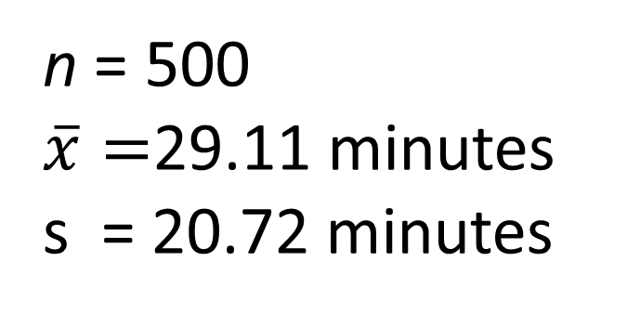
Sample of n=500 Atlanta Commutes
n = 500
$\overline{x}=$29.11 minutes
s = 20.72 minutes
Where might the “true” μ be?

Slide 8
“Bootstrap” Samples
Key idea: Sample with replacement from the original sample using the same n.
Assumes the “population” is many, many copies of the original sample.

Slide 9
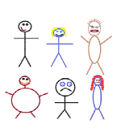
Suppose we have a random sample of 6 people:
Notes:
Patti

Slide 10
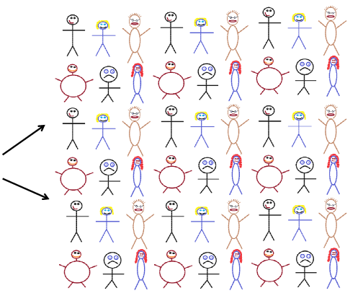
Original Sample
A simulated “population” to sample from
Notes:
Patti

Slide 11




Bootstrap Sample: Sample with replacement from the original sample, using the same sample size.
Original Sample
Bootstrap Sample
Notes:
Patti

Slide 12
Atlanta Commutes – Original Sample

Slide 13
Atlanta Commutes: Simulated Population
Sample from this “population”

Slide 14
Creating a Bootstrap Distribution
Bootstrap sample
Bootstrap statistic
1. Compute a statistic of interest (original sample).
2. Create a new sample with replacement (same n).
3. Compute the same statistic for the new sample.
4. Repeat 2 & 3 many times, storing the results.
Bootstrap distribution
Important point: The basic process is the same for ANY parameter/statistic.

Slide 15
BootstrapSample
Bootstrap Statistic
BootstrapSample
Bootstrap Statistic
Original Sample
Bootstrap Distribution
.
.
.
.
.
.
Sample Statistic
BootstrapSample
Bootstrap Statistic
Notes:
Patti

Slide 16
We need technology!
StatKey
www.lock5stat.com
Notes:
Patti

Slide 17
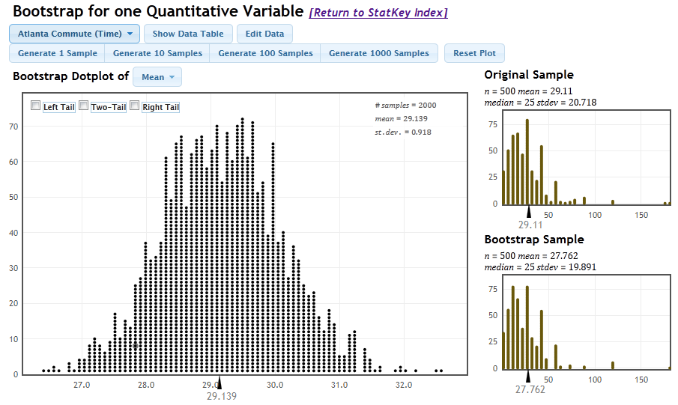
StatKey
One to Many Samples
Three Distributions

Slide 18
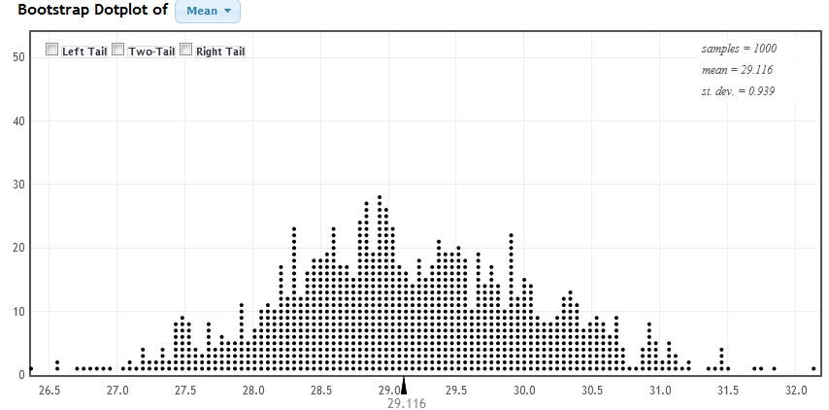
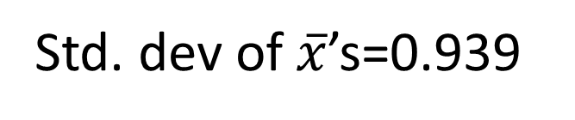
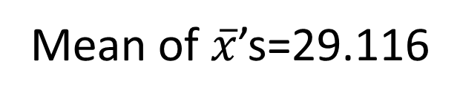
Bootstrap Distribution of 1000 Atlanta Commute Means
Mean of $\overline{x}$’s=29.116
Std. dev of $\overline{x}$’s=0.939

Slide 19
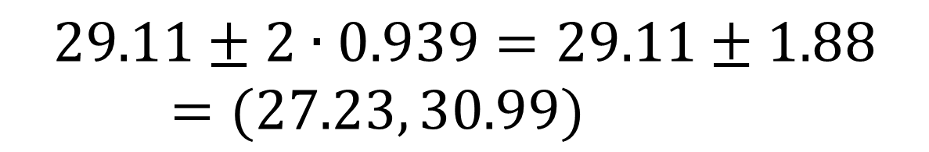

Using the Bootstrap Distribution to Get a Confidence Interval – Version #1
The standard deviation of the bootstrap statistics estimates the standard error of the sample statistic.
Quick interval estimate :
$$Original Statistic ±2∙SE$$
For the mean Atlanta commute time:
$$29.11±2∙0.939=29.11±1.88=(27.23, 30.99)$$

Slide 20
Example #2 : Find a confidence interval for the standard deviation, σ, of prices (in $1,000’s) for Mustang(cars) for sale on an internet site.
Original sample: n=25, s=11.11

Slide 21


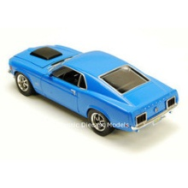
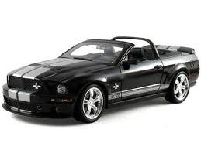
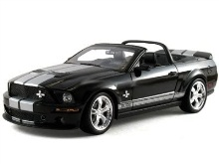
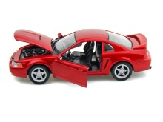






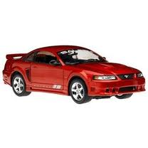

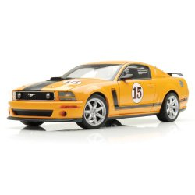

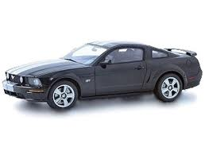



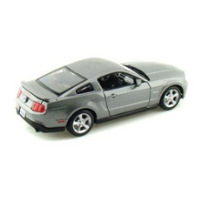


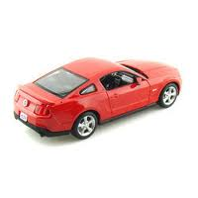


Original Sample
Bootstrap Sample

Slide 22
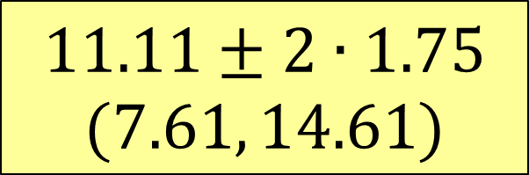
Example #2 : Find a confidence interval for the standard deviation, σ, of prices (in $1,000’s) for Mustang(cars) for sale on an internet site.
Original sample: n=25, s=11.11
Bootstrap distribution of sample std. dev’s
$$11.11±2∙1.75$$
$$(7.61, 14.61)$$
SE=1.75

Slide 23
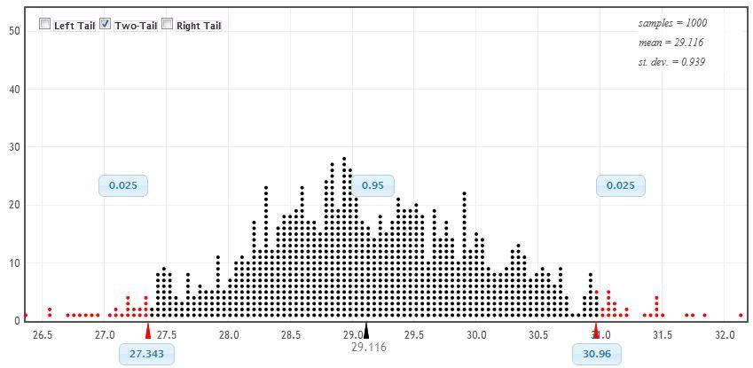
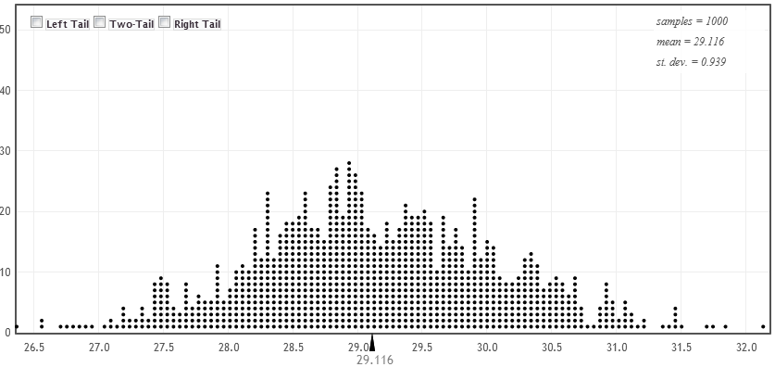
Using the Bootstrap Distribution to Get a Confidence Interval – Method #2
95% CI=(27.34,31.96)
27.34
30.96
Chop 2.5% in each tail
Keep 95% in middle
Chop 2.5% in each tail
For a 95% CI, find the 2.5%-tile and 97.5%-tile in the bootstrap distribution

Slide 24
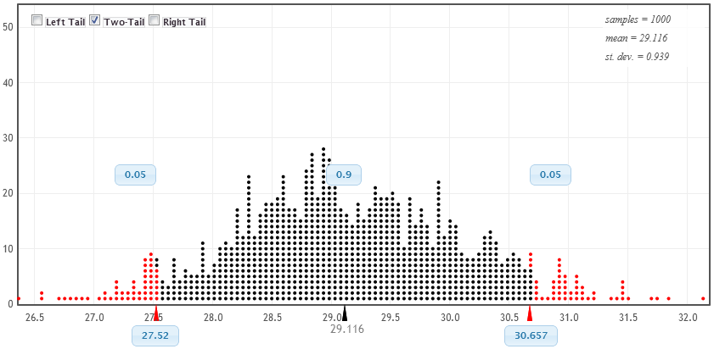
90% CI for Mean Atlanta Commute
90% CI=(27.52,30.66)
27.52
30.66
Chop 5% in each tail
Keep 90% in middle
Chop 5% in each tail
For a 90% CI, find the 5%-tile and 95%-tile in the bootstrap distribution

Slide 25
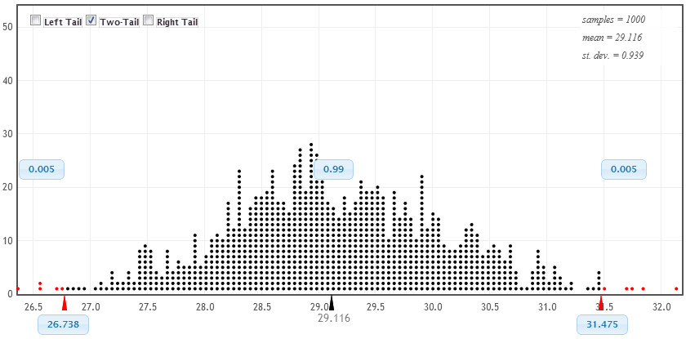
99% CI for Mean Atlanta Commute
99% CI=(26.74,31.48)
26.74
31.48
Chop 0.5% in each tail
Keep 99% in middle
Chop 0.5% in each tail
For a 99% CI, find the 0.5%-tile and 99.5%-tile in the bootstrap distribution

Slide 26
What About Technology?
Other possible options?
Fathom
R
Minitab (macros)
JMP
StatCrunch
Others?
xbar=function(x,i) mean(x[i])
x=boot(Time,xbar,1000)
x=do(1000)*sd(sample(Price,25,replace=TRUE))

Slide 27
Why
does the bootstrap work?

Slide 28
Sampling Distribution
Population
BUT, in practice we don’t see the “tree” or all of the “seeds” – we only have ONE seed
µ

Slide 29
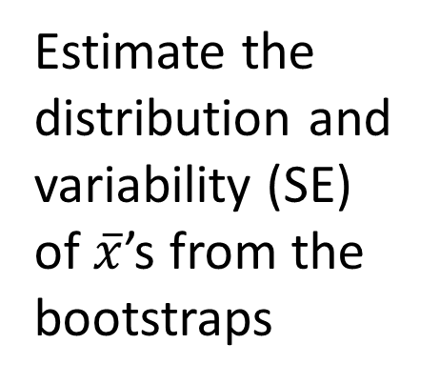

Bootstrap Distribution
What can we do with just one seed?
Bootstrap
“Population”
Estimate the distribution and variability (SE) of $\overline{x}$’s from the bootstraps
Grow a NEW tree!
$$\overline{x}$$
µ

Slide 30
Golden Rule of Bootstraps
The bootstrap statistics are to the original statistic
as
the original statistic is to the population parameter.

Slide 31

Example #3: Find a 95% confidence interval for the correlation between size of bill and tips at a restaurant.
Data: n=157 bills at First Crush Bistro (Potsdam, NY)
r=0.915

Slide 32
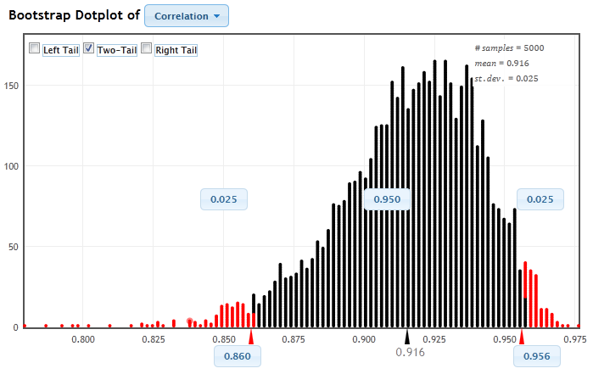

Bootstrap correlations
0.055
0.041
$$r=0.915$$
95% (percentile) interval for correlation is (0.860, 0.956)
BUT, this is not symmetric…

Slide 33

Method #3: Reverse Percentiles
Golden rule of bootstraps:
Bootstrap statistics are to the original statistic as the original statistic is to the population parameter.
0.055
0.041
$$r=0.915$$
$Lower bound = 0.915−0.041=0.874$
$Upper bound = 0.915+0.055=0.970$
Reverse percentile interval for ρ is 0.874 to 0.970

Slide 34
What About Hypothesis Tests?

Slide 35
“Randomization” Samples
Key idea: Generate samples that are
based on the original sample
AND
consistent with some null hypothesis.

Slide 36

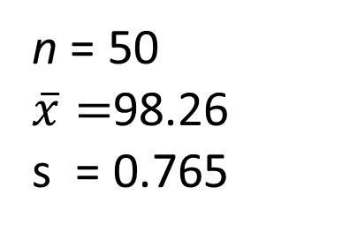
Example: Mean Body Temperature
Is the average body temperature really 98.6ºF?
H₀:μ=98.6
H_{a}:μ≠98.6
Data: A sample of n=50 body temperatures.
n = 50
$\overline{x}=$98.26
s = 0.765
Data from Allen Shoemaker, 1996 JSE data set article

Slide 37
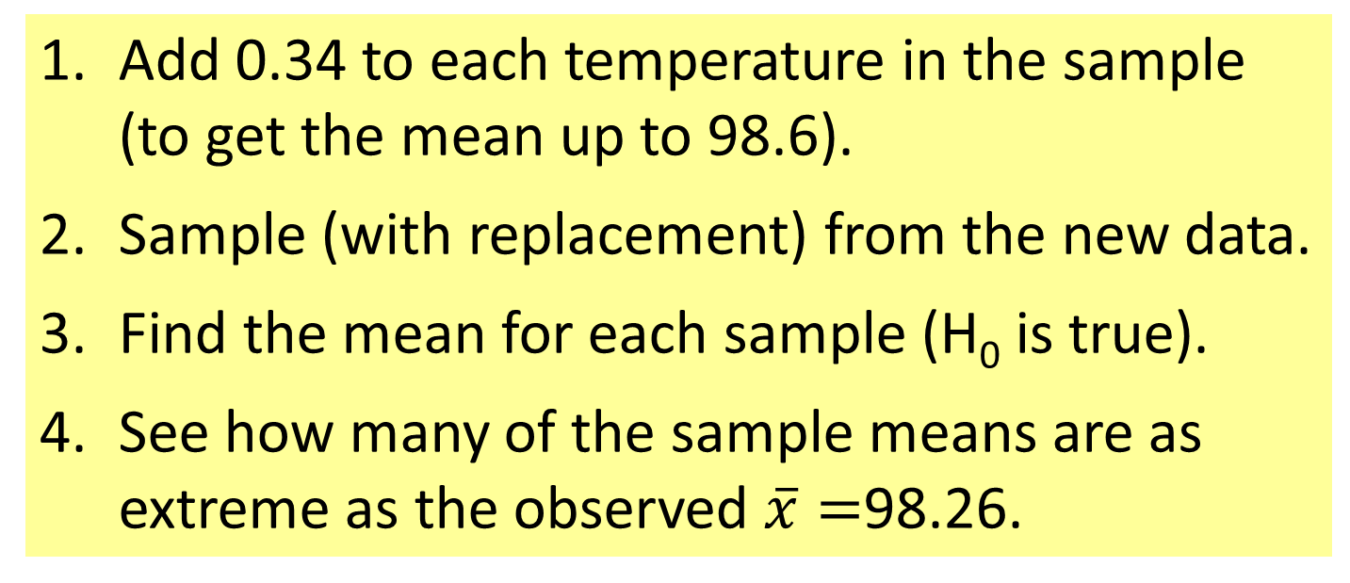
Randomization Samples
How to simulate samples of body temperatures to be consistent with H₀: μ=98.6?
Add 0.34 to each temperature in the sample (to get the mean up to 98.6).
Sample (with replacement) from the new data.
Find the mean for each sample (H₀ is true).
See how many of the sample means are as extreme as the observed $\overline{x}=$98.26.
Try it with StatKey

Slide 38
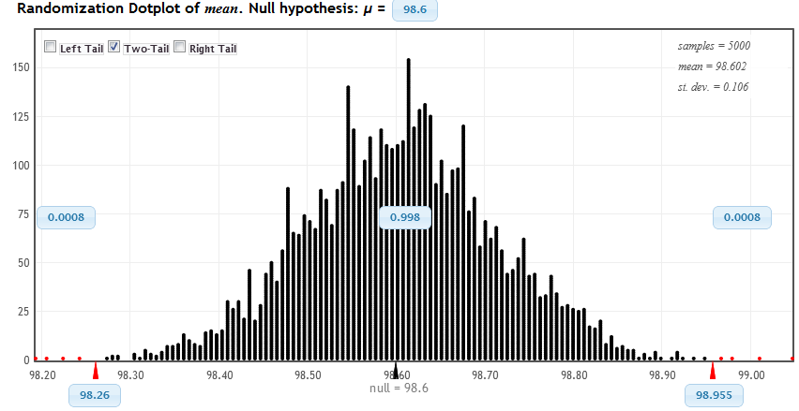
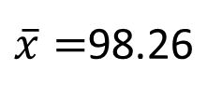
Randomization Distribution
$\overline{x}=$98.26
Looks pretty unusual…
two-tail p-value ≈ 4/5000 x 2 = 0.0016

Slide 39
Choosing a Randomization Method
Example: Finger tap rates (Handbook of Small Datasets)
A=Caffeine | 246 | 248 | 250 | 252 | 248 | 250 | 246 | 248 | 245 | 250 | mean=248.3
B=No Caffeine | 242 | 245 | 244 | 248 | 247 | 248 | 242 | 244 | 246 | 241 | mean=244.7
H₀: μ_{A}=μ_{B} vs. H_{a}: μ_{A}>μ_{B}
Method #1: Randomly scramble the A and B labels and assign to the 20 tap rates.
Method #2: Add 1.8 to each B rate and subtract 1.8 from each A rate (to make both means equal to 246.5). Sample 10 values (with replacement) within each group.
Method #3: Pool the 20 values and select two samples of size 10 (with replacement)

Slide 40
Connecting CI’s and Tests
Randomization body temp means when μ=98.6
Bootstrap body temp means from the original sample
Fathom Demo

Slide 41
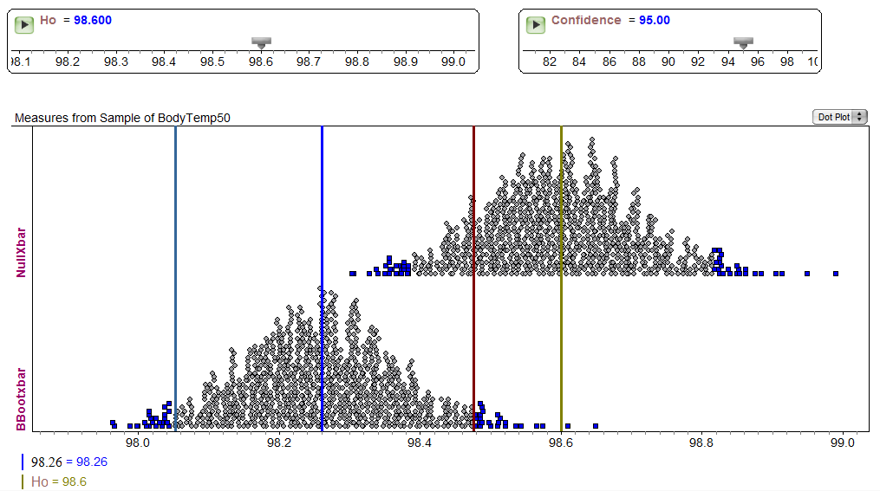
Fathom Demo: Test & CI

Slide 42
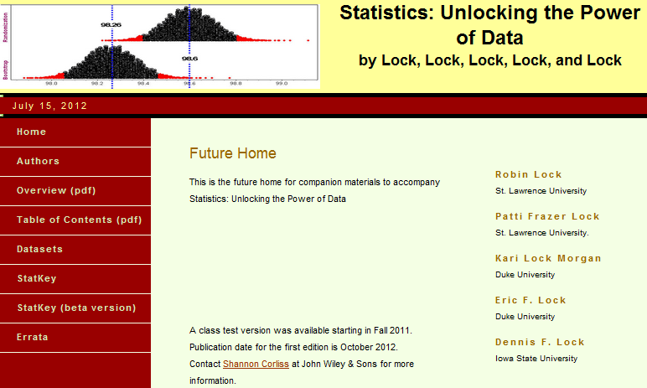
Materials for Teaching Bootstrap/Randomization Methods?
www.lock5stat.com rlock@stlawu.edu

