Slide 1
Improving Understanding and Success Rates in
Introductory Statistics
Patti Frazer Lock
Cummings Professor of Mathematics
St. Lawrence University
Canton, New York
AMATYC
November, 2017

Slide 2

The Lock⁵ Team
Kari
[Harvard]
Penn State
Eric
[North Carolina]
Minnesota
Dennis
[Iowa State]
Miami Dolphins
Patti & Robin
St. Lawrence

Slide 3
Intro Stats is rapidly increasing in importance
MAA Curriculum Guidelines
K-12 Math Common Core
Increasingly an option for math requirement
Fastest growing math course
Improving Intro Stats
Improving student understanding
Improving success rates
Increasing student interest and retention
Increasing faculty enjoyment
Intellectually rigorous while not algebra-heavy

Slide 4
How can we do this?
Using Simulation Methods to help students understand the two main concepts in statistical inference:
Variability of sample statistics
And
Strength of evidence

Slide 5
First:
Variability of Sample Statistics
[Confidence Intervals]

Slide 6
Example 1: What is the average price of a used Mustang car?
Select a random sample of n=25 Mustangs from a website (autotrader.com) and record the price (in $1,000’s) for each car.

Slide 7
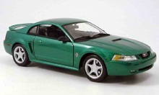
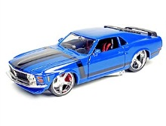
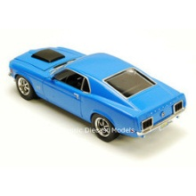
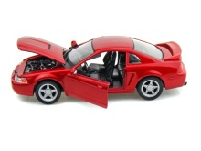
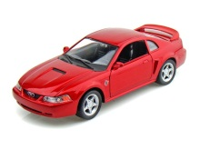
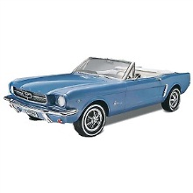
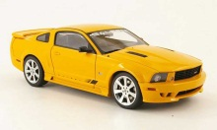
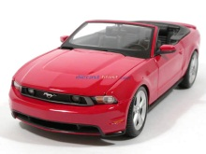
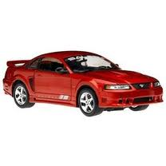
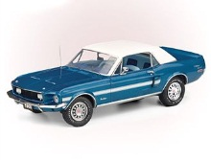
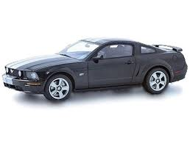
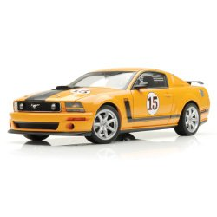
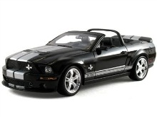
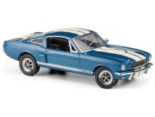
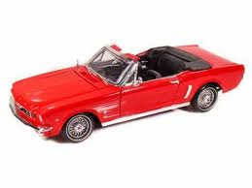
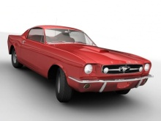
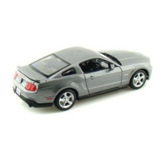
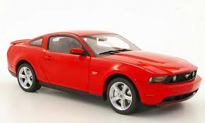
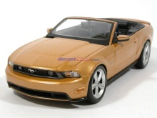
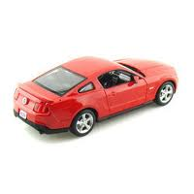
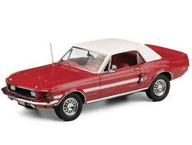
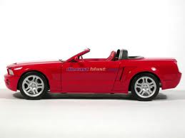
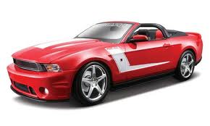
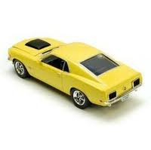
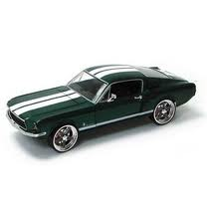

Sample of Mustangs:
$$n=25 \overline{x}=15.98 s=11.11$$
Our best estimate for the average price of used Mustangs is $15,980, but how accurate is that estimate?
We would like some kind of margin of error or a confidence interval.
Key concept: How much can we expect the sample means to vary just by random chance?

Slide 8
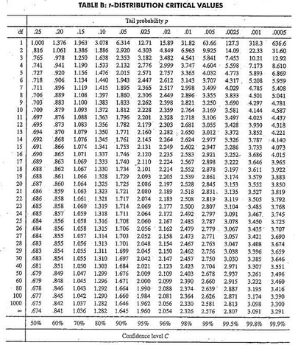
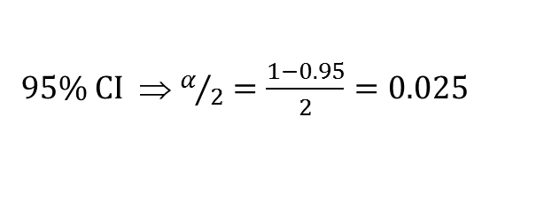

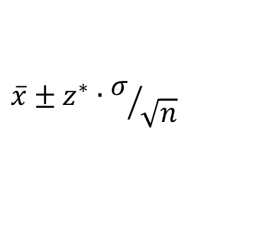

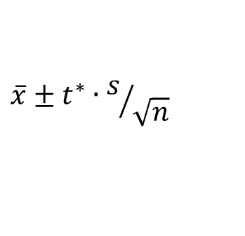
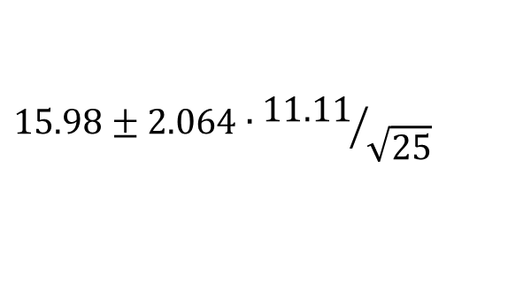

Traditional Inference
1. Check conditions
CI for a mean
2. Which formula?
$$\overline{x}±z^{∗}∙σ/{\sqrt{n}}$$
OR
$$\overline{x}±t^{∗}∙s/{\sqrt{n}}$$
3. Calculate summary stats
$n=25, \overline{x}=15.98$, $s=11.11$
4. Find t*
5. df?
95% CI ⇒ $α/2=\frac{1−0.95}{2}=0.025$
df=25$−$1=24
t*=2.064
6. Plug and chug
$$15.98±2.064∙{11.11}/{\sqrt{25}}$$
$$15.98±4.59=(11.39, 20.57)$$
7. Interpret in context

Slide 9
“We are 95% confident that the mean price of all used Mustang cars is between $11,390 and $20,570.”
Answer is good, but the process is not very helpful at building understanding.
Our students are often great visual learners but get nervous about formulas and algebra. Can we find a way to use their visual intuition?

Slide 10
Bootstrapping
“Let your data be your guide.”
Key Idea: Assume the “population” is many, many copies of the original sample.

Slide 11
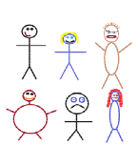
Suppose we have a random sample of 6 people:
Notes:
Patti

Slide 12
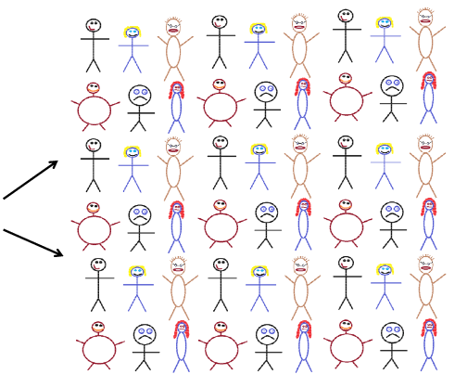
Original Sample
A simulated “population” to sample from
Notes:
Patti

Slide 13




Bootstrap Sample: Sample with replacement from the original sample, using the same sample size.
Original Sample
Bootstrap Sample
Notes:
Patti

Slide 14
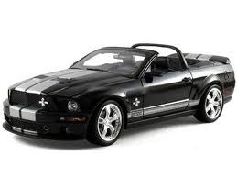
Original Sample
Bootstrap Sample

Slide 15
BootstrapSample
Bootstrap Statistic
BootstrapSample
Bootstrap Statistic
Original Sample
Bootstrap Distribution
●
●
●
●
●
●
Sample Statistic
BootstrapSample
Bootstrap Statistic

Slide 16
We need technology!
StatKey
www.lock5stat.com
(Free, easy-to-use, works on all platforms)
Notes:
Patti

Slide 17
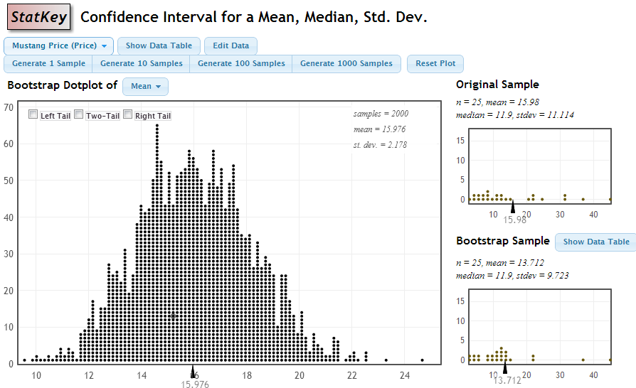

StatKey
Standard Error
$$\frac{s}{\sqrt{n}}=\frac{11.11}{\sqrt{25}}=2.2$$

Slide 18
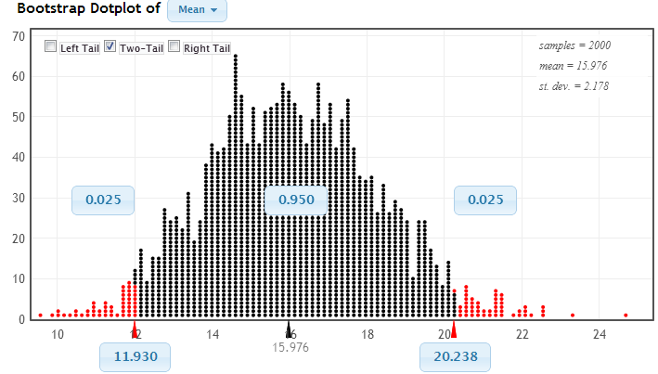
Using the Bootstrap Distribution to Get a Confidence Interval
Chop 2.5% in each tail
Keep 95% in middle
Chop 2.5% in each tail
We are 95% sure that the mean price for Mustangs is between $11,930 and $20,238

Slide 19
Example 2: (We’ll use you as our sample)
Did you dress up in any kind of costume at any point during this past Halloween season?
Use the sample data to find a 90% confidence interval for the proportion dressing up for Halloween of all people who attend AMATYC.
www.lock5stat.com/statkey
Notes:
Denn

Slide 20
Why
does the bootstrap work?

Slide 21
Sampling Distribution
Population
BUT, in practice we don’t see the “tree” or all of the “seeds” – we only have ONE seed
µ

Slide 22
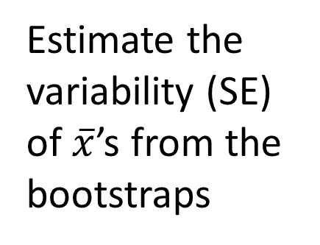

Bootstrap Distribution
What can we do with just one seed?
Bootstrap
“Population”
Estimate the variability (SE) of $\overline{x}$’s from the bootstraps
Grow a NEW tree!
$$\overline{x}$$

Slide 23
Example 3: Diet Cola and Calcium
What is the difference in mean amount of calcium excreted between people who drink diet cola and people who drink water?
Find a 95% confidence interval for the difference in means.

Slide 24
Example 3: Diet Cola and Calcium
www.lock5stat.com
Statkey
Select “CI for Difference in Means”
Use the menu at the top left to find the correct dataset.
Check out the sample: what are the sample sizes? Which group excretes more in the sample?
Generate one bootstrap statistic. Compare it to the original.
Generate a full bootstrap distribution (1000 or more).
Use the “two-tailed” option to find a 95% confidence interval for the difference in means.
What is the confidence interval?

Slide 25
Summary: Bootstrap Confidence Intervals
Same process for all parameters! Enables big picture understanding
Reinforces the concept of sampling variability
Very visual!
Low emphasis on algebra and formulas
Ties directly (and visually) to understanding confidence level

Slide 26
Second:
Strength of Evidence
[Hypothesis Tests]

Slide 27
P-value: The probability of seeing results as extreme as, or more extreme than, the sample results, if the null hypothesis is true.
Say what????

Slide 28
Example #4: Beer & Mosquitoes
Question: Does consuming beer attract mosquitoes?
Experiment:
25 volunteers drank a liter of beer,
18 volunteers drank a liter of water
Randomly assigned!
Mosquitoes were caught in traps as they approached the volunteers.¹
¹ Lefvre, T., et. al., “Beer Consumption Increases Human Attractiveness to Malaria Mosquitoes, ” PLoS ONE, 2010; 5(3): e9546.

Slide 29
Beer and Mosquitoes
Number of Mosquitoes
Beer
27
20
21
26
27
31
24
19
23
24
28
19
24
29
20
17
31
20
25
28
21
27
21
18
20
Water
21
22
15
12
21
16
19
15
24
19
23
13
22
20
24
18
20
22
Beer mean = 23.6
Water mean
= 19.22
Beer mean – Water mean = 4.38
On average, the beer drinkers attracted 4.38 more mosquitoes than the water drinkers.
Is this a “significant” difference?

Slide 30
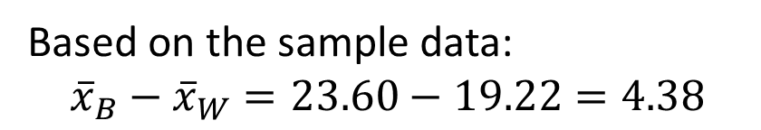
Randomization Approach
Number of Mosquitoes
Two possible explanations:
Beer attracts mosquitos
No difference; random chance
Beer
27
20
21
26
27
31
24
19
23
24
28
19
24
29
20
17
31
20
25
28
21
27
21
18
20
Water
21
22
15
12
21
16
19
15
24
19
23
13
22
20
24
18
20
22
What might happen just by random chance, if there is no difference??
µ = mean number of attracted mosquitoes
H₀: μ_{B} = μ_{W}
H_{a}: μ_{B} > μ_{W}
Based on the sample data:
$${\overline{x}}_{B}−{\overline{x}}_{W}=23.60−19.22=4.38$$

Slide 31
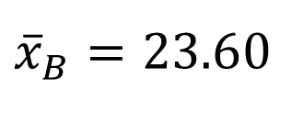


Randomization Approach
Number of Mosquitoes
To simulate samples under H₀ (no difference):
Re-randomize the values into Beer & Water groups
Beer
27
20
21
26
27
31
24
19
23
24
28
19
24
29
20
17
31
20
25
28
21
27
21
18
20
Water
21
22
15
12
21
16
19
15
24
19
23
13
22
20
24
18
20
22
27 19 21 24
20 24 18 19
21 29 20 23
26 20 21 13
27 27 22 22
31 31 15 20
24 20 12 24
19 25 21 18
23 28 16 20
24 21 19 22
28 27 15
${\overline{x}}_{B}=23.6$0
$${\overline{x}}_{W}=19.22$$
$${\overline{x}}_{B}−{\overline{x}}_{W}=4.38$$

Slide 32

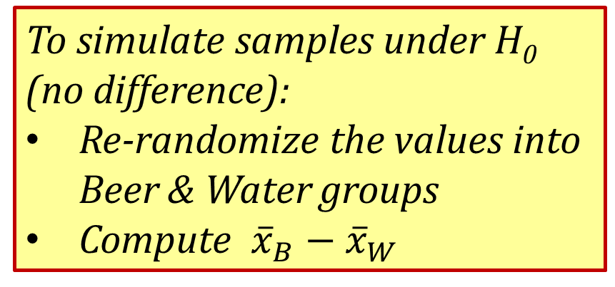


Randomization Approach
Number of Mosquitoes
To simulate samples under H₀ (no difference):
Re-randomize the values into Beer & Water groups
Compute ${\overline{x}}_{B}−{\overline{x}}_{W}$
Beer
Water
24
20 24 18 19
21 29 20 23
26 20 21 13
27 27 22 22
31 31 15 20
24 20 12 24
19 25 21 18
23 28 16 20
24 21 19 22
28 27 15
27
19
21
20
24
19
20
24
31
13
18
24
25
21
18
15
21
16
28
22
19
27
20
23
22
21
20
26
31
19
23
15
22
12
24
29
20
27
21
17
24
28
Repeat this process 1000’s of times to see how “unusual” the original difference of 4.38 is.
$${\overline{x}}_{B}=21.76$$
$${\overline{x}}_{W}=22.50$$
StatKey
$${\overline{x}}_{B}−{\overline{x}}_{W}=−0.84$$

Slide 33
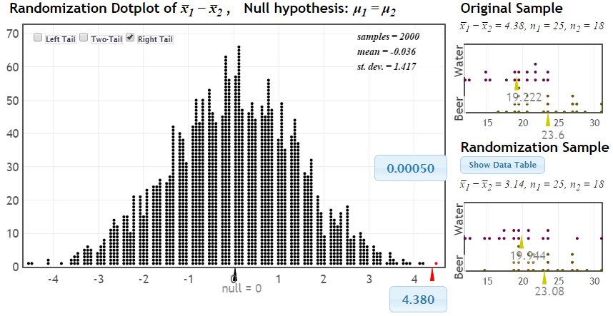
Randomization Test
p-value
Distribution of statistic if H₀ true
observed statistic
If there were no difference between beer and water, we would only see differences this extreme 0.05% of the time!

Slide 34
p-value: The chance of obtaining a statistic as extreme as that observed, just by random chance, if the null hypothesis is true
p-value: The chance of obtaining a statistic as extreme as that observed, just by random chance, if the null hypothesis is true
p-value: The chance of obtaining a statistic as extreme as that observed, just by random chance, if the null hypothesis is true
p-value: The chance of obtaining a statistic as extreme as that observed, just by random chance, if the null hypothesis is true
p-value: The chance of obtaining a statistic as extreme as that observed, just by random chance, if the null hypothesis is true

Slide 35
The difference of 4.38 is very unlikely to happen just by random chance.
We have strong evidence that drinking beer does attract mosquitoes!

Slide 36
Beer and Mosquitoes: Take 2
Number of Mosquitoes
Beer
27
20
21
26
27
31
24
19
23
24
28
19
24
29
20
17
31
20
25
28
21
27
21
18
20
Water
21
22
15
12
21
16
19
15
24
19
23
13
22
20
24
18
20
22
Does drinking beer actually attract mosquitoes, OR is the difference just due to random chance?
What about the traditional approach to this question?

Slide 37

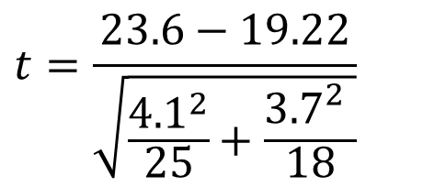
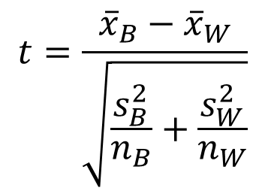
Traditional Inference
1. Check conditions
2. Which formula?
5. Which theoretical distribution?
$$t=\frac{{\overline{x}}_{B}−{\overline{x}}_{W}}{\sqrt{\frac{s_{B}^{2}}{n_{B}}+\frac{s_{W}^{2}}{n_{W}}}}$$
6. df?
7. Find p-value
8. Interpret a decision
3. Calculate numbers and plug into formula
$$t=\frac{23.6−19.22}{\sqrt{\frac{{4.1}^{2}}{25}+\frac{{3.7}_{}^{2}}{18}}}$$
4. Chug with calculator
$$t=3.68$$
0.0005 < p-value < 0.001

Slide 38
Again, the conclusion is the same, but the method used to get there is very different.

Slide 39
Example 5: Malevolent Uniforms
Do sports teams with more “malevolent” uniforms get penalized more often?

Slide 40
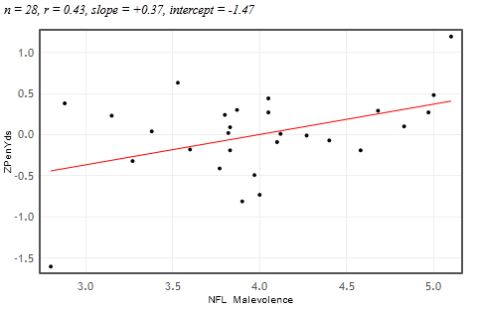


Example 5: Malevolent Uniforms
Sample Correlation
= 0.43
Do teams with more malevolent uniforms commit more penalties, or is the relationship just due to random chance?

Slide 41
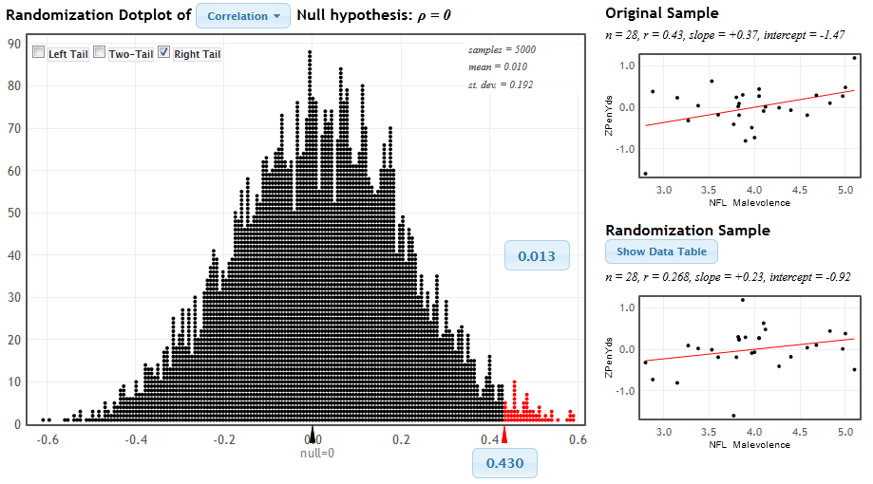
StatKey
www.lock5stat.com/statkey
P-value

Slide 42
Malevolent Uniforms
The Conclusion!
The results seen in the study are unlikely to happen just by random chance (just about 1 out of 100).
We have some evidence that teams with more malevolent uniforms get more penalties.

Slide 43

Example 6: Split or Steal?
http://www.youtube.com/watch?v=p3Uos2fzIJ0
 | Split | Steal | Total
Under 40 | 187 | 195 | 382
Over 40 | 116 | 76 | 192
Total | 303 | 271 | n=574
Van den Assem, M., Van Dolder, D., and Thaler, R., “Split or Steal? Cooperative Behavior When the Stakes Are Large,” 2/19/11.
Notes:
Watch the video… pause before the results, and ask students what they would do

Slide 44
Example 6: Split or Steal?
www.lock5stat.com
Statkey
Select “Test for Difference in Proportions”
Use the “Edit Data” button to put in values:
Group 1 (under 40): Count = 187, Sample Size = 382
Group 2 (over 40): Count = 116, Sample Size = 192
What are the two sample proportions? What is the difference in proportions? Which group is more likely to “split”?
Generate a randomization distribution (1000 or more).
Use the “left-tail” option, and enter the sample difference in proportions in the lower blue box.
What is the p-value?

Slide 45
Summary: Randomization Hypothesis Tests
Similar process for all parameters! Enables big picture understanding
Reinforces (again) importance of understanding random variation
Helps understanding of p-value: How extreme are sample results if null hypothesis is true?
Very visual!
Low emphasis on algebra and formulas
Ties directly (and visually) to understanding strength of evidence

Slide 46
Simulation Methods
These randomization-based methods tie directly to the key ideas of statistical inference.
They are ideal for building conceptual understanding of the key ideas.
Not only are these methods great for teaching statistics, but they are increasingly being used for doing statistics.

Slide 47
What to do?
Incorporate these ideas in a small way in an existing course to help build student understanding.
Cover only these methods for a valuable statistical literacy course
Use these methods to build understanding of the key ideas, and then cover traditional normal and t-based methods as “short-cut formulas” for an Intro Stats course. Students see the standard methods but have a deeper understanding.

Slide 48
It is the way of the past…
"Actually, the statistician does not carry out this very simple and very tedious process, but his conclusions have no justification beyond the fact that they agree with those which could have been arrived at by this elementary method."
-- Sir R. A. Fisher, 1936

Slide 49
… and the way of the future
“... the consensus curriculum is still an unwitting prisoner of history. What we teach is largely the technical machinery of numerical approximations based on the normal distribution and its many subsidiary cogs. This machinery was once necessary, because the conceptually simpler alternative based on permutations was computationally beyond our reach. Before computers statisticians had no choice. These days we have no excuse. Randomization-based inference makes a direct connection between data production and the logic of inference that deserves to be at the core of every introductory course.”
-- Professor George Cobb, 2007

Slide 50
Additional Resources
www.lock5stat.com
Statkey
Descriptive Statistics
Sampling Distributions
Confidence Interval Demo
Normal and t-Distributions

Slide 51
Thanks for listening!
plock@stlawu.edu
www.lock5stat.com

