Slide 1
Bootstraps
An Intuitive Introduction to Confidence Intervals
Robin Lock
Burry Professor of Statistics
St. Lawrence University
AMATYC Webinar
December 6, 2016

Slide 2

The Lock⁵ Team
Kari
Harvard
Penn State
Eric
North Carolina
Minnesota
Dennis
Iowa State
Miami Dolphins
Patti & Robin
St. Lawrence

Slide 3
Two Approaches to Inference
Traditional:
Assume some distribution (e.g. normal or t) to describe the behavior of sample statistics
Estimate parameters for that distribution from sample statistics
Calculate the desired quantities from the theoretical distribution
Simulation (SBI):
Generate many samples (by computer) to show the behavior of sample statistics
Calculate the desired quantities from the simulation distribution

Slide 4

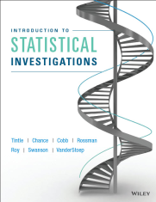
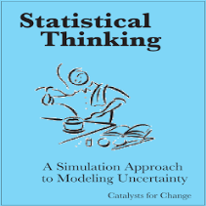
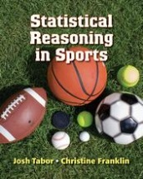
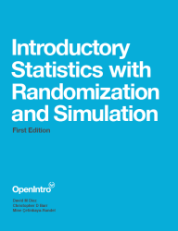
Simulation-Based Inference (SBI) Projects
Lock⁵ lock5stat.com
Tintle, et al math.hope.edu/isi
Catalst www.tc.umn.edu/~catalst
Tabor/Franklin www.highschool.bfwpub.com
Open Intro www.openintro.org

Slide 5
Intro Stat – Revised Topics
Descriptive Statistics – one and two samples
Descriptive Statistics – one and two samples
Normal distributions
Bootstrap confidence intervals
Bootstrap confidence intervals
Data production (samples/experiments)
Data production (samples/experiments)
Randomization-based hypothesis tests
Randomization-based hypothesis tests
Sampling distributions (mean/proportion)
Normal distributions
Confidence intervals (means/proportions)
Hypothesis tests (means/proportions)
ANOVA for several means, Inference for regression, Chi-square tests
Notes:
Bozz

Slide 6
Intro Stat – Revised Topics
Data production (samples/experiments)
Descriptive Statistics – one and two samples
Bootstrap confidence intervals
Randomization-based hypothesis tests
Normal distributions
See the April 7, 2016 AMATYC Webinar on “Teaching Introductory Statistics with Simulation-Base Inference”
by Allan Rossman and Beth Chance
Confidence intervals (means/proportions)
Hypothesis tests (means/proportions)
ANOVA for several means, Inference for regression, Chi-square tests
Notes:
Bozz

Slide 7
Intro Stat – Revised Topics
Data production (samples/experiments)
Descriptive Statistics – one and two samples
Bootstrap confidence intervals
Randomization-based hypothesis tests
Normal distributions
See the rest of THIS webinar!
Confidence intervals (means/proportions)
Hypothesis tests (means/proportions)
ANOVA for several means, Inference for regression, Chi-square tests
Notes:
Bozz

Slide 8
Questions to Address
What is bootstrapping?
How can we use bootstrapping to find confidence intervals?
Can bootstrapping be made accessible to intro statistics students?
Can it be used as a way to introduce students to key ideas of confidence intervals?
Why does bootstrapping work?
What about traditional methods?

Slide 9
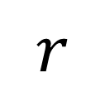

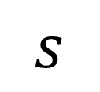
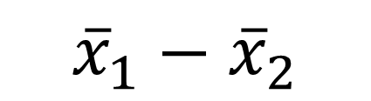
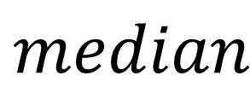
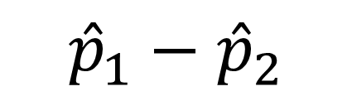
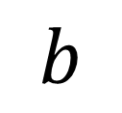

Where are we in the course?
Students have seen…
Data Production: Random sampling, random assignment
Graphical
Displays:
$$\overline{x}$$
$${\overline{x}}_{1}−{\overline{x}}_{2}$$
$$median$$
$$s$$
Summary
Statistics:
$$\hat{p}$$
$${\hat{p}}_{1}−{\hat{p}}_{2}$$
$$r$$
$$b$$
How accurate are these estimates?

Slide 10
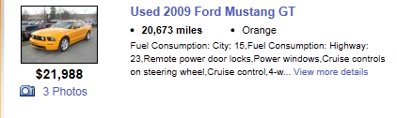
Example #1: What is the average price of a used Mustang car?
A student selects a random sample of n=25 Mustangs from a website (autotrader.com) and records the price (in $1,000’s) for each car.

Slide 11
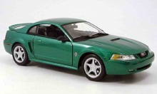

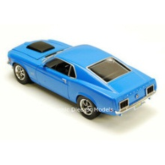
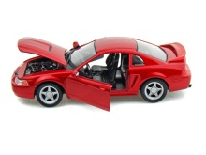
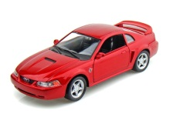
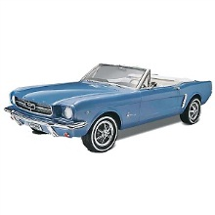

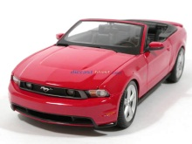
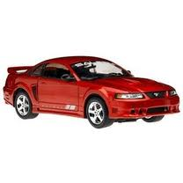

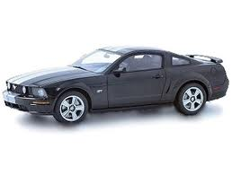
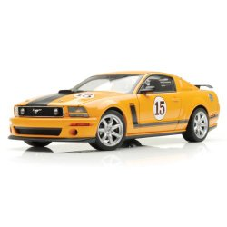
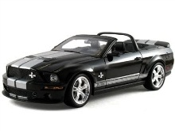
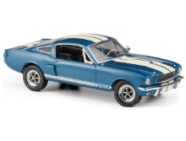
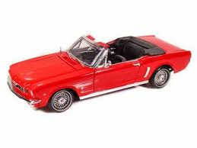

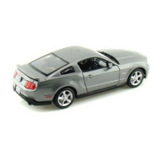
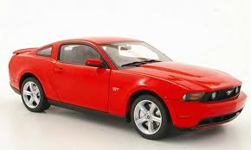

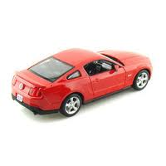
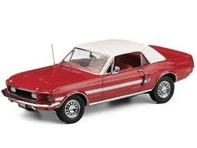
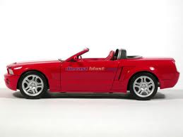
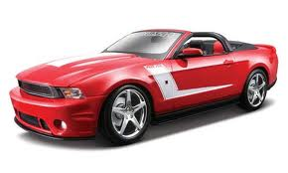
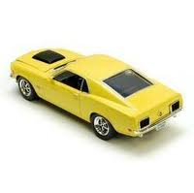
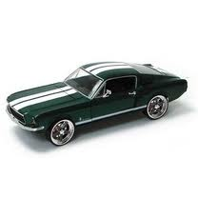

Sample of Mustangs:
$$n=25 \overline{x}=15.98 s=11.1$$
Our best estimate for the average price of used Mustangs is $15,980, but how accurate is that estimate?
Goal: Find an interval that is likely to contain the mean price for all Mustangs
Confidence Interval
Key idea: How much do we expect the mean price to vary when we take samples of 25 cars at a time?

Slide 12
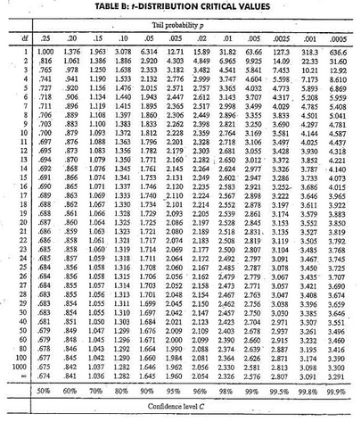

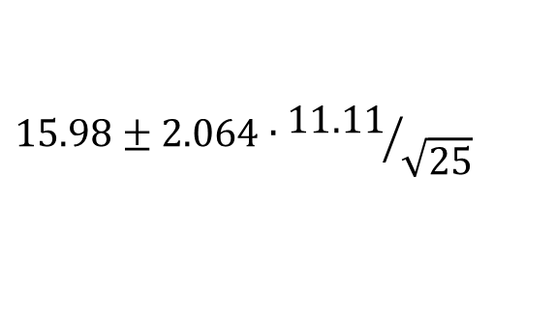

Traditional Inference
1. Check conditions
n = 25
2. Which formula?
CI for a mean
3. Calculate summary stats
4. Find t*
5. df?
df=25$−$1=24
t*=2.064
6. Plug and chug
$$15.98±2.064∙{11.11}/{\sqrt{25}}$$
$$15.98±4.59=(11.39, 20.57)$$
7. Interpret in context
“We are 95% confident that the mean price of all used Mustang cars at this site is between $11,390 and $20,570.”

Slide 13
Traditional Inference
Answer is fine, but the process is not very helpful at building understanding of a CI.
Can we arrive at the same answer in a way that also builds understanding?
(yes!)

Slide 14
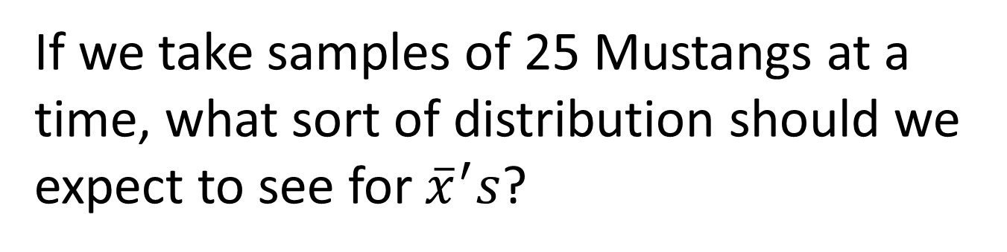
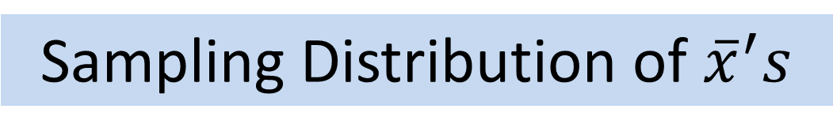
Key Concept: How much do sample statistics vary?
If we take samples of 25 Mustangs at a time, what sort of distribution should we expect to see for ${\overline{x}}^{′}s$?
Sampling Distribution of ${\overline{x}}^{′}s$
Notes:
Bozz

Slide 15
Producing a Sampling Distribution
Possible traditional approaches:
Know the value of the parameter and distribution of the population
Take thousands of samples from the population
Rely on theoretical approximations
and (2) are not practical in real situations
(3) is difficult for introductory students

Slide 16
Key Concept: How much do sample statistics vary?
How can we figure out how much sample statistics vary when we only have ONE sample?
Bootstrap!!!
Notes:
Bozz

Slide 17

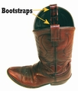
Bootstrapping
Brad Efron Stanford University
Key idea: Take many samples with replacement from the original sample using the same n to see how the statistic varies.
Assumes the “population” is many, many copies of the original sample.

Slide 18
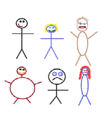
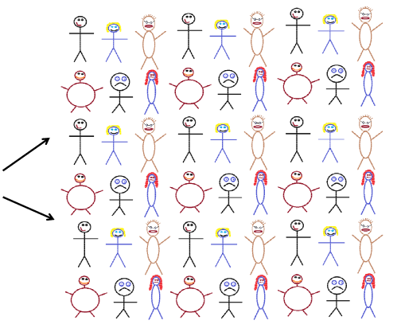




Finding a Bootstrap Sample
Original Sample (n=6)
A simulated “population” to sample from
Bootstrap Sample: (sample with replacement from the original sample)
Notes:
Patti

Slide 19
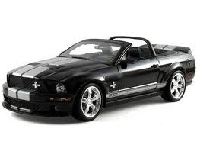


Original Sample
Bootstrap Sample
Repeat 1,000’s of times!
$$\overline{x}=15.98$$
$$\overline{x}=17.51$$
Notes:
Robin

Slide 20
BootstrapSample
Bootstrap Statistic
BootstrapSample
Bootstrap Statistic
Original Sample
Bootstrap Distribution
●
●
●
Many times
●
●
●
Sample Statistic
We need technology!
BootstrapSample
Bootstrap Statistic

Slide 21
StatKey
lock5stat.com/statkey
Freely available web apps with no login required
Runs in (almost) any browser (incl. smartphones/tablets)
Google Chrome App available (no internet needed)
Use standalone or supplement to existing technology
Notes:
Patti

Slide 22
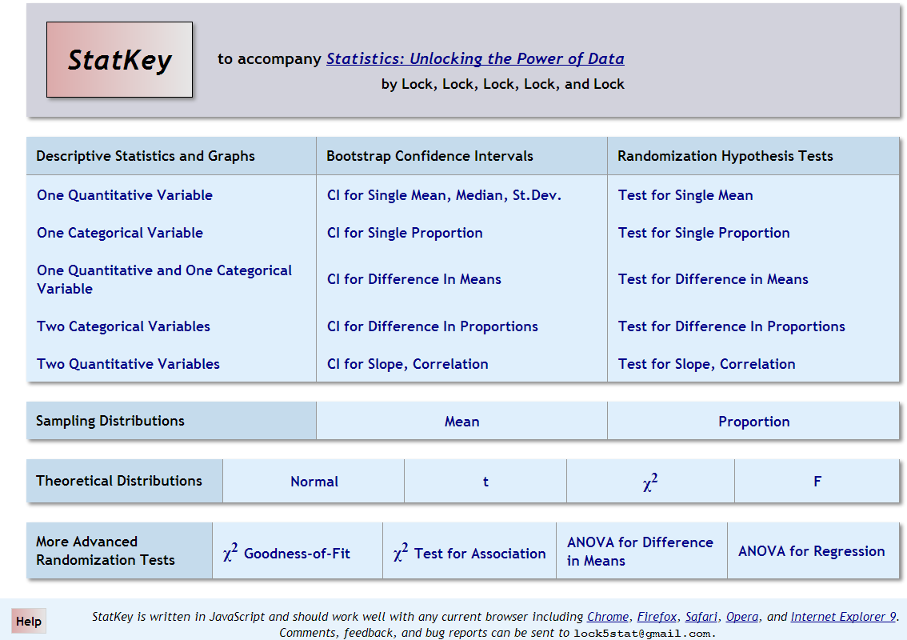
lock5stat.com/statkey

Slide 23
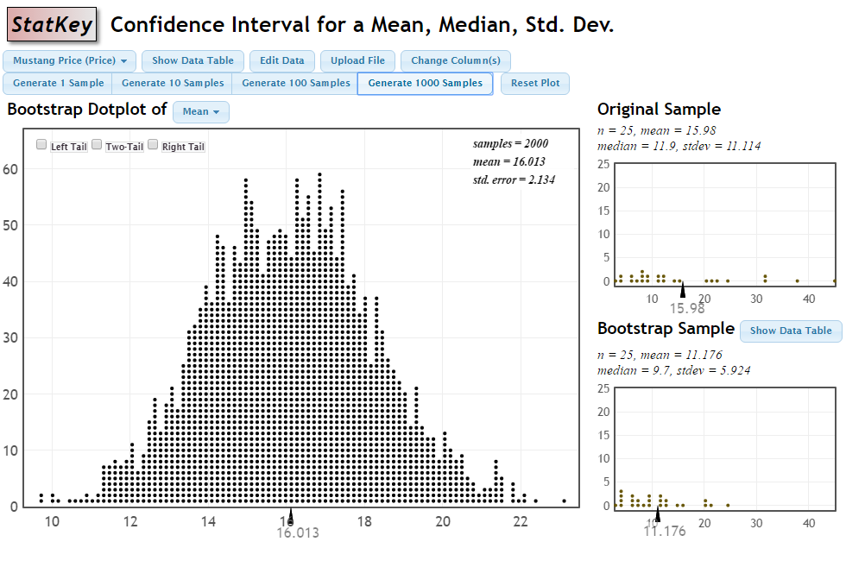
Bootstrap Distribution for Mustang Price Means

Slide 24
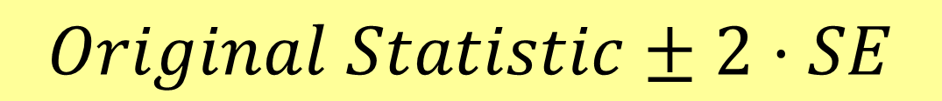
How do we get a CI from the bootstrap distribution?
Method #1: Standard Error
Find the standard error (SE) as the standard deviation of the bootstrap statistics
Find an interval with
$$Original Statistic±2⋅SE$$

Slide 25
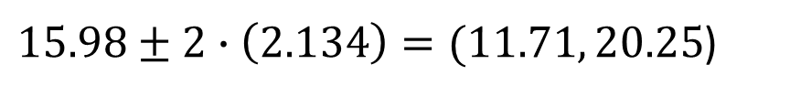
Standard Error
$15.98±2∙\left(2.134\right)=(11.71, 20.25$)

Slide 26
How do we get a CI from the bootstrap distribution?
Method #1: Standard Error
Find the standard error (SE) as the standard deviation of the bootstrap statistics
Find an interval with
$$Original Statistic±2⋅SE$$
Method #2: Percentile Interval
For a 95% interval, find the endpoints that cut off 2.5% of the bootstrap means from each tail, leaving 95% in the middle

Slide 27
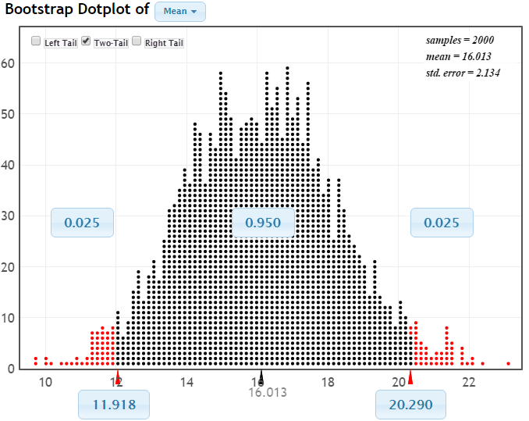
95% CI via Percentiles
Chop 2.5% in each tail
Keep 95% in middle
Chop 2.5% in each tail
We are 95% sure that the mean price for Mustangs is between $11,918 and $20,290

Slide 28
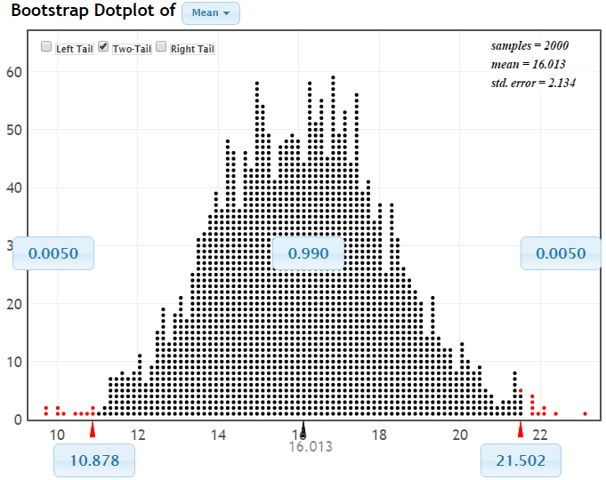
99% CI via Percentiles
Keep 99% in middle
Chop 0.5% in each tail
Chop 0.5% in each tail
We are 99% sure that the mean price for Mustangs is between $10,878 and $21,502

Slide 29
Bootstrap Confidence Intervals
Version 1 (Statistic ± 2 SE):
Great preparation for moving to
traditional methods
Version 2 (Percentiles):
Great at building understanding of
confidence level
Same process works for different parameters

Slide 30
Brief pause for questions so far?

Slide 31

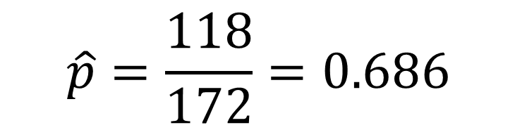
Example #2: What proportion of statistics students use a Mac?
A sample of n=172 stat students contains 118 that use a Mac.
$$\hat{p}=\frac{118}{172}=0.686$$
How accurate is that sample proportion?
Find a 95% confidence interval for the proportion of all statistics students that use a Mac.

Slide 32
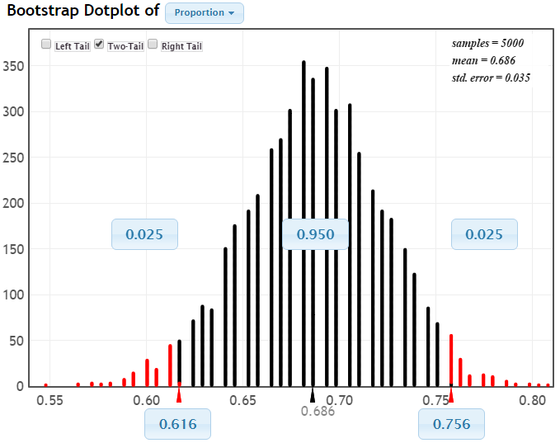
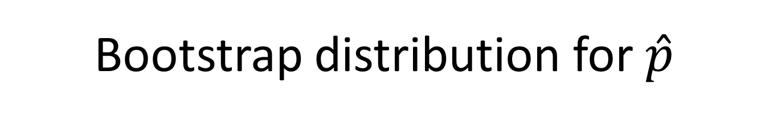



Bootstrap distribution for $\hat{p}$
$$0.686±2∗0.035$$
$$0.686±0.07$$
$$0.616 \text{to} 0.756$$
We are 95% sure that the proportion of stat students with Macs is between 0.616 and 0.756.

Slide 33
Example #3: Find a 95% CI for the difference in average Math SAT score between female and male stat students.
Data: StudentSurvey.csv available at http://lock5stat.com
Example #4: Find a 90% CI for the standard deviation of Math SAT score for stat students.

Slide 34
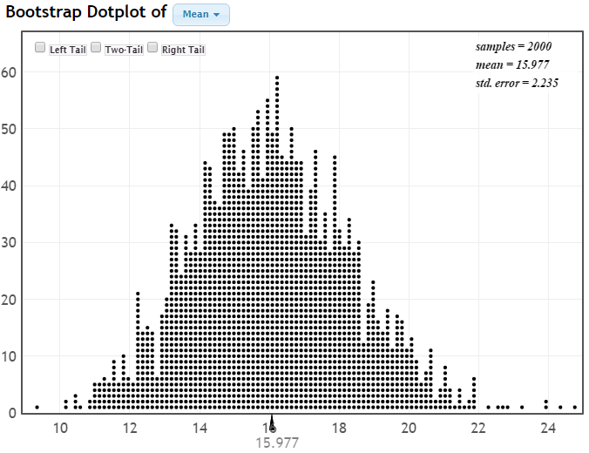
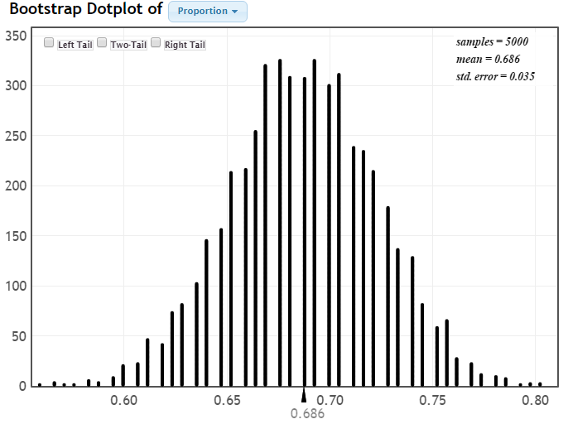






Transition to Traditional Methods
$\overline{x}$ for Mustang prices
All symmetric bell-shapes!
$\hat{p}$for Mac owners
${\overline{x}}_{m}−{\overline{x}}_{f}$ for Math SAT
$s$ for Math SAT

Slide 35

Normal Distribution

Slide 36



$$statistic±2∙SE$$
N(0,1)
This is where the “2” comes from
$$statistic±z^{∗}∙SE$$
where z* comes from the normal distribution to give the desired confidence.

Slide 37




Formulas for SE
We complete the transition to a traditional (formula) CI, IF
(a) We have a formula to compute the SE
(b) We have conditions to know the distribution
Example: CI for p
$$SE=\sqrt{\frac{\hat{p}(1−\hat{p})}{n}}$$
$$Statistic=\hat{p}$$
Normal if $n\hat{p}≥10$and $n(1−\hat{p})≥10$
$$\hat{p}±z^{∗}\sqrt{\frac{\hat{p}(1−\hat{p})}{n}}$$

Slide 38





Verifying with Bootstraps
$$\hat{p}=\frac{90}{100}=0.9$$
$$\hat{p}=\frac{27}{30}=0.9$$
$$SE=\sqrt{\frac{0.9\left(1−0.9\right)}{100}}=0.030$$

Slide 39
Why
does the bootstrap work?

Slide 40
Sampling Distribution
Population
BUT, in practice we don’t see the “tree” or all of the “seeds” – we only have ONE seed
µ
Notes:
Robin

Slide 41


Bootstrap Distribution
What can we do with just one seed?
Estimate the distribution and variability (SE) of $\overline{x}$’s from the bootstraps
Bootstrap
“Population”
Grow a NEW tree!
$$\overline{x}$$
µ
Use the bootstrap errors that we CAN see to estimate the sampling errors that we CAN’T see.
Notes:
Robin

Slide 42
Golden Rule of Bootstraps
The bootstrap statistics are to the original statistic
as
the original statistic is to the population parameter.

Slide 43
Final Thoughts
The bootstrap approach is a way to introduce students to the main ideas of confidence intervals, while requiring only minimal background knowledge of sampling and summary statistics.
The methods are easily generalized to lots of parameter situations.
Use of the bootstrap distribution appeals to visual learners.
Some technology (e.g. StatKey) is needed.
Techniques lead smoothly into traditional methods.
rlock@stlawu.edu
lock5stat.com
Thanks for Listening!

Slide 44
Thanks for listening!
rlock@stlawu.edu
lock5stat.com

